Slide 1
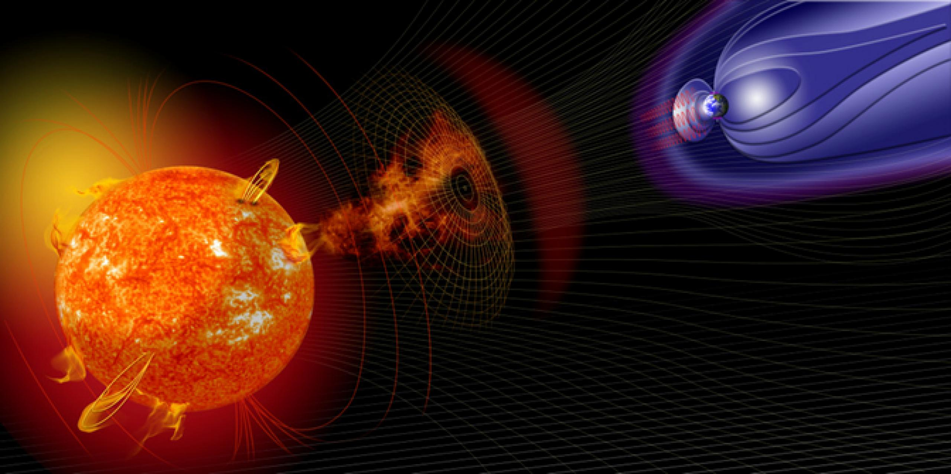




On the possible magnetospheric and ionospheric sources of the geoelectric field variations during the May 2021 Geomagnetic storm.
Piersanti M.¹, G. D’Angelo² and D. Recchiuti^{3,2}
1. University of L’Aquila, L’Aquila, Italy.
2. National Institute of Astrophysics - IAPS, Rome, Italy
3. University of Trento, Trento, Italy.
mirko.piersanti@univaq.it

Slide 2
Introduction
The circumterrestrial environment is constantly subjected to changes in the solar wind flow generated at the Sun, especially during coronal mass ejections (CMEs) occurrence.
The impact of CMEs on the Earth's magnetosphere perturbs the geomagnetic field causing the occurrence of geomagnetic storms (GSs).
GSs trigger geomagnetic effects measurable not only in the geospace but also in the magnetosphere, ionosphere, upper atmosphere, and on the ground.
During extreme events, rapidly changing in geomagnetic fields causes geomagnetically induced currents (GICs), representing one of the most dangerous hazard for our technological systems.
The correct understanding of the physical mechanisms behind the generation and amplification of GIC in terms of both ionospheric and magnetospheric current system can help in a better modelling (forecasting) and mitigation of GIC effects.
This work presents the analysis of the GIC determined by the use of the MA.I.GIC. (Magnetosphere - Ionosphere - Ground Induced Current) model (Piersanti et al., 2019), on May 12, 2021 Geomagnetic Storm over the northern hemisphere. In addition, we discriminate between the ionospheric and magnetospheric origin contribution on the geoelectric field in Europe and Northern America in order to evaluate their relative contribution to the GIC amplitude.

Slide 3
MA.I.G.I.C. Model
A new global MAgnetospheric – Ionospheric and Geomagnetically Induced Currents (MA.I.GIC. – Piersanti et al. 2018) model has been developed.
Starting from the Solar Wind observations, it is able to:
Evaluate the geomagnetically induced currents (GIC) at ground from magnetic observations.
Discriminate between, and evaluate, the magnetospheric and ionospheric origin contribution from ground magnetic observations;

Slide 4
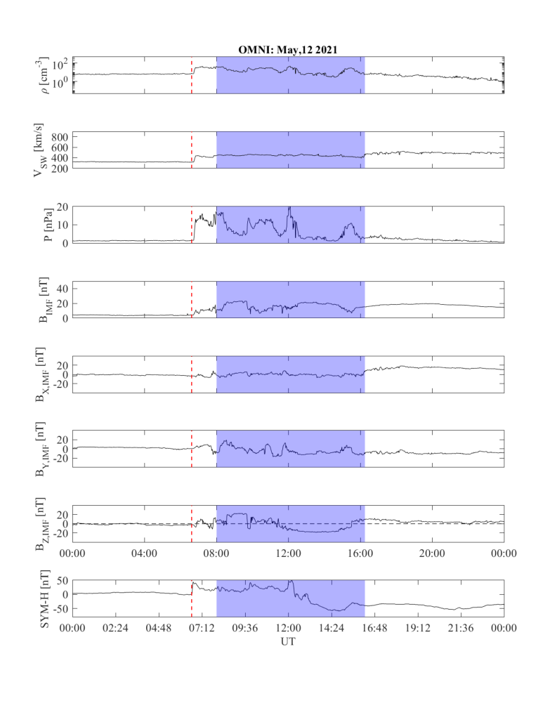
May 2021 GS: SW overview
Interplanetary Shock (IS-red dashed line), identified by the clear jump in all the SW parameters at∼06:34 UT on May 12.
A magnetic cloud (MC - blue region): enhancement of the IMF strength + smooth rotation of B_{Z,IMF} (08:00<UT<16:40).
The shock normal orientation for IPs: Φ_{GSE} ∼ 111°, Θ_{GSE} ∼177°, V_{sh} ∼ 538 km/s (Piersanti et al., 2022).
The Sym-H shows a sudden Impulse at 06:34 UT and a main phase whose peak occurs (-84 nT) at 15:05 UT

Slide 5
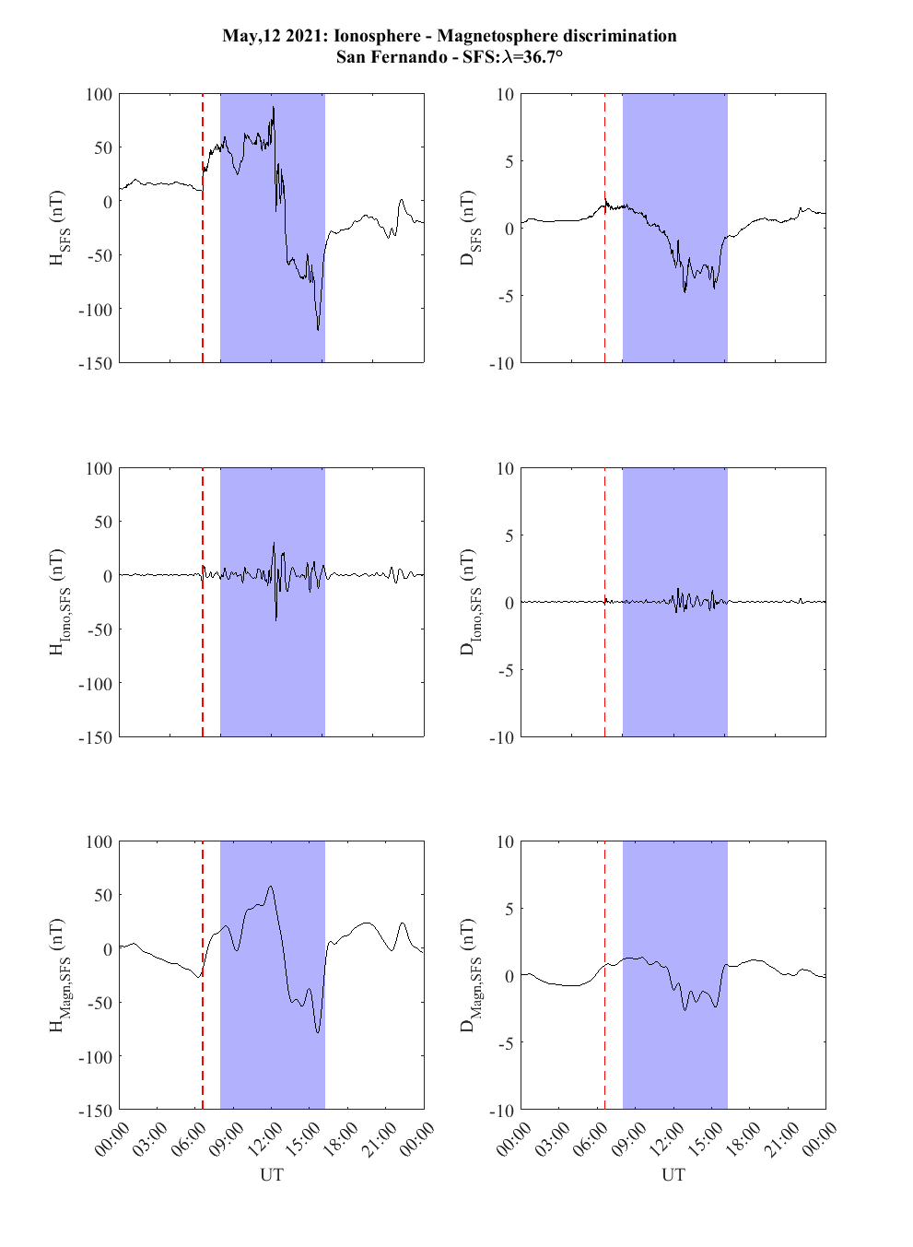
Magnetospheric Ionospheric discrimination
We applied MA.I.GIC. to obtain the ionospheric and the magnetospheric origin contribution to the magnetic observations (80 observatories)
As expected the magnetospheric contribution is dominant at low/middle latitudes

Slide 6
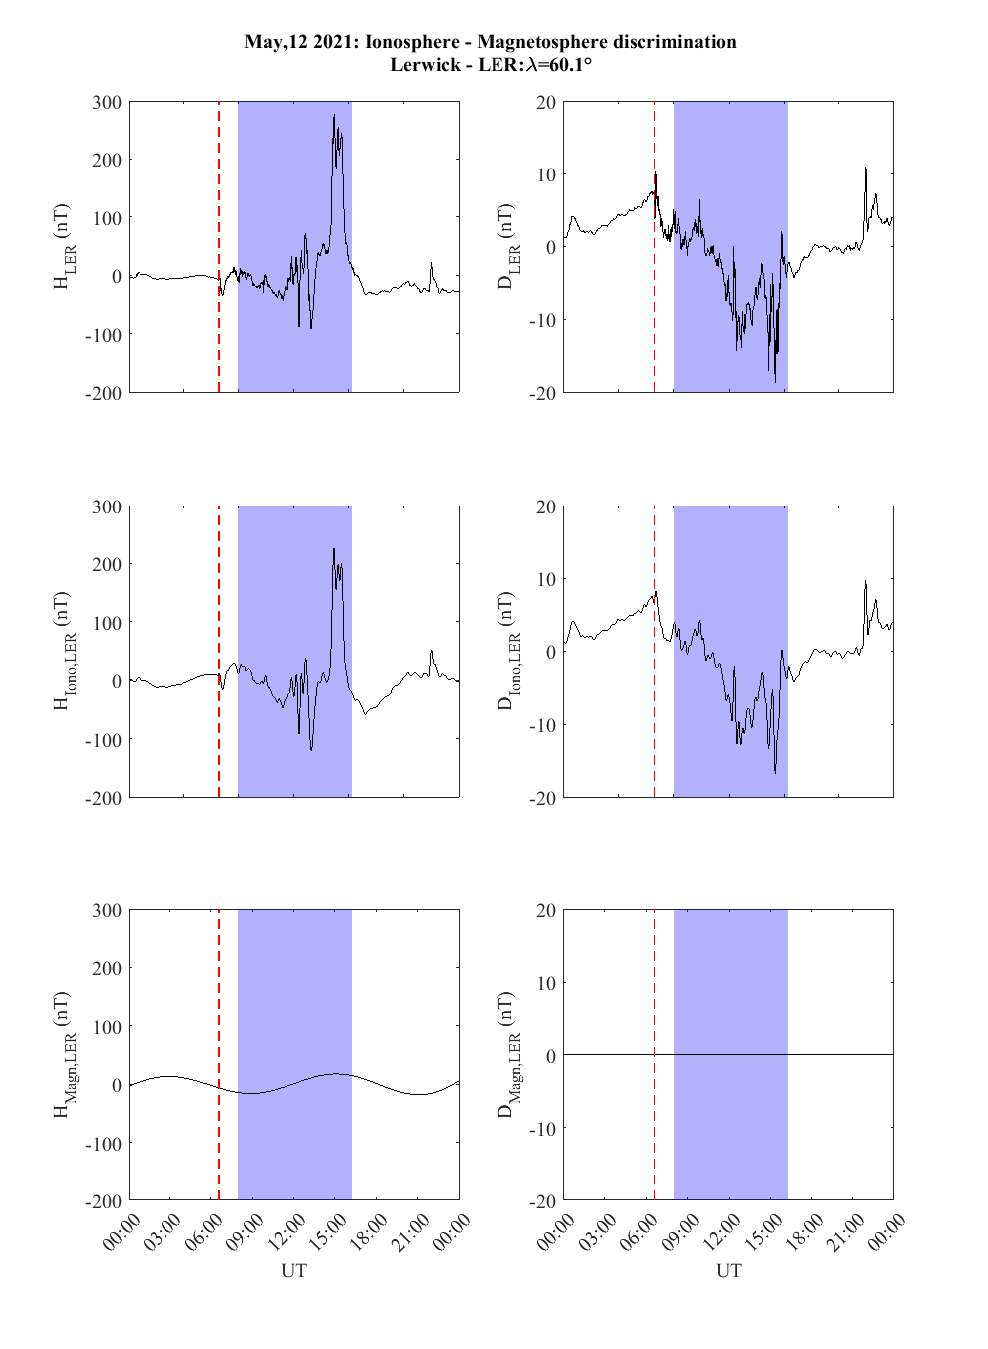
Magnetospheric Ionospheric discrimination
We applied MA.I.GIC. to obtain the ionospheric and the magnetospheric origin contribution to the magnetic observations
As expected the Ionospheric contribution is dominant at higher latitudes

Slide 7
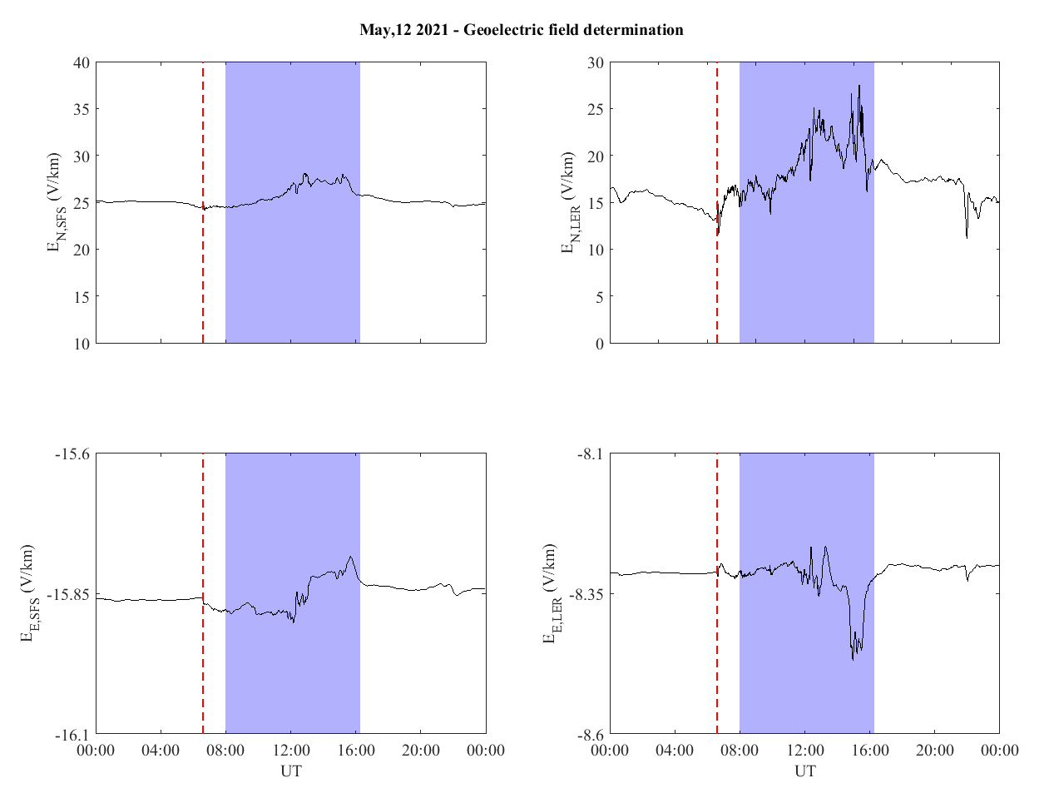
May 12, 2021 GS: GIC
We applied MA.I.GIC. to evaluate the geoelectric field at 80 ground stations in the Northern Hemisphere.
Clear evidence that higher amplitude GIC are at higher latitudes as expected.
The global GIC behaviour is….

Slide 8
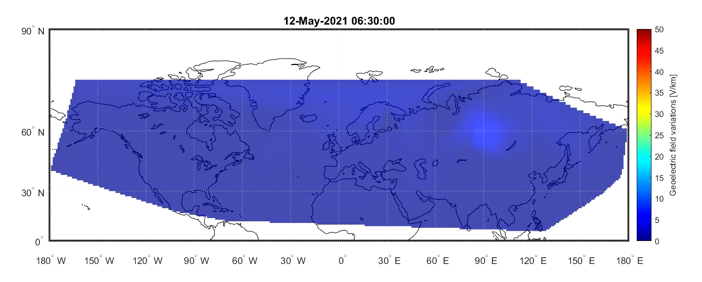
May 12, 2021 GS: GIC at SI
Clear enhancement of the geoelectric field at the moment of the IPs arrival…it is directly driven by the SI current system

Slide 9
Conclusions
Our model was able to efficiently discriminate between the ionospheric and the magnetospheric field contribution involved into the GIC calculation.
We found a direct relation between the highest value of GIC and the ionospheric induction process.
The GIC calculous has been conducted for both the May 2021 Sudden Impulse and for the entire main phase of the relative geomagnetic storm.
Using the MA.I.GIC. model we tried to produce a global view of the magnetosphere-ionosphere coupling in causing GIC.

Slide 10
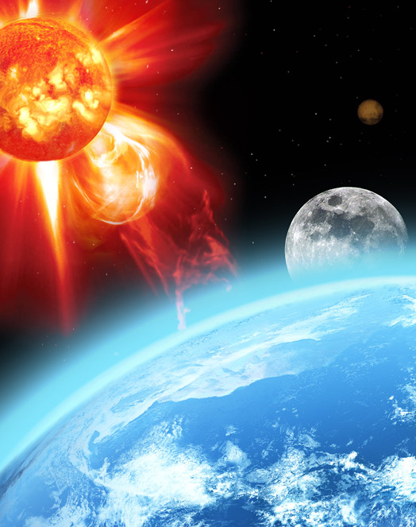
Thank you
for
your attention

Slide 11
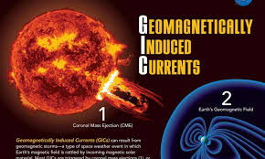
Back up slides

Slide 12
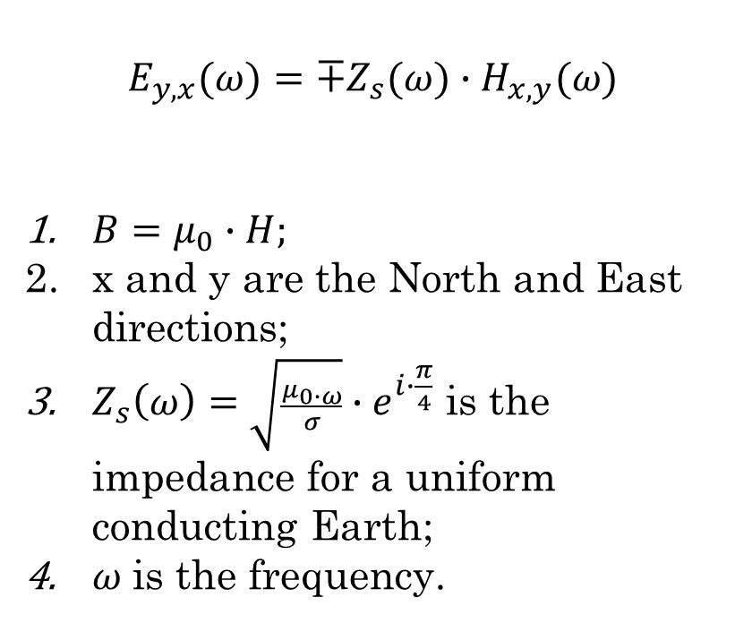
MA.I.GIC. model
MAIGIC model evaluates the GIC in a completely new way, using: magnetometer observations, a new non linear data analysis technique (ALIF – Piersanti et al., 2017) and a global ground conductivity model (Alekseev et al. 2015). It is based on this simple equation:
$$E_{y,x}(ω)=∓Z_{s}(ω)∙H_{x,y}(ω)$$
$B=μ_{0}∙H;$
x and y are the North and East directions;
$Z_{s}\left(ω\right)=\sqrt{\frac{μ_{0∙ω}}{σ}}∙e^{i∙\frac{π}{4}}$ is the impedance for a uniform conducting Earth;
$ω$is the frequency.

Slide 13
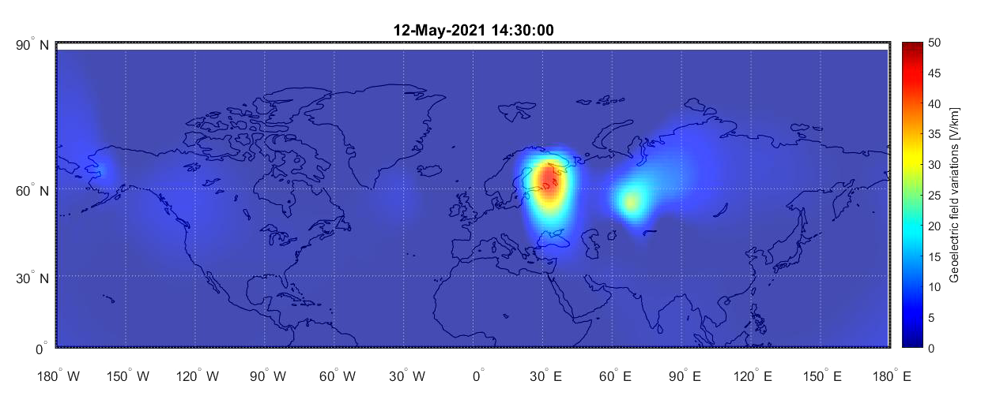
May 12, 2021 GS: GIC at MF
Clear enhancement of the geoelectric field at the moment of the peak of the main phase

