Slide 1


Site Characterization of Mohand Region along Himalayan Frontal Thrust (HFT) using passive HVSR method
IIT Kanpur
EGU22-12520
https://doi.org/10.5194/egusphere-egu22-12520
EGU General Assembly 2022
Authors: Kethavath Bhopya Naik, Ghosal D., Verma S., Srivastav H., Vikas
Email id: ketha@iitk.ac.in*

Slide 2
Outline
IIT Kanpur
Results and Conclusion
HVSR Calculation
5
4
Data Acquisition and Methodology
3
Study Area
2
Introduction to the problem statement
1
1

Slide 3

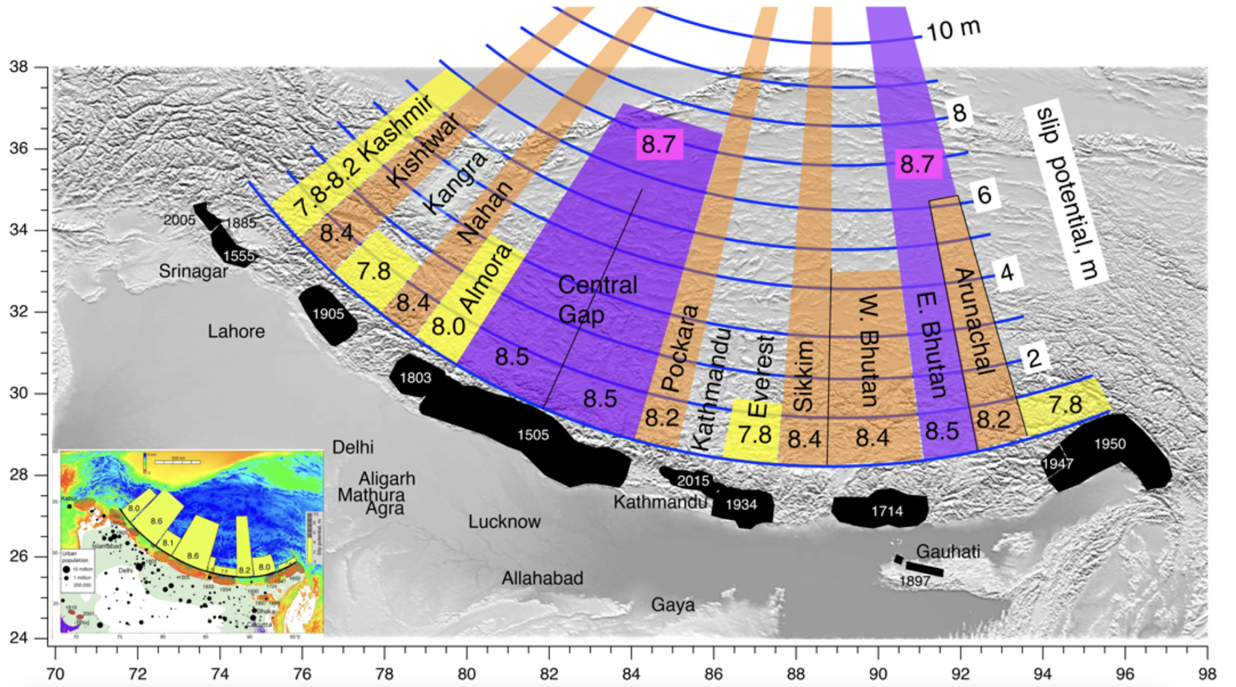
Introduction to the Problem Statement
IIT Kanpur
Several great and medium-sized earthquakes have struck and were causing substantial damage to lives and property in the densely populated foothills and alluvial plains of the Indo-Gangetic Plains
Future Earthquakes?
Two areas with violet shading could host Mw > 8.7 earthquakes.
Six areas with brown shading could rupture in Mw 8.4 earthquakes.
Five areas shaded yellow, could presently slip in Mw ≥ 7.7 earthquakes similar to the recent Gorkha earthquake
In this study, we estimate resonance frequency and subsurface shear wave velocity, P wave velocity, and density.
Source: Bilham et al., 2019
2

Slide 4
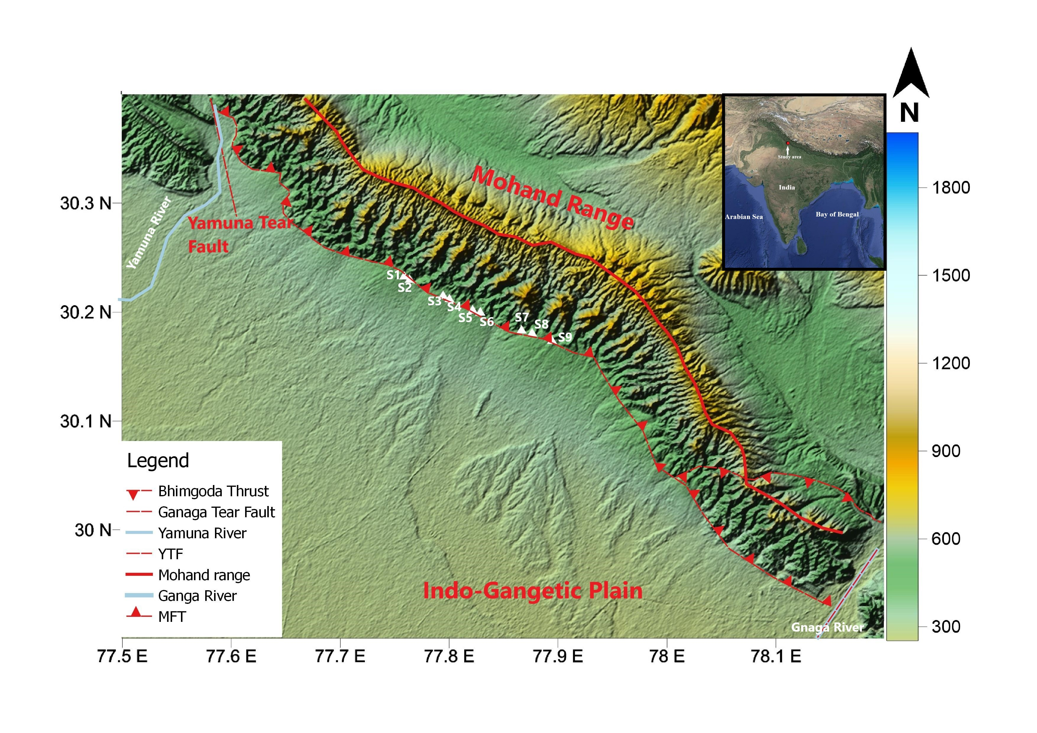
Study Area
IIT Kanpur
It is bordered to the east and west by the Ganga and Yamuna tear faults and rivers
The eastern half of the Mohand range is bisected by the Bhimgoda thrust, a south-dipping back thrust inside the MFT sheet that adds substantial complication
The Dehradun recess geomorphology was dominated by alluvial fan deposits which are derived from the proximal Lesser Himalaya and two large fluvial systems (Sinha and Sinha, 2016).
3

Slide 5
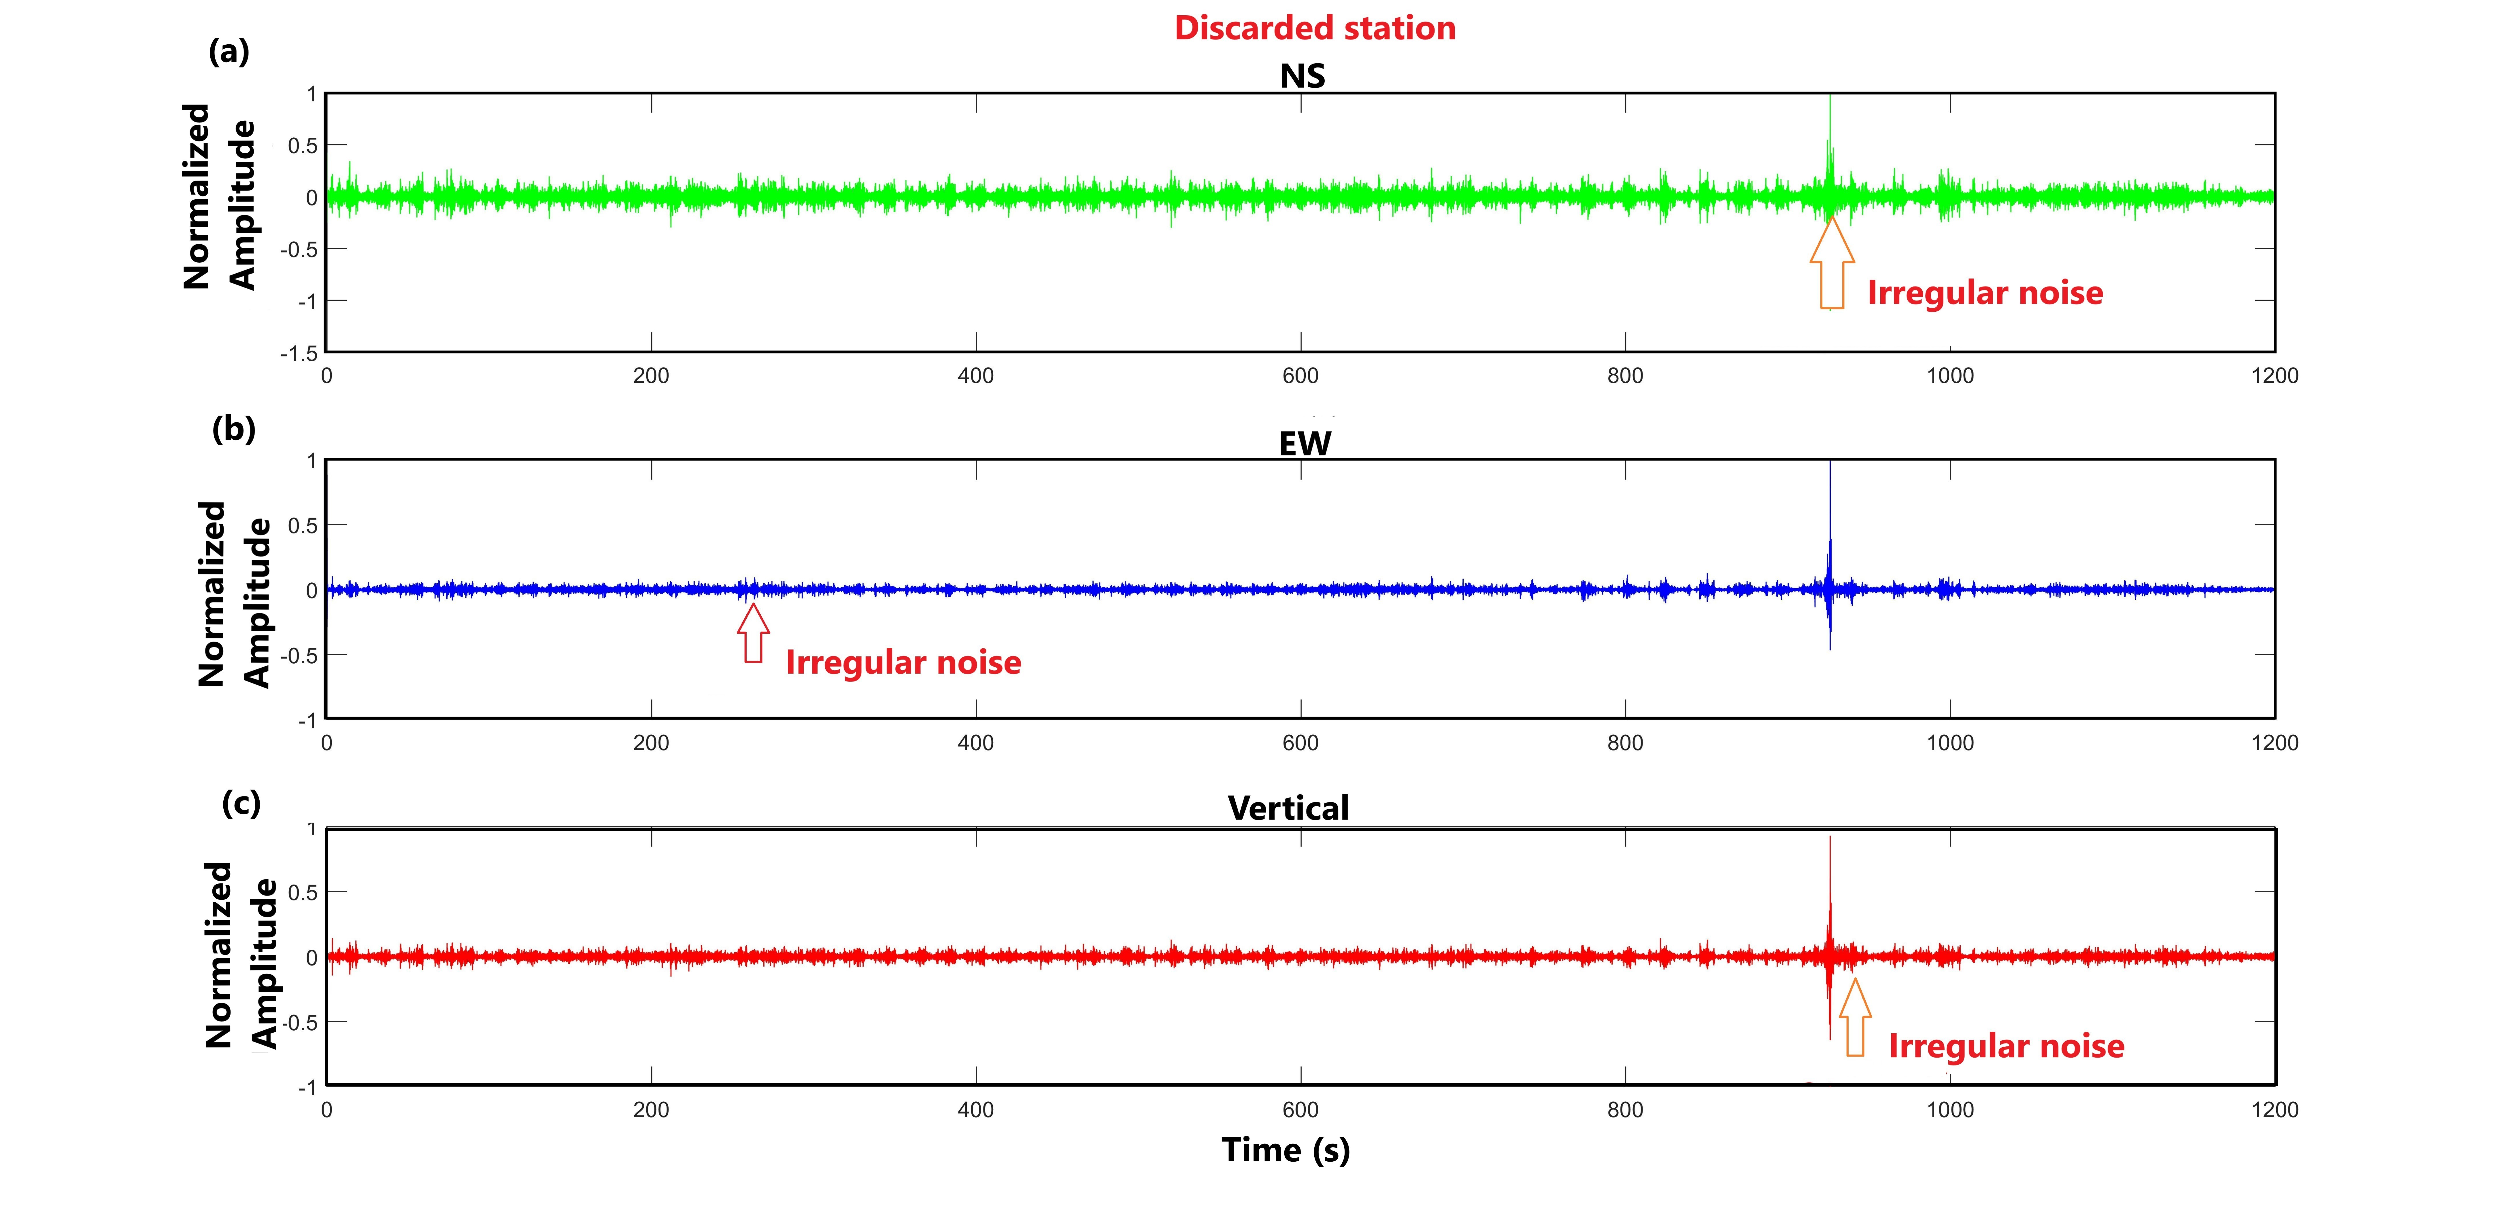
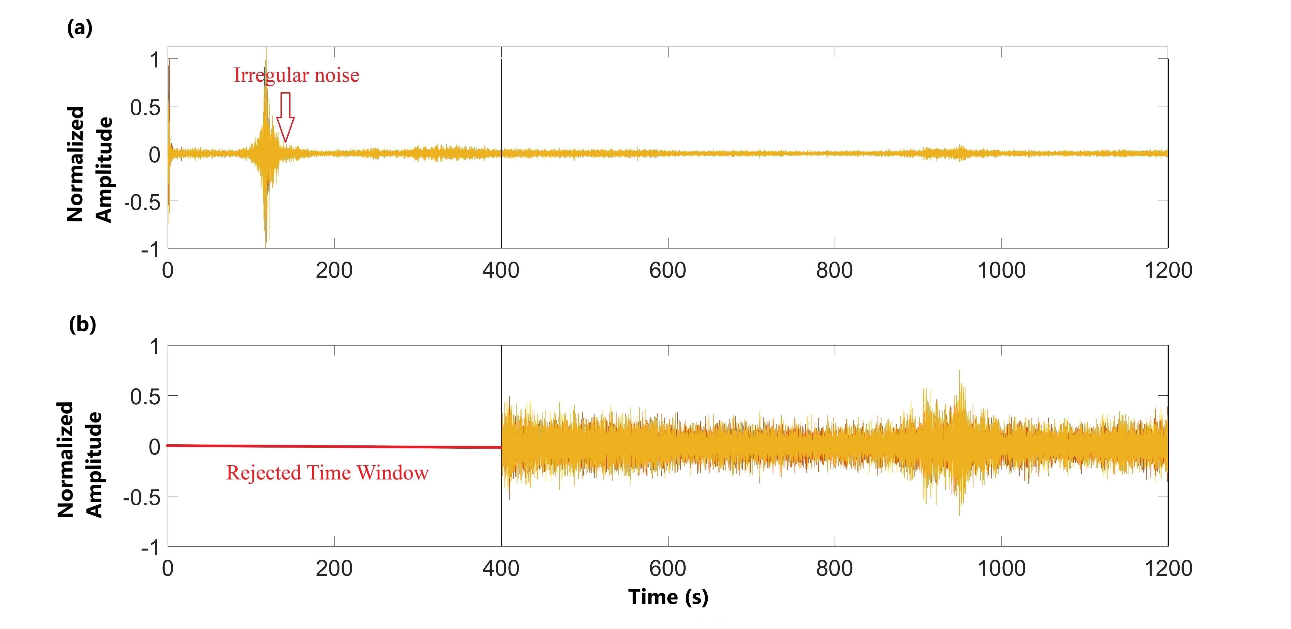
Data Acquisition and Methodology
IIT Kanpur
Workflow
Raw Data
Pre-processing
HVSR calculation
Inversion
4

Slide 6
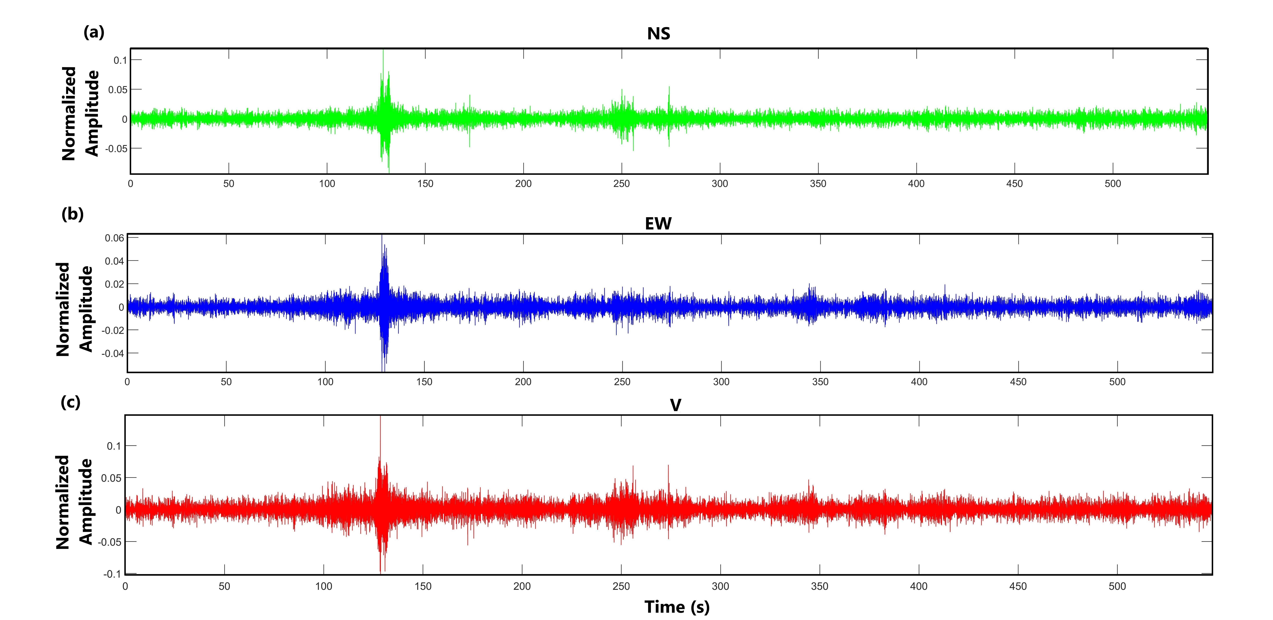
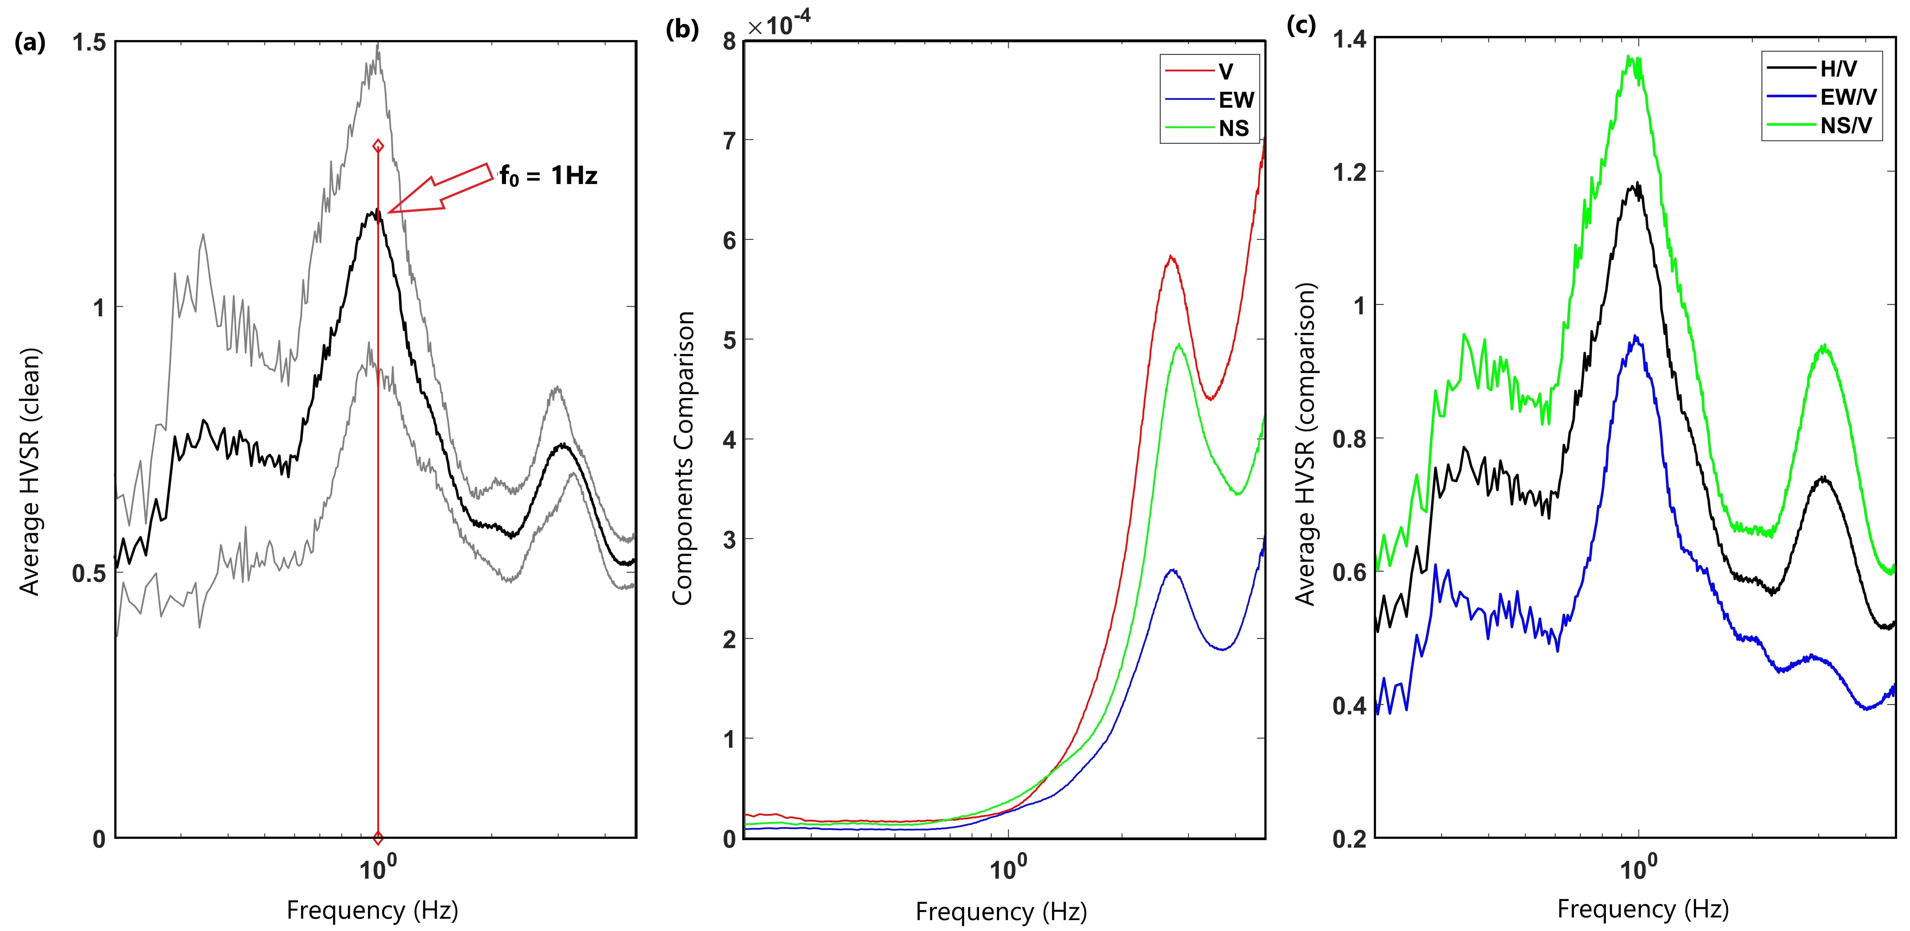
HVSR Calculation
IIT Kanpur
Parameters used for HVSR calculation
Data recording: 20 min
Sampling frequency: 128 Hz
bandpass filtered: 0.4 – 4.8 Hz
Window length: 80 s
Tapering: 5%
Konno and ohmachi smoothing : 24%
5

Slide 7
Result and Conclusion
IIT Kanpur
6

Slide 8
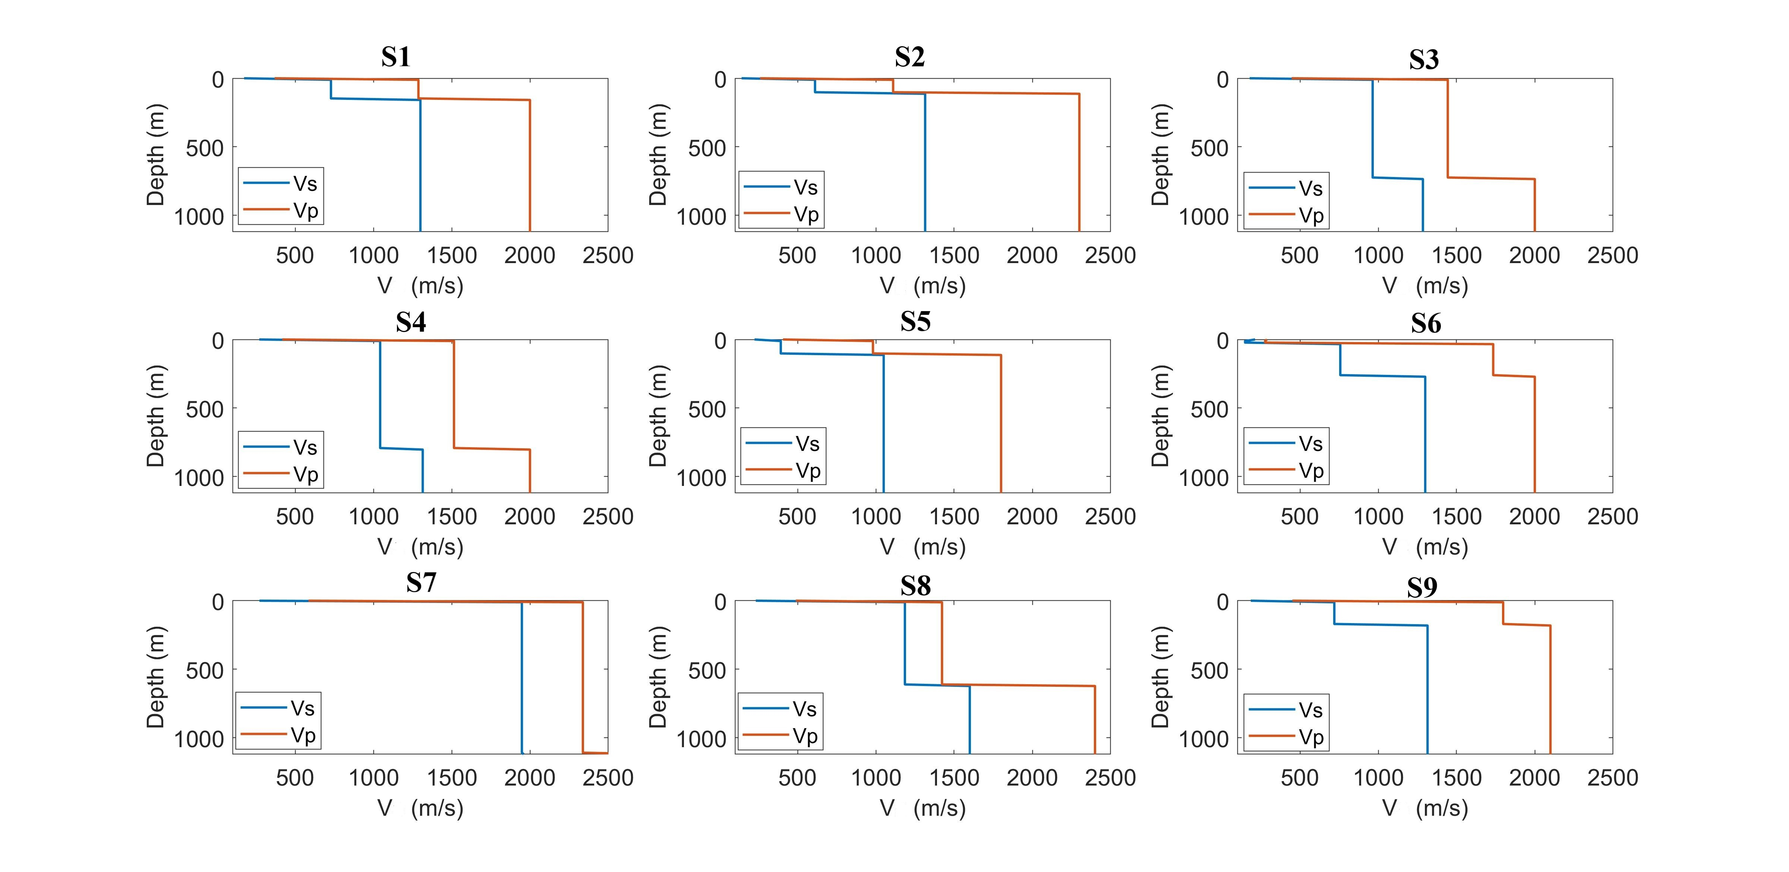
Result and Conclusion
IIT Kanpur
We identified three layers.
The top is 3 meters thick, with mean Vs, Vp, and 𝜌 of 218 m/s, 385 m/s, and 1.17 g/cm^3, respectively.
The second layer is 6 meters thick and has mean Vs, Vp, and 𝜌 of 406 m/s, 725 m/s, and 1.7 g/cm^3, respectively.
The mean bedrock depth in this region is 127 meters, and the mean Vs, Vp, and 𝜌 are 582 m/s, 1238 m/s, and 1.8 g/cm^3 accordingly
7

Slide 9
IIT Kanpur
Thank You
6

