Slide 1
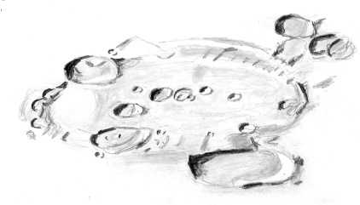

Groundwater Movement Within Playa Environments on Mars: Subsurface Imaging of the Makgadikgadi Salt Pans of Botswana
Gene Schmidt, PhD
Assegnista di Ricerca,
Dipartimento di Scienza, Università Roma Tre
GeoQuTe
BA Geology, Western Michigan University, USA
MA Planetary Science, Brock University, CA
PhD Planetary Science, IRSPS - Università "G.D'Annunzio“, IT
(Laboratorio di Geodinamica Quantitativa e Telerilevamento)

Slide 2
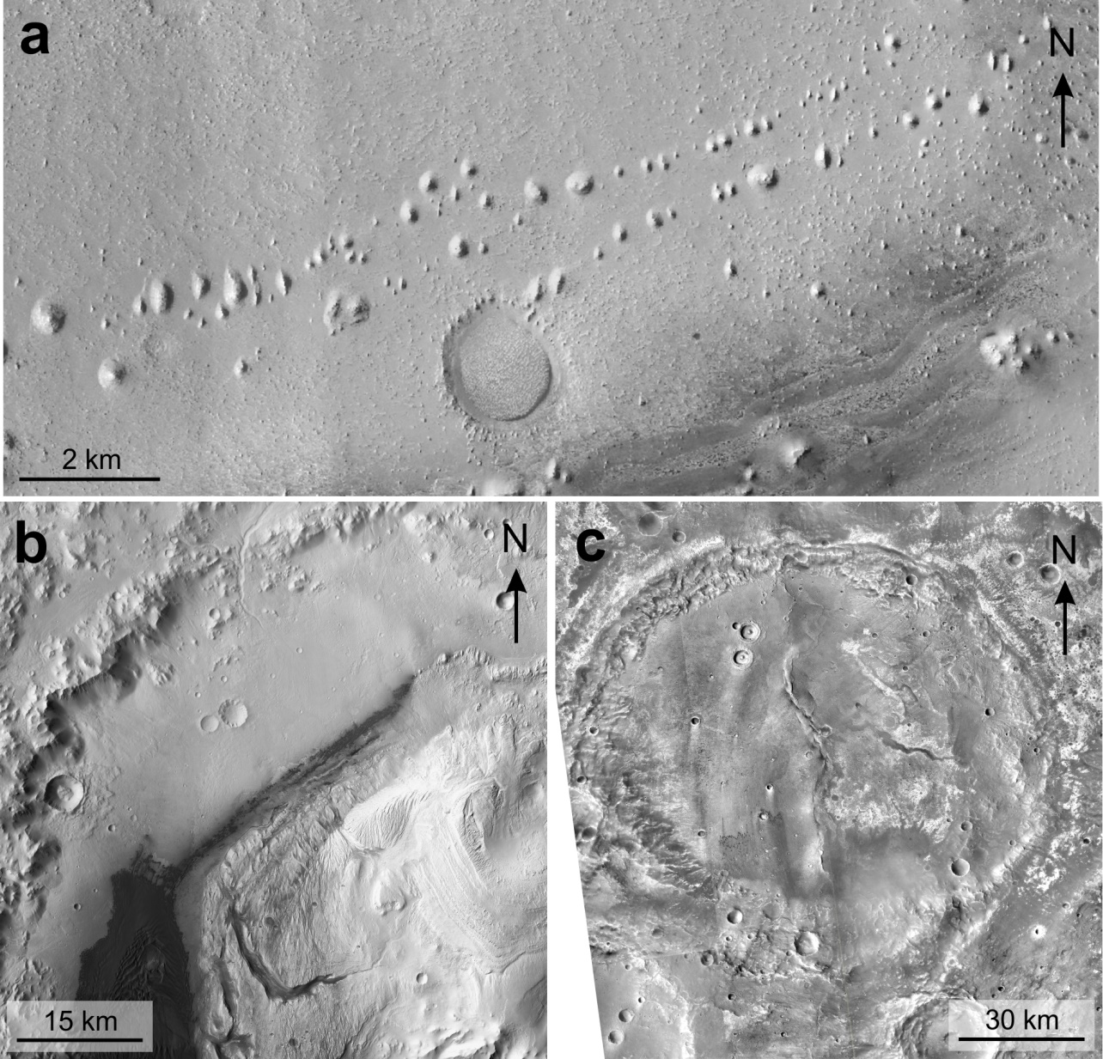
Lacustrine and Evaporite Environments on Mars

Slide 3
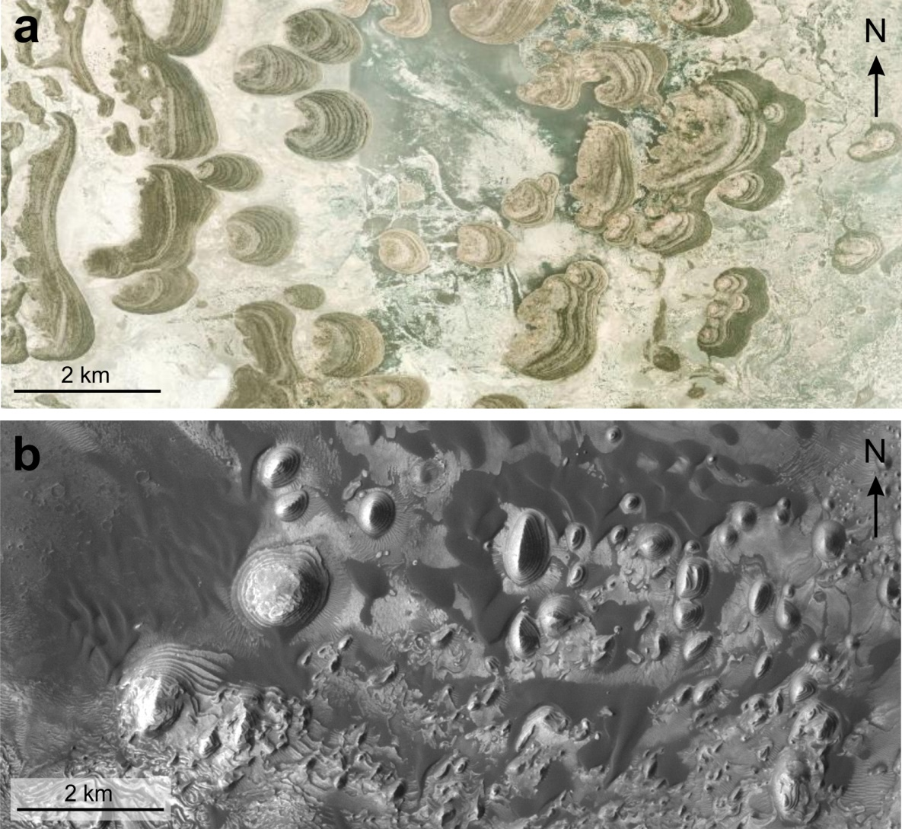
Lacustrine and Evaporite Environments on Mars

Slide 4
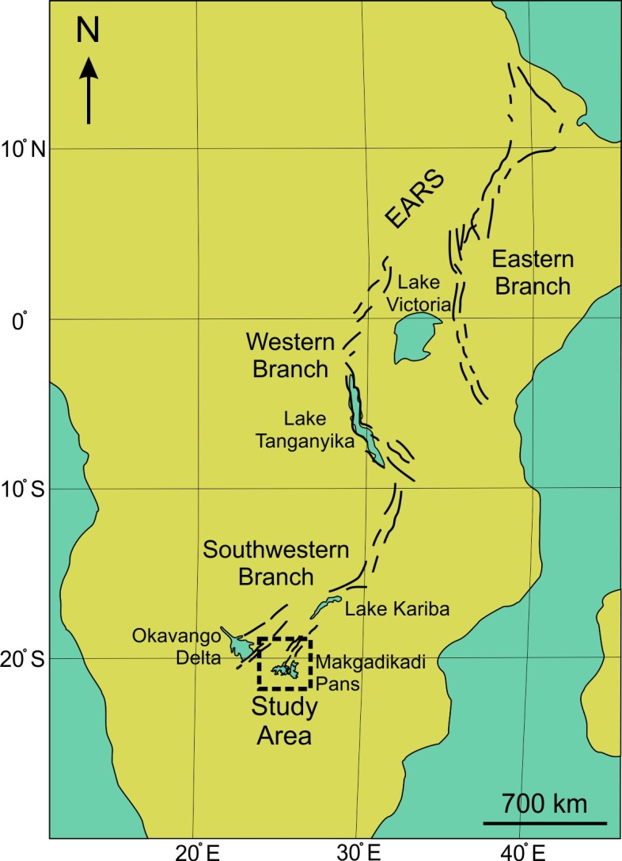
Makgadikgadi Salt Pans

Slide 5
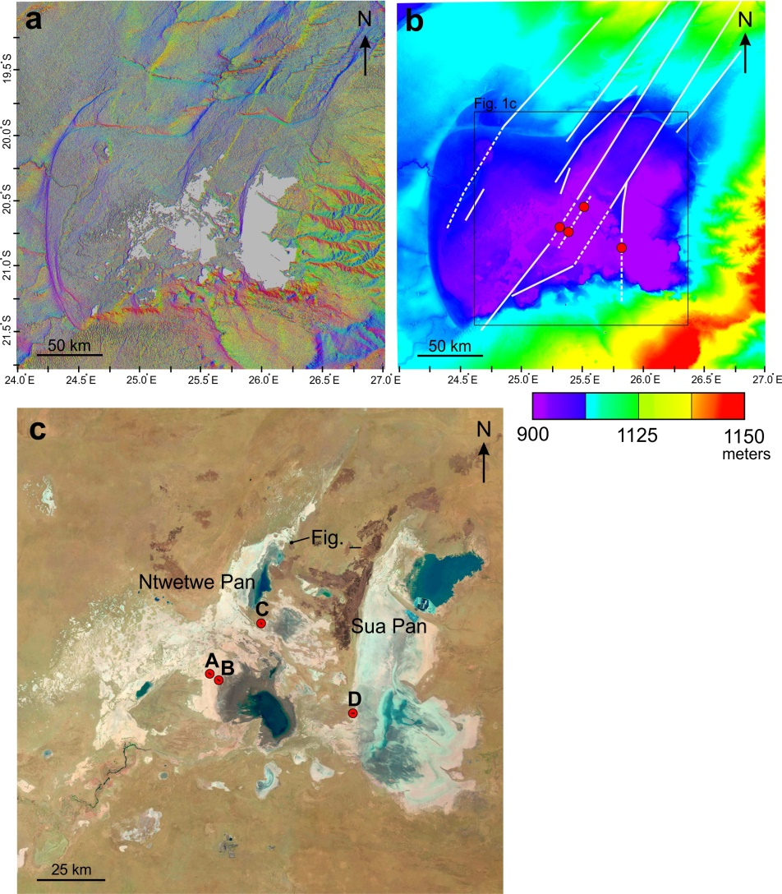
Makgadikgadi Salt Pans

Slide 6
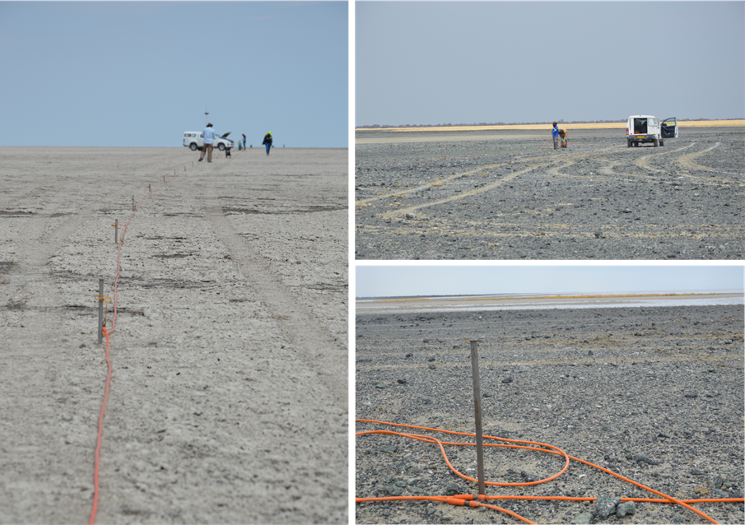
Subsurface Imaging

Slide 7
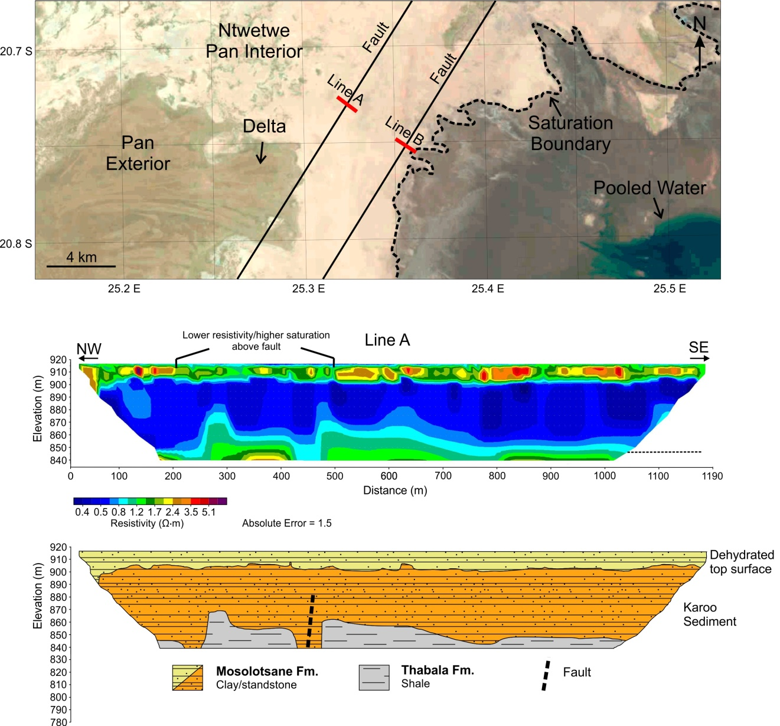
Results

Slide 8
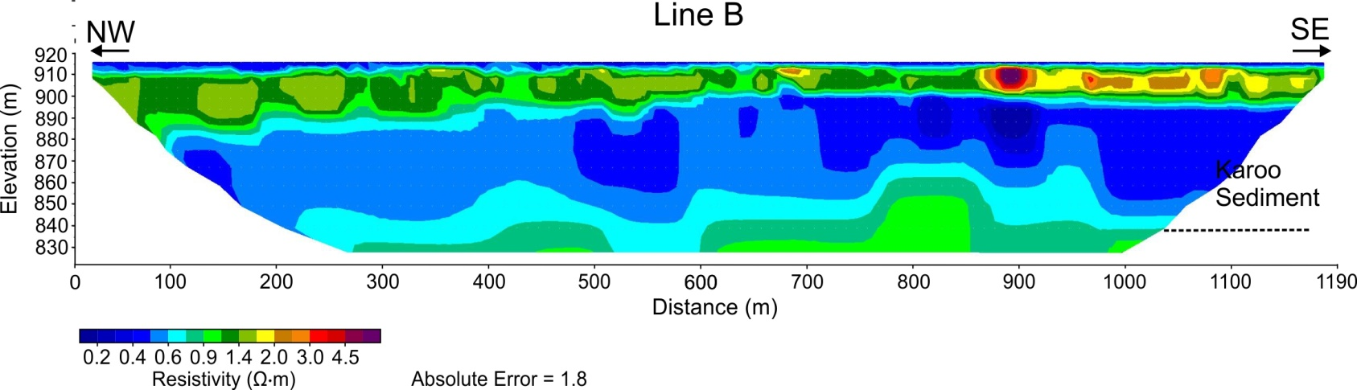
Results

Slide 9
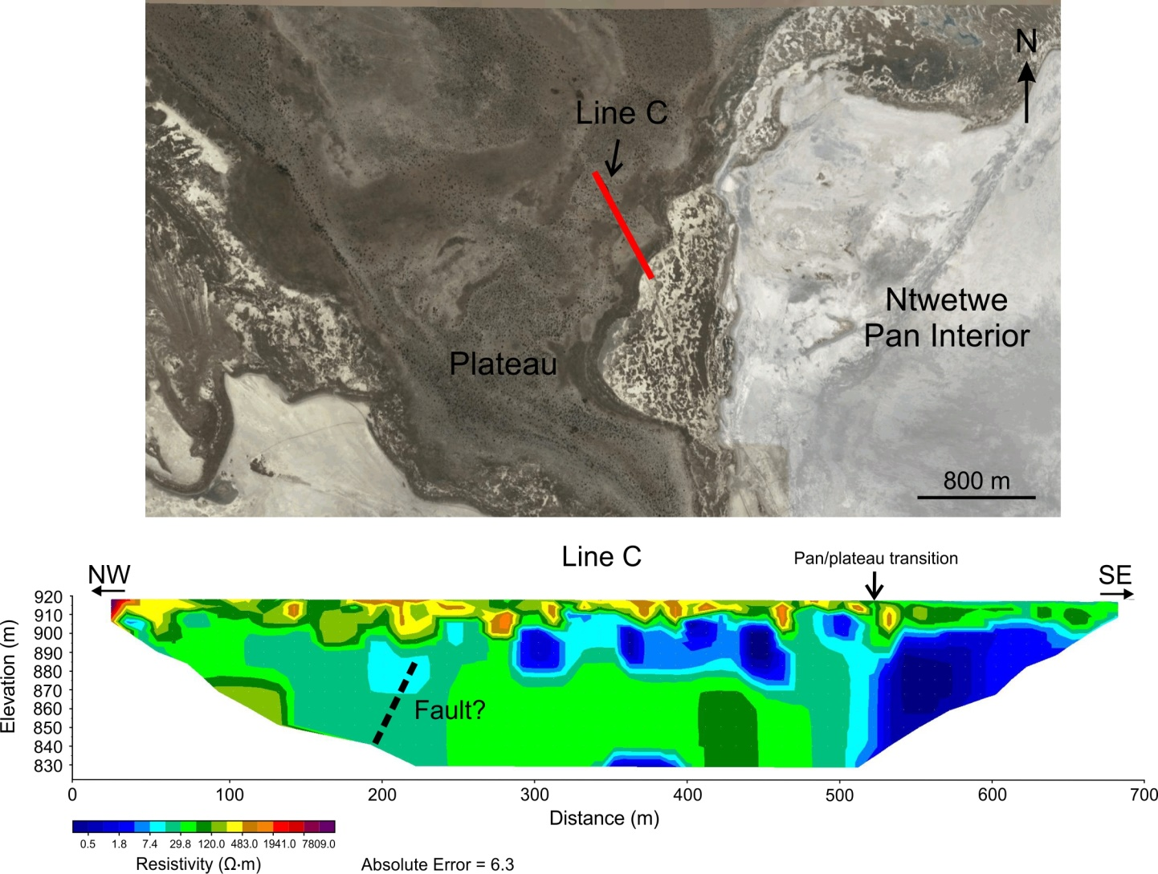
Results

Slide 10
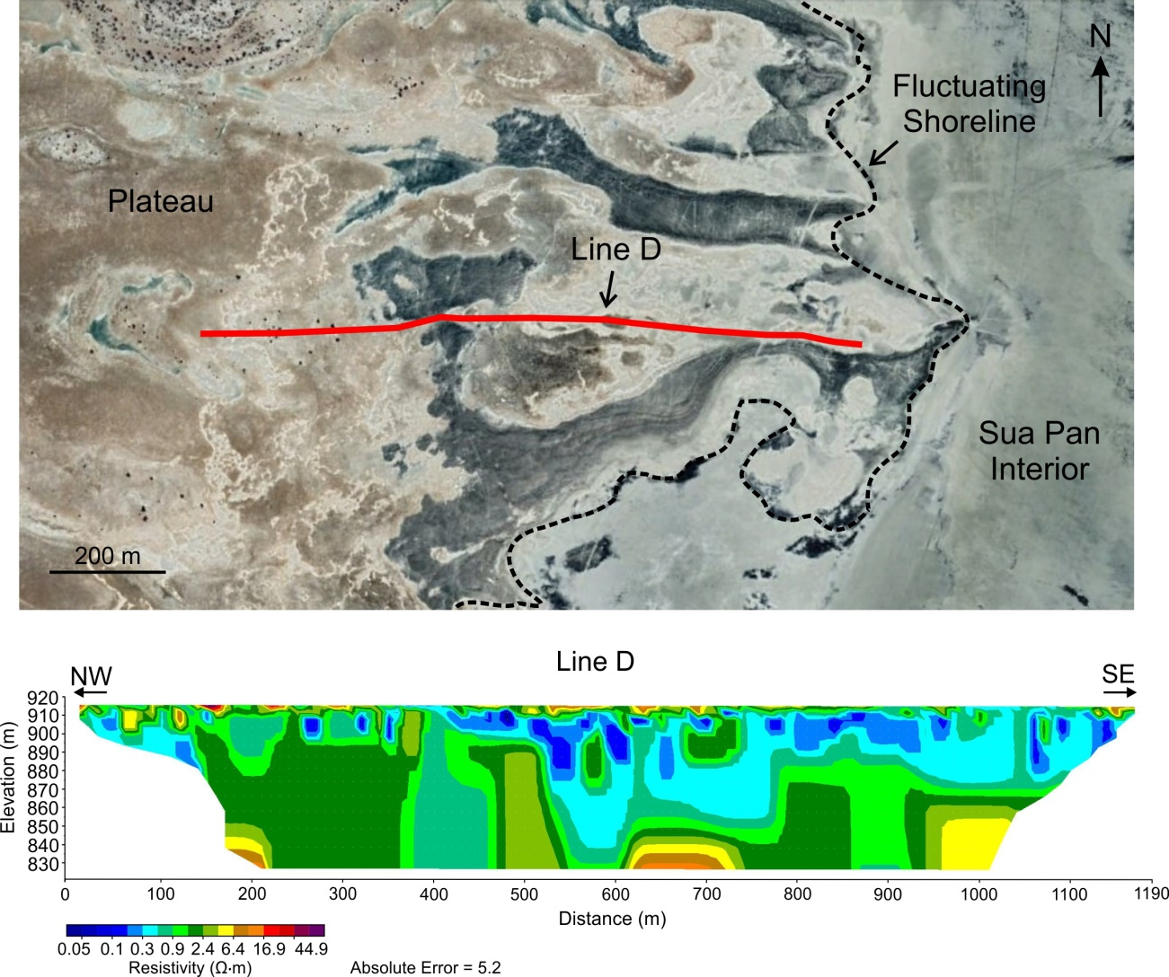
Results

Slide 11
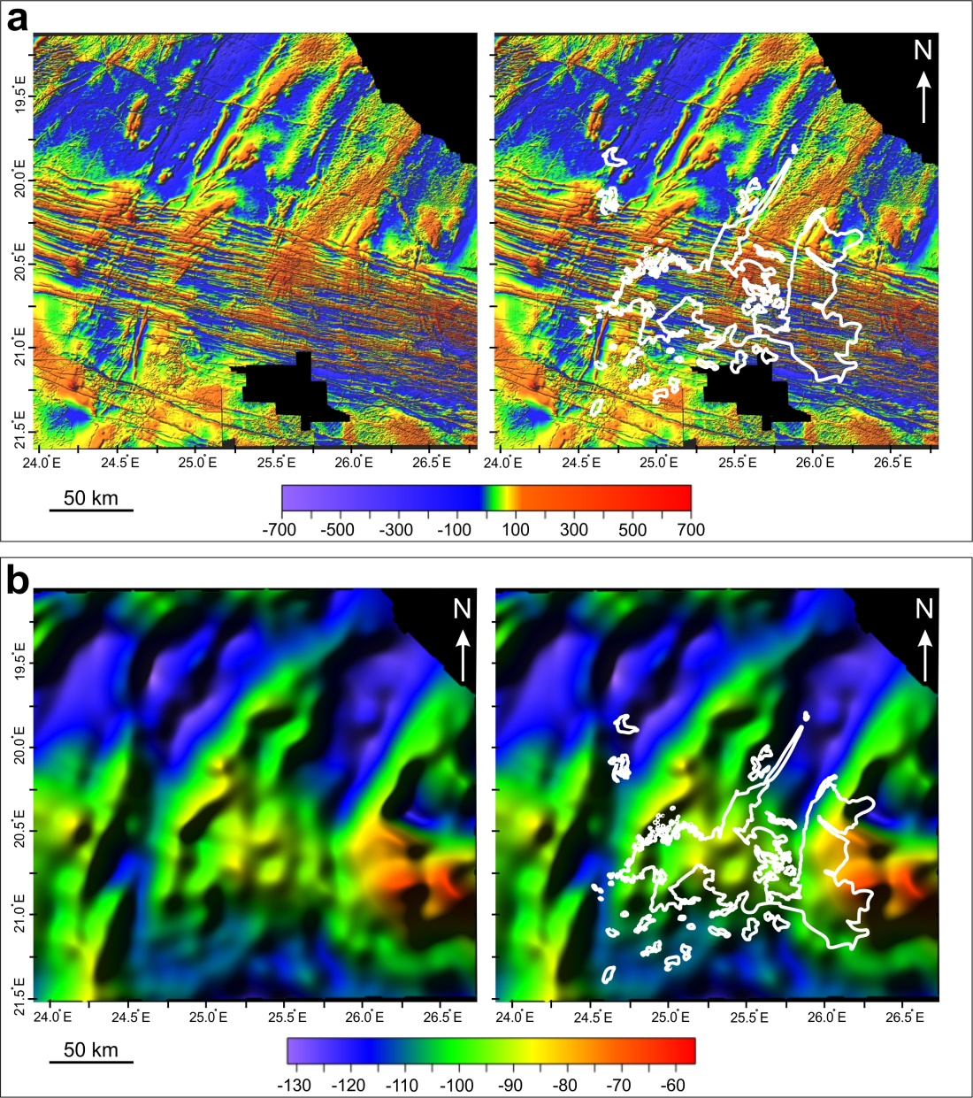
Results

