Slide 1
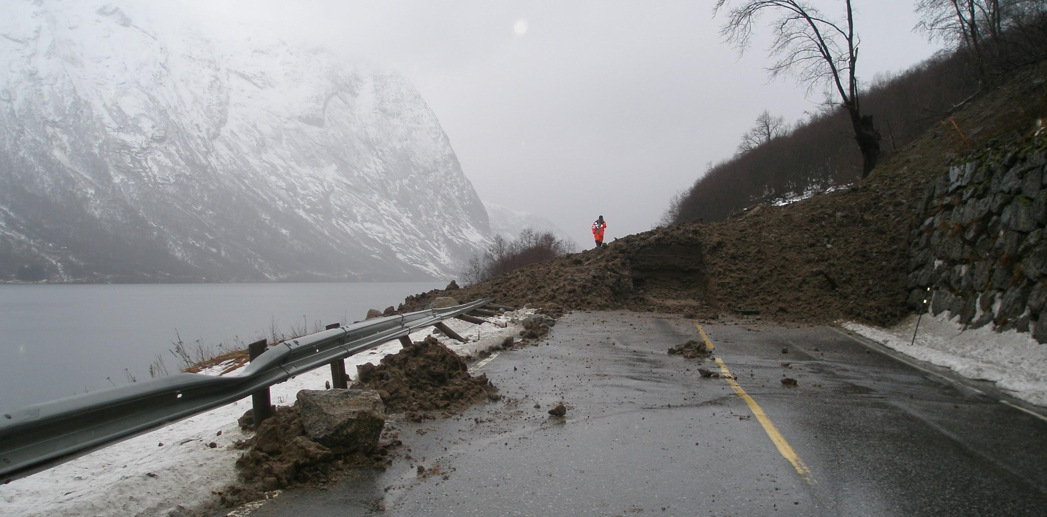


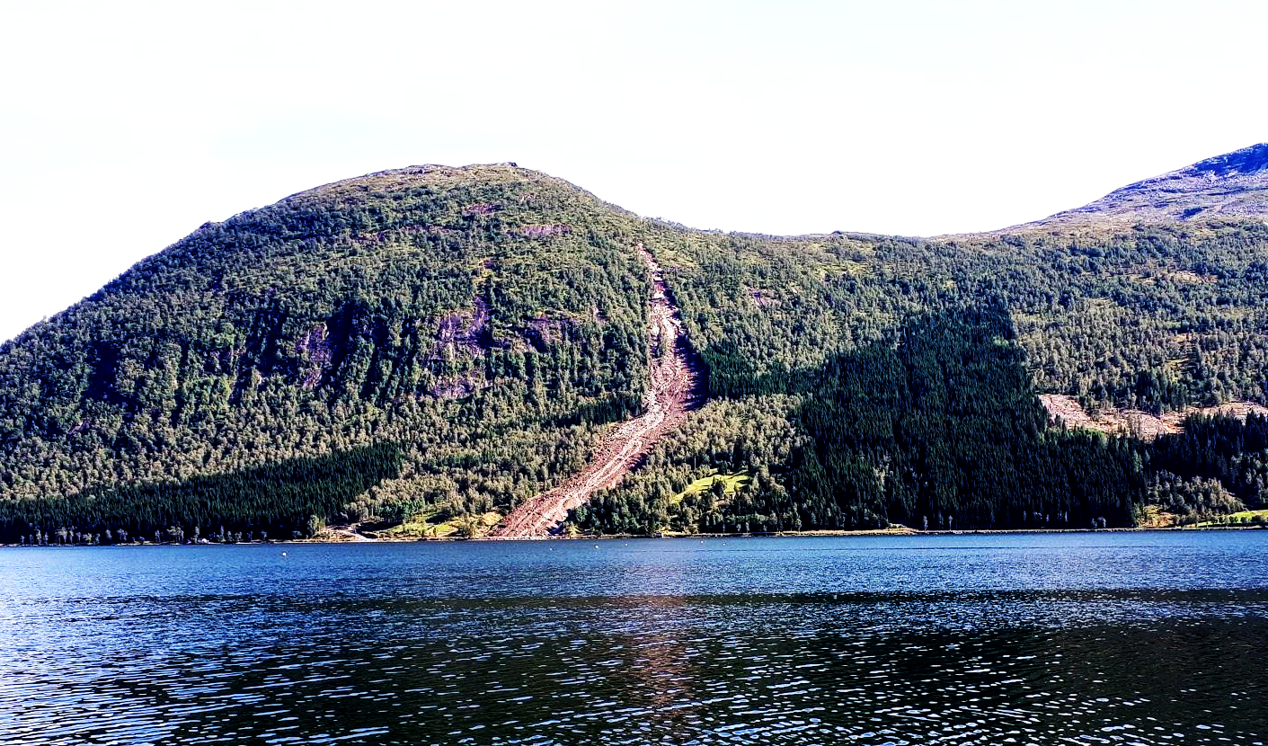

Improving landslide data with satellite images
Erin Lindsay, PhD candidate
Notes:
Today I want to talk about how we can improve landslide data using satellite images.

Slide 2
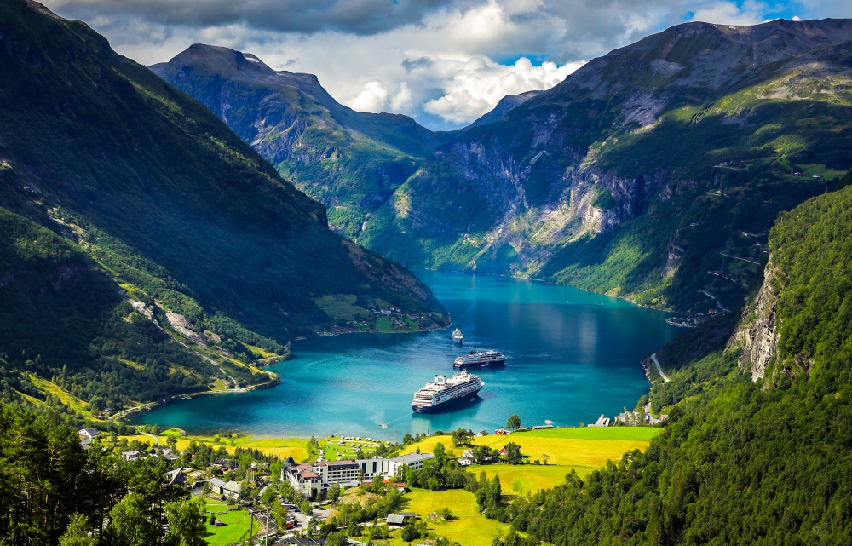
NORWAY
A land of beautiful fjords and mountains
Notes:
My study is set in Norway – a country with beautiful fjords and mountains.

Slide 3
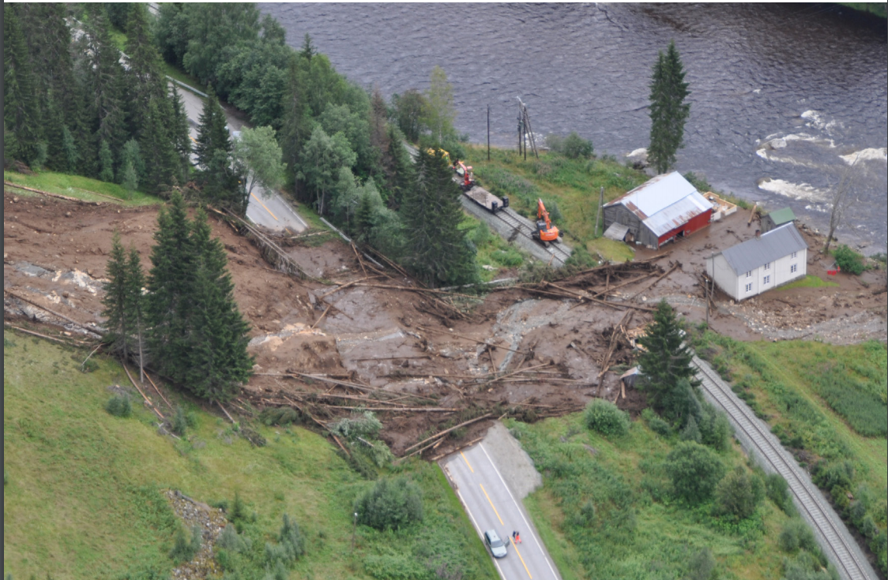
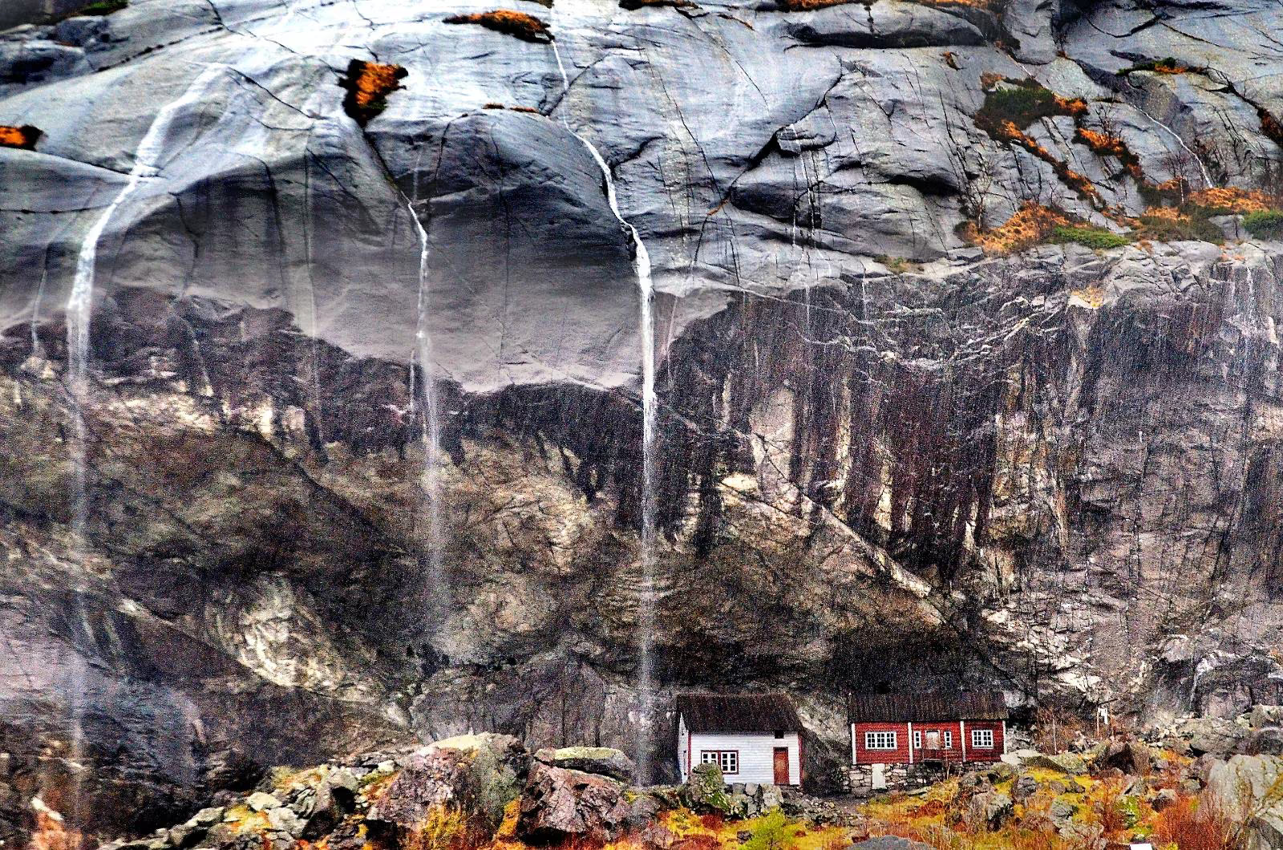
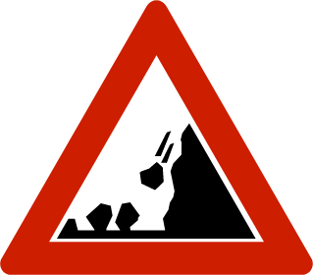
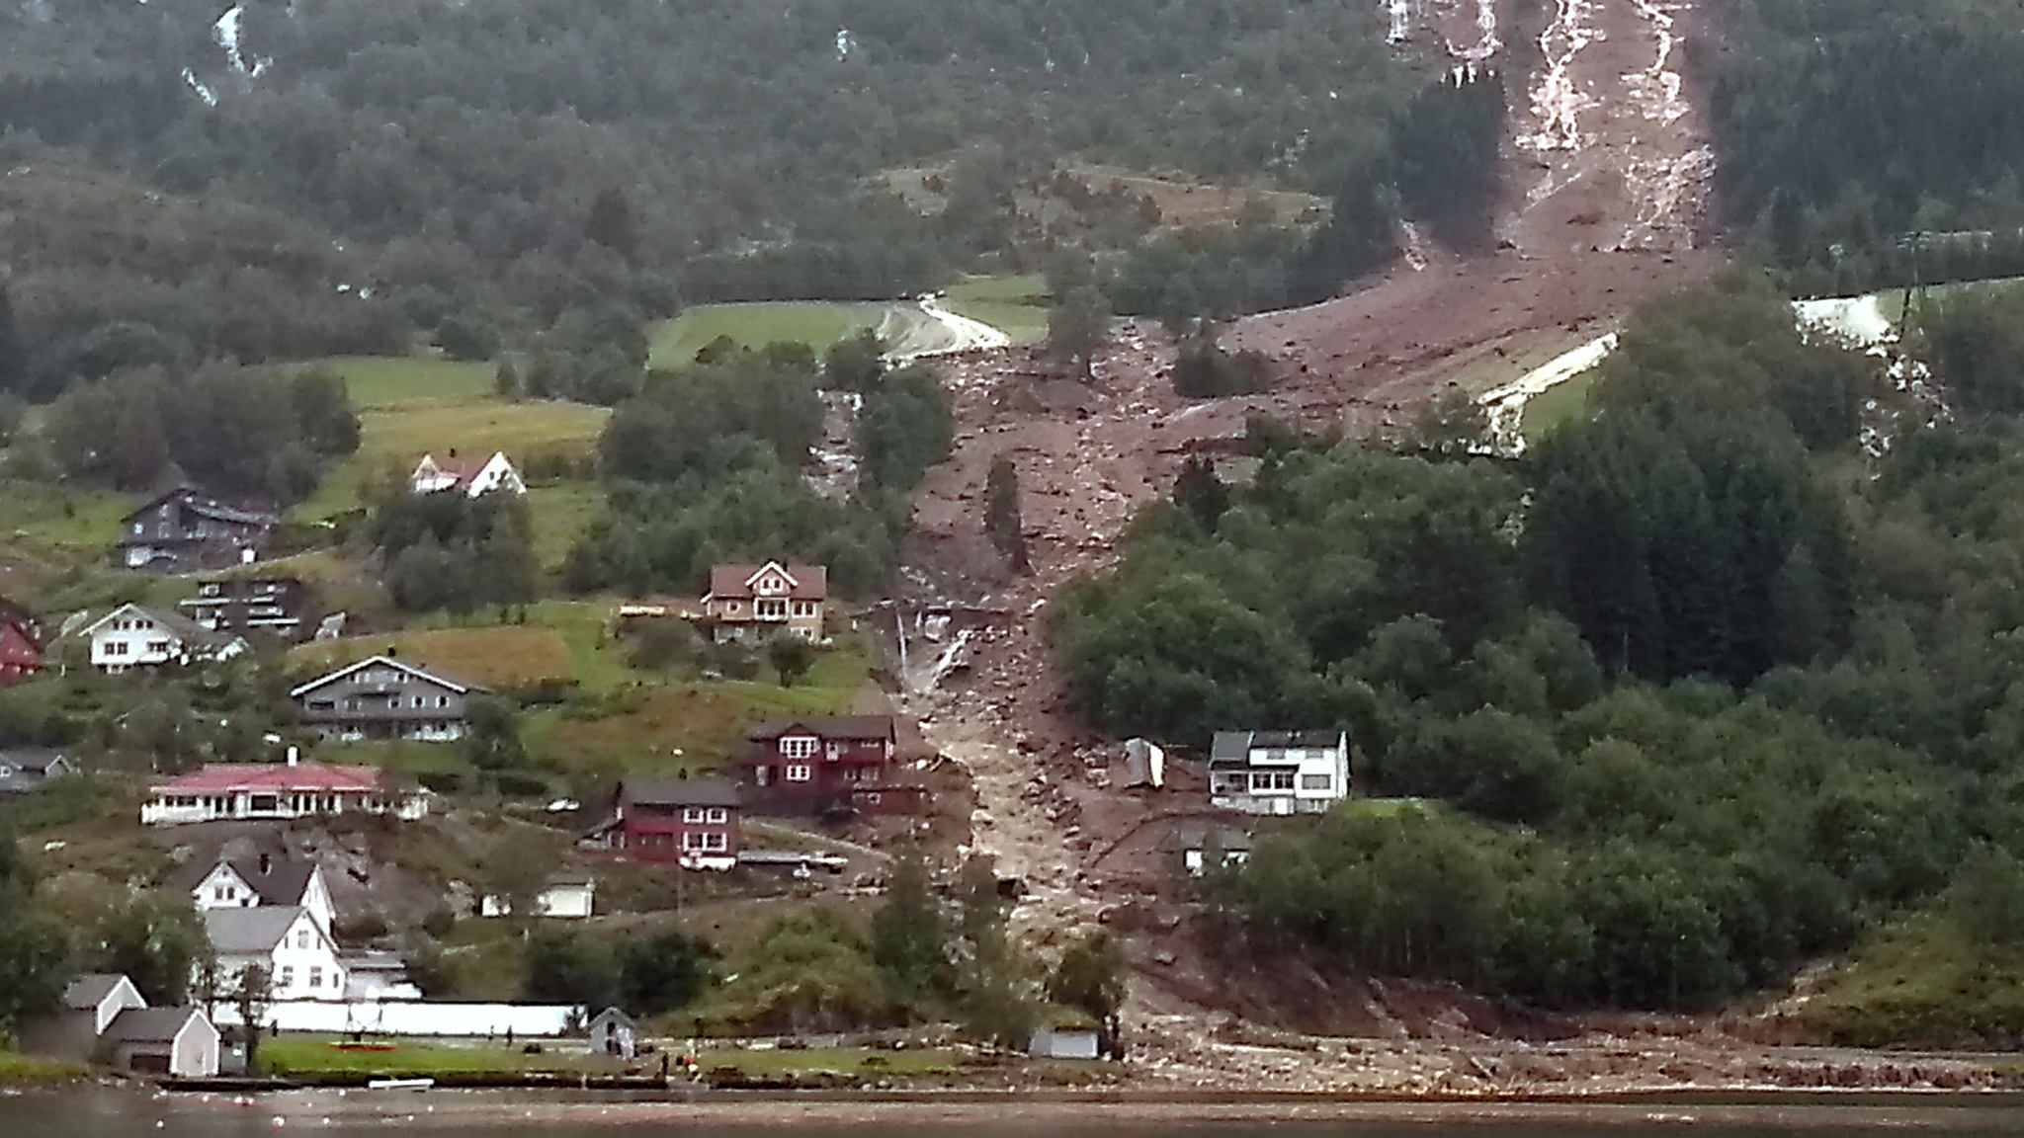
Where people live with the risk of landslides
Notes:
Where people are living at risk of landslides.

Slide 4
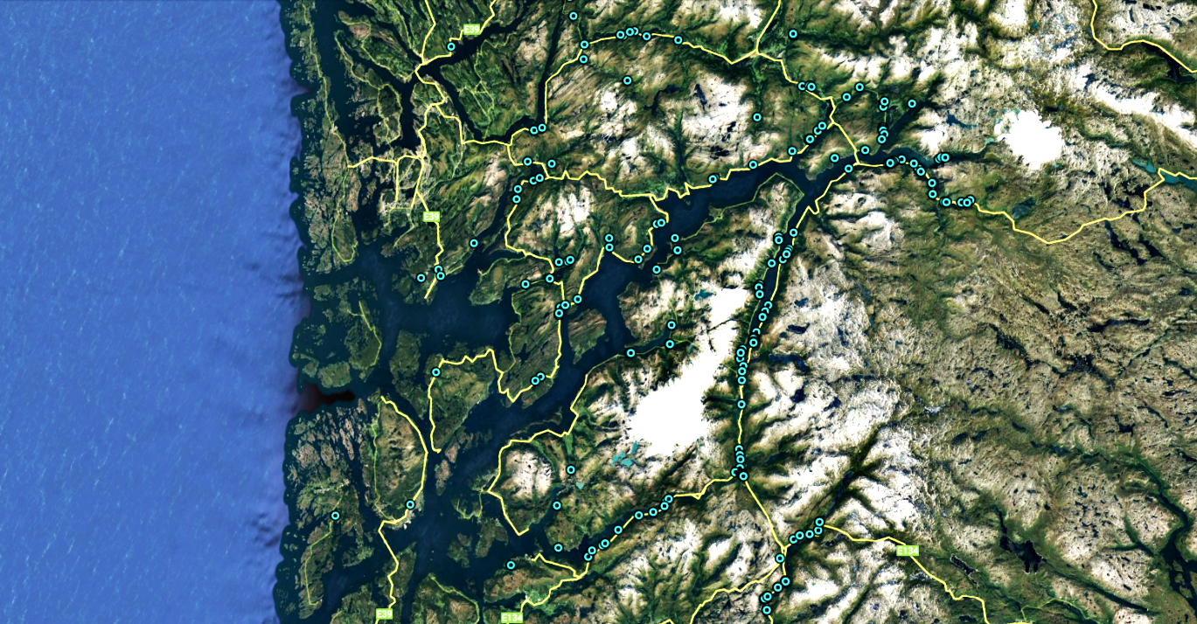
Landslide database
Spatial bias
90% within 100m of a road
Missing info
Size
Trigger
Date
Room for improvement
Representative of the true spatial distribution of landslides ??
Notes:
The landslide database gives some information about where landslides occur, and how often.
But as you can see here, there is a strong spatial bias in the data towards roads, because that is where most of the data is reported from. Additionally, we often lack information such as the size, and trigger information.

Slide 5
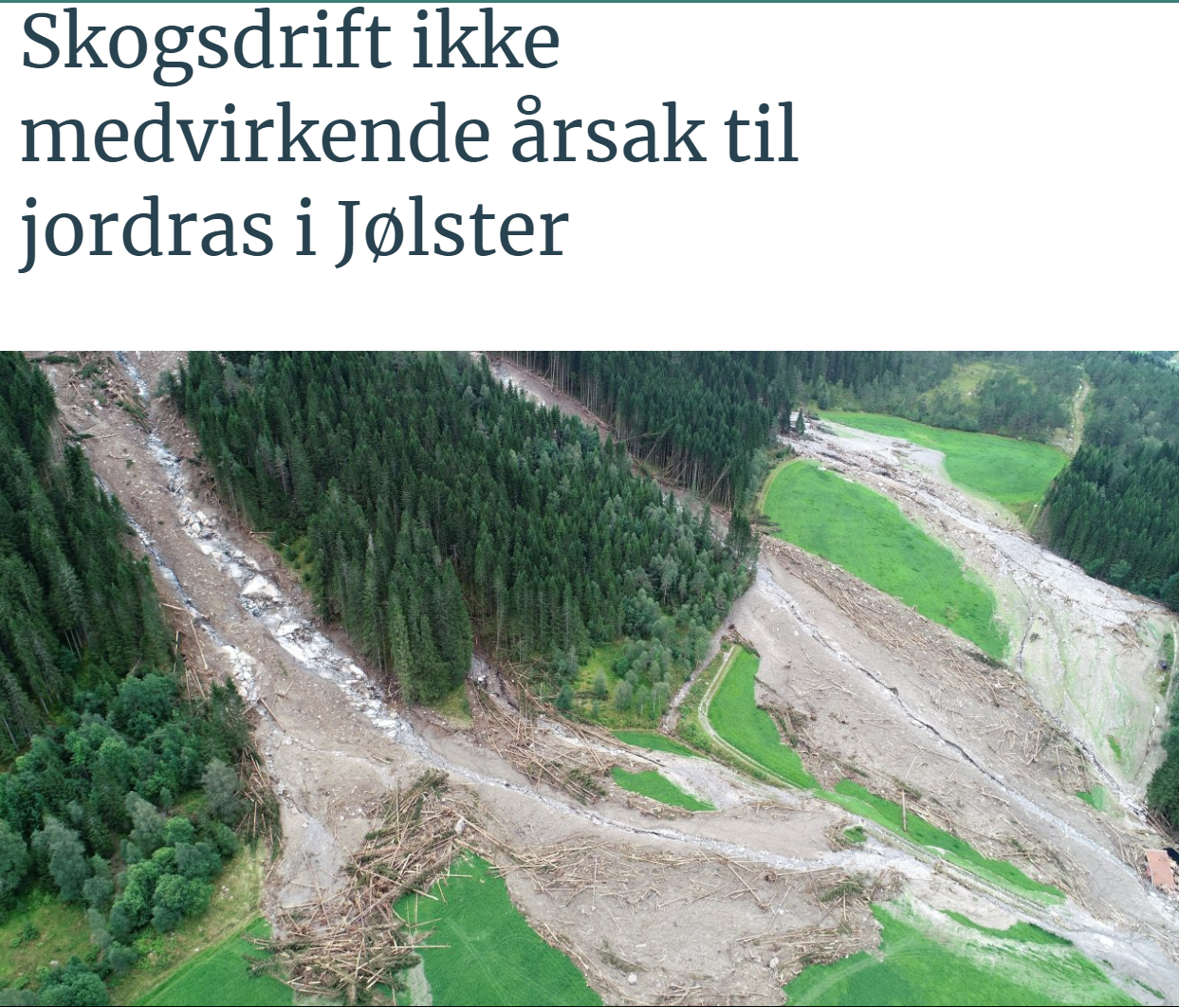
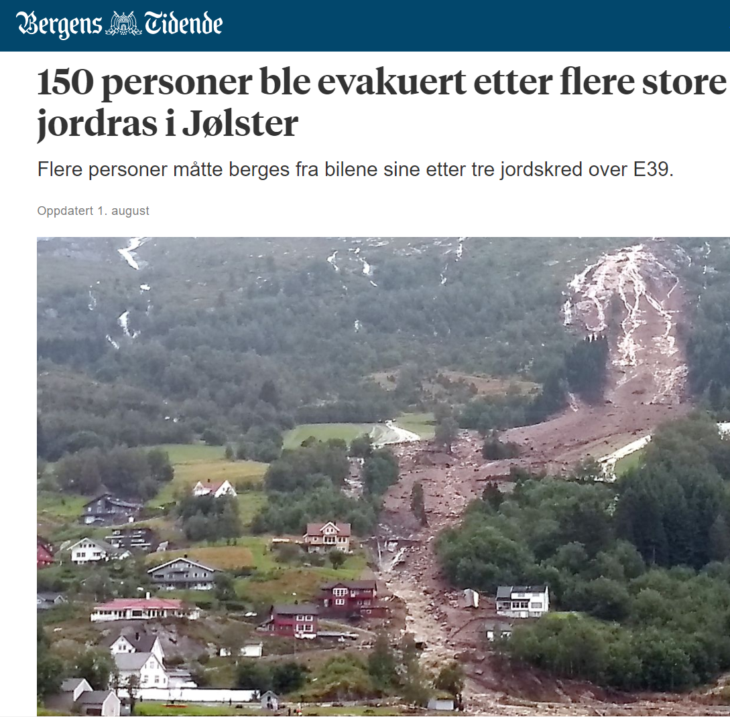
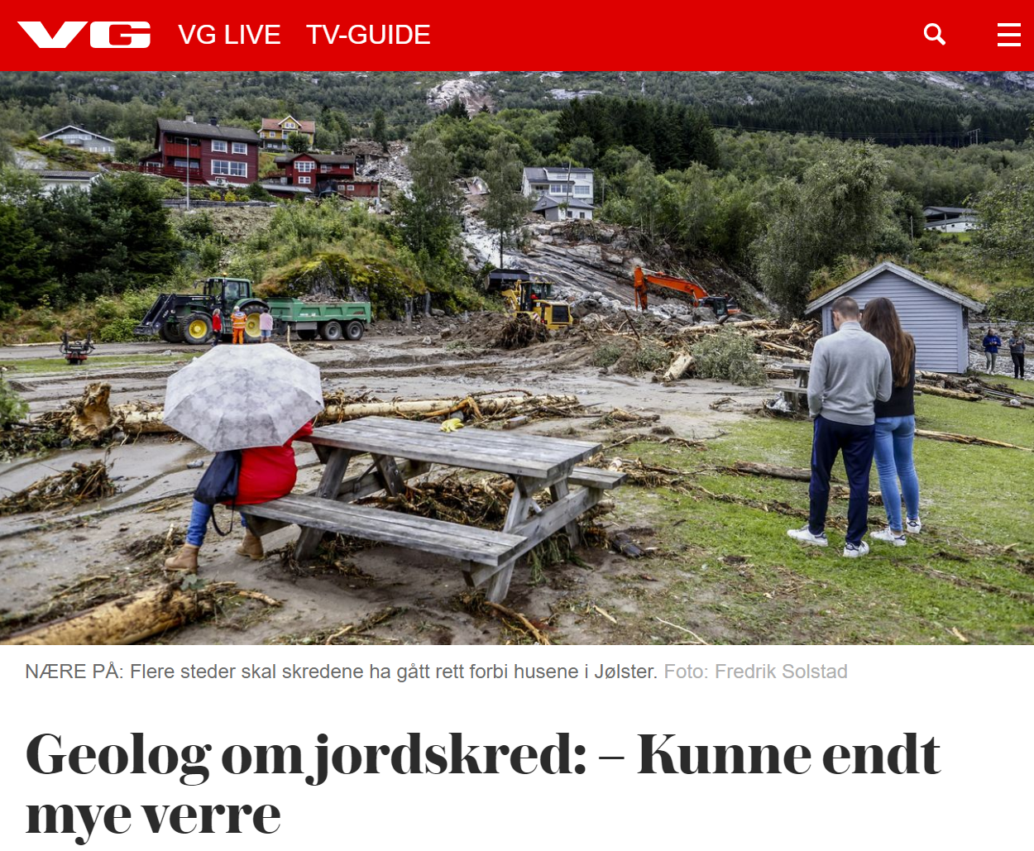
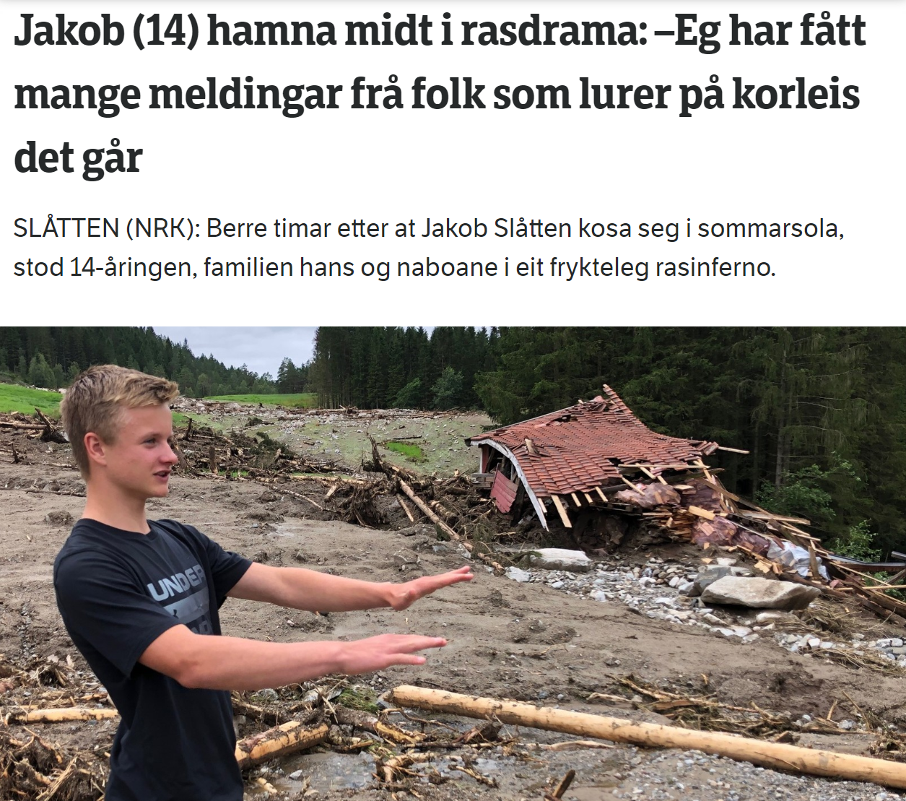
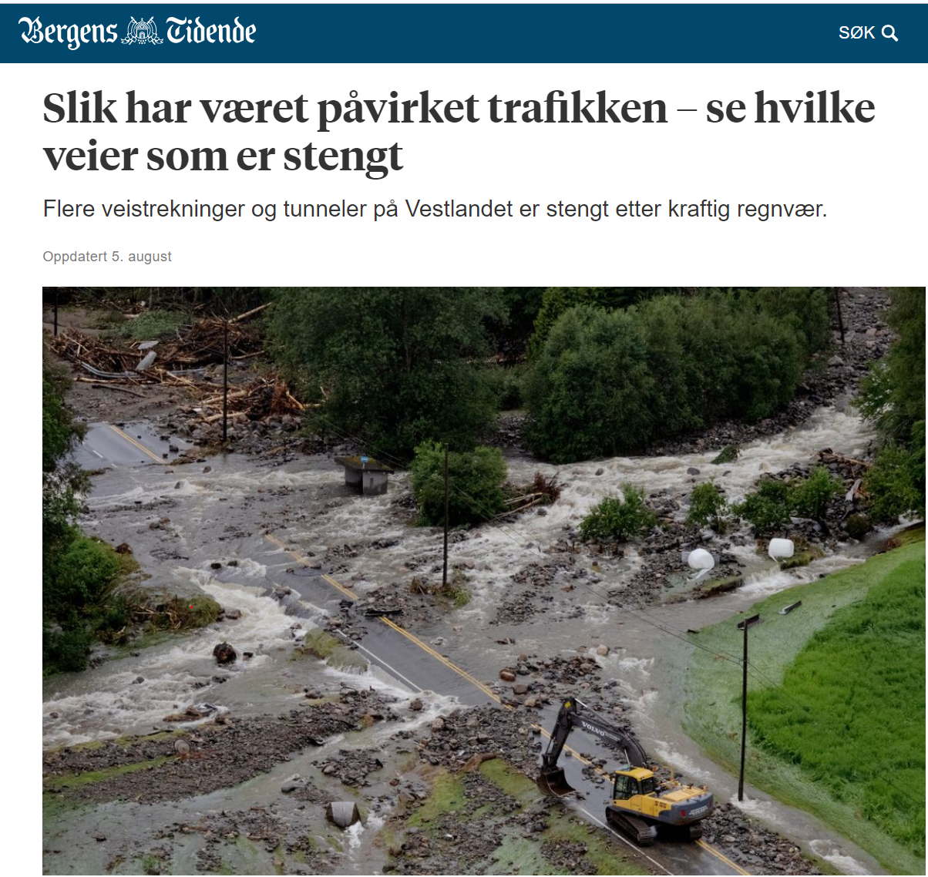
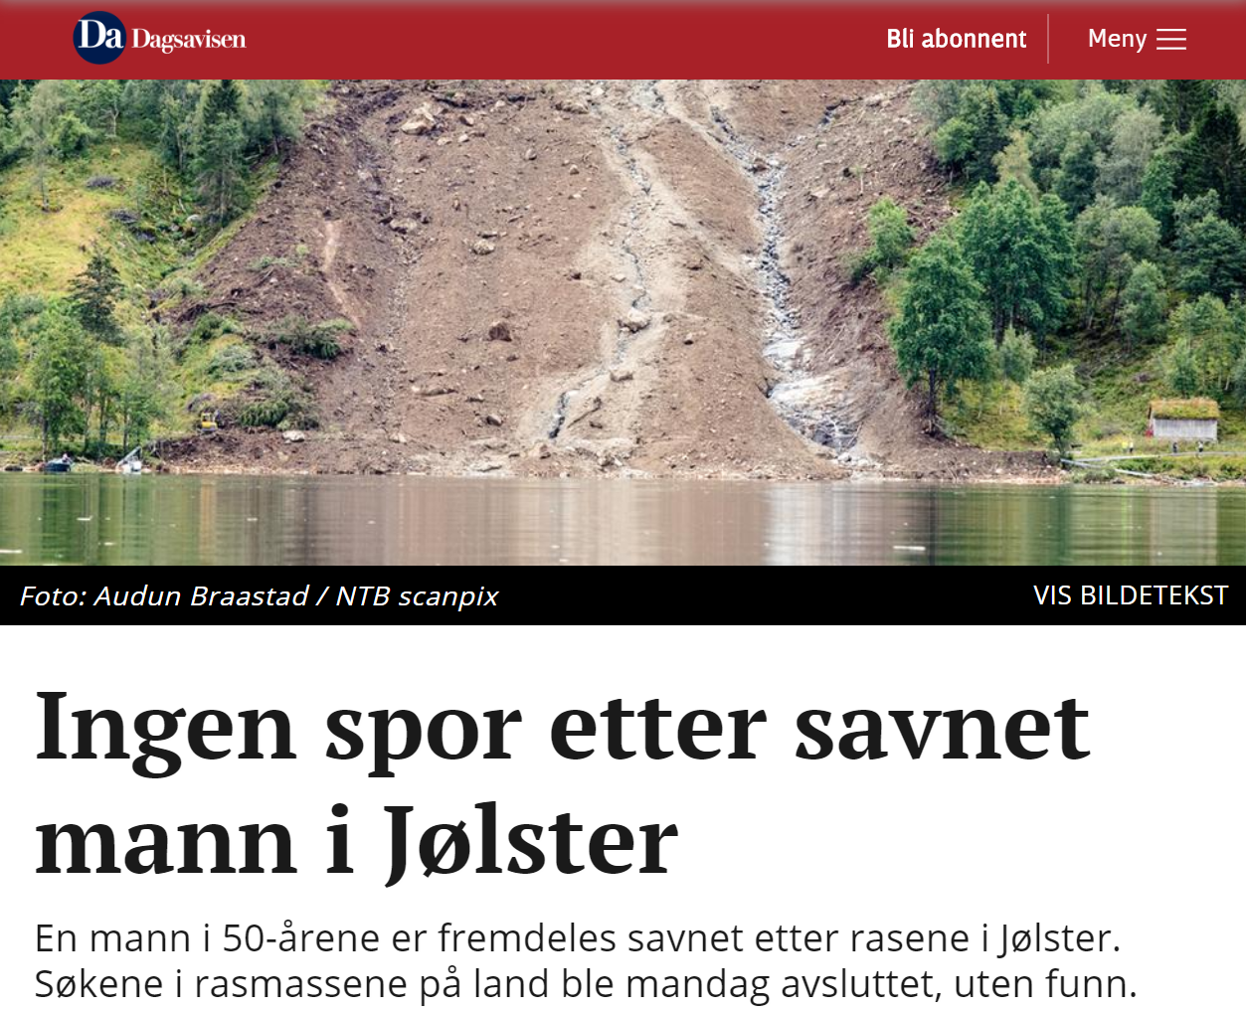
Consequences
Case study: Jølster, July 30, 2019
Notes:
To demonstrate how we can use satellite images to extract more information on the location and date of landslides, I am showing some recent results from Jølster.
This was one of the worst multiple landslide events in Norway. On the 30th of July 2019, the area received a 200 year magnitude rainfall, and this resulted in several landslides that blocked every road out of the town, and caused a lot of damage.
Point out the Vassenden Landslide.

Slide 6
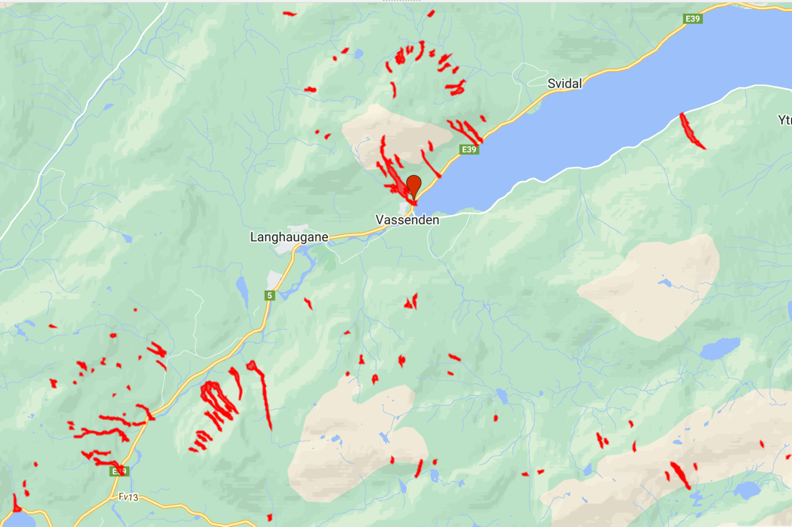
First - an event inventory of 120 landslides was created based on Sentinel-2 images, verified by field observations
Where did the landslides occur?
Lindsay et. al (2022). Multi-Temporal Satellite Image Composites in Google Earth Engine for Improved Landslide Visibility: A Case Study of a Glacial Landscape.

Slide 7
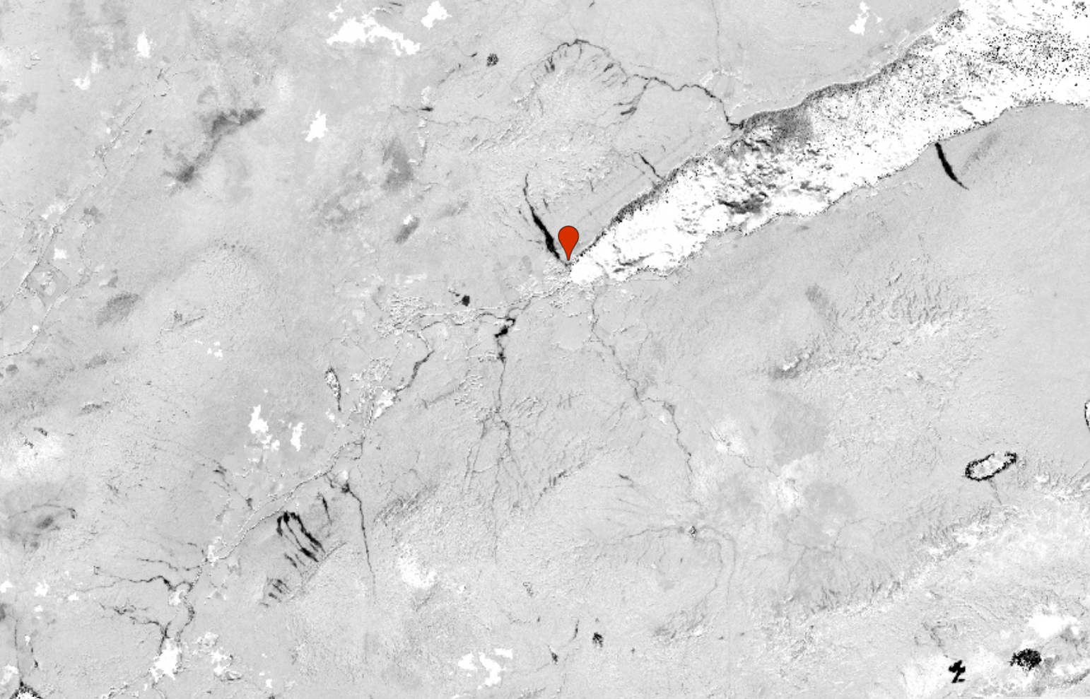
First - an event inventory of 120 landslides was created based on Sentinel-2 images, verified by field observations
First - an event inventory of 120 landslides was created based on Sentinel-2 images, verified by field observations
Increased no. of landslides from 14 to 120
Significantly reduced spatial bias (30% within 100m of road)
Lindsay et. al (2022). Multi-Temporal Satellite Image Composites in Google Earth Engine for Improved Landslide Visibility: A Case Study of a Glacial Landscape.
Lindsay et. al (2022). Multi-Temporal Satellite Image Composites in Google Earth Engine for Improved Landslide Visibility: A Case Study of a Glacial Landscape.

Slide 8
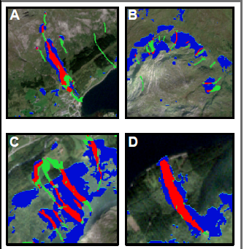
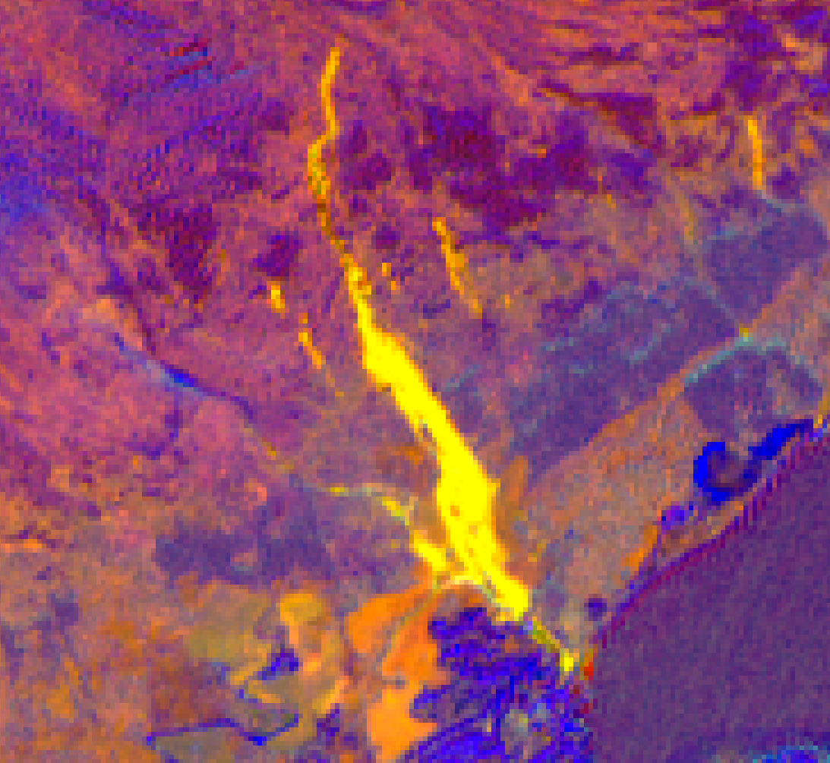
Globally-trained ML models for landslide detection
Tehrani (2021): No landslides detected
https://doi.org/10.1080/19475705.2021.1912196
Prakash (2021): better, but not great.
https://doi.org/10.1038/s41598-021-89015-8
Neither performed well in a glacial landscape.
Much better results with a locally-trained model.
Notes:
This shows vegetation indexes over time - using cloud-filtered Landsat data and Sentinel 2.
the kNDVI values over 6 years at the large Vassenden landslide. For the chosen point in the landslide, it is possible to extract the VI values at that point from every single image, and filter out clouds. Making these plot took just seconds with Google Earth Engine.
kNDVI – a shiny new ML-based version of NDVI.
Similar to NDVI, higher values represent healthy green vegetation, while low values are non-vegetated. So prior to the landslide this location had forest, and we see seasonal cycles in the kNVI values. We see a really clear and abrupt change at the time when the landslide occurred. After which, the kNDVI stays low.
Using this method we could narrow down the date range of when the landslide occurred to within 5 days.
https://doi.org/10.3389/fclim.2020.576740
DOI: 10.1126/sciadv.abc7447

Slide 9
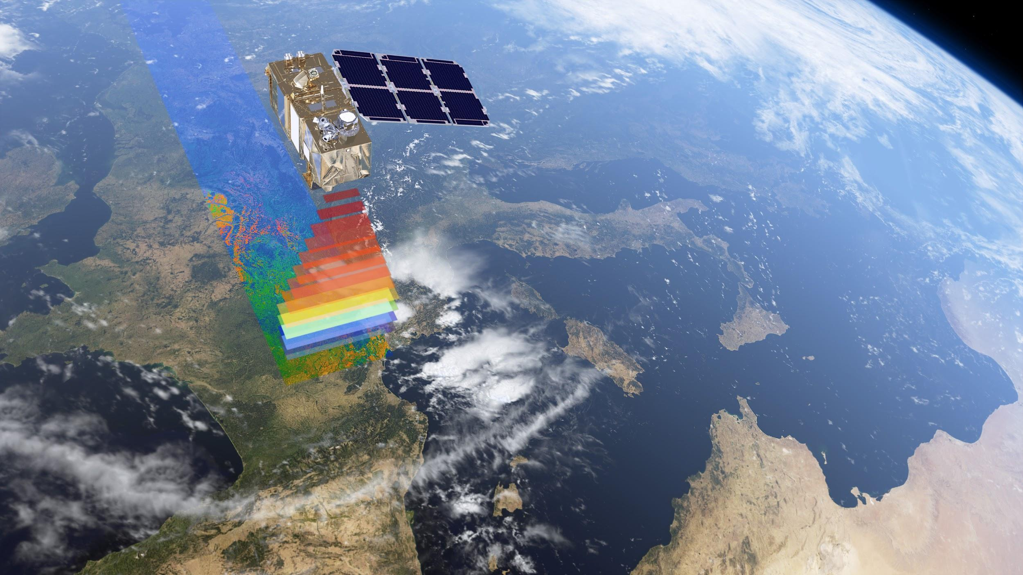
Part 2.
When did the landslides occur?
Back-analysis of time-series data using
Google Earth Engine

Slide 10
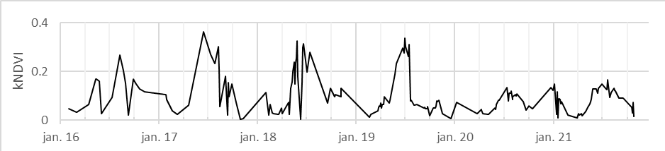


Sentinel-2 - vegetation indices
Vassenden landslide
vegetation
bare soil
kNDVI (Sentinel-2)
Abrupt change in kNDVI values after landslide occurs
5 day window (July 27 to Aug 2)
Notes:
This shows vegetation indexes over time - using cloud-filtered Landsat data and Sentinel 2.
the kNDVI values over 6 years at the large Vassenden landslide. For the chosen point in the landslide, it is possible to extract the VI values at that point from every single image, and filter out clouds. Making these plot took just seconds with Google Earth Engine.
kNDVI – a shiny new ML-based version of NDVI.
Similar to NDVI, higher values represent healthy green vegetation, while low values are non-vegetated. So prior to the landslide this location had forest, and we see seasonal cycles in the kNVI values. We see a really clear and abrupt change at the time when the landslide occurred. After which, the kNDVI stays low.
Using this method we could narrow down the date range of when the landslide occurred to within 5 days.
https://doi.org/10.3389/fclim.2020.576740
DOI: 10.1126/sciadv.abc7447

Slide 11
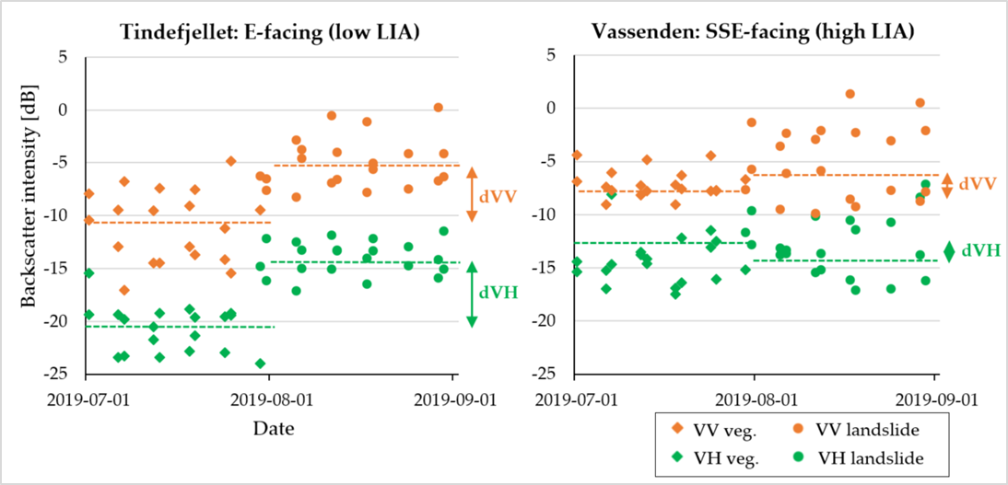
Sentinel-1: backscatter intensity
vegetation
vegetation
bare soil
bare soil
1 day window (July 29-30)
LIA = local incidence angle
Notes:
We did a similar thing with Sentinel-1 SAR data, which for most of Europe - you can get as both VV or VH polaralised.
Here we show just 1 month before and after the landslide occurred, and dashed lines show the mean for each period.
This shows the back scatter intensity which is a measure of the strength of the signal that gets reflected off the ground surface and makes it way back to the satellites sensor.
To put it simply, bare soil is a more reflective surface than trees – therefore we expect a higher intensity for bare soil than for vegetation.
In the Tindefjellet example, we see an abrupt change in the signal, when the landslide occurred.
However, for Vassenden it is not as clear, although you can still see this trend in the VV data.
The likely reason for this is probably the orientation of the landslide relative to the sensor.
In this case we could narrow down the date to one day.

Slide 12
Conclusions from the Jølster case study
How can we improve landslide data with satellite images?
Spatial bias reduced significantly with dNDVI mapping
Globally-trained ML models did not perform well
Sentinel 1 and 2 time-series data: 1-5 day date window
Results of SAR data affected by orientation of landslide relative to the sensor
Thanks for listening!

