Slide 1


Effects of winter warming events on vegetation ecophysiology on a low-alpine ridge
Eirik Aasmo Finne^{1,2}, Lena M. Tallaksen¹, Frode Stordal¹, and Jarle W. Bjerke²
¹University of Oslo, Department of Geosciences, Oslo, Norway (e.a.finne@geo.uio.no)
²Norwegian Institute for Nature Research, Tromsø, Norway (eirik.finne@nina.no)

Slide 2
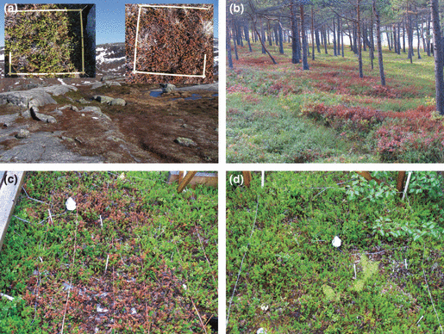
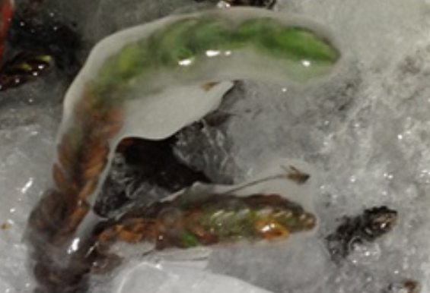
Winter warming affects snow-adapted vegetation
Journal of Ecology, Volume: 97, Issue: 6, Pages: 1408-1415, First published: 13 October 2009, DOI: (10.1111/j.1365-2745.2009.01554.x)
1.Milner, J. M., Varpe, O., Wal, R. van der & Hansen, B. B. Experimental icing affects growth, mortality, and flowering in a high Arctic dwarf shrub. Ecology and Evolution 6, 2139–2148 (2016).

Slide 3
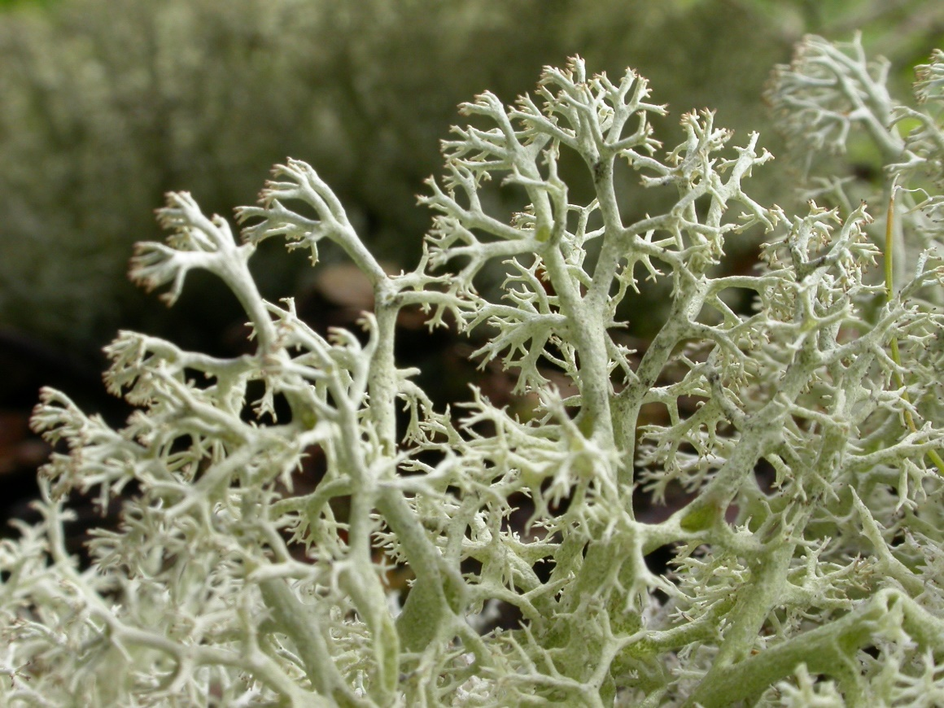
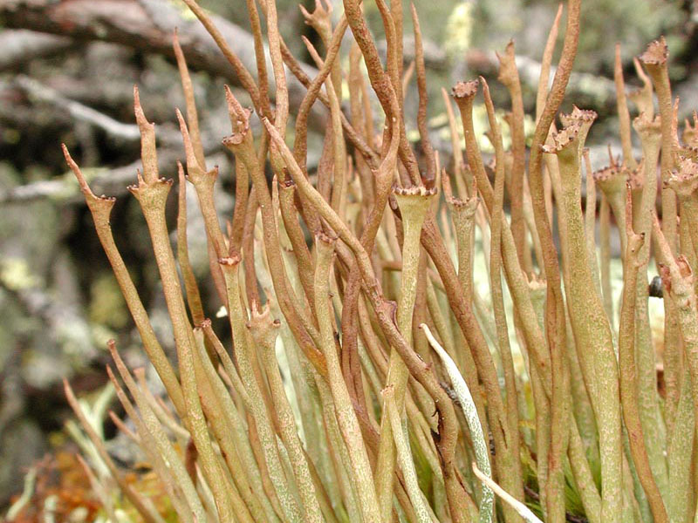
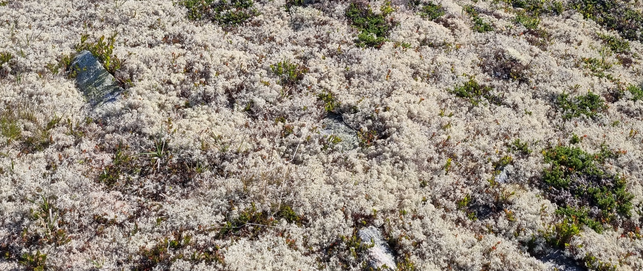
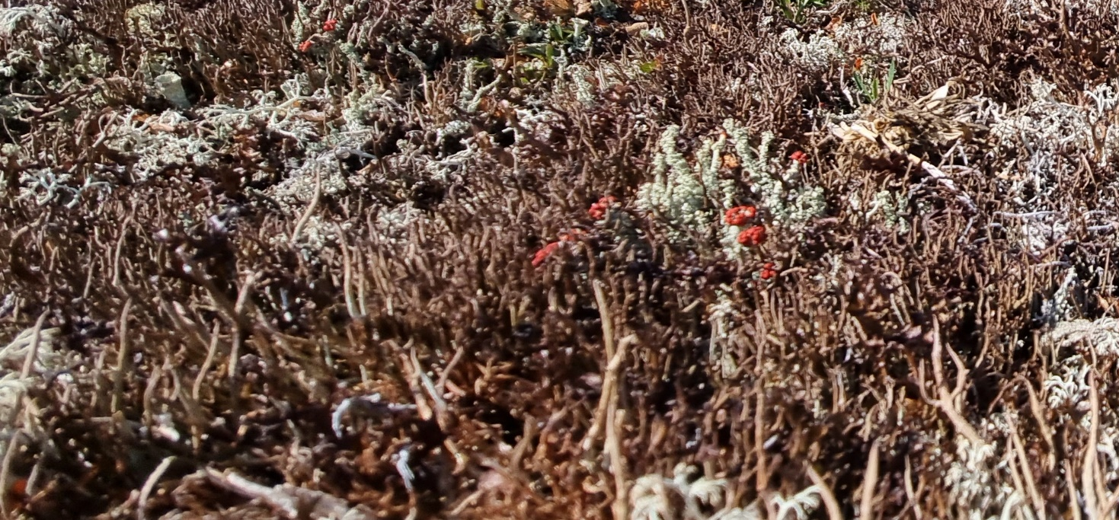
But how does lichens respond to extreme winter warming?
© ET
© ET

Slide 4
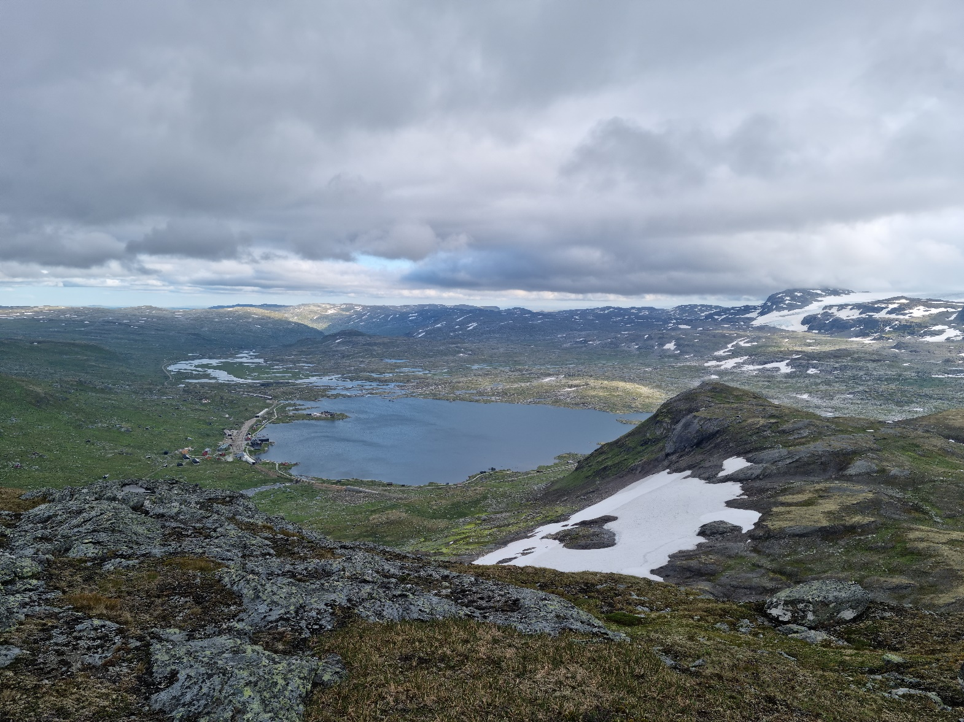
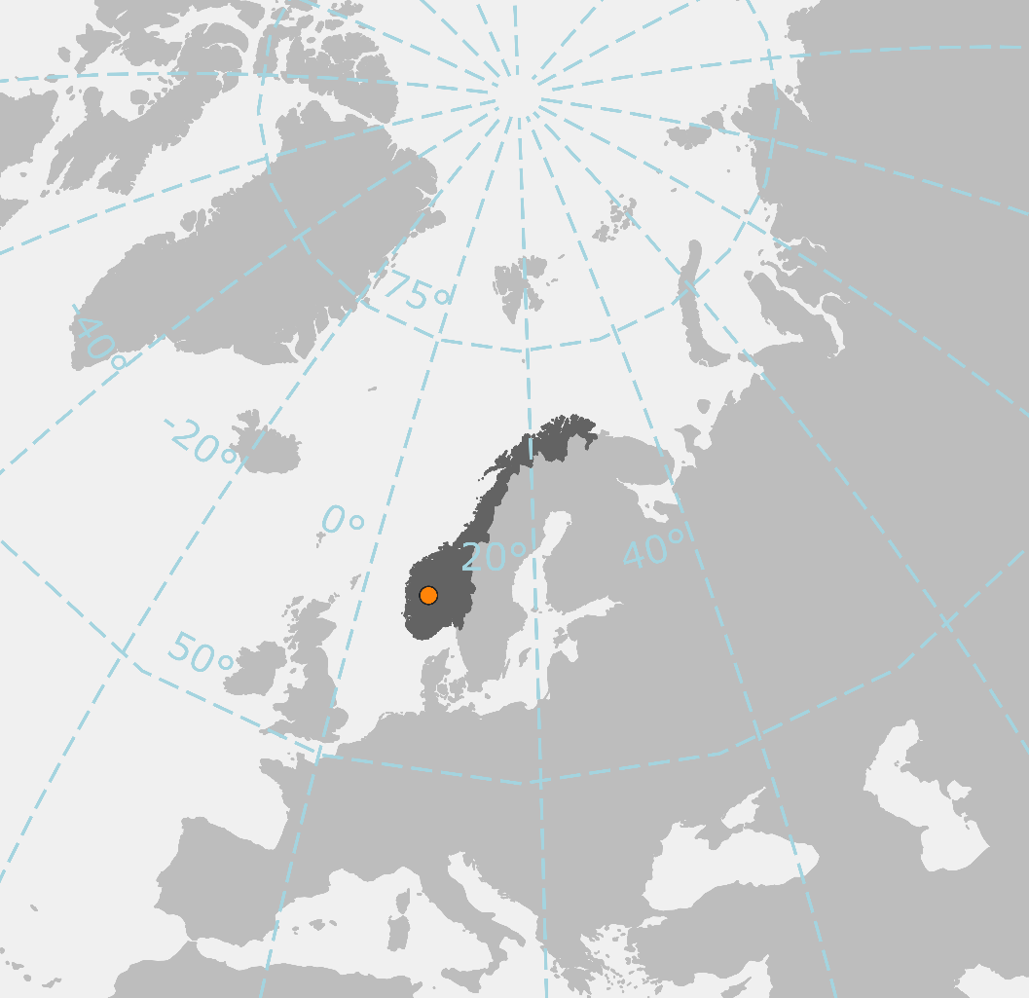
Finse, Norway, 1200 m.a.s.l.

Slide 5
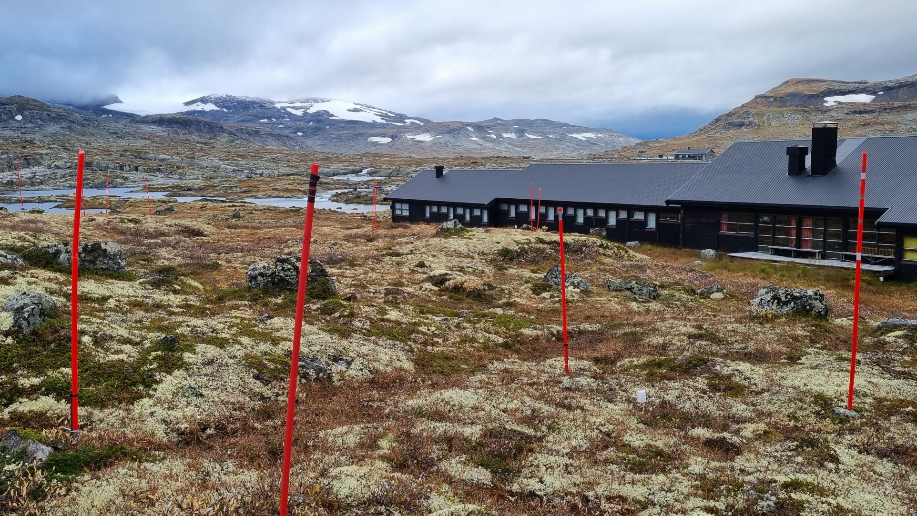
Experimental setup

Slide 6
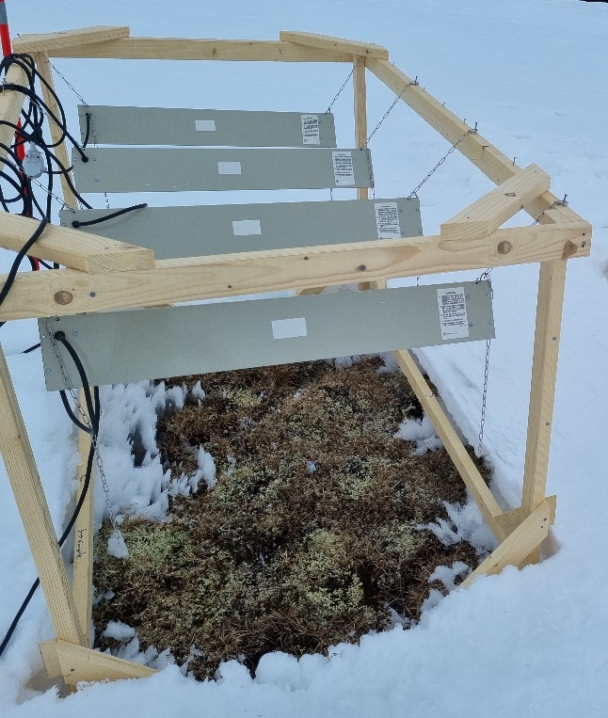
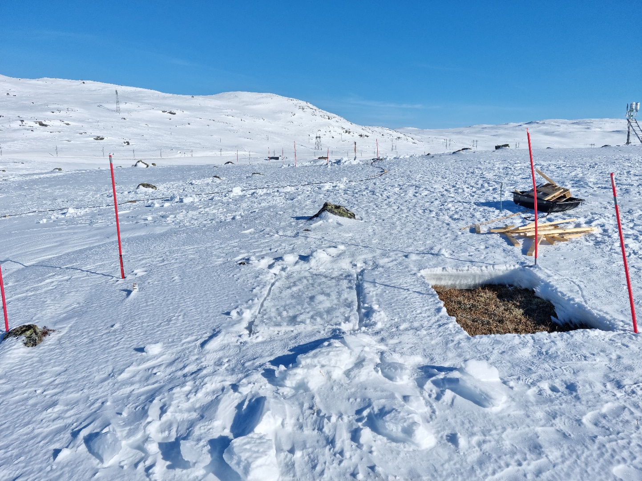
Experimental setup
Control
Icing
Heating
6 Replicates

Slide 7
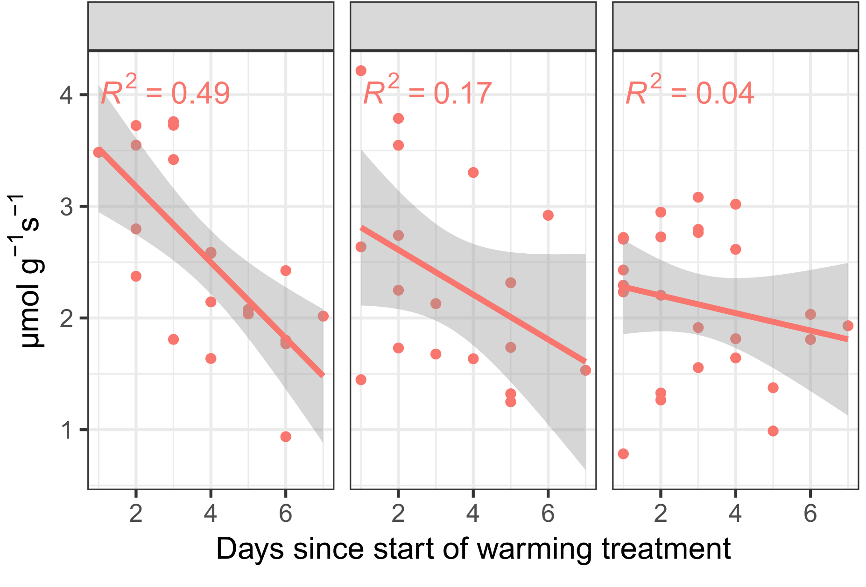
Lichens active during winter
Cladonia arbuscula
Cetraria islandica
Nephromopsis nivalis
Dark respiration

Slide 8
Preliminary results from last summer

Slide 9
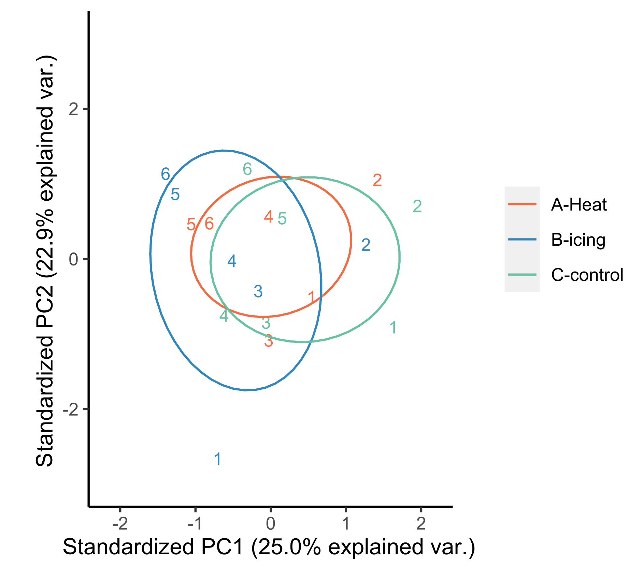
Ordination of summer ecophysiological activity
Plots 1, 5 and 6 are the most wind- exposed

Slide 10
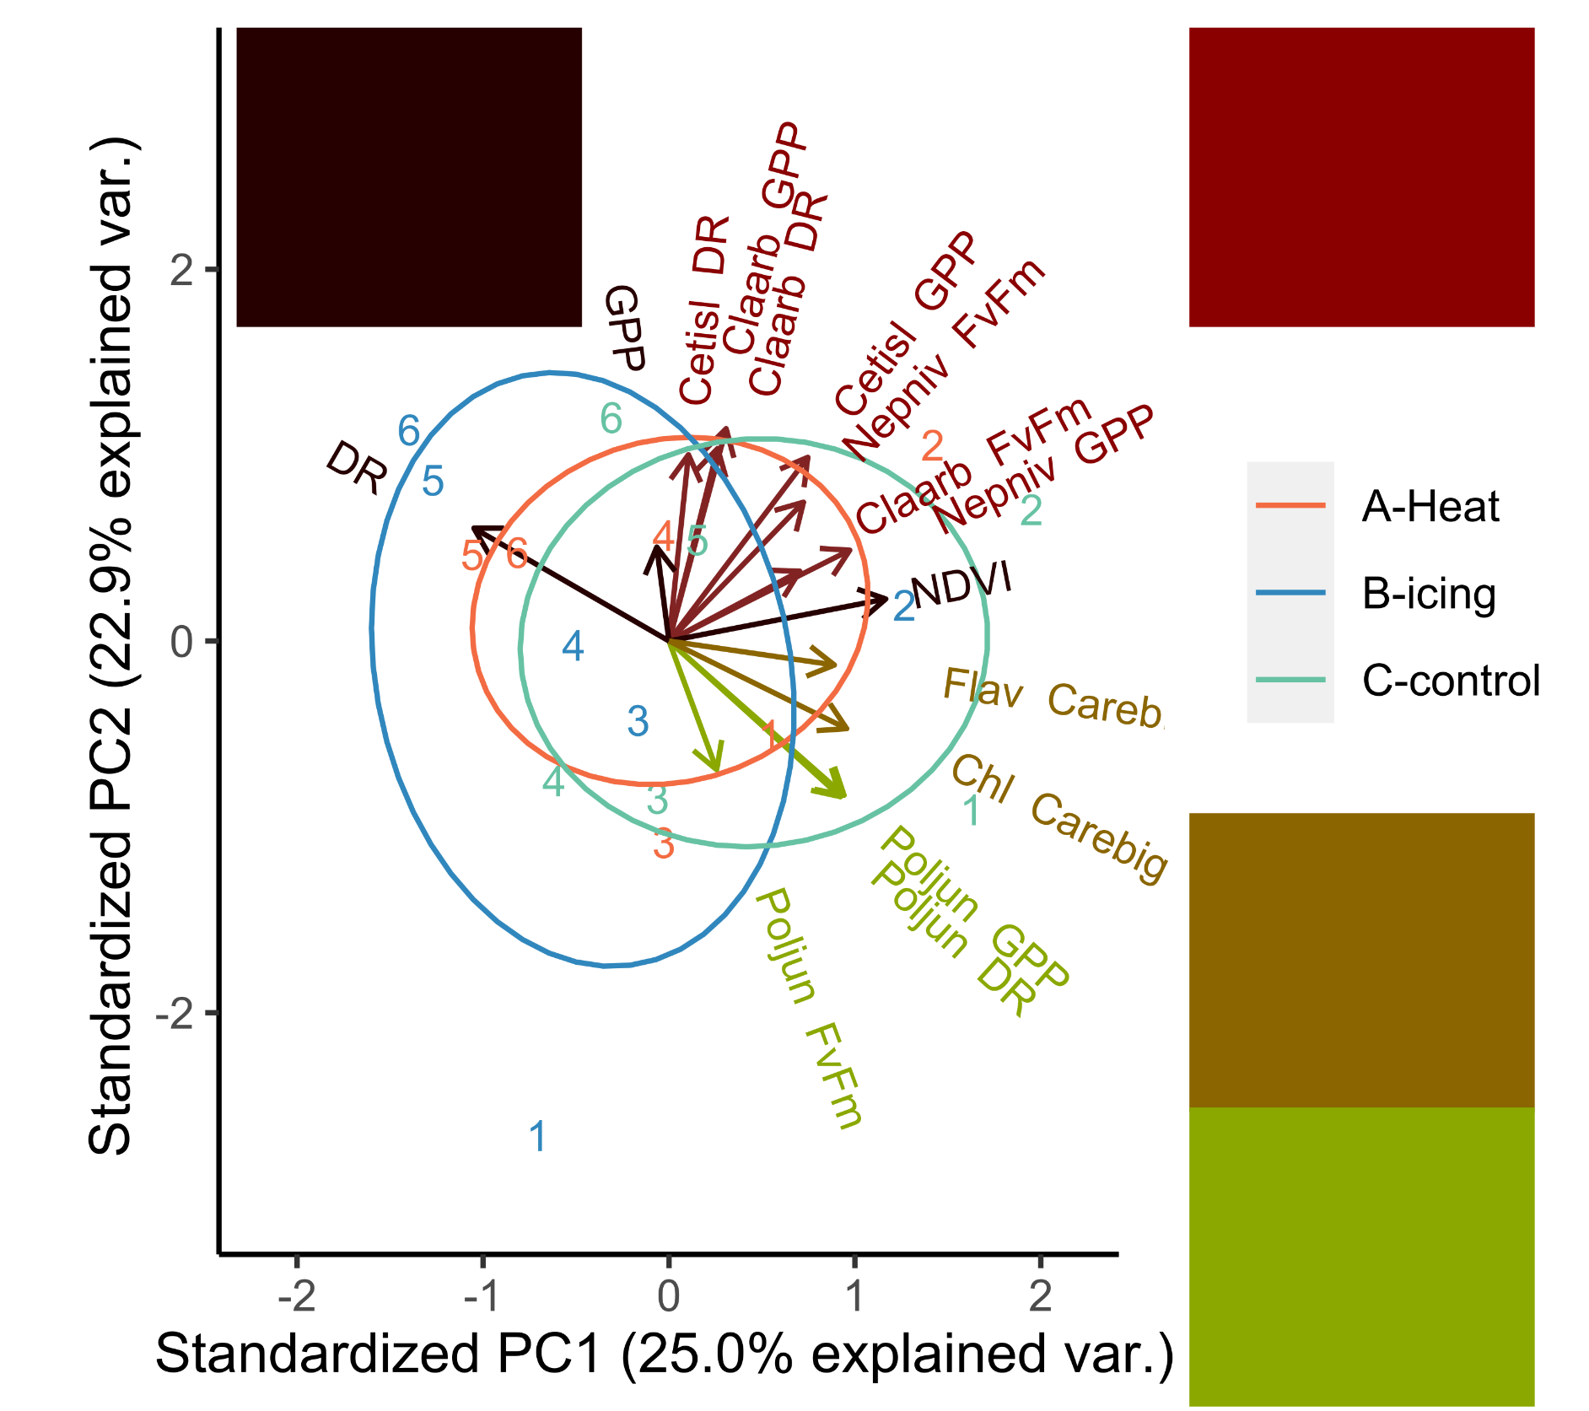
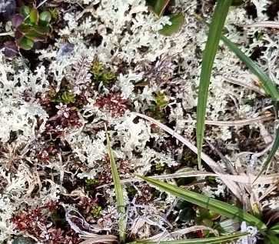
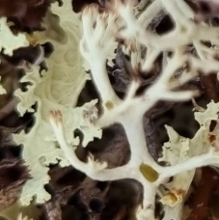
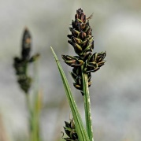
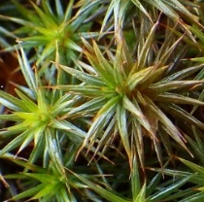
Ordination of summer ecophysiological activity

Slide 11
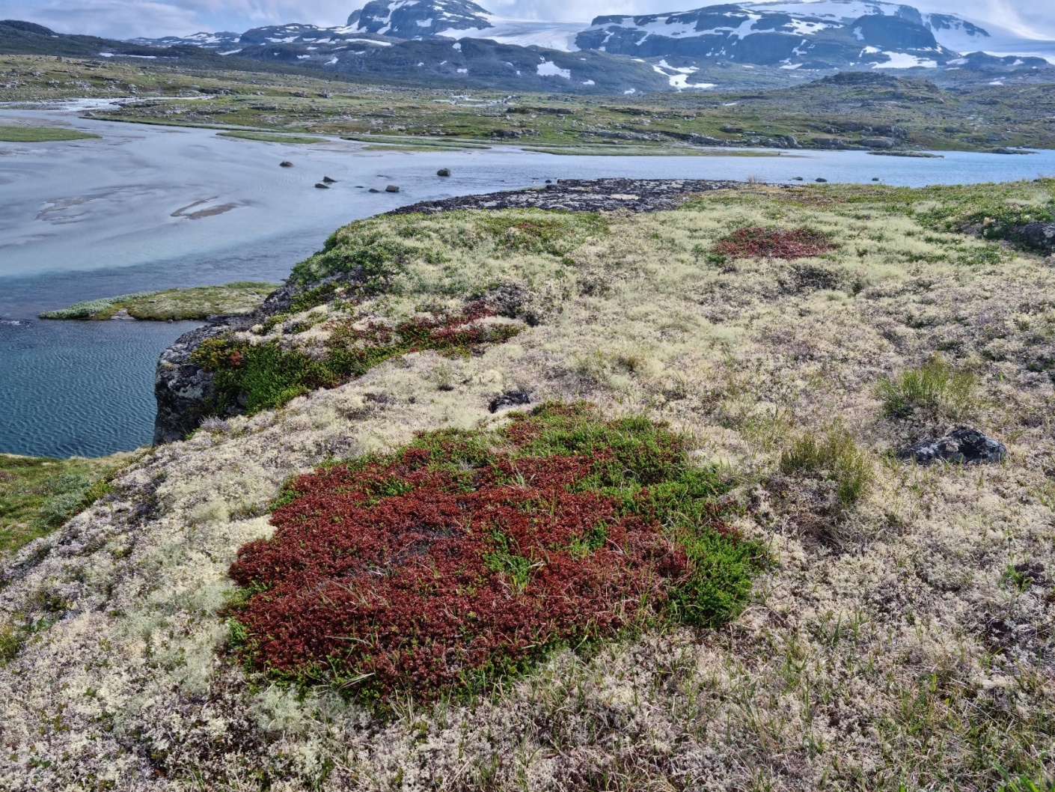


Take-home messages
Even short duration of extreme events can have a profound impact on vegetation.
Lichens resistant against winter warming?
Winter climate change can offset vegetation change promoted by summer warming

