Slide 1
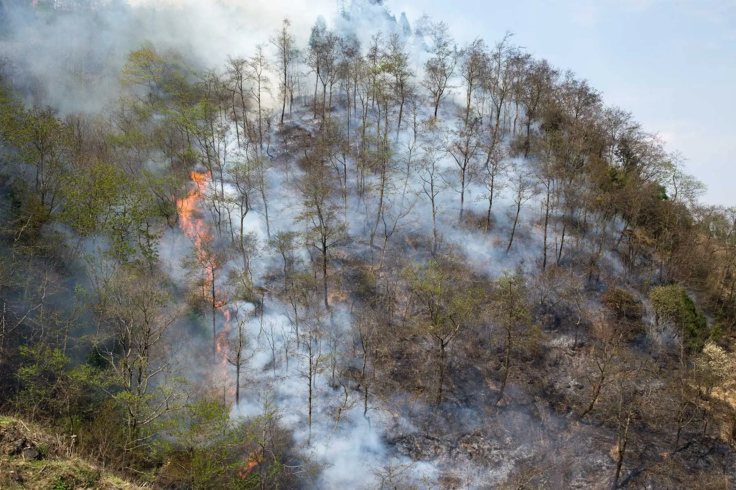
Effect of wildfire on stemflow velocity of pine
Yusen Zhang, Lunjiang Wang, Jing Yang
E-mail: gs.yushenzhang21@gzu.edu.cn
College of Forestry, Guizhou University, China

Slide 2
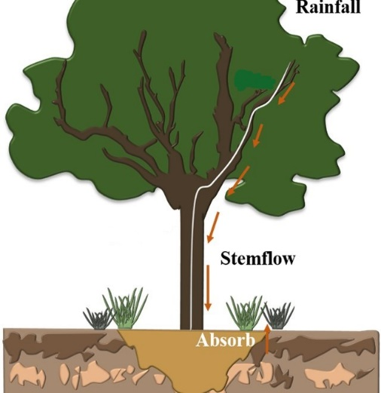
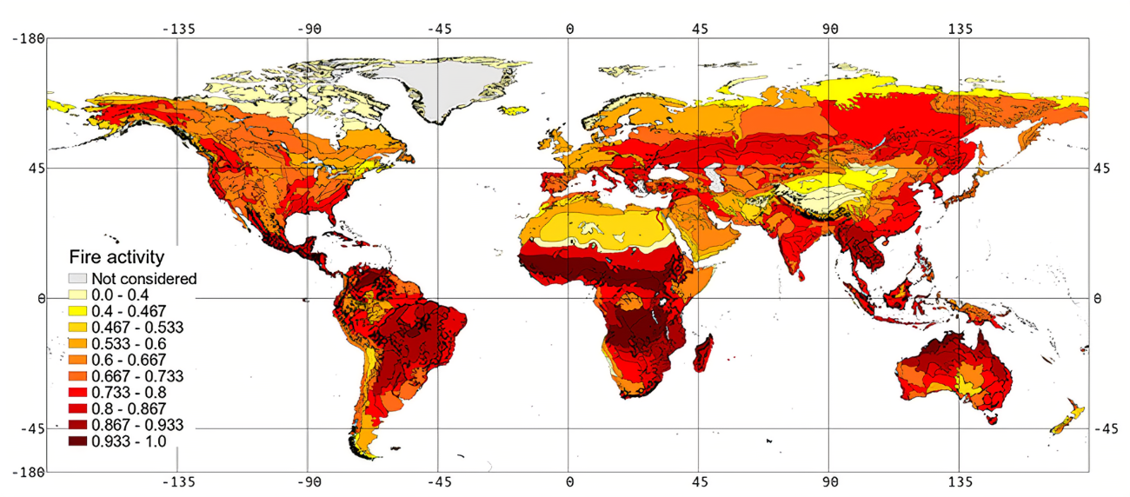
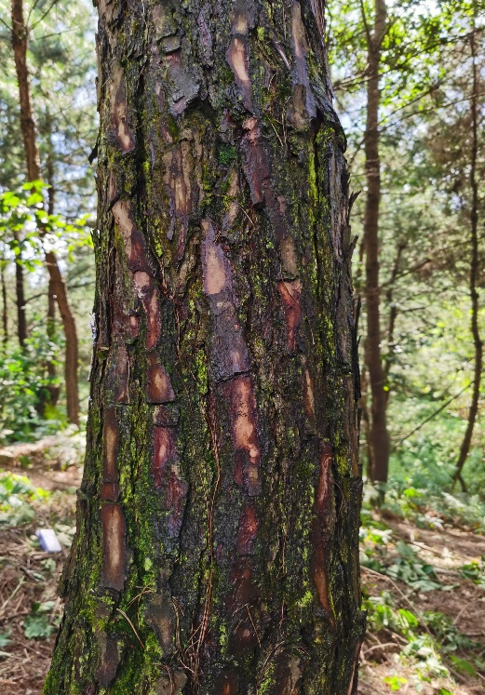
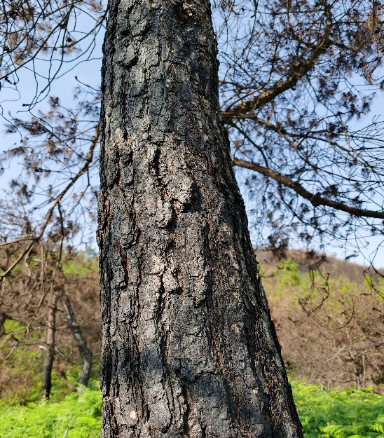
Introduction
Wildfires are frequent events on Earth occurring in almost all vegetation-covered locations.
wildfire would damage the rough pine bark and epiphytes. Those variation may made stemflow velocity change and affect the degree of erosion.
Stemflow, which is water running along a tree’s stem to the ground surface.
Stemflow velocity link to the delivery and spatial distribution of water, nutrients, and microbes from the canopy to the land surface.
Before
After

Slide 3
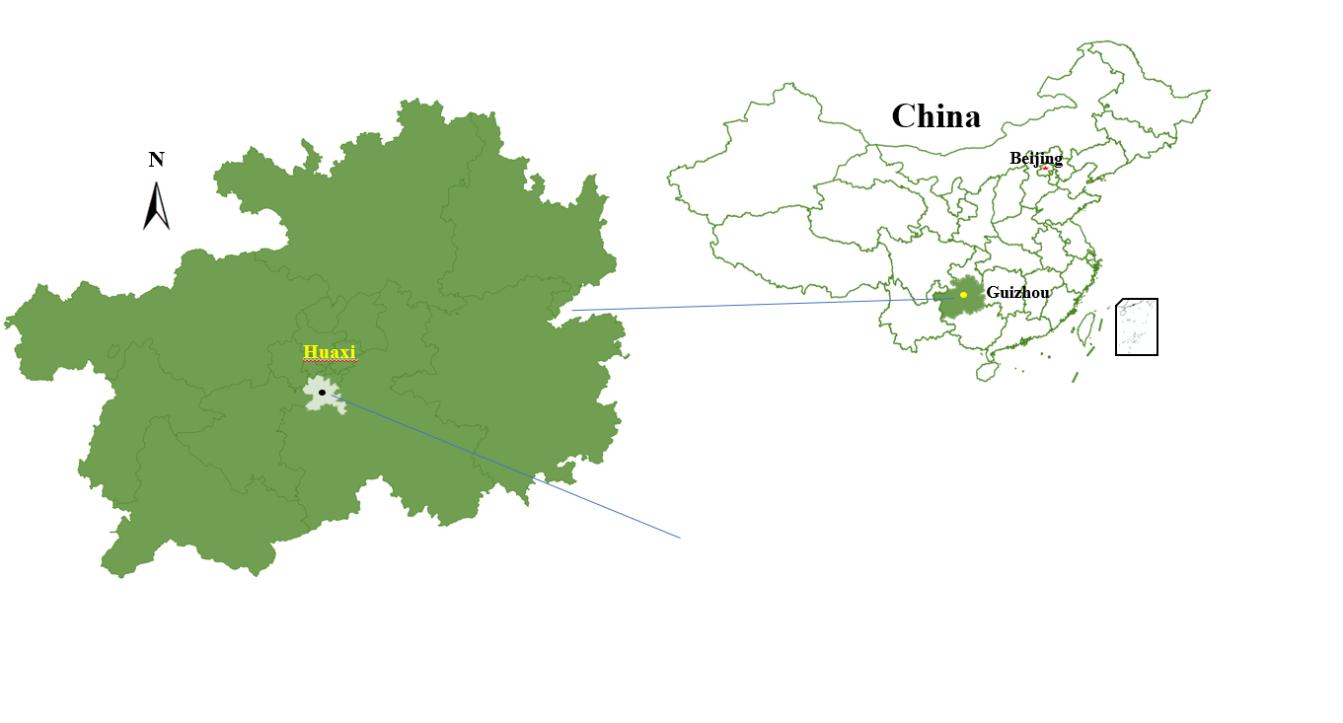
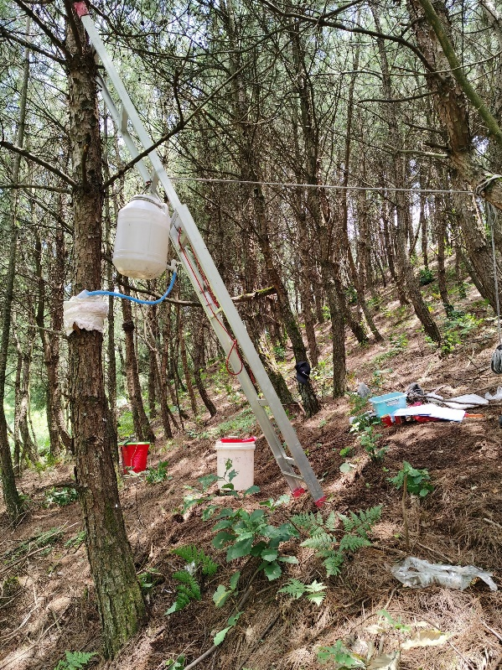
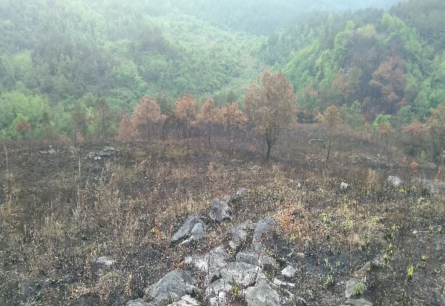
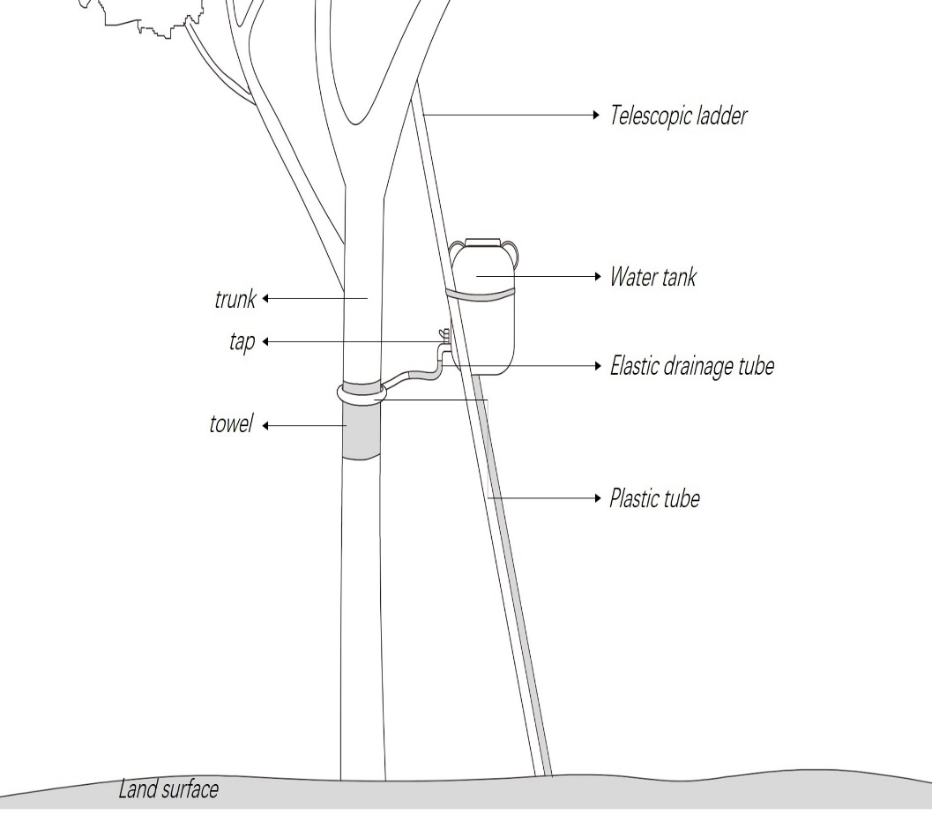
Materials and methods
Study site
we designed a device to conduct the experiment.
Self-made device to simulate stemflow
Our study was conducted in Longli County, Guiyang City, China.

Slide 4
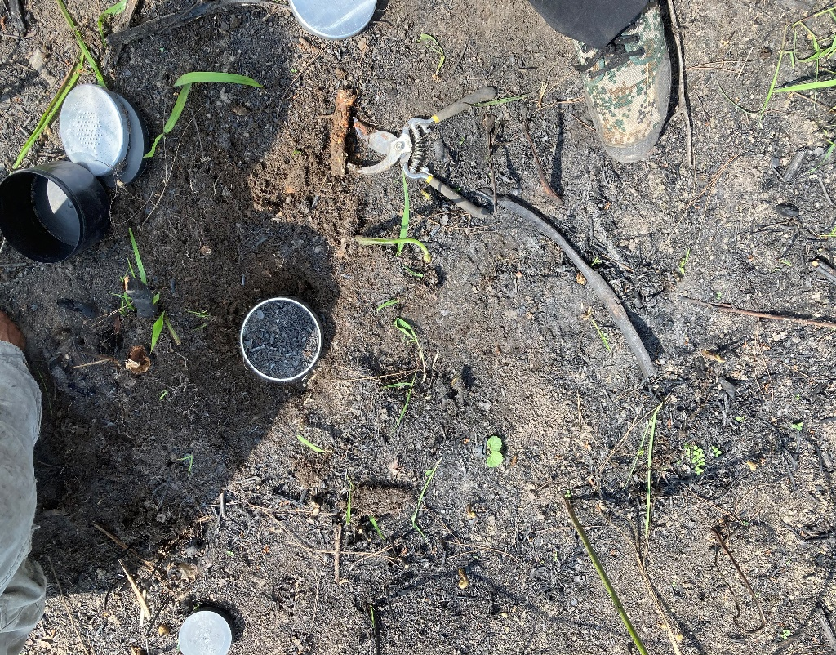
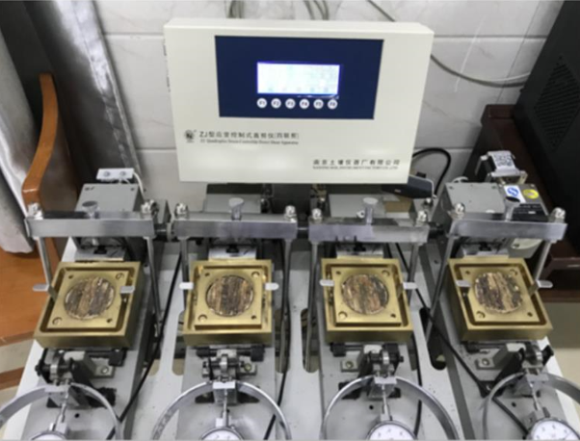
Materials and methods
Using steel sampling ring to collect soil samples
A typical strain-controlled direct shear apparatus
(ZJ-2, Nanjing soil instrument Inc., Nanjing, China).

Slide 5
Objectives
A
Whether stemflow velocity varies after the stem is burned by a wildfire
Aims to determine
B
How the velocity varies with stemflow rate and the tree height
C
The role of stem surface roughness in affecting stemflow velocity

Slide 6
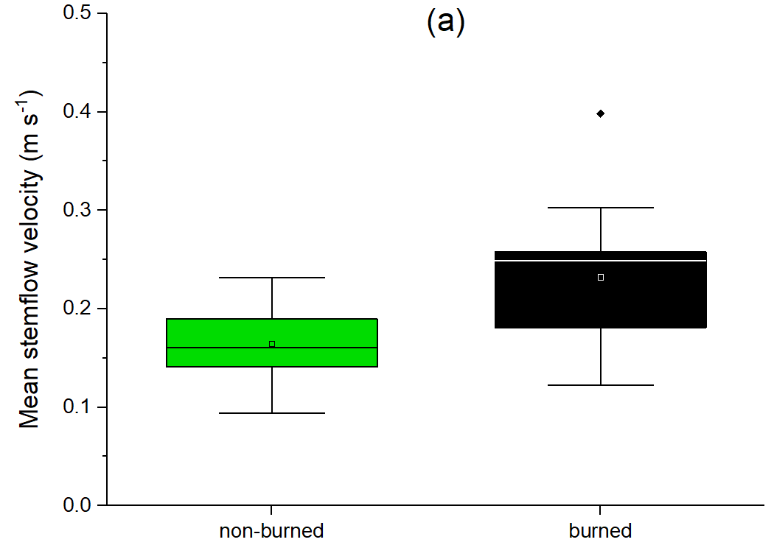
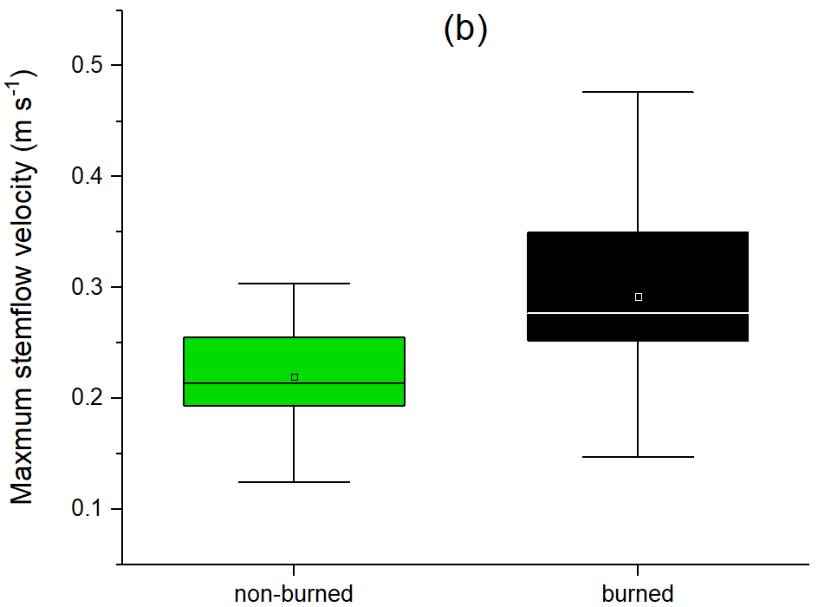
Results
Mean and maximum stemflow velocities increased by 41% and 33%, respectively, after wildfire.

Slide 7
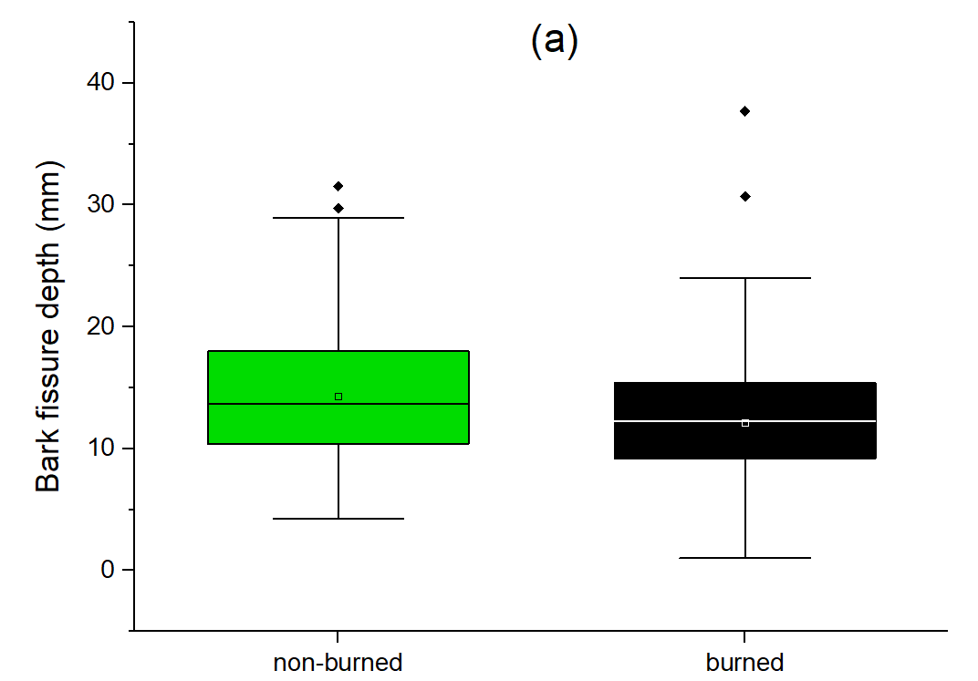
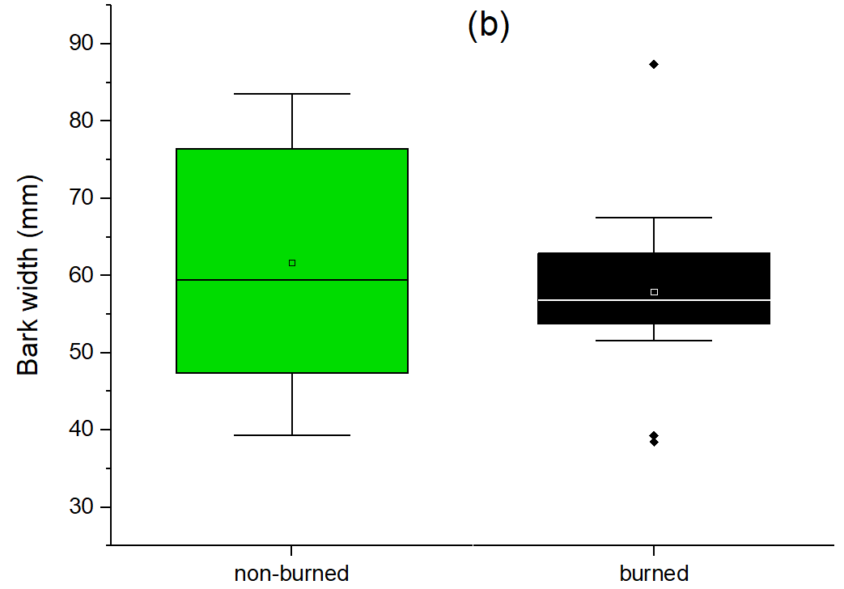
Results
The bark fissure depth ranged between 1~36 mm with means of 14 and 12 mm for the unburned and burned pines, respectively.
The mean bark width varied between 38~87 mm, with means of 57 and 62 mm for the burned and unburned pines, respectively.
Both bark fissure depth and bark width had negative linear relationship to the stemflow velocity.

Slide 8
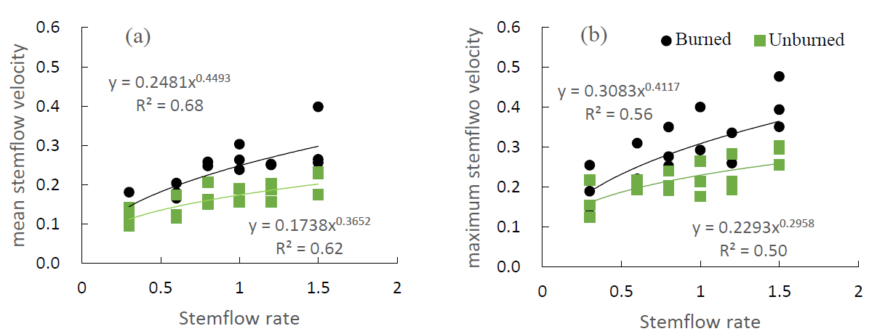
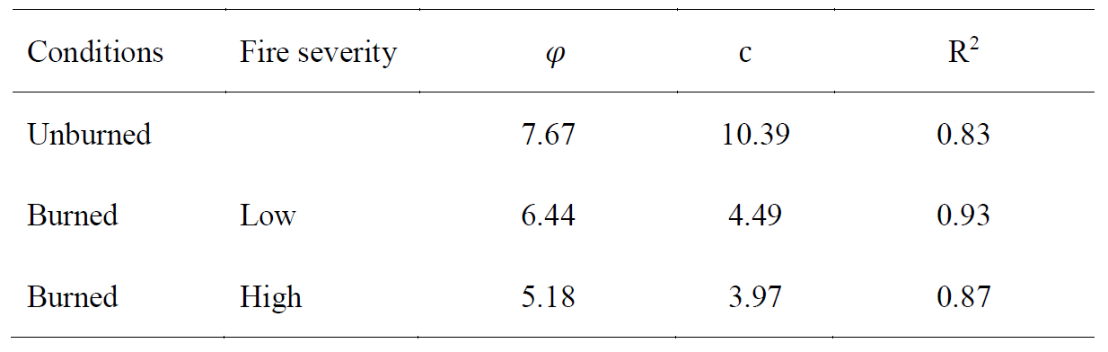
Results
Compared to the unburn soil, the low and high fire reduced internal friction angles by 16% and 32%, and soil cohesions by 57% and 62%.
The linear relationship between shear strength (τ, kPa) and normal stress (𝜎,kPa) (τ = 𝜎𝑡𝑎𝑛𝜑 + c) of different soils affected by the wildfire.
We detected power dependence between the stemflow velocity and stemflow rate for the burned and unburned trees. An increase in the stemflow rate led to greater flow velocity.

Slide 9
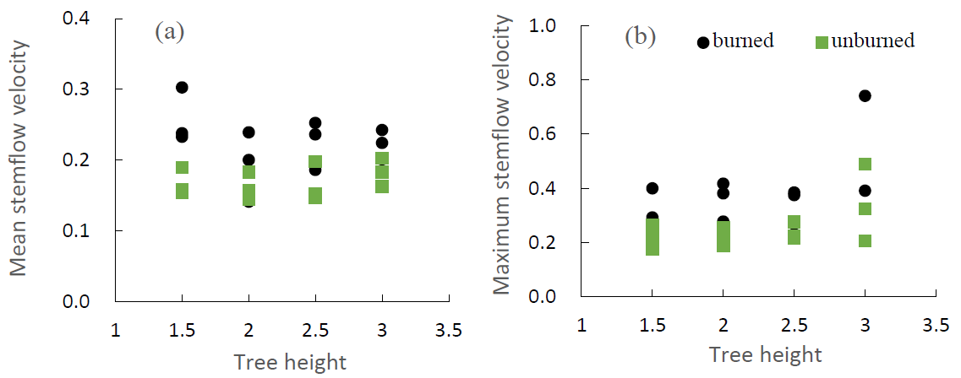
Results
The analysis did not exhibit a significant relationship between stemflow velocities and tree height for both burned and unburned pines.
An increase in the pine diameter caused less stemflow velocity. There is a negative linear relationship between them.

Slide 10
Conclusion
After wildfire, the increase of stemflow velocity was explained by the damage to bark morphology and destruction of biocrust previously adhering to the stem surface.
The combustion caused a substantial decrease in the internal friction angle and soil cohesion, indicating a reduced soil resistance to erosion.
The enhanced stemflow energy can increase soil erosion and thus cause root exposure in the areas around the trunk.

Slide 11

Thanks for your listening!
Presented by Yusen Zhang

