Slide 1



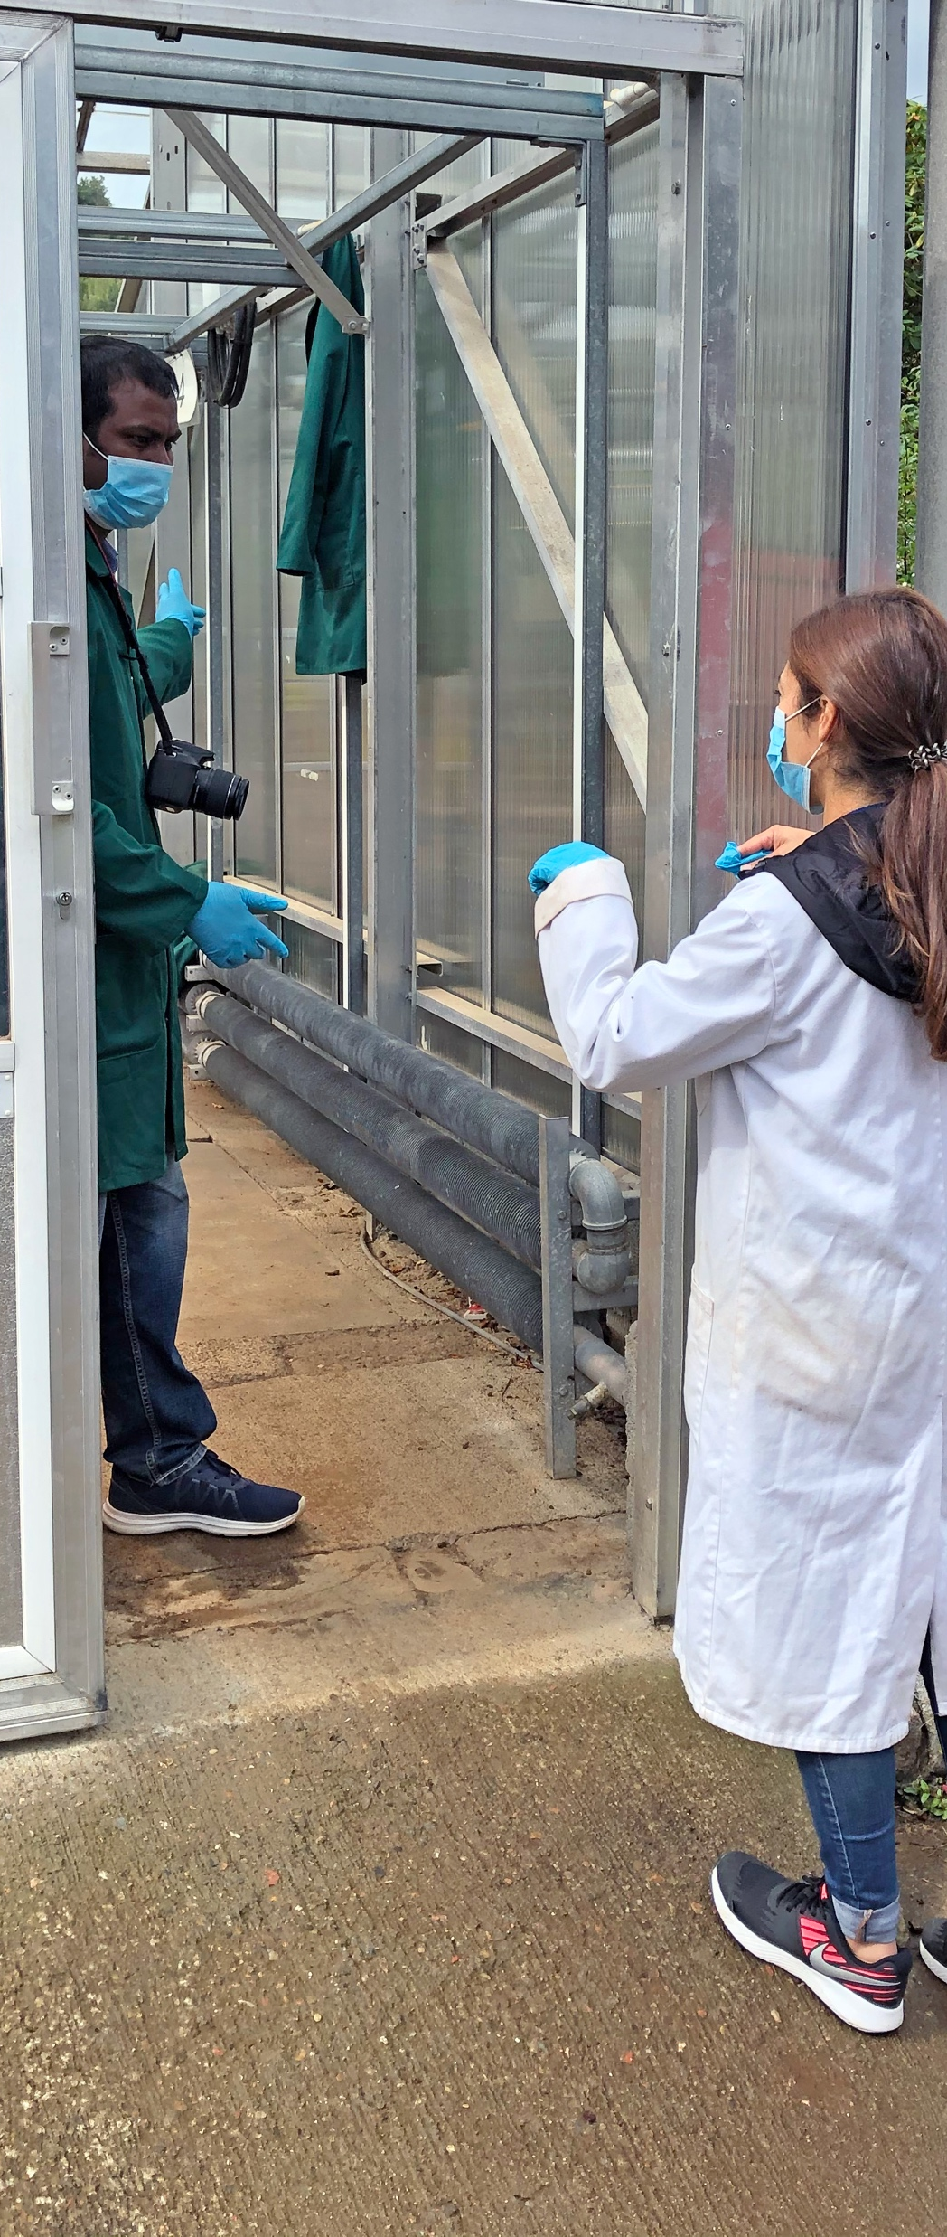

Rooting out soil structure
Paul Hallett¹, Md. Dhin Islam¹, Licida Giuliani^{1,2}, Kenneth Loades² and Adam Price¹
¹School of Biological Sciences, University of Aberdeen, Aberdeen, AB24 3UU, UK
²Ecological Sciences Group, The James Hutton Institute, Invergowrie, Dundee, DD2 5DA, United Kingdom
^{Paul.Hallett@abdn.ac.uk}
1

Slide 2

Root plasticity to soil physics
Susceptible
Tolerant

Slide 3
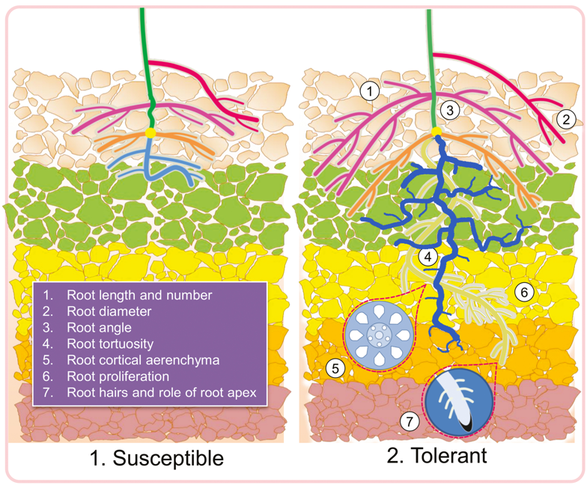
Root plasticity to soil physics - macropores
Susceptible
Tolerant
Photoshopped from

Slide 4
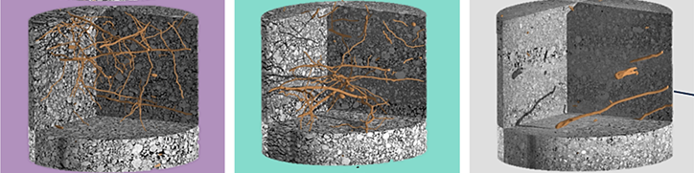
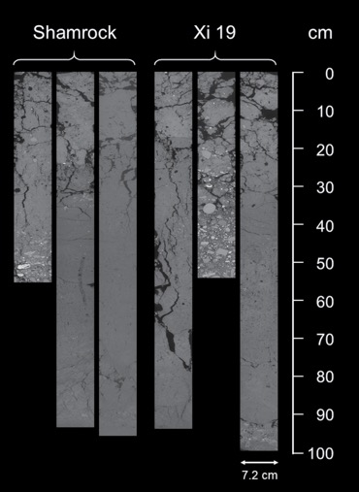
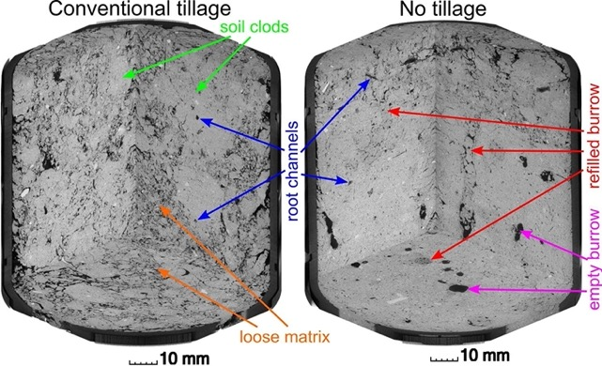
How we study root growth in soils
Sieved Soil
Control
Repeatable
Homogeneous
Structured Soil
Lucas et al., 2019. Sci. Rep., 16236
Realistic
Less control
Less repeatable
Heterogeneous
Multiple factors between treatments (e.g. tillage, compaction)
Zhou et al., 2021. J. Exp. Bot., 72, 747-756
Schlüter et al., 2020. Geoderma, 114082

Slide 5
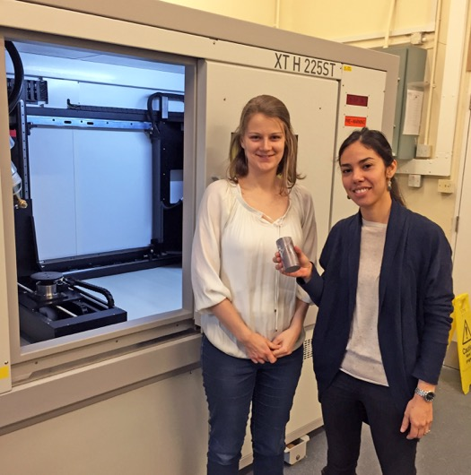
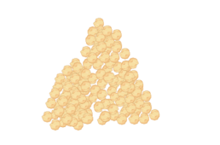
How does soil structure influence root growth?
Desired soil treatments – Density x Soil Structure
Plants with contrasting roots – Arabidopsis, Barley, Peas
No Structure
Structured
Soil Sieved
< 2mm
Water Content
Adjusted
Lici Giuliani
Soil Packed to Desired Bulk Density

Slide 6
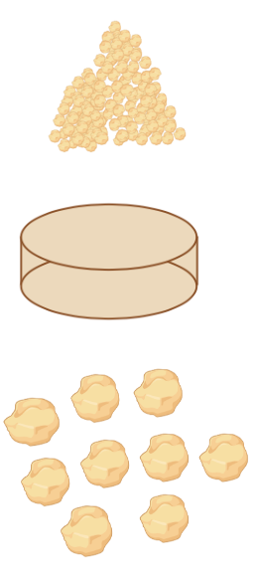
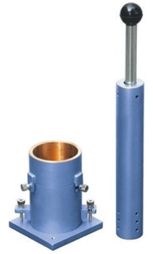
How does soil structure influence root growth?
Desired soil treatments – Density x Soil Structure
Plants with contrasting roots – Arabidopsis, Barley, Peas
No Structure
Structured
Soil Sieved
< 2mm
Water Content
Adjusted
Proctor Density Packing
Soil ‘Cake’ Fragmented to ‘Aggregates’
Lici Giuliani
Soil Packed to Desired Bulk Density

Slide 7
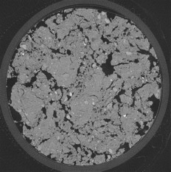
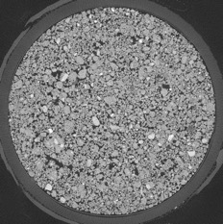
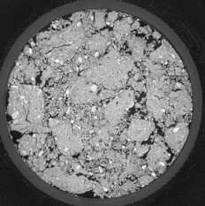
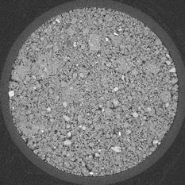
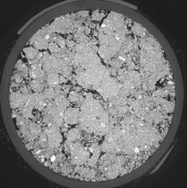
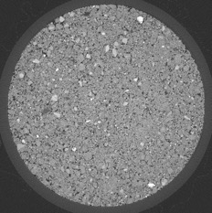

How does soil structure influence root growth?
Property | Unstructured Soil |  |  | Structured Soil
Bulk Density (g cm⁻³) | 1.25 | 1.40 | 1.55 | 1.25 | 1.40 | 1.55
Penetrometer Resistance (MPa) | 0.40(0.114) | 0.67(0.208) | 1.08(0.160) | 0.46(0.287) | 0.87(0.384) | 1.25(0.500)
Total Porosity (m³m⁻³) | 0.53(0.002) | 0.47(0.002) | 0.41(0.002) | 0.50(0.007) | 0.47(0.002) | 0.41(0.002)
Air Filled Porosity at -5 kPa (m³m⁻³) | 0.26(0.013) | 0.18(0.009) | 0.08(0.010) | 0.22(0.016) | 0.16(0.010) | 0.08(0.005)
Structured
Unstructured
Soil pore structure – Xray CT
1.2 g cm⁻³
1.40 g cm⁻³
Structure = More Macropores
1.5 g cm⁻³

Slide 8
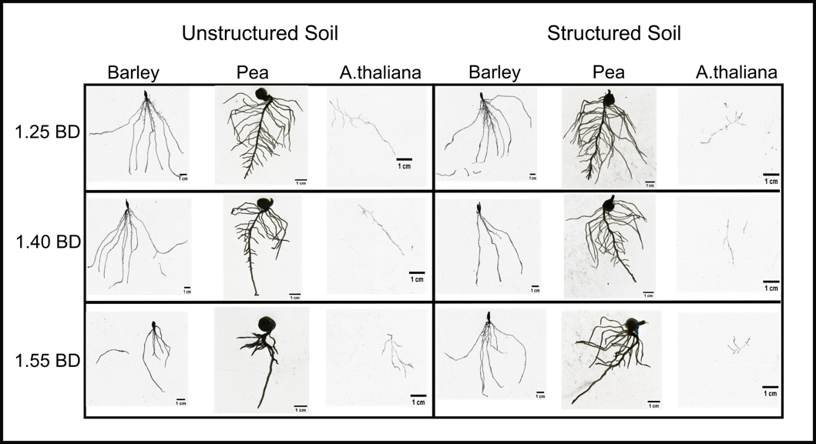
How does soil structure influence root growth?
Unstructured
Structured
Peas
Total Root Length (cm)
Barley
Bulk Density (g cm⁻³)

Slide 9
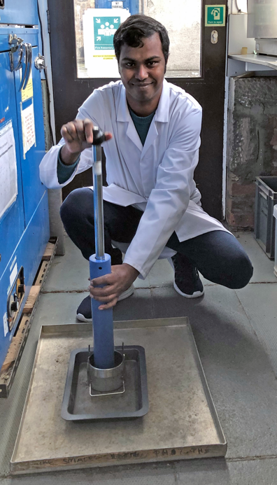
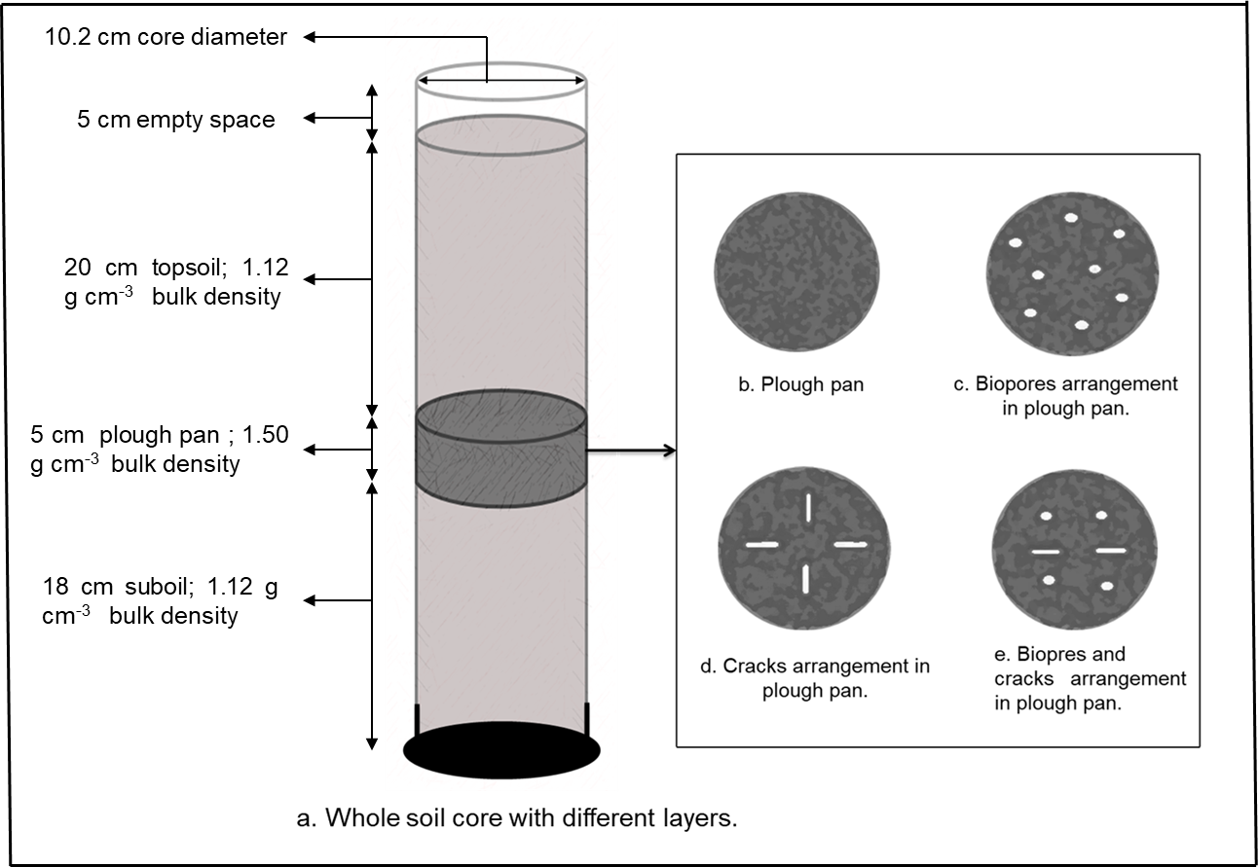
What about macropore shape? Cracks vs. Biopores
Md Dhin Islam

Slide 10
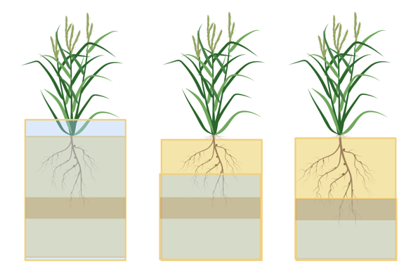
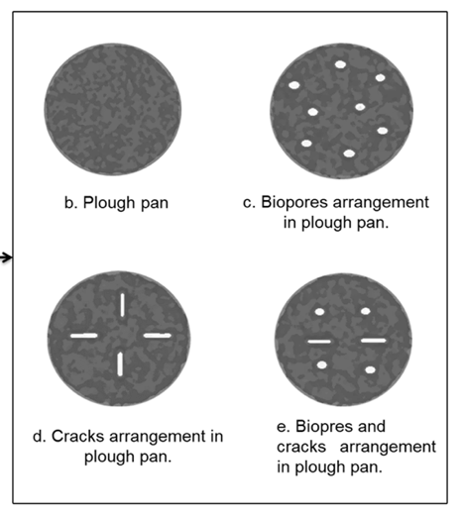
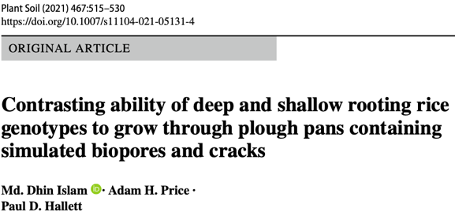
Macropore shape on growth of deep and shallow rooting rice genotypes
Rice root growth affected by plough pans
Water scarcity major threat to rice production
Shift to water conservation – physical constraints to root
Experiment:
2 x Rice Genotypes
  IR64 – Shallow Rooting
  Black Gora (BG) – Deep Rooting
Macropore – Presence and Shape
‘Upland’ water regime
Flooded AWD Upland
Less water use

Slide 11

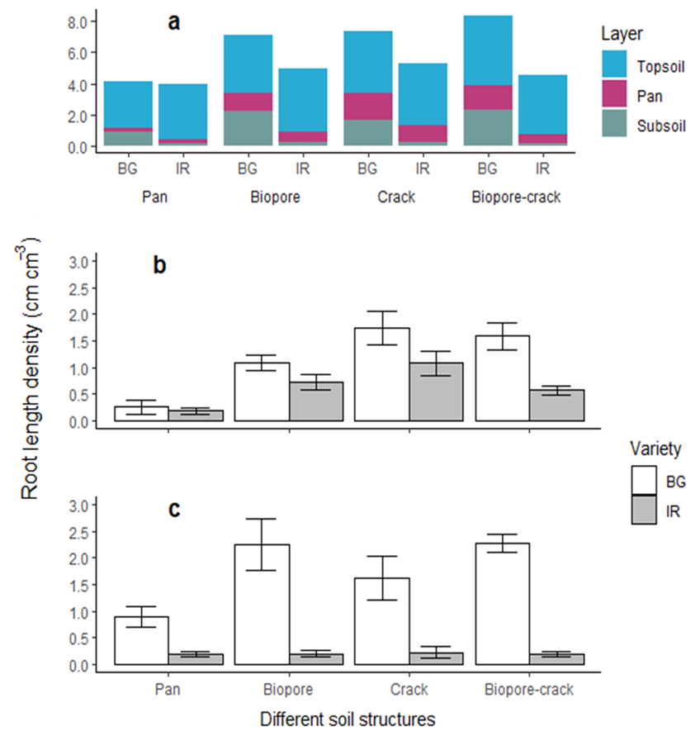
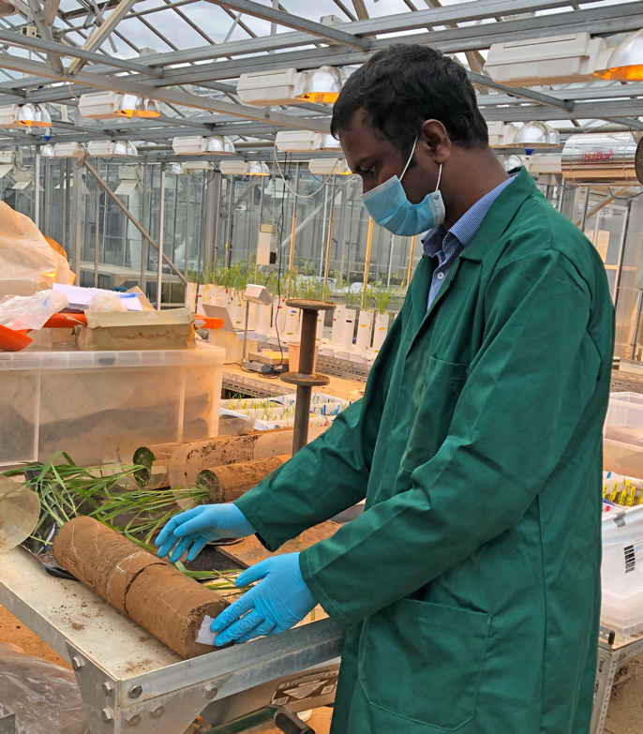
Macropore shape on growth of deep and shallow rooting rice genotypes
All layers
Plough Pan
Variety***
Structure***
Root length density (cm cm⁻³)
Variety***
Structure*
Subsoil
BG – Black Gora
Deep Rooting
IR64
Shallow Rooting

Slide 12
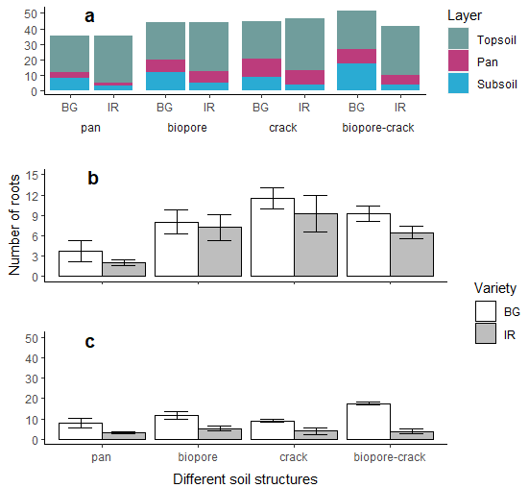
Macropore shape on growth of deep and shallow rooting rice genotypes
All layers
All layers
Plough Pan
Variety***
Structure***
Variety n.s.
Structure**
Plough Pan
Root length density (cm cm⁻³)
Number of roots
Variety***
Structure*
Variety***
Structure**
Subsoil
Subsoil
BG – Black Gora
Deep Rooting
IR64
Shallow Rooting

Slide 13
Conclusions
At the same bulk density, soil structure has a massive impact on root growth.
Greater root length and depth with presence of macropores
Roots root out areas of weakness in the soil
Root structure between species and genotypes affects root growth response to soil structure
Variety screens should factor in soil structure impacts
On-going research exploring macropores produced from preceding crops and cracking by weathering.

