Slide 1

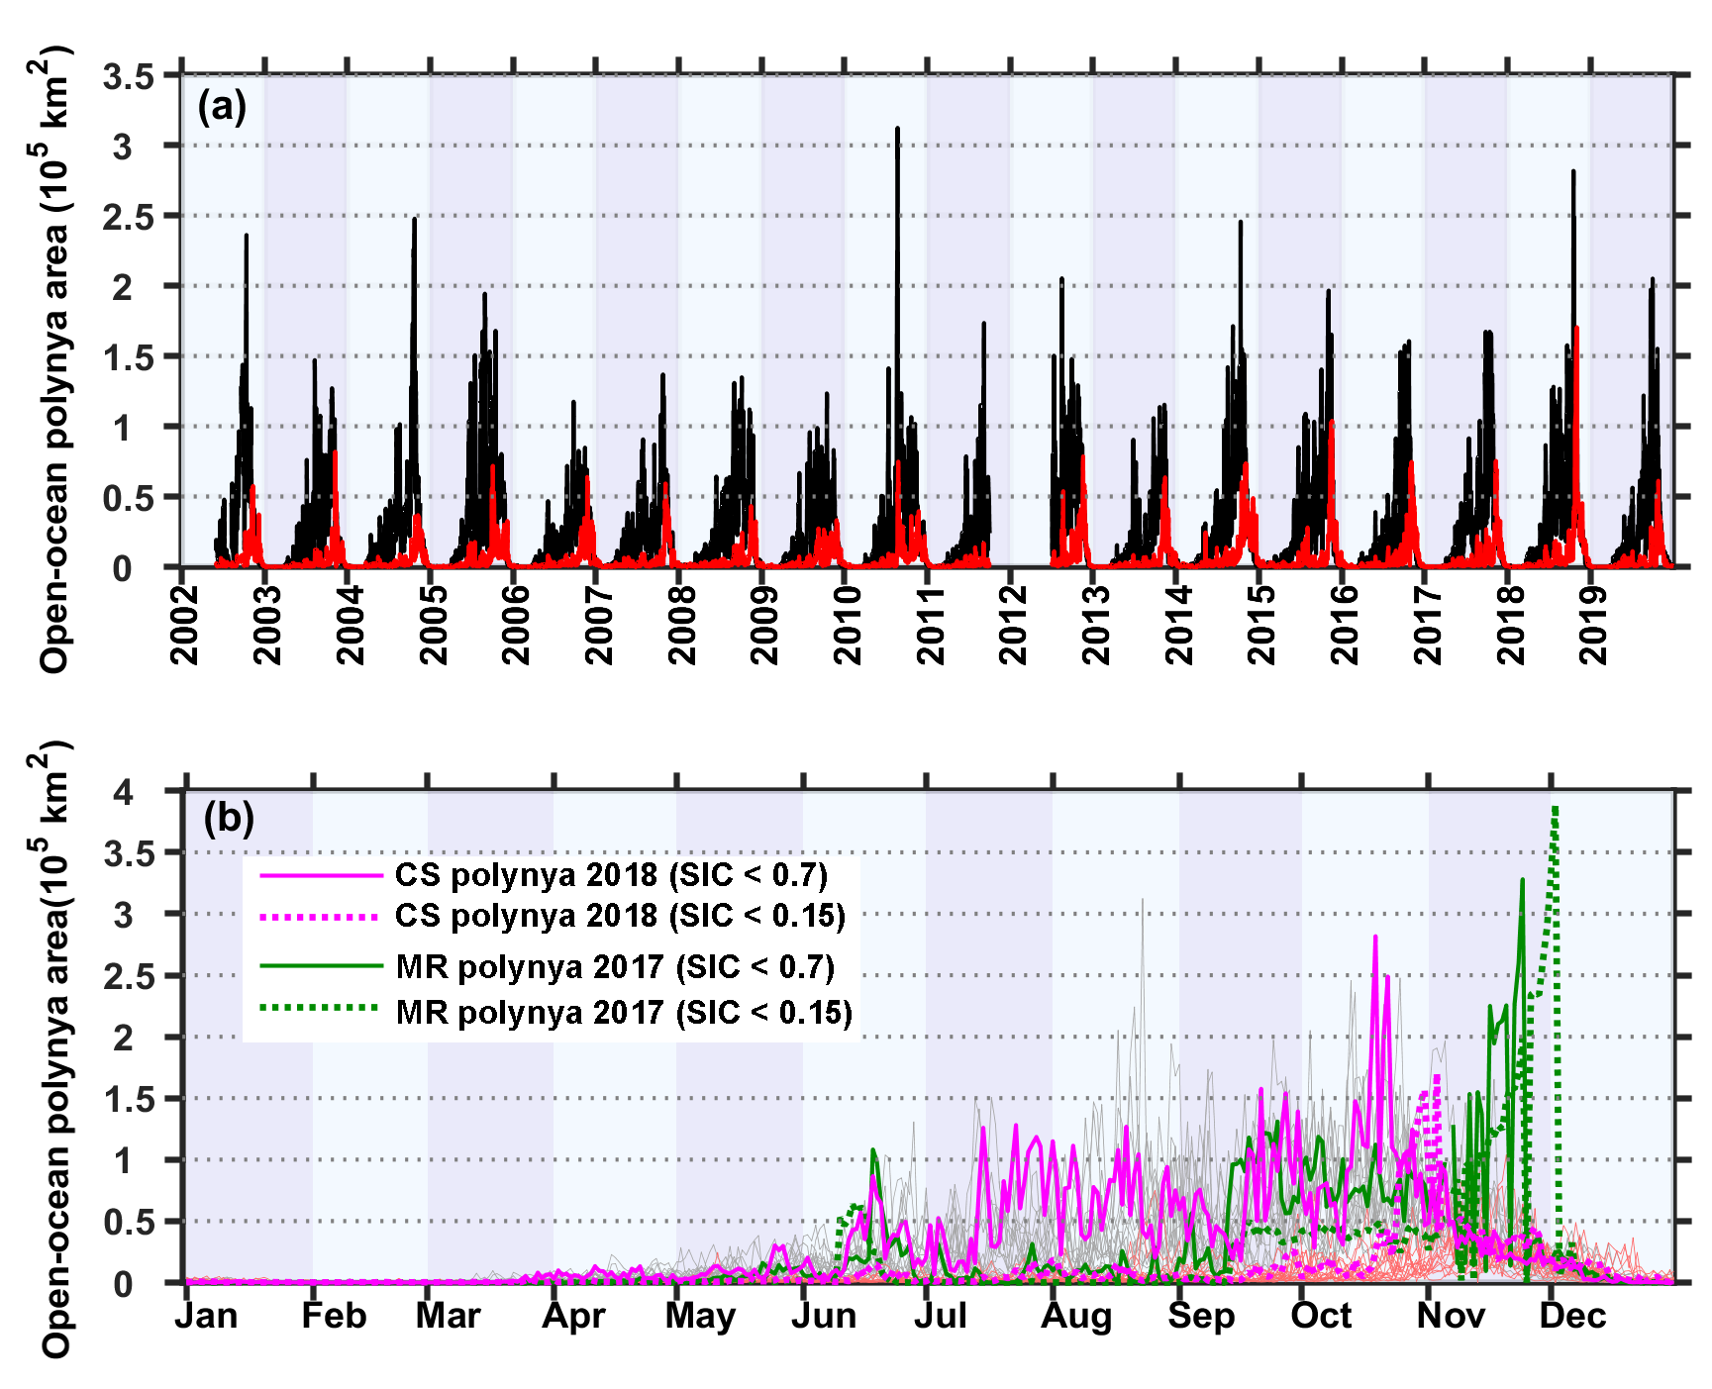
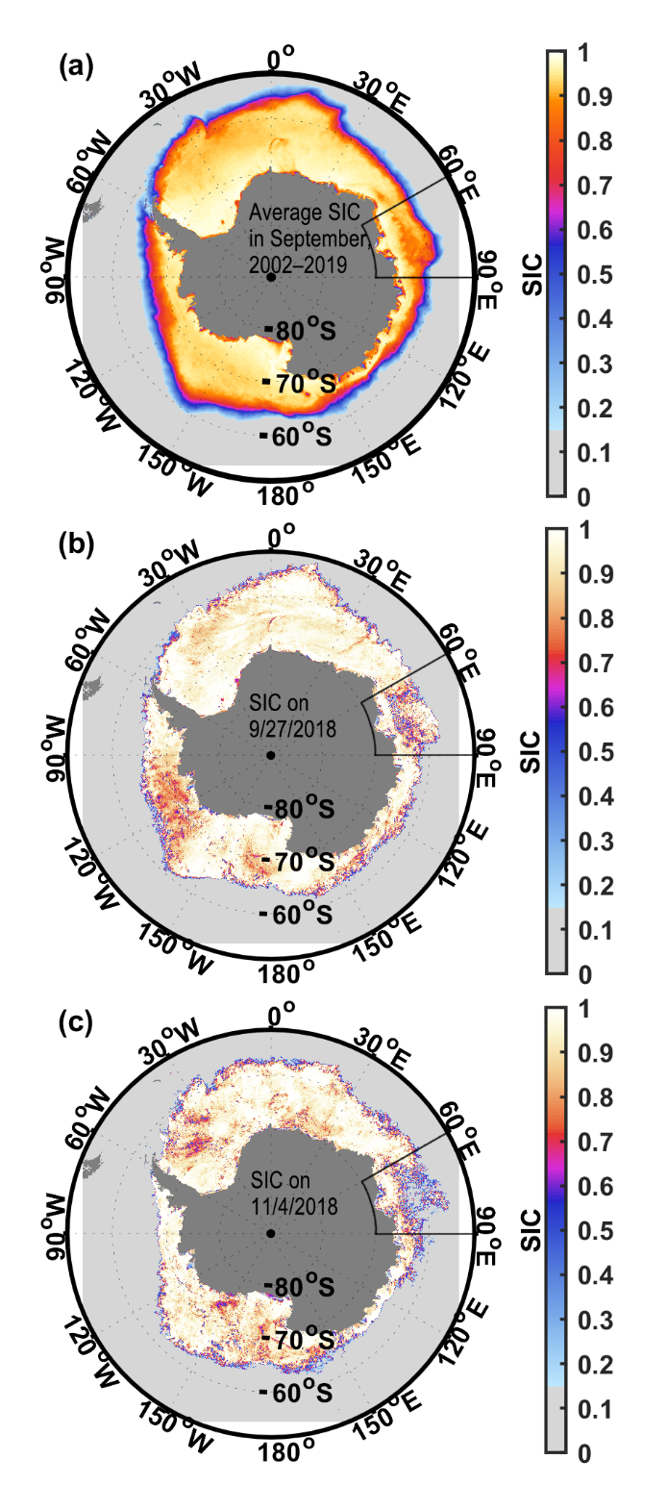
Open-Ocean Polynyas in the Cooperation Sea, Antarctica
Qing Qinª, Zhaomin Wangª*, Chengyan Liu^{b}*, Chen Cheng^{b}.
a College of Oceanography, Hohai University, Nanjing, China.
b Southern Marine Science and Engineering Guangdong Laboratory (Zhuhai), China.
Open-ocean polynyas in the Cooperation Sea
312.4 × 10³ km²
The open-ocean polynyas in the CS are much more persistent than the MRP and the polynya in the Cosmonaut Sea during the period 2002-2019.
Dataset | Variable | Resolution | Time period
AMSR-E | SIC | 3.125 km × 3.125 km; daily | 01/06/2002-04/10/2011
AMSR2 | SIC | 3.125 km × 3.125 km; daily | 03/07/2012-31/12/2019

Slide 2
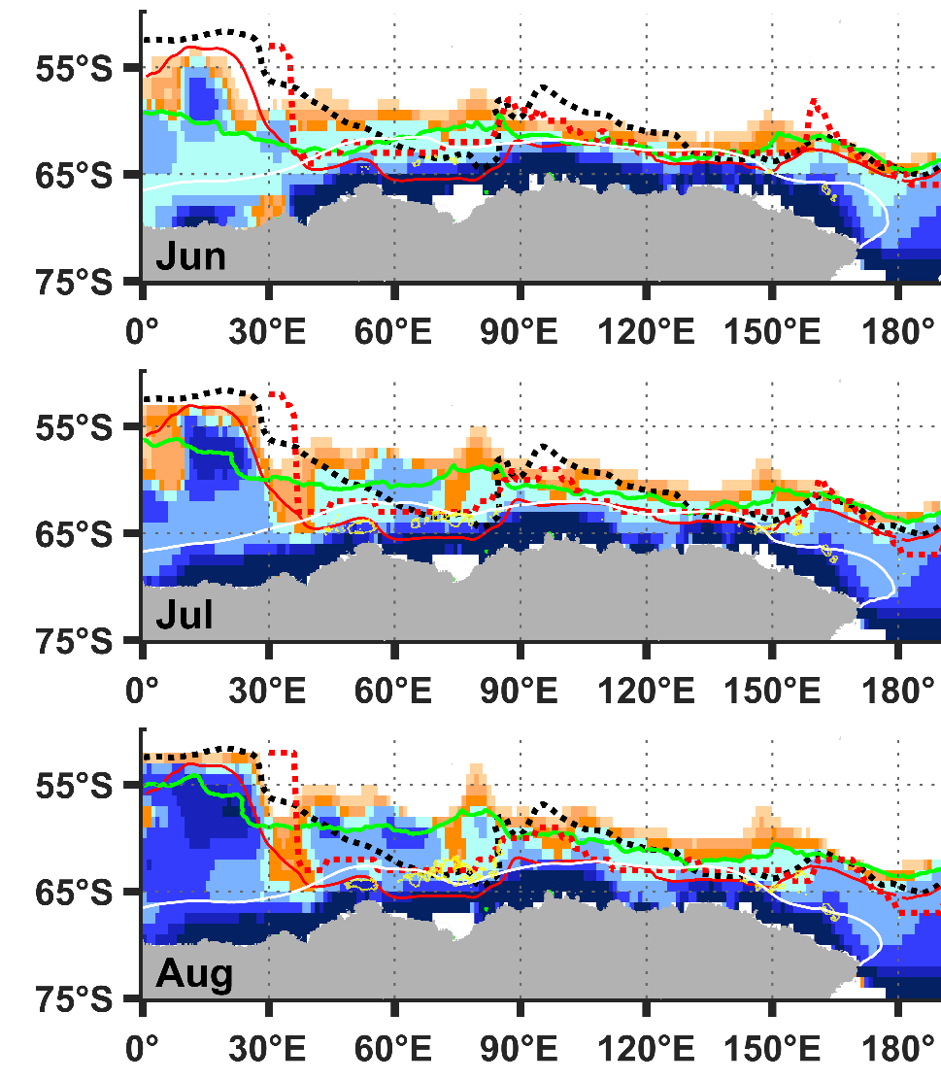
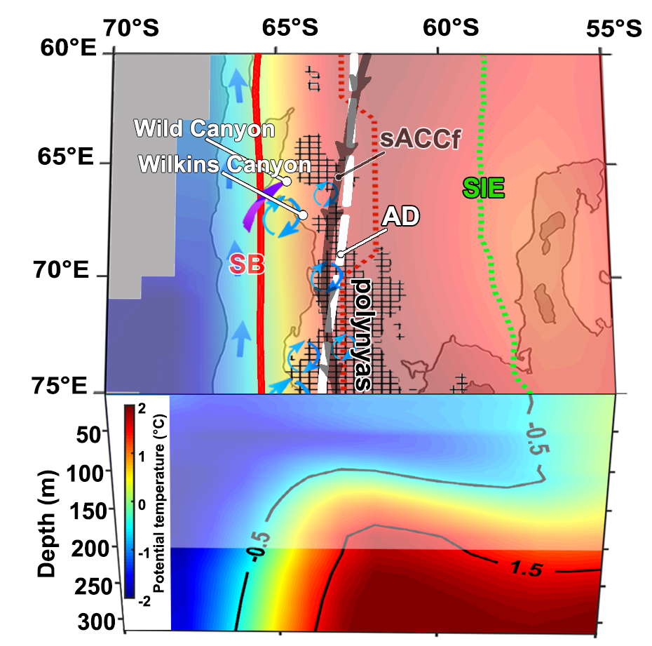

Large-scale Atmospheric and Oceanic Forcing
Antarctic Divergence (AD)
— The zero line of monthly eastward wind stress defines the core location of the AD.
Southern Boundary (SB)
— defined as the poleward limit of UCDW.
— The location of the SB is primarily determined by the structure of the ACC and the subpolar gyres.
Cooperation Sea

Slide 3
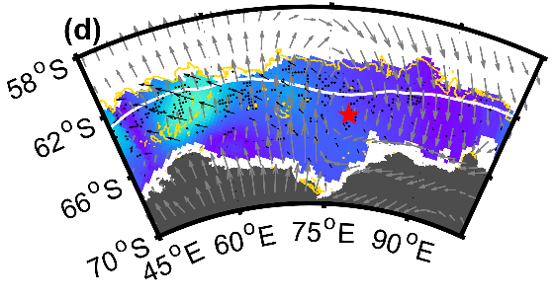
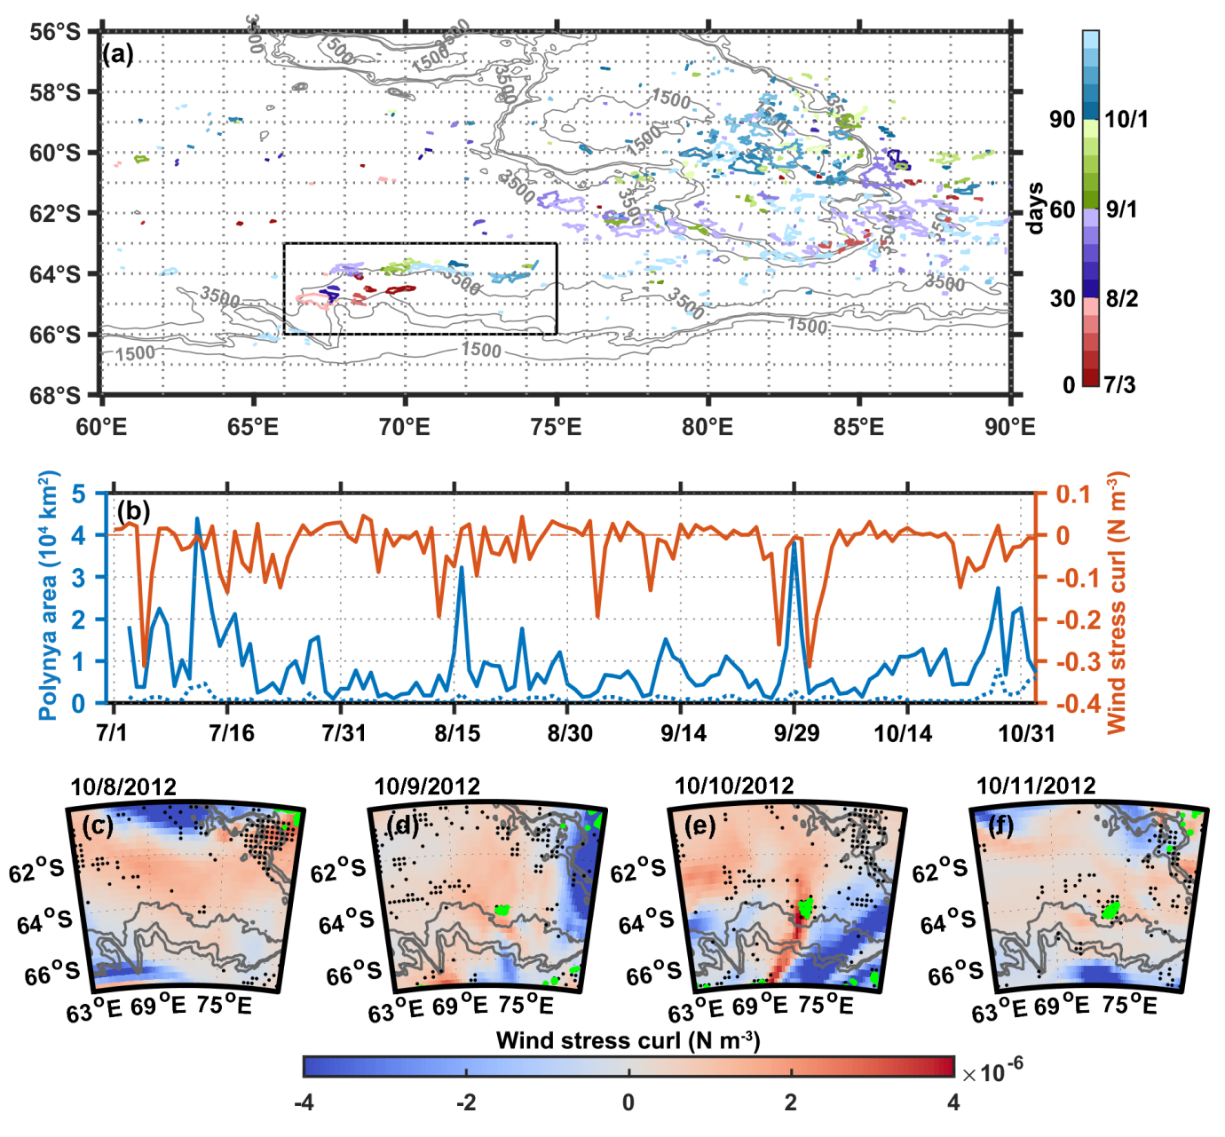
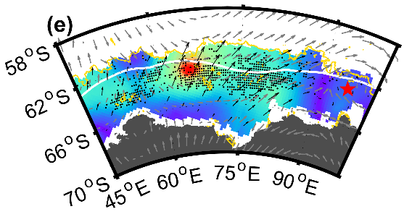
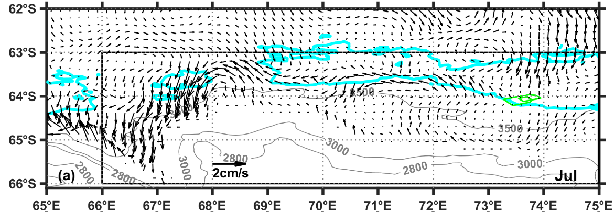
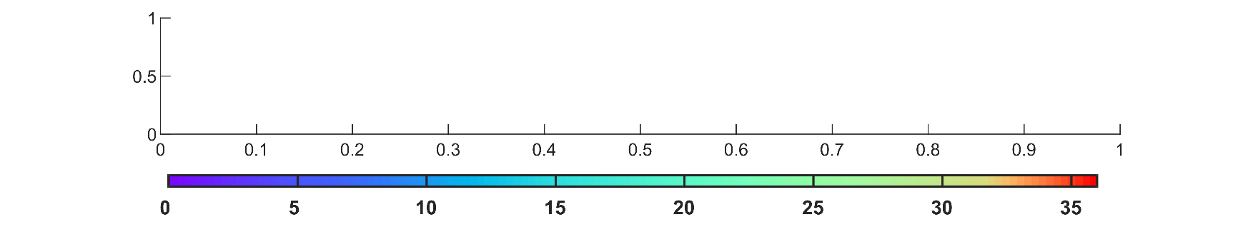
Synoptic Atmospheric and Oceanic Forcing
Role of storms
Role of eddies
Intense storms can cause strong sea ice divergence.
Some polynyas formed in the region featured by canyons and drifts near Wild Canyon (~67.5°E) or Wilkins Canyon (~68.5°E) were not storm-related.
The monthly mean climatological horizontal current at a depth of 3,325 m during 2005-2010 indicates the possible presence of the cyclonic circulation.
From 10 July to 21 July, with the deepening of the mixed layer (from 66 m to 100 m), the average heat entrainment rate is estimated as 262.3 W/m².
11 July
Wild Canyon
Wilkins Canyon
12 July
sea ice speed (cm/s)
SOSE 2005-2010

Slide 4
Summary
Using high-resolution sea ice concentration data from AMSR-E and AMSR2 for the period 2002-2019, we documented the spatial and temporal patterns of the open-ocean polynyas in the Cooperation Sea.
We offer the atmospheric and oceanic forcing mechanisms responsible for the formation of the open-ocean polynyas in the CS.

