Slide 1

Formaldehyde column retrievals from the GEMS instrument and evaluation against TROPOMI and model data
Isabelle De Smedt¹, Jeroen Van Gent¹, Huan Yu¹, Jonas Vlietinck¹, Caroline Fayt¹, Christophe Lerot¹, Nicolas Theys¹, François Hendrick¹, Michel Van Roozendael¹
Rokjin J. Park², Gitaek Lee², Seunga Shin², Hyeong-Ahn Kwon³
Belgian Institute for Space Aeronomy, Brussels, Belgium
School of Earth and Environmental Sciences, Seoul National University, Korea
Harvard-Smithsonian Center for Astrophysics, USA
EGU – Vienna - 26.05.2022

Slide 2
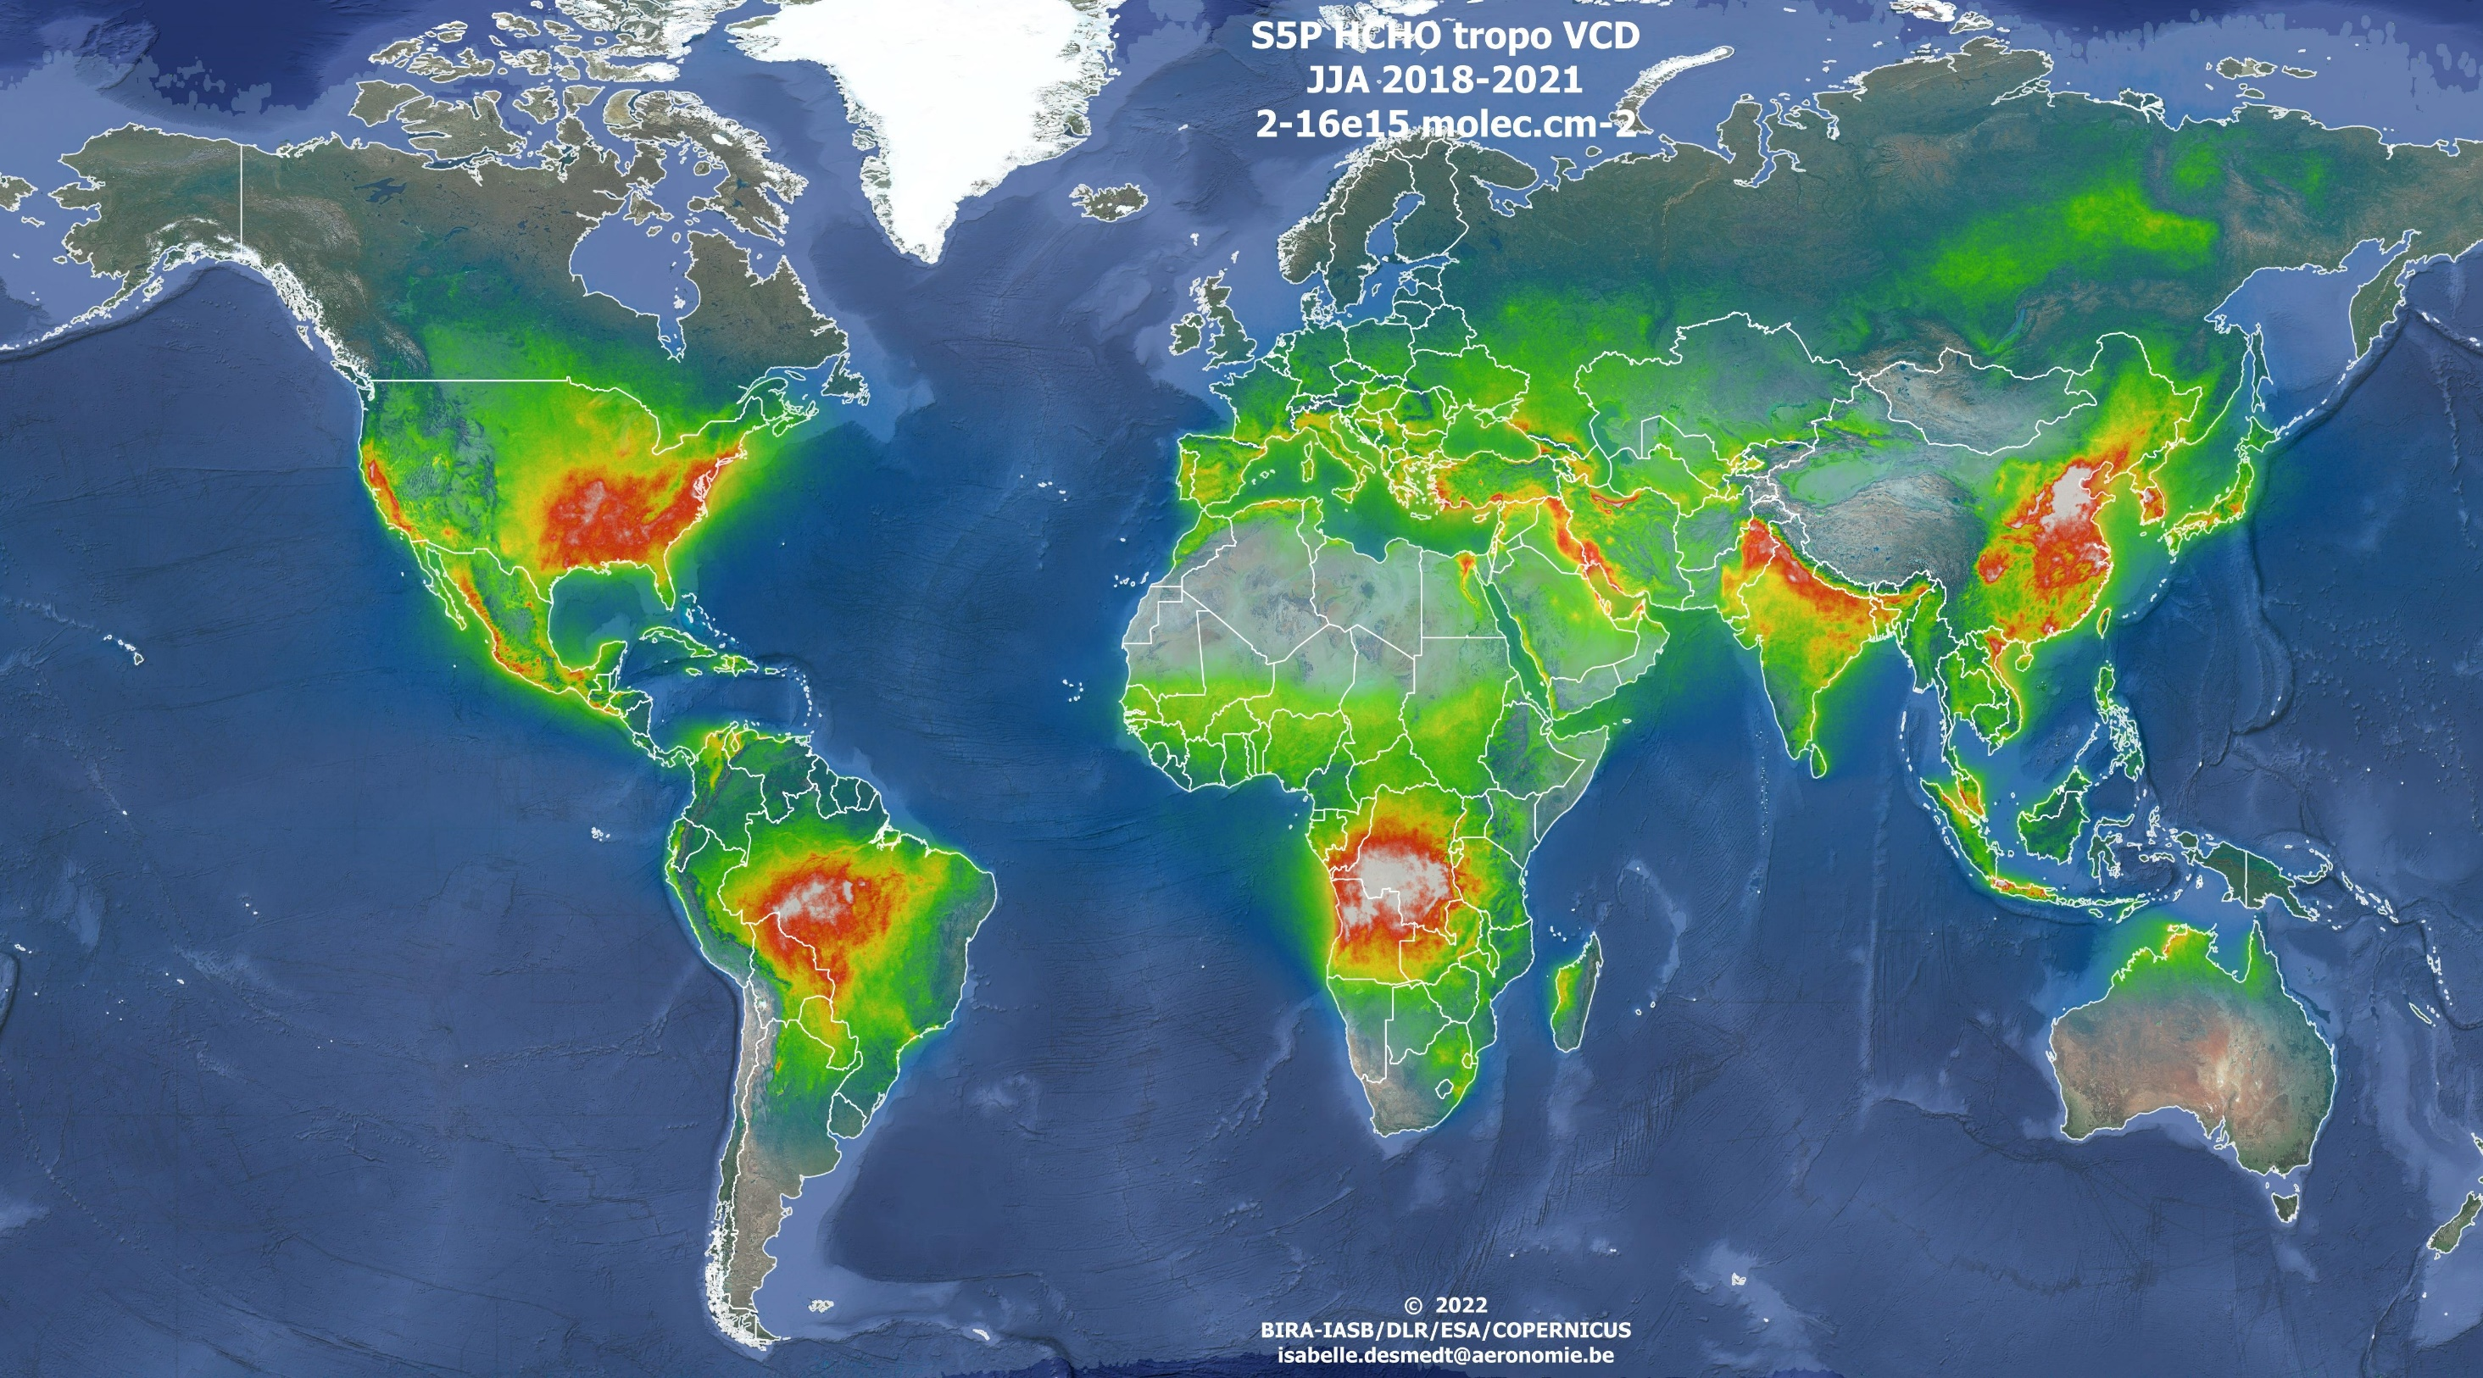
TROPOMI HCHO
JJA 2018-2021
GEMS Mission
S4 (hourly)
GEMS (hourly)
Tempo (hourly)
Geostationary Environment Monitoring Spectrometer (GEMS).
Launched on-board the GEO-KOMPSAT-2B satellite in February 2020.
First geostationary sensor dedicated to air quality and atmospheric composition measurements.
GEMS will be joined by TEMPO in 2022 and Sentinel-4 in 2024.
Notes:
The Geostationary Environment Monitoring Spectrometer (GEMS), launched on-board the GEO-KOMPSAT-2B satellite in February 2020 is the first geostationary sensor dedicated to air quality and atmospheric composition measurements. GEMS (observing South-East Asia hourly) will be joined by TEMPO in 2022 (United States) and Sentinel-4 (S4, 2024), monitoring Europe and Northern Africa.
BIRA-IASB is responsible for the development of the bread-board algorithms for the retrieval of total vertical columns of formaldehyde (HCHO) and sulfur dioxide (SO2), is involved in the algorithm for total ozone, and will perform the independent verification of the glyoxal total column algorithm.

Slide 3
DOAS retrieval algorithm in 3 steps
TROPOMI
Fit of the SCD in the 328.5-359 nm interval
AMF at 340 nm
Background correction using the Pacific Ocean as reference sector
GEMS
Fit of the SCD in the 328.5-359 nm interval
AMF at 340 nm
Background correction using the Pacific Ocean as reference sector
The BIRA HCHO retrieval algorithm is a DOAS-type scheme based on algorithms for previous satellite sensors, such as S5P/TROPOMI (De Smedt et al., 2018; 2021).
Within the frame of the ESA S4 L2 project, the HCHO retrieval scheme can be tested and evaluated using GEMS data.
See the extra slides for more details.
EGU – Vienna - 26.05.2022
Notes:
The BIRA algorithm for the retrieval of total HCHO column is a DOAS-type scheme based on algorithms for previous satellite sensors, such as S-5P/TROPOMI (De Smedt et al., 2018). As is the case with polar sensors, the application to GEMS measurements is expected to show large offsets and striping patterns, due to imperfect slant-column fits and instrumental characteristics. For polar orbiting instruments, these phenomena are usually corrected by means of a background correction step. This involves a reference region over the Pacific ocean, where the formaldehyde columns are small and well known. For GEMS, an alternative approach needs to be found for this, as it only scans the Pacific at the begining of the day. Within the frame of the ESA S4 L2 project (see talk of Diego this morning), the HCHO retrieval scheme can be tested and evaluated using GEMS data. It is expected that these can then be applied to S4 data and fine-tuned after the launch of S4 .

Slide 4
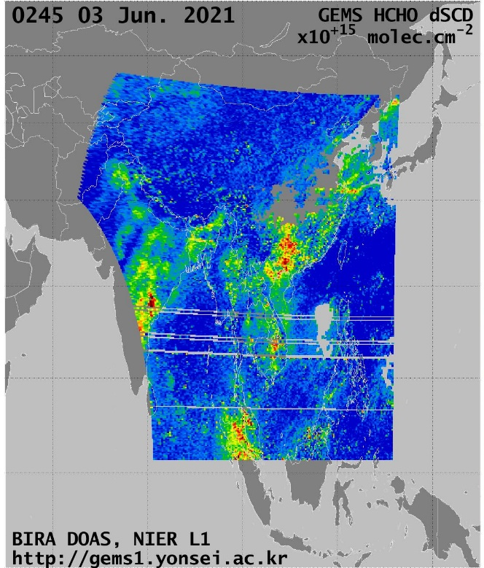
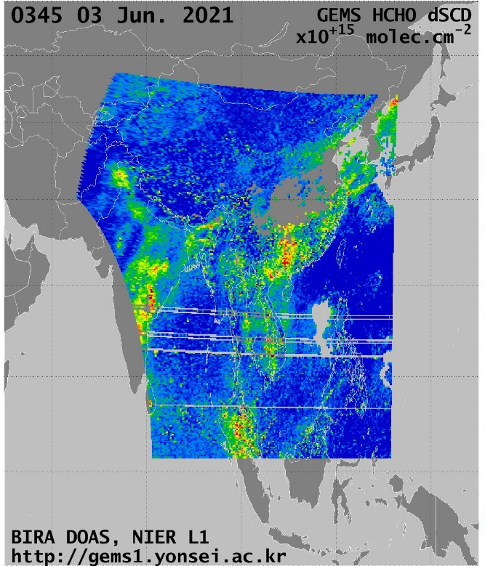
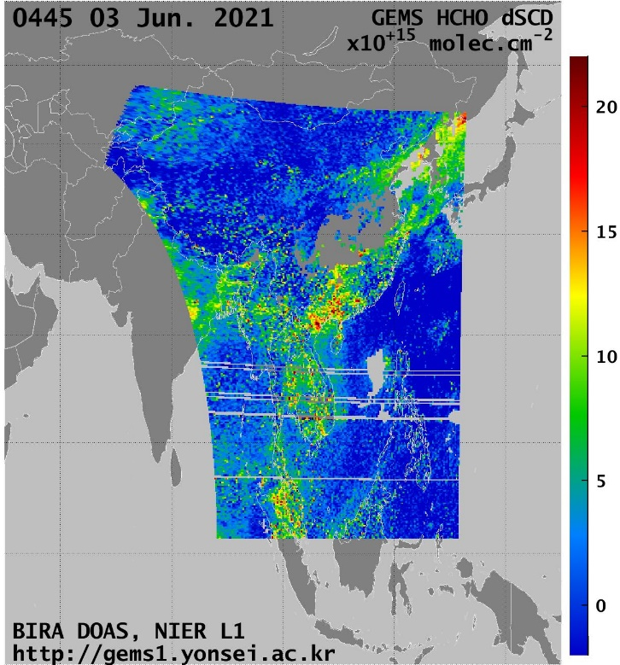
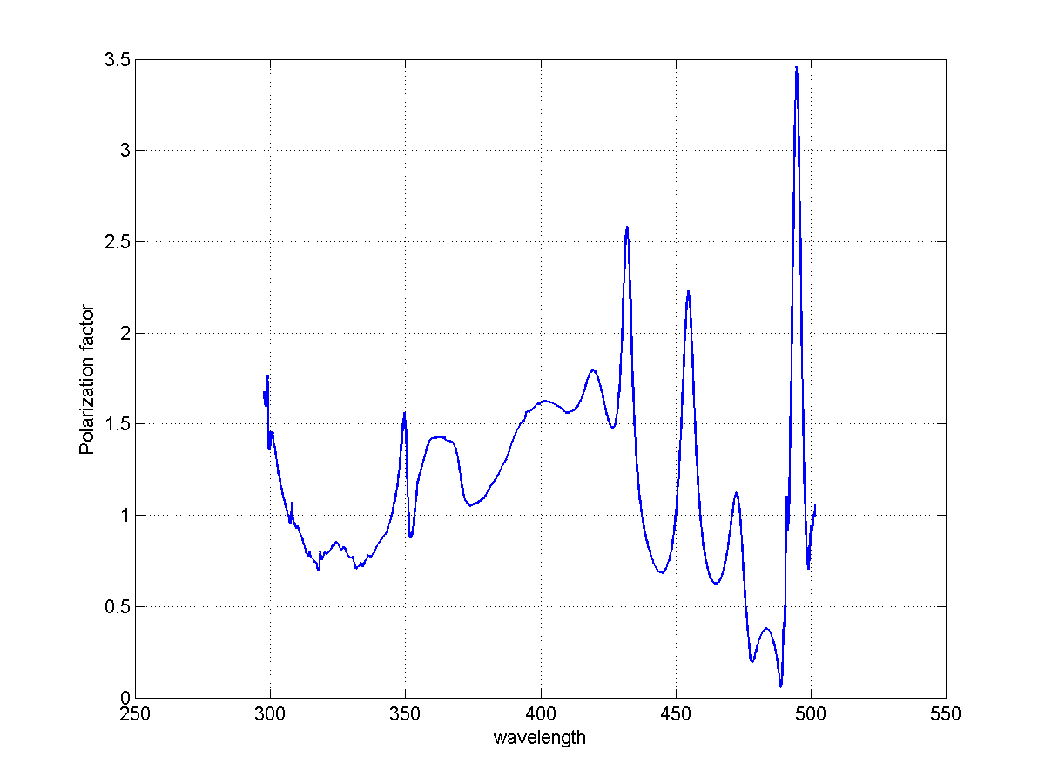
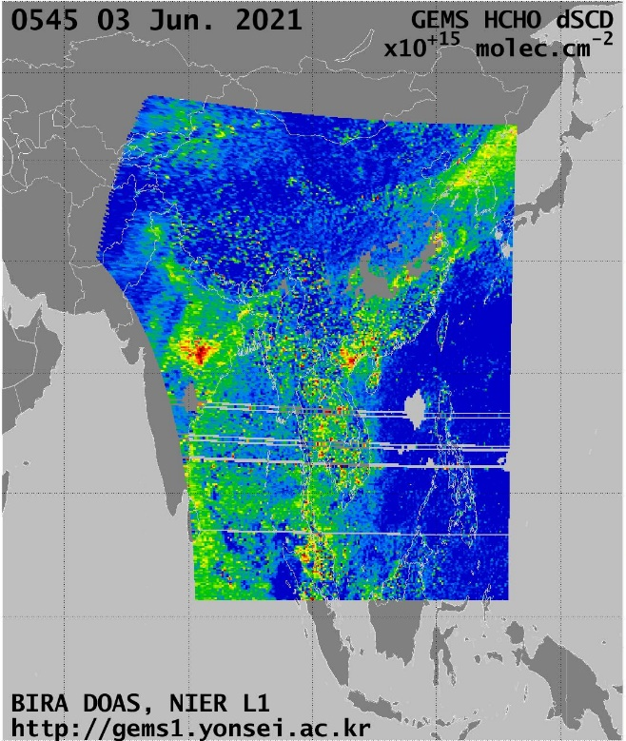
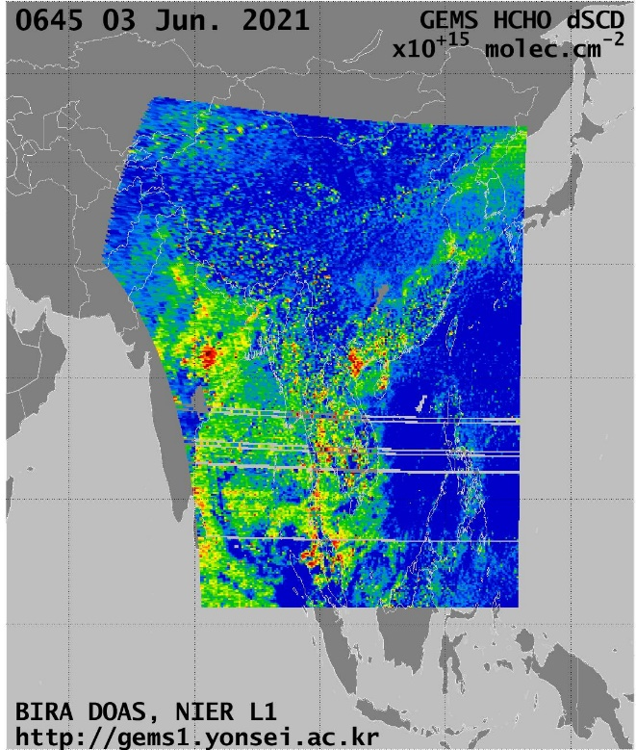
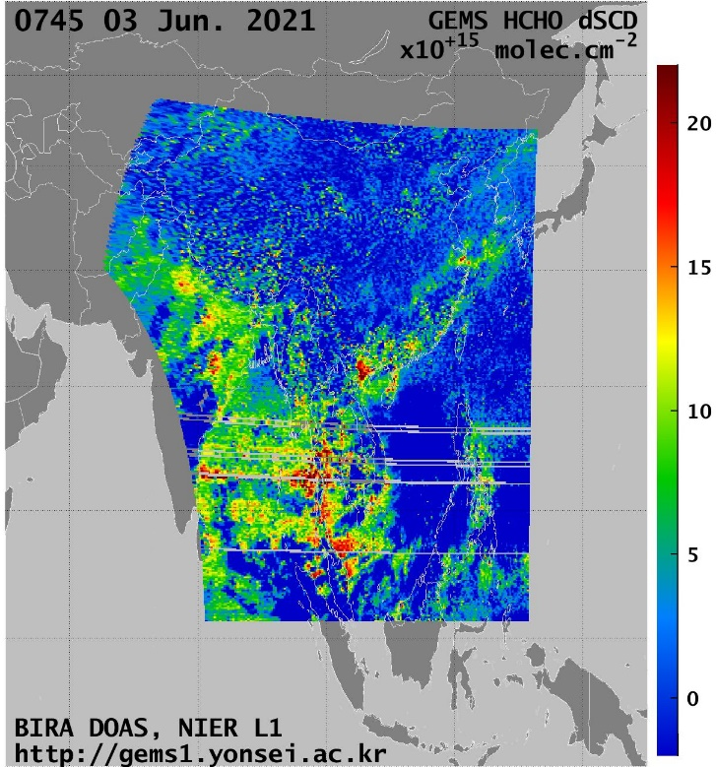
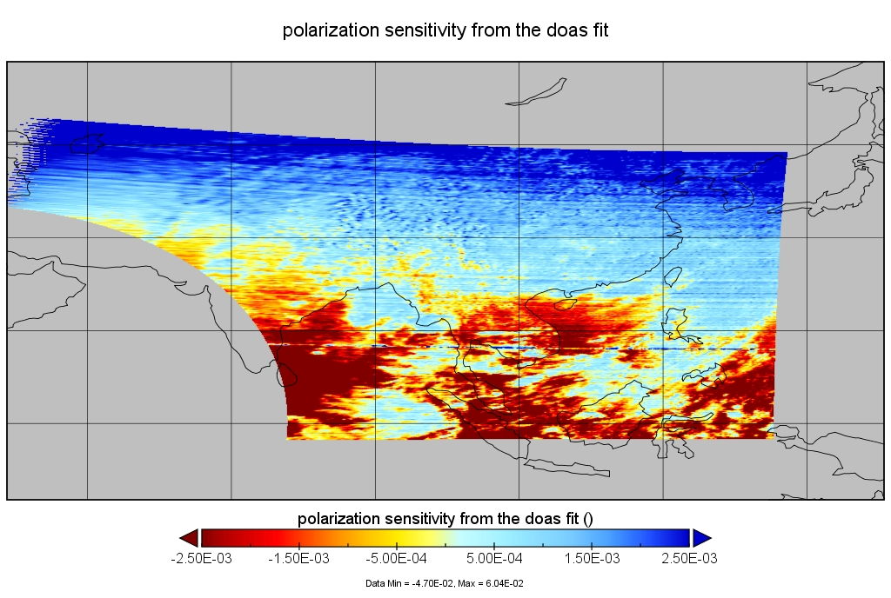
Diurnal variation,
3 June,
Destriped HCHO SCD
Many thanks to Hanlim Lee and Kyung-Jung Moon for providing the data
A clear degradation of the fits was observed in the afternoon.
More pronounced in the Southern part of the scene.
Polarisation effect.
EGU – Vienna - 26.05.2022

Slide 5
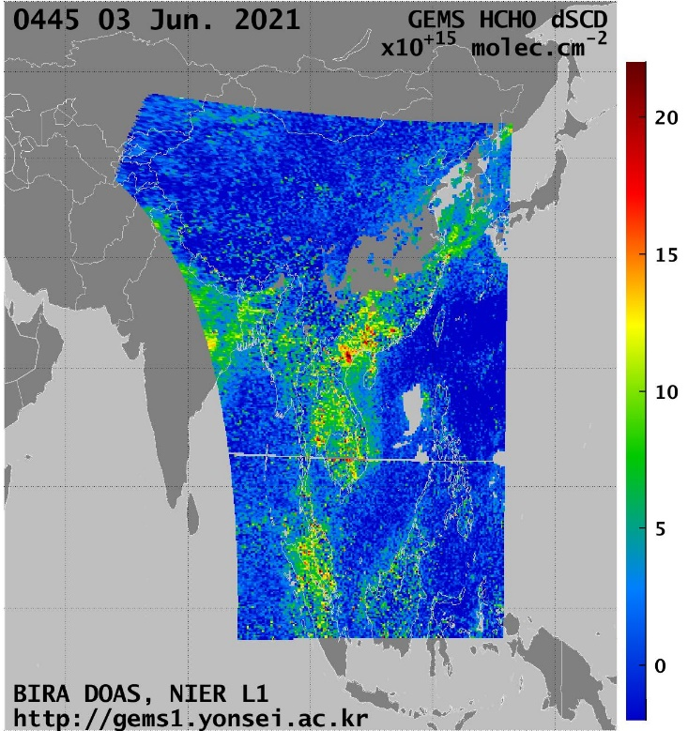
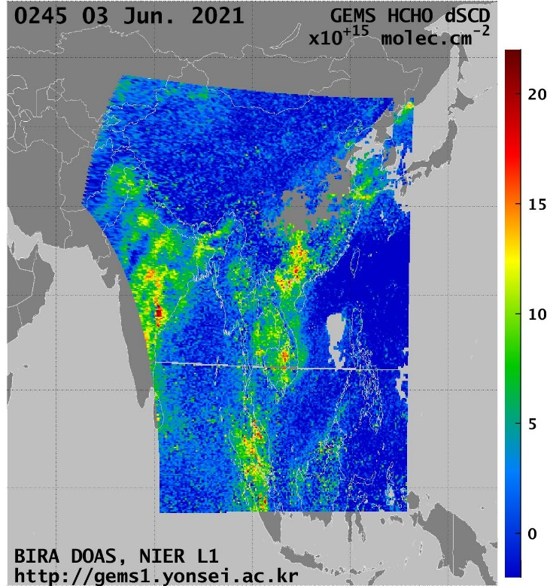
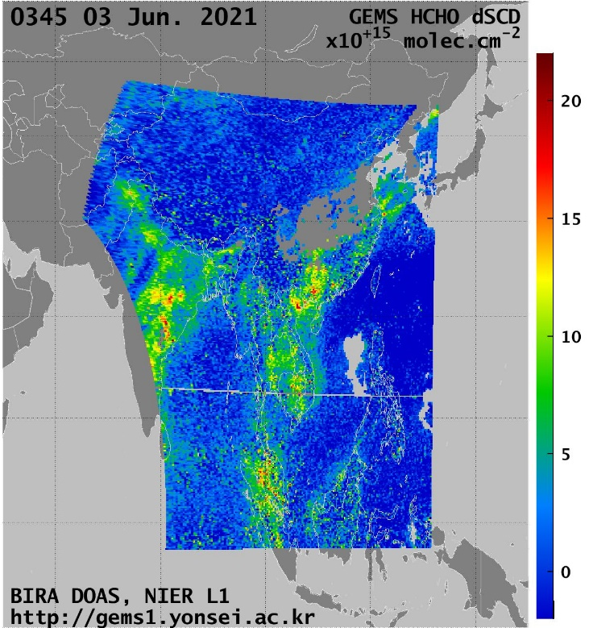
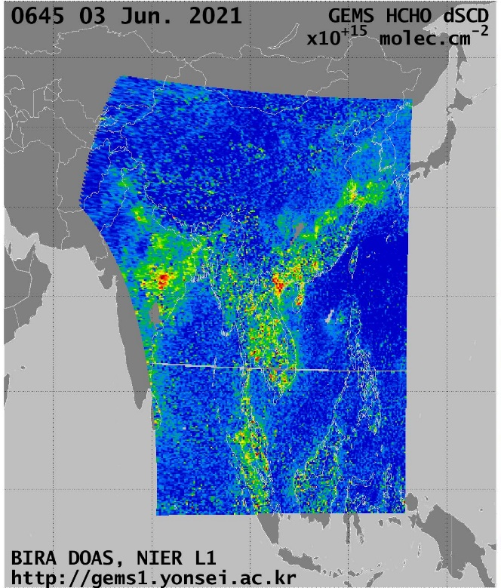
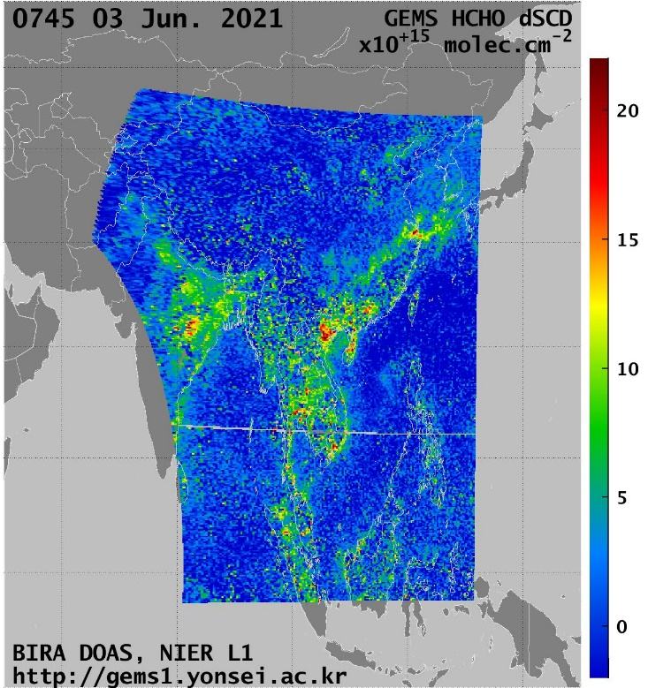
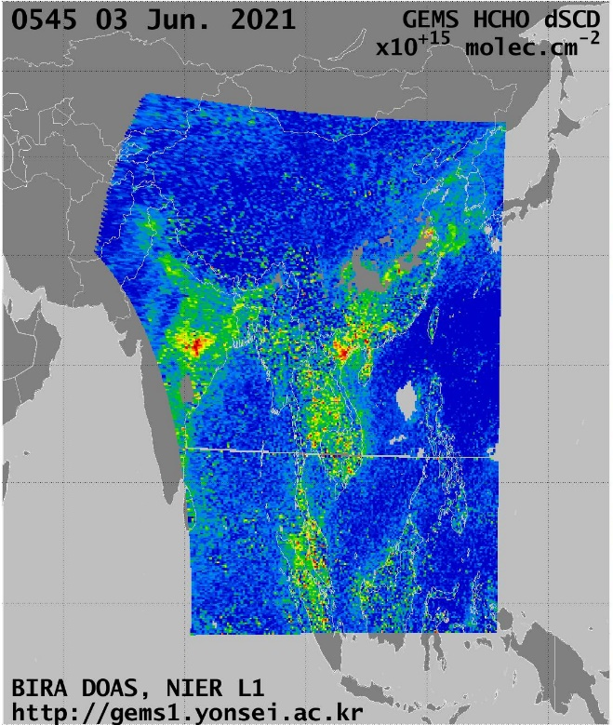
Diurnal variation,
3 June,
Destriped HCHO SCD
The inclusion of the provided GEMS polarisation vector in the HCHO fits mostly solves the issue.
EGU – Vienna - 26.05.2022

Slide 6
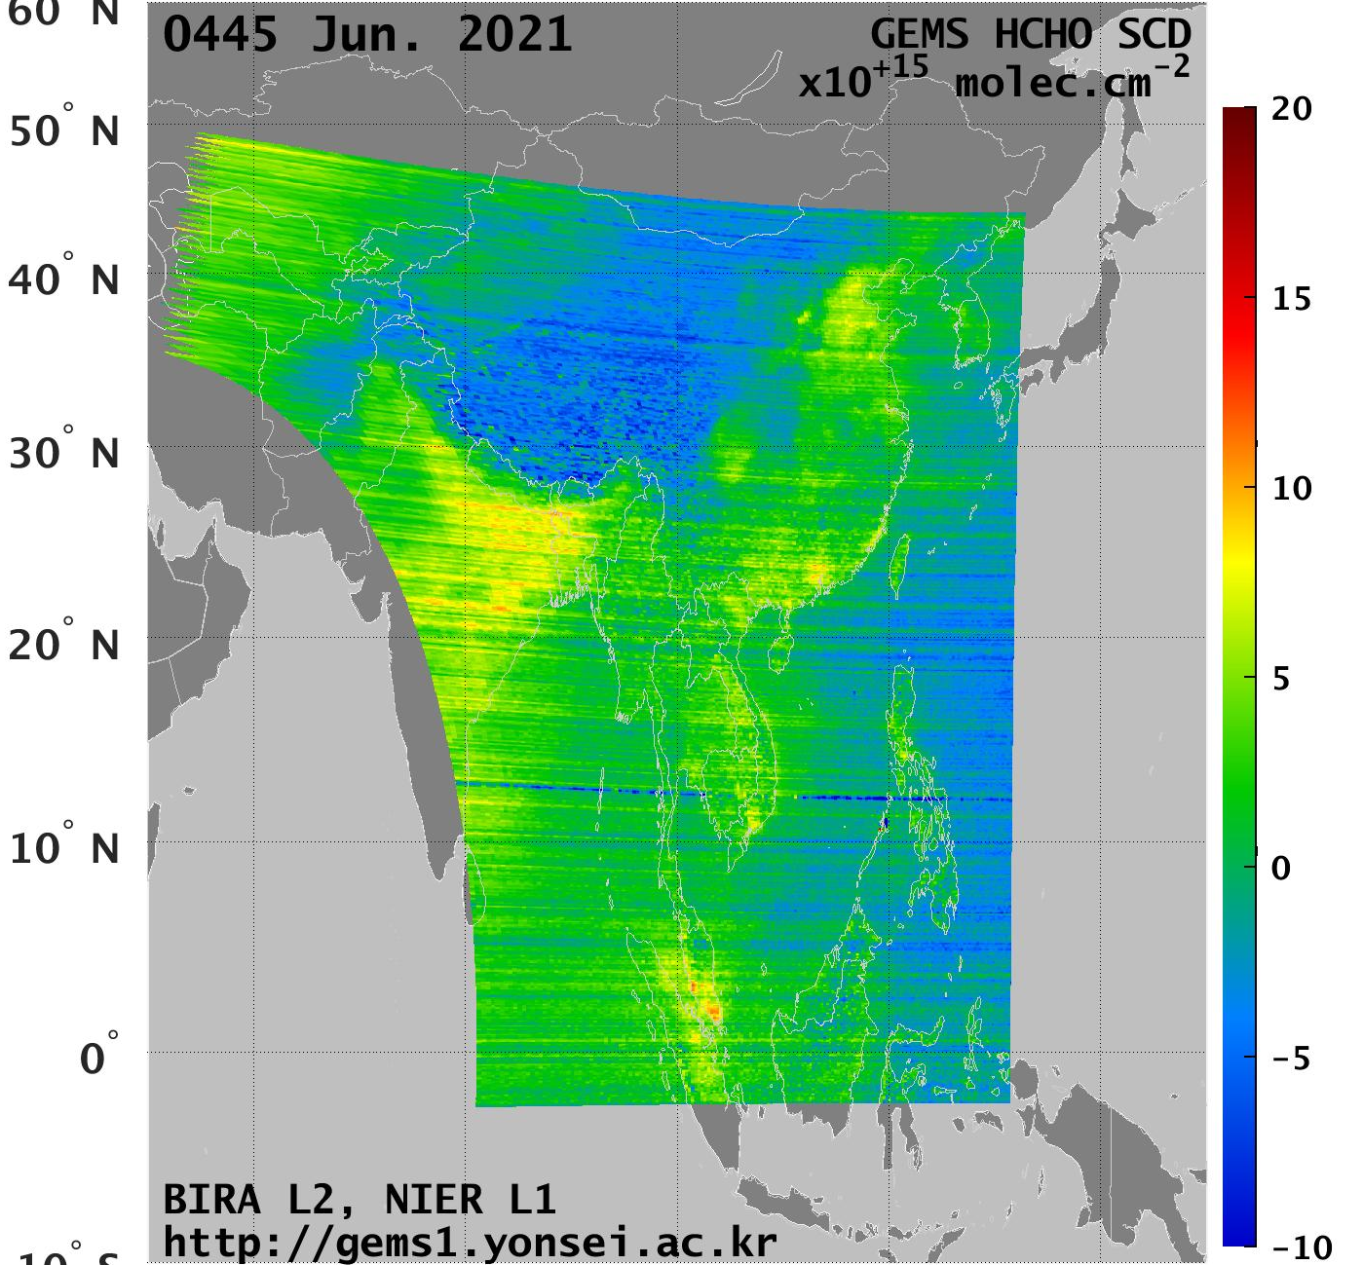
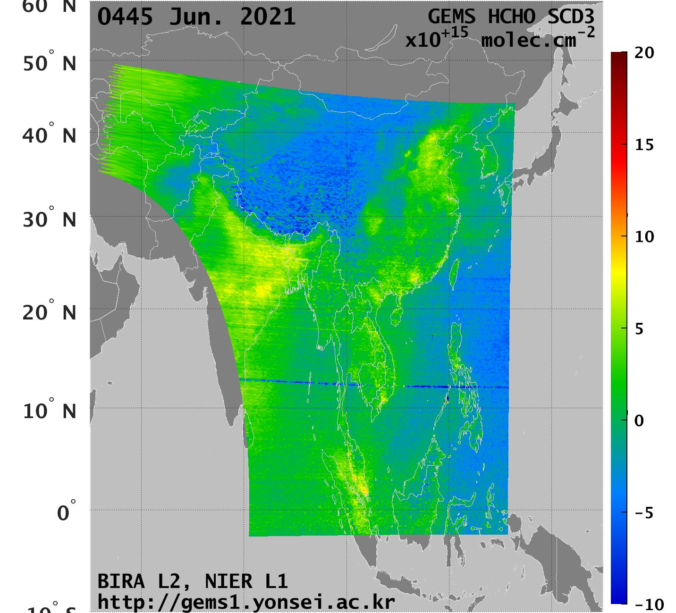
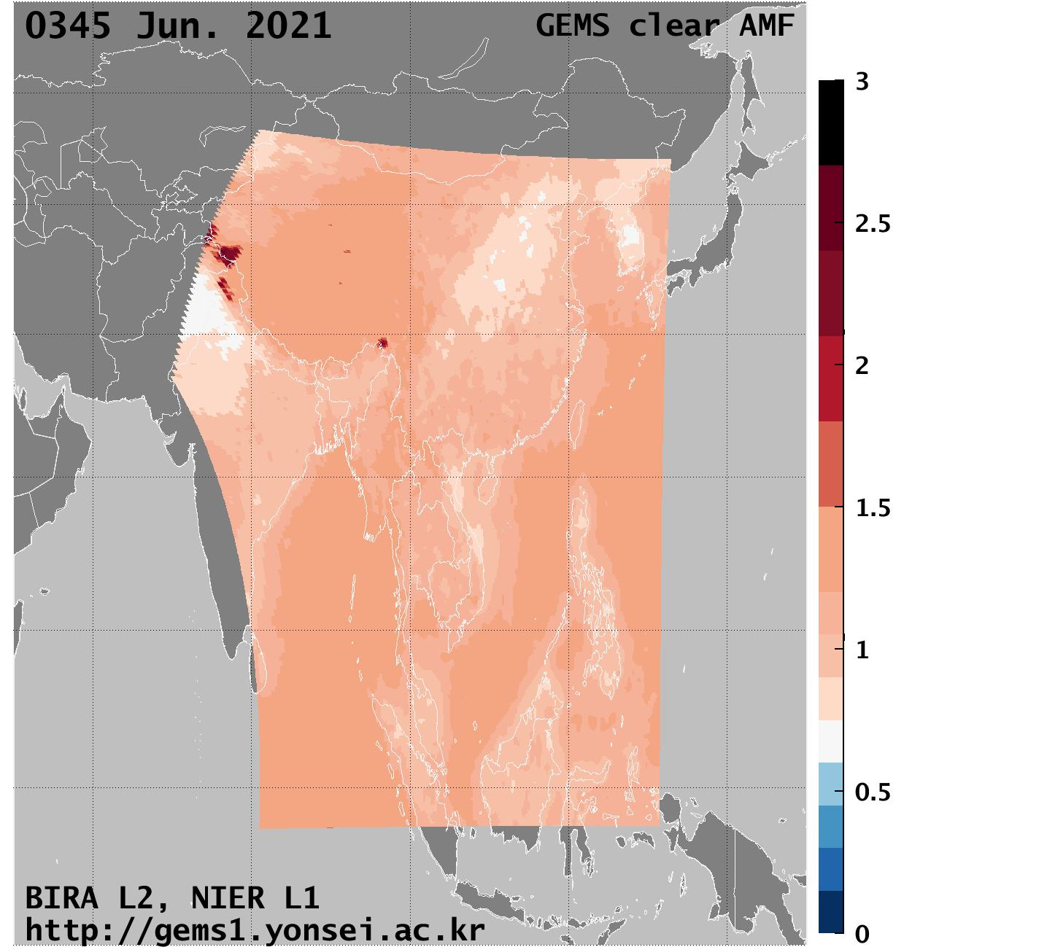
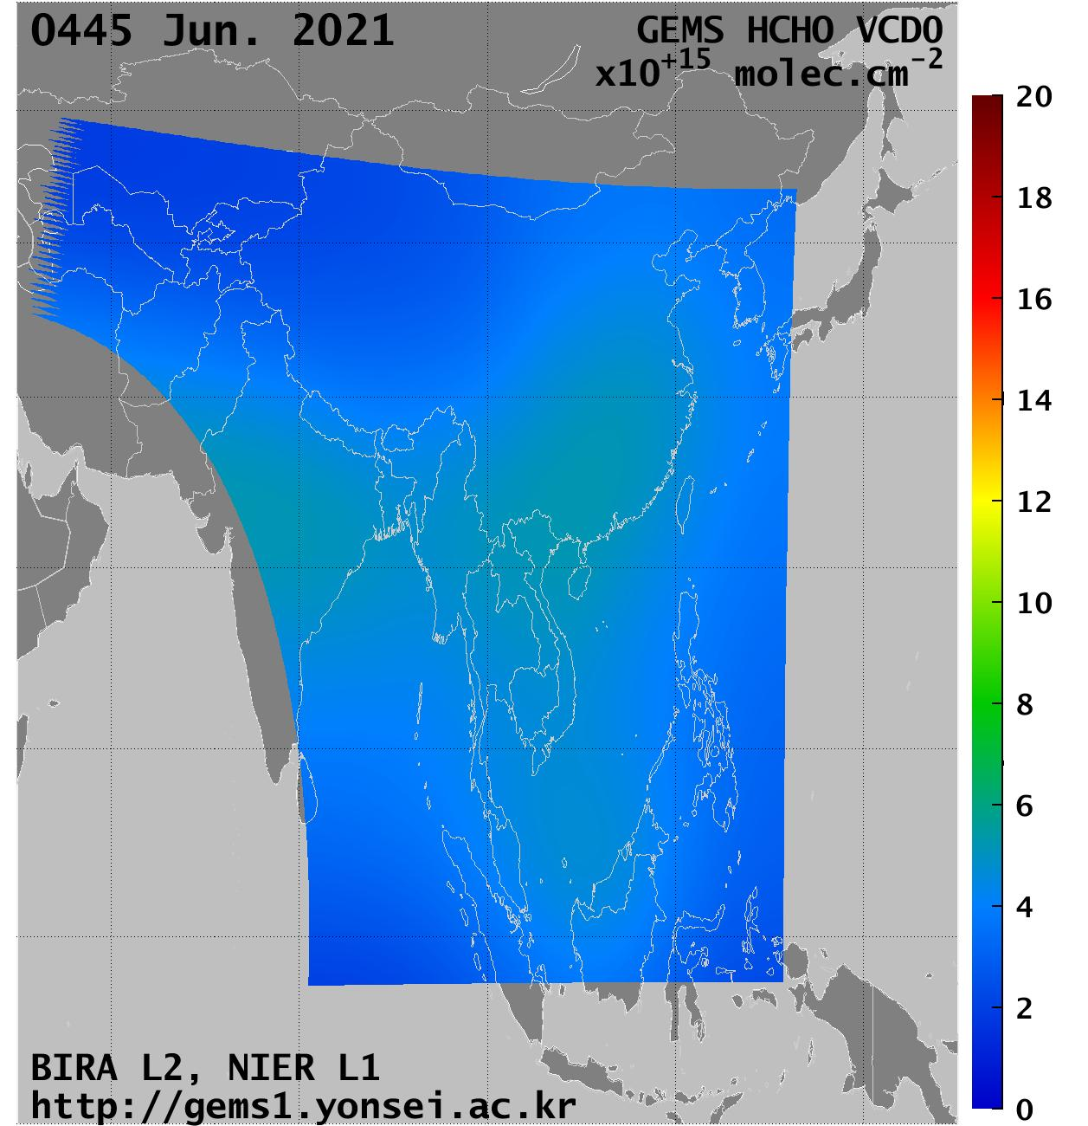
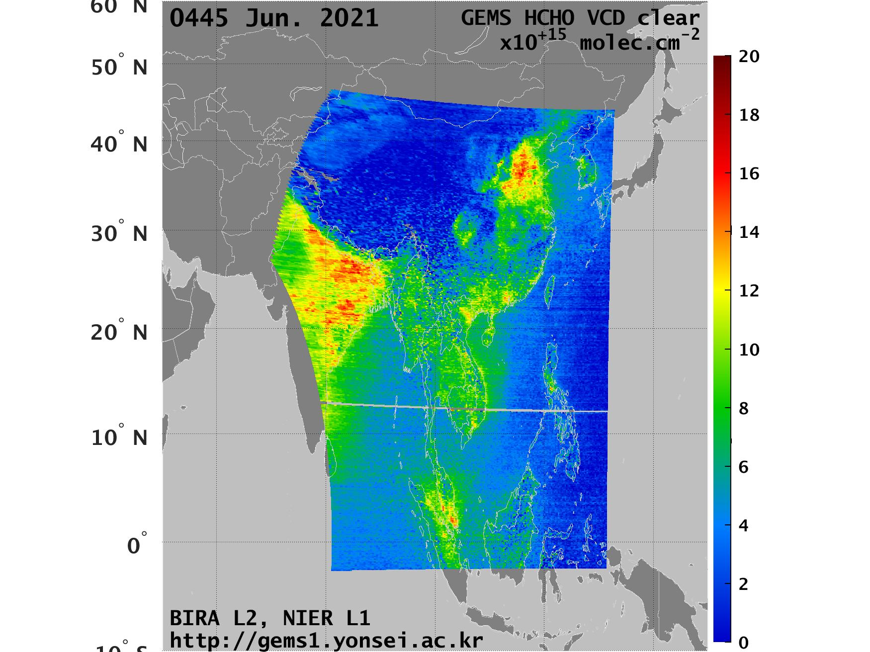
HCHO Fits: June, 04h45
Destriped HCHO SCD
AMF
Background Model Column
HCHO VCD
EGU – Vienna - 26.05.2022

Slide 7
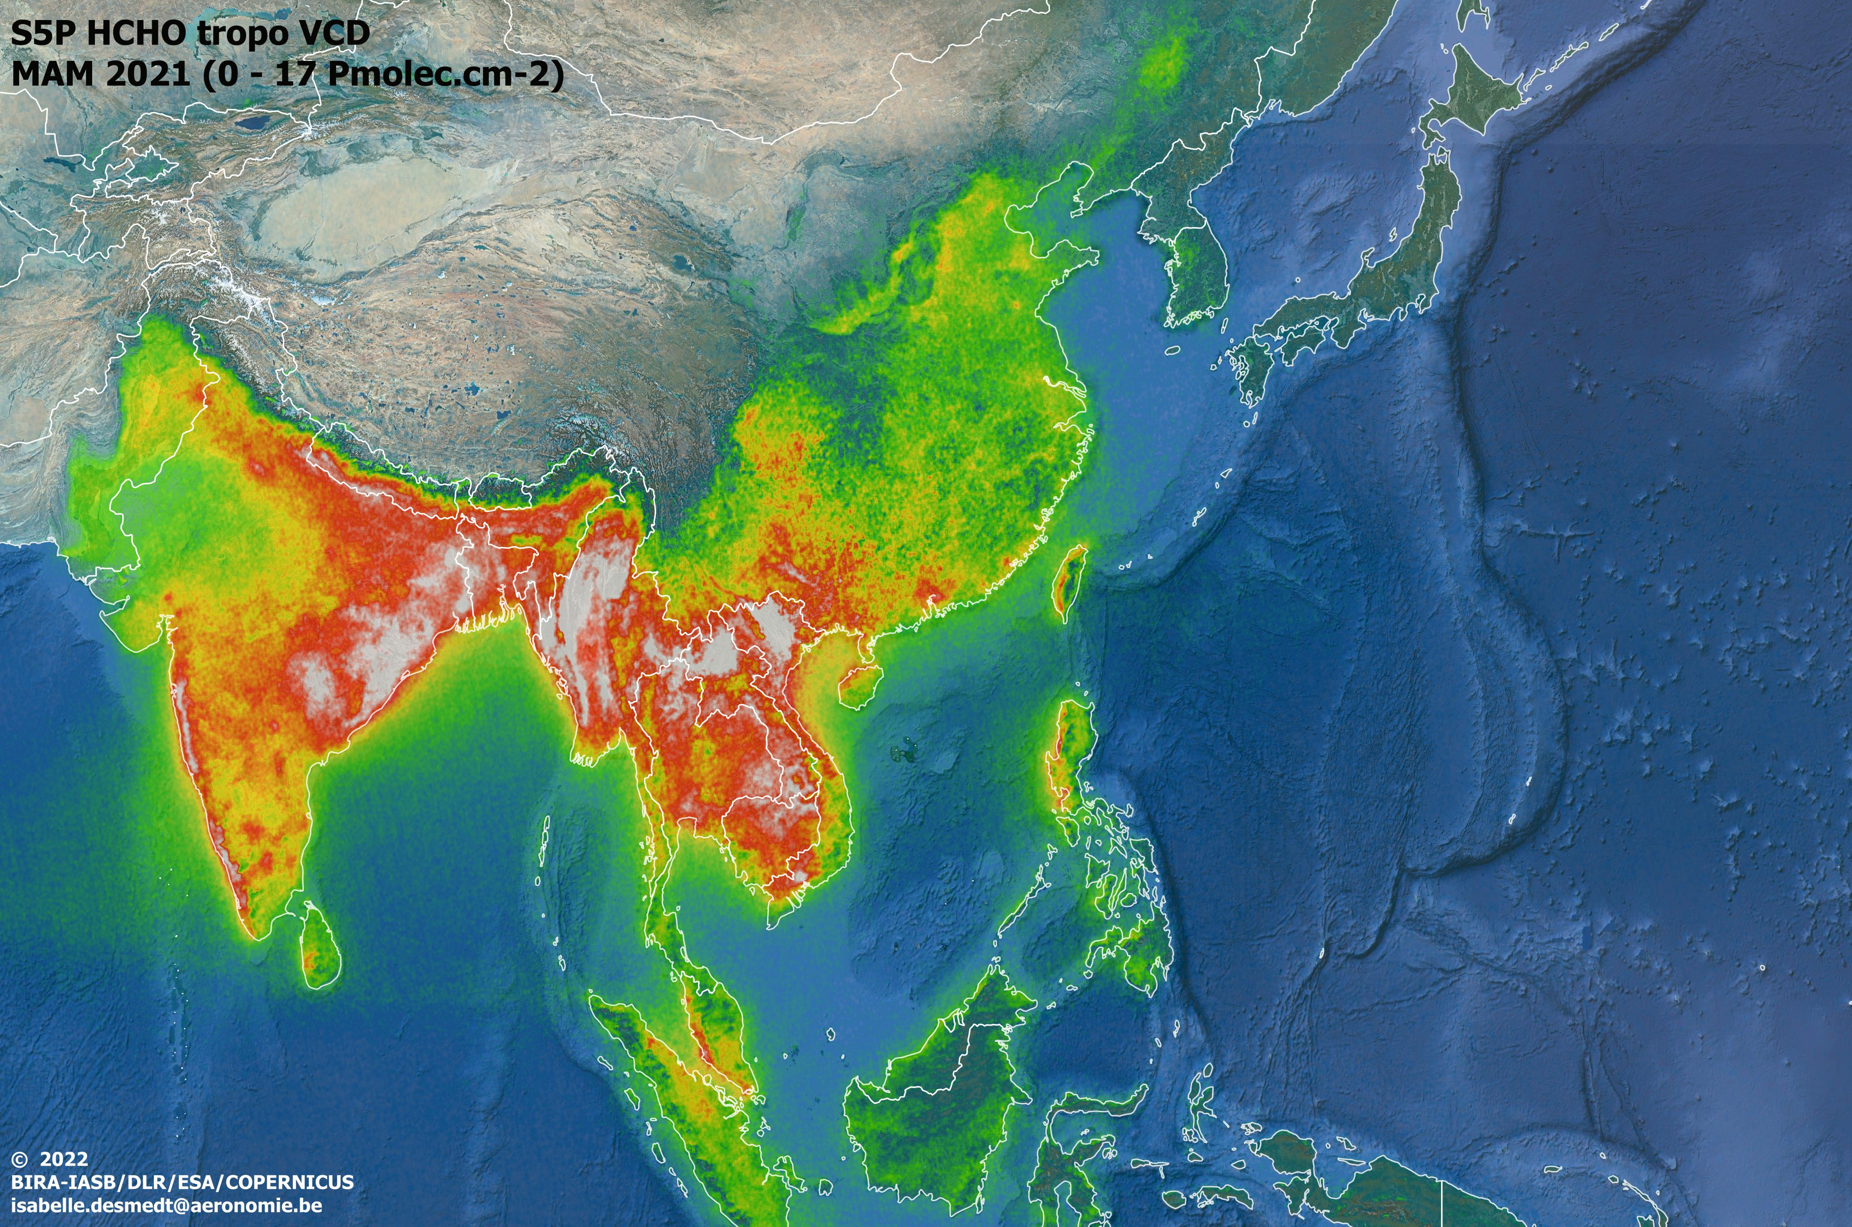
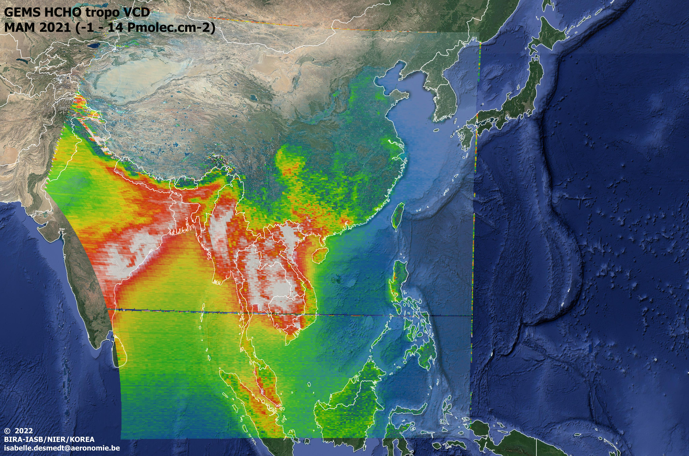


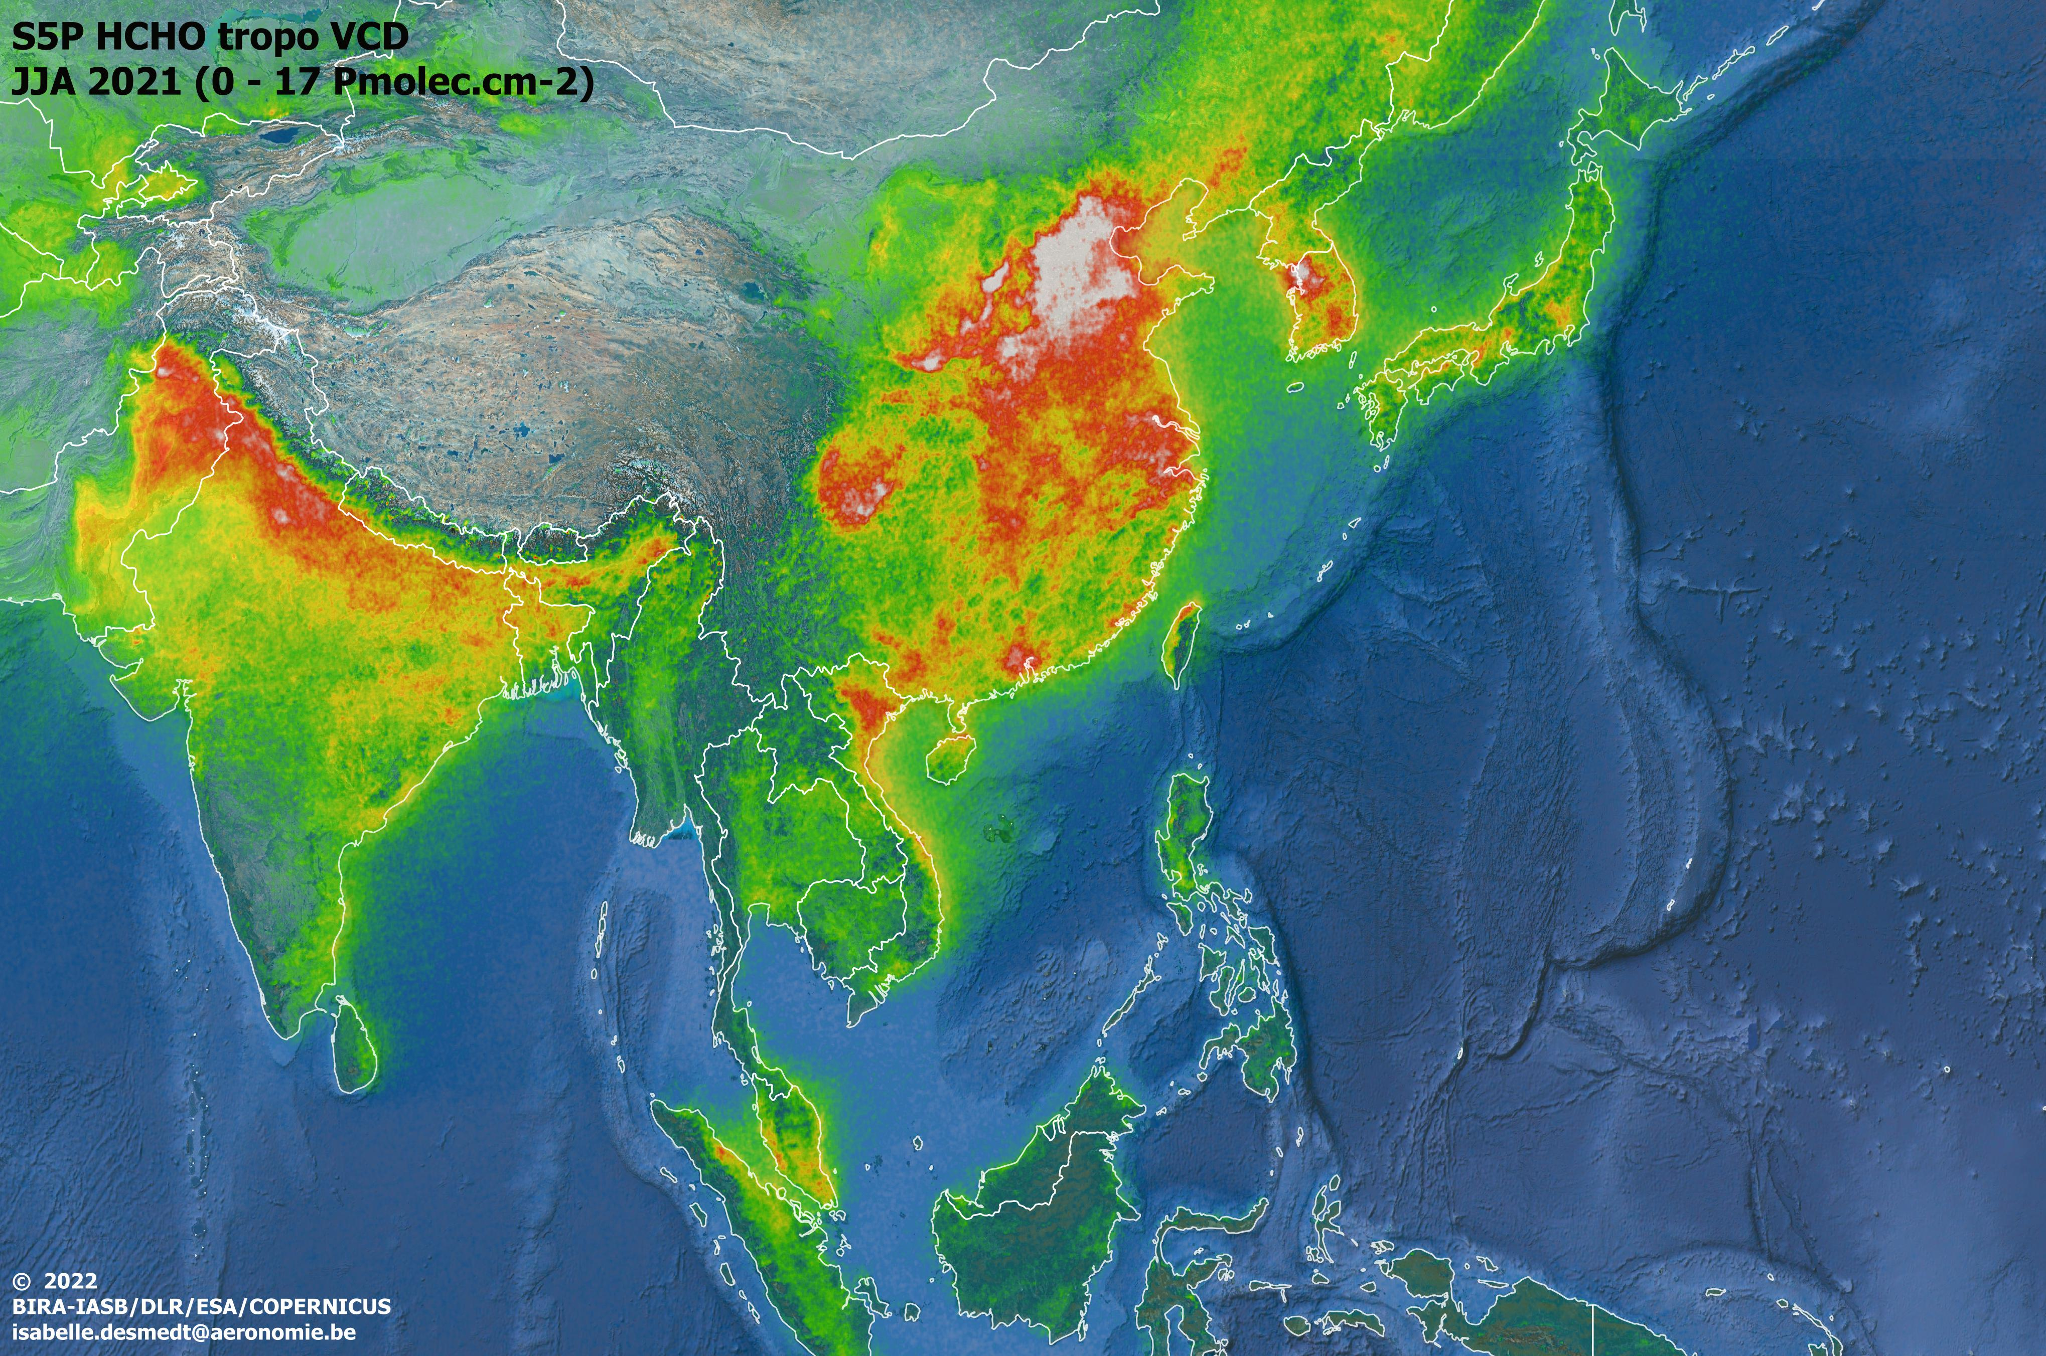
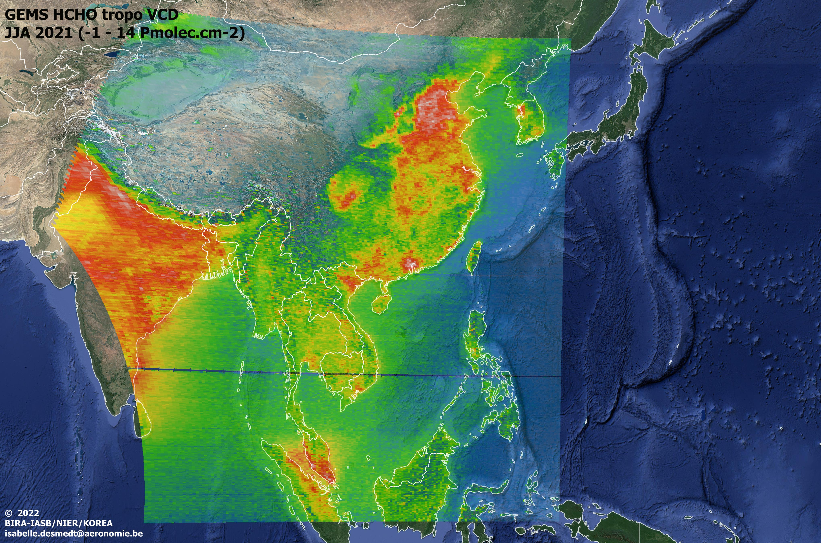
S5P
MAM
GEMS
MAM
04UTC
Seasonal HCHO MAPS
Comparison between TROPOMI and « S4» GEMS retrievals
Current results show a negative bias of ~3^{e15} molec.cm⁻² between GEMS and TROPOMI.
GEMS
JJA
04UTC
S5P
JJA
EGU – Vienna - 26.05.2022
ESA LPS – Bonn- 24.05.2022

Slide 8

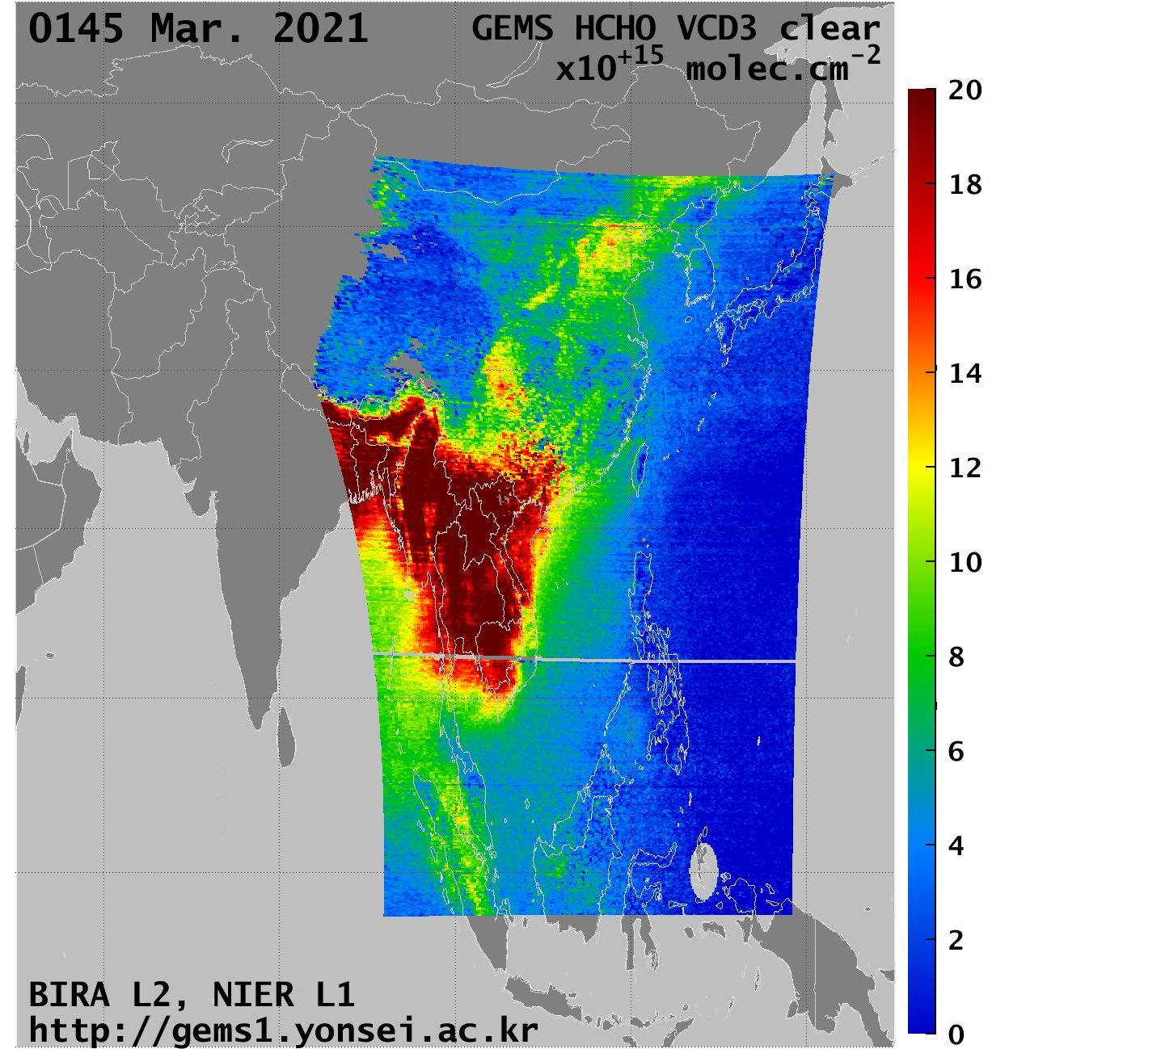
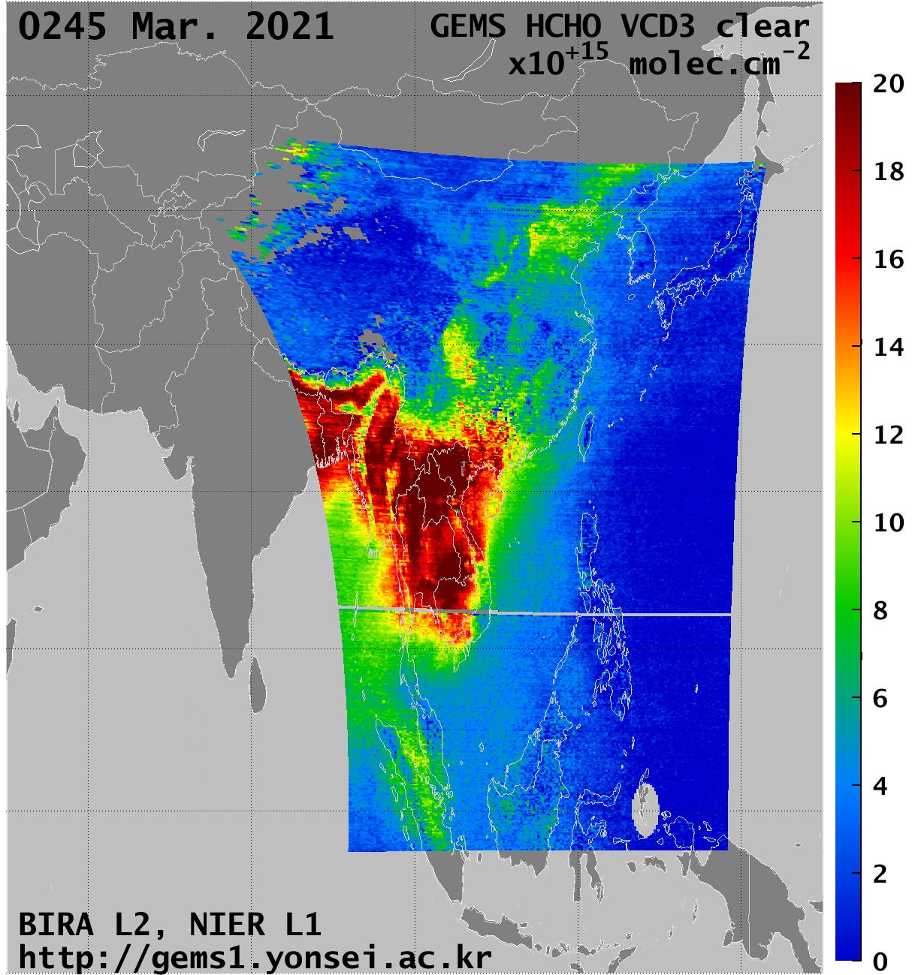
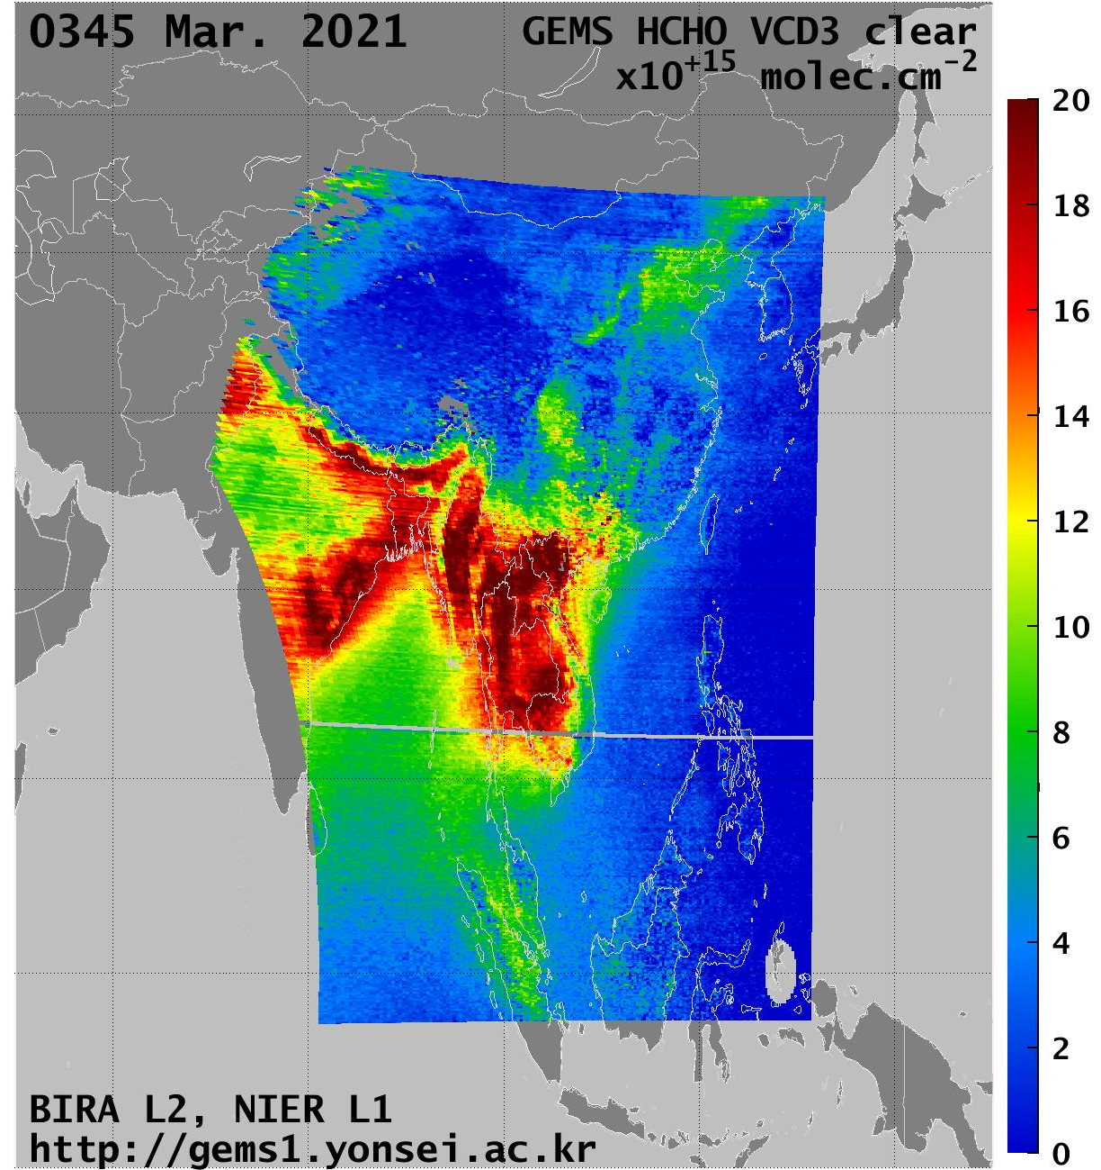
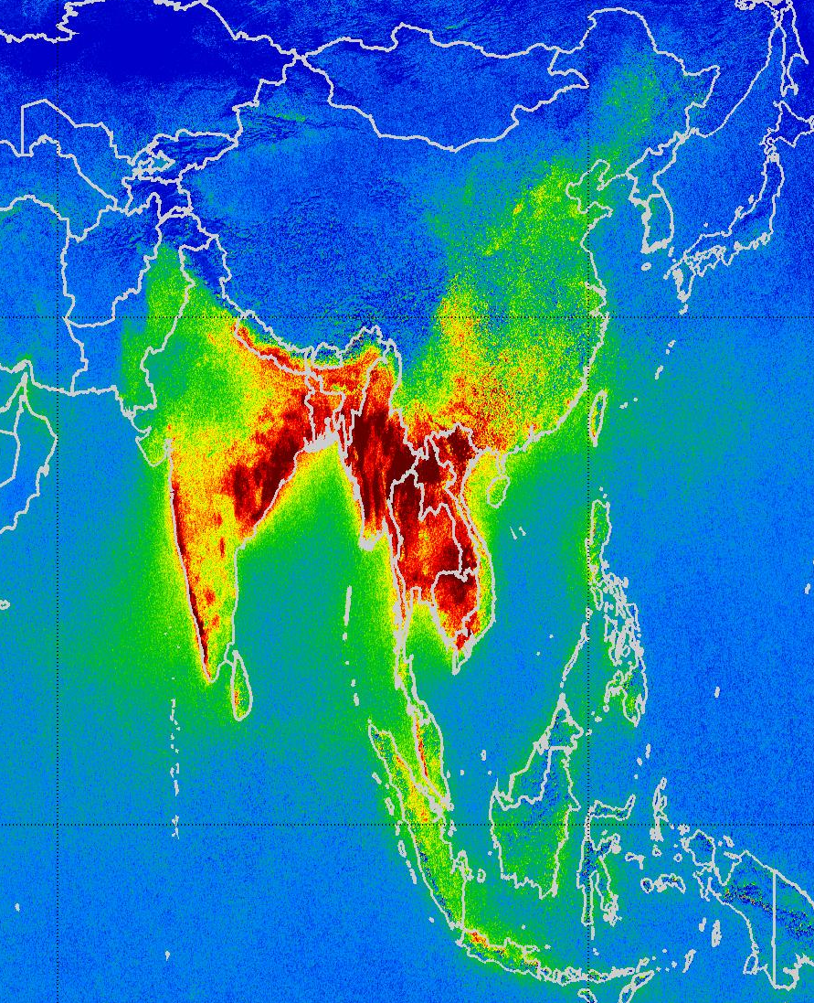
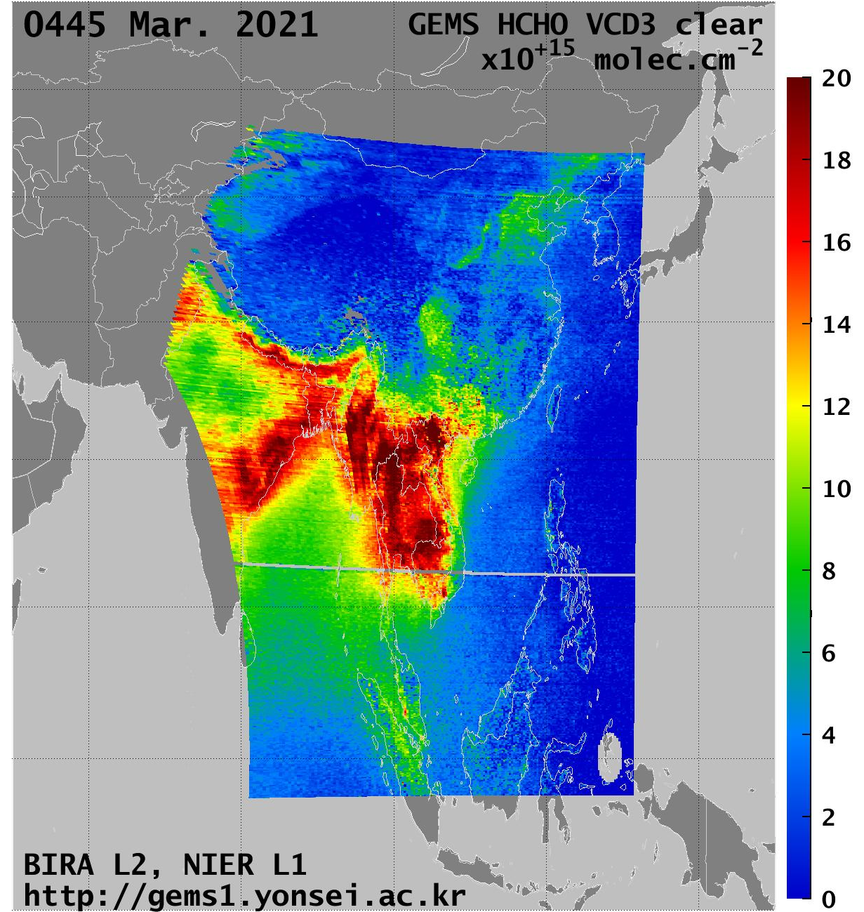
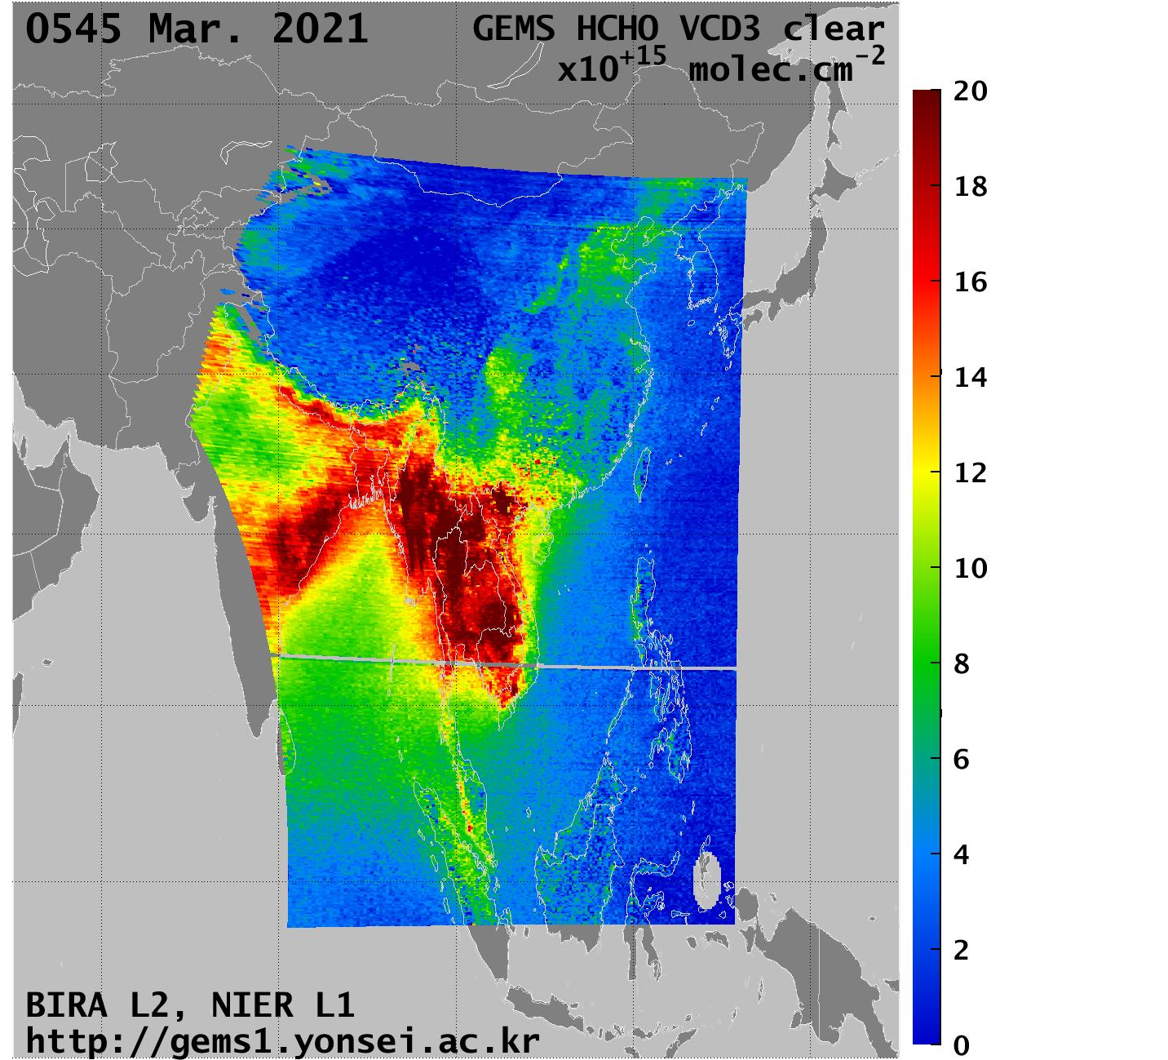
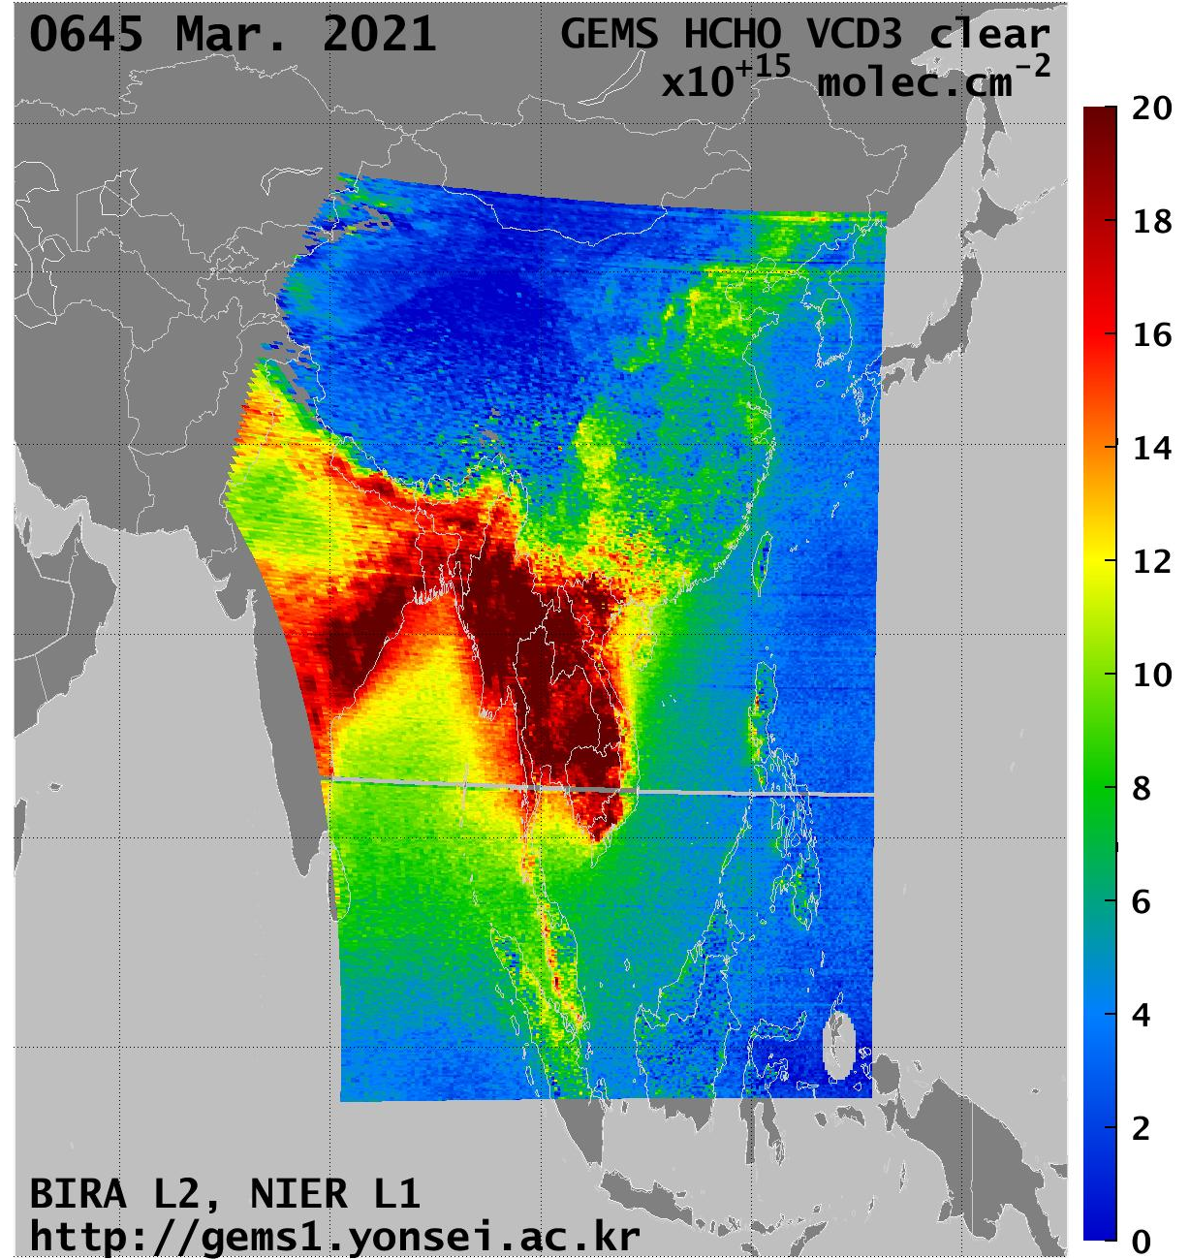
March 2021
TROPOMI HCHO

Slide 9
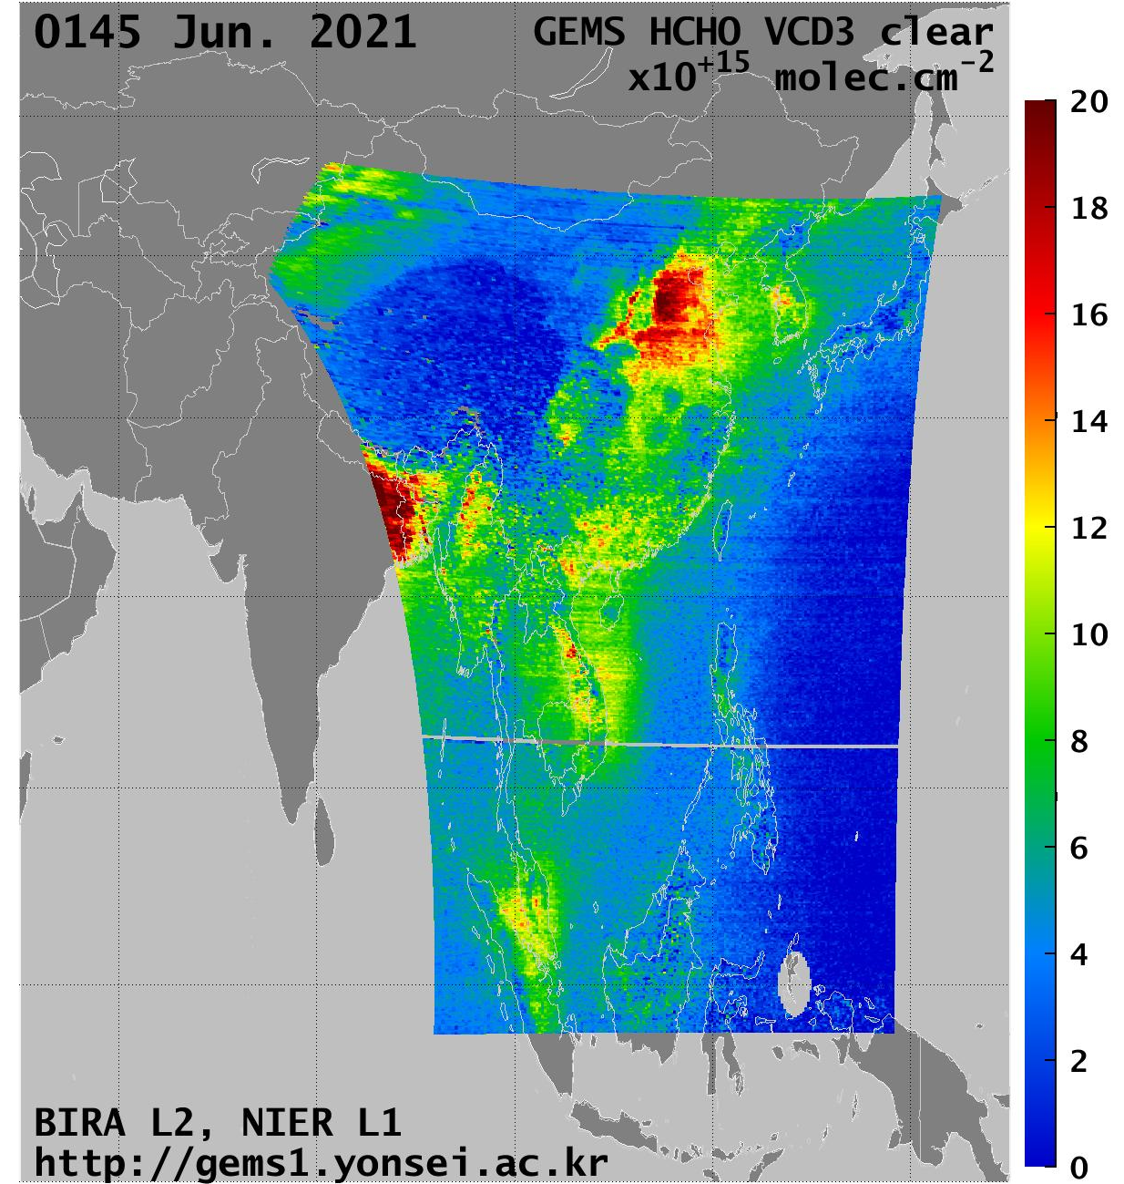
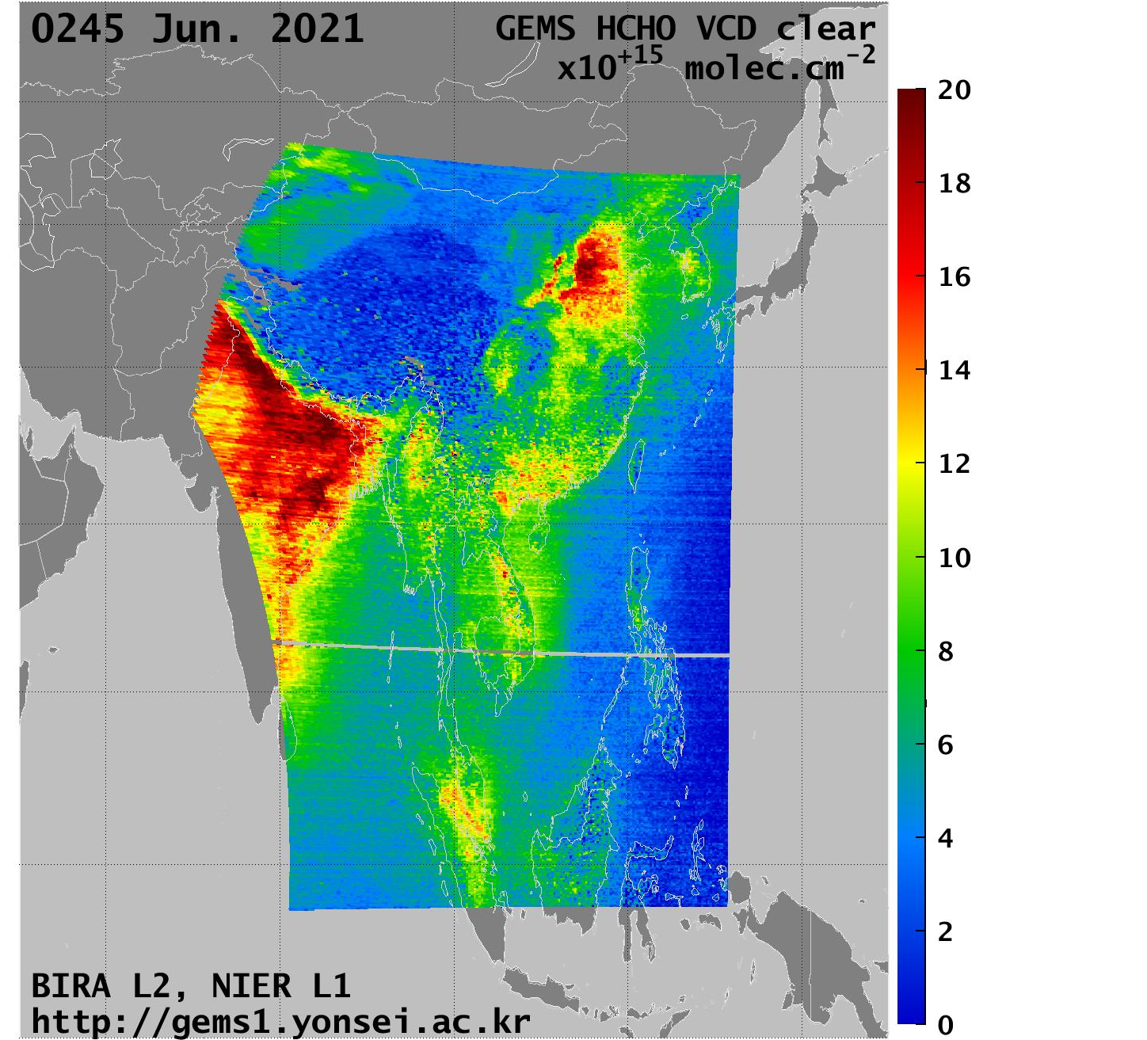
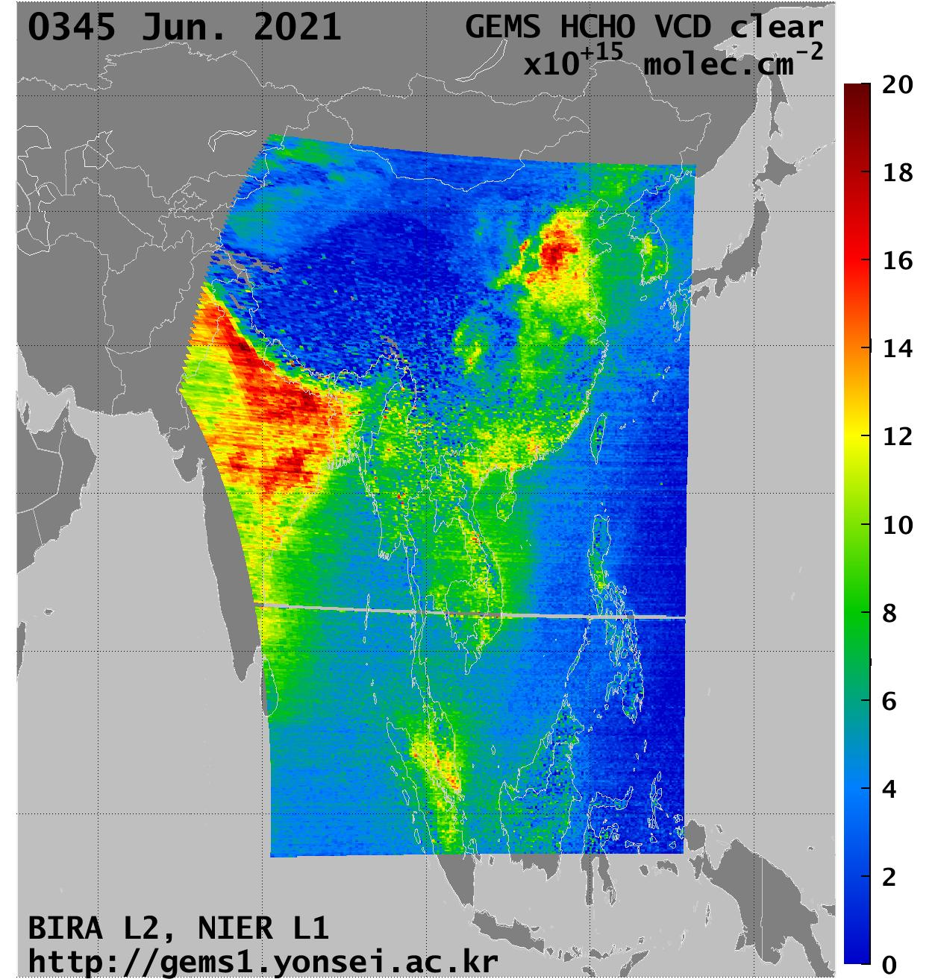
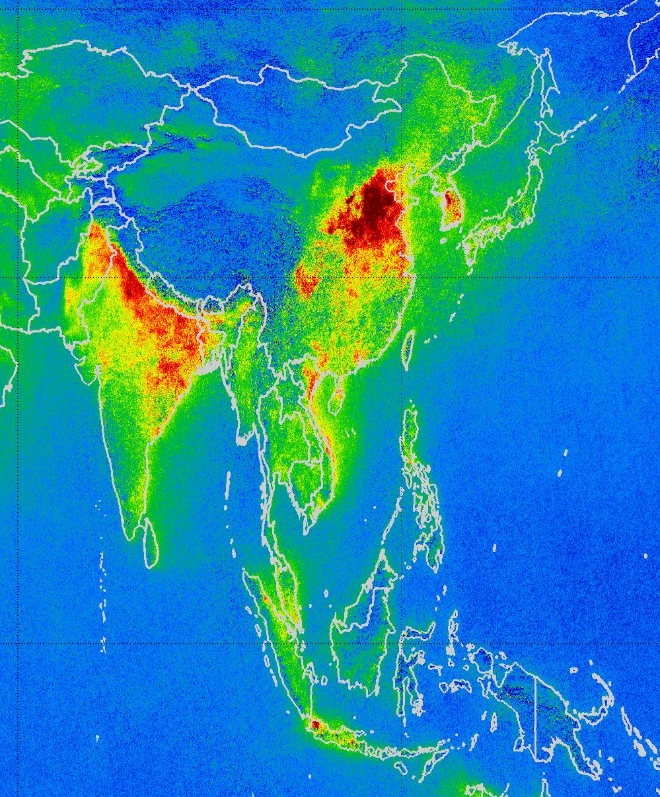
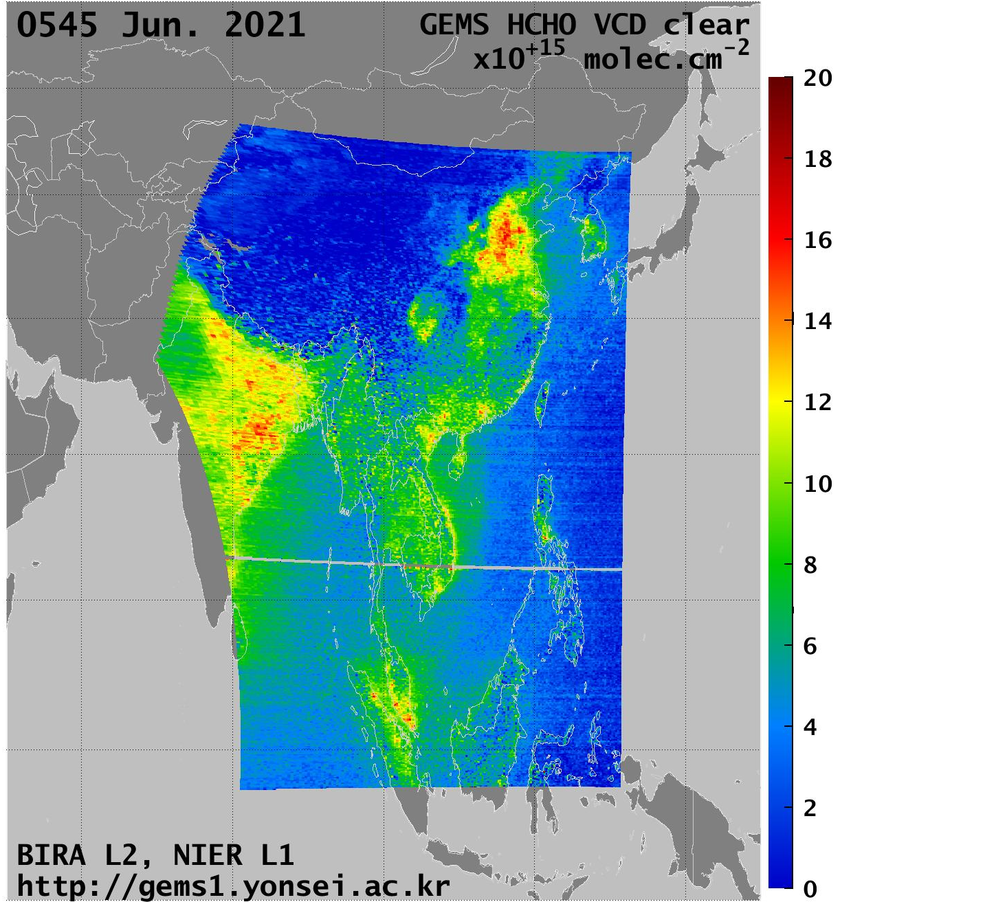
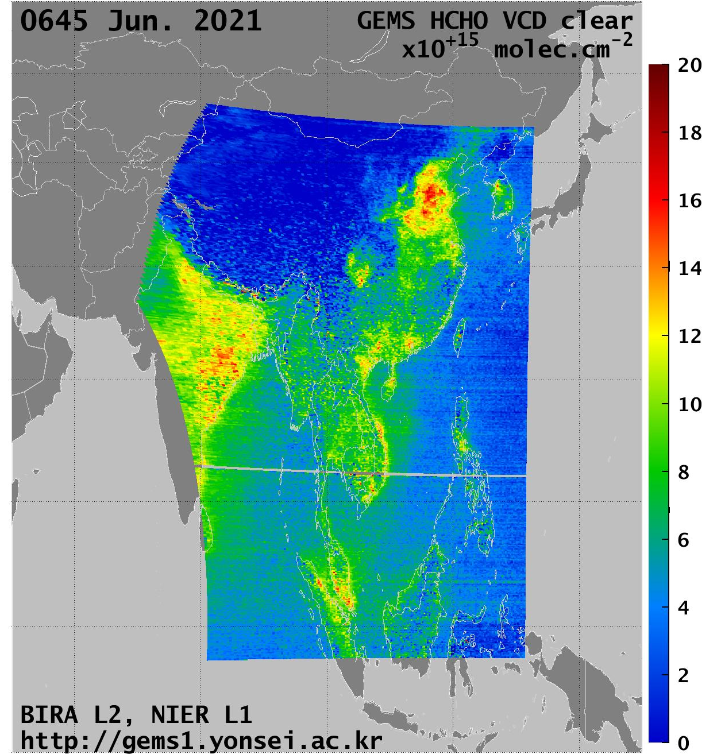
GEMS HCHO
June 2021
TROPOMI HCHO
EGU – Vienna - 26.05.2022
ESA LPS – Bonn- 24.05.2022

Slide 10
Monthly averages between 11h and 15h LT
IGP India
Vietnam-Laos
Center-East China
Good correlations of the daily variations between GEMS and TROPOMI
GEMS is low biased in India and China
TROPOMI
BIRA GEMS
ESA LPS – Bonn- 24.05.2022

Slide 11
Seasonal diurnal variations
+ TROPOMI
BIRA GEMS
IGP India
MAM
JJA
Center-East China
MAM
JJA
LOCAL TIME
Vietnam-Laos
MAM
LOCAL TIME
JJA
GEMS afternoon observations stop early.
Strange morning high values in the BIRA data.
LOCAL TIME
EGU – Vienna - 26.05.2022

Slide 12
Conclusions
We are starting to get good quality HCHO retrievals from GEMS.
Daily and seasonal variations: Good correlations between GEMS and TROPOMI.
HCHO columns: good agreement in South Asia, low bias over emissions in Eastern China and India.
Unexpected diurnal variations: improvement of the algorithm is needed.
  Updated polarisation correction? New L1 version?
  Realistic diurnal variation of the a priori profiles?
  Improved background correction taking into account large SZA and VZA.
Important challenges to address, especially for S4:
  Larger observation angles
  Lower HCHO levels in Europe than in Asia.
EGU – Vienna - 26.05.2022

Slide 13
Extra slides

Slide 14
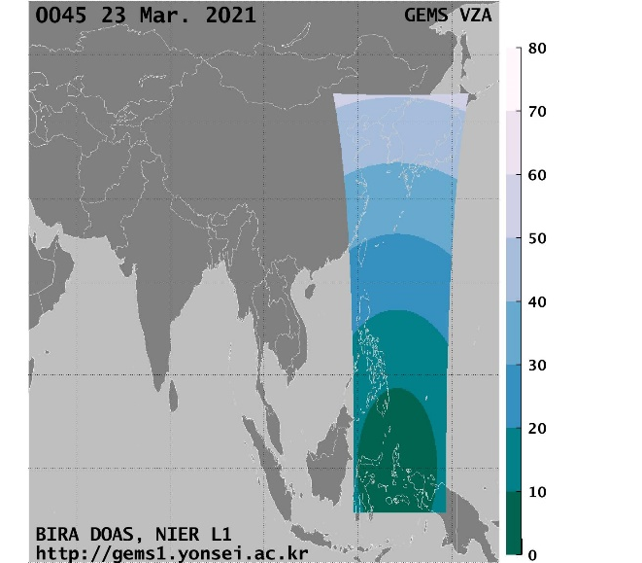
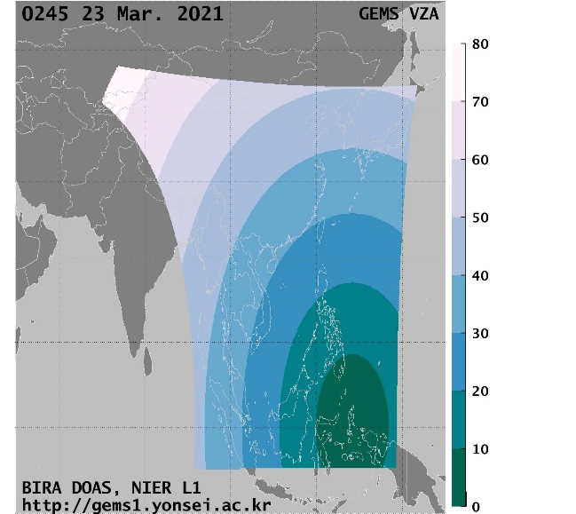
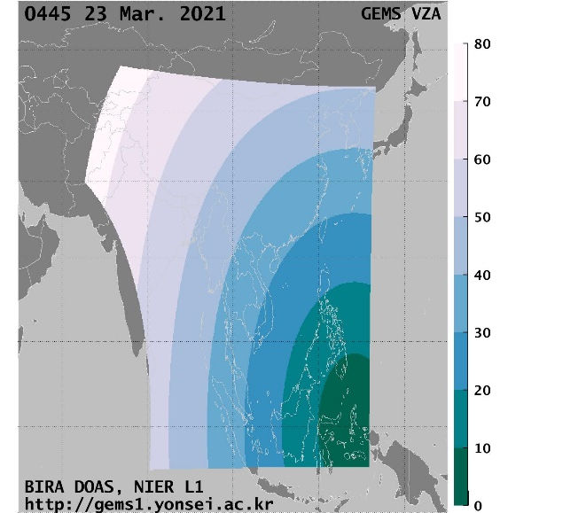

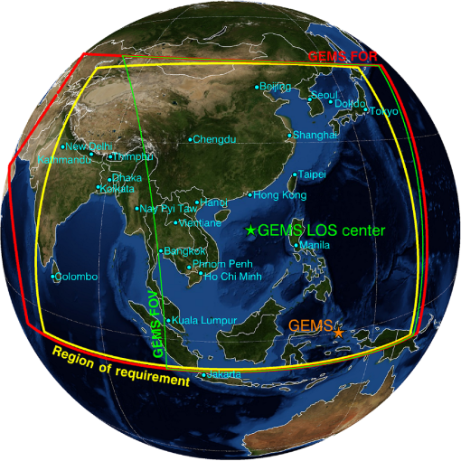
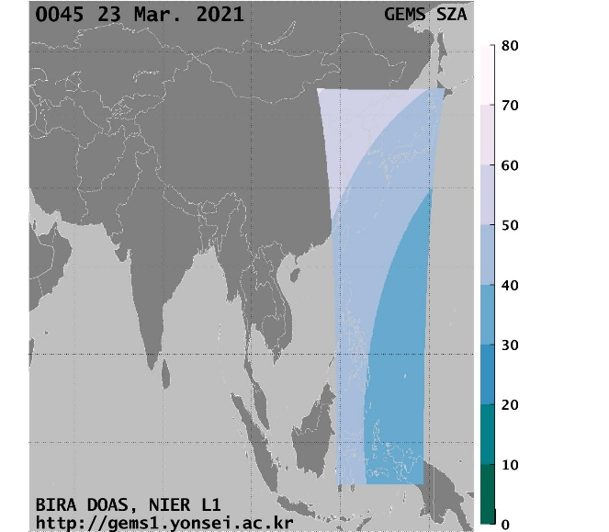
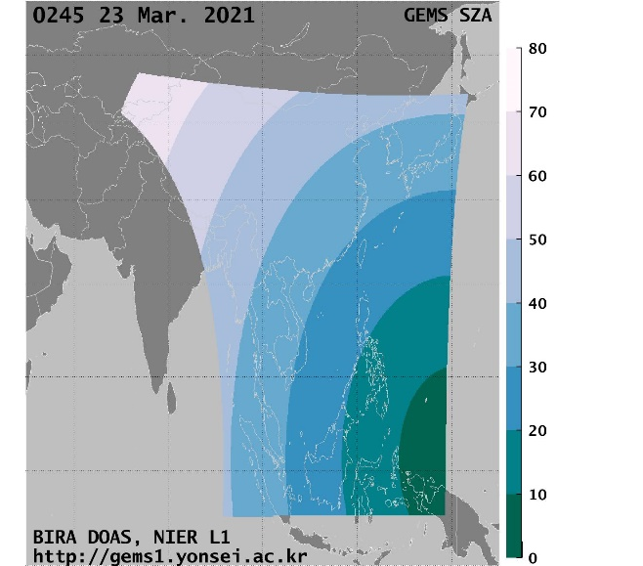
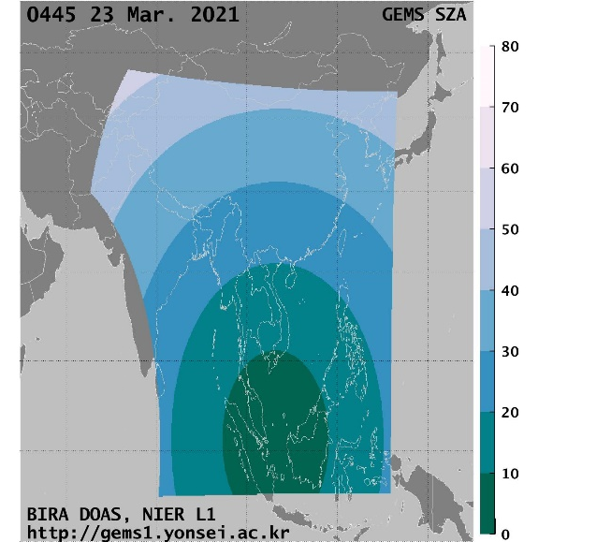
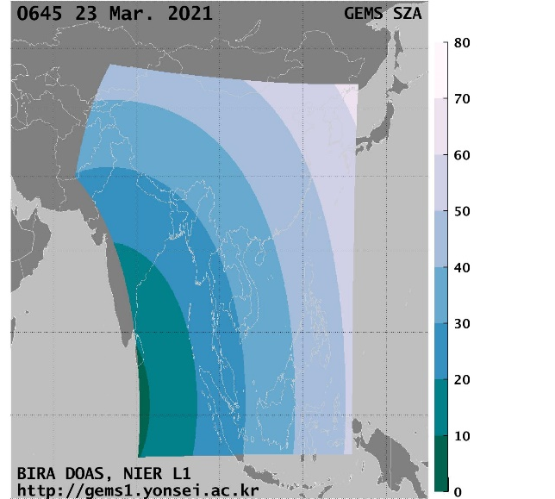
GEMS Mission
GEMS VZA: viewing zenith angle, line of sight
GEMS SZA: solar zenith angle
EGU – Vienna - 26.05.2022
Notes:
The geostationary observation geometry of GEO sensors poses challenges to an HCHO retrieval scheme due to the changing scene illumination and long light paths (Figure 3).

Slide 15
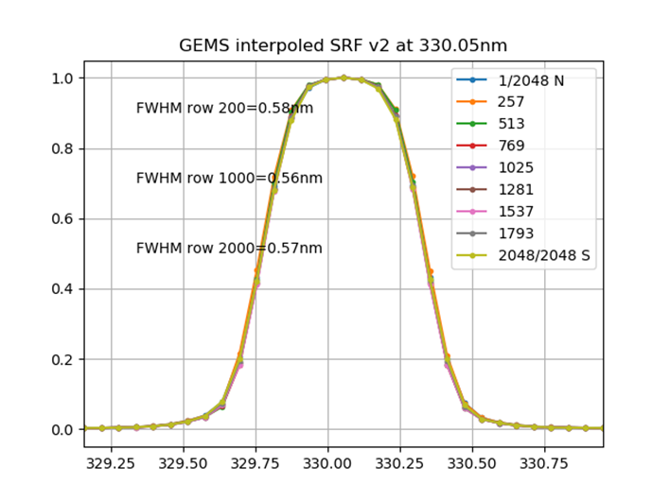
Slant column fit
Wavelength calibration + adjustment of the pre-flight slit function width for each row
Online convolution of cross-sections based on the adjusted ISRF.
Use of daily irradiance spectra as the DOAS reference.
Fitting window: 328.5-359 nm
  HCHO, BrO, NO2, O4
  O3 223 and 243K, I0 correction
  two O3 Pukite terms (online in QDOAS)
  Ring effect (Chance et al.)
  Polynomial degree 5
  Linear offset
  Shift and stretch of radiances
  + polarisation vector
Focus on 4x4 binned L1 data (512 horizontal rows x 175 E-W scans).
EGU – Vienna - 26.05.2022

Slide 16
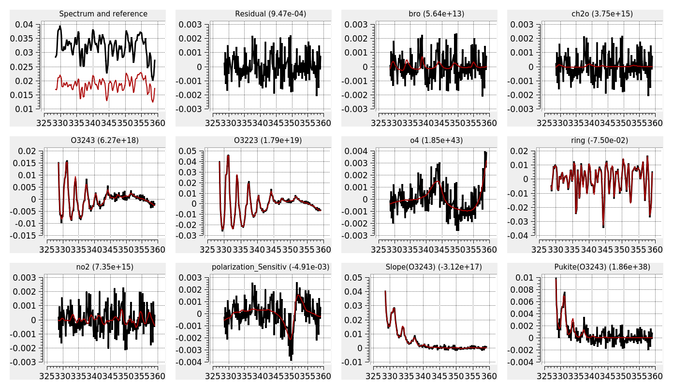
GEMS polarisation factor, now included in the DOAS fit
Many thanks to Hanlim Lee and Kyung-Jung Moon for providing the data

Slide 17
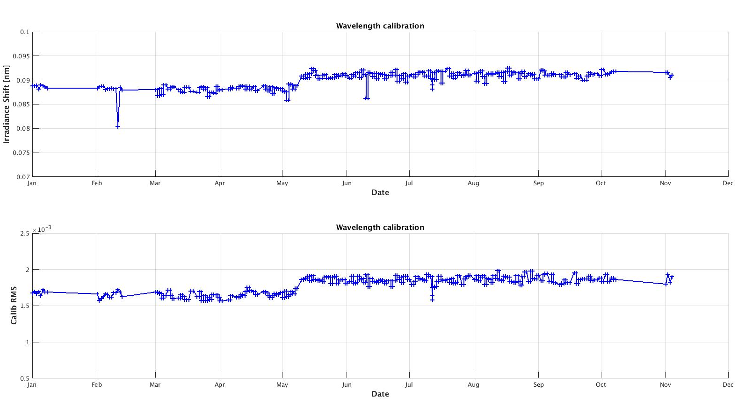
Calibration results in 2021
Irradiance Wavelength Shifts [nm]
Calibration RMS
EGU – Vienna - 26.05.2022

Slide 18
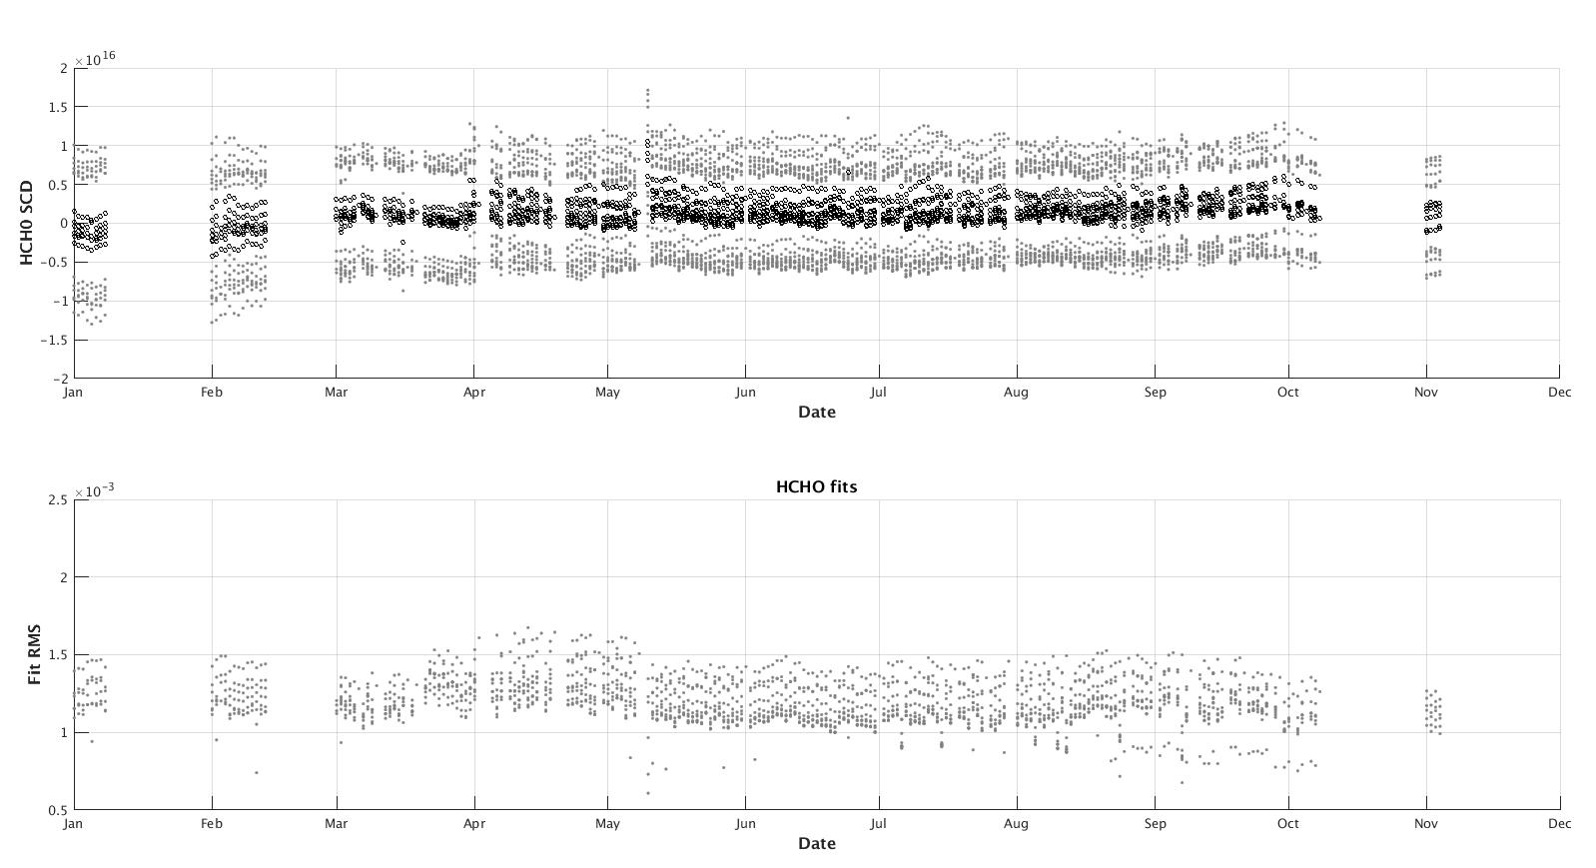
HCHO Fits results in 2021
HCHO mean SCD per scene [molec.cm⁻²]
Fit mean RMS per scene [molec.cm⁻²]
EGU – Vienna - 26.05.2022

Slide 19
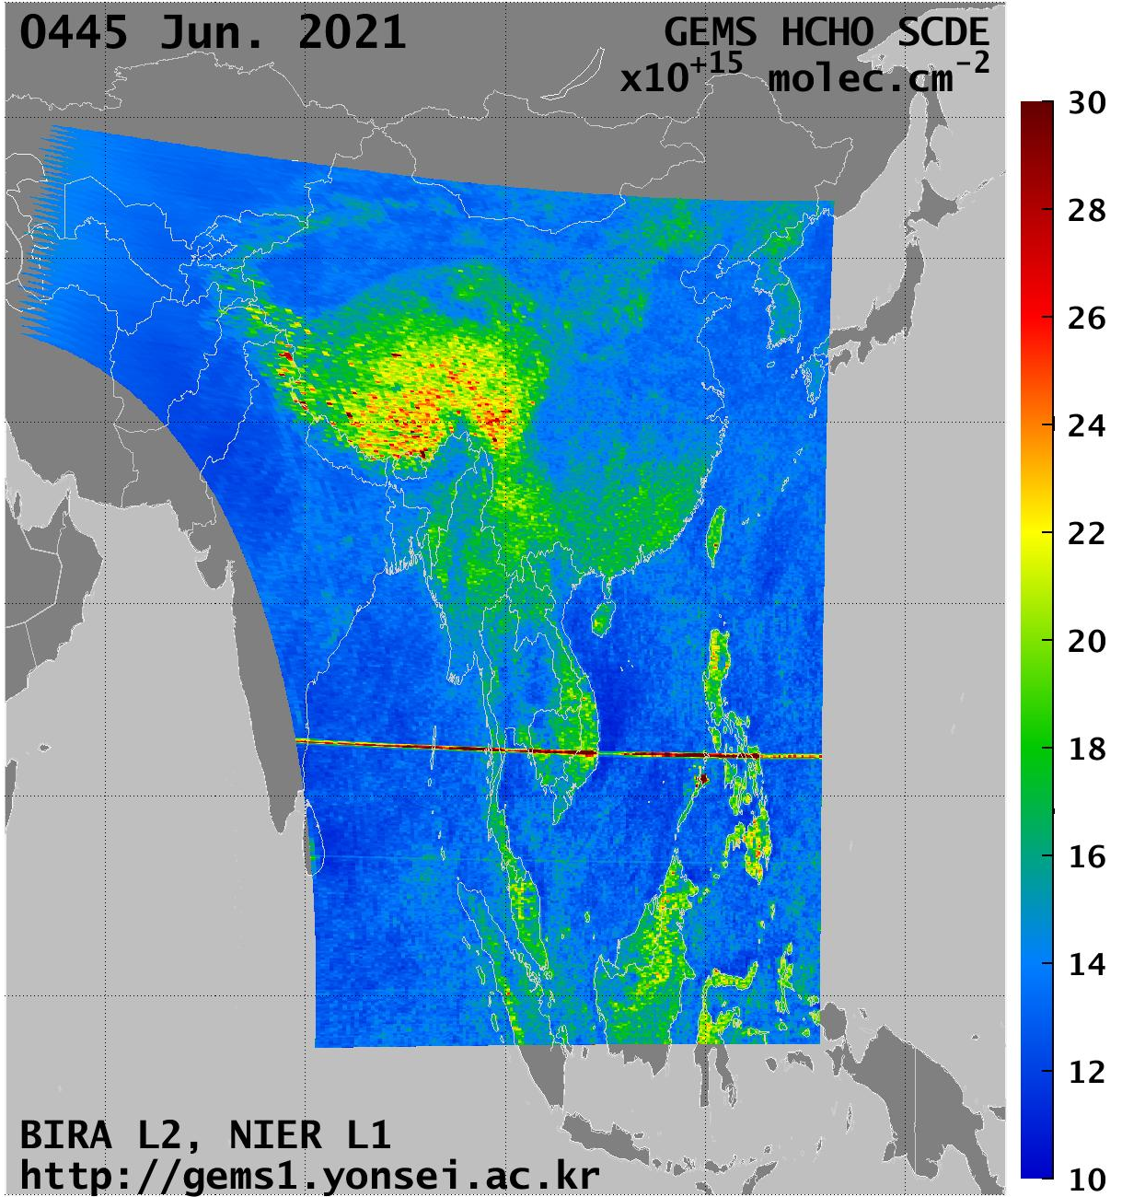
HCHO Fits: June, 04h45
SCDE
HCHO SCD
Destriped HCHO SCD
Clear degradation of the fitting errors over mountains and clouds.
SCDs are striped => destriping procedure.
ESA LPS – Bonn- 24.05.2022
EGU – Vienna - 26.05.2022

Slide 20


Destriping
Use of the full scene
Creation of hourly arrays of “background reference values” (dim: row x scan x hour)
Filters:
  RMS>3e-3
  HCHO SCD > 2xSTD per row
  CF>0.4
  SZA and VZA>70
Median of the filtered SCD
  per row (destriping)
  per day (in order to keep the info on the diurnal variation).
The stripes are ~constant from scene to scene.
Remove the median from all SCDs of the row.
EGU – Vienna - 26.05.2022

Slide 21



AMF: tropospheric AMFs in the UV
Same LUT of altitude-resolved AMFs as for TROPOMI.
TM5-MP a priori profiles (from TROPOMI AUX files), including diurnal variation.
Cloud filtering based on GEMS L2 cloud fractions.
Albedo: OMI min LER at 340 nm.
Weak dependencies with angles
EGU – Vienna - 26.05.2022

Slide 22


Background HCHO column
Destriping per day (=> mean dSCD ~0)
Background from CH₄ oxidation:
  taken from TM5 profiles in the free troposphere
  integration of the a priori profiles excluding the 4 first layers
  spatial smoothing
GEMS MODEL BACKGROUND COLUMN
TROPOMI MODEL BACKGROUND COLUMN
EGU – Vienna - 26.05.2022

Slide 23






Operational GEMS HCHO product
New version
March 2021
Full spatial resolution
Filtered using the provided CF in the product.
OMI mode LER at 340 nm
ESA LPS – Bonn- 24.05.2022

Slide 24







Operational GEMS HCHO product
New version
June 2021
ESA LPS – Bonn- 24.05.2022

Slide 25



Seasonal diurnal variations measured with MAX-DOAS
Ground-based observations show rather week diurnal variations
Increase along the day in summer time in Xianghe
Over Phimai, morning HCHO columns seem to be larger during the fire season (MAM)
MAX-DOAS data provided by:
MPI-C, IISER, Mohali, India
Chiba U, Japan
BIRA-IASB, CAS, Beijing, China
EGU – Vienna - 26.05.2022

