Slide 1

A Statistical Study of tropospheric variability on the Ionosphere Parameters
Potužníková K. and Koucká Knížová P.
kaca@ufa.cas.cz, pkn@ufa.cas.cz
Institute of Atmospheric Physics, Czech Academy of Sciences
Prague, Czech Republic
What types of atmospheric motions in the troposphere can be the source of the acoustic-gravity waves that reach up to the ionosphere?
What meteorological parameters seem to determine whether the response in the ionosphere is significant?

Slide 2
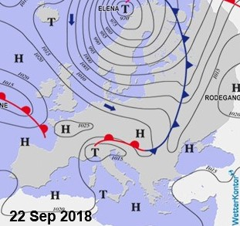
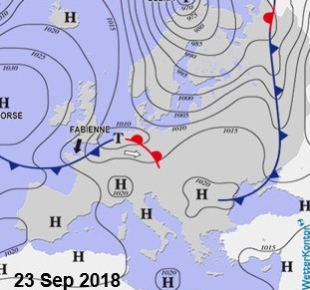
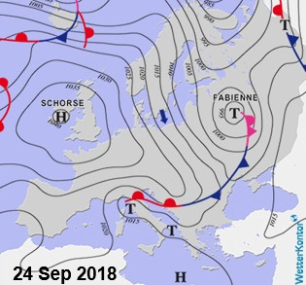
Earlier studies – fast motion of the cyclonal systems significant influence up to ionospheric hight of the F2 layer.
Cold front associated with cyclone passed above Europe in a zonal flow within 24 hours with top speed reaching values of 30 m.s⁻¹ (approx. 108 km.h⁻¹)
storms and wind gusts reached extreme values of 45 m.s⁻¹ (162 km.h⁻¹)
the temperature drop on frontal border of 10 °C
Koucká Knížová, P., Podolská, K., Potužníková, K., Kouba, D., Mošna, Z., Boška, J., et al. (2020). Evidence of vertical coupling: meteorological storm Fabienne on 23 September 2018 and its related effects observed up to the ionosphere. Ann. Geophys. 38, 73–93. doi: 10.5194/angeo-38-73-2020
Koucká Knížová P, Laštovička J, Kouba D, Mošna Z, Podolská K, Potužníková K, Šindelářová T, Chum J and Rusz J (2021) Ionosphere Influenced From Lower-Lying Atmospheric Regions. Front. Astron. Space Sci. 8:651445. doi: 10.3389/fspas.2021.651445

Slide 3
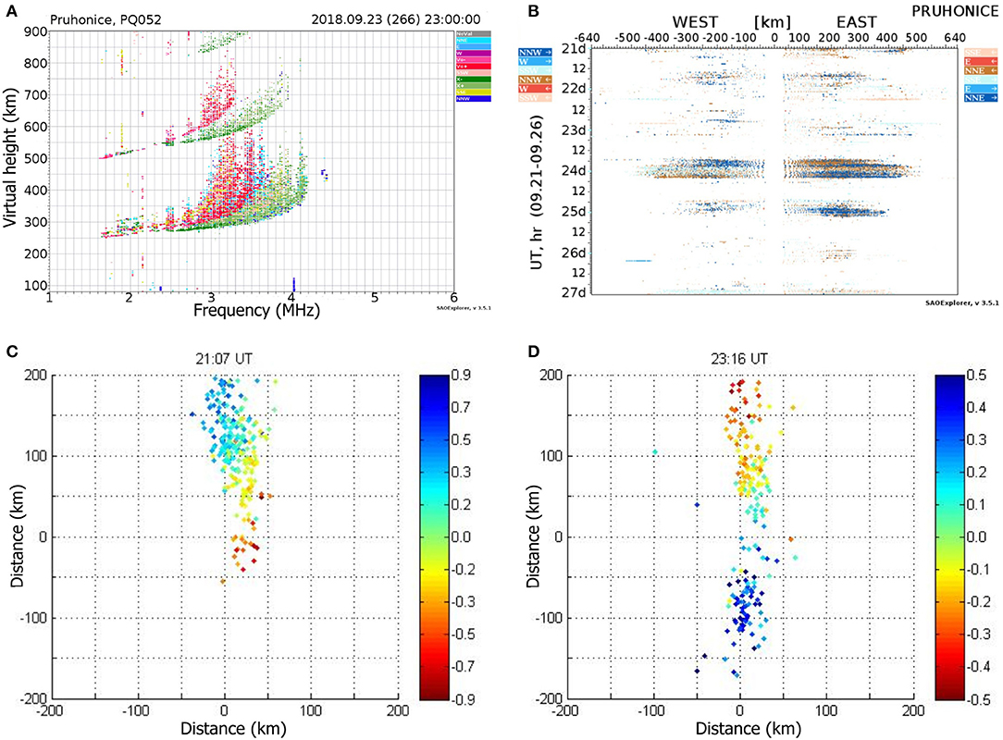
A. spread of F ionogram recorded after the Fabienne cyclone frontal system passage
B. directograms measured for several consequent days (B) before and after Fabienne Cyclone
Strong echo in a Fabienne case
Change in the color indicates plasma flow shears

Slide 4
Data
Records of atmospheric front passage over the meteorological station at Prague Ruzyně Airport
since 1950
Determining of atmospheric fronts are subjective, based on 6 criteria:
Surface observation (the pressure tendency before and after the front, change in wind direction, atmospheric precipitation, wind gusts)
temperature gradient at the level of 850 hPa
density and curvature of isohypse of 500 hPa pressure surface
surface and upper air pressure charts (Isobars of close proximity represent higher wind speeds than isobars of wide spacing. Nebo The small isobar spacing represents an area of large gradients of temperature and high wind speed.)
Meteorological records from ground-level measurements from the station Praha- Spořilov located in the garden of our Institute of Atmospheric Physics of the Academy of Sciences
since 2006
Surface pressure chart
for looking at high and at low pressure region, atmospheric fronts and drylines
and upper air charts
850 hPa chart for assessing low level warm air and cold air advection
500 hPa – chart of steering flow, which indicates the speed and direction of mooving of surface pressure patterns (cyclone, anticyclone, atmospheric fronts)

Slide 5
Preliminary results:
An intense surface front may not cause a significant echo in the ionosphere as the waves may not reach the ionospheric heights due to season that is not favourable for penetration high enough.
Also, we found cases of an upper front that is not extended to the ground, but we found significant increase of acoustic-gravity waves launched from the troposphere on the ionogram and directogram recordings.
Atmospheric waves may propagate through the atmosphere up to ionospheric height. Whether they reach it depends on the state of the atmosphere as it forms natural filter (season, winds, existence of critical layer).
2 basic types of synoptic patterns emerging from more then 40 cases associated with the significant echo detected in ionospheric F2 layer:
Frontal cyclones of sub-synoptical scales that are very quickly moving over Central Europe (typically spring and autumn situations) – example: Fabienne case
Synoptic patterns of continental scale associated with large vertical shear of wind speed throughout the troposphere

Slide 6
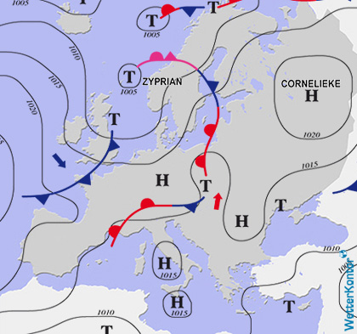
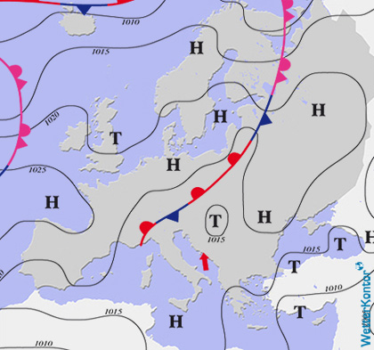
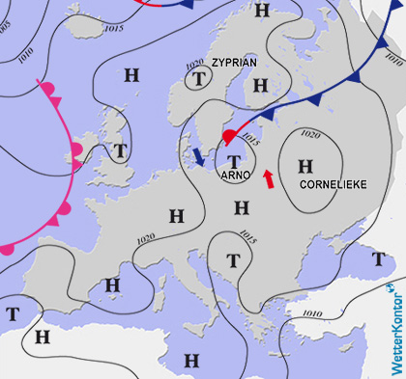
Synoptic patterns of continental scale associated with large vertical shear of wind speed throughout the troposphere.
2A. Summer passage of the convective system over Central Europe from the southwest.
insignificant surface pressure field
transition of warm moist air in the lower troposphere - significant temperature gradient close to the earth's surface
significant wind shear over the entire troposphere layer
situations in which severe thunderstorms and tornadoes can occur
Frontal boundary was extending along the Alps through central Poland, dividing hot and well-mixed air masses across the Balkans from moist and cooler air to the west. Along a frontal boundary the cyclogenesis occured. The cold front brought showers and thunderstorms that were regionally strong.
7 Jul 2021
12:00 UTC
8 Jul 2021
12:00 UTC
9 Jul 2021
12:00 UTC

Slide 7
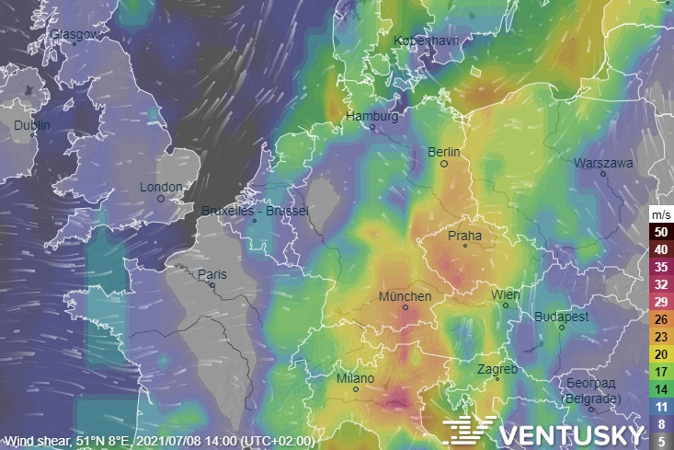
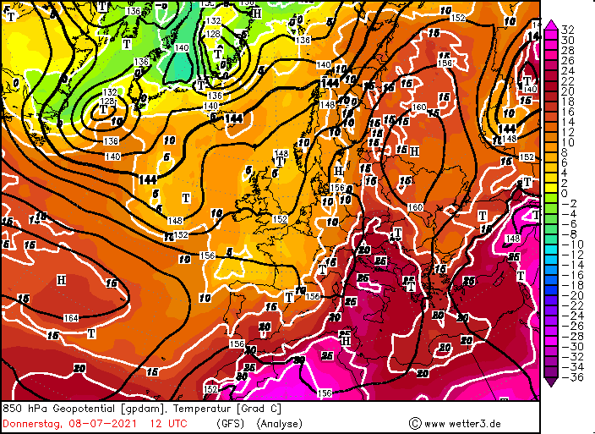
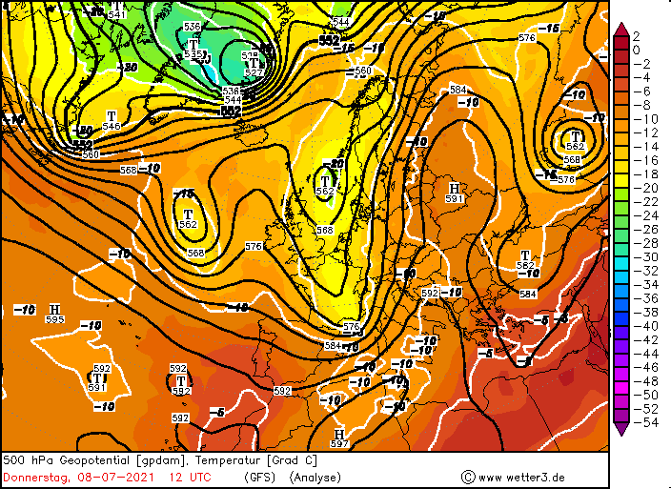
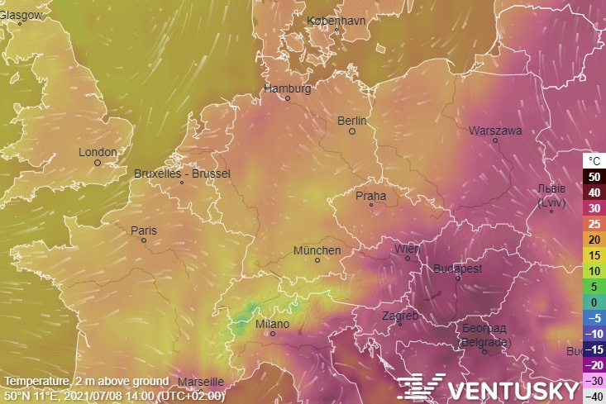
The interface of two air masses with different temperatures is visible up to the middle troposphere
A: 850 hPa - about 1.5 km above the ground
B: 500 hPa - about 5.5 km above the ground.)
Vertical wind shear up to 30 m/s
in the 1.5-12 km layer
D
A
Strong Frontal Boundary
Strong temperature gradient of the temperature at 2 m sbove the ground
18°C ÷ 35 °C (approx. 400 km)
B
C

Slide 8
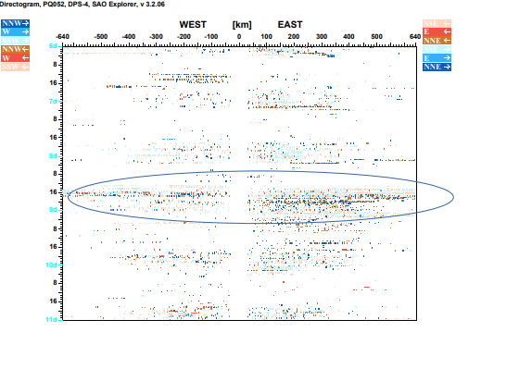
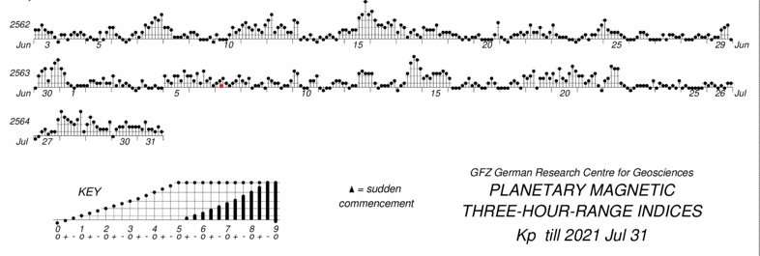
DPS-4D
measurements
Directograms
– significant increase of the echo on 8 July
- strong horizontal motion
- changing color indicates that there is a strong motion shear
Low geomagnetical activity
Kp < 3

Slide 9
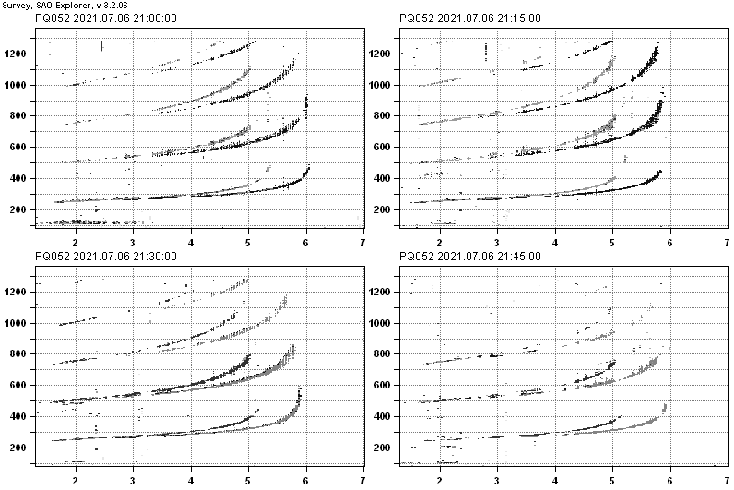
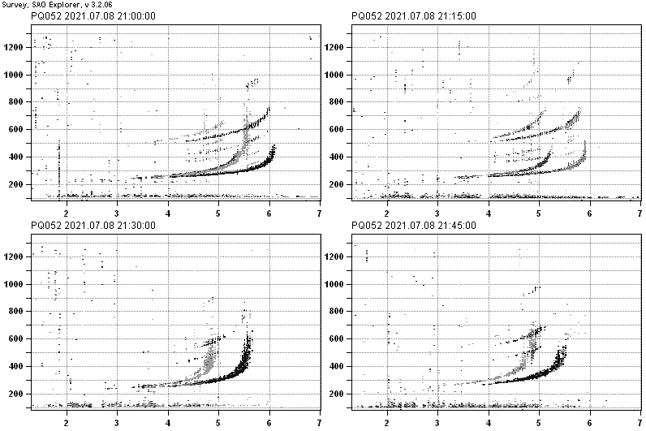
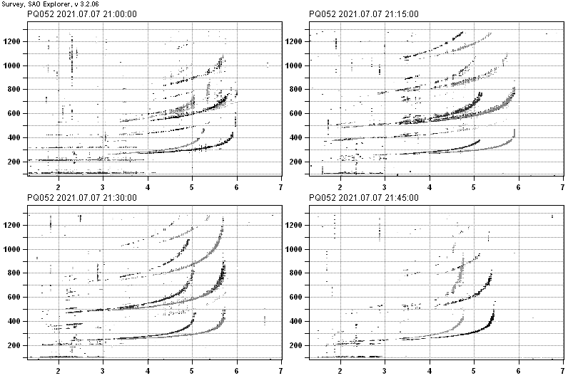
DPS-4D measurements
6 and 7 July - reflection from practically horizontal reflection plane
8 July - Spread F echo es on the ionograms suggests that reflection planes are significantly deformed by propagating waveswith source in the lower-lying atmosphere
6 July 2021
1
8 July 2021
7 July 2021

Slide 10
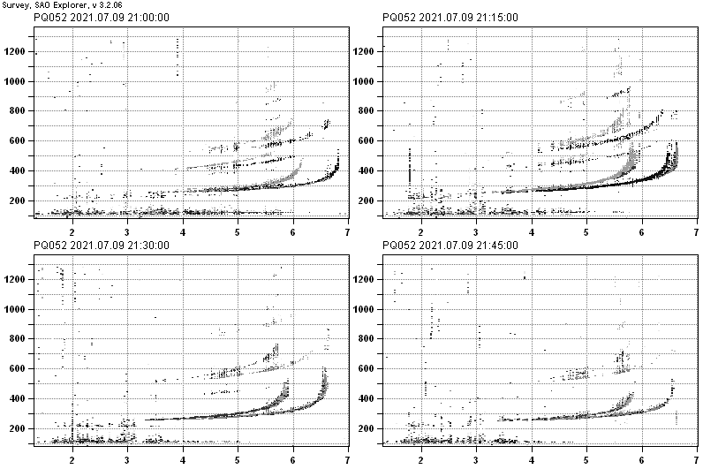
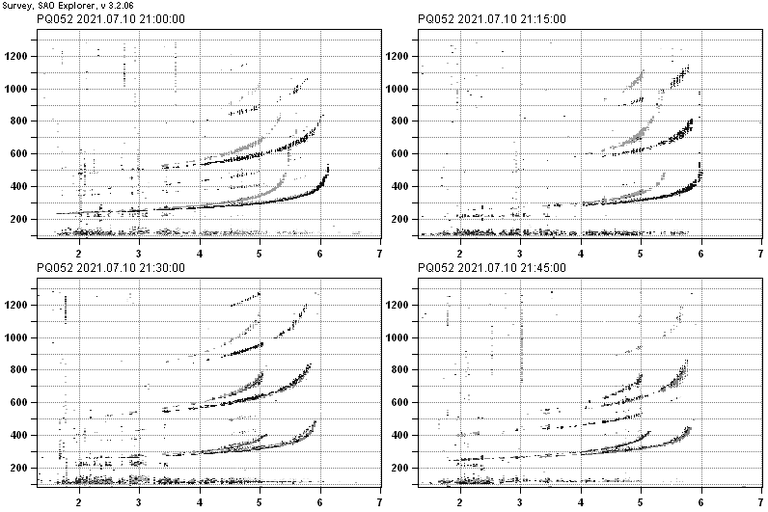
Spread F conditions continue till 9 July, day after the frontal system passage
9 July 2021
8 July 2021
10 July 2021

Slide 11
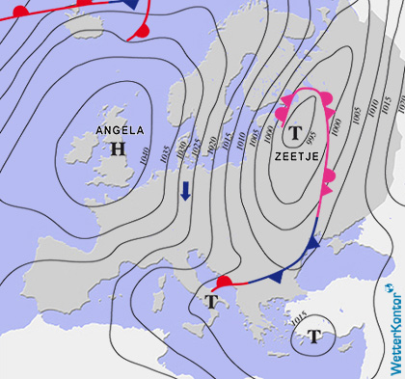
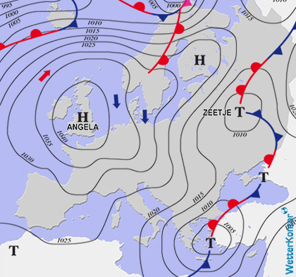
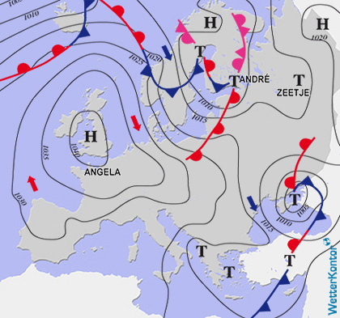
Synoptic patterns of continental scale associated with large vertical shear of wind speed throughout the troposphere.
2B. Winter passage of a warm atmospheric front over Central Europe
Central Europe was located between the anticyclone over the British Isles and the cyclone over Eastern Europe. Cold moist air flowed over the Czech Republic of the North along the pressure level. 4. 1. in the morning, a warm front crossed from the northwest (precipitation, snow in the mountains, temperature increase of 4°C in the Czech Republic).
2 Jan 2019
12:00 UTC
3 Jan 2019
12:00 UTC
4 Jan 2019
12:00 UTC

Slide 12
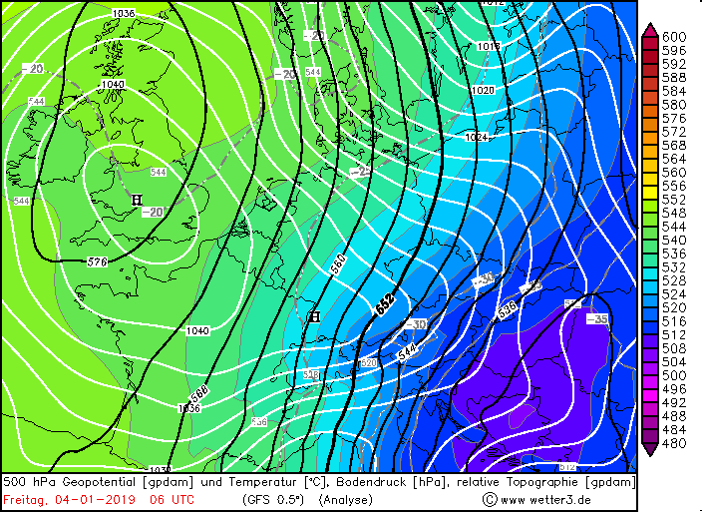
The 500 hPa map (black) shows the main flow regime of the troposphere. (The atmosphere at an altitude about 5.5 km is no longer under the influence of surface friction. In synoptic meteorology 500 hPa map is used to determine the speed and direction of synoptic patterns.) Ventusky.com confirms that the speed of the north-eastern flow over the Czech Rep. is higher than 100 km/h at an altitude of 5.5 km.
Surface level chart (white) shows intense warm advection in the north-west flow over the Czech.
Relative topography of 500-1000 hPa indicates the vertical distance between two fixed pressure levels. (Small vertical distances indicate layers of compressed cool air indicate vertically more massive and warmer layers of air.)
500hPa Geopotential Height
(black line)
Surface Level Pressure
(white line)
Relative Topography H500-H1000 (coloured)
4 Jan 2019 06 UTC

Slide 13
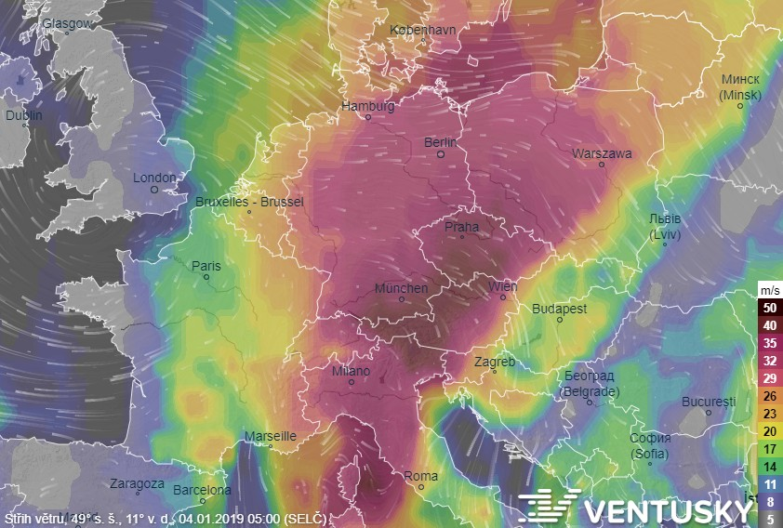
Vertical wind shear – the difference in wind speed between 850 hPa (altitude about 1.5 km) and 200 hPa (altitude about 12 km) is 40 m/s over the Czech Republic.
4 Jan 2019, 04 UTC
Vertical wind shear is an important factor to watch when predicting a storm and possibly a tornado. With a small vertical wind shear, only local thunderstorms are formed from the heat, which quickly expire and disappear. Whereas when the convective air flow is simultaneously carried sideways, convection intensifies with time and the storm cloud grows to the size of a supercell.

Slide 14
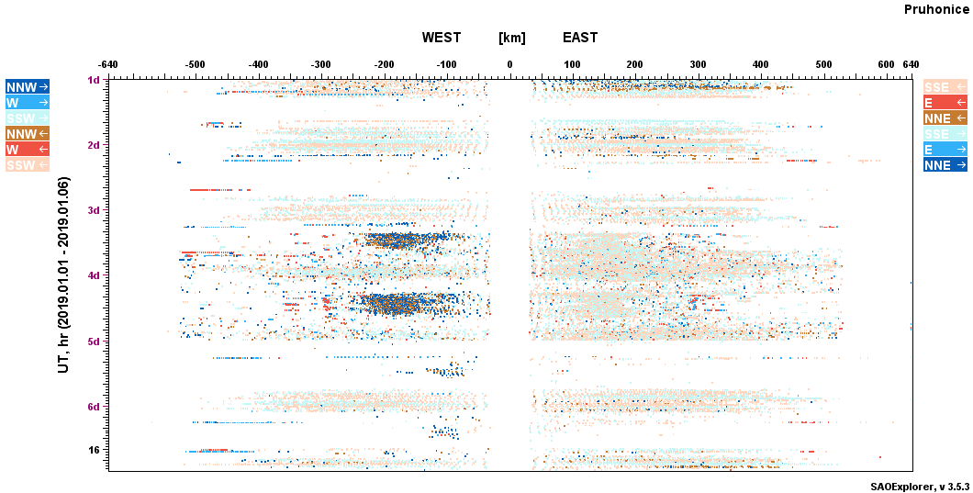
Directograms
3.1.- 4.1. – significant increase of the intensity of the horizontal flow corresponds to the strong horizontal wind shear in the troposphere above the Průhonice station

Slide 15


Conclusions
Further detail classification of tropospheric situations is necessary.
As it seems that not only the lowest part of the tropospehere is enough to considered.
Up to now, we identified more than 40 cases associated with a significant echo detected in the F2 ionospheric layer, which we divided into two types: fast moving meso-synoptical cyclones and synoptic patterns of continental scale.
In our opinion the main synoptic feature leading to the induction of gravity waves that can reach ionospheric heights appears to be the speed of movement of synoptic patterns exceeding 100 km/h. The energy and driving force for the movement of pressure formations is a strong temperature gradient.

