Slide 1
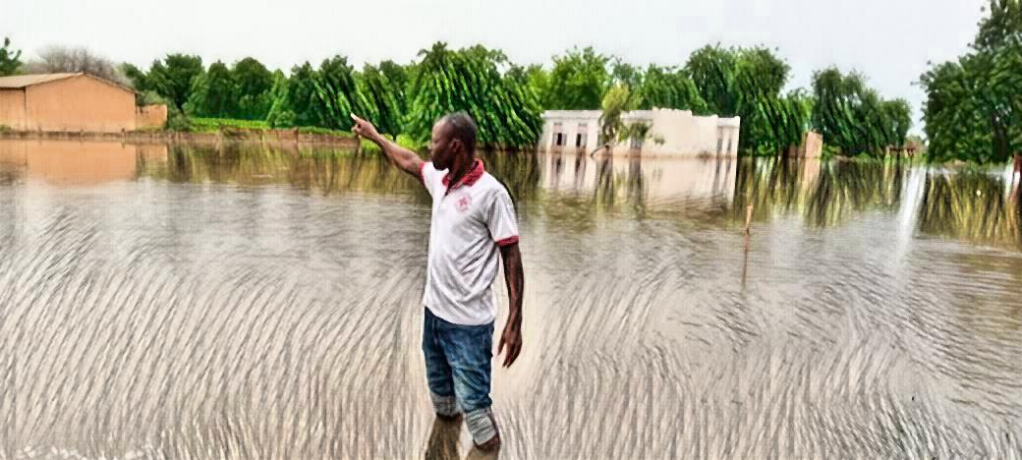






Assessing the riverine flood forecast skill of GloFAS with streamflow observations and impact data: a case study for Mali
Marc van den Homberg, Andrea Ficchi, Phuoc Phung, Sidiky Sangare, Abdouramane Gado Djibo, and Cheikh Kane
EGU 2022

Slide 2



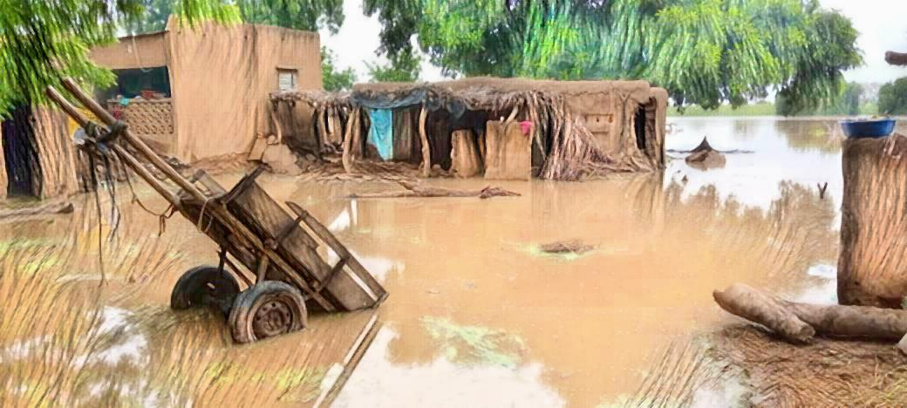
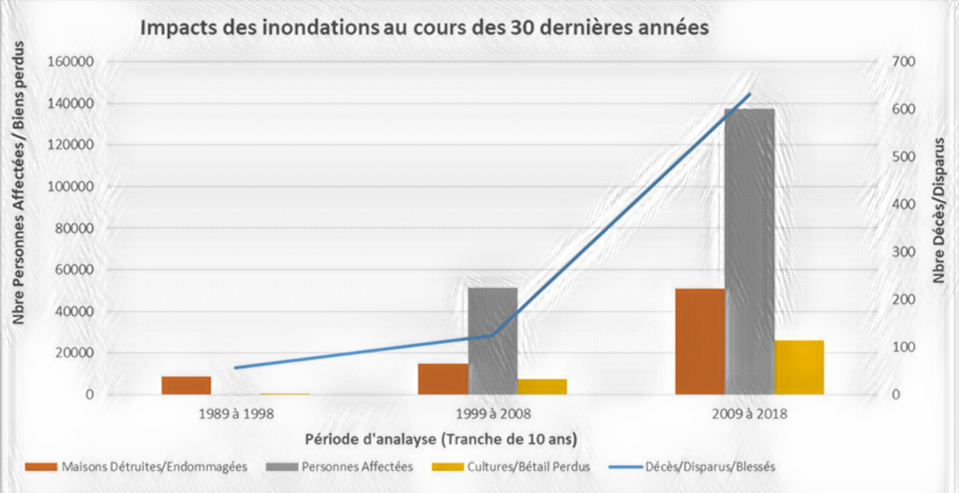
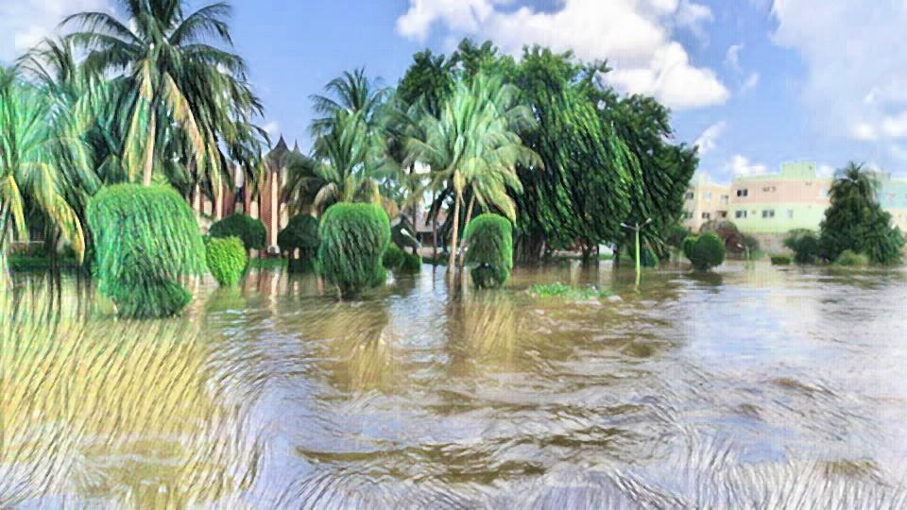
Impact of flooding has increased
Mali Red Cross started in 2017 with a Technical Working Group to develop a flood trigger mechanism for Niger river basin
Early Action Protocol approved in 2020

Slide 3
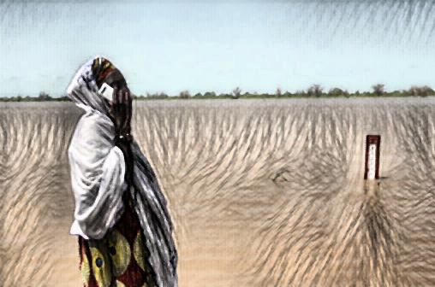
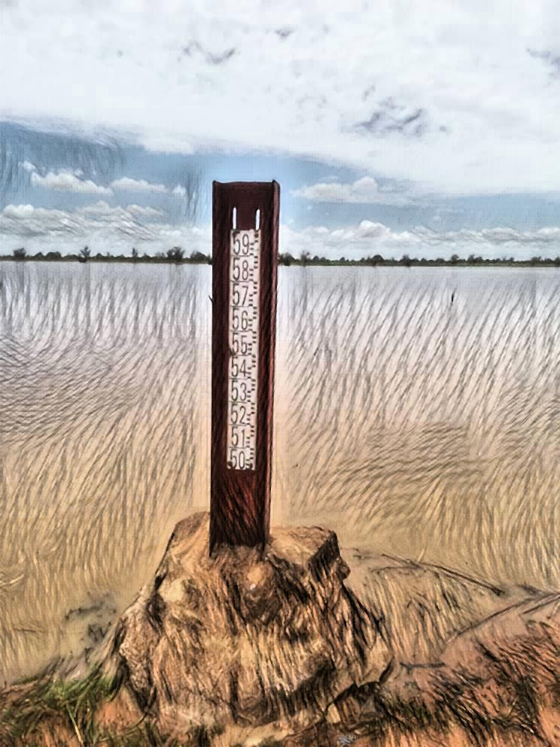

Trigger mechanism in approved Early Action Protocol
Real-time observations from the hydrological monitoring network of National Directorate of Hydraulics (DNH)
Measured twice daily. If observed upstream water level > 5-year return period, actions are triggered to prepare for floods downstream
With a lead time of 4 days, taking into account delays in propagation of the flood

Slide 4
Can we increase the lead time?
Hypothesis
Global flood forecasting systems can possibly complement this local flood monitoring model, especially in large transboundary river basins
Research objective
Assess riverine flood forecast skill of Global Flood Awareness System
Evaluate reforecast data against two reference datasets:
  River flow observations
  Impact data

Slide 5
Reforecast data
GloFAS 3.1 reforecast data freely available from the Copernicus Climate Data Store (CDS)
Long-term run over a 20-year period from January 1999 up to December 2018

Slide 6
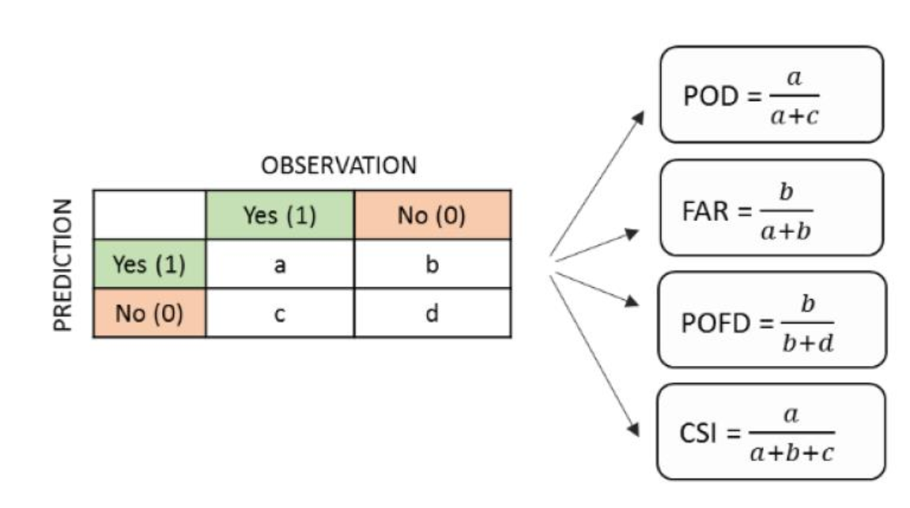
Performance metrics:
Observation (river flow or impact) vs
GloFAS threshold-based prediction
a =Hits events predicted by model and observed
b= False alarms events predicted by model but not observed
c = Misses events observed but not predicted by model
d = Correct negatives events predicted to not occur and also not observed.
Probability of detection (POD) proportion of observed flood events that are correctly modelled (hits) over all hits and misses. Perfect score = 1
False Alarm Ratio (FAR) proportion of false alarms over total of false alarms and misses. Perfect score = 0

Slide 7
Evaluate reforecast data against impact data

Slide 8
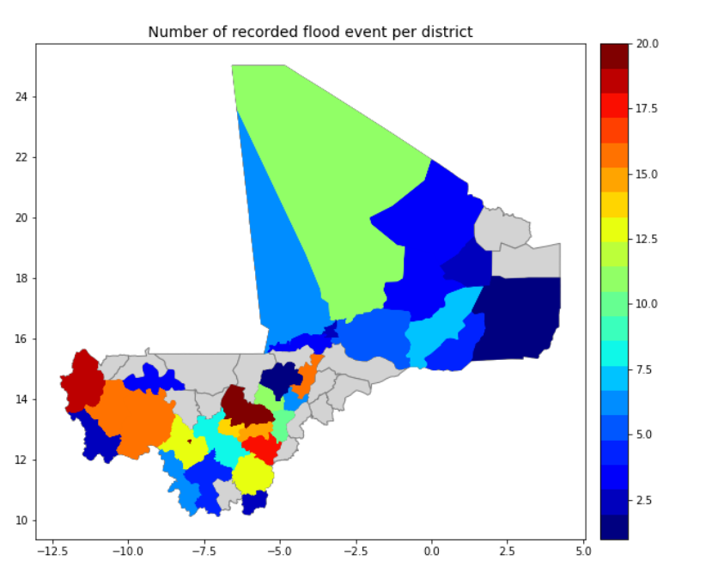
Reference impact dataset per admin-2 (cercle)
Create a blended impact database over 1994-2018
  Desinventar
  EM-DAT
  Direction Générale de la protection civile
  Text mining
With and without deduplication

Slide 9
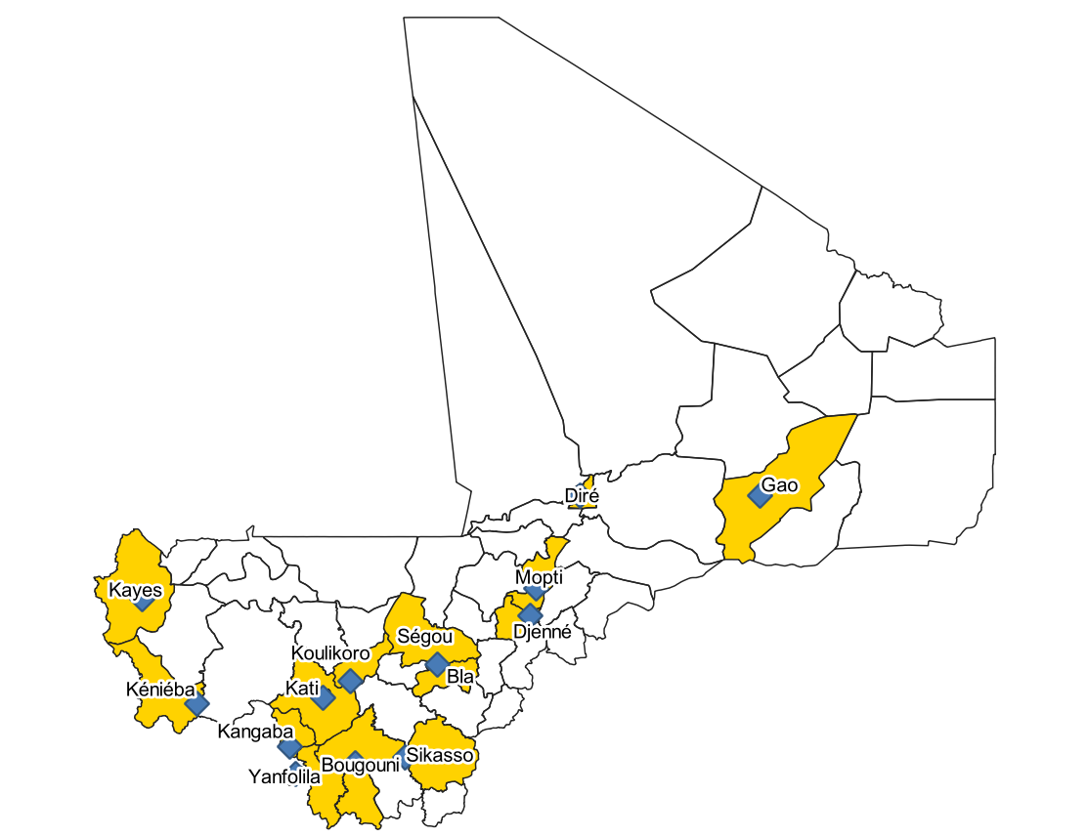
Where to extract Glofas Virtual stations
11 virtual stations of GLOFAS used for analysis (excluding Kayes and Kéniéba stations (in Sénégal Catchment))
Because of their proximity, some stations are linked to more than one district e.g G1001 for Mopti and Djenné
The GloFAS data of 4 days and 7 days lead time have been extracted from all these points

Slide 10
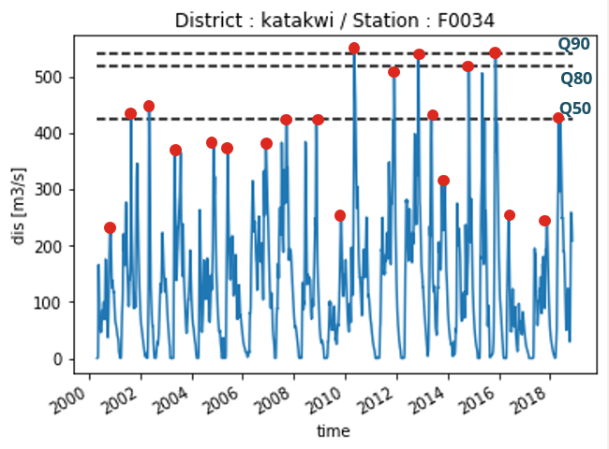
Threshold computation per station
Extreme event analysis
  Yearly daily maximum discharge value extracted
Calculations on yearly maximum discharge
  Q50, Q80, Q90, Q95 quantile
  2, 5, 10, 20 years return period
Notes:
http://stream1.cmatc.cn/pub/comet/HydrologyFlooding/flood/comet/hydro/basic/FloodFrequency/print_version/02-statistical_rep.htm

Slide 11
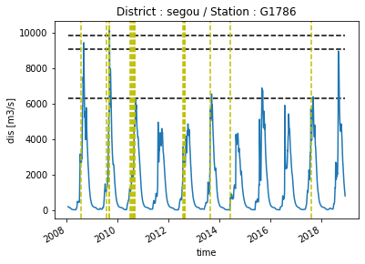
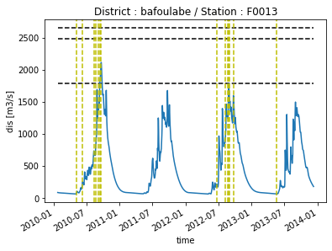
Examples of admin-2 streamflow versus impact graph for two stations

Slide 12
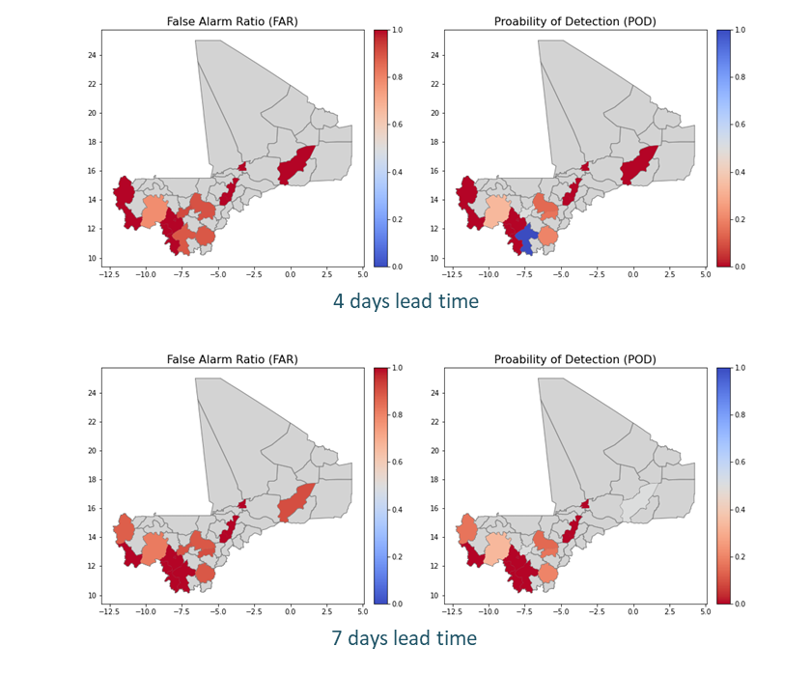
Results reforecast data against impact data
At some stations the POD is good/reasonable, but the FAR is too high
Examples for Q50 threshold

Slide 13
Evaluate reforecast data against observations

Slide 14
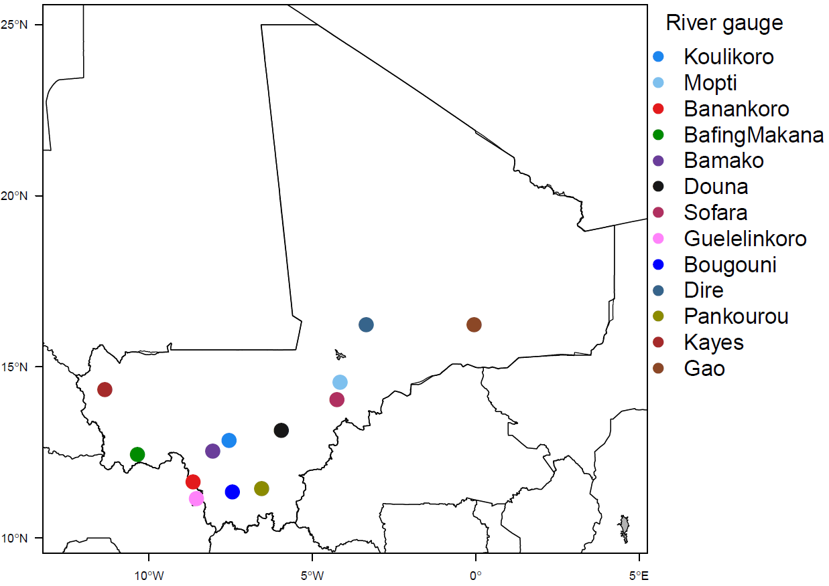
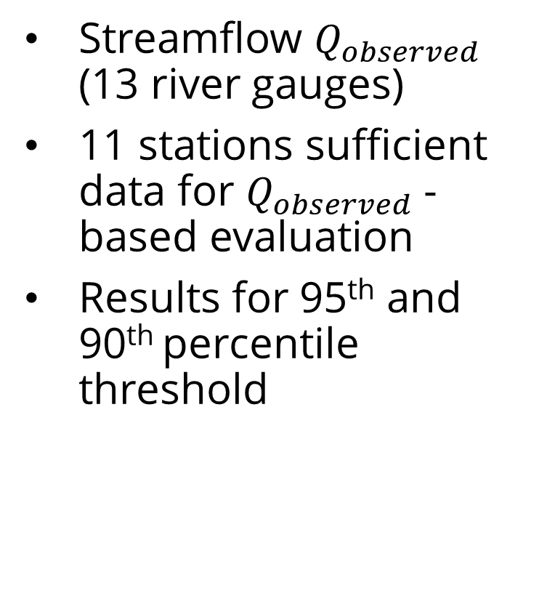
Reference data set: streamflow observations
Streamflow $Q_{observed}$ (13 river gauges)
11 stations sufficient data for $Q_{observed}$-based evaluation
Results for 95th and 90th percentile threshold

Slide 15
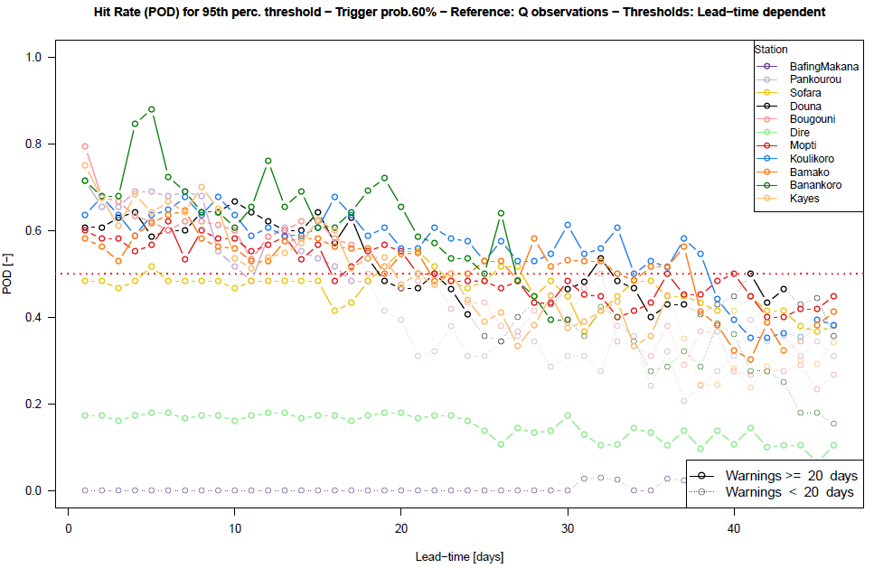
Results reforecast data against observations: POD

Slide 16
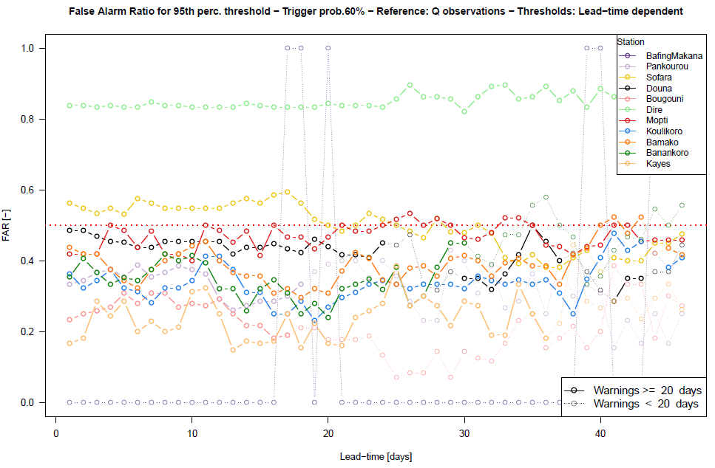
Results reforecast data against observations: FAR

Slide 17
Results reforecast data against observations
Most river gauge stations with enough observations (8 out of 15) show good and robust skill scores for all lead times up to 10 days with FAR<0.5 and POD>0.5 (over a sample of paired observations-forecasts larger than 20 days).
For longer lead times (> 20 days), POD scores decrease for most stations and drop below 0.5 (especially for lead times > 25 days), while FAR scores slightly increase or stay constant at most stations (around 0.4 on average).

Slide 18
Preliminary conclusions
GloFAS has potential to complement existing monitoring system with a four-day lead time
But trigger levels for longer lead times (up to 10 days) can be determined with good forecast skill only for those locations where enough streamflow observation data is available
Using impact data to set triggers is hampered by limitations in current hazard-impact data
  No precise date/time for flood events
  Distinction river vs flash flood difficult
  Different granularity of reporting
  Possibly only high impact-high return period events included?

Slide 19


Resources & contact
  Resources
  Mali EAP floods https://adore.ifrc.org/Download.aspx?FileId=369555
  GAR contributing chapter https://www.preventionweb.net/publication/enriching-impact-data-mining-digital-media
  Code of flood modelling using impact: https://github.com/rodekruis/Flood_impact_models
  Contact information
  mvandenhomberg@redcross.nl

Slide 20


