Slide 1
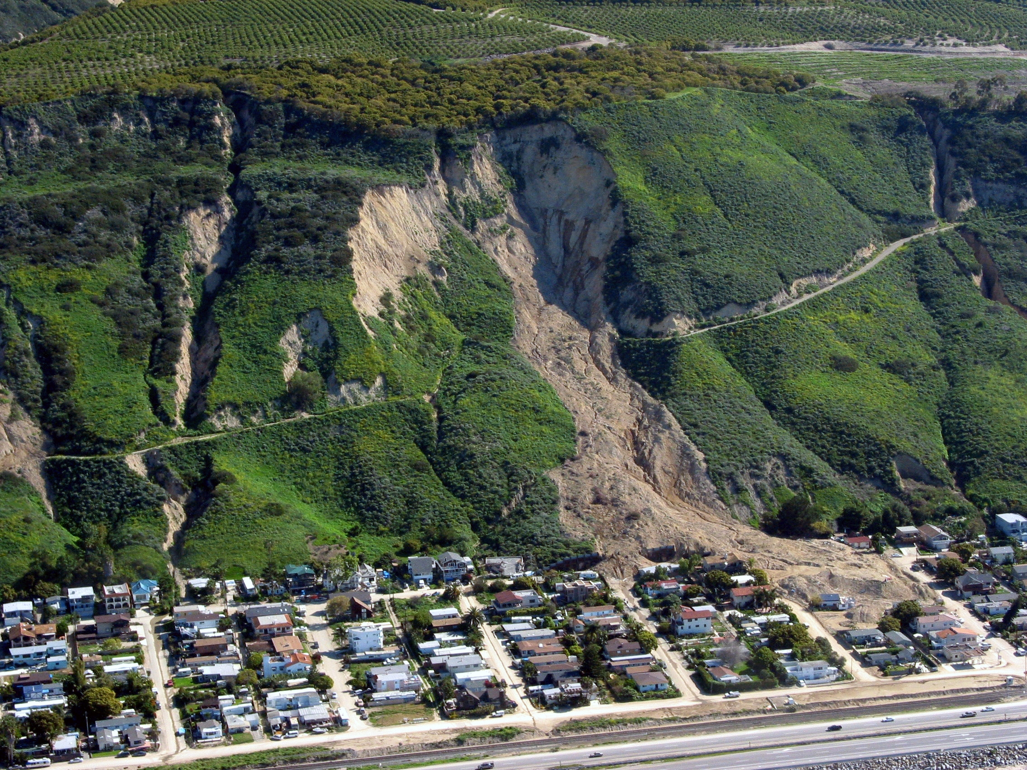

23–27 May 2022
www.weatherwizkids.com
Landslide susceptibility mapping by using various selection strategies of landslide conditioning factors and XGBoost
Tymon Lewandowski, Kamila Pawłuszek-Filipiak

Slide 2
Agenda
Study areas
Data
Methodology
Feature selection
Model training
Results
Conclusions

Slide 3
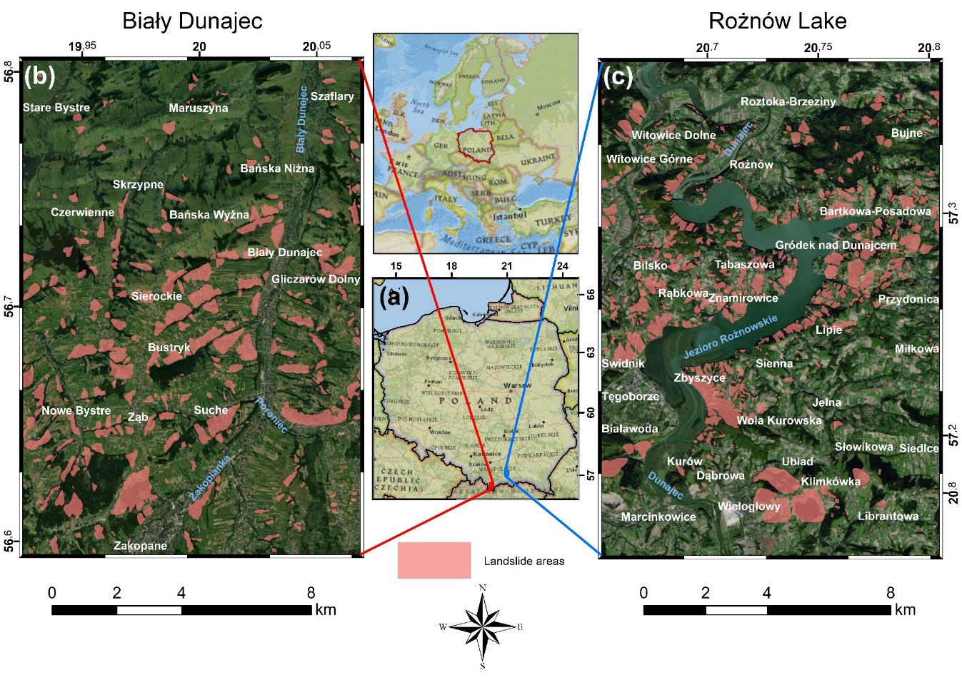
Study areas
Biały Dunajec:
- Area 156 km²
Landslide area 19.7 km²
Rożnów:
- Area 149 km²
Landslide area 20.9 km²

Slide 4
Source Data
ISOK
Digital Elevation Model
Geological Maps
PGI
MIIP
Agricultural Maps
Satellite Images
Sentinel-2
IMGW
Precipitation
Road and river network
OSM

Slide 5
Landlisde Conditioning Factors
Digital Elevation Model
Geological Maps
Road and river network
Aspect
Tectonics
Roads proximity
Slope
Fault proximity
River proximity
Flow direction
Thrust proximity
Curvature
Agricultural maps
Satellite images
Planar curvature
Profile curvature
Soil suitability
Land Cover
CTI
Soil texture
NDVI
TPI
Soil type
SEI
IMI
Precipitations
Stream proximity

Slide 6
Methodology
SOPO
LCF
Train test split
70/30
Feature Selection
Model training
Hyperparameters optimalization
Model evaluation

Slide 7

Methodology
SOPO
LCF
Train test split
70/30
Which landlisde
conditioning factors
should be applied to
susceptibility model?
Feature Selection
ANOVA
Pearson
SU
Model training
Hyperparameters optimalization
Model evaluation

Slide 8
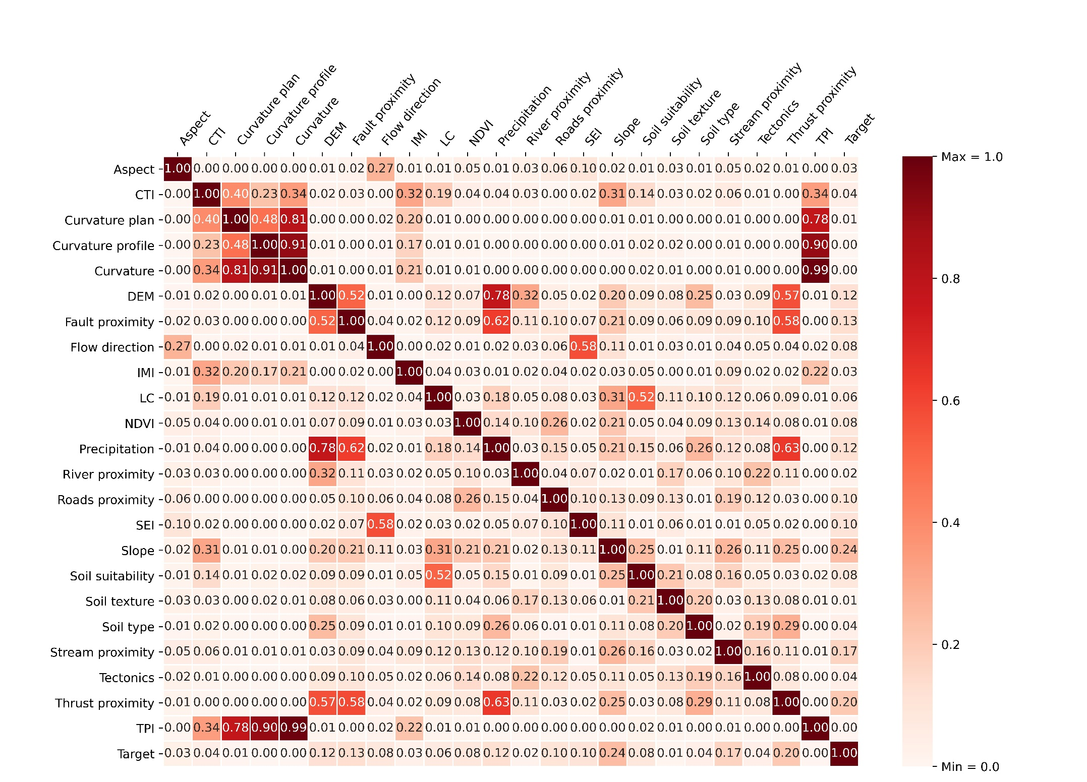
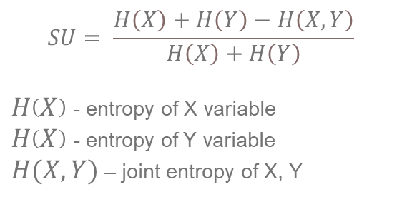
Feature selection
Methods:
Pearson Correlation Coefficient
(Wang et al. 2021)
Analysis of variance (ANOVA)
(Gunarathna et al. 2018)
Symmetrical Uncertainty (SU)
(Sahin 2020)
$$SU= \frac{H\left(X\right)+H\left(Y\right)−H\left(X,Y\right)}{H\left(X\right)+H\left(Y\right)}$$
$H\left(X\right)$ - entropy of X variable
$H\left(X\right)$ - entropy of Y variable
$H(X,Y)$ – joint entropy of X, Y

Slide 9
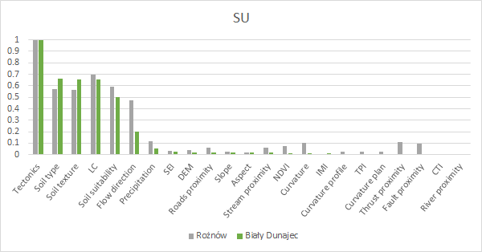
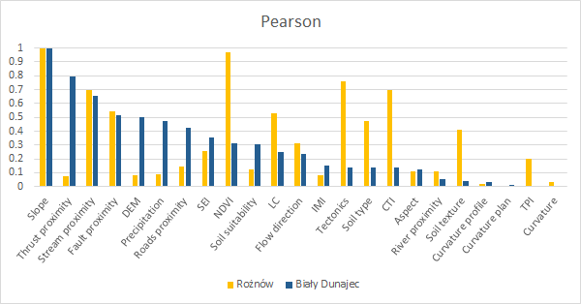
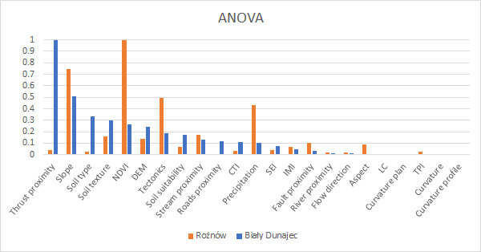
Biały Dunajec
Rożnów
Rejected LCF:
Pearson: Curvature, Curvature plan, Curvature profile, River proximity, Soil texture, TPI
ANOVA: Aspect, Curvature, Curvature plan, Curvature profile, Flow direction, LC, Main geological units, River proximity, TPI
SU: CTI, Curvature, Curvature plan, DEM, Fault proximity, IMI, River proximity, Thrust proximity, TPI
Rejected LCF:
Pearson: Curvature, Curvature plan, Curvature profile
ANOVA: Curvature profile, DEM, Curvature, Curvature plan, Precipitation, Roads proximity
SU: River proximity, CTI, IMI

Slide 10
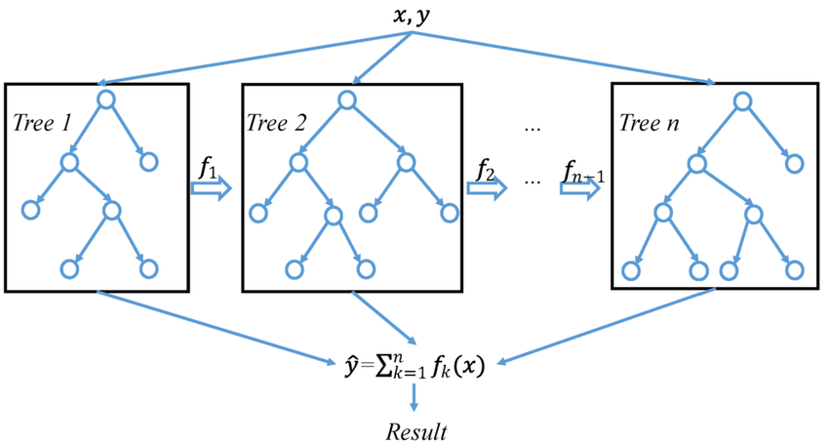
Model training
Decision Trees
Ensemble learning
Gradient Boosting
Regularization
Wang, Yuanchao & Pan, Z. & Zheng, J. & Qian, L. & Mingtao, Li. (2019). A hybrid ensemble method for pulsar candidate classification.
Applied in:
Can R, Kocaman S, Gokceoglu C (2021) A comprehensive assessment of XGBoost algorithm for landslide susceptibility mapping in the upper basin of Ataturk dam, Turkey
Pradhan AMS, Kim YT (2020) Rainfall-induced shallow landslide susceptibility mapping at two adjacent catchments using advanced machine learning algorithms
Sahin EK (2020) Assessing the predictive capability of ensemble tree methods for landslide susceptibility mapping using XGBoost, gradient boosting machine, and random forest.
Wang S, Zhuang J, Zheng J, et al (2021) Application of Bayesian Hyperparameter Optimized Random Forest and XGBoost Model for Landslide Susceptibility Mapping.

Slide 11
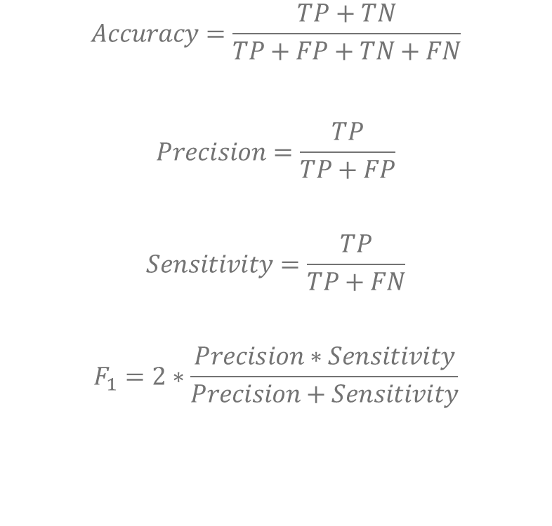
Evaluation
Predicted value
$$Accuracy=\frac{TP+TN}{TP+FP+TN+FN}$$
$$Precision=\frac{TP}{TP+FP}$$
$$Sensitivity=\frac{TP}{TP+FN}$$
$$F_{1}=2∗\frac{Precision∗Sensitivity}{Precision+Sensitivity}$$
TRUE POSITIVE
FALSE NEGATIVE
Actual value
FALSE POSITIVE
TRUE NEGATIVE

Slide 12
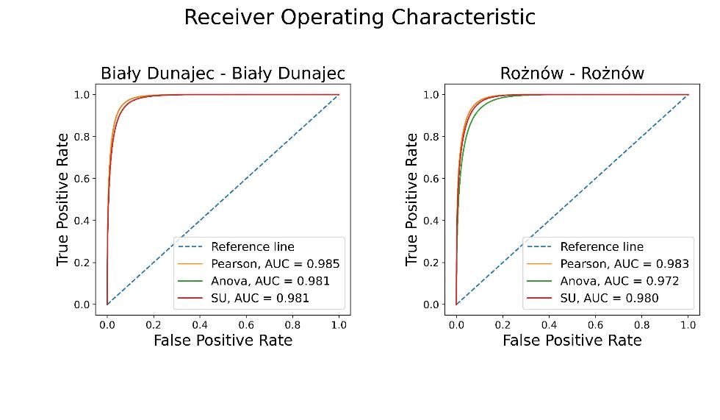
Results
 | Biały Dunajec |  |  | Rożnów
Measure | Pearson_{BD} [%] | ANOVA_{BD} [%] | SU_{BD} [%] | Pearson_{R} [%] | ANOVA_{R} [%] | SU_{R} [%]
ACCURACY | 93.2 | 92.9 | 90.3 | 93.1 | 91.0 | 92.6
PRECISION | 66.0 | 64.7 | 56.8 | 68.7 | 62.0 | 67.0
SENSITIVITY | 93.0 | 93.0 | 89.4 | 94.1 | 92.1 | 93.3
F1 | 77.2 | 76.3 | 69.5 | 79.4 | 74.1 | 78.0

Slide 13
Conclusions
Landslide suceptibility modeling using machine learning allows to achieve model accuracy of 93.1% with precision of 68.7% and recall of 94.1%
Achieved results are similar to those presented by other reaserchers
Right choice of landslide conditioning factors allows to achieve similar results for landslide susceptibility modelling for two distinct study areas
Feature selection method does not have greater impact in susceptibility modelling considering used landslide conditioning factors in this work
Pearson correlation coefficient allowed to achieve best results for both study areas

Slide 14
References
Can R, Kocaman S, Gokceoglu C (2021) A comprehensive assessment of XGBoost algorithm for landslide susceptibility mapping in the upper basin of Ataturk dam, Turkey. Appl Sci 11:. https://doi.org/10.3390/app11114993
Gunarathna BWGID, Jayasinghe AB, Abenayake CC, Mahanama PKS (2018) Assessing the impact of land use on triggering landslides: A case of Sabaragamuwa Province, Sri Lanka. Bhumi, Plan Res J 6:15. https://doi.org/10.4038/bhumi.v6i2.42
Pradhan AMS, Kim YT (2020) Rainfall-induced shallow landslide susceptibility mapping at two adjacent catchments using advanced machine learning algorithms. ISPRS Int J Geo-Information 9:. https://doi.org/10.3390/ijgi9100569
Sahin EK (2020) Assessing the predictive capability of ensemble tree methods for landslide susceptibility mapping using XGBoost, gradient boosting machine, and random forest. SN Appl Sci 2:1–17. https://doi.org/10.1007/s42452-020-3060-1
Wang S, Zhuang J, Zheng J, et al (2021) Application of Bayesian Hyperparameter Optimized Random Forest and XGBoost Model for Landslide Susceptibility Mapping. Front Earth Sci 9:. https://doi.org/10.3389/feart.2021.712240

Slide 15
Thank you for your attention

