Slide 1

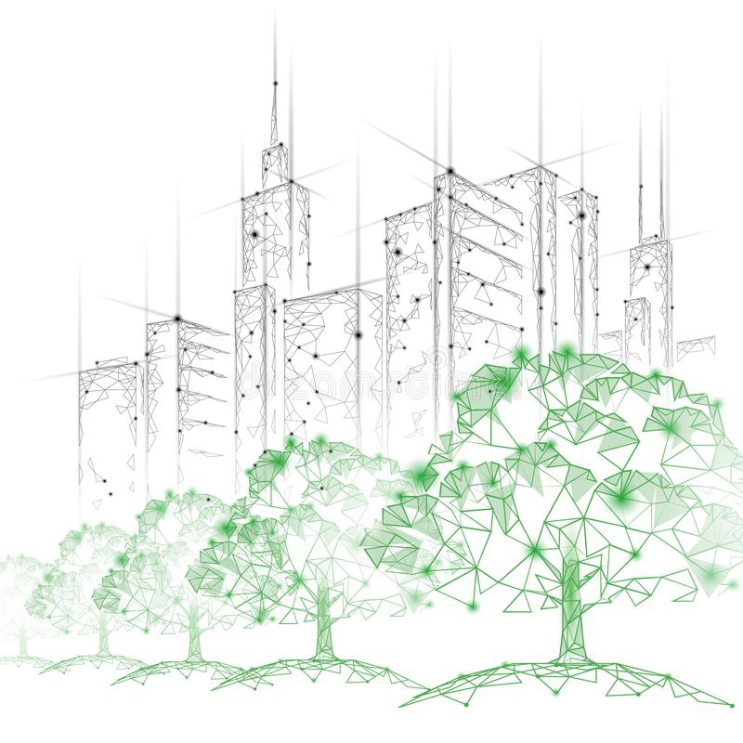




Turbulent transfer and concentration statistics in a street canyon with tree planting
Sofia Fellini
Annika Vittoria Del Ponte, Marilina Barulli, Luca Ridolfi, Lionel Soulhac, Massimo Marro, and Pietro Salizzoni
sofia.fellini@ec-lyon.fr
https://www.researchgate.net/profile/Sofia-Fellini

Slide 2
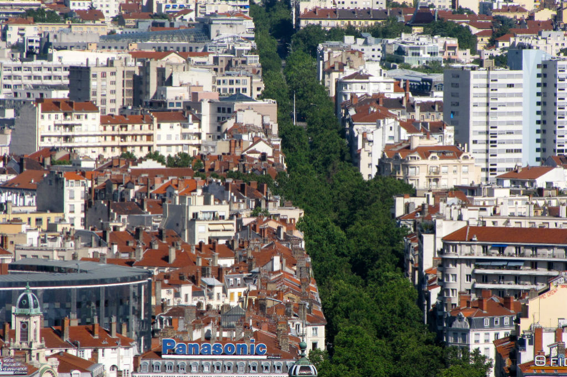


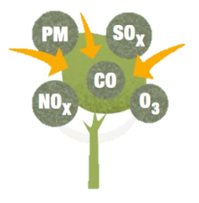

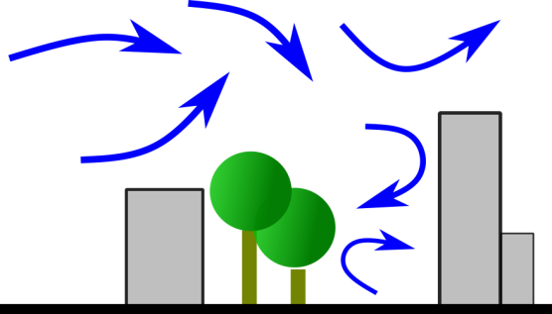
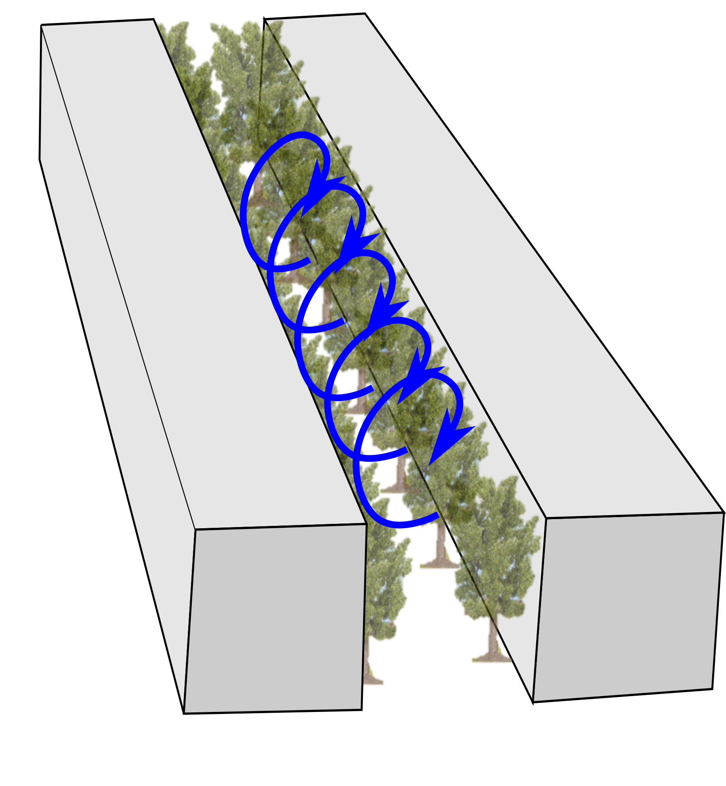
Boulevard in Paris © K.G.Hawes
Tree planting in urban areas
Temperature regulation
Filters for pollutant particles
Regulate water flow
Physical and mental health
Urban biodiversity
What about the aerodynamic effect?
Turbulent transfer and concentration statistics in a street canyon with tree planting
Sofia Fellini (DIATI and LMFA)
Sofia Fellini
Notes:
Transport and mixing processes in the urban environment are characterized
168 by complex uid structures due to the interaction between the atmospheric
169 ow and the city. The presence of buildings and vegetation highly aects the
170 structure of the urban boundary layer, characterized by the generation of a
171 shear layer at the top of the canopy, wake diusion behind buildings, and form
172 drag due to the pressure dierences across the roughness elements (Roth, 2000).
173 Moreover, the ow eld in the streets is altered by the advectiveconvective uxes
174 due to the dierential solar irradiance on building walls and to the heat sources
175 related to human activities

Slide 3
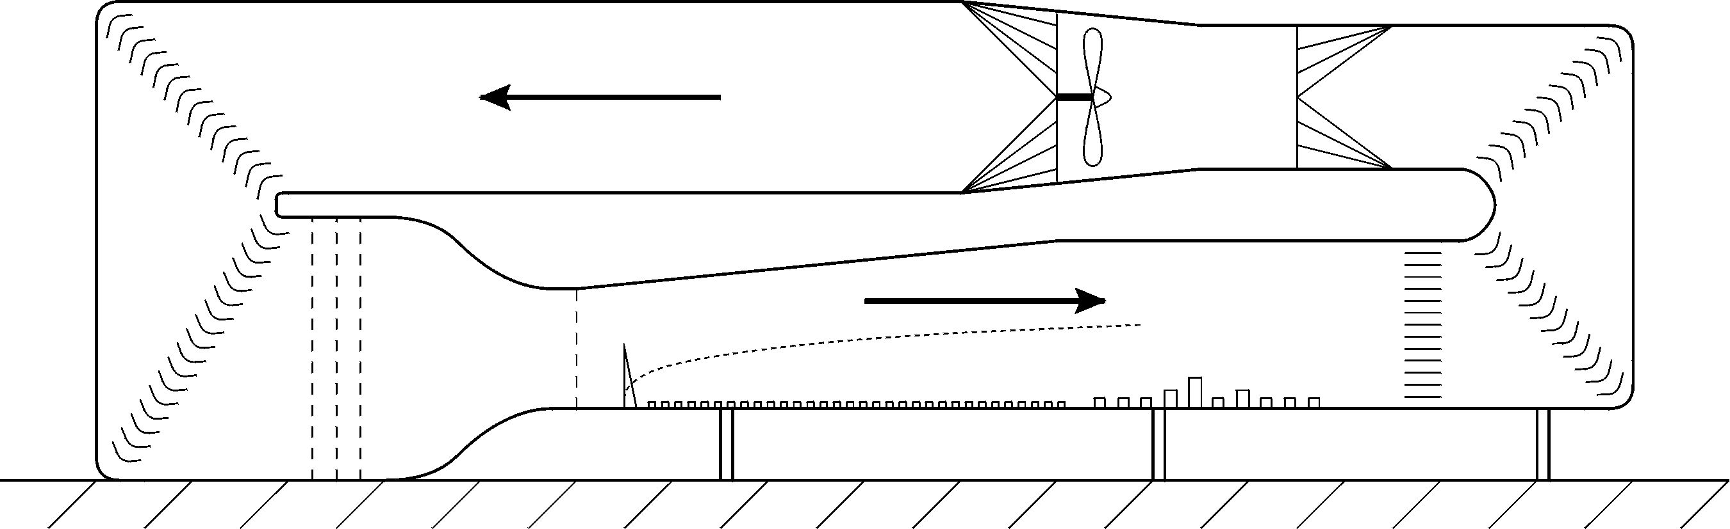

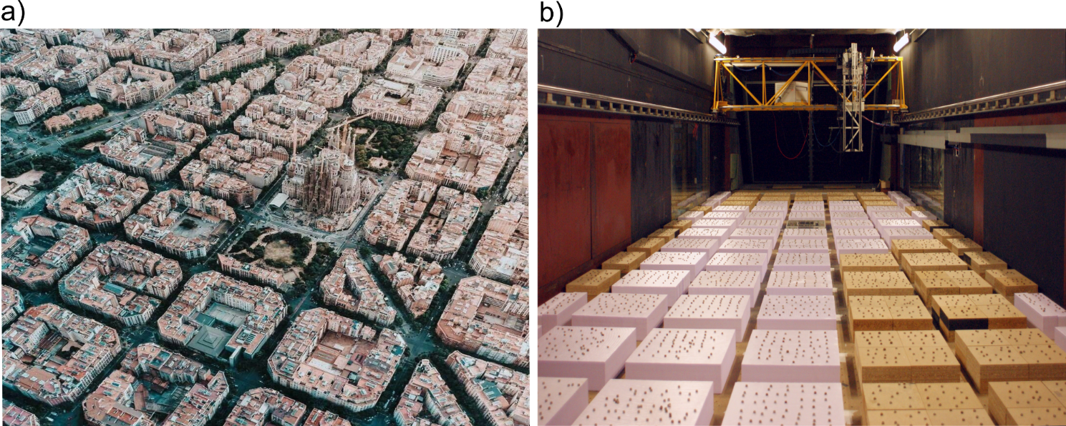
The experimental setup
Realistic interaction between turbulent flow and urban canopy
Separation between the flow within and above the canopy
Turbulent transfer and concentration statistics in a street canyon with tree planting
Sofia Fellini (DIATI and LMFA)
Sofia Fellini

Slide 4
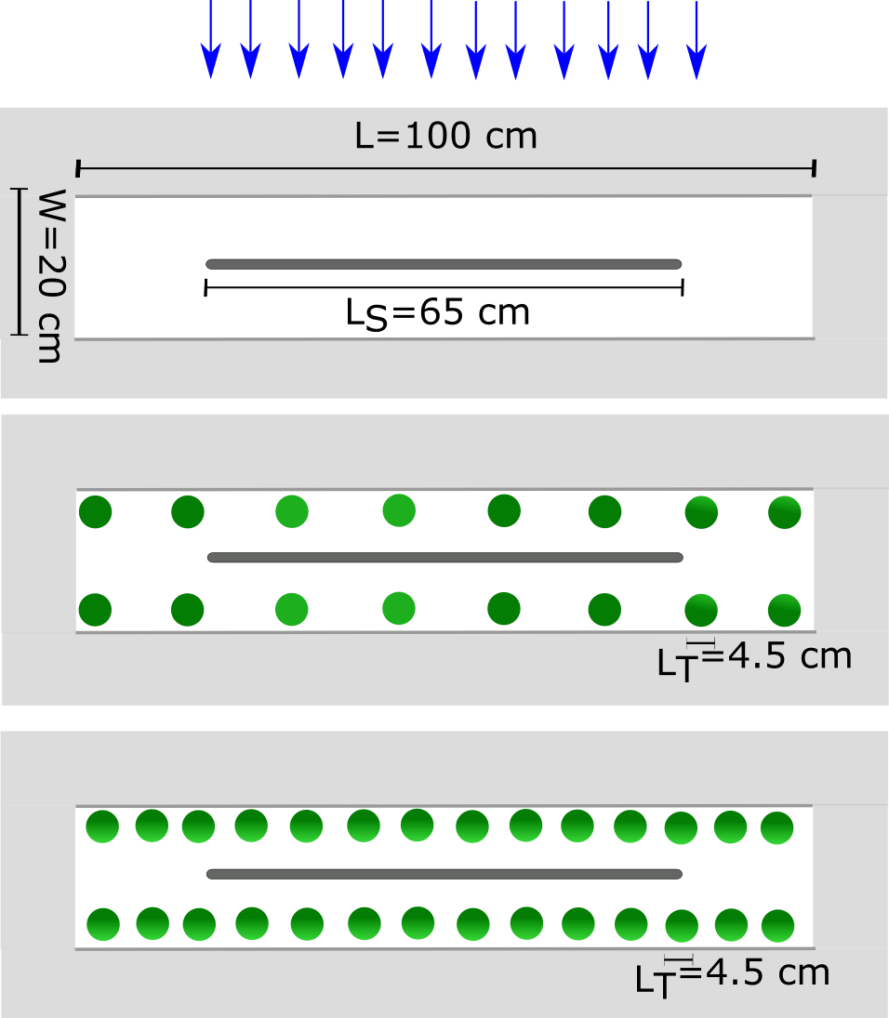
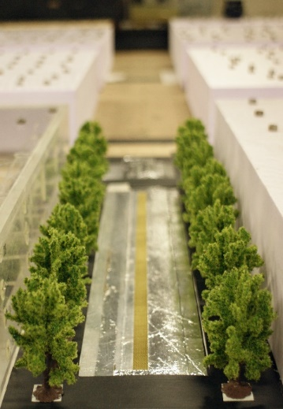
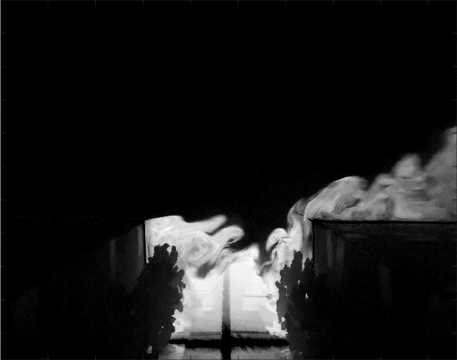
The experimental setup
Scale 1:200
Large street canyon with height 10 cm, width 20 cm, length 50 cm (H/W=0.5)
Two lateral rows of trees, with space between 14 cm and space from the buildings 3 cm
Linear source at street level emitting Ethane as passive scalar
Sofia Fellini (DIATI and LMFA)
Turbulent transfer and concentration statistics in a street canyon with tree planting
Sofia Fellini (DIATI and LMFA)
Sofia Fellini

Slide 5
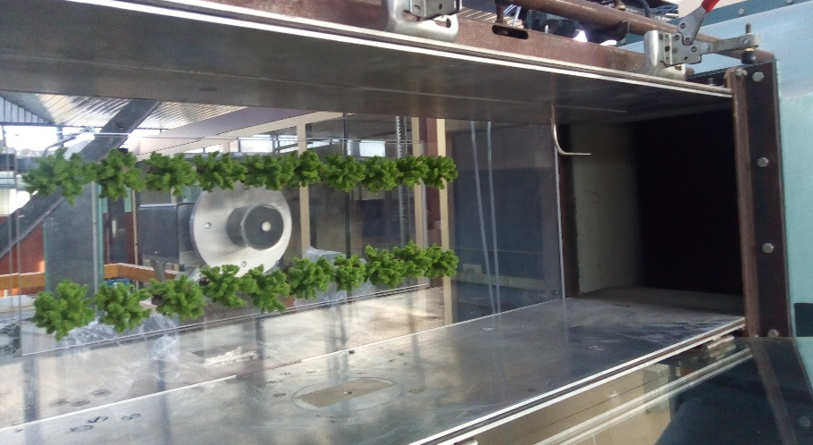
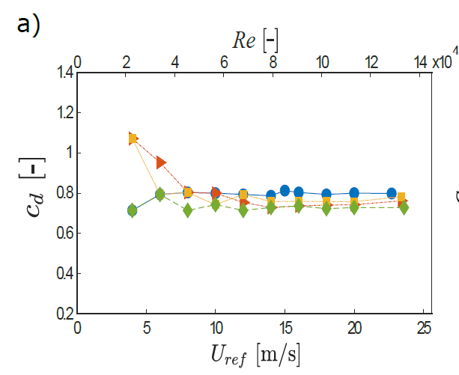
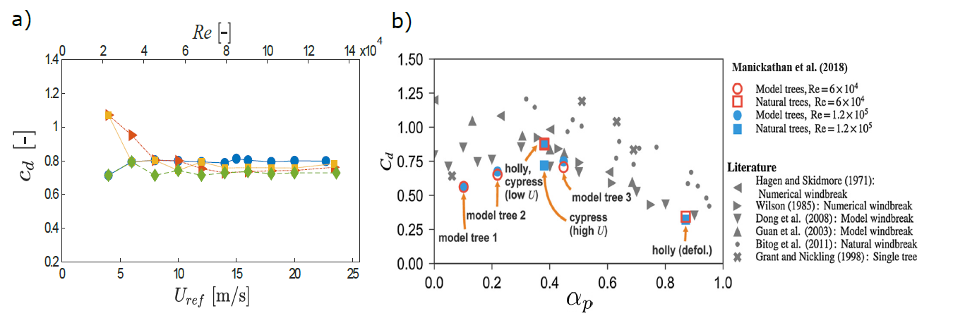
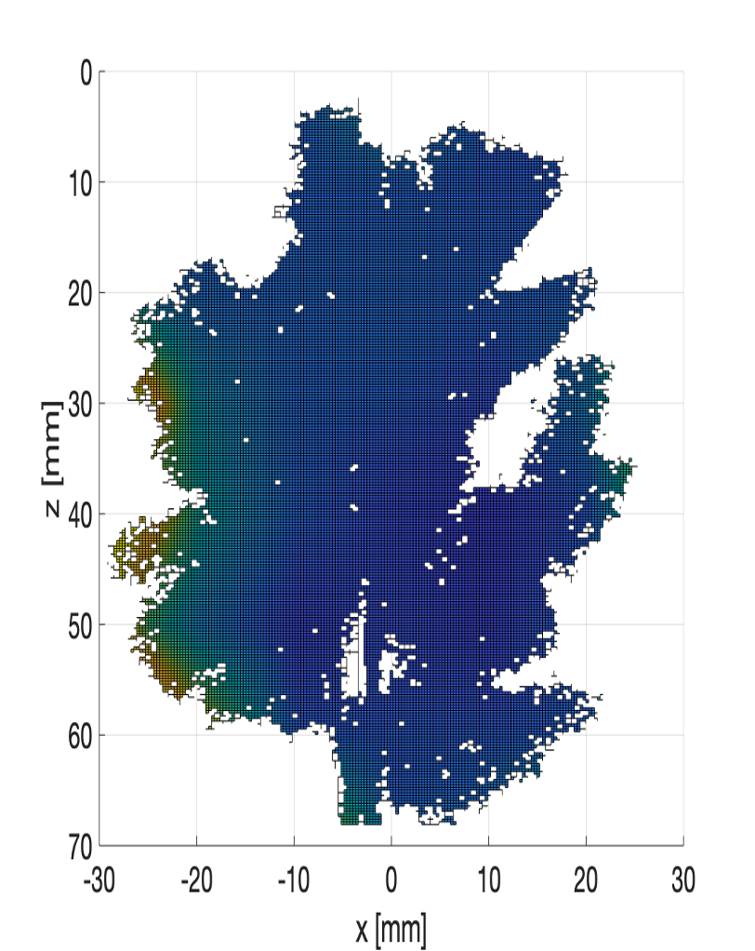
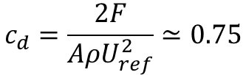
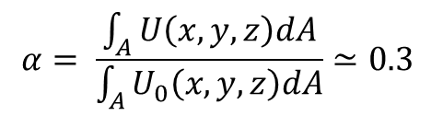
Characterization of model trees
DRAG COEFFICIENT
$$c_{d}=\frac{2F}{AρU_{ref}^{2}}≃0.75$$
AERODYNAMIC POROSITY
$$α= \frac{\int_{A}{U\left(x,y,z\right)dA}}{\int_{A}{U_{0}\left(x,y,z\right)dA}}≃0.3$$
Turbulent transfer and concentration statistics in a street canyon with tree planting
Sofia Fellini (DIATI and LMFA)
Sofia Fellini

Slide 6
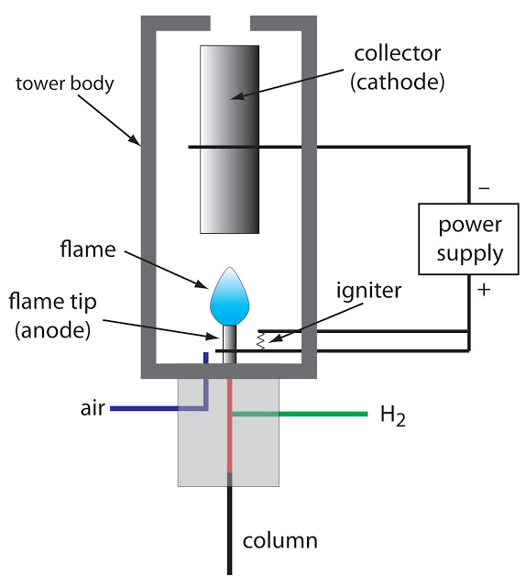
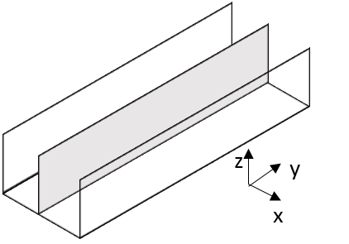
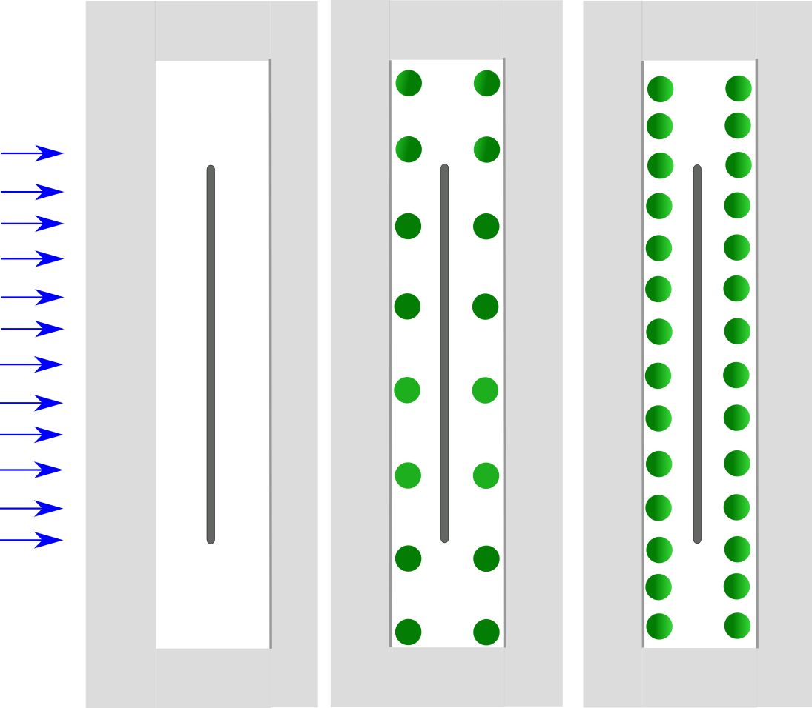
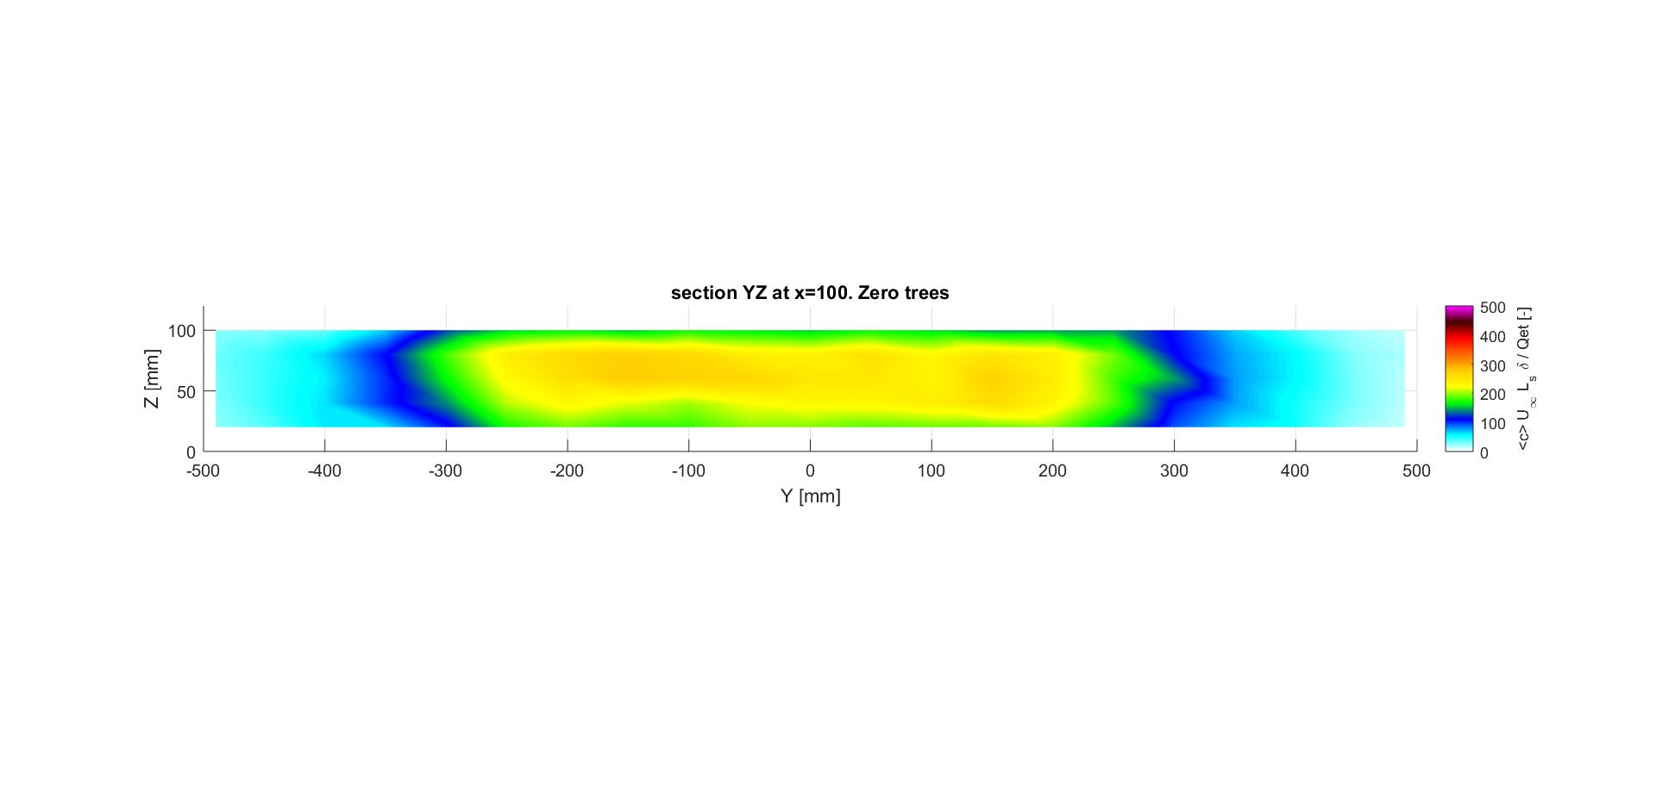
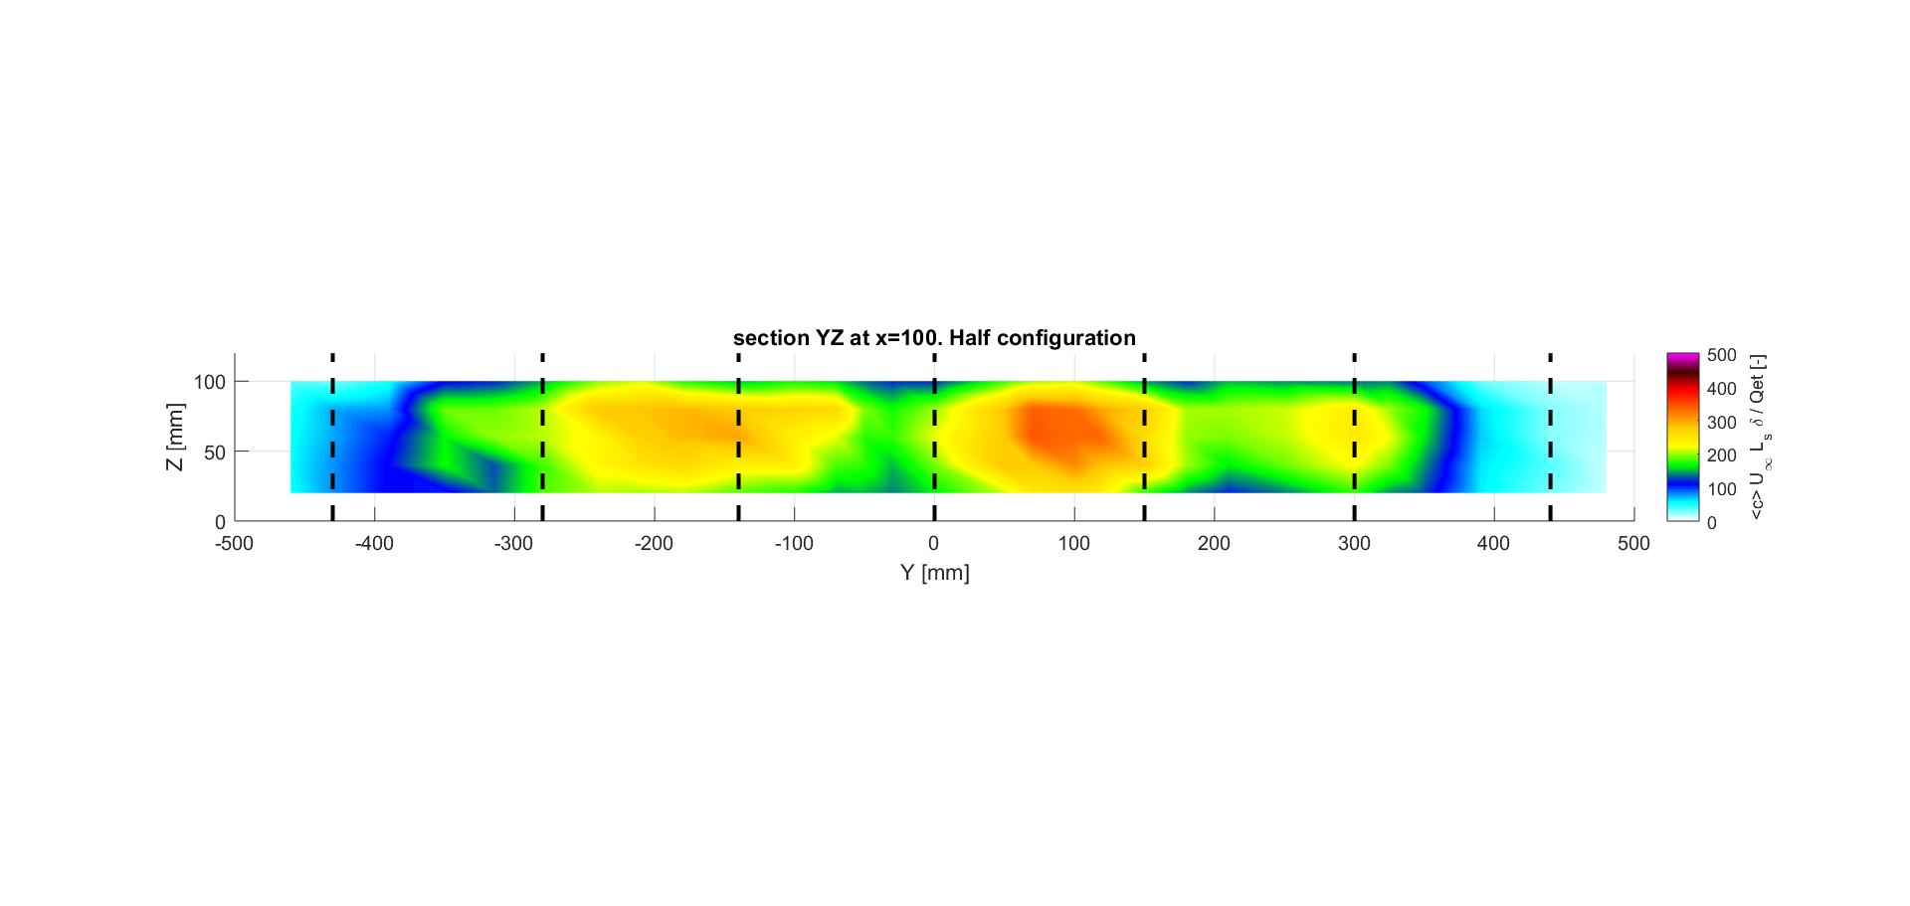
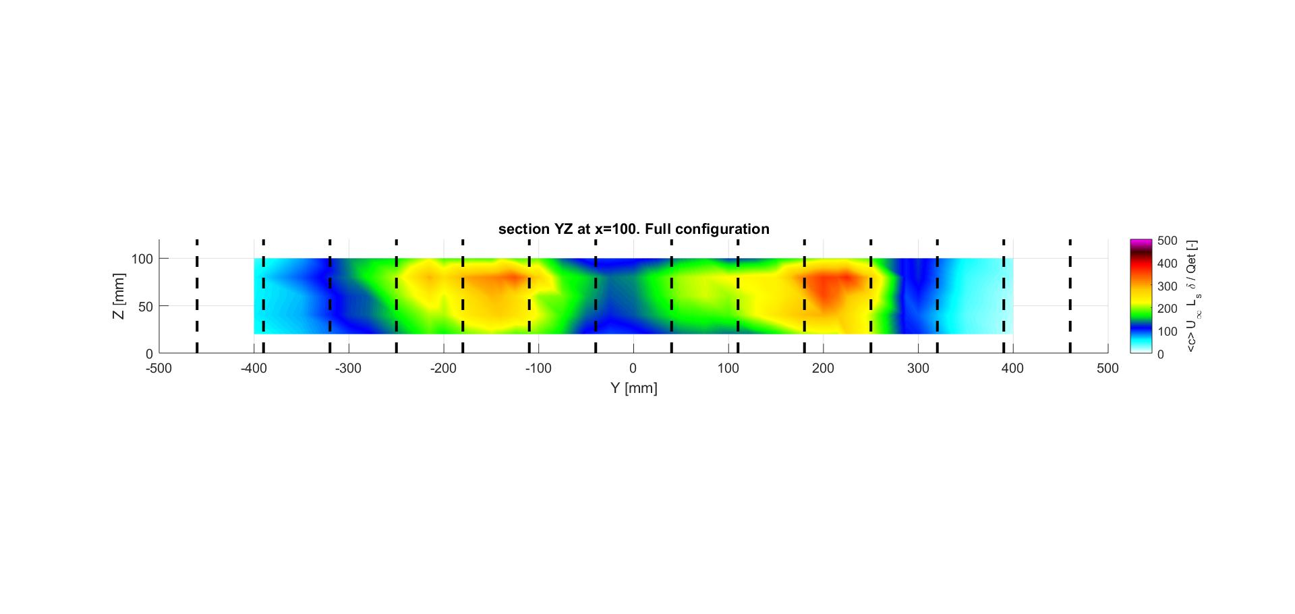

Flame Ionization Detector (FID)
Mean concentration field
$C^{∗}=\frac{{Cu}_{∞}L_{s}δ}{Q_{et}}$
500
400
300
200
100
0
Turbulent transfer and concentration statistics in a street canyon with tree planting
Sofia Fellini (DIATI and LMFA)
Sofia Fellini

Slide 7
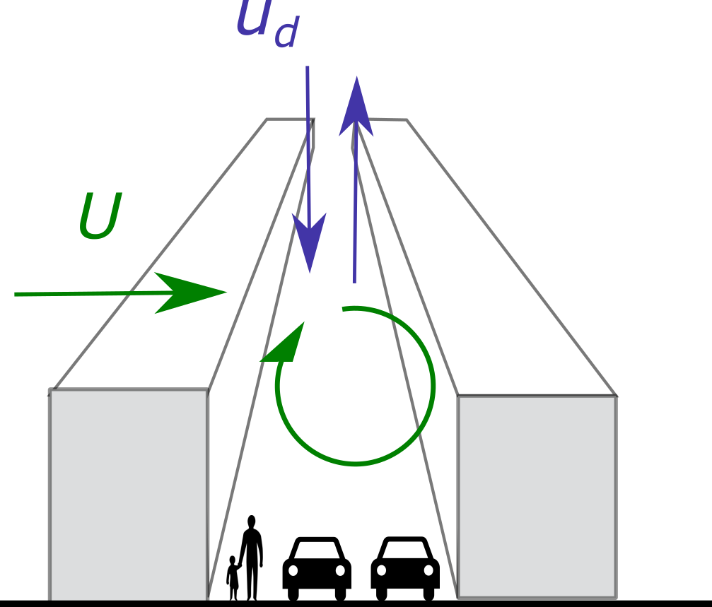
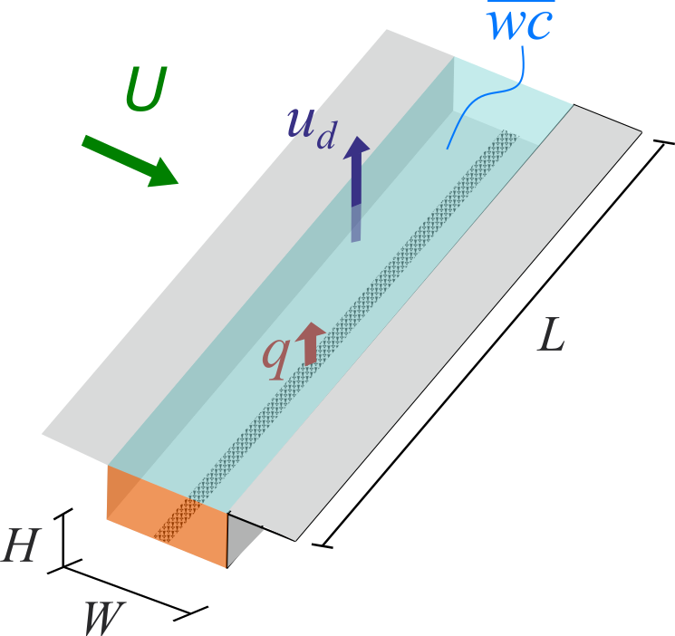
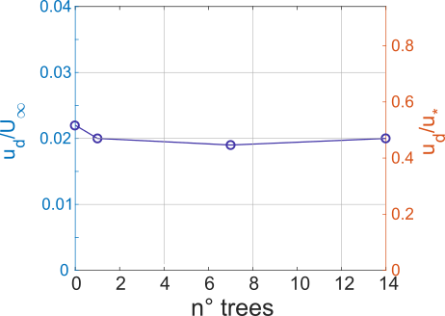

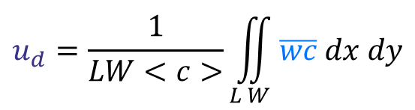
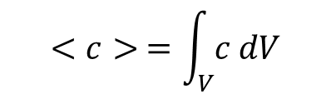
The ventilation efficiency
$$u_{d}=\frac{1}{LW<c>}\iint_{L W}{\overline{wc} dx dy}$$
$$q=u_{d}LW<c>$$
$$<c> =\int_{V}{c dV}$$
Turbulent transfer and concentration statistics in a street canyon with tree planting
Sofia Fellini (DIATI and LMFA)
Sofia Fellini

Slide 8
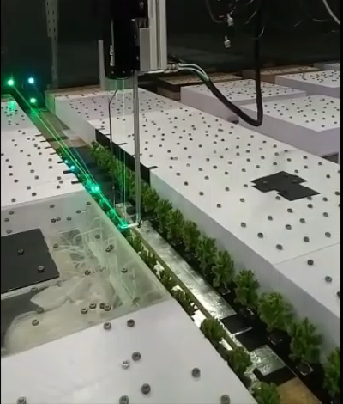
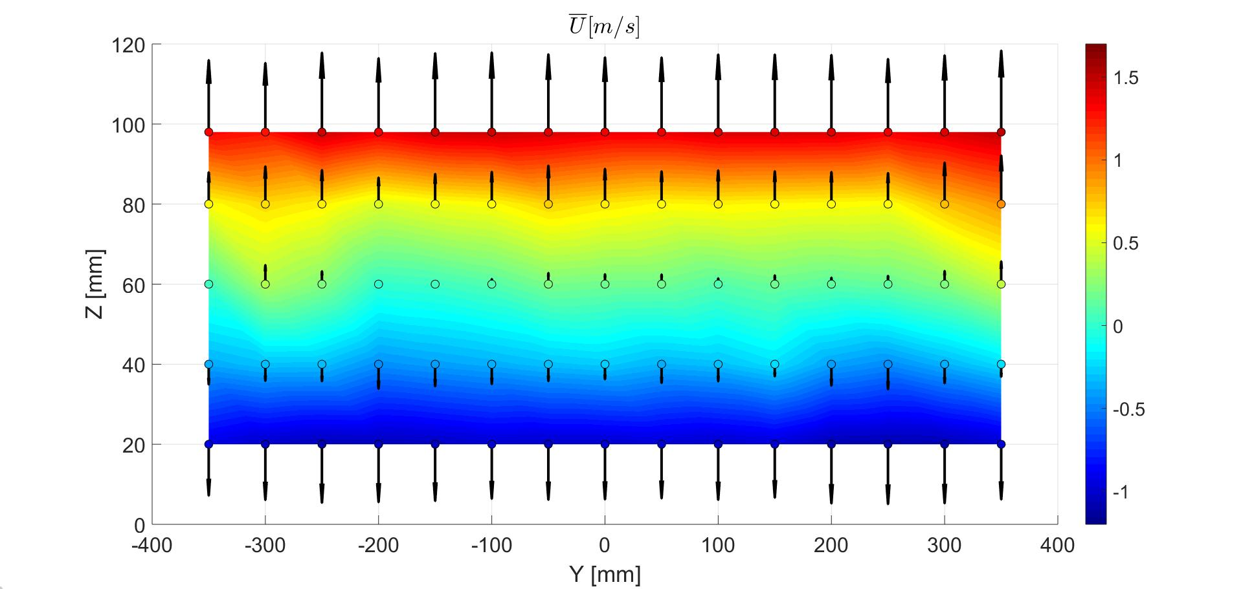
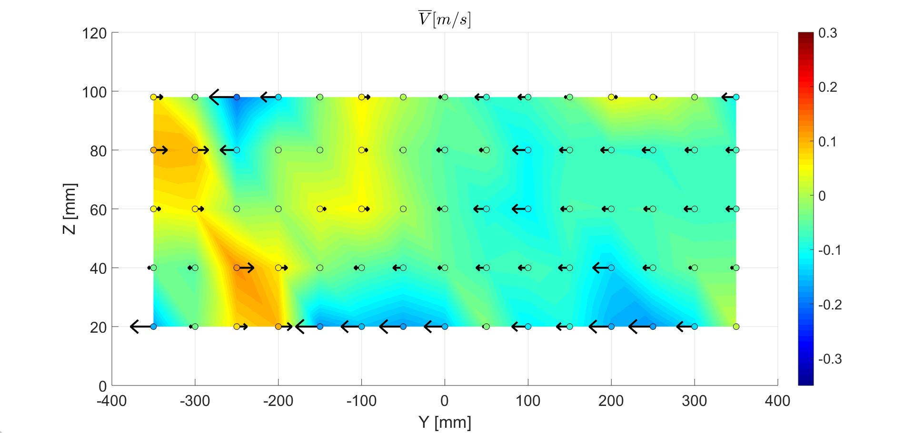
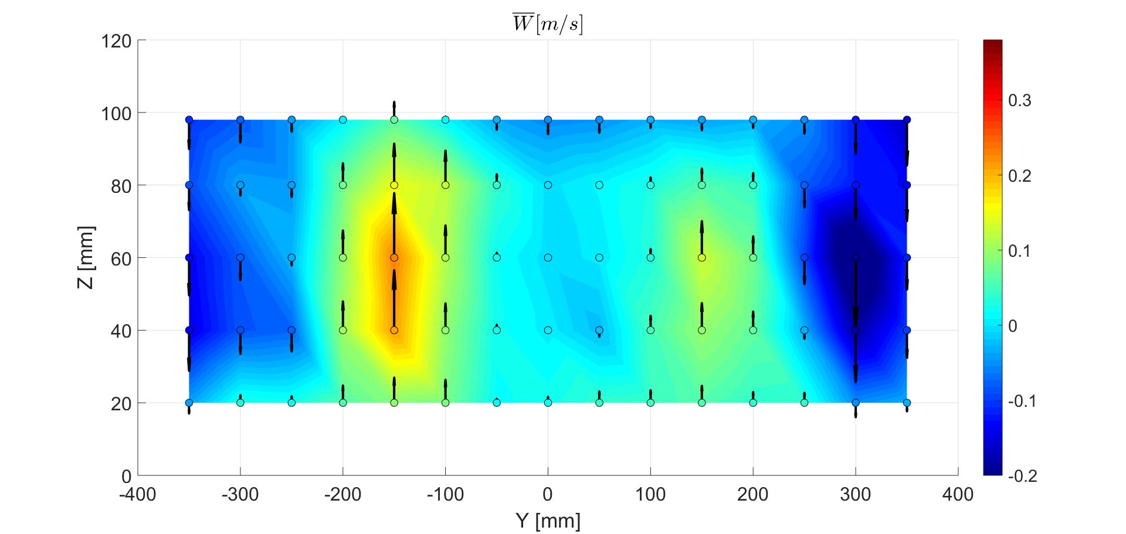
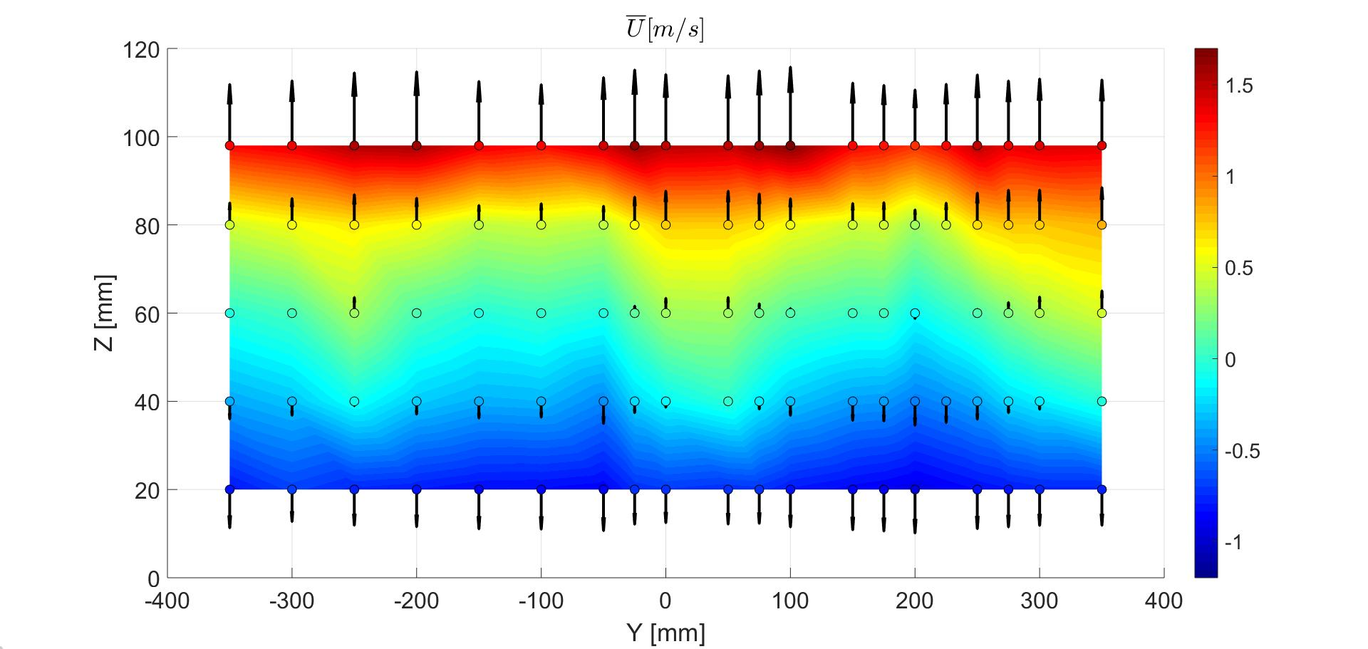
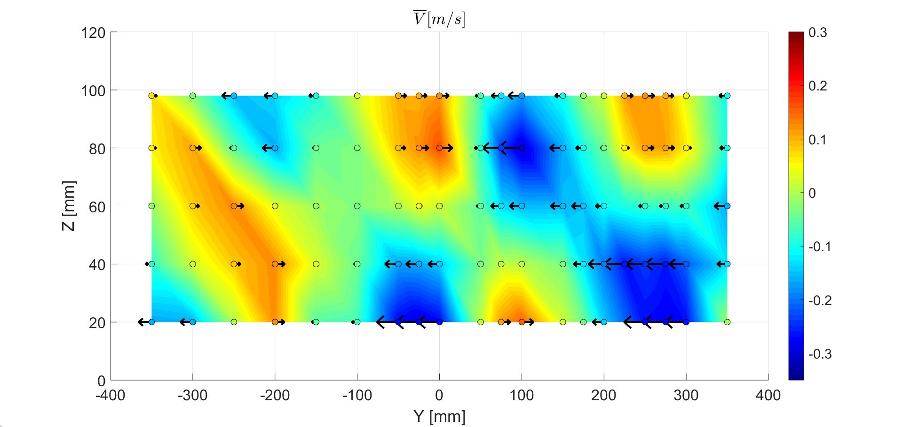
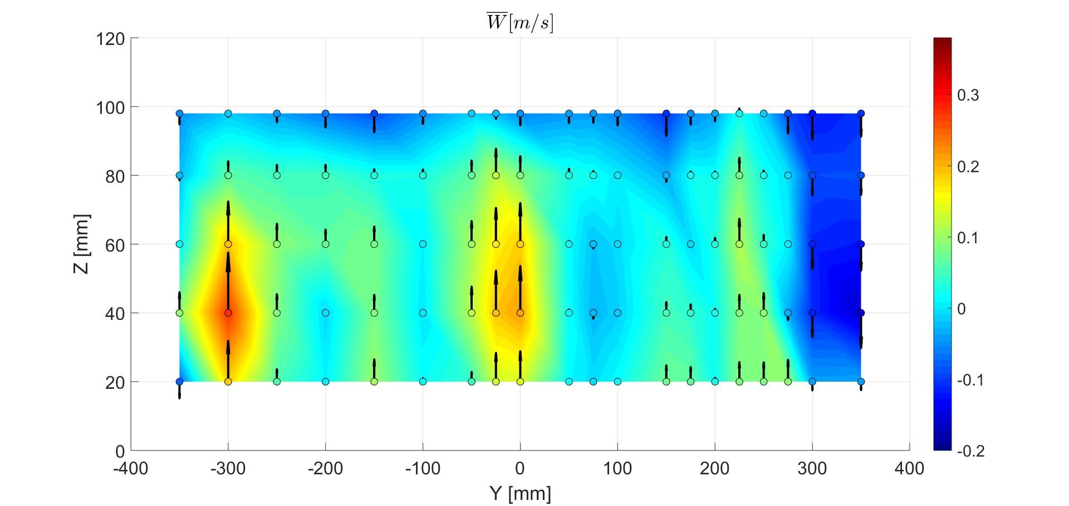
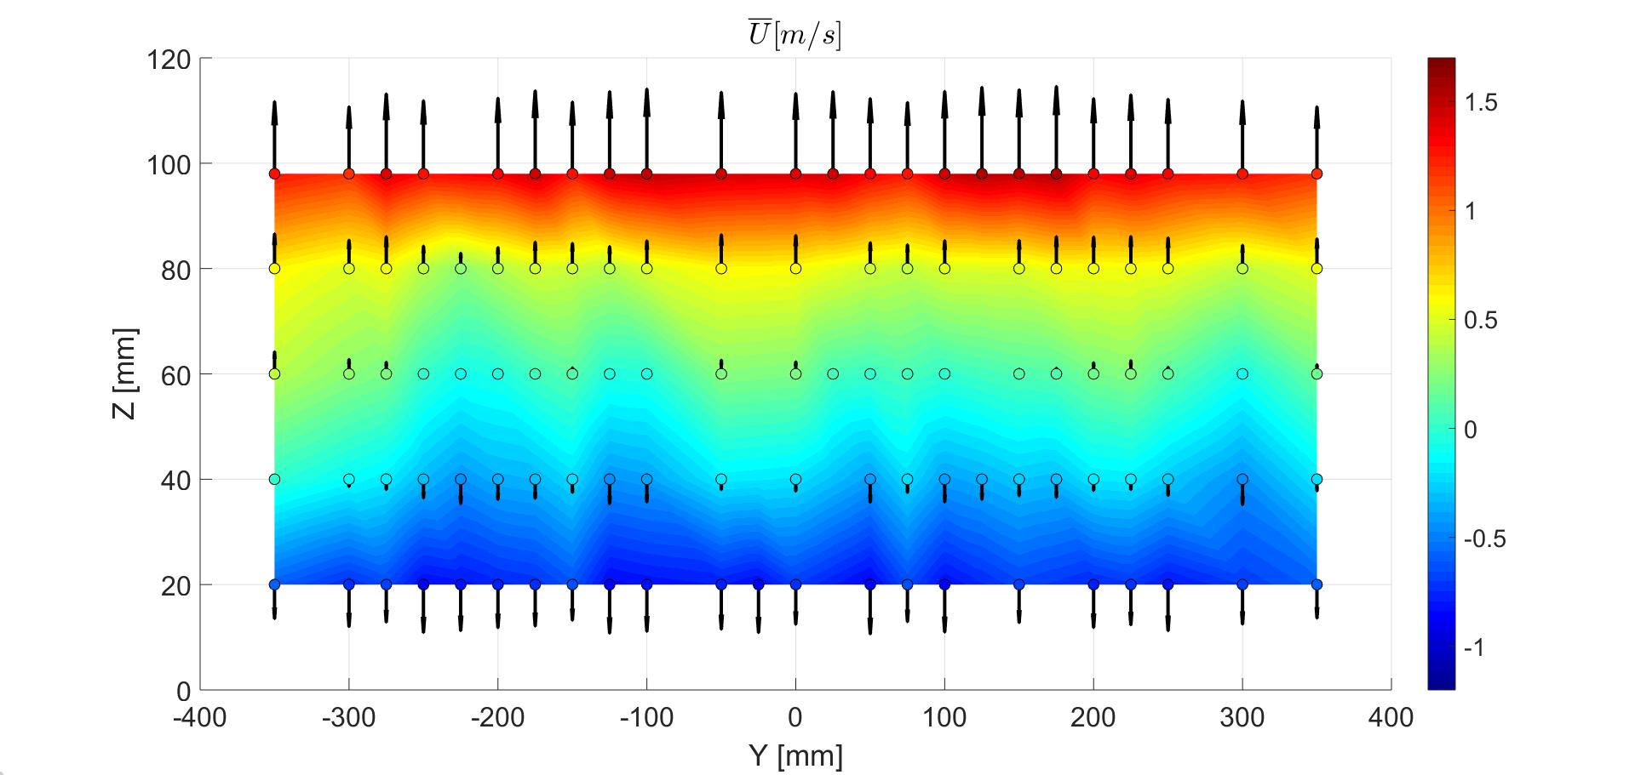
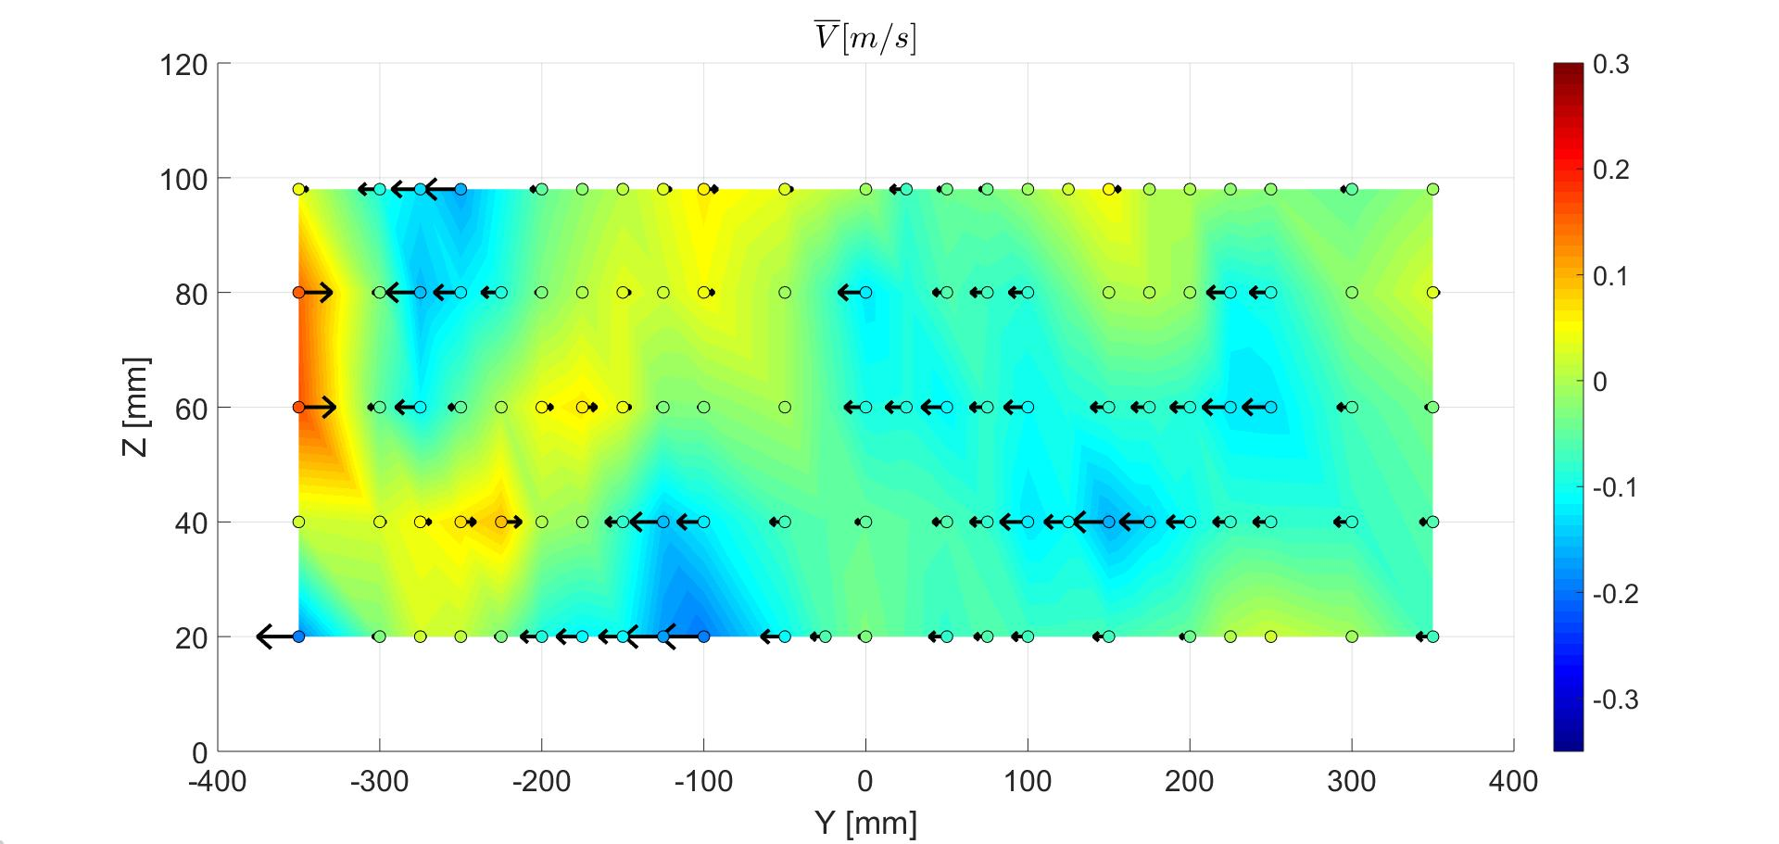
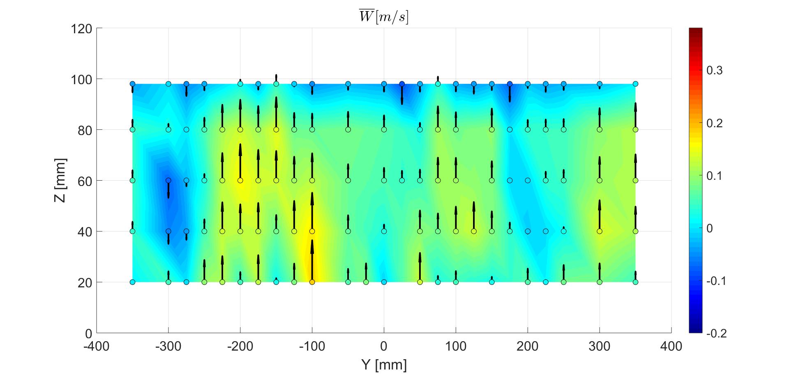



$$\overline{U} [m/s]$$
Laser
Doppler
Anemometer
(LDA)
Mean velocity field
$$\overline{V} [m/s]$$
$$\overline{W} [m/s]$$
-1
-0.5
0
0.5
1
1.5
-0.3
-0.2
-0.1
0
0.1
0.2
0.3
-0.2
-0.1
0
0.1
0.2
0.3
120
100
80
60
Z [mm]
40
20
100
80
Z [mm]
60
40
20
100
80
60
Z [mm]
40
20
0
-300
-200
-100
-0
100
200
300
-300
-200
-100
-0
100
200
300
-300
-200
-100
-0
100
200
300
Y [mm]
Y [mm]
Y [mm]
Turbulent transfer and concentration statistics in a street canyon with tree planting
Sofia Fellini (DIATI and LMFA)
Sofia Fellini

Slide 9
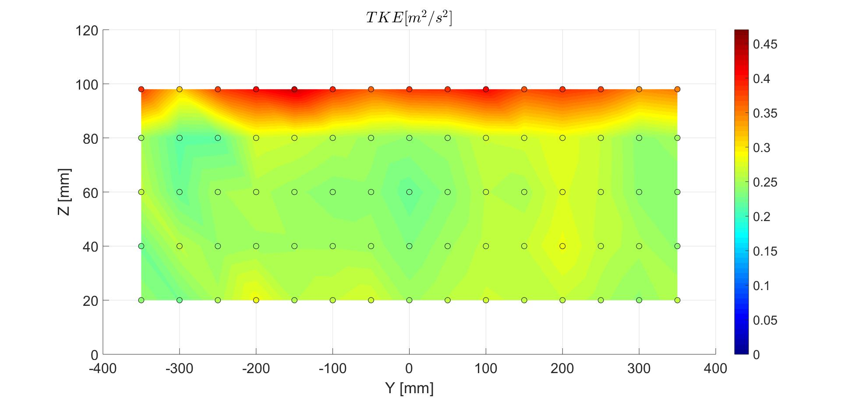
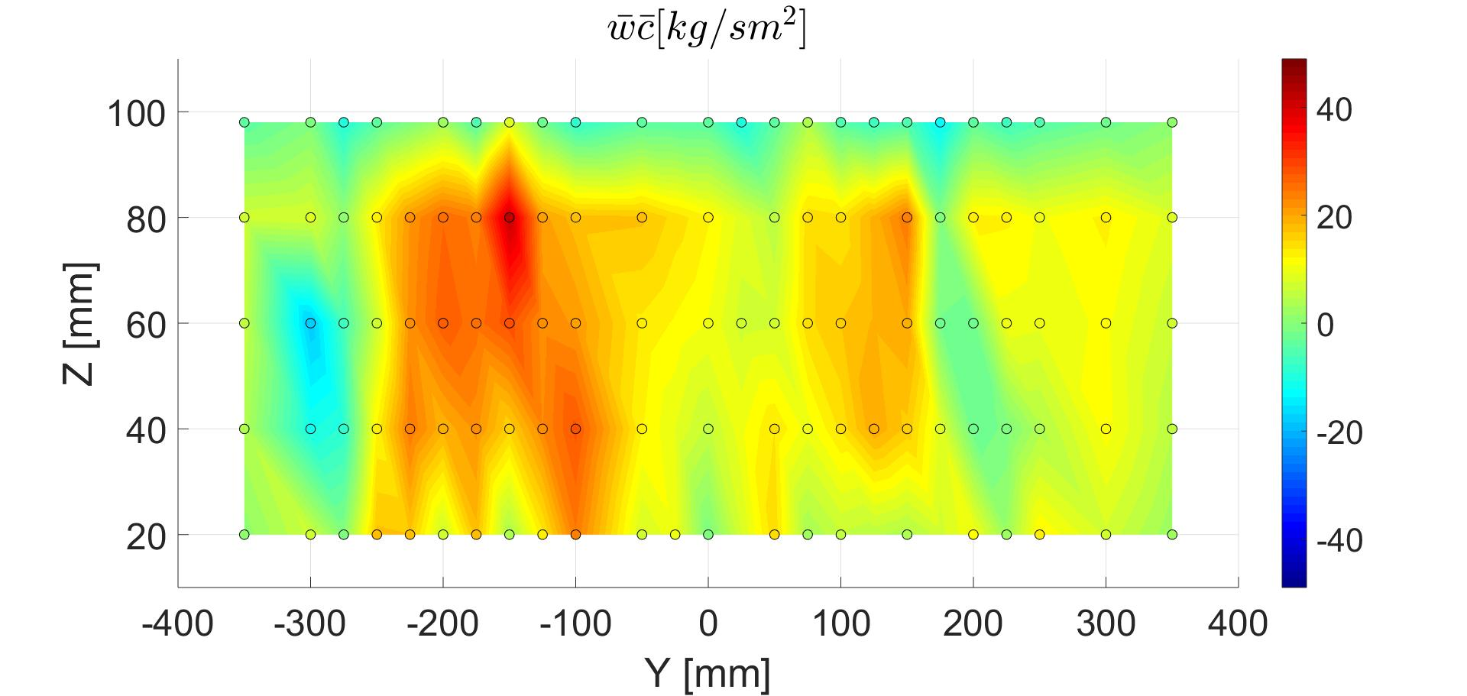
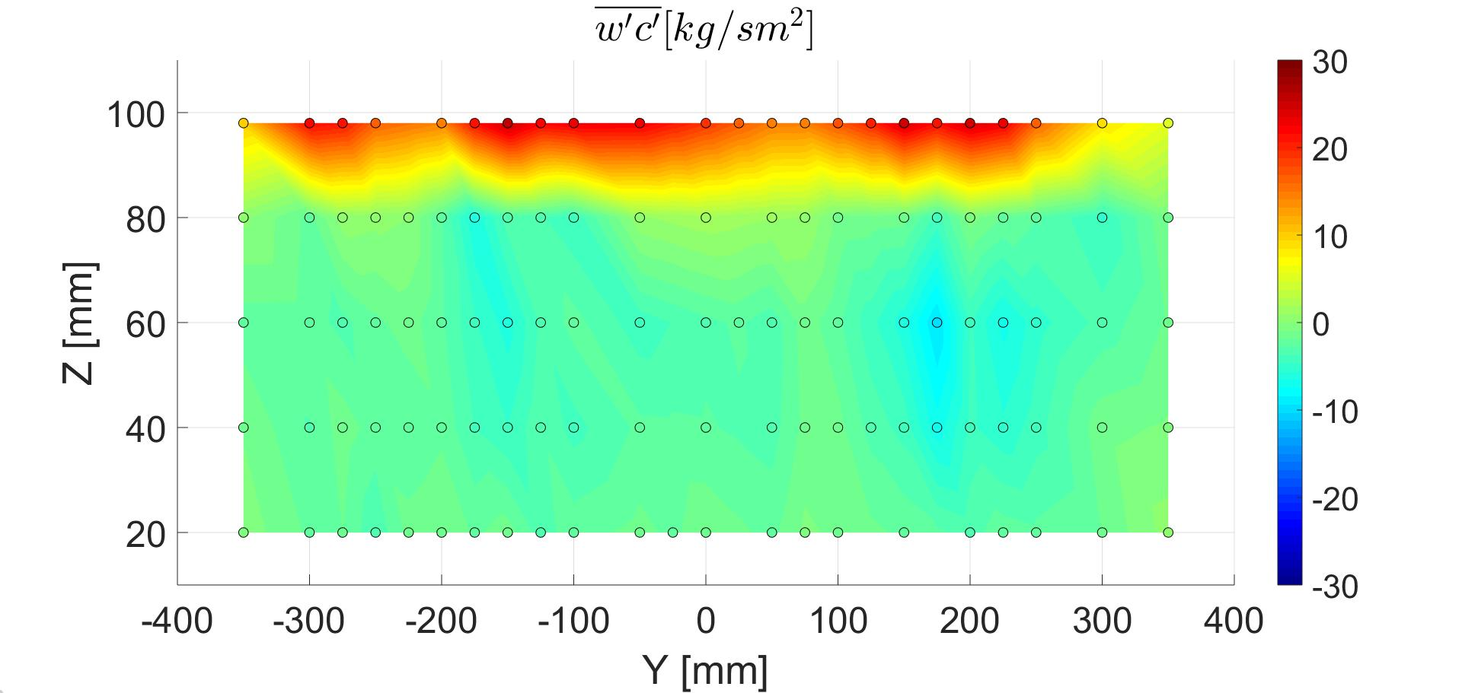
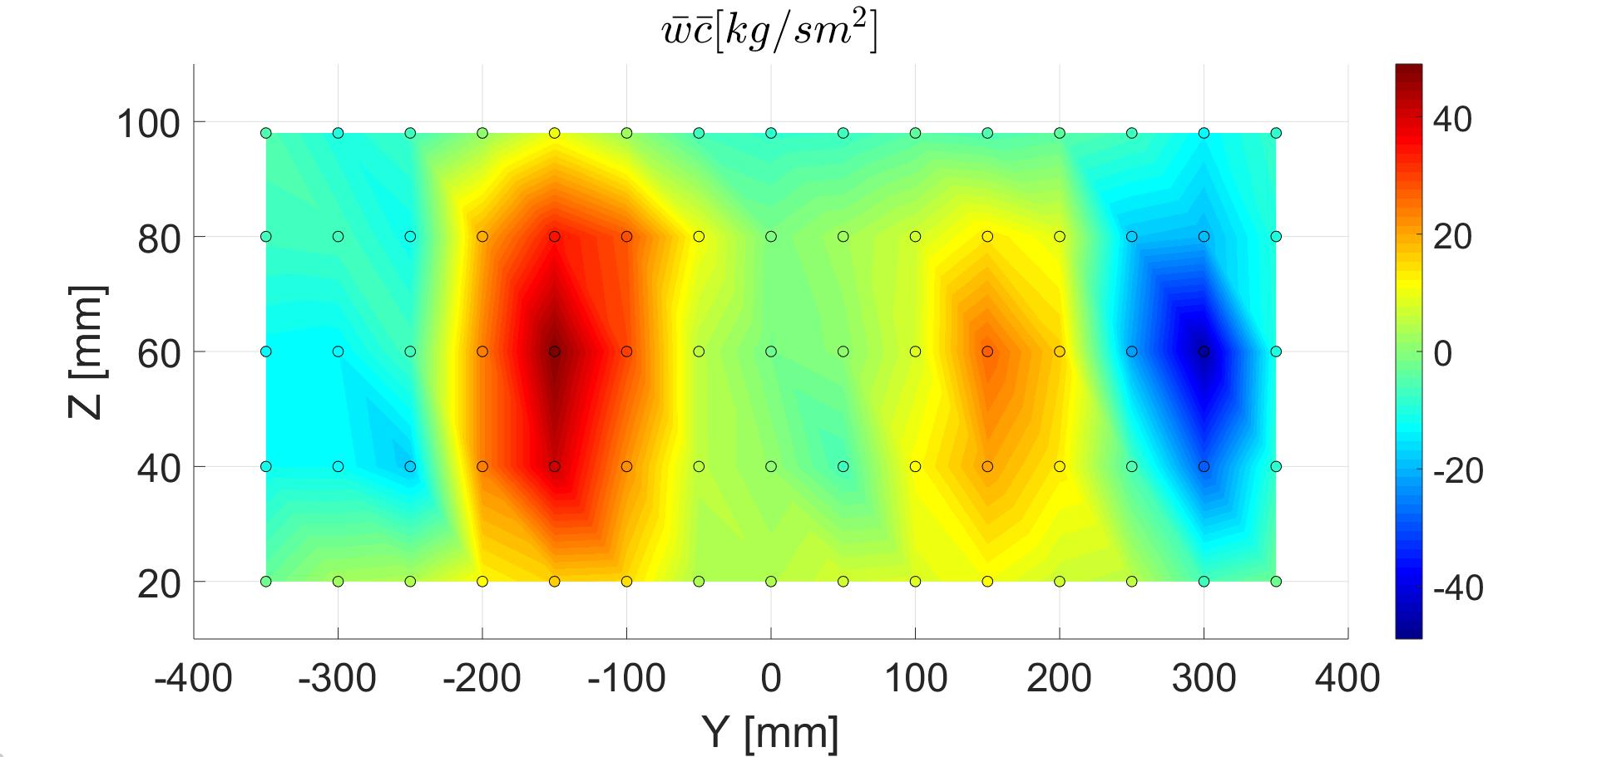
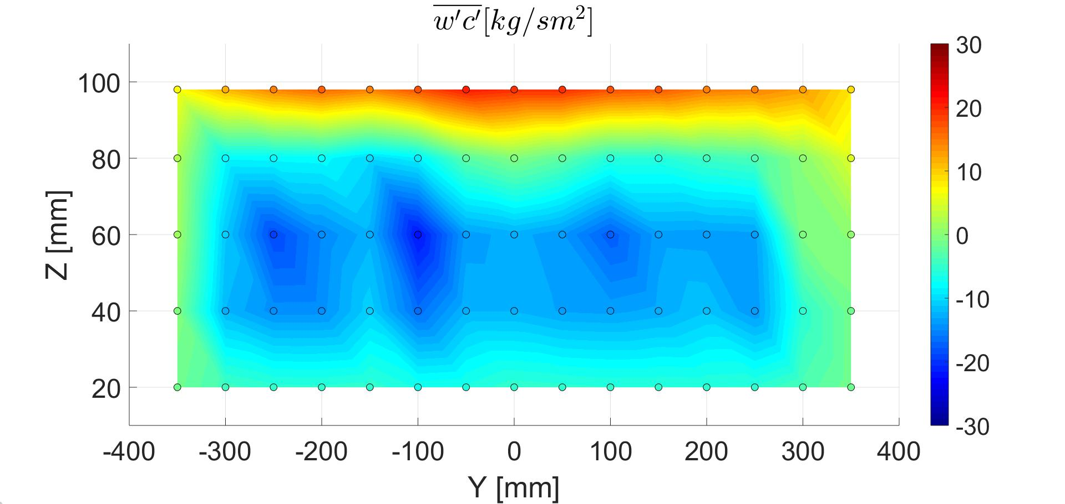
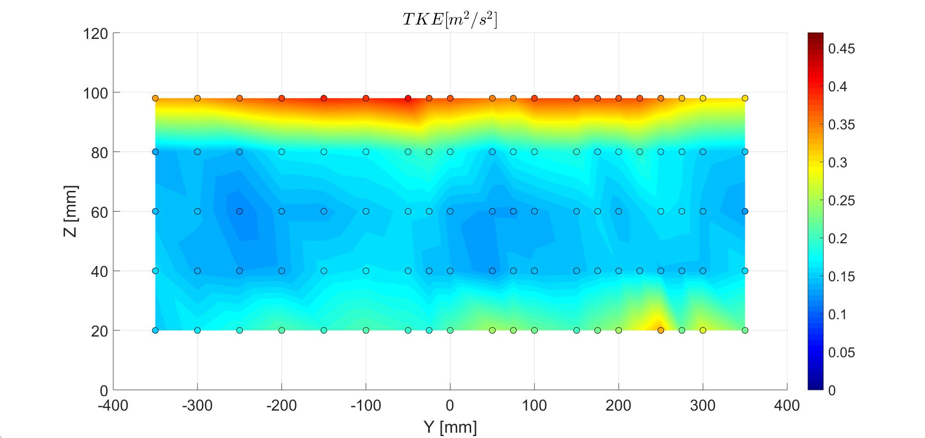
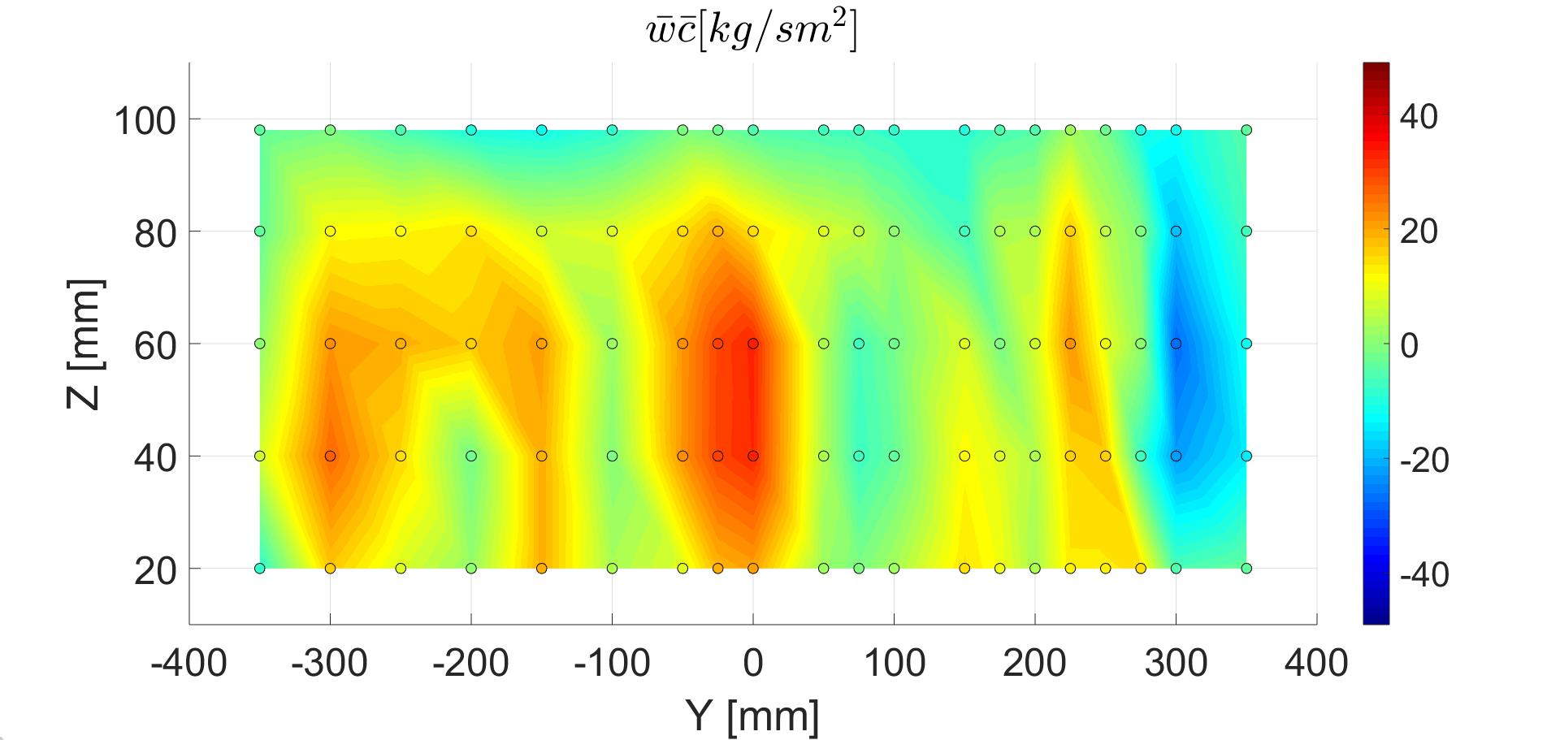
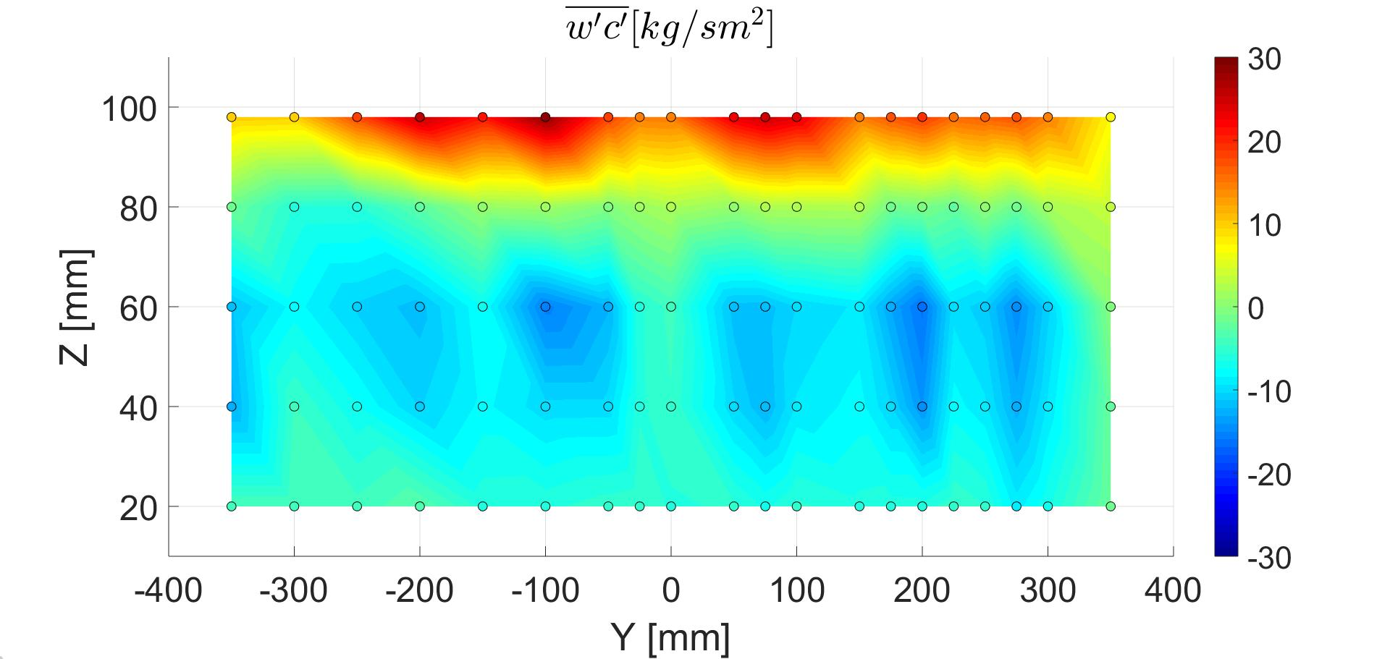
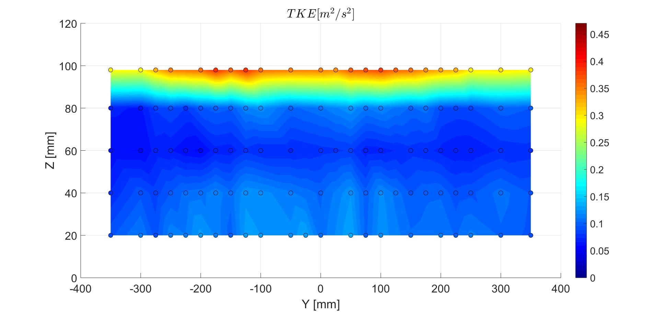



$$TKE [m^{2}s^{2}]$$
LDA
+
FID
TKE and mass fluxes
$$\overline{wc} [ppm m s^{−1}]$$
$$\overline{w′c′} [ppm m s^{−1}]$$
0
0.1
0.2
0.3
0.4
-40
-20
0
20
40
-30
-20
-10
0
10
20
30
120
100
80
60
Z [mm]
40
20
100
80
Z [mm]
60
40
20
100
80
60
Z [mm]
40
20
-300
-200
-100
-0
100
200
300
-300
-200
-100
-0
100
200
300
-300
-200
-100
-0
100
200
300
Y [mm]
Y [mm]
Y [mm]
Turbulent transfer and concentration statistics in a street canyon with tree planting
Sofia Fellini (DIATI and LMFA)
Sofia Fellini

Slide 10
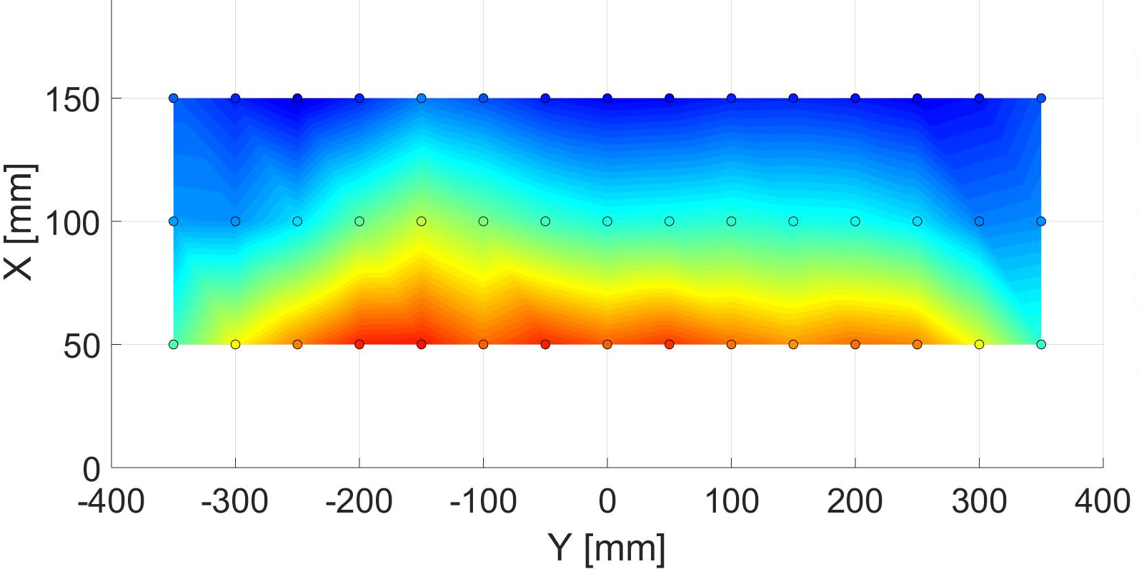
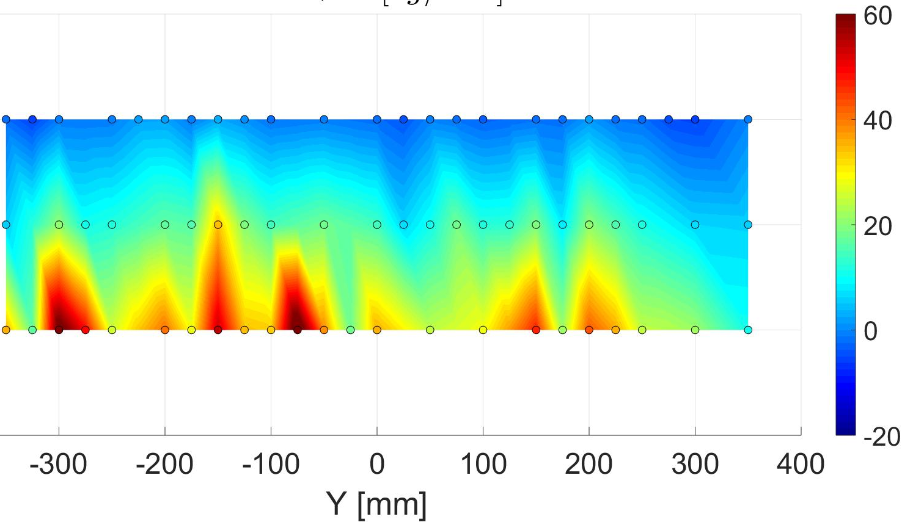
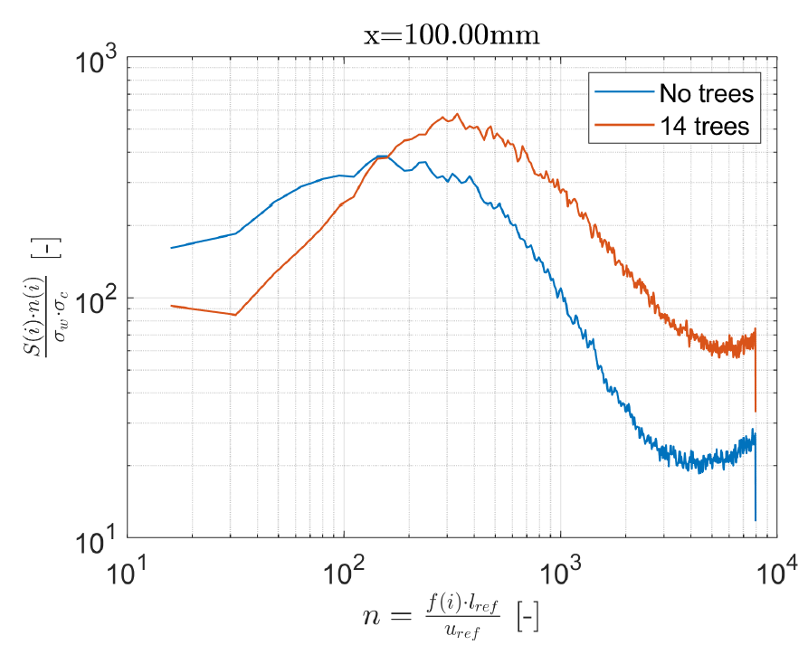
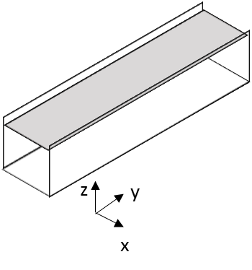




$$\overline{wc}+\overline{w^{′}c′}$$
$$[ppm m s^{−1}]$$
Work in progress
Vertical flux
at roof
Spectra at roof
Statistical analysis of concentration signal
Turbulent mass flux becomes dominant with trees
Increase of turbulent flux at small scales with trees
Gamma distribution with constant $σ_{c}/\overline{C}$
Turbulent transfer and concentration statistics in a street canyon with tree planting
Sofia Fellini (DIATI and LMFA)
Sofia Fellini

