Slide 1

Comparative Assessment of Available Soil Nutrients under Different Tillage and Crop Residue Management Practices in Rice-Wheat Cropping System
Deepti Singh^{*1} and Usha Mina²
School of Environmental Sciences, Jawaharlal Nehru University, New Delhi,India.
¹deeptiparibhu@gmail.com,
²ushamina@mail.jnu.ac.in

Slide 2
Introduction
Soil is an important natural resource and is fundamental for healthy food production.
According to United Nations ,the soil left is only for eighty to hundred harvests that means only for coming 40-60 years of agriculture.
In India 30% land is already degraded and about 90% India’s states are seeing soil turn to desert.
Continuous population growth and increasing resource demands are stressing and degrading soil of agricultural lands.
Soil provides numerous ecosystem services and provision of these services totally depends on soil health and its nutrient balance which is affected by different agricultural management practices.
In the present study the effect of different tillage and crop residue management practices on available soil macro and micronutrients have been evaluated

Slide 3
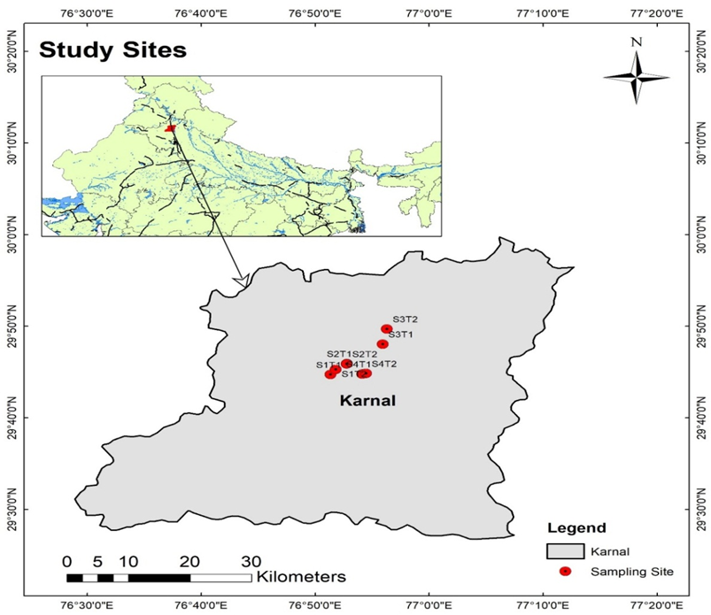
Study Sites and Treatments
The experimental site for the present study was Karnal district, (29⁰44’42.8’’N to 29⁰ 49’41.7’’N latitude and 76 ⁰51’21.0’’E to 76 ⁰56’17.5’’E longitude), Haryana, India.
Figure 1:Sampling sites of the study area (S indicates different sampling sites with respect to treatments)
Figure 1

Slide 4
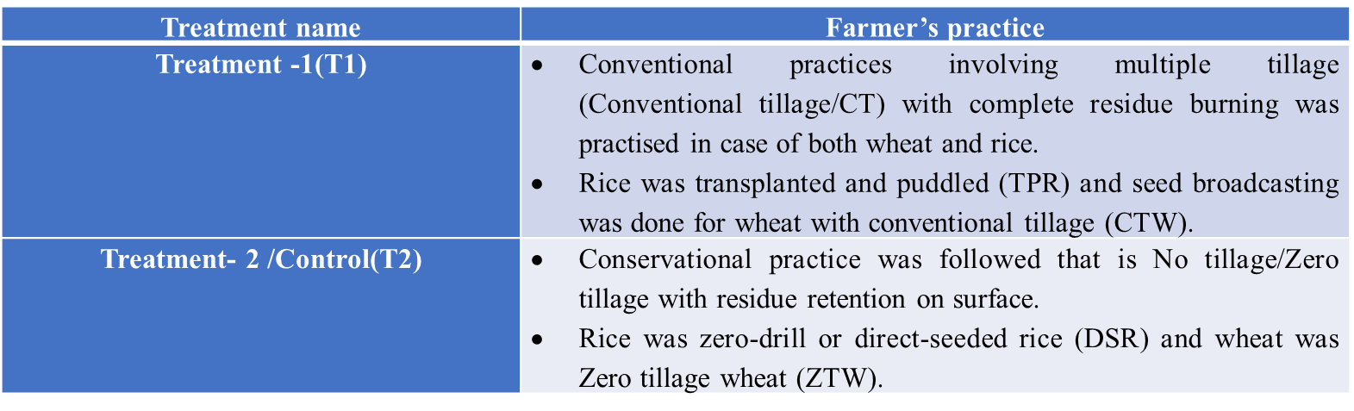
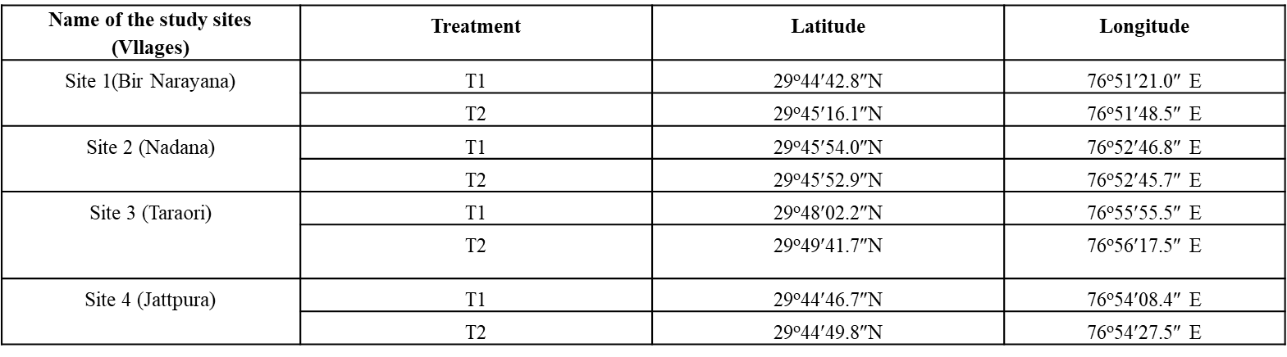

Slide 5
Description about Study site
According to the District Census Handbook of Karnal, Haryana (Census of India, 2011)- the total extent of geographical area of Karnal is 2520 sq. Km. and being inhabited by 1,505, 324 people .
Total net sown area of this district is 2000 sq km. and cultivable land is 2100 sq. km.
Rice and wheat are the principal crops in this region. Wheat occupies 171000 ha land and rice is cultivated in 173000 ha area of agricultural land.
Apart from these, Bajra, Barley and Sugar Cane are also considered as major crops in this region (Central Ground Water Board, India, 2013).
The common sources of irrigation are both surface water and groundwater. Tube-wells, borewells, canals are the major forms of structures (Figure 3.3) to serve the irrigation purpose, depending on the season and rainfall quantity, (Central Ground Water Board, India, 2013).
Although Karnal District is in a better position in terms of agriculture production and farmer’s economic solvency than many other parts of rural Haryana, adaption of CA farming is still not very popular among the marginalized and small scale farmers.

Slide 6
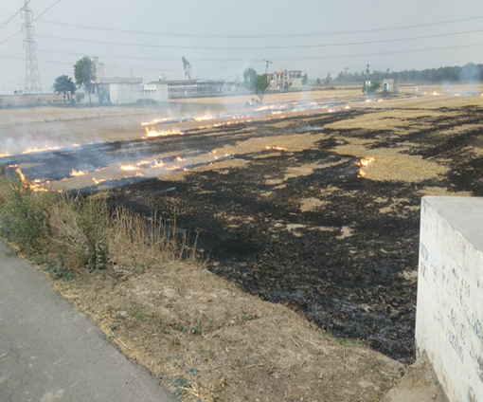
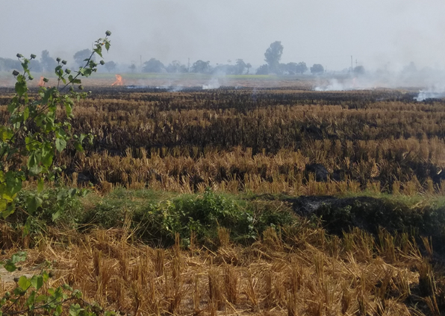
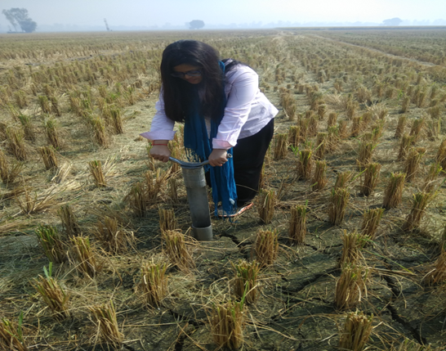
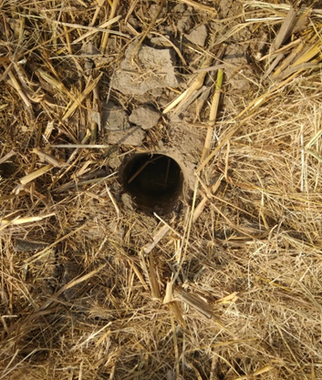
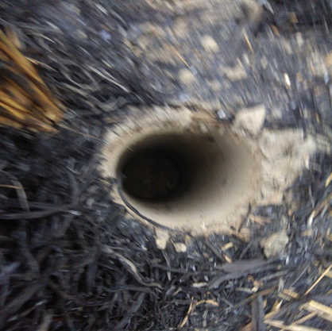
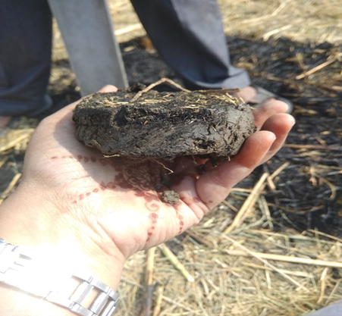
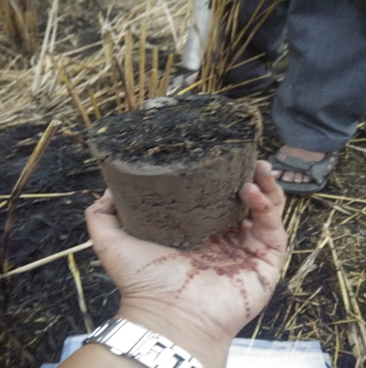
To conduct the study samples were taken from different fields in Karnal district of Haryana,India, under prevalent agricultural practices from two soil depths that is (0-5) cm. and (5-15)cm.
A
B
C
E
F
G
D
A:Whet residue burning B: Paddy Residue burning C: soil sampling with tube auger D: Before burning condition E: After burning Condition F: Soil core (0-5)cm depth G: Soil core (5-15)cm depth

Slide 7
A
B
A:Field under CA practice in Nadana village (Karnal), B:Haapy seeder Machine:A CA Incentive
A
B
A: Sowing of seeds through happy seeder in field, B: Furrows having seeds, created by happy seeder over the surface retained crop residues

Slide 8

Methodology
Soil Texture determination by hydrometer method
Soil pH and EC using pH and EC meter by taking 1:2 soil: water ratio(Jackson,1967)
SOC and SOM( Walkley and Black method
Soil Microbial Biomass Carbon by Fumigation-extraction method
Soil Available Nitrogen
(Kjeldahl method)
Soil Available Phosphorous
(Olsen’s method by spectrophotometer
Soil Available Potassium by Ammonium acetate extractable method through Flame photometer
Soil Available Micronutrients by DTPA extractable method through ICP-AES

Slide 9
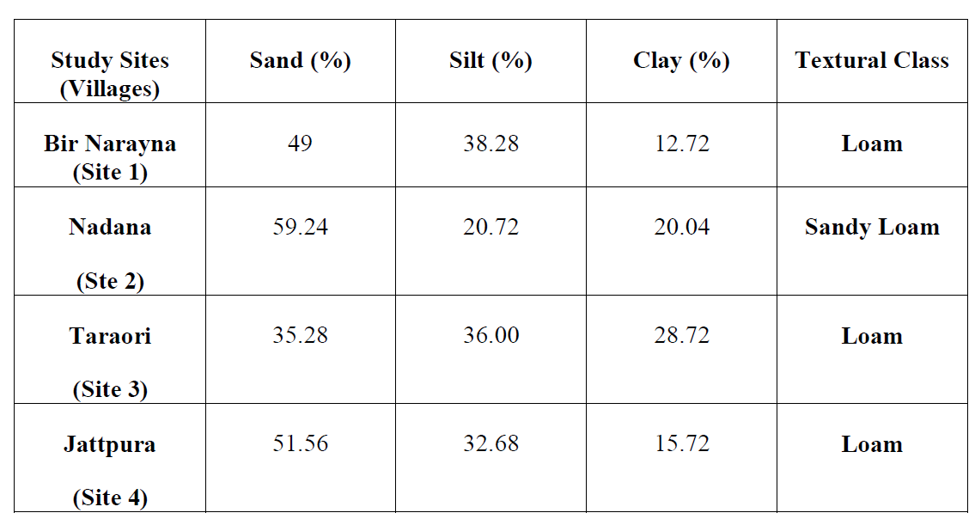
Results
Soil Texture
Soil pH
Soil pH of the area was found in the range of 7.5-8.2.In the uper surface layer (0-5)cm the pH was found be under conventional practice in compare to CA practice.The probable reason is that, with more accumulation of OM in upper surface layers of CA field, thereby increasing the electrolyte concentration and decreasing the pH (Rahman et al., 2000; Choudhary et al., 2017).

Slide 10
Available Soil Organic Carbon(SOC)
The SOC in the upper surface layer is found lower in case of conventional practice in compare to conservation practice. Therefore, in terms of carbon availability, the CA mechanism with zero tillage direct planting technology is having a very effective impact on the upper depth of the soil than the deeper depth. Moreover, the results are consistent with the study done by Choudhary et al. (2019) and Maher et al. (2020)- have mentioned that it can be due to retention /recycling of residues and also by decreasing the organic carbon decomposition rate by reducing the breakdown of the macro-aggregates in contrast to conventional practices where repeated intensive tillage /puddling exposes the soils that results into decomposition of Organic matter and thereby low OM and OC.
However in case of burning the organic carbon is found is little higher in the same layer in compare to before burning samples.That may be attributed to sudden increase in ash content as a result of residue burning.
Soil Microbial Biomass Carbon(MBC)
Soil microbial biomass was found higher in CA practices compare to conventional practice in both the layers. This is by virtue of higher amount of carbon availability to micro-organisms for their growth and activity, more pore spaces and aeration in the conservation than CT practice (Alvear et al., 2005; Choudhary et al., 2018). Due to zero tillage practice in the fields and residue incorporation from previously harvested plants, the availability of the living components of soil is also abundant in the deeper part under CA practice.
Higher Temperature may lead to death of microorganisms and there fore low MBC in both layers that before burning samples.

Slide 11
Soil Available Phosphorous
Soil Available Nitrogen

Slide 12
Soil Available Potassium
Soil Available Micronutrients

Slide 14
Conclusion
Available soil phosphorous, available potassium, available SOC all were increased by 10%,14.85%, 2.4% respectively at 0-5 cm depth in after residue burning samples as compare to before burning samples.
Whereas available soil nitrogen, available micronutrients (Cu, Zn, Mn, Ni and Fe)and microbial biomass carbon(MBC) were found to be decreased in after burning samples as compare to before burning samples at same 0-5cm depth.
Available P, available SOC, MBC, available potassium all were found to be 13.89%,17.7%,6.9%and 0.5% higher in control treatment as compare to T1 however micronutrient concentrations were decreased in control.
The result of the study indicates that burning of paddy residues and multiple tillage operations can be attributed to decline in soil carbon and nitrogen parameters as compare to conservation agriculture practice.
CA principles protect the biological functioning of the soil by keeping the ecological balance restored and maintaining an undisturbed microclimate- which is a prerequisite for sustainable agriculture practices.
More subsidies should be allocated targeting the marginal and small-scale farmers in order to incorporate them in this sustainable hierarchy of development which will ultimately secure their future along with advancing the nation.

Slide 15
References
Choudhary, M., Datta, A., Jat, H.S., Yadav, A.K., Gathala, M.K., Sapkota, T.B., Das, A.K., Sharma, P.C., Jat, M.L., Singh, R. and Ladha, J.K., 2018. Changes in soil biology under conservation agriculture based sustainable intensification of cereal systems in Indo-Gangetic Plains. Geoderma, 313, pp.193-204.
Singh, Y. and Sidhu, H.S., 2014, March. Management of cereal crop residues for sustainable rice-wheat production system in the Indo-Gangetic plains of India. In Proc Indian Natl Sci Acad (Vol. 80, No. 1, pp. 95-114).
Singh, J.S., 2018.Crop residue management in agro-environmental sustaianability. Climate Change, ISSN 2394-8558.
Walkley, A. and Black, I.A., 1934. An examination of the Degtjareff method for determining soil organic matter, and a proposed modification of the chromic acid titration method. Soil science, 37(1), pp.29-38.
Olsen, S.R., 1954. Estimation of available phosphorus in soils by extraction with sodium bicarbonate. United States Department Of Agriculture; Washington.
Bouycous, G.J., 1962. Hydrometer method improved for making particle size analysis of soil. Agron J, 54, pp.406-465.
Jackson, M.L., 1967.Soil Chemical analysis,pp.452-485,234-246,38-56.

