Slide 1
Beyond Hazard:
Combining pan-European exposure data with flash flood hazard forecasts to create impact forecasts for civil protection agencies
Eleanor Hansford
Eleanor.Hansford@ecmwf.int
Calum Baugh, Christel Prudhomme, Marc Berenguer, Shinju Park, Annakaisa von Lerber, Anna Berruezo, Victor González, Juan Colonese, Corentin Carton de Wiart, Seppo Pulkkinen, and Tero Niemi

Slide 2
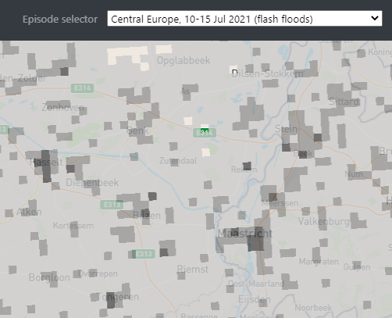
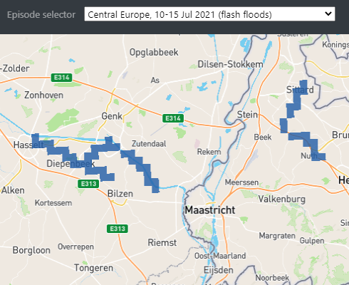
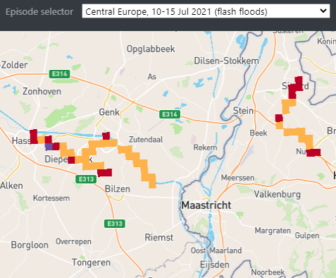



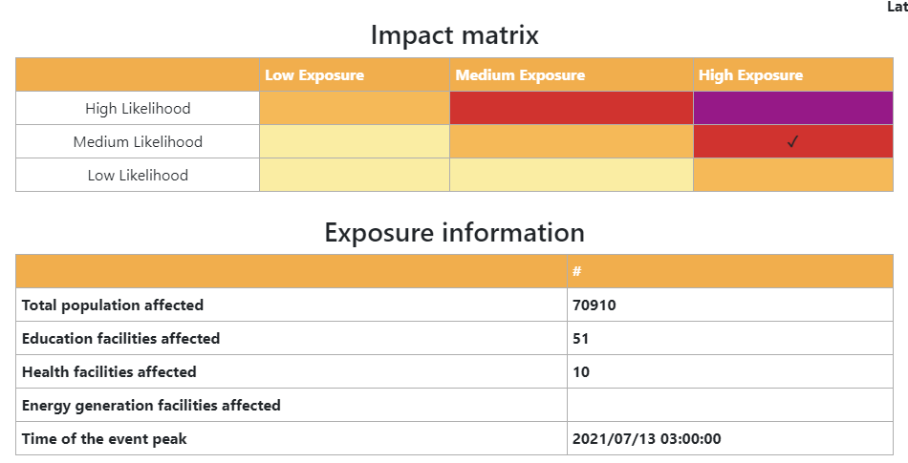

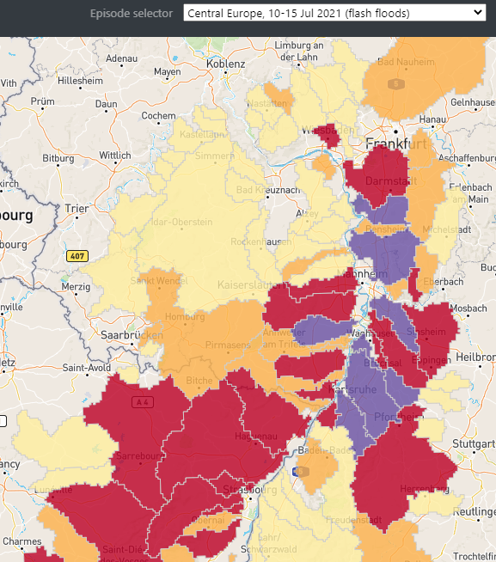

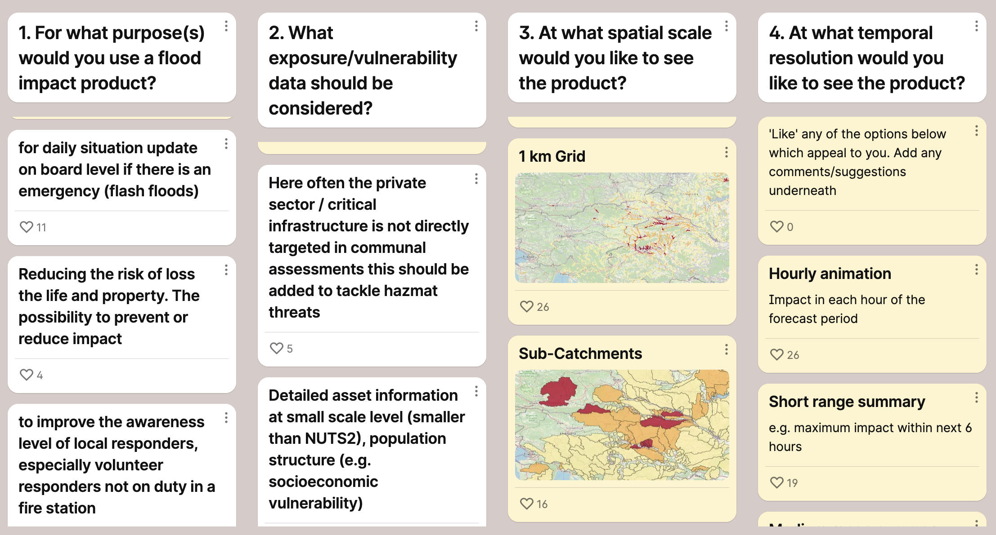
Creation of Impact Forecasts
Exposure
Hazard
Impact
Categories informed by end-user workshop:
Flash flood hazard forecasts on a 1km river network
0 - 6h → blending of radar & numerical weather prediction (NWP) data
6 - 120h → NWP forcing only
NWP thresholds calculated from ECMWF reforecasts
Two visualisations:
Impact on a 1km river network
Impact summary over subcatchment
Education
Energy
Health
Population
Transport

Slide 3

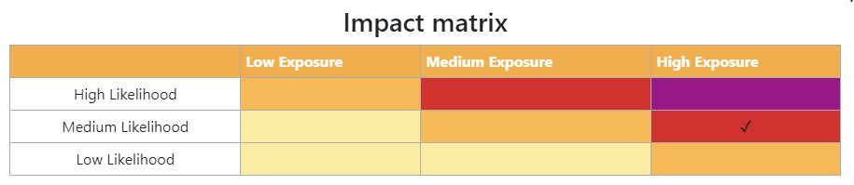

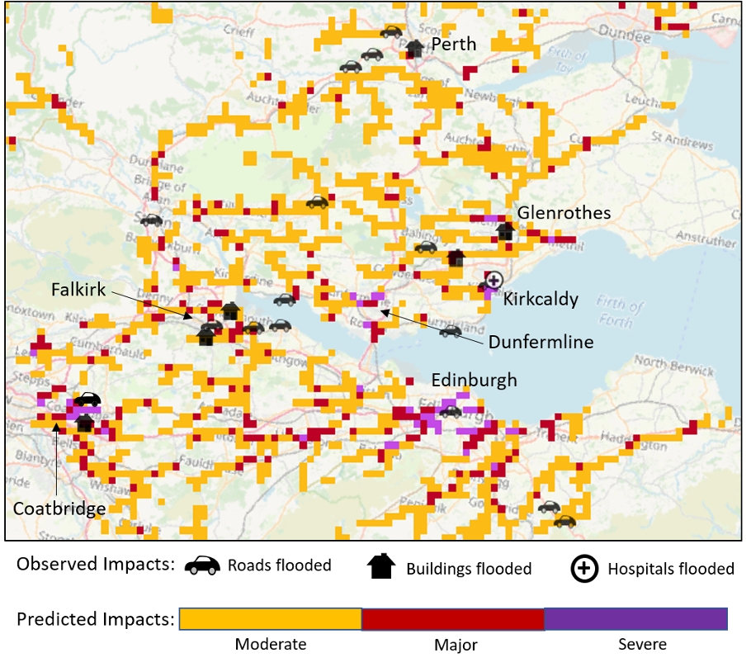
Impact Matrix and Evaluation
Exposure
Values based on distribution of combined exposure layer
1.0 – 1.3
1.3 – 1.6
1.6 – 2.0
Hazard
Forecasts
>80%
50 - 80%
5 – 50%
Probability of exceeding 2 year return period threshold
But, is it useful?
Internal evaluations of case studies showed forecasted impacts closely matched observed impacts →
Final end-user workshop held May 2022 highlighted going forward a greater emphasis on training, documentation and integration into existing workflows of civil protection agents would be beneficial.

Slide 4
Next Steps & Key Takeaways
TAMIR products will soon be made available on the European Flood Awareness System (EFAS) platform, and as a WMS-T
Combining probabilistic flash flood hazard forecasts with exposure data does add value compared to hazard forecasts alone
End-user engagement throughout the project lifecycle is vital when creating products that forecast impacts
Maximum uptake of such products requires comprehensive documentation and end-user training, alongside the provision of technical help in integrating the products into existing workflows

Slide 5

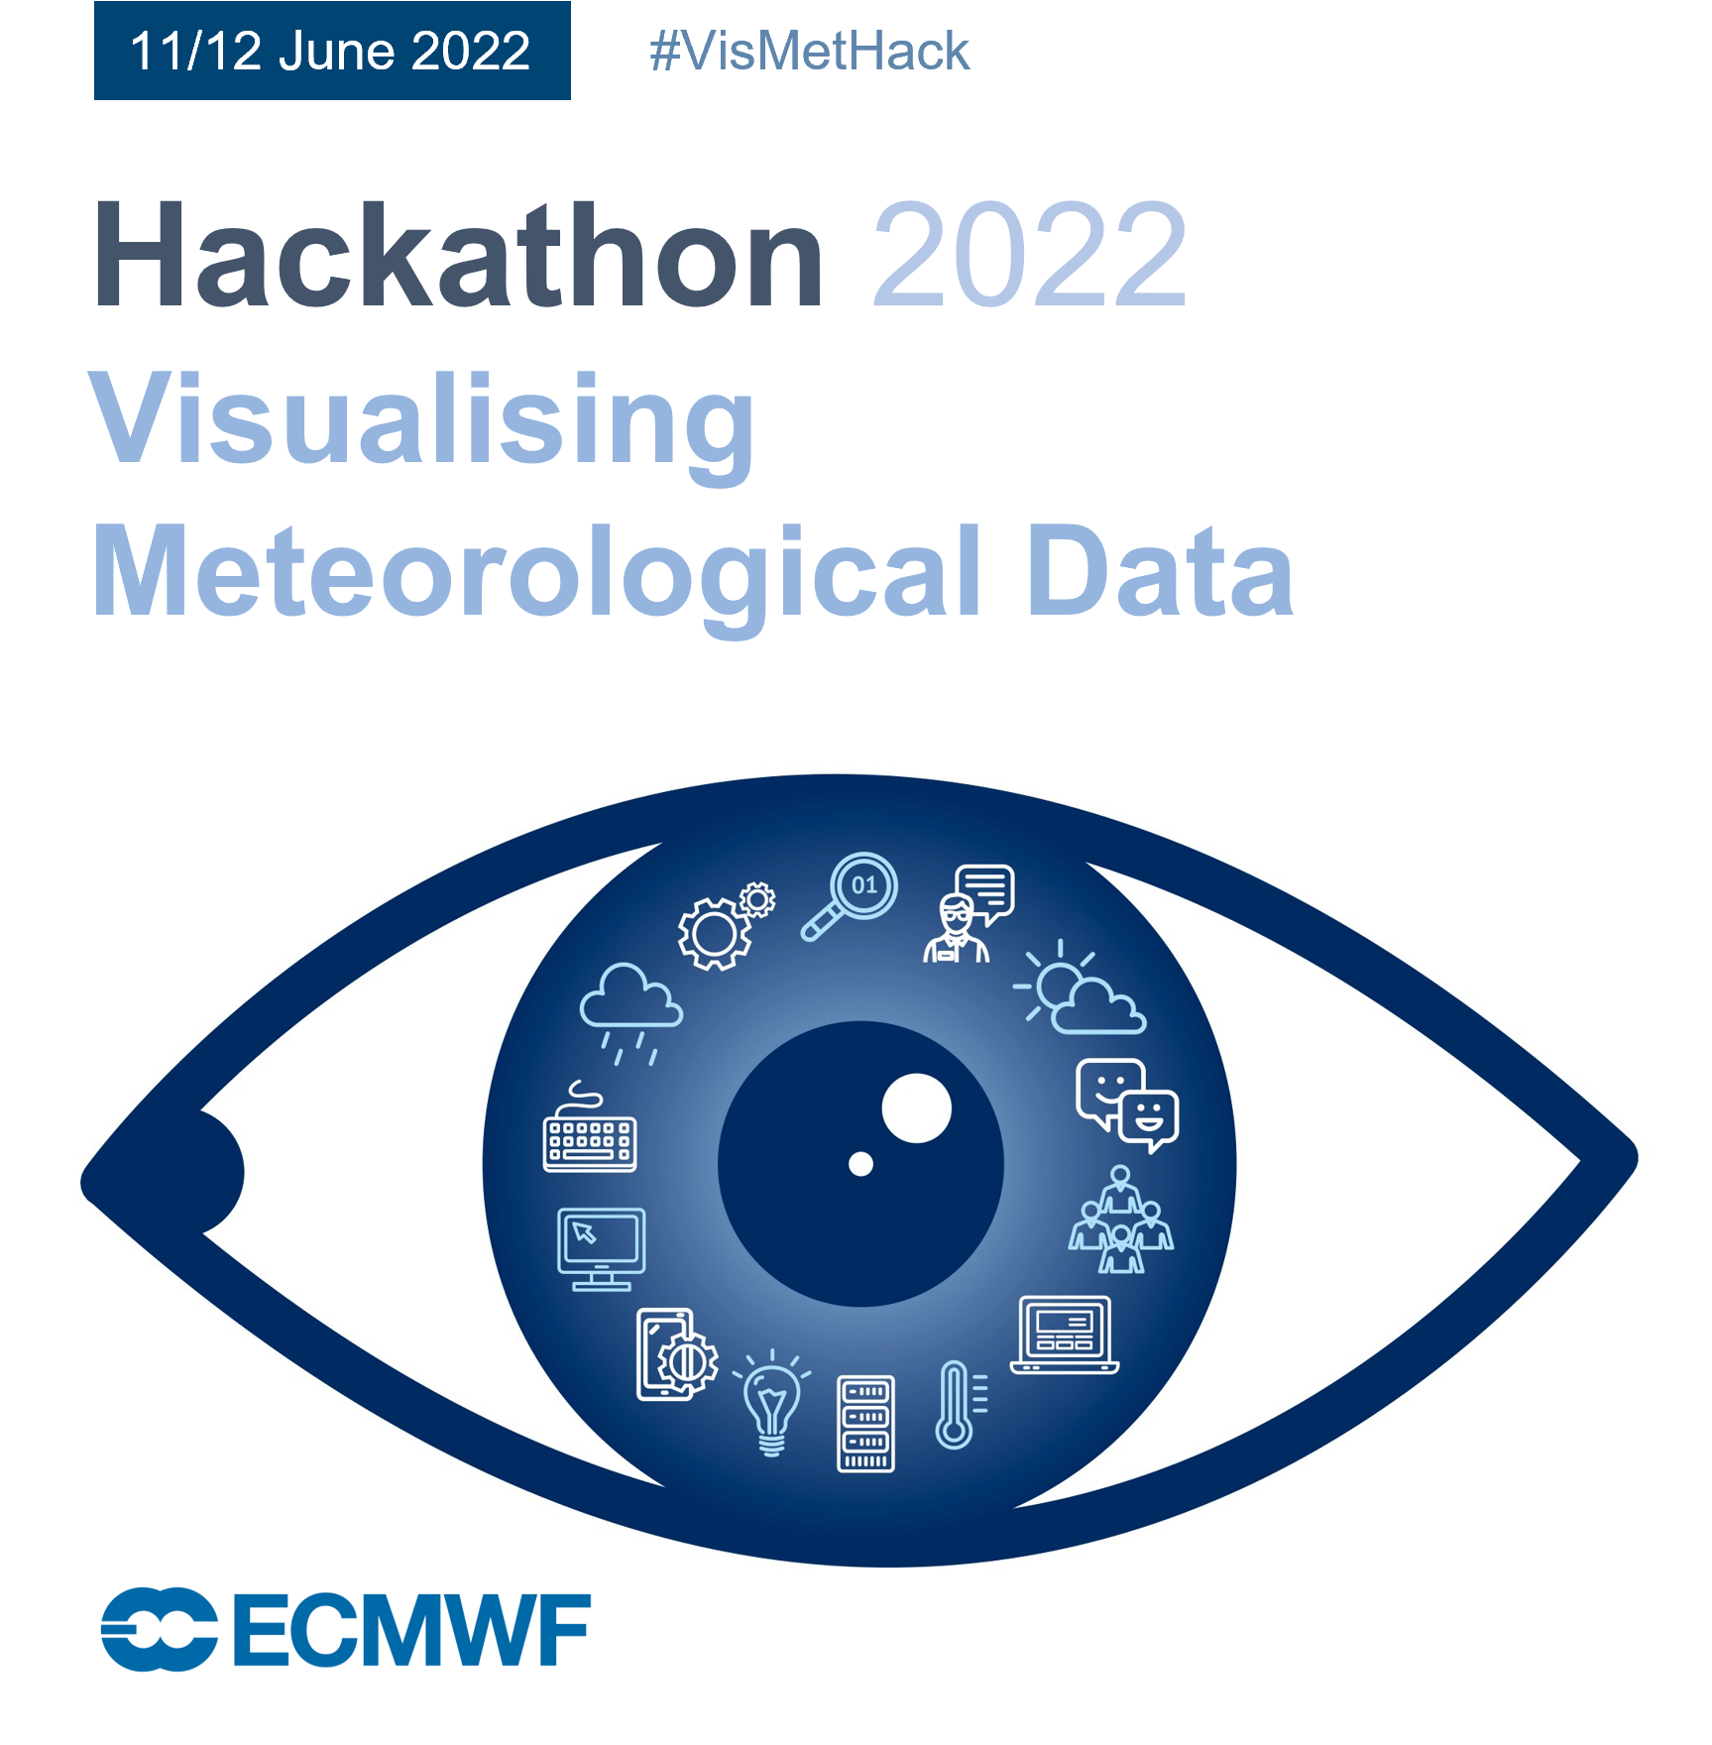

Thank you! Questions?
Eleanor.Hansford@ecmwf.int
11/12 June 2022
In-person at ECMWF HQ, Reading, UK
More information and registration:
https://events.ecmwf.int/event/305/
Google ‘ECMWF Hackathon 2022’
@ECMWF #VisMetHack on Twitter
GitHub https://github.com/vismethack

