Slide 1
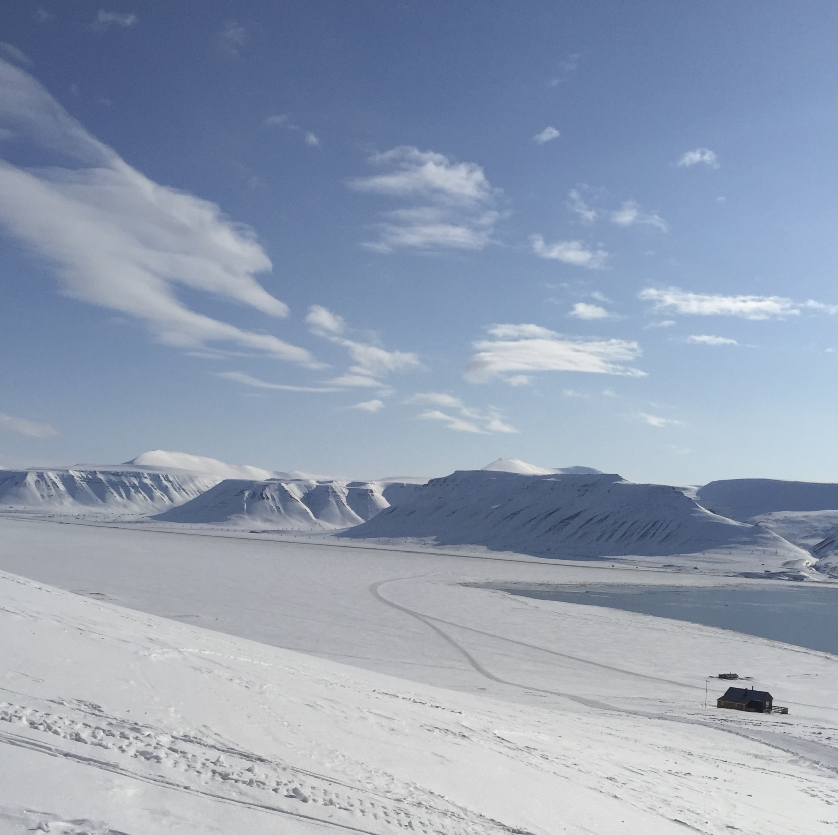

Estimates of the dependence of snow cover extent on surface air temperature of the Northern Hemisphere for the last several decades
By Maria Parfenova, Igor I. Mokhov, Maxim Arzhanov
A.M. Obukhov Institute of Atmospheric Physics RAS
M.V. Lomonosov Moscow State University

Slide 2
Positive climatic feedback:
Decrease the snow-ice covered area
Decrease in the surface albedo under the temperature increase
Sensitivity of the temperature regime to external (natural and anthropogenic) influences increase
Increase in the solar radiation absorption
Further increase in temperature

Slide 3
Mean Snow Cover Extent (SCE) Values in the NH
 | 1980-2019 | 1980-1999 | 2000-2019
Jan | 47.1 | 46.4 | 47.8
Feb | 45.8 | 45.4 | 46.3
Mar | 40.2 | 40.4 | 39.9
Apr | 30.2 | 30.7 | 29.8
May | 18.7 | 19.5 | 17.8
June | 8.8 | 10.0 | 7.6
July | 3.5 | 4.0 | 3.0
Aug | 2.8 | 3.0 | 2.6
Sept | 5.4 | 5.2 | 5.5
Oct | 18.2 | 16.6 | 19.9
Nov | 34.5 | 33.8 | 35.1
Dec | 43.9 | 43.3 | 44.5
In the last 2 two decades the snow cover extent increased in autumn-winter months and decreased in spring-summer months

Slide 4
Methods:
Seasonal features of variations in the area of ​​snow cover in the annual cycle and their changes over the past decades are analysed using the corresponding phase portraits.
Parameters of the sensitivity of snow cover to temperature change were estimated with linear regressions.
To assess the interdecadal variability, along with a correlation analysis, a cross-wavelet analysis was used.
Numerical simulations using the models of CMIP6 project were also analysed.
Snow Cover Extent (SCE) – GSL (https://climate.rutgers.edu/)
Surface Air Temperature – ERA5 reanalysis data (https://www.ecmwf.int/en/forecasts/datasets/reanalysis-datasets/era5)
CMIP6 (https://esgf-node.llnl.gov/projects/cmip6/)
Data:

Slide 5
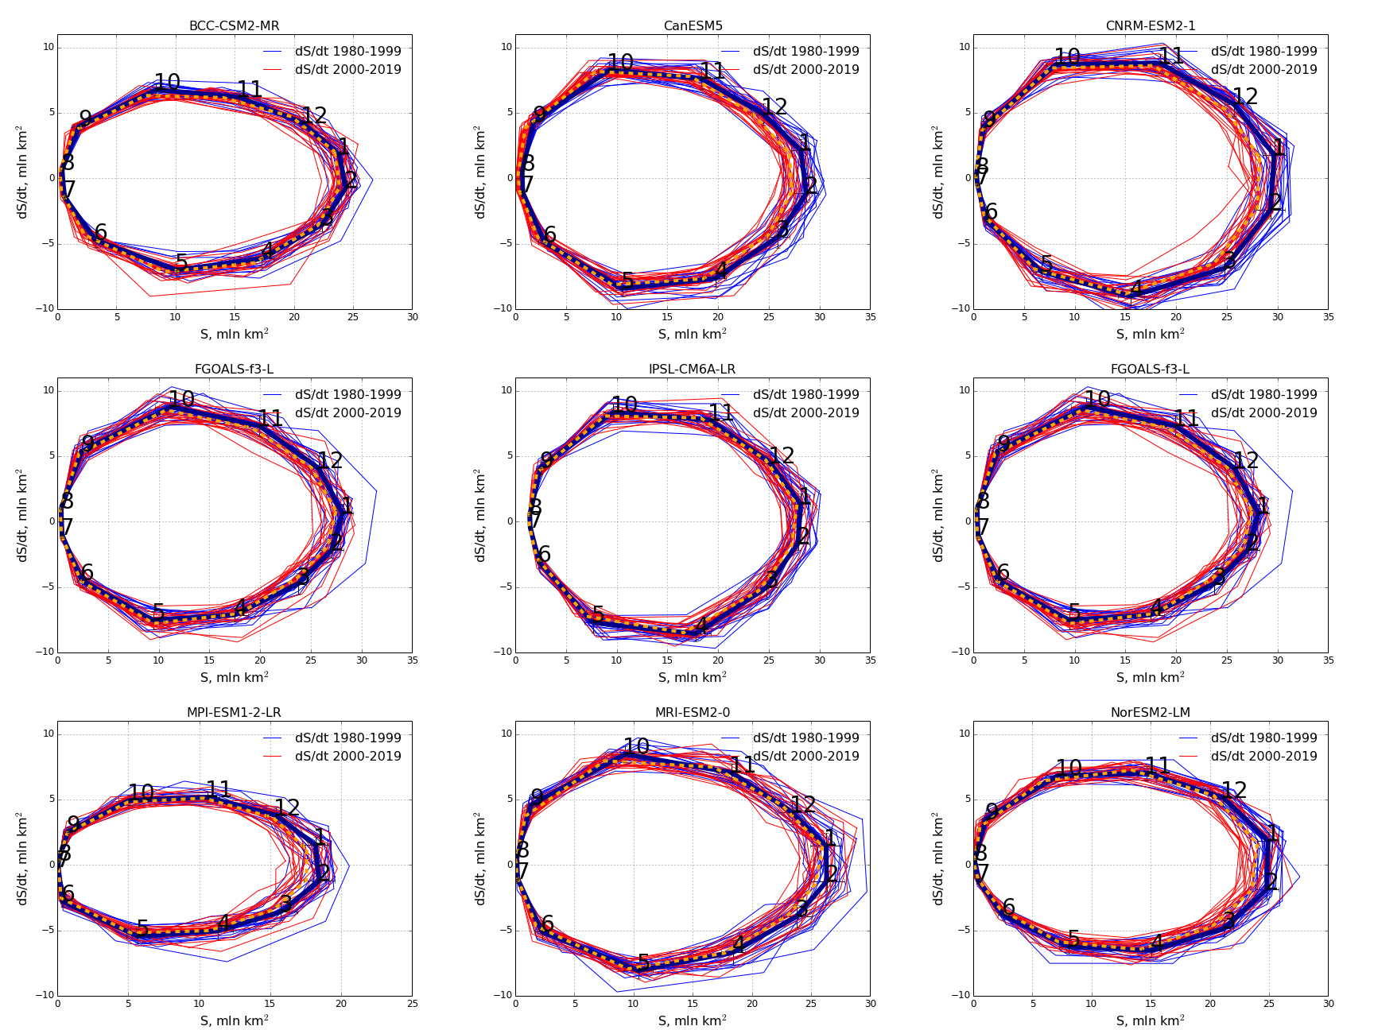
Seasonal features of SCE variations in Eurasia in the annual course and their changes over the decades
Satellite data & ERA5 reanalisys
CMIP6 models
For the summer months, the variability of the SCE is noticeably less, while the tendency for a decrease in the SCE with general warming in recent decades is more pronounced for them than for the winter months.

Slide 6
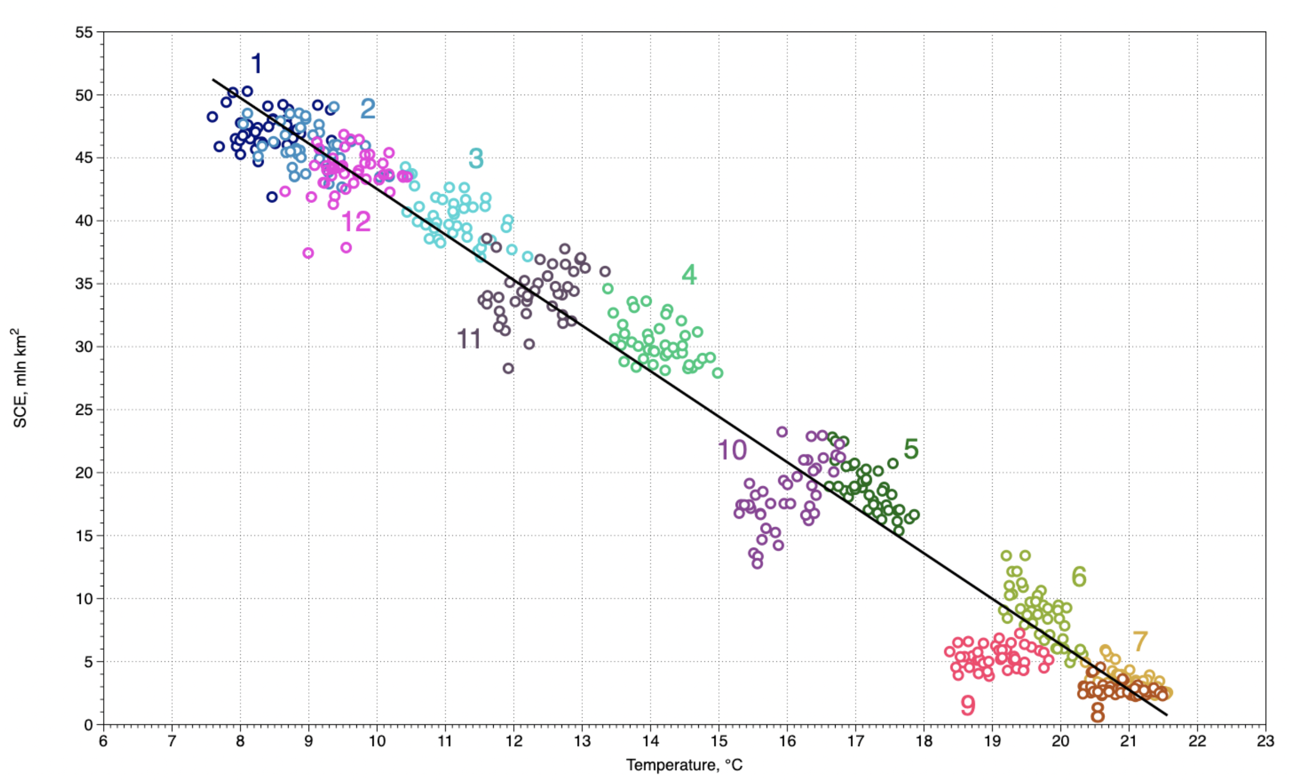
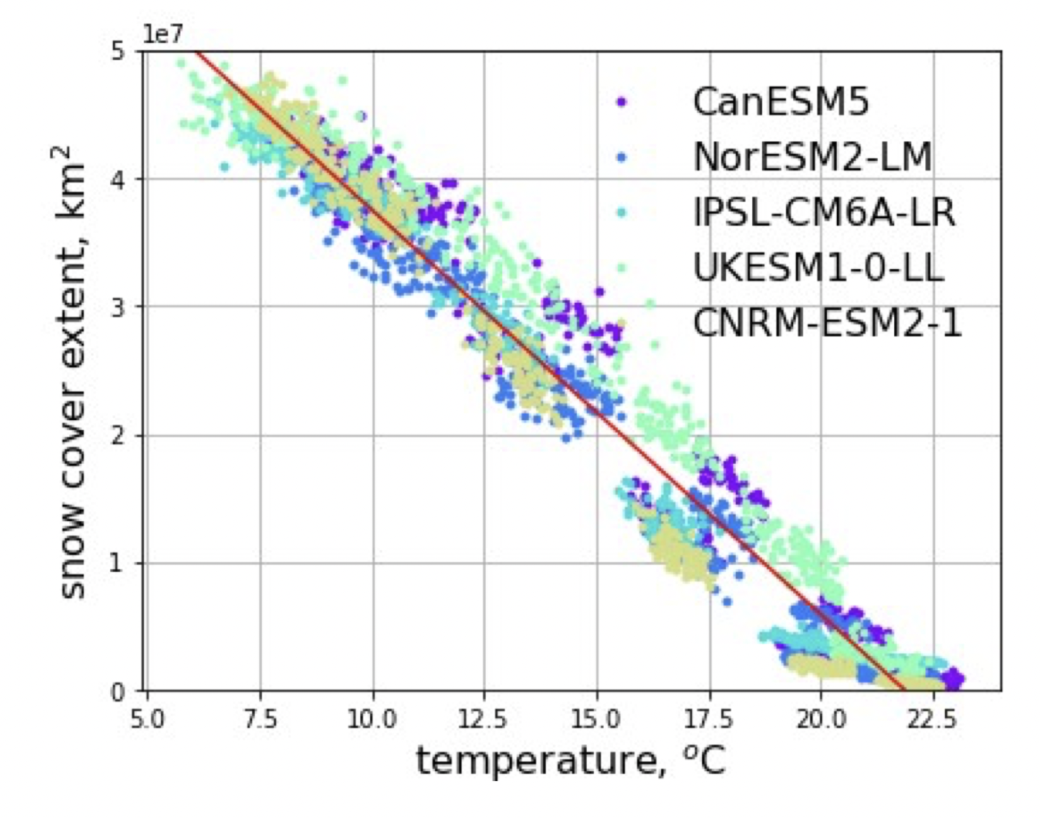


Sensitivity of the SCE to the changes in the surface air temperature
The coefficients of the linear regressions (characterized by the straight line) by
Satellite data & ERA5 reanalisys
Numerical simulations
Agree well.

Slide 7
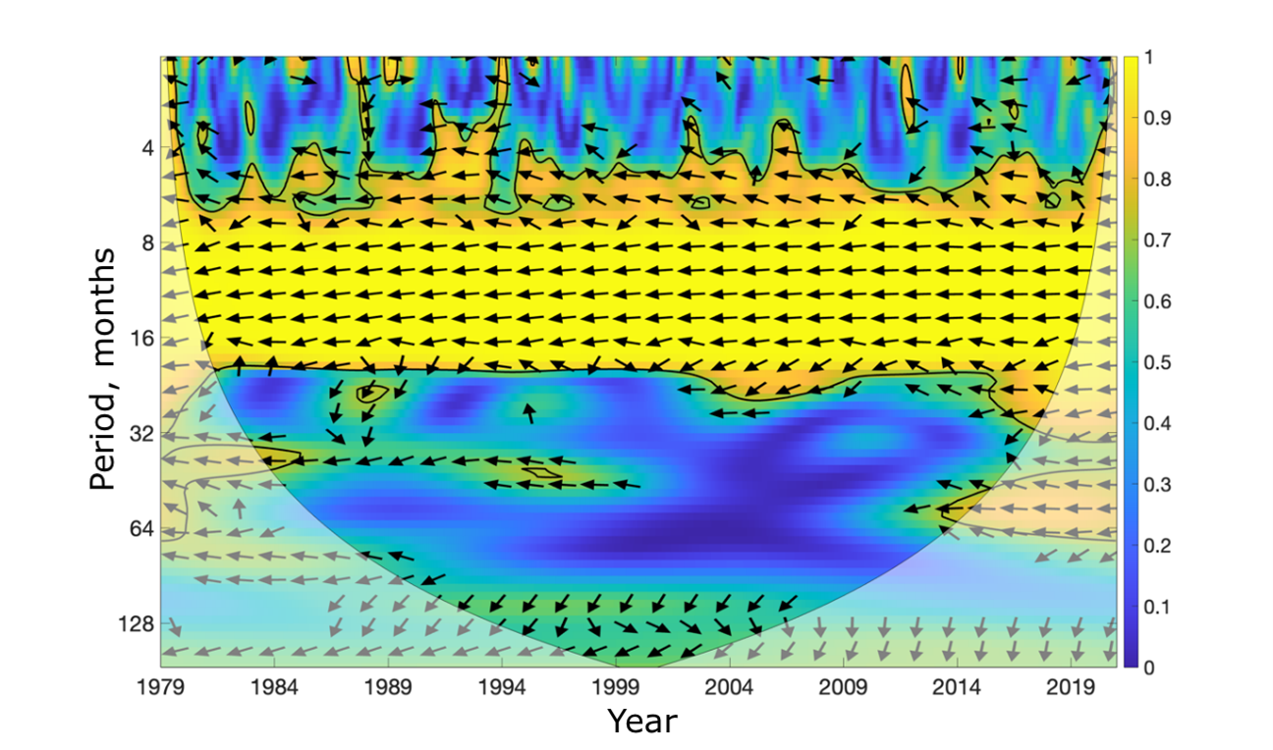
Cross-wavelet analysis of Snow Cover Extent and temperature regime
12 months = annual cycle
60 months = 5 years ~ El Nino

Slide 8
Conclusions
The variations in the surface air temperature and the SCE are stronger within the annual cycle, but interannual variations also appear for each month.
A significant negative correlation was noted in SCE and surface air temperature with the corresponding interannual variations.
The increase of SCE in the autumn months during warming can be explained by an increase in the transport of water vapor in the atmosphere with snowfall over the continents due to a decrease in the area of sea ice in the Arctic Ocean. It is significant that for the modern climate of recent decades, in particular for Eurasia, it is in October that a transition to negative surface temperatures and the formation of snow cover starts.
Features of snow cover changes can be associated not only with long-term trends in climate change and modes of interdecadal and intradecadal climatic variability, which manifest themselves differently in different regions, but also with the features of the analyzed data and its homogeneity, including CDR satellite observation data. In particular, the need to correct the CDR data until 2005 was noted in several papers.

Slide 9
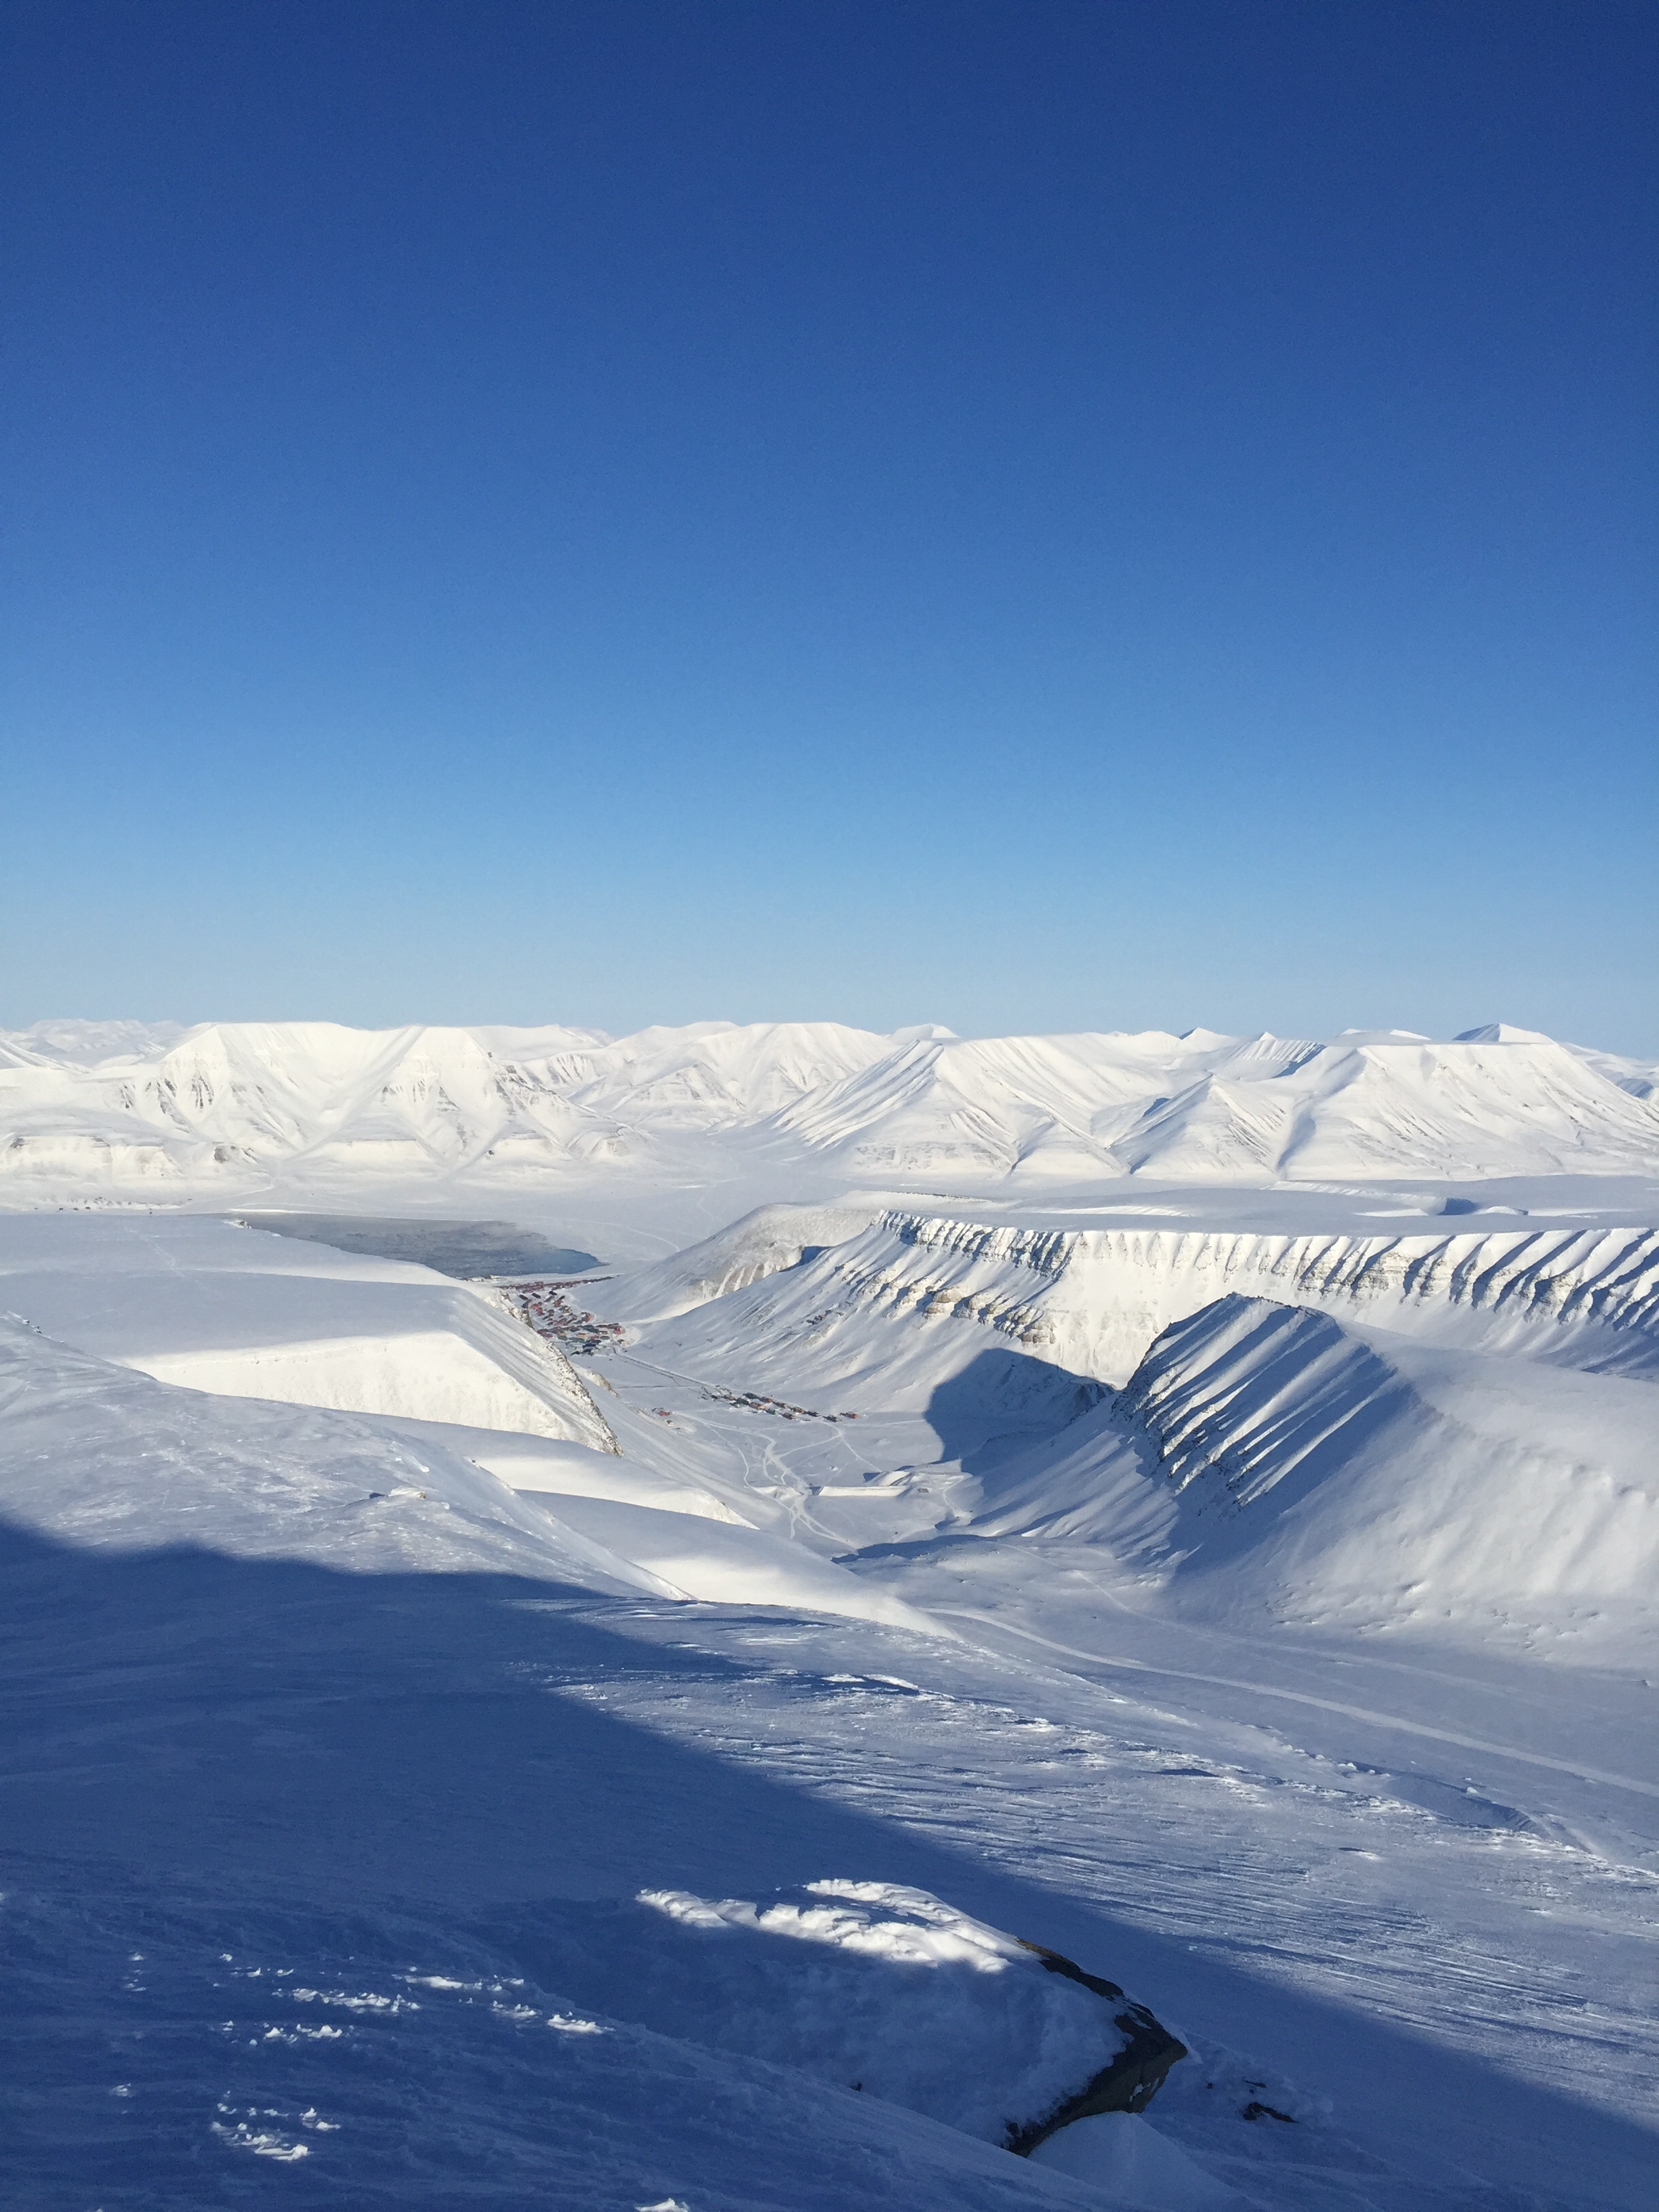

Thank you!
Contact: parfenova@ifaran.ru

