Slide 1
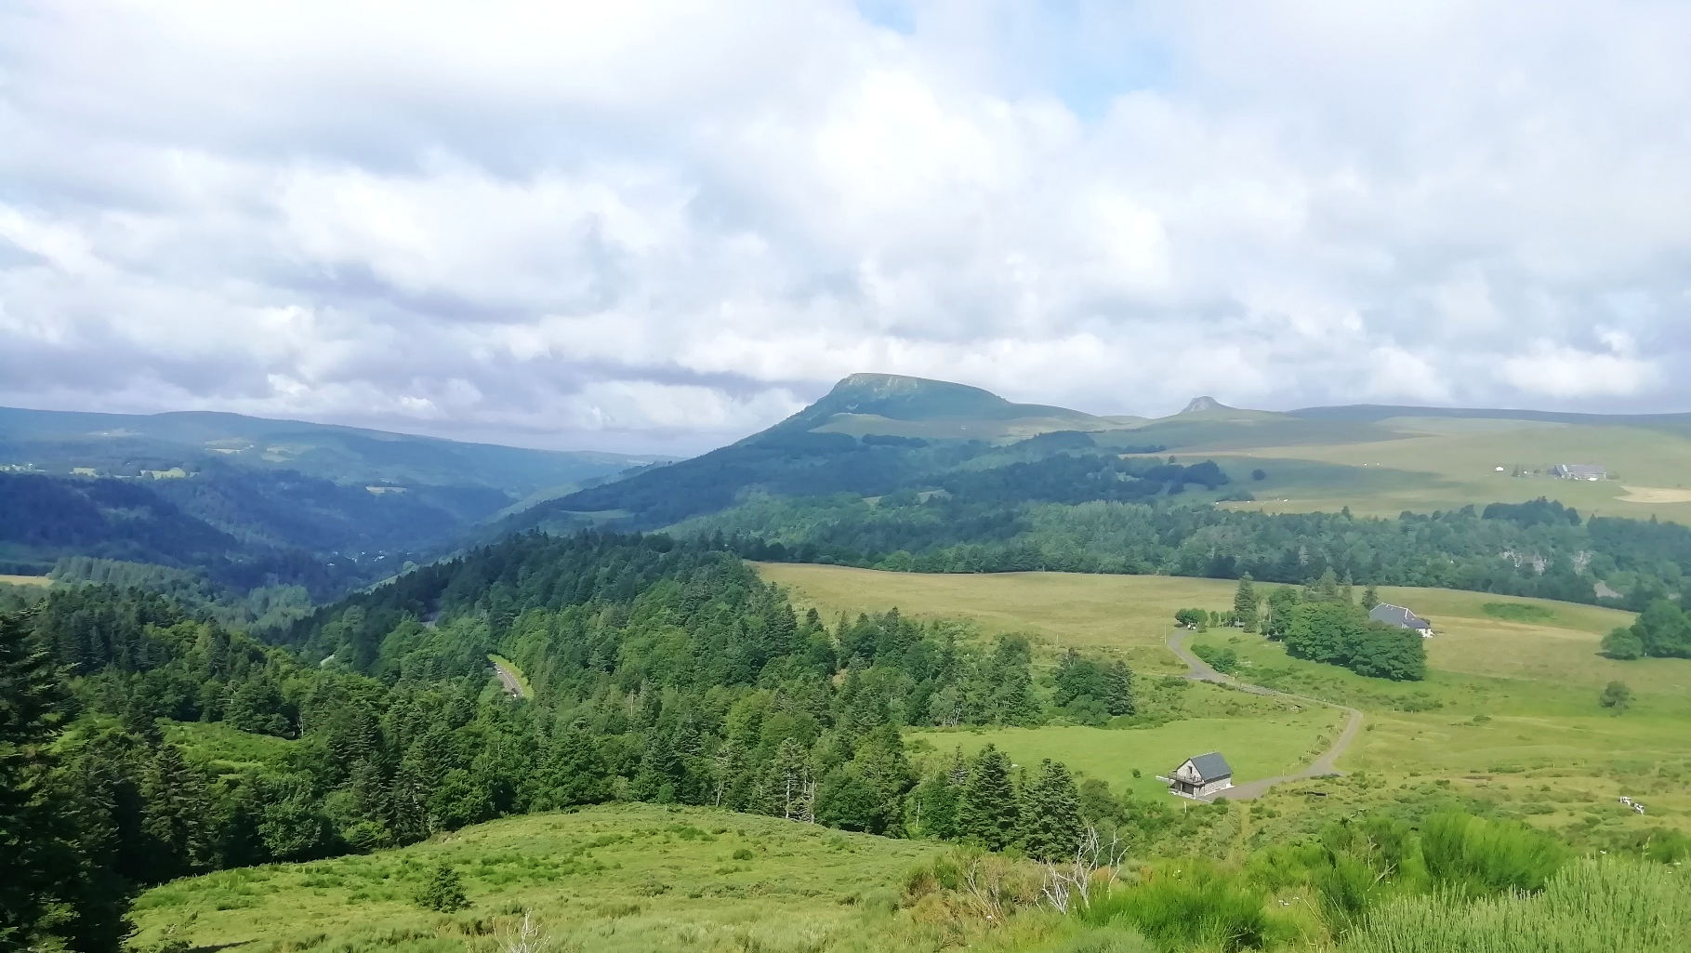

CO₂ and heat content of the French Massif Central thermal and mineral waters.
Lisa Ricci, Francesco Frondini, Daniele Morgavi, Guillaume Boudoire, Mickael Laumonier, Carlo Cardellini, Artur Ionescu, Alessandra Ariano, and Giovanni Chiodini.
Notes:
1

Slide 2

Introduction
Study area
Results and discussions
Conclusions
Heat flow trasported by fluids that circulate in a geothermal region is a crucial parameter in geothermal prospection.
The study of CO₂ degassing from geothermal systems is of primary importance to evaluate the environmental impact of greehouse gases associated with the geothermal power production.
Furthermore, the computation of the QCO₂/heat content is a powerful tool to charactrize a geothermal system.
GMPV6.2
Lisa Ricci
CO₂ and heat content of the French Massif Central thermal and mineral waters.
Notes:
2

Slide 3
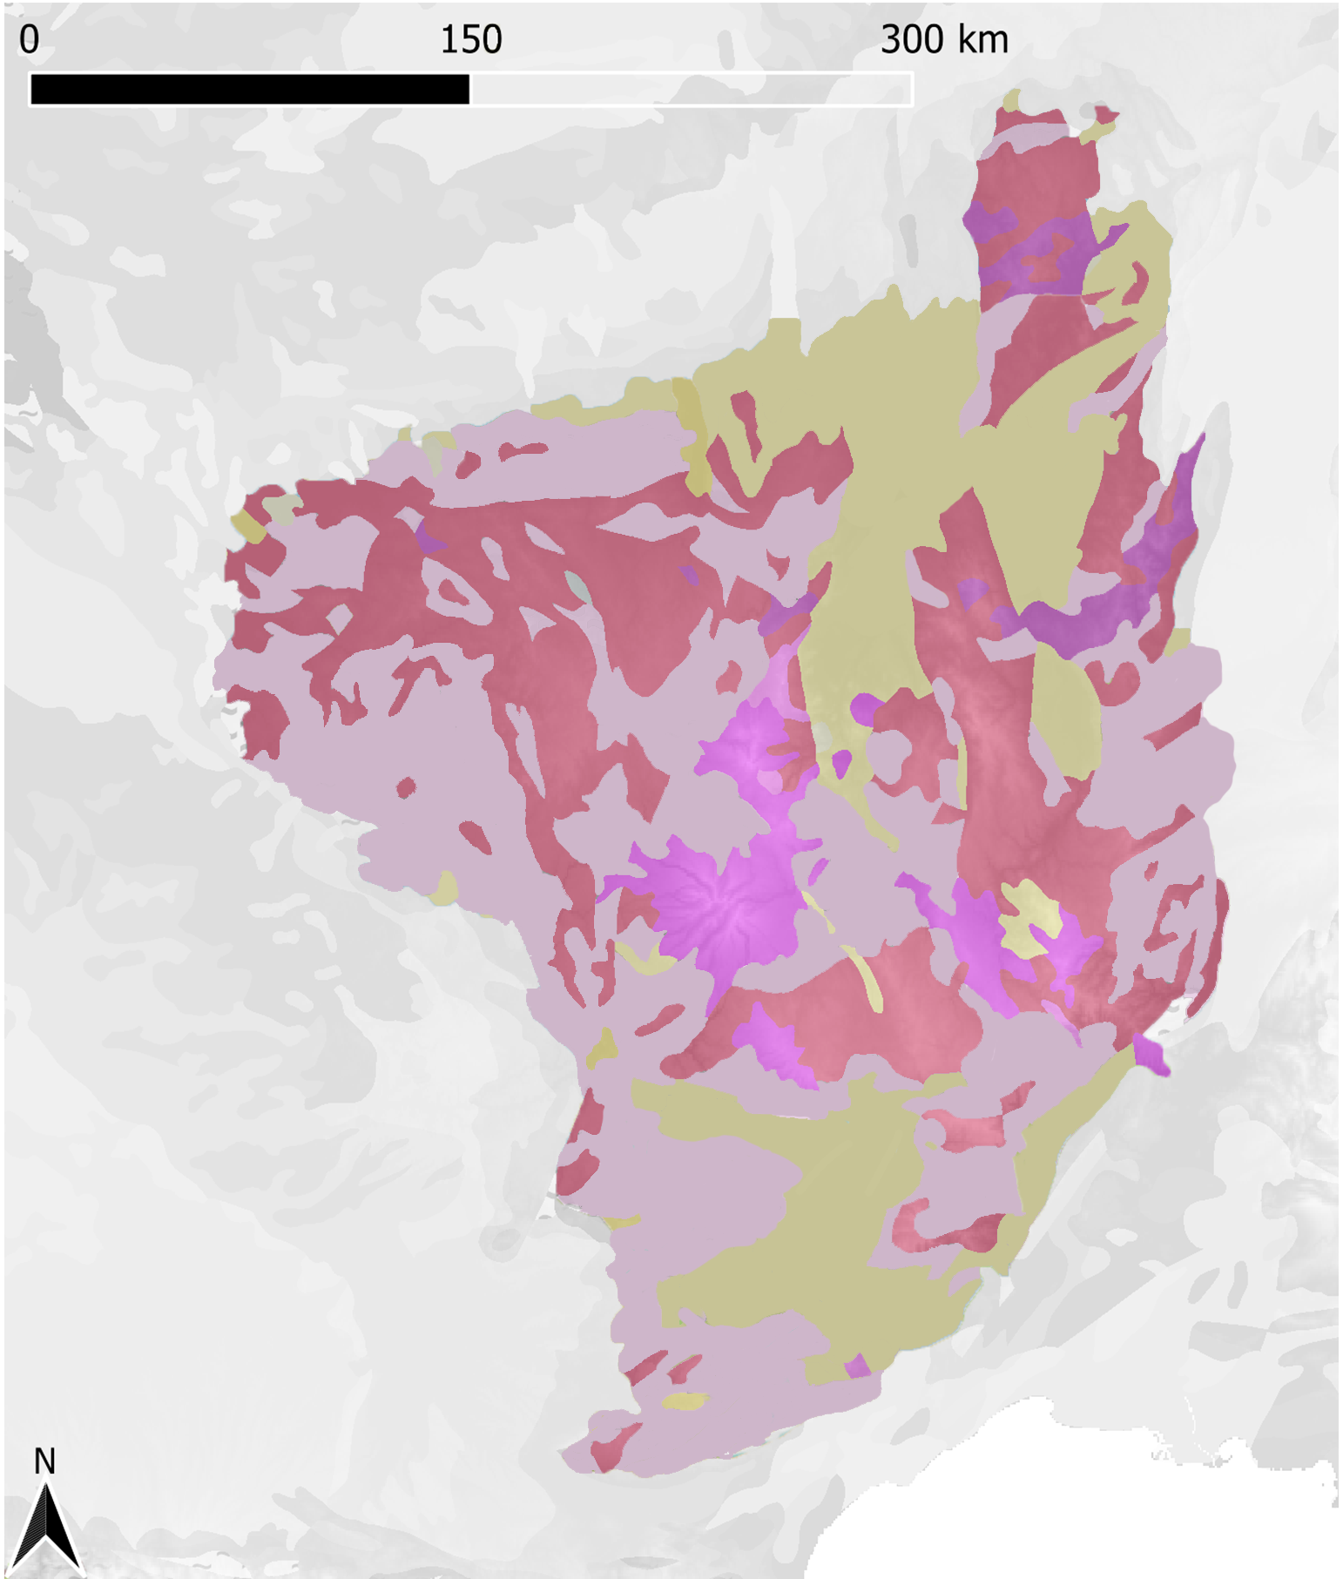
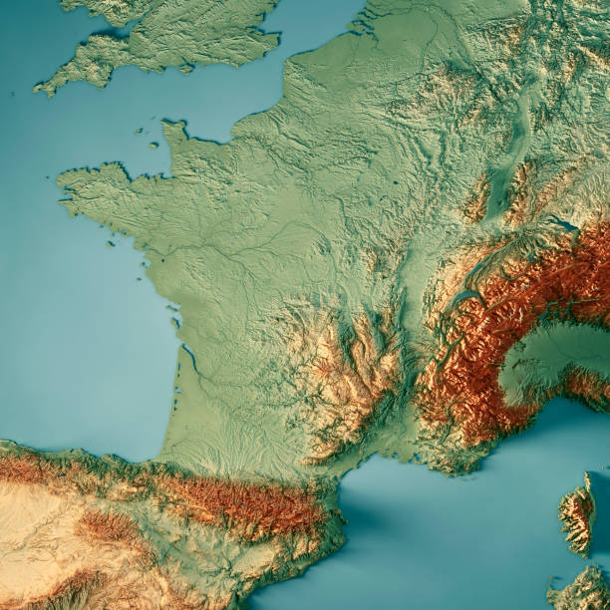
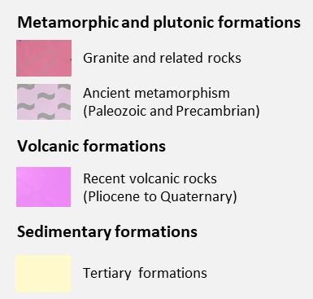
Introduction
Study area
Results and discussions
Conclusions
Vichy
Limagne
Clermont-
Ferrand
Mont
Dore
Cezallier
Cantal
Chaudes-
Aigues
Devès
Velay
Aubrac
https://www.istockphoto.com/it/search/2/image?phrase=massif+central
Mesozoic and tertiary formations
Modified from EuroGeoSurveys’ European Geological Data Infrastructure
GMPV6.2
Lisa Ricci
CO₂ and heat content of the French Massif Central thermal and mineral waters.
Notes:
3

Slide 4
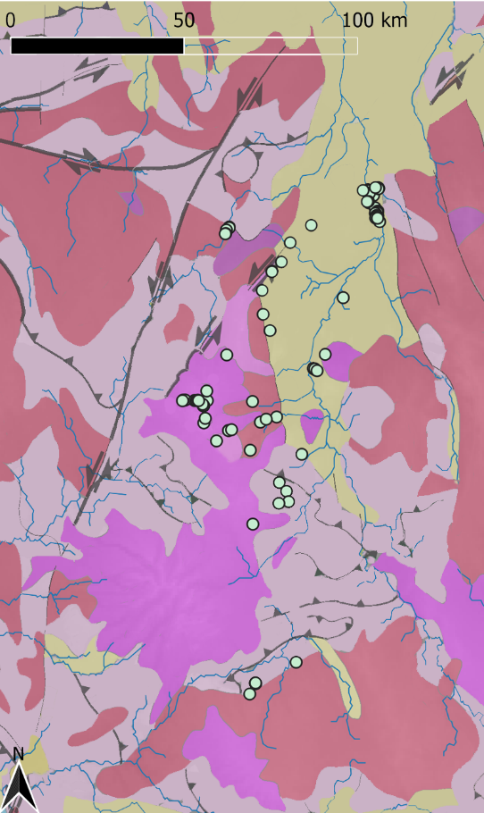
Introduction
Study area
Results and discussions
Conclusions
Vichy
Limagne
Clermont-
Ferrand
Mont
Dore
Cezallier
Cantal
Chaudes-
Aigues
Devès
Velay
Aubrac
https://www.istockphoto.com/it/search/2/image?phrase=massif+central
Mesozoic and tertiary formations
Modified from EuroGeoSurveys’ European Geological Data Infrastructure
GMPV6.2
Lisa Ricci
CO₂ and heat content of the French Massif Central thermal and mineral waters.
Notes:
4

Slide 5
Introduction
Study area
Results and discussions
Conclusions
CHEMICAL COMPOSITION OF WATERS: LANGELIER-LUDWIG DIAGRAM
R(Cl+SO
)
4
Na-HCO₃
waters
Water-rock interaction in the volcanic aquifer or in the cristalline basement
Interaction of water with CO₂
R(Na+K)
R(Mg+Ca)
R(HCO
)
3
Massif Central waters
GMPV6.2
Lisa Ricci
CO₂ and heat content of the French Massif Central thermal and mineral waters.
Notes:
5

Slide 6
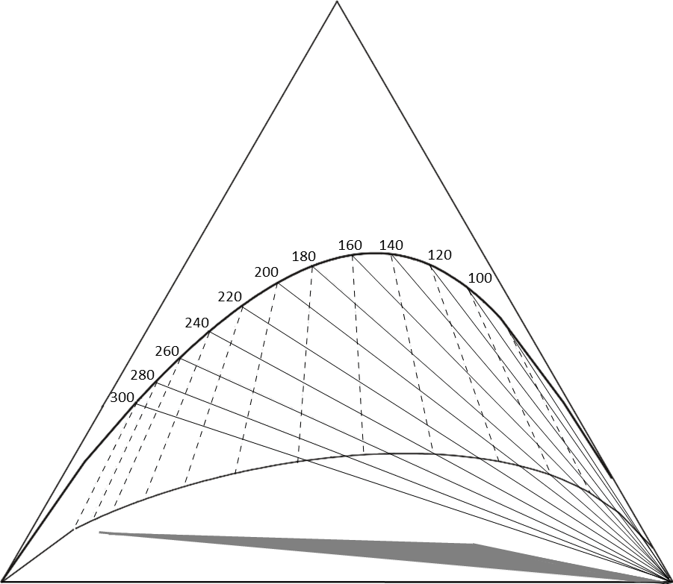
Introduction
Study area
Results and discussions
Conclusions
GIGGENBACH DIAGRAM (1988)
Na/1000
Massif Central waters
full equilibrium
The majority of samples fall in the field of Immature waters
partial equilibrium
Immature waters
rock
K/100
√Mg
GMPV6.2
Lisa Ricci
CO₂ and heat content of the French Massif Central thermal and mineral waters.
Notes:
6

Slide 7
Introduction
Study area
Results and discussions
Conclusions
GIGGENBACH DIAGRAM (1988)
Na/1000
Massif Central waters
Vichy waters
full equilibrium
Vichy waters are in partial equilibrium with silicates and suggest a reservoir temperature between 160 and 220 °C, in agreement with previous studies and with the Li-Na geothermometers.
partial equilibrium
Immature waters
rock
K/100
√Mg
GMPV6.2
Lisa Ricci
CO₂ and heat content of the French Massif Central thermal and mineral waters.
Notes:
7

Slide 8
Introduction
Study area
Results and discussions
Conclusions
GMPV6.2
Lisa Ricci
CO₂ and heat content of the French Massif Central thermal and mineral waters.
Notes:
8

Slide 9
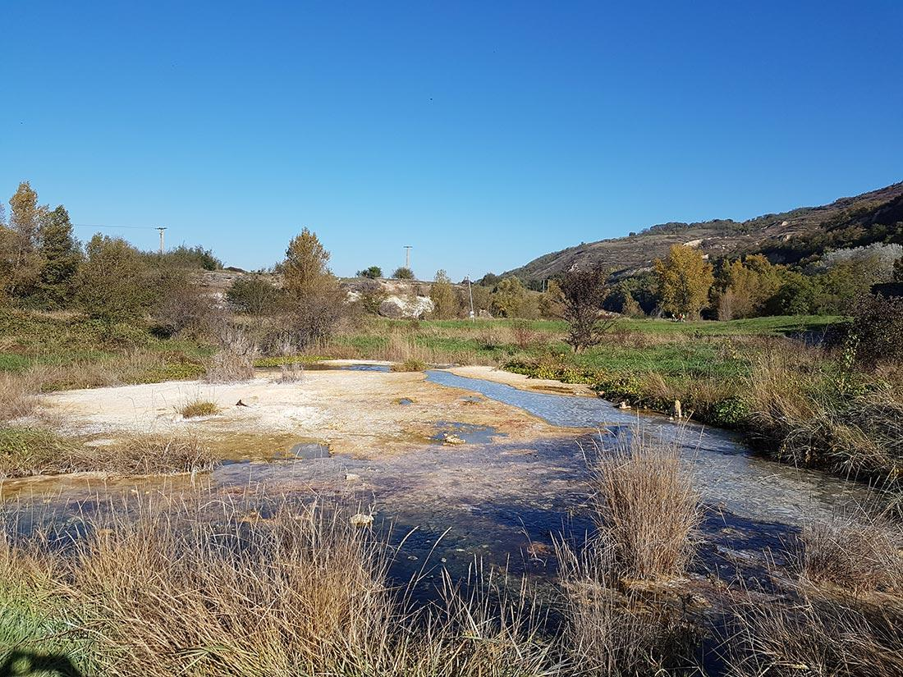
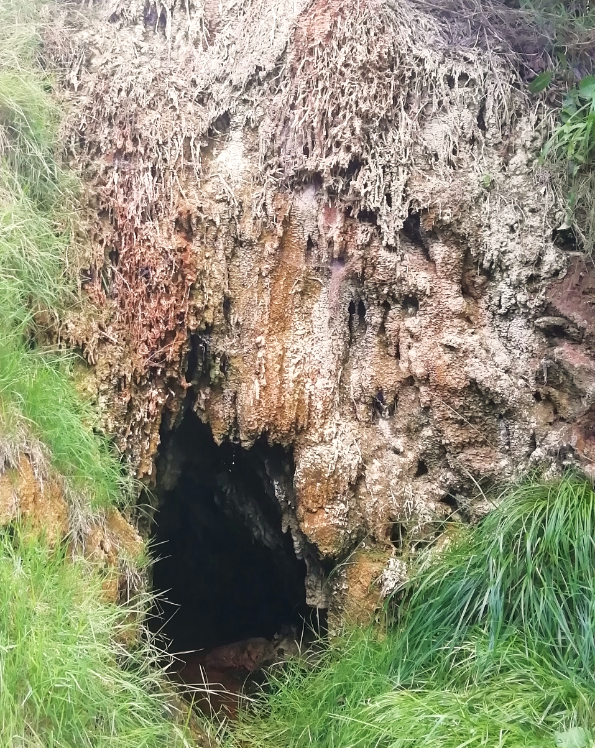
Introduction
Study area
Results and discussions
Conclusions
54.8% of samples are oversaturated with calcite
Sainte Marguerite: SI calcite=0.78
https://cen-auvergne.fr/sites-et-milieux-naturels/sources-salees-de-sainte-marguerite
Calcite precipitation
Saurier: SI calcite=0.86
GMPV6.2
Lisa Ricci
CO₂ and heat content of the French Massif Central thermal and mineral waters.
Notes:
9

Slide 10
Introduction
Study area
Results and discussions
Conclusions
PARTIAL PRESSURES OF CARBON DIOXIDE
GMPV6.2
Lisa Ricci
CO₂ and heat content of the French Massif Central thermal and mineral waters.
Notes:
10

Slide 11
Introduction
Study area
Results and discussions
Conclusions
CO₂ MASS FLOW RATE AND HEAT CONTENT
600
R²=0.37
The CO₂ mass flow rate of Massif Central is 0.43 Kg/s, corresponding to 37 t/d
The heat content associated to the geothermal system is 61.88 MW.
R²=0.71
500
400
(MW)
R²=0.88
H
300
Q
R²=0.67
200
System | QCO₂/Q_{H} (Kg/MJ)
Massif Central | 0.007
Taupo, Salton Trough | 0.003
Reykjanes | 0.001
Nisyros | 0.008
Italian aquifers and geothermal wells | 0.03
100
0
0
2
4
6
8
10
12
Q(CO
) (Kg s
-1
)
2
Italian geothermal wells
Taupo, Salton Trough
Best fit of Italian geothermal wells
Best fit of Taupo and Salton Trough
Reykjanes, Nisyros
Torre Alfina, Latera
Massif Central waters
Italian aquifers
Massif Central (sum)
Best fit of Italian aquifers
Best fit of Massif Central waters
GMPV6.2
Lisa Ricci
CO₂ and heat content of the French Massif Central thermal and mineral waters.
Notes:
11

Slide 12
Introduction
Study area
Results and discussions
Conclusions
The Massif Central area is characterized by hydrothermal systems with temperatures up to 200 °C and a total thermal and mineral water flow rate of about 1 m³ s⁻¹.
The heat flow/QCO₂ ratio is higher than italian systems, but the heat amount is one order of magnitude lower.
These features make the region attractive to the direct use of geothermal energy.
Furthermore, it may be evaluated the electrical exploitation through the binary exchange power plants.
GMPV6.2
Lisa Ricci
CO₂ and heat content of the French Massif Central thermal and mineral waters.
Notes:
12

