Slide 1




Large-scale tank experiments simulating soil aquifer treatment Assessing the attenuation potential of emerging organic compounds and nutrients during managed aquifer recharge Marcel Horovitz^{1,2}, Edinsson Muñoz-Vega², Teresa Leitão¹, Christoph Schüth², Stephan Schulz² ¹ Laboratório Nacional de Engenharia Civil (LNEC), Hydraulics and Environment Department, Water Resources and Hydraulic Structures Unit, Avenida do Brasil 101, 1700-066 Lisbon, Portugal ² Technical University of Darmstadt, Institute of Applied Geosciences, Hydrogeology Group, Schnittspahnstraße 9, 64287 Darmstadt, Germany

Slide 2
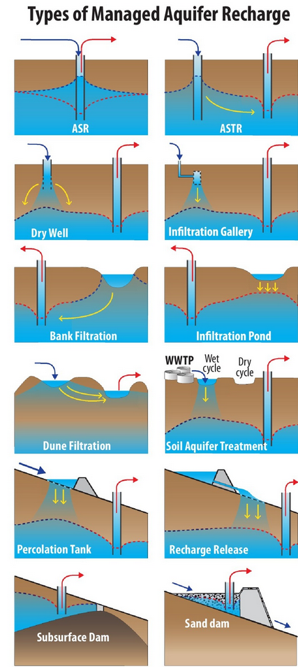
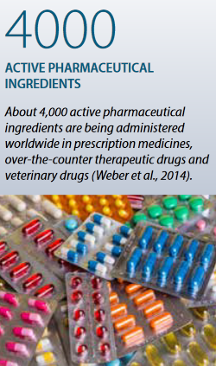
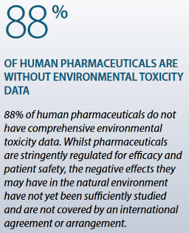
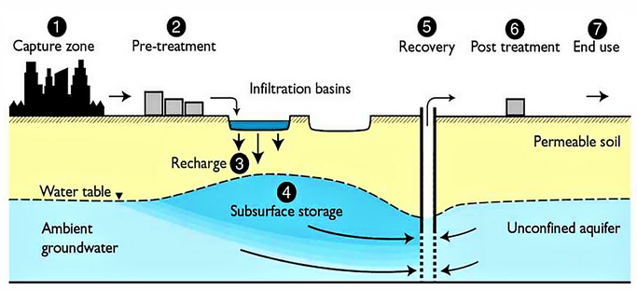
Introduction – SAT-MAR
Soil Aquifer Treatment (SAT) is one of several techniques of Managed Aquifer Recharge (MAR) using treated wastewater effluent as feedwater to recharge groundwater resources in water scarce regions and providing intermediate storage for later use
SAT-MAR as tertiary treatment for secondary treated wastewater effluents:
Risks due nutrients (N, P) and emerging organic compounds (e.g., pharmaceuticals)
https://sswm.info/water-nutrient-cycle/reuse-and-recharge/hardwares/recharge-and-disposal/soil-aquifer-treatment (accessed: 22.04.2022)
OECD (2019), Pharmaceutical Residues in Freshwater: Hazards and Policy Responses
OECD (2019), Pharmaceutical Residues in Freshwater: Hazards and Policy Responses
Alam et al. (2021,)Managed aquifer recharge implementation criteria to achieve water sustainability

Slide 3
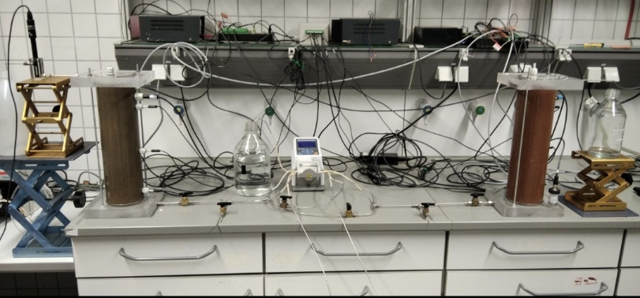
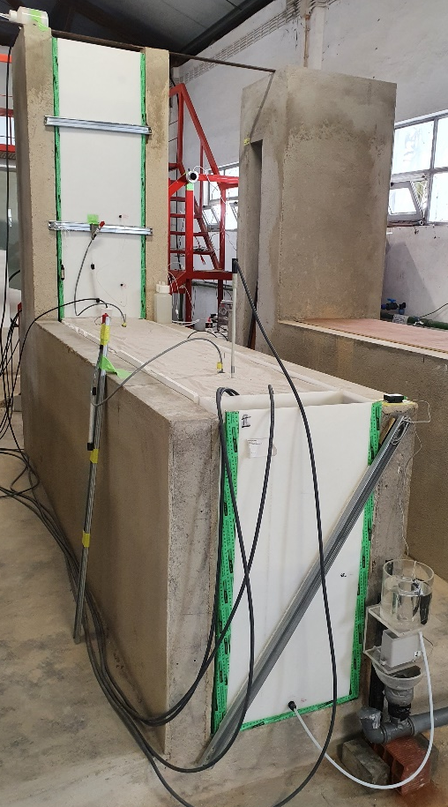
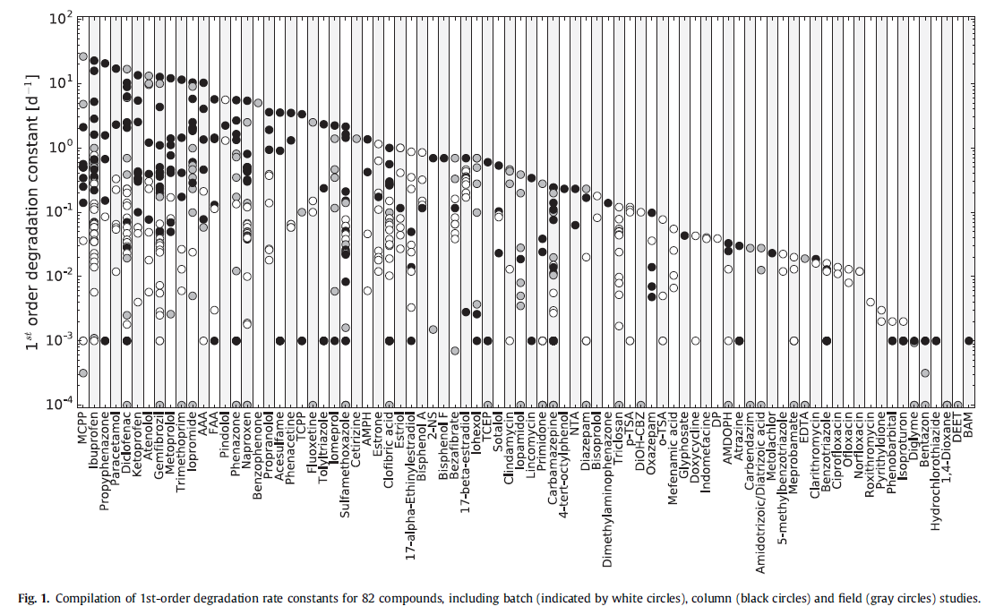
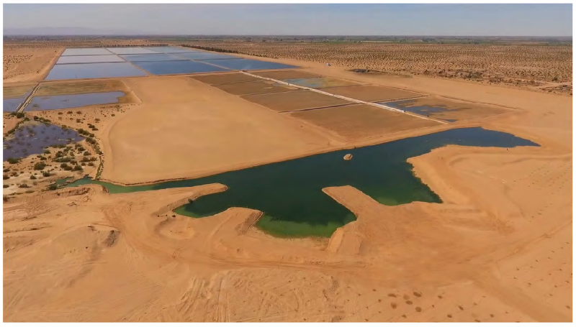
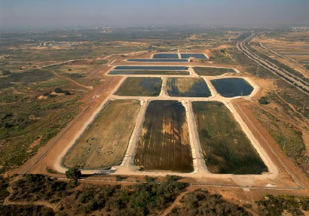
Motivation for large-scale sand tank experiments simulating SAT-MAR
Attempt to bridge the gap:
Sand Tank Experiments
Small Scale – Column Experiments
Processes due to mixing of groundwater and infiltrating treated wastewater
High resolution monitoring and sampling
Controlled conditions
Dry and wet cycles
Risk assessment
Edinsson Muñoz-Vega (PhD Thesis) – Role of organic matter, redox processes and biofilm formation in the transport of selected emerging organic contaminants
Field Scale – SAT-MAR Sites
UNESCO (2021) – MANAGING AQUIFER RECHARGE: A Showcase for Resilience and Sustainability
Greskowiak et al. (2017), The uncertainty of biodegradation rate constants of emerging organic compounds in soil and groundwater - A compilation of literature values for 82 substances

Slide 4
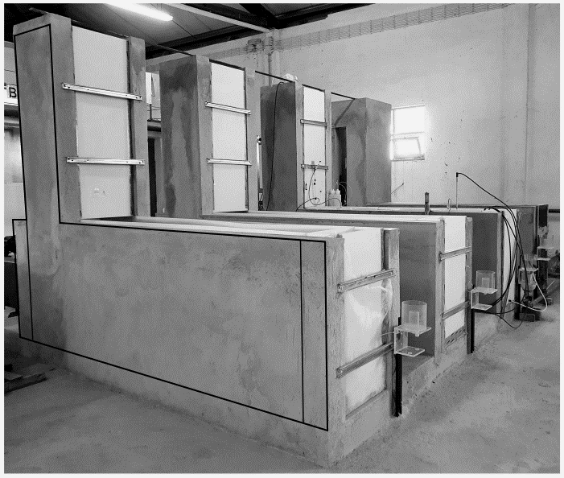
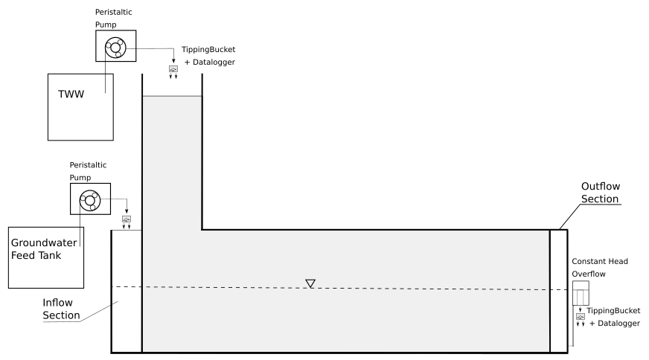
Experimental Facility – Design of Large-Scale Sand Tanks
Three large-scale sand tanks made from HDPE (high density polyethylene)
0.5 m
Feed waters:
Treated wastewater effluent (Lisbon treatment plant)
Groundwater (LNEC campus)
SAT-Basin
0.5 m
2.5 m
Unsaturated Zone
1.0 m
fine sand
2.76 m
Saturated Zone
(GW flow)
Dry and wet cycles (3 days infiltration, 4 days drying)

Slide 5
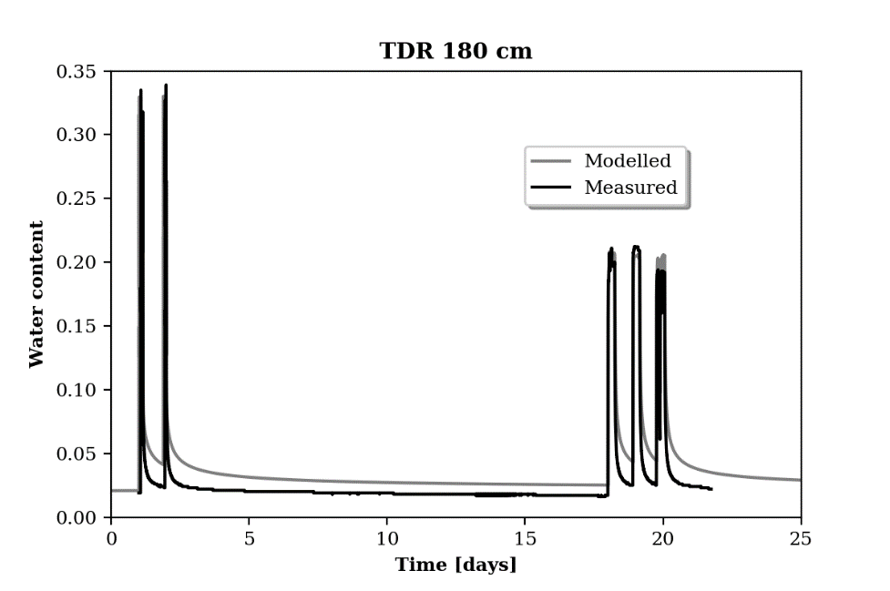
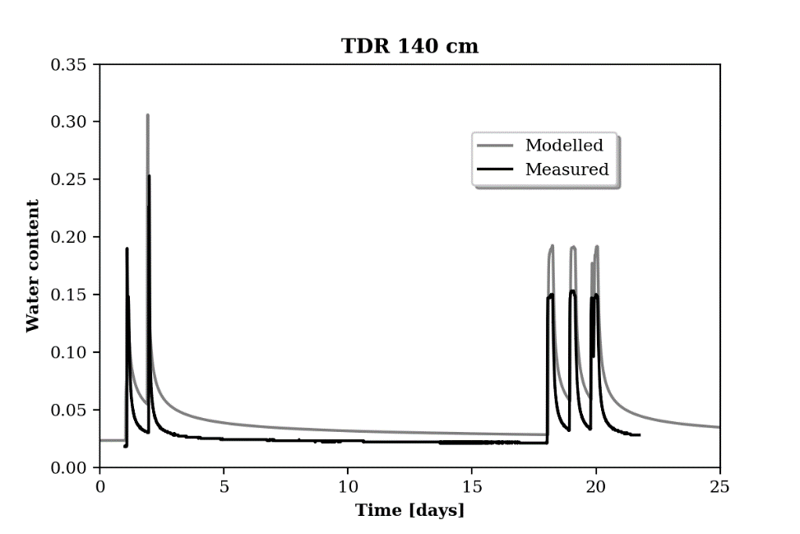
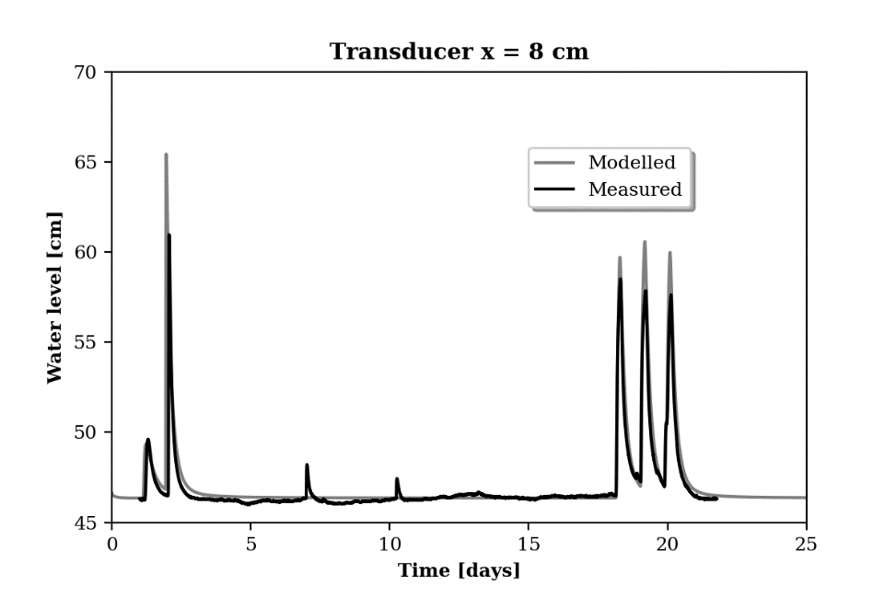
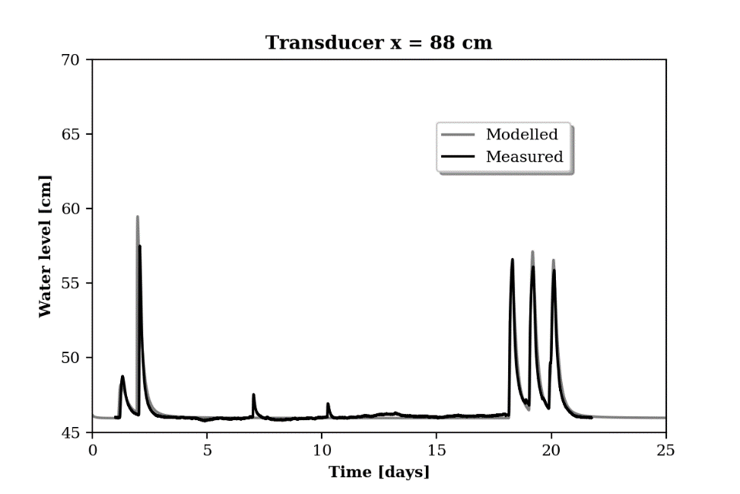
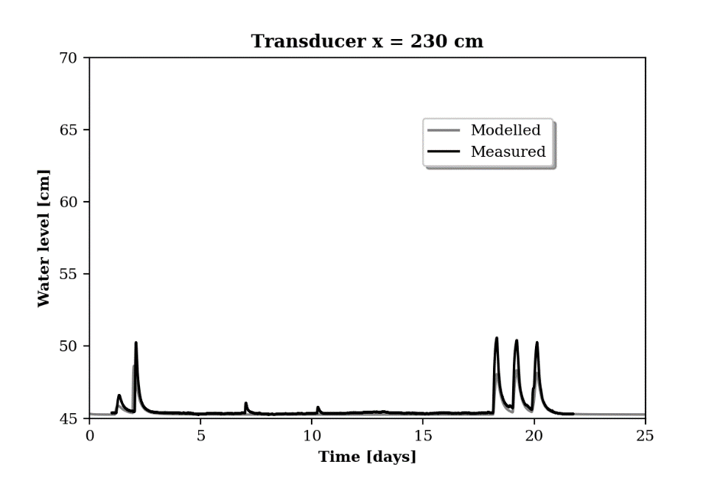
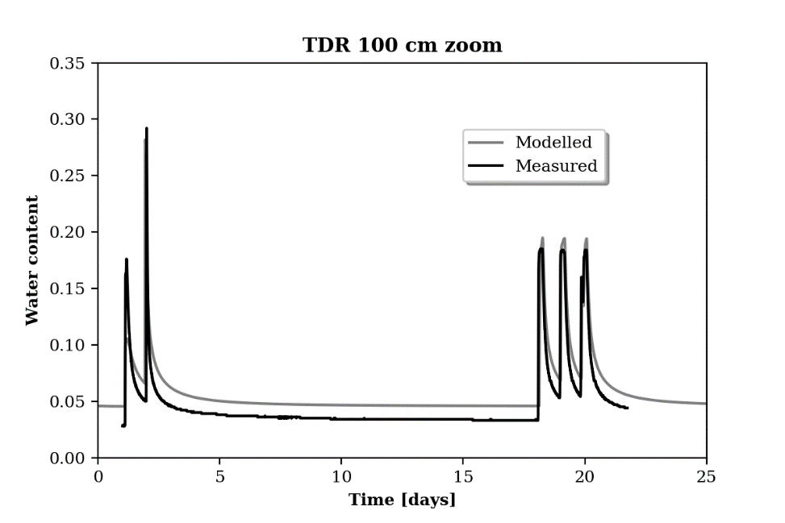
Numerical Model
Feflow Model
Ksat ~ 1.2 * 10-4 m/s
Porosity = 0.33
Dispersivity
Longitudinal = 1 cm
Transversal = 0.1 cm
Van Genuchten Parameter
Alpha = 3.6 m-1
N = 4.7
Theta_s = 0.33
Pressure transducer
Soil moisture probes

Slide 6
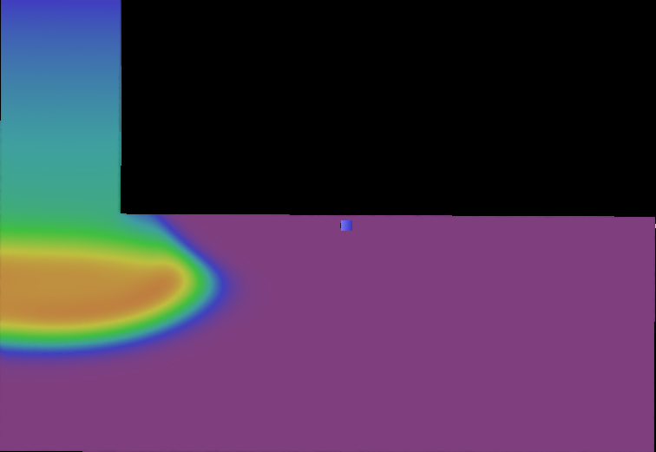
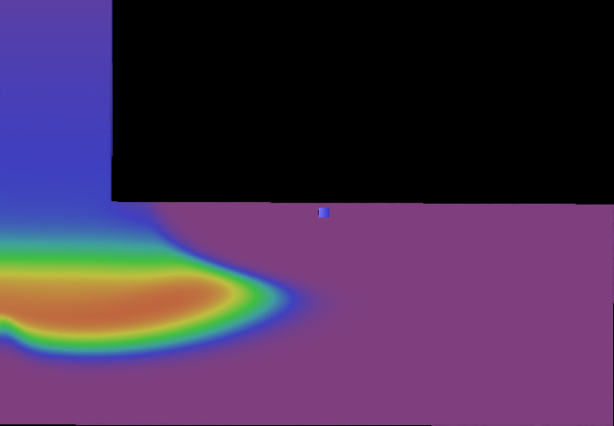
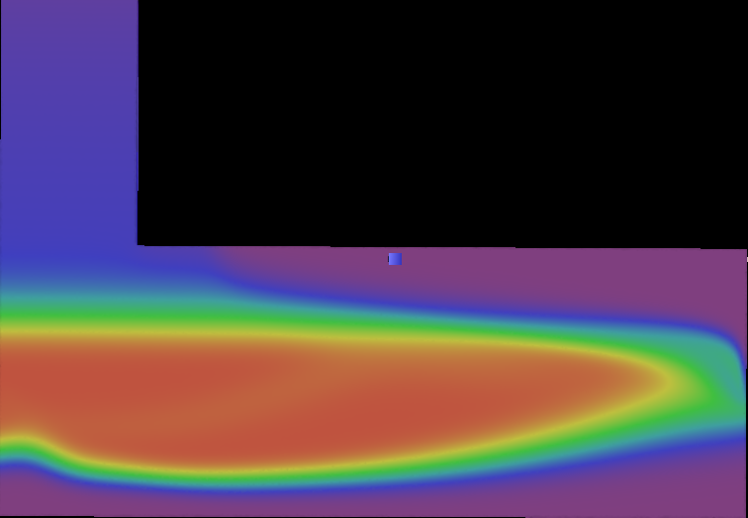
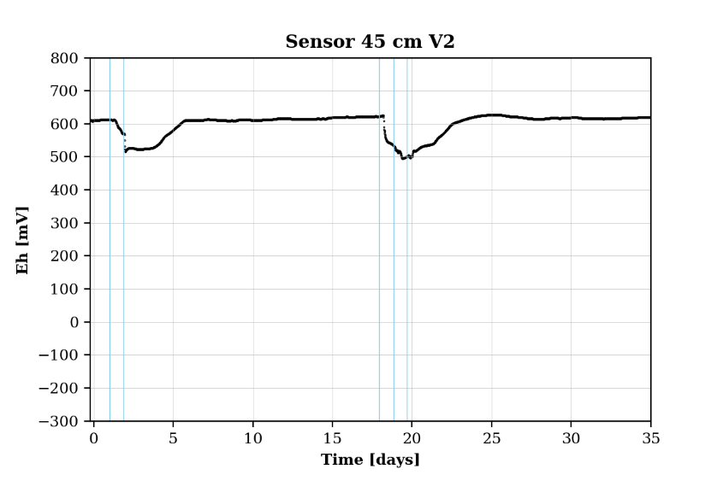
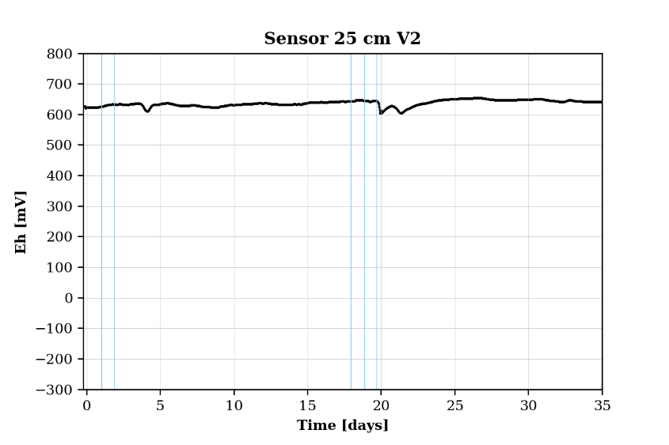
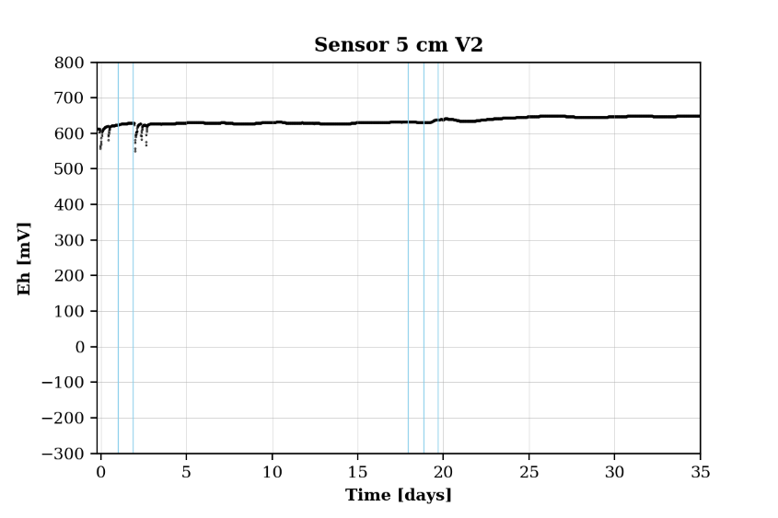
Numerical Model vs. Observation of Redox Potential
Redox probe (18 readings) in the infiltration section (white dashed line)
Timestep = 1 day
Timestep = 1.5 days
Timestep = 20 days
45 cm
45 cm
45 cm
25 cm
25 cm
25 cm
5 cm
5 cm
5 cm

Slide 7
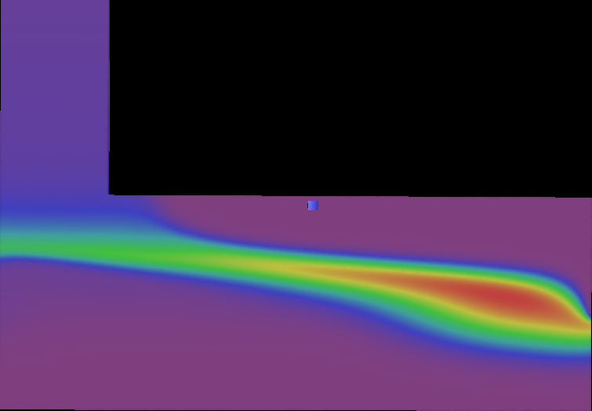
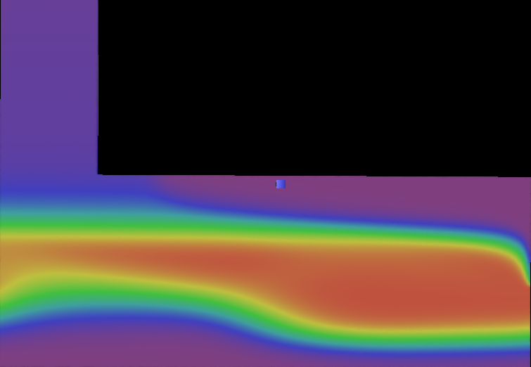
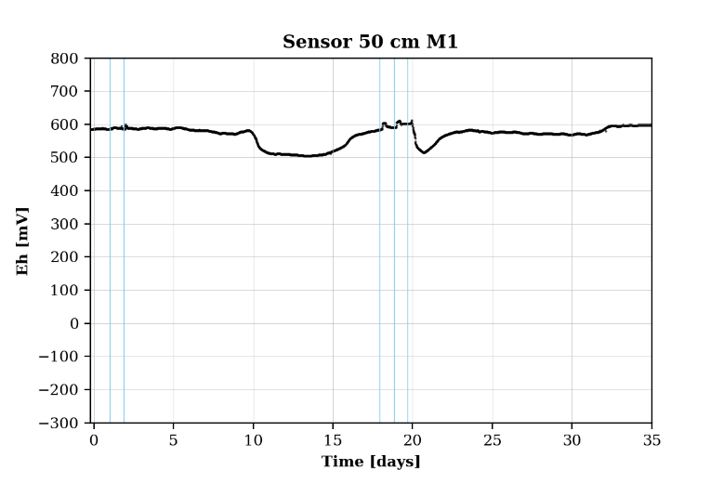
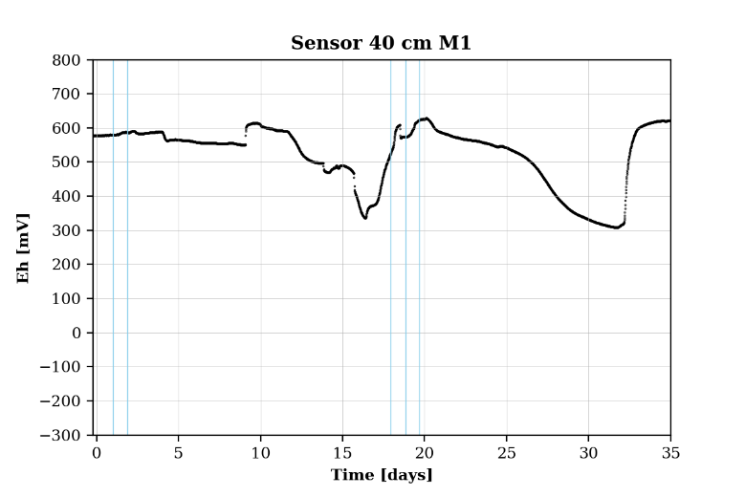
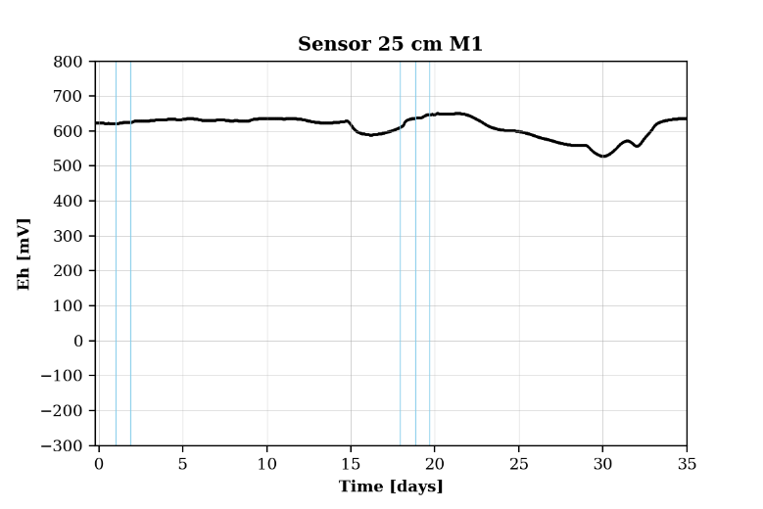
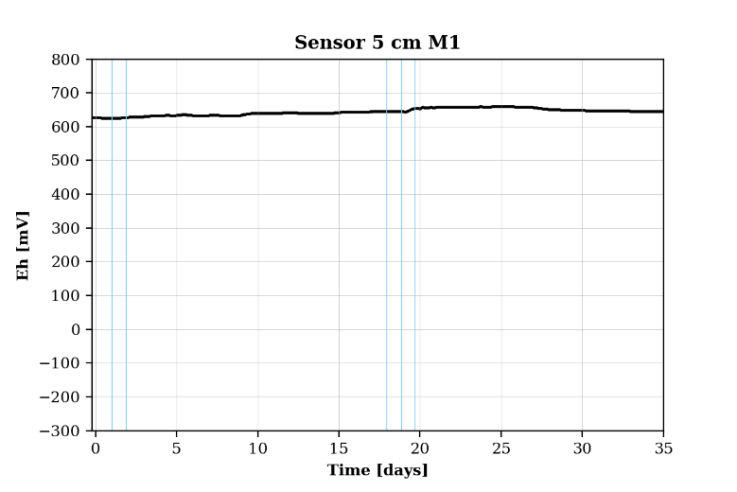
Numerical Model vs. Observation of Redox Potential
Redox probe (18 readings) near the end of the sand-tank (white dashed line)
Timestep = 13.5 days
Timestep = 27 days
50 cm
50 cm
40 cm
40 cm
25 cm
25 cm
5 cm
5 cm

Slide 8
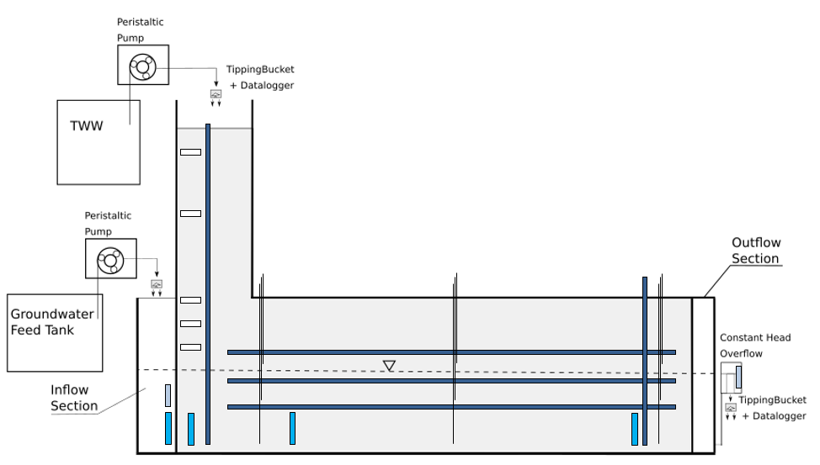
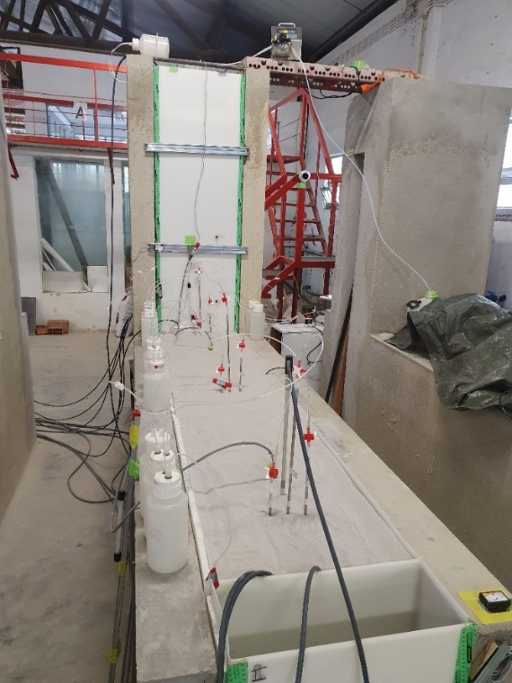
Highly equipped sand tank to study mixing processes - Ongoing
In total 90 redox sensors:
2 vertical redox probes with 18 sensors each
3 horizontal redox probes with 18 sensors each
Soil moisture probes in 5 depths
Electrical conductivity logger at inflow and outflow
Sampling in saturated zone:
Micropiezometers at 3 positions and screened in 3 depths
Sampling in vadose zone:
Suction cups at 3 depths
Redox probes
Pressure transducer
Suction Cup
Soil moisture probes
Electrical conductivity logger

Slide 9
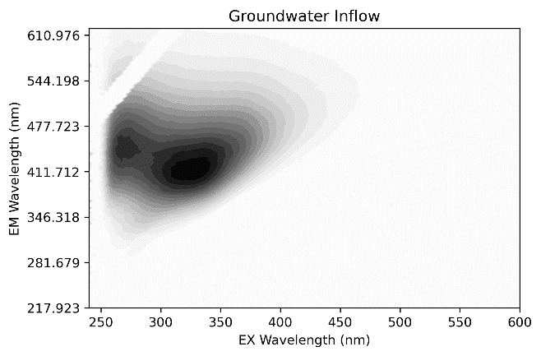
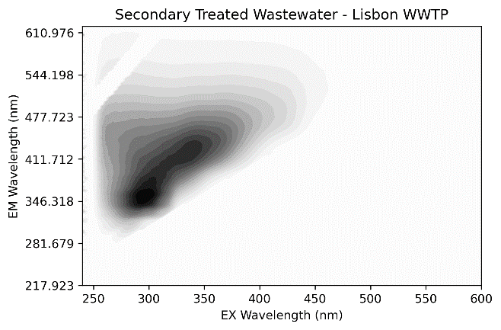
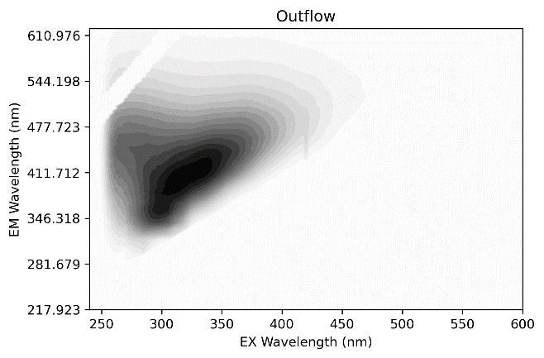
Highly equipped sand tank to study mixing processes - Ongoing
Samples to be analyzed for:
Major ions
Trace metals
DOC
Pharmaceuticals (carbamazepine, diclofenac, ibuprofen, naproxen, gemfibrozil, and triclosan) with wide range of physicochemical parameter and degradation potential
Dissolved organic matter characterization via fluorescence spectrometry
Humic and fulvic like composition in groundwater
Protein-like (readily degradable) and slightly humic-like in treated wastewater effluent
Outflow shows mixing and might show degradation of protein-like components
+
+
+
+
+
+

Slide 10
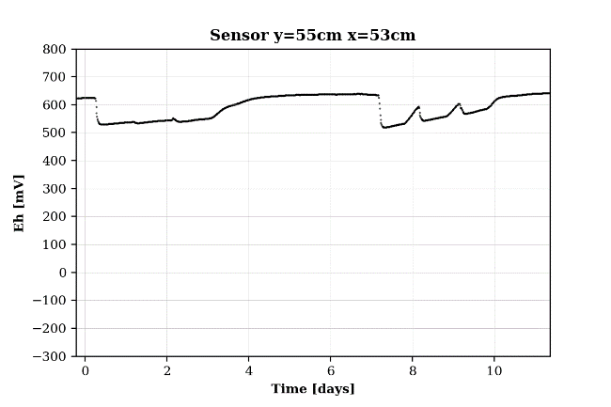
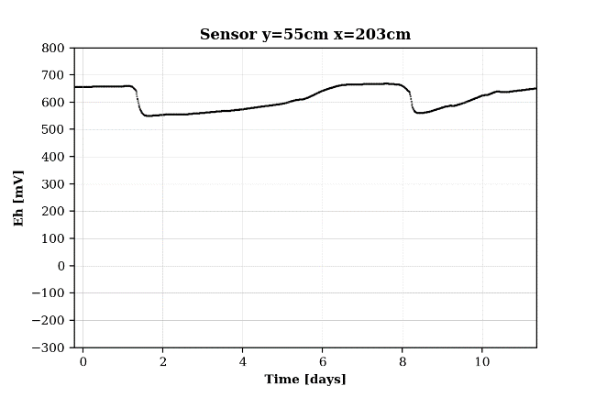
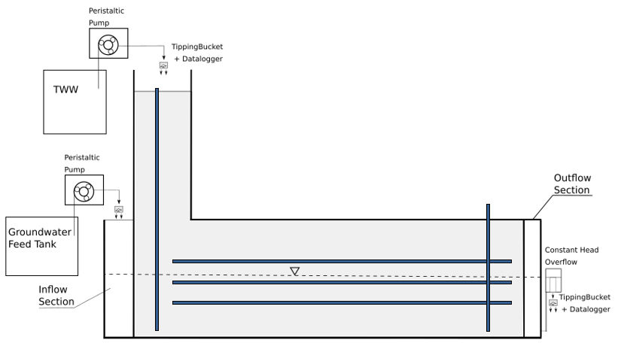
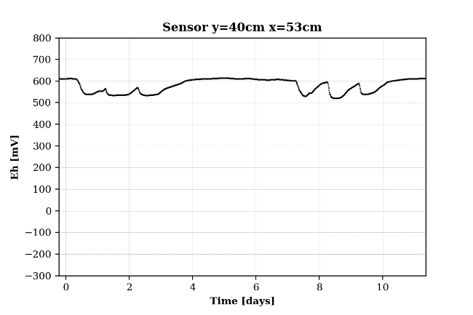
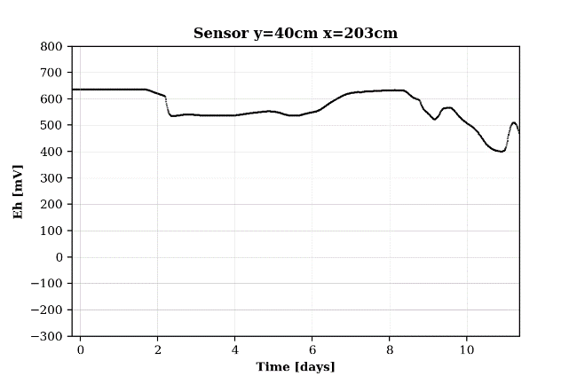
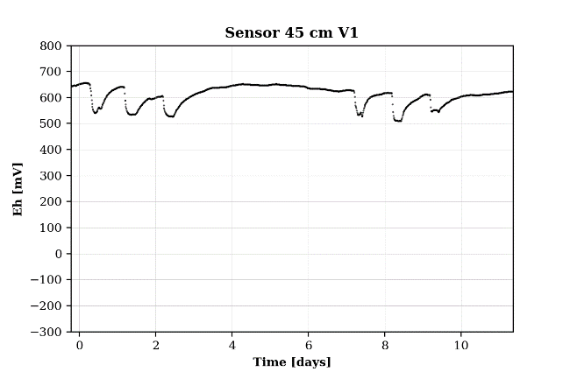
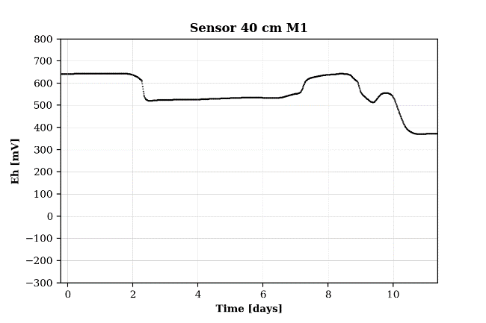
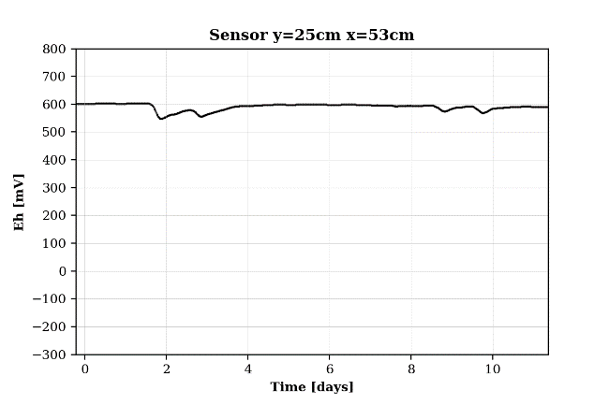
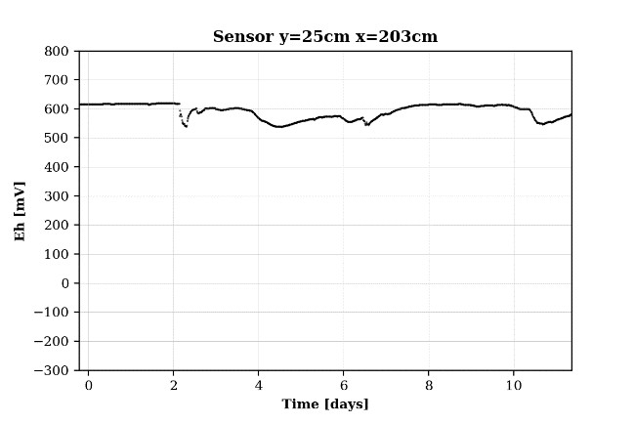
Highly equipped sand tank – Ongoing – Preliminary Results of Redox Probes
Mixing processes of infiltrating treated wastewater and groundwater observable in redox signal
Reaching nitrate reducing conditions

Slide 11

Thank you for your attention
Further information on MARSoluT project:
https://www.marsolut-itn.eu/
For questions: mhorovitz@lnec.pt
The MARSoluT ITN has received funding from the European Union’s
Horizon 2020 research and innovation programme under the
Marie Skłodowska Curie grant agreement No 814066.

