Slide 1


Graziela Luzia, Andrea N. Hahmann, and Matti J. Koivisto
Department of Wind and Energy Systems
Technical University of Denmark
EGU General Assembly 2022 - 25 May 2022
Mesoscale modeling of the spatio-temporal variability in wind speed time series for power and energy system applications
EGU abstract

Slide 2
Introduction
PhD context
Planning highly weather-dependent future power and energy systems require climate data including possible impacts from climate change.
Special data format is required for the intermittent variable renewable energy generation analysis at the European level.
E.g.: ~10 km-hourly data, available vertical levels for rather representing turbine hub-heights than fixed 10m wind speed, etc.
Objective of this presentation
Optimize WRF¹ simulations for producing time series suitable for power and energy system applications.
Methodology
Using a model configuration validated for the New European Wind Atlas (NEWA) [1,2] to test different model setup focused on the time series characteristics.
1: The Weather Research and Forecast model

Slide 3
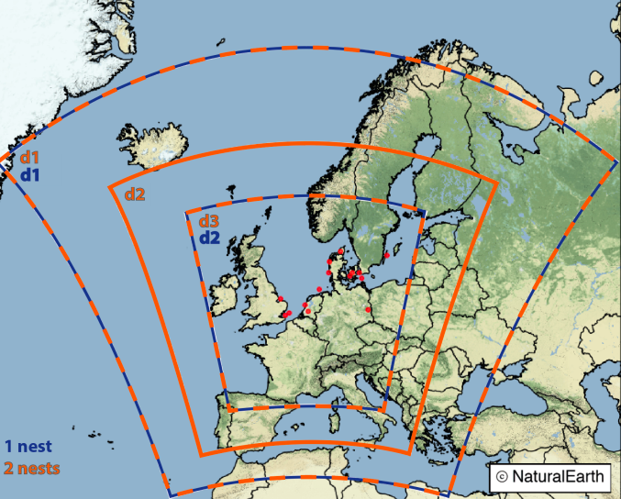
Model sensitivity experiments
simulation name | nesting ratio | resolution jump (km) | forcing | WRF version
10km | 1 / 3 | 30 / 10 | ERA5 | 4.2.1
6km | 1 / 5 | 30 / 6 | ERA5 | 4.2.1
5km | 2 / 3 | 15 / 5 | ERA5 | 4.2.1
3.3km | 1 / 3 / 3 | 30 / 10 / 3 | ERA5 | 4.2.1
10km_erai | 1 / 3 | 30 / 10 | ERA-Interim | 4.2.1
10km_v3 | 1 / 3 | 30 / 10 | ERA5 | 3.8.1
10km_sr | 1 / 3 | 30 / 10 | ERA5 | 4.2.1
Compared against observations and time series from ERA5 [3] and NEWA [1,2] renalyses.

Slide 4
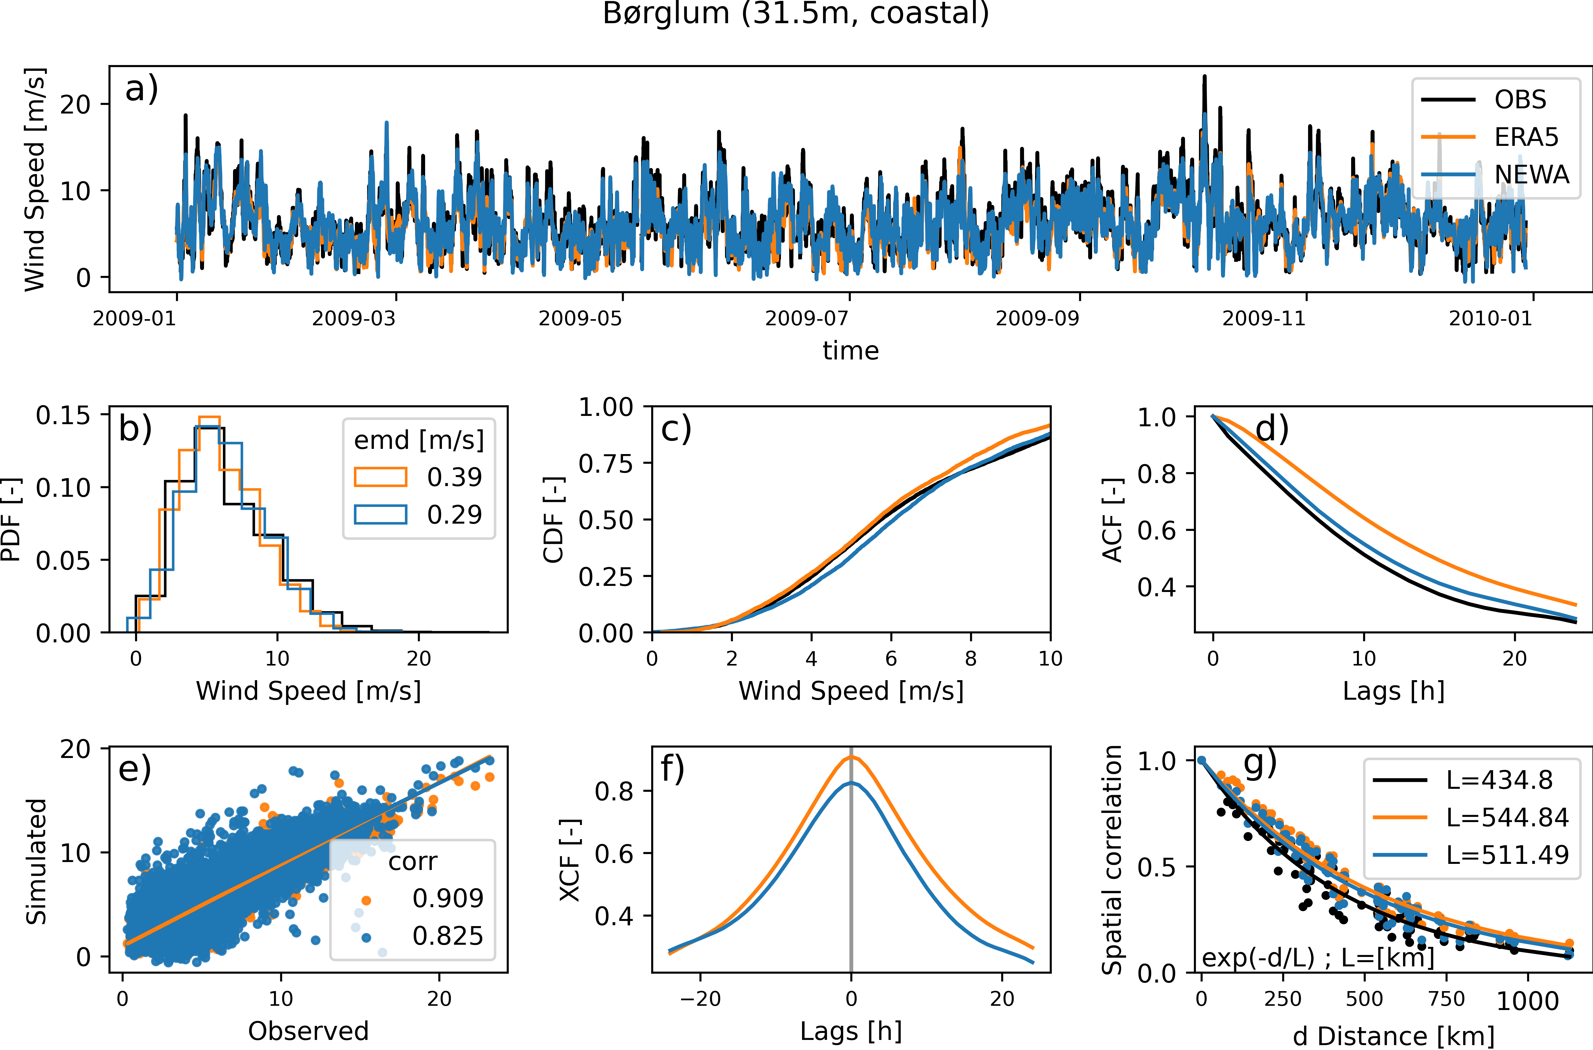
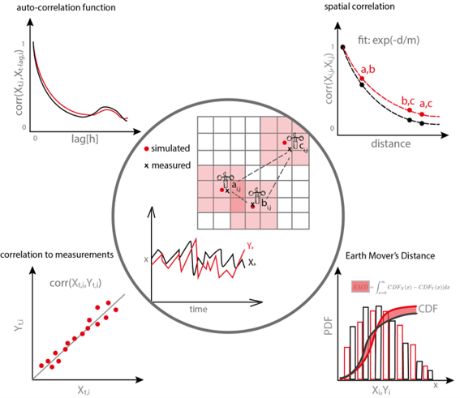
Validation metrics
Time series validations are crucial for power system applications*
*(see more on the supplementary slides)

Slide 5
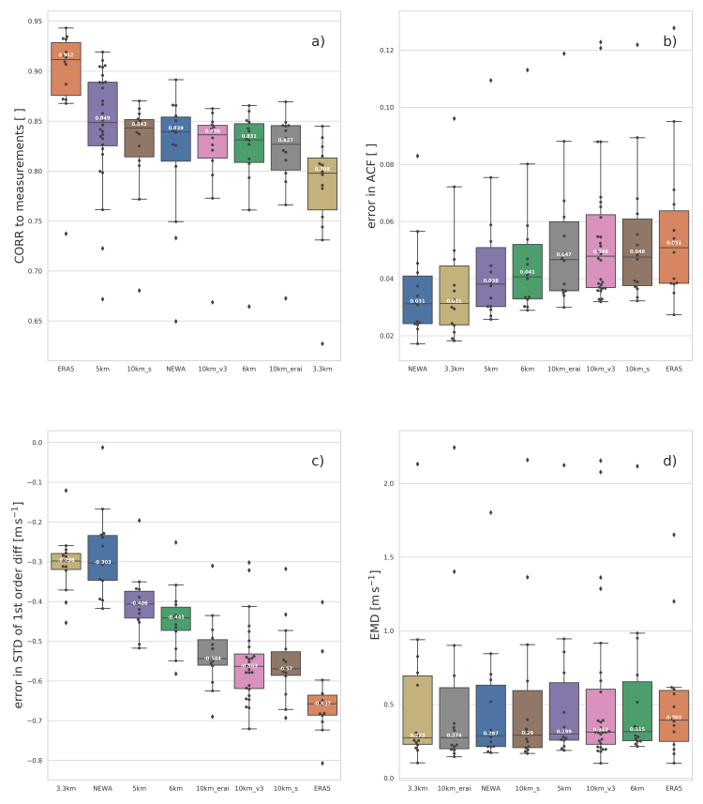
Results
(a) Correlation to measurements
ERA5 is the most accurate, followed by the 5km.
Reanalysis has data assimilation
"5km" versus "6km": smoother resolution jump
(b) and (c)Temporal dependencies
3.3km and NEWA (3km) the most accurate, and ERA5 the last in the ranking.
Clear impact from grid spacing
(d) Wind speed distribution (EMD)
Homogeneous results among all simulations. Sensitive to the analyzed period.
a, b, and c consistent in different considered periods and in both model versions.
Grid spacing
Grid spacing

Slide 6
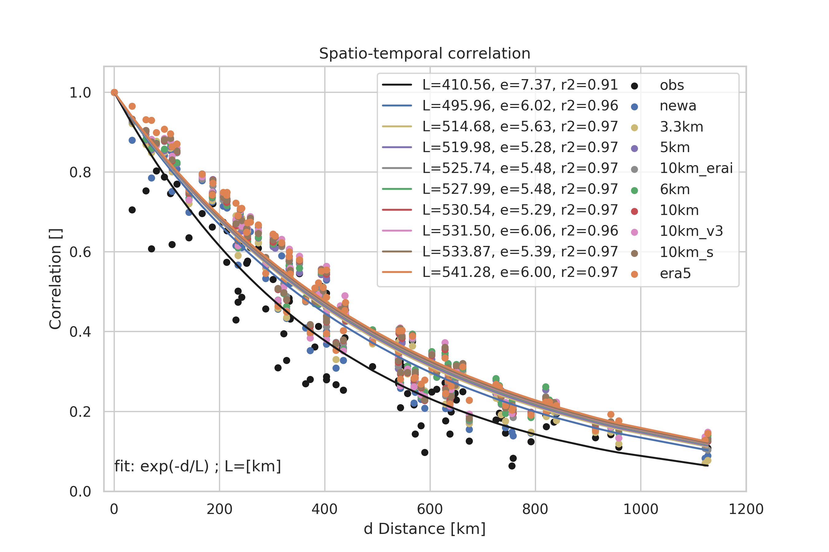
Results
All simulations overestimate the correlations, which agrees with previous studies [4,5]
3.3km and NEWA (3km) the most accurate spatial correlations, and ERA5 the last in the ranking.
    Impact from grid spacing

Slide 7
Conclusions
Model configuration such as the nesting choice and horizontal resolution can be used to optimize simulations of wind speed for power system applications.
Finer resolution improves the representation of spatial and temporal correlations. Inconclusive how it affects the wind speed distribution.
To increase the correlation to the measurements, a higher influence from the forcing data on the simulation (smoother transition between computational domains) can be used.
E.g.: ERA5->15km->5km >>> ERA5->30km->6km
The resultant time series are more impacted by the mesoscale model than the forcing data. No clear difference between simulations forced by ERA5 and ERA-Interim. In all results, WRF v.4.2.1 performed better than v.3.8.2.

Slide 8
Thank you!
gldco@dtu.dk
Supplementary material in the next slides.

Slide 9
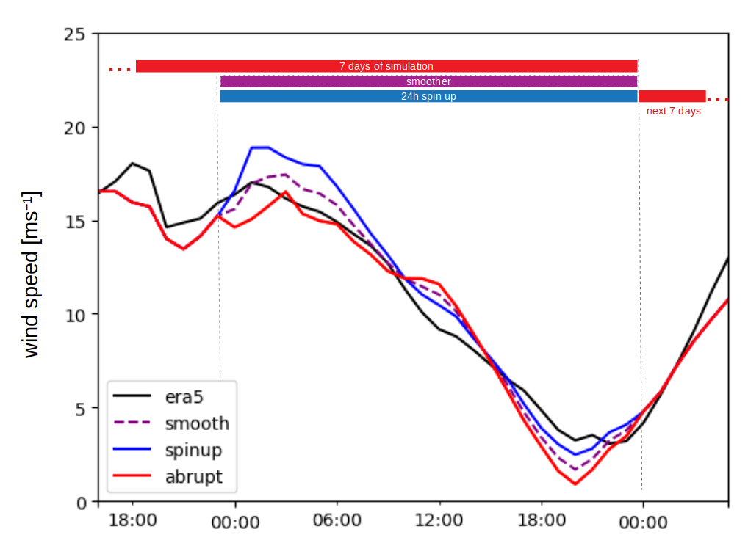
Supplementary slides
The ACF represents how well the simulated data can represent temporal variability seen in the measured data.​
spatial correlations are relevant for system integration studies, as the probability of wind speeds ramping up or down simultaneously in multiple locations impacts the aggregated wind generation in the system.​
ERA5 and WRF forced by ERA5
Smoother reinitialization
"10km" in red; "10km_s" in purple.
Relevant when the wind speed data needs to be correctly correlated with other time series (e.g., electricity price)
Accurate wind speed distribution is important for estimating a site’s potential annual energy production and understanding storm shutdown risks.

Slide 10
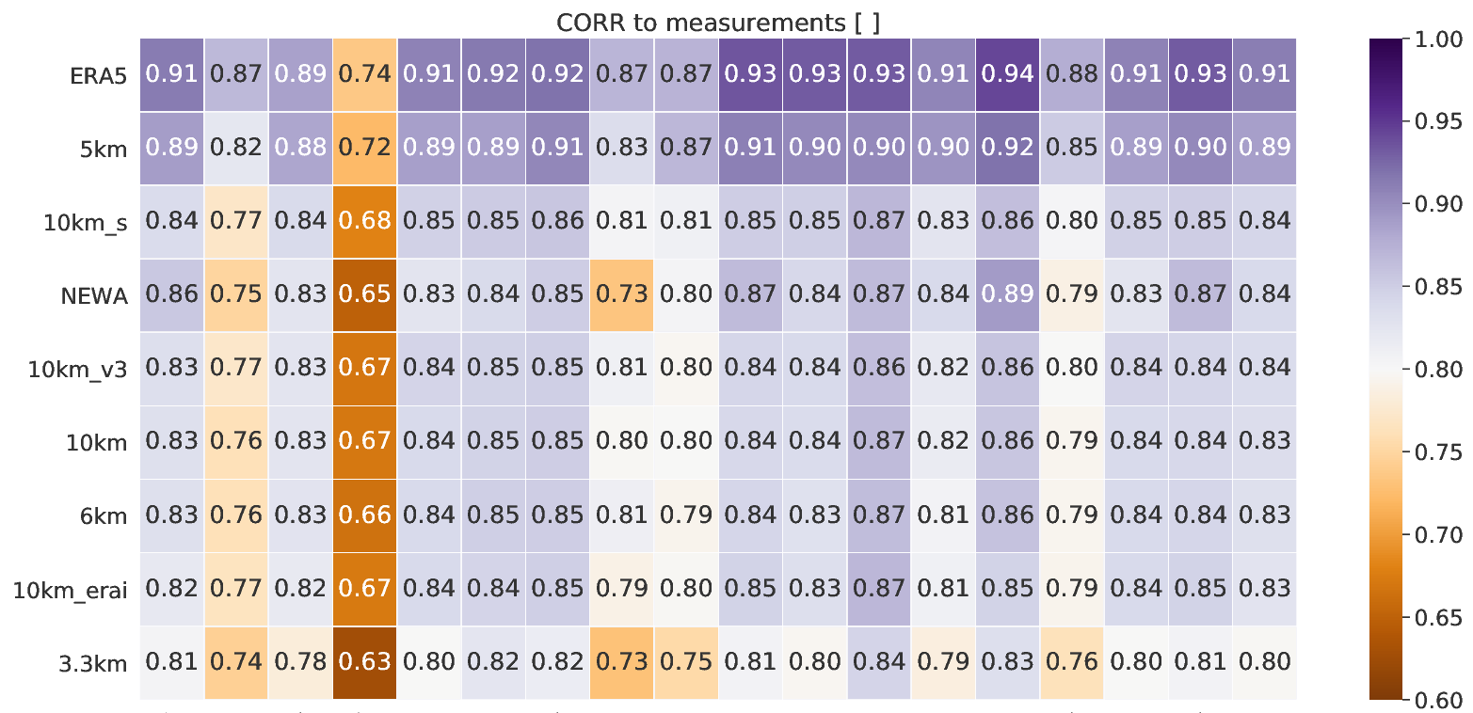
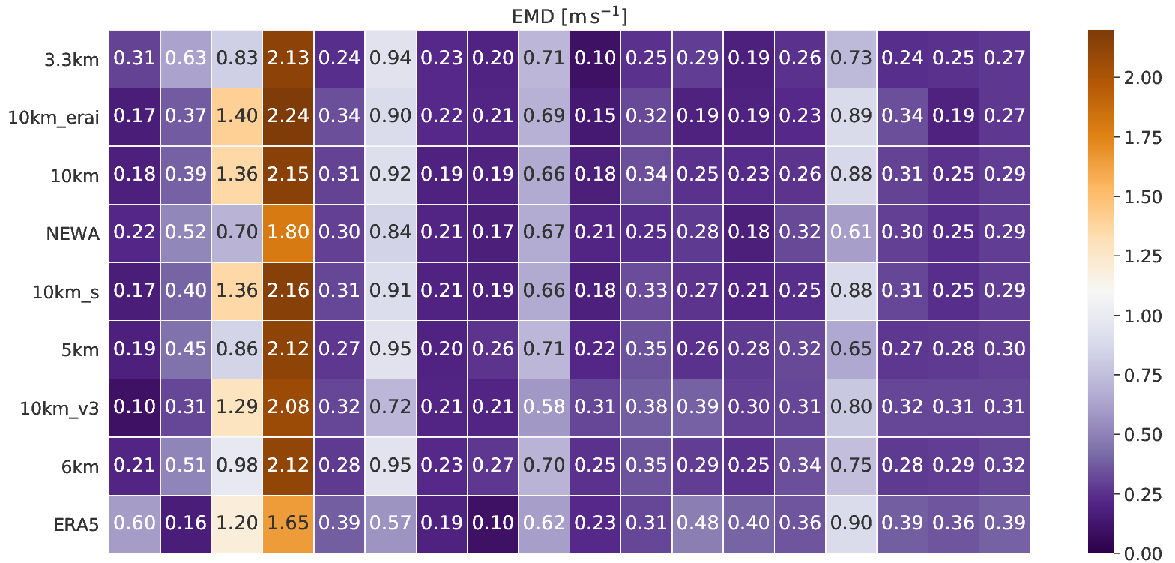
Supplementary slides
inland
coastal
offshore
median over all sites
all sites​
The conclusions were based on the medians over all sites​

Slide 11
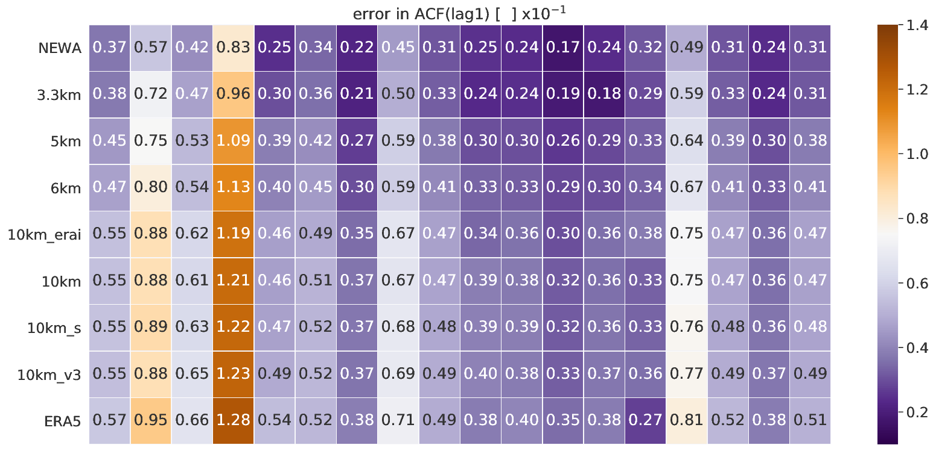
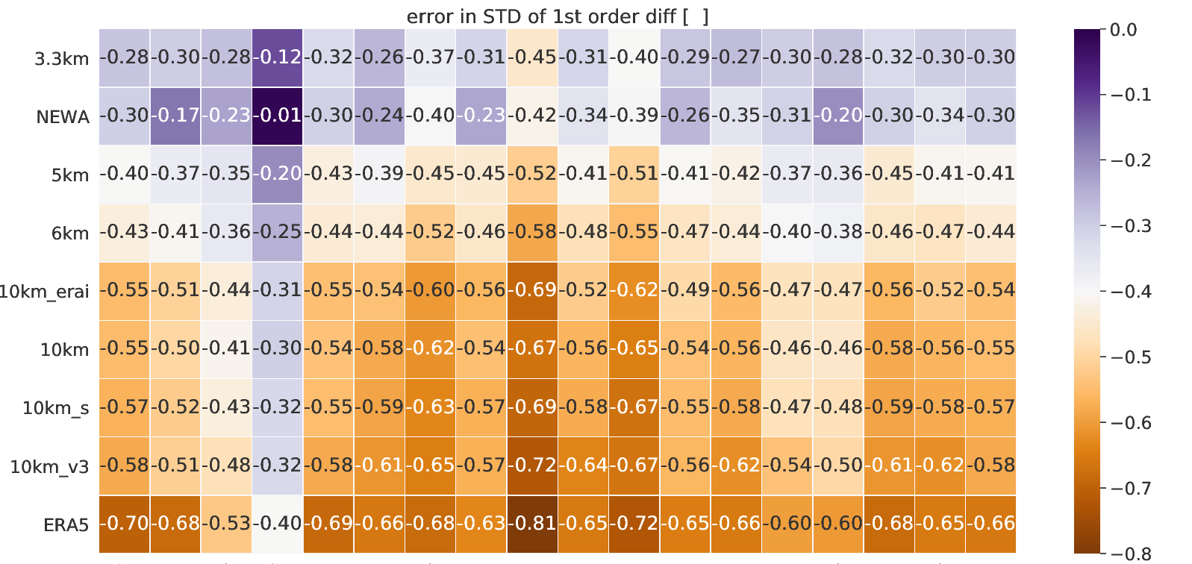
Supplementary slides

Slide 12
References
[1] Hahmann et al.: The making of the New European Wind Atlas – Part 1: Model sensitivity., Geoscientific Model Development, 13, 5053–5078, doi.org/10.5194/gmd-13-5053-2020, 2020b.
[2] Dörenkämper et al.: The Making of the New European Wind Atlas – Part 2: Production and evaluation, Geoscientific Model Development, 13, 5079–5102, doi.org/10.5194/gmd-13-507-2020, 2020.
[3] Dee et al.: The ERA5 global reanalysis, Quarterly Journal of the Royal Meteorological Society, 146, 1999–2049, doi.org/https://doi.org/10.1002/qj.3803, 2020.
[4] Murcia et al.: Validation of European-scale simulated wind speed and wind generation time series, Applied Energy, 305, doi.org/10.1016/j.apenergy.2021.117794, 2022.
[5] Mehrens et al.: Correlation and coherence of mesoscale wind speeds over the sea, Quarterly Journal of the Royal Meteorological Society, 142, 3186–3194, doi.org/10.1002/qj.2900, 2016.

