Slide 1
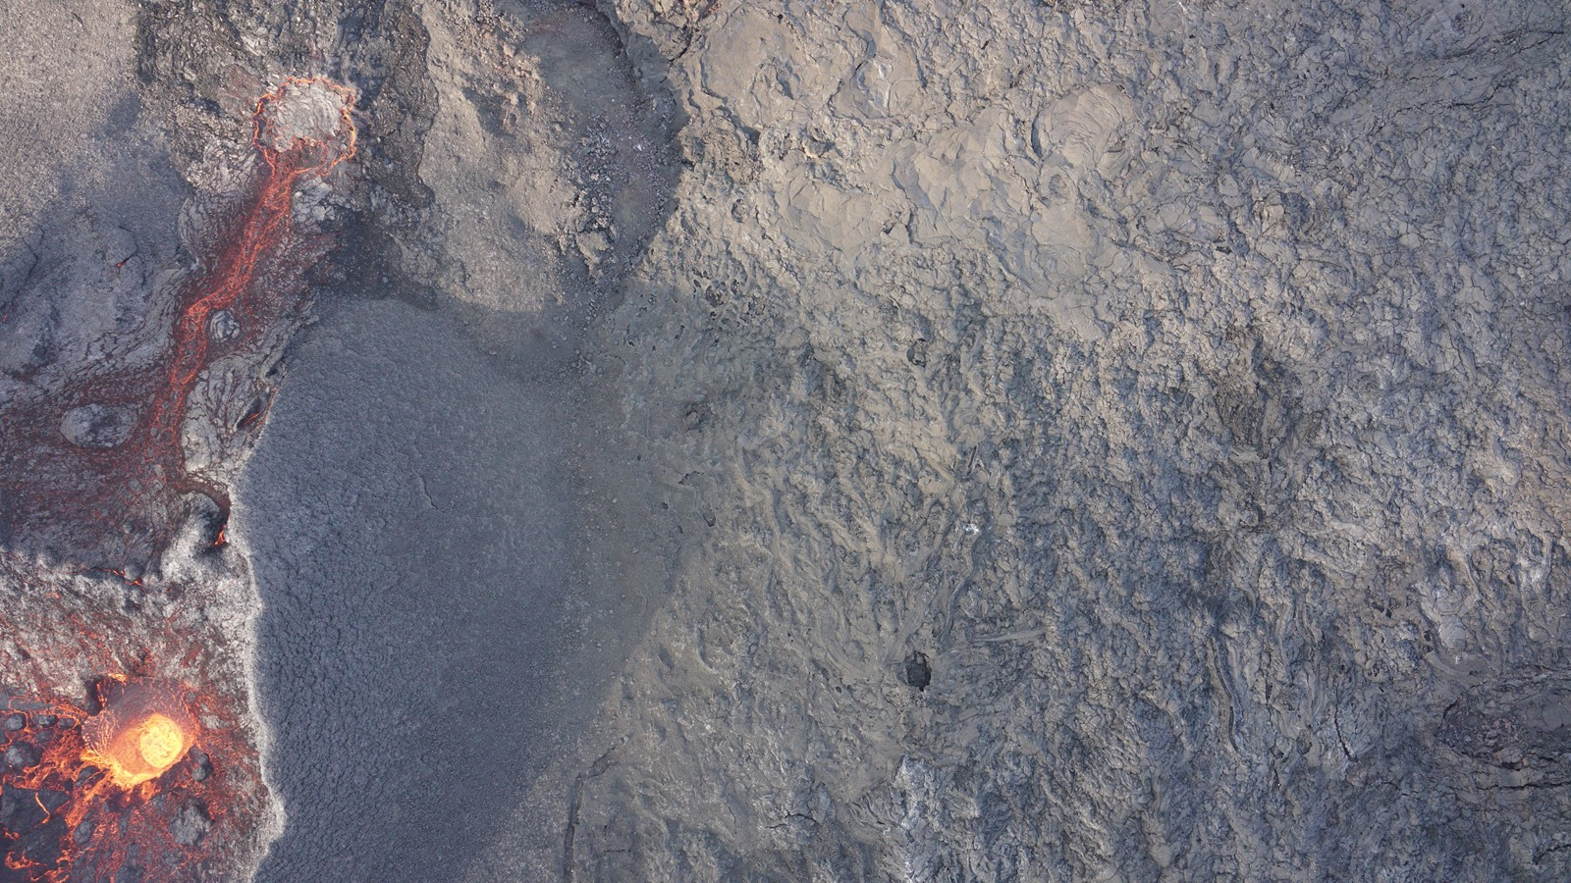
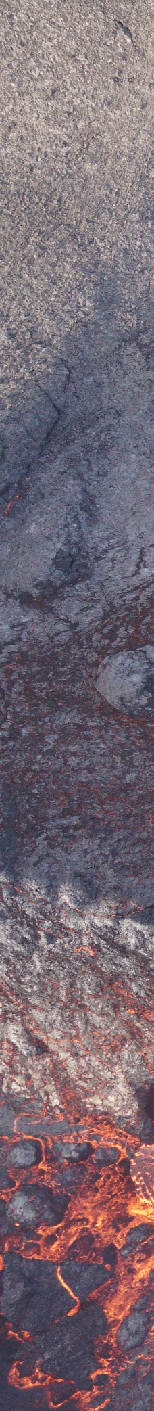


Obliquity and rifting: Interaction of faulting and magma propagation during volcano-tectonic events in North Iceland using UAV-based structural data
Elisabetta Panza*, Joël Ruch*
*Department of Earth Sciences, University of Geneva, Rue des Maraîchers 13, CH-1205 Genève
Elisabetta.Panza@unige.ch

Slide 2

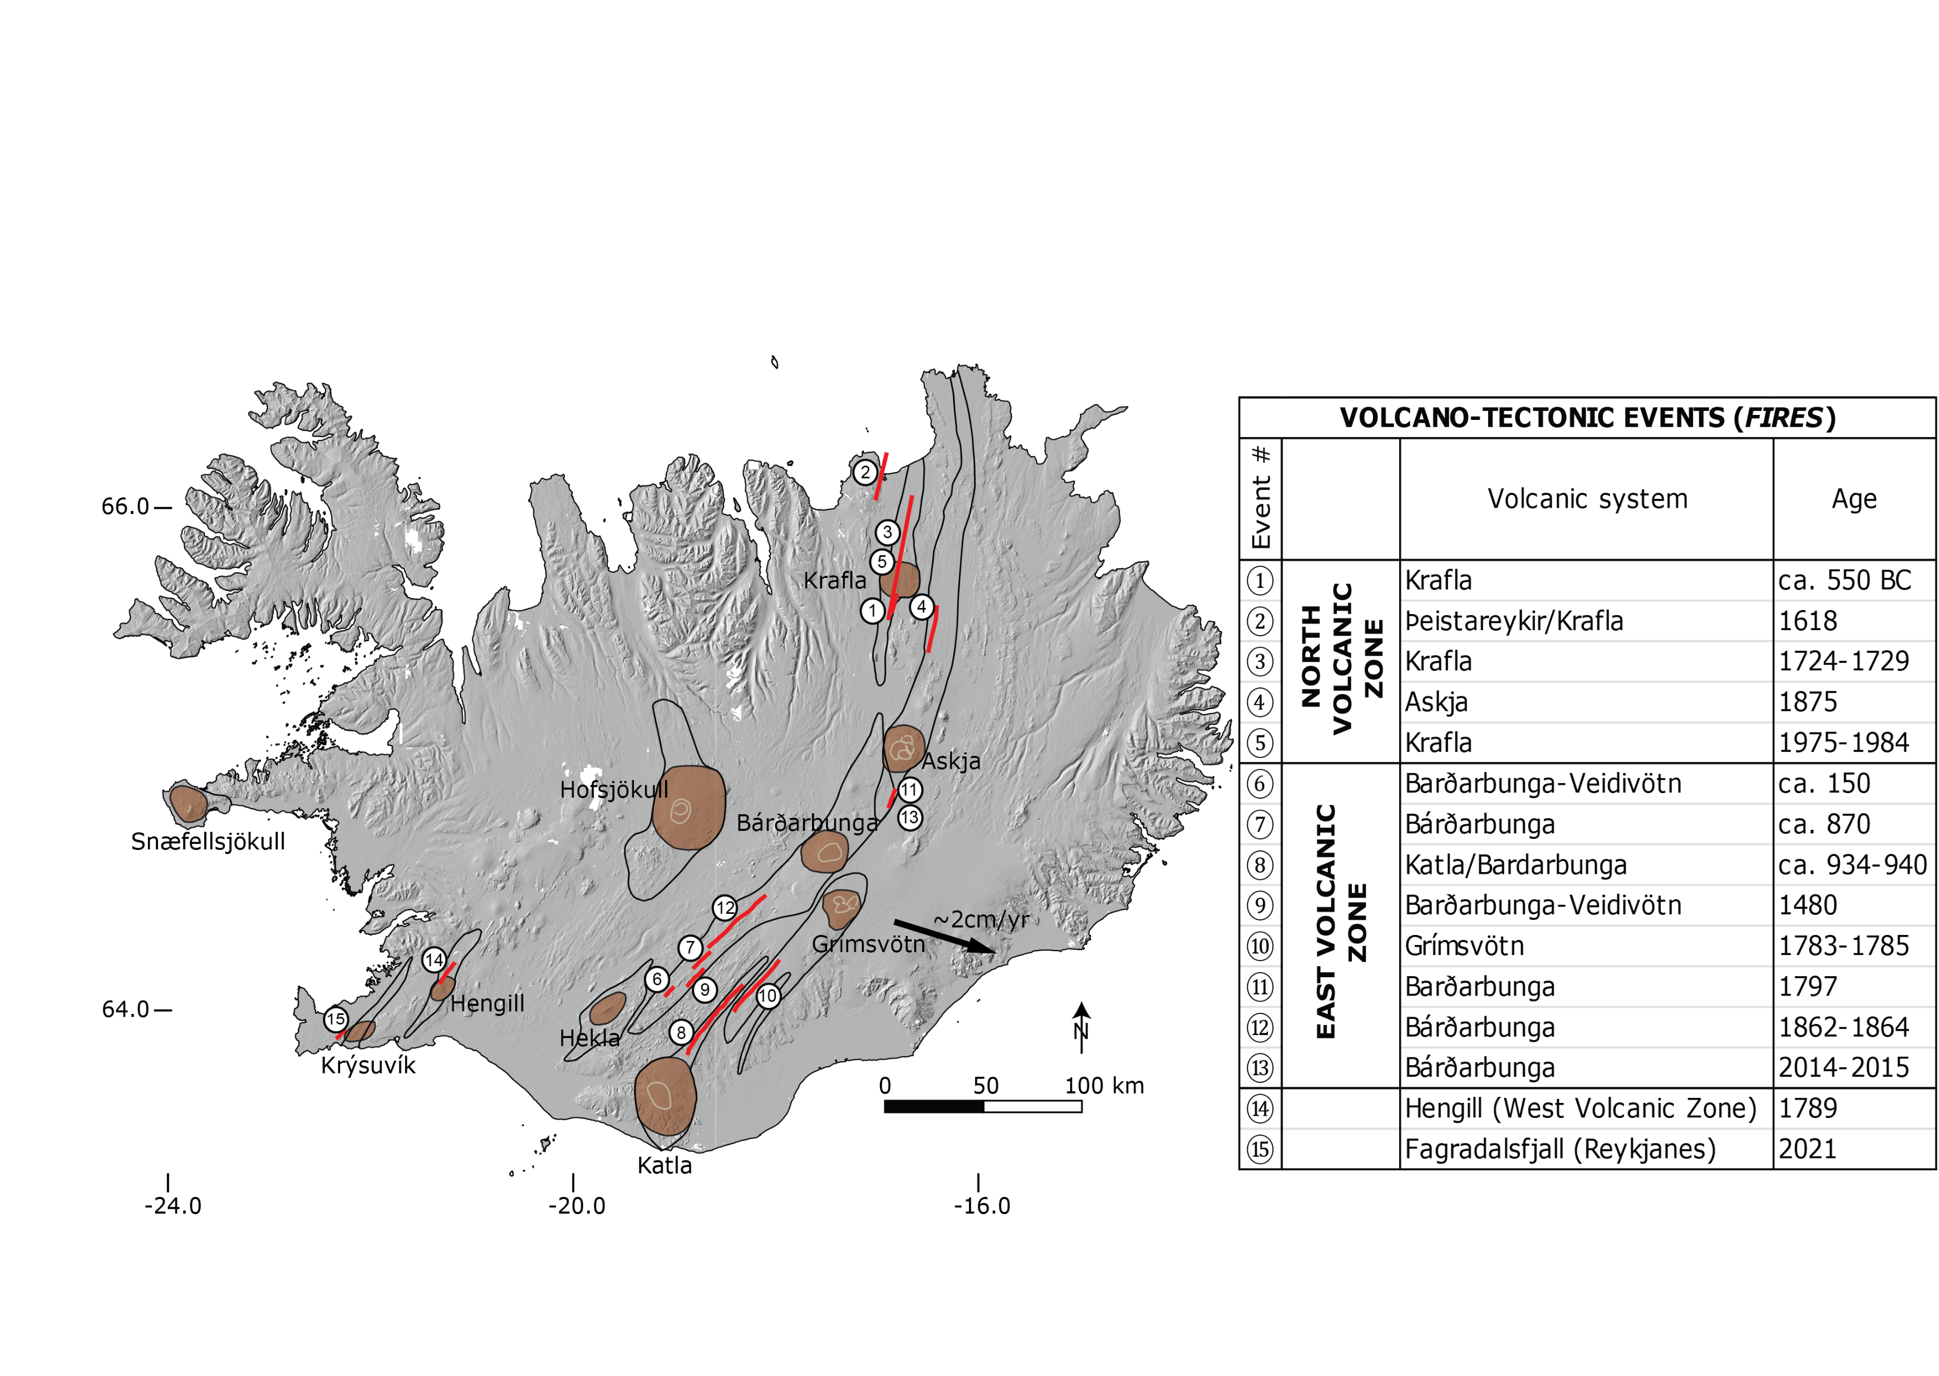
Volcano-tectonic processes
Recurrent
Broad time scales (days–100s years)
Often reactivation of pre-existing tectonic structures
Notes:
DEM (ArcticDEM) overlaid by the principal volcanic systems, composed by a central volcano (in brown) and a fissure swarm (outlined in black), and the locations of the historical volcano-tectonic events (in red). The numbers correspond to the events listed in the table. The black arrow is the rift opening rate obtained by geodetic studies (e.g. DeMets et al., 2010).

Slide 3
Motivations
How magma propagates in the crust and eventually erupts → key point in volcanology research
Focus on extensional tectonic environments.
Classical magma propagation models → homogeneous crust (without structures)

Slide 4
Motivations
How magma propagates in the crust and eventually erupts → key point in volcanology research
Focus on extensional tectonic environments.
Classical magma propagation models → homogeneous crust (without structures)
However, in nature:
Faulted and fractured crust in volcano-tectonically active systems
Inherited structures not necessarily optimally oriented with the current stress field
Consider that obliquity affects > 70% of Earth’s rifts

Slide 5
Motivations
How magma propagates in the crust and eventually erupts → key point in volcanology research
Focus on extensional tectonic environments.
Classical magma propagation models → homogeneous crust (without structures)
However, in nature:
Faulted and fractured crust in volcano-tectonically active systems
Inherited structures not necessarily optimally oriented with the current stress field
Consider that obliquity affects > 70% of Earth’s rifts
Aim: Assess the role of faulting and tectonics in controlling magma pathway

Slide 6
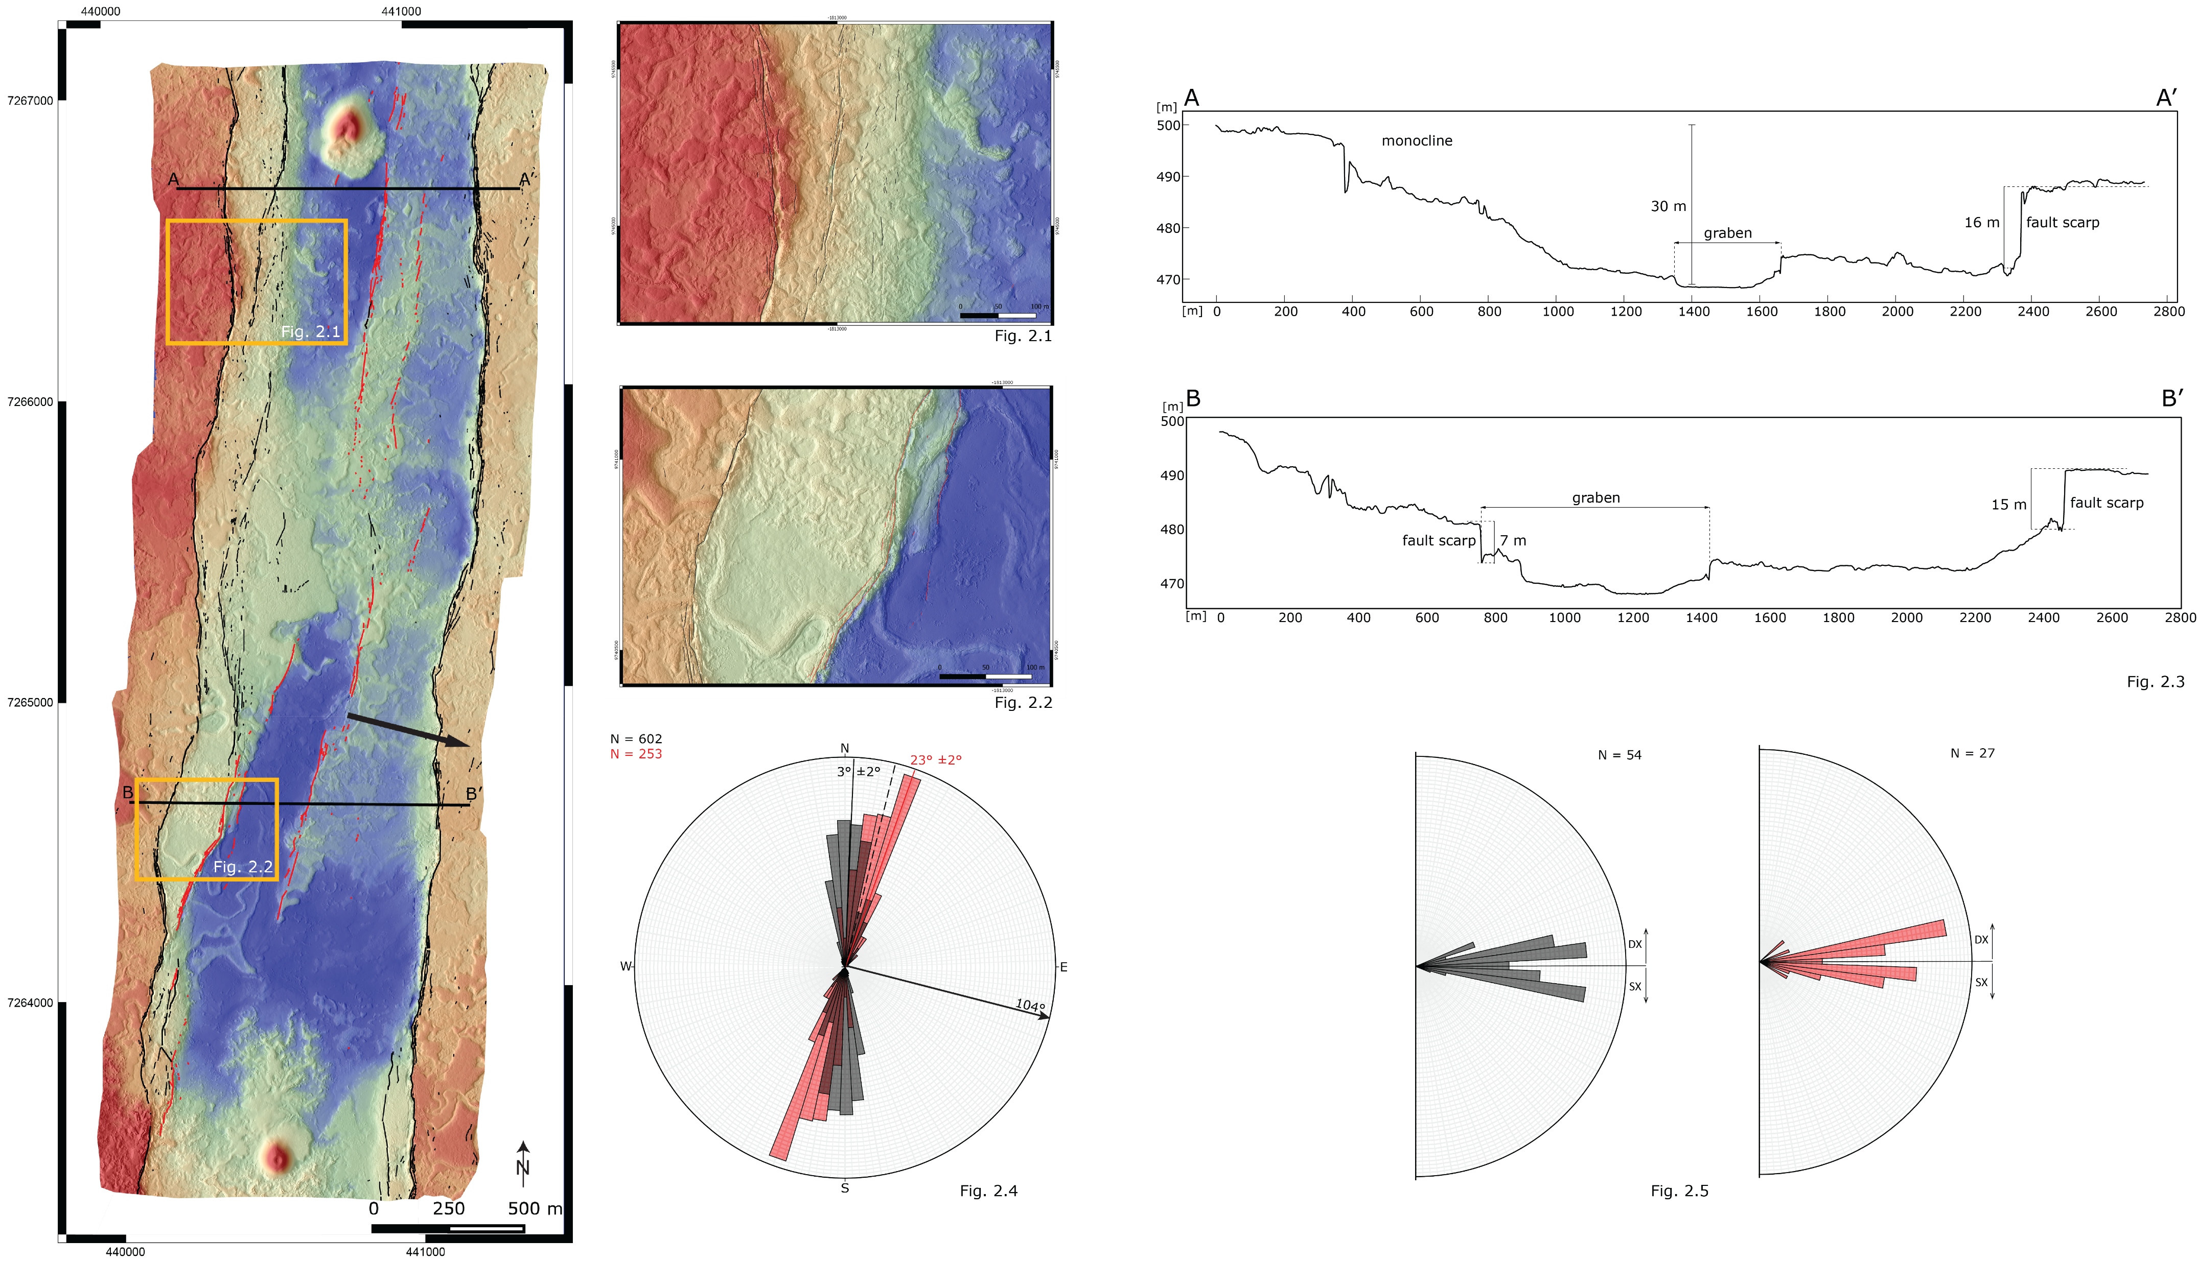
Field data
Notes:
Parlare qui anche dei metodi (risoluzione…)
Fig. 2 DEM and structural mapping of the northern part of the field area. The red lineaments underline the oblique nested graben, which could suggest an intrusion oblique to the main graben shoulders. The black arrow indicates the regional strain field (N104°).
Fig. 2.1 and 2.2 are zooms on monoclines and graben morphologies
Fig. 2.3 shows two profiles (as indicated in fig. 2) that cross the nested graben. The height of the fault scarps implies fault reactivation in multiple events, as normally each event causes a vertical offset of only a few meters at most.
Fig. 2.4 Rose diagram of the strikes of the extension fractures mapped near the main graben shoulders (in black) and in the nested graben (in red). The black and red solid lines indicate the bin with highest number of elements for the main graben shoulders population and the nested graben population respectively. The black arrow indicates the regional strain field (N104°) and the dashed lines is perpendicular to it.
20° difference between the two populations
nested graben seems better oriented with the current plates motion
Fig. 2.5 Asperity-fit plots of the structures near the main graben shoulders (black) and in the nested graben (red).
oblique component
no sharp predominance of right-lateral or left-lateral

Slide 7
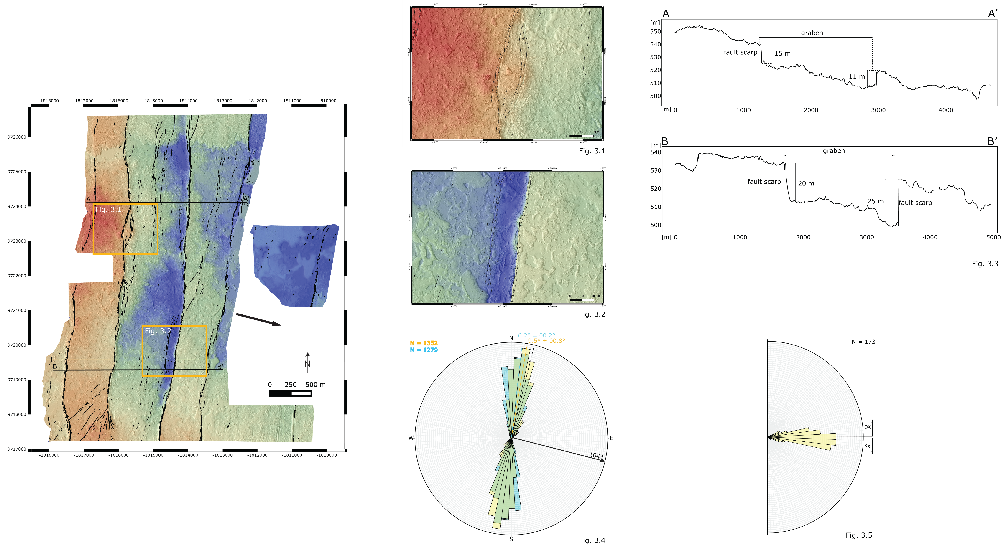
Field data
Notes:
Fig. 3 DEM and structural mapping of the southern part of the field area. The black arrow indicates the regional strain field (N104°).
Fig. 3.1 and 3.2 are zooms on graben morphologies
Overall higher topography compared to North area (shield nearby in the SW)
graben structures more widely laterally distributed compared to the northern area
Fig. 3.3 shows two profiles (as indicated in fig. 3) that cross the graben. The height of the fault scarps (15-25 m) implies fault reactivation in multiple events.
Fig. 3.4 Rose diagram of the strikes of the extension fractures mapped in the North field area (in blue) and in the Southfield area (in yellow). The blue and yellow solid lines indicate the mean strike for the North area population and the South area population respectively. The black arrow indicates the regional strain field (N104°) and the dashed lines is perpendicular to it.
Rotation of the structures trend of ~3° going from North to South
Fig. 3.5 Asperity-fit plots of the structures in the South field area.
oblique component
no sharp predominance of right-lateral or left-lateral

Slide 8
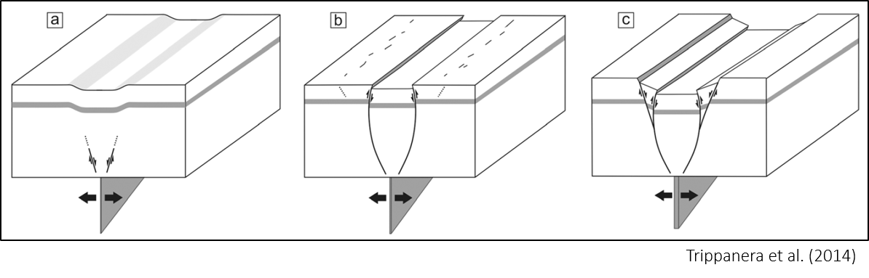
Discussion
Infer magmatic activity from surface morphology that could be ascribed to tectonics

Slide 9
Discussion
Infer magmatic activity from surface morphology that could be ascribed to tectonics
Inward dipping monoclines in grabens → dike injection

Slide 10
Discussion
Infer magmatic activity from surface morphology that could be ascribed to tectonics
Inward dipping monoclines in grabens → dike injection
Proximity of the vents in the nested graben → possible examples of magma induced fracturing

Slide 11
Discussion
Infer magmatic activity from surface morphology that could be ascribed to tectonics
Inward dipping monoclines in grabens → dike injection
Proximity of the vents in the nested graben → possible examples of magma induced fracturing
Different orientation main graben and nested graben:
- successive processes?
- same process with stress field rotation?

Slide 12
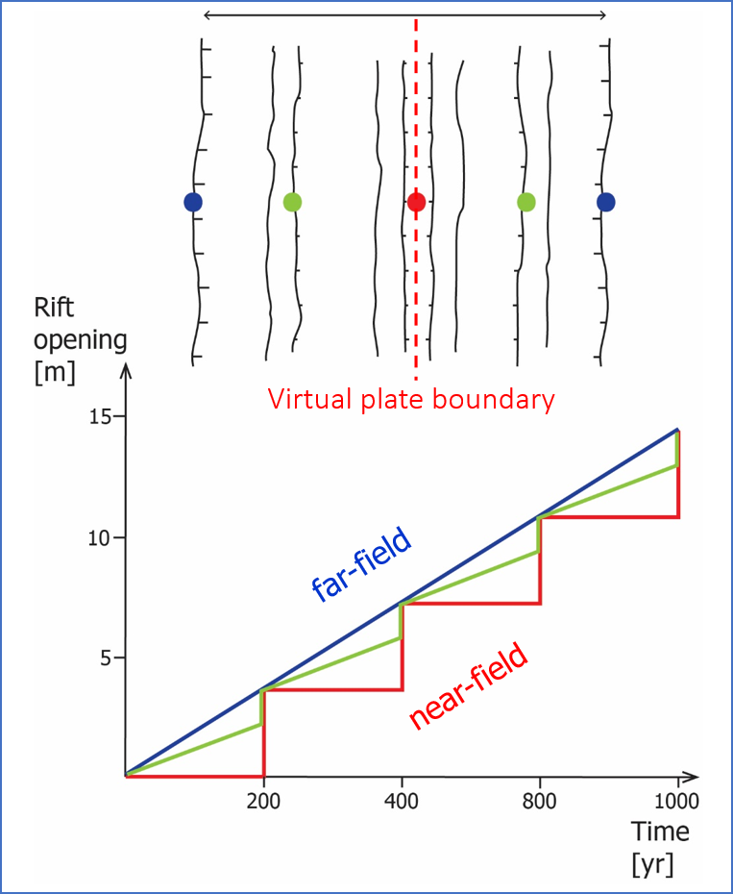
Discussion
~2 cm/yr extension rate at the plate boundary in Iceland

Slide 13
Discussion
~2 cm/yr extension rate at the plate boundary in Iceland
stepwise strain release through rifting episodes:
→ release over days or weeks tectonic strain deficit accumulated over several decades or hundreds of years

Slide 14
Discussion
~2 cm/yr extension rate at the plate boundary in Iceland
stepwise strain release through rifting episodes:
→ release over days or weeks tectonic strain deficit accumulated over several decades or hundreds of years
structures reactivation

Slide 15
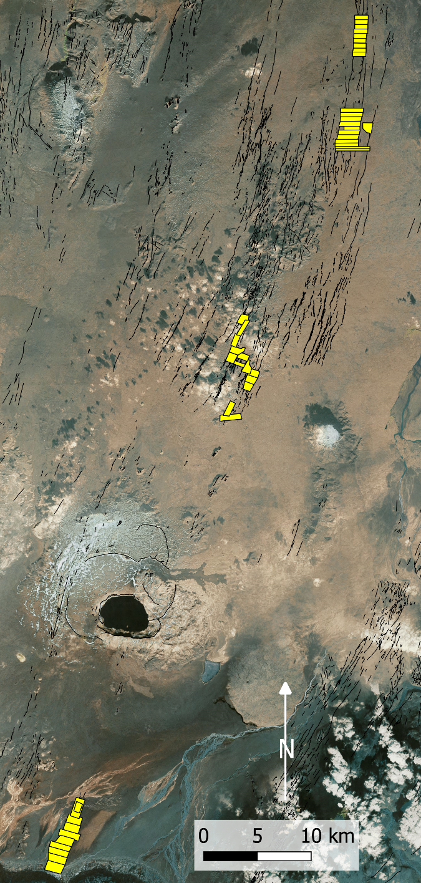
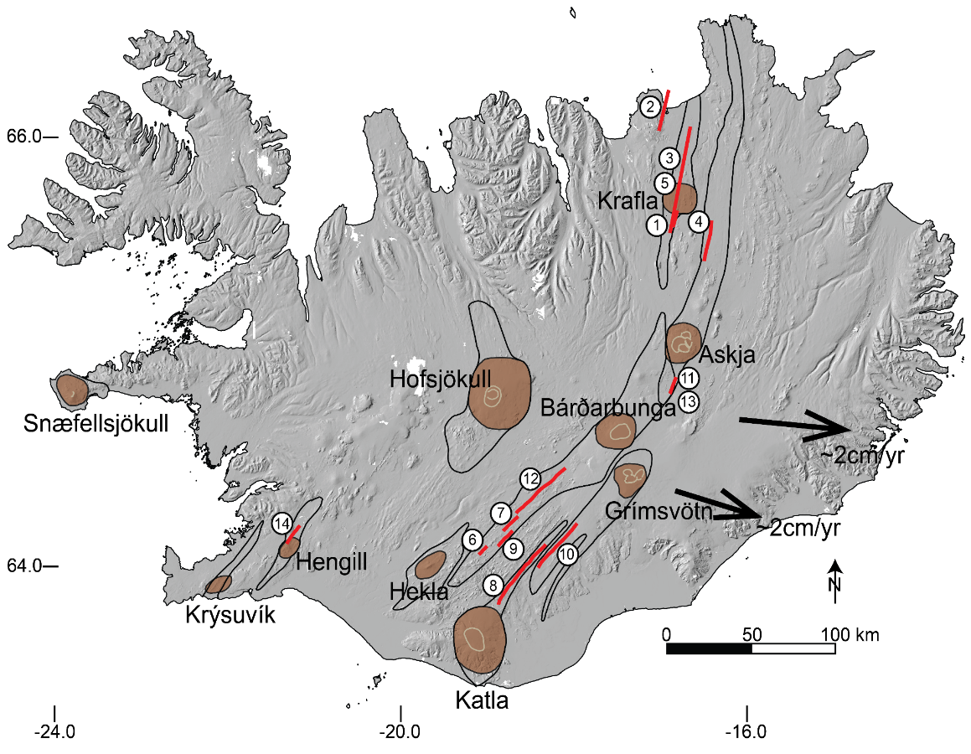
Ongoing mapping and analysis
~N004
2019
2020
2021

Slide 16
Ongoing mapping and analysis
Same current geodetic strain field
Curvature of the volcanic system’s structures
~N004
2019
2020
~N025
~N023
2021

Slide 17
Ongoing mapping and analysis
Same current geodetic strain field
Curvature of the volcanic system’s structures
~N004
2019
Could this influence the obliquity of the fracture field at the plate boundary?
2020
~N025
~N023
2021

Slide 18
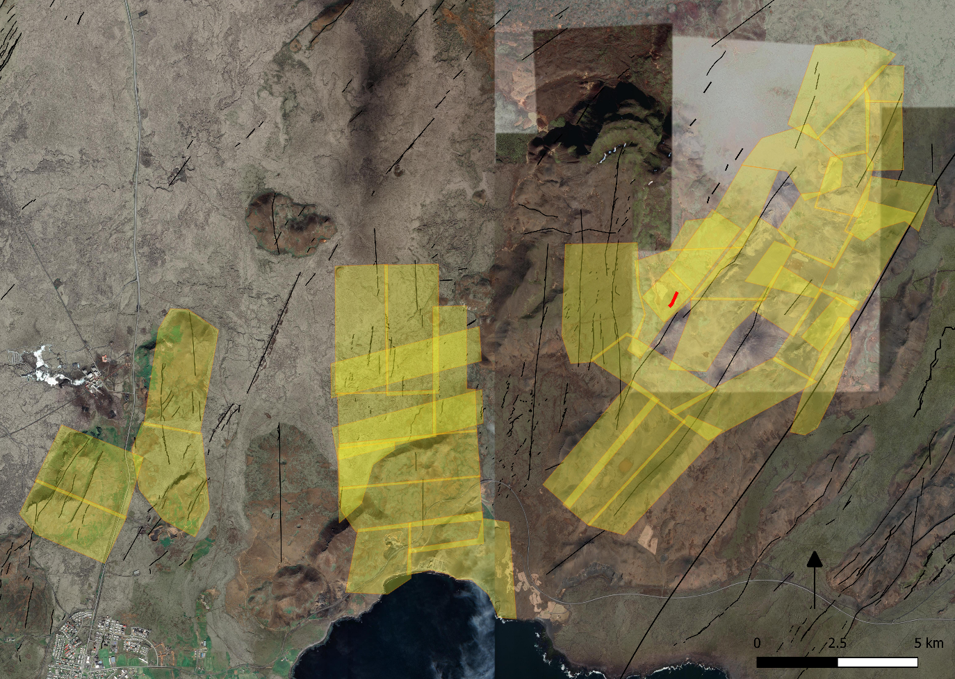
Discussion
2021 Fagradalsfjall volcano-tectonic event:
Example of a seismic crisis + eruption
(= volcano-tectonic event) in a very oblique setting

Slide 19
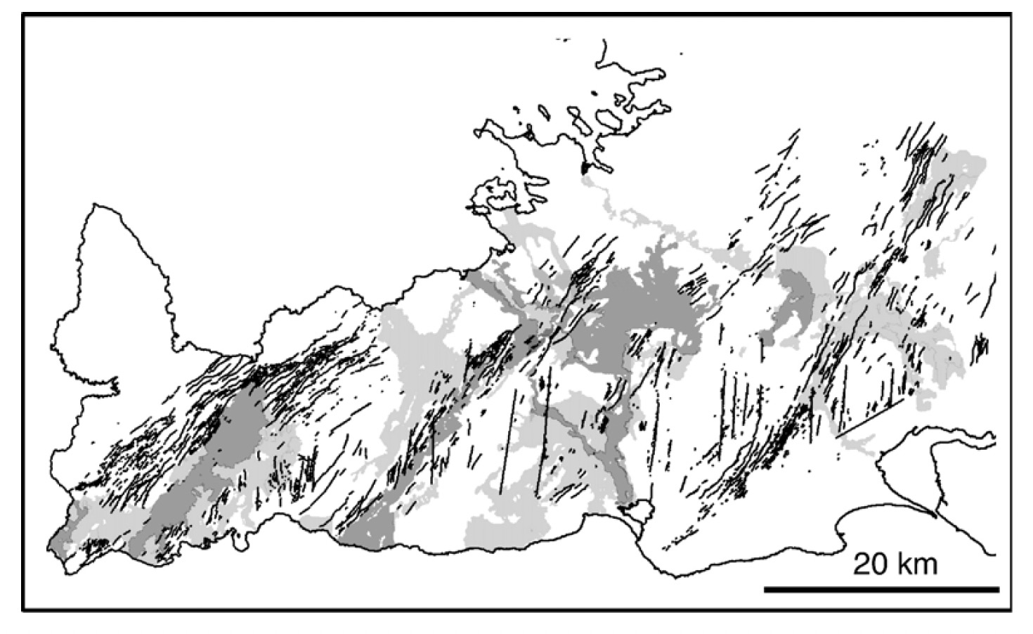
Discussion
2021 Fagradalsfjall volcano-tectonic event:
Example of a seismic crisis + eruption
(= volcano-tectonic event) in a very oblique setting
Clifton & Kattenhorn (2006)
Still N104 plate extension direction

Slide 20
Thanks for the attention

