Slide 1




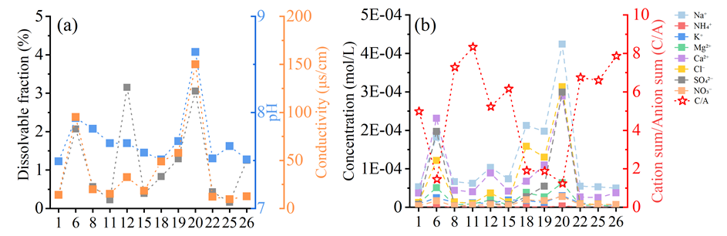
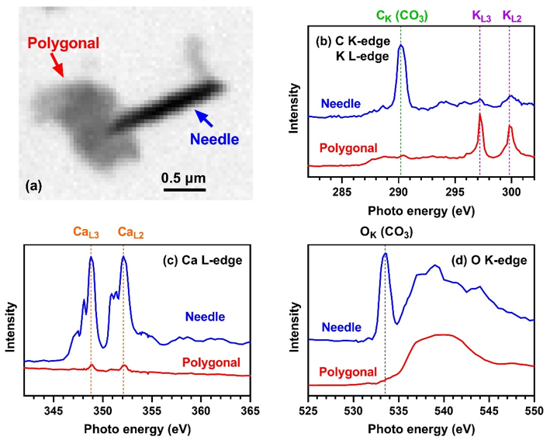
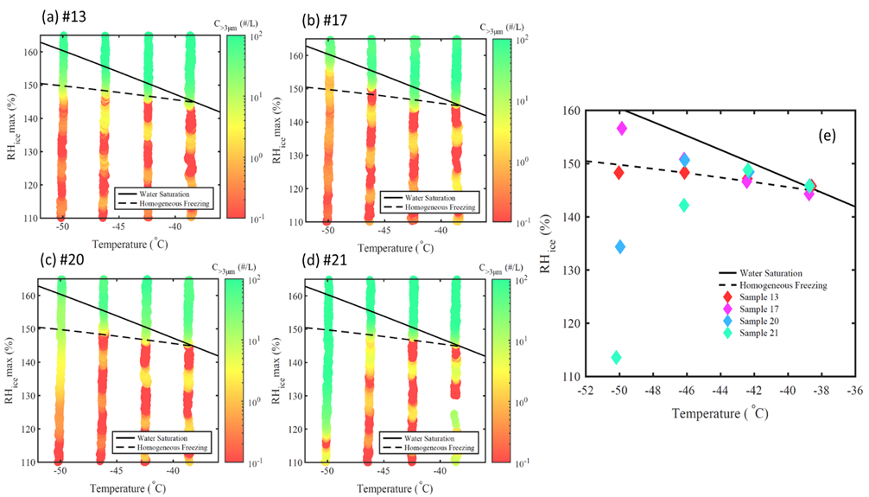
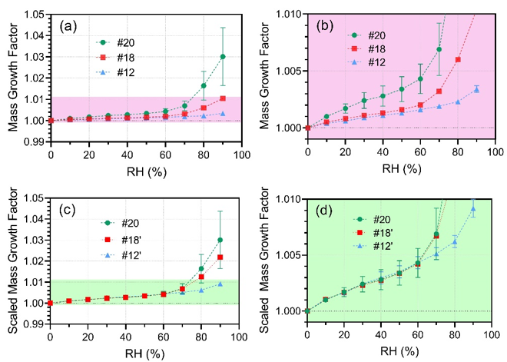

Hygroscopicity and Ice Nucleation Properties of Dust/Salt Mixtures Originating from the Source of East Asian Dust Storms
Jun Li¹, Wanyu Liu¹, Dimitri Castarède², Wenjun Gu³, Linjie Li², Takuji Ohigashi⁴, Guiqian Zhang¹, Mingjin Tang³, Erik S. Thomson², Mattias Hallquist², Sen Wang¹*, Xiangrui Kong²*
¹Shaanxi Key Laboratory of Earth Surface System and Environmental Carrying Capacity, Northwest University, Xi'an 710127, China; ²Department of Chemistry and Molecular Biology, Atmospheric Science, University of Gothenburg, SE-412 96 Gothenburg, Sweden;
³State Key Laboratory of Organic Geochemistry, Guangzhou Institute of Geochemistry, Chinese Academy of Sciences, Guangzhou, China; ⁴UVSOR Synchrotron, Institute for Molecular Science, Okazaki 444-8585, Japan
Background
Dust storms are common meteorological disasters which occur frequently in the late spring and early summer in arid and semi-arid areas.
Deserts in North Africa, Middle East Asia, Western Australia and Western North America are the most important dust-prone areas in the world.
The resulting lofted dust and salt mixtures can impact atmospheric chemistry and climate system through many pathways represented by aerosol-cloud-climate interactions.
Results and discussion
Sample collection and analysis
Ionic compositions
Hygroscopicity
Particle morphology
Ice nucleation activity
Dust and salt samples
Badain Jaran Desert, Tengger Desert, Ulan Buh Desert
Figure 1. (a) Dissolvable fractions, pH and conductivities of 12 sample solutions. (b) Ionic molar concentrations and the ratio of total cationic charges to total anionic charges (C/A).
Figure 3. STXM image and X-ray spectra of representative particles. (a) Optical image, (b) spectra scanned at C K-edge and K L-edge, (c) Ca L-edge spectra, (d) O K-edge spectra.
Figure 4. (a-d) Particle concentrations observed in the OPC >3 μm size channel. (e) Critical RHice of ice nucleation onset.
Figure 2. (a) Mass growth factor (m/m0) as a function of RH. (b) Zoomed-in, (c) scaled, and (d) scaled and zoomed-in mass growth factors.
Full paper is under review: Li, J.; Liu, W.; et al.
Take-home messages
The ionic concentrations, pH and dissolvable fractions of dust samples show a positive correlation, indicating that the dissolved content is rich in alkaline ions.
Needle-shaped CaCO₃ particles are observed as are more irregularly shaped high K-containing particles.
Ice nucleation activity was measured for typical salts, with both homogeneous freezing and deposition nucleation observed from atomized and dried salt solutions/particles. The results indicate that the salts primarily act as cloud condensation nuclei that freeze at low temperatures but can also act as ice nucleating particles at lower vapor saturations and at low temperatures.

