Slide 1

Variability and changes of tropical-extratropical cloudband events over the Southern Hemisphere using a synoptic climatology approach
Authors: Marcia Zilli & Neil Hart
School of Geography and the Environment, University of Oxford
EGU 2022 – Vienna, Austria
Marcia Zilli

Slide 2
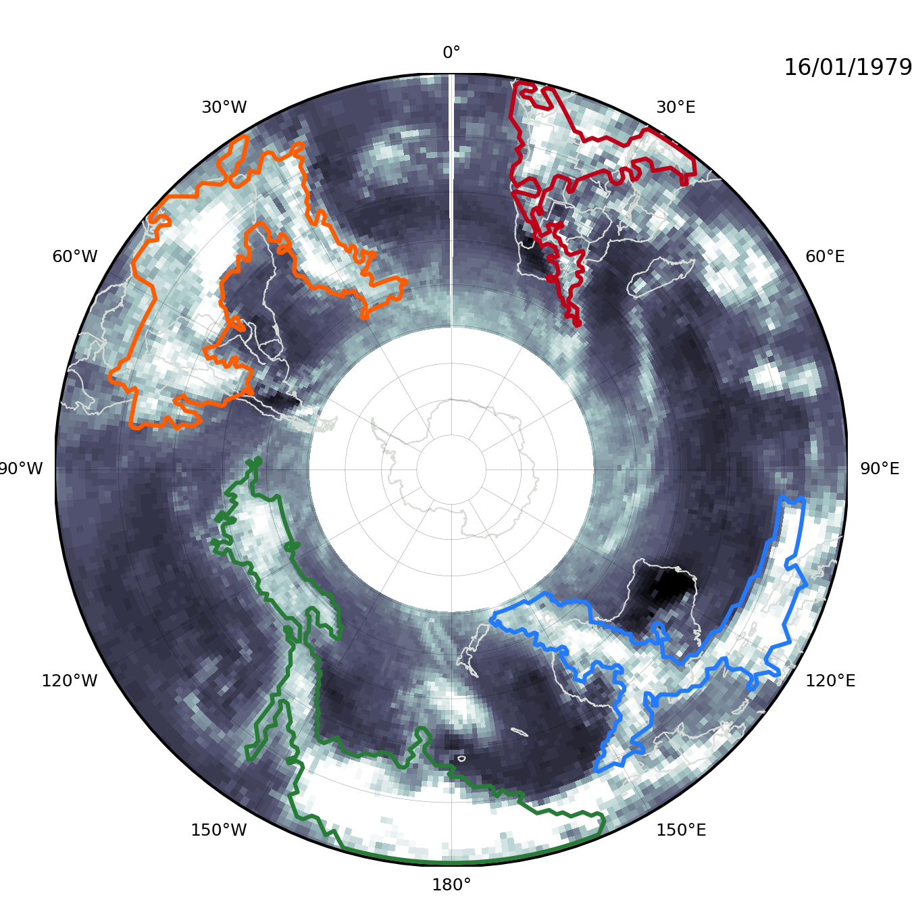

What are Cloud Bands?
SACZ
Continuous areas of low OLR connecting convective areas from the tropics to the extratropics.
SICZ
Responsible for large fractions of the rainy season precipitation ​
Intense events: floods and landslides
Absence/late onset: dry spells and drought ​
SPCZ
North-western cloud bands

Slide 3
Identifying the Cloud Bands
Cloud band detection algorithm developed by Hart et al. (2012, 2013) and adapted to South America [Zilli and Hart 2021].
Dataset:​
OLR – HIRS dataset from NOAA CDR V1.2​
Precipitation – ERA5 (1979 on)
Parameters:​
Minimum OLR: 230 W.m⁻²
Diagonally extent from tropics to the extratropics
Notes:
MetBot amounts to an automation of Neil Streten's 1973 manual analysis and others later such as Mike Harrison '84 over southern African and Ivan Kuhnel 1990 over Australia.

Slide 4
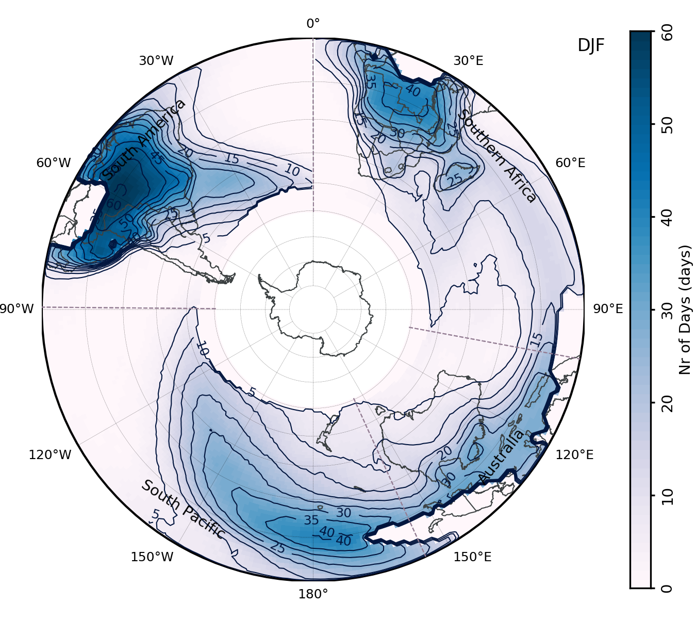
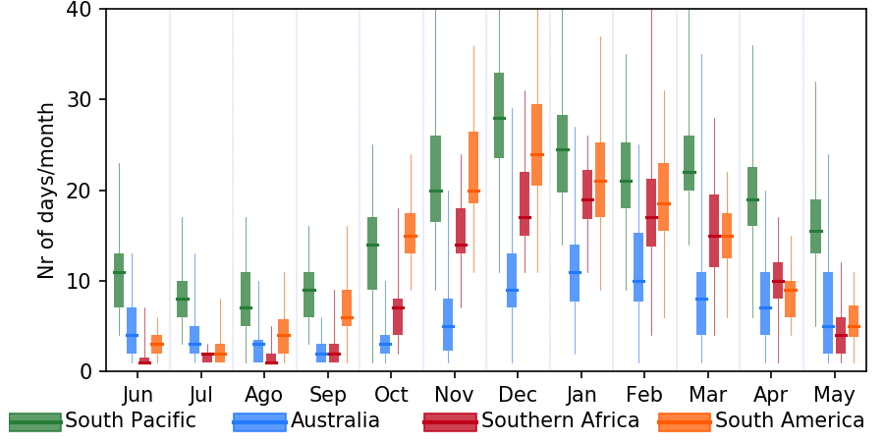
Climatology
Number of Days with cloud bands per month
Number of Days with cloud bands (DJF)

Slide 5
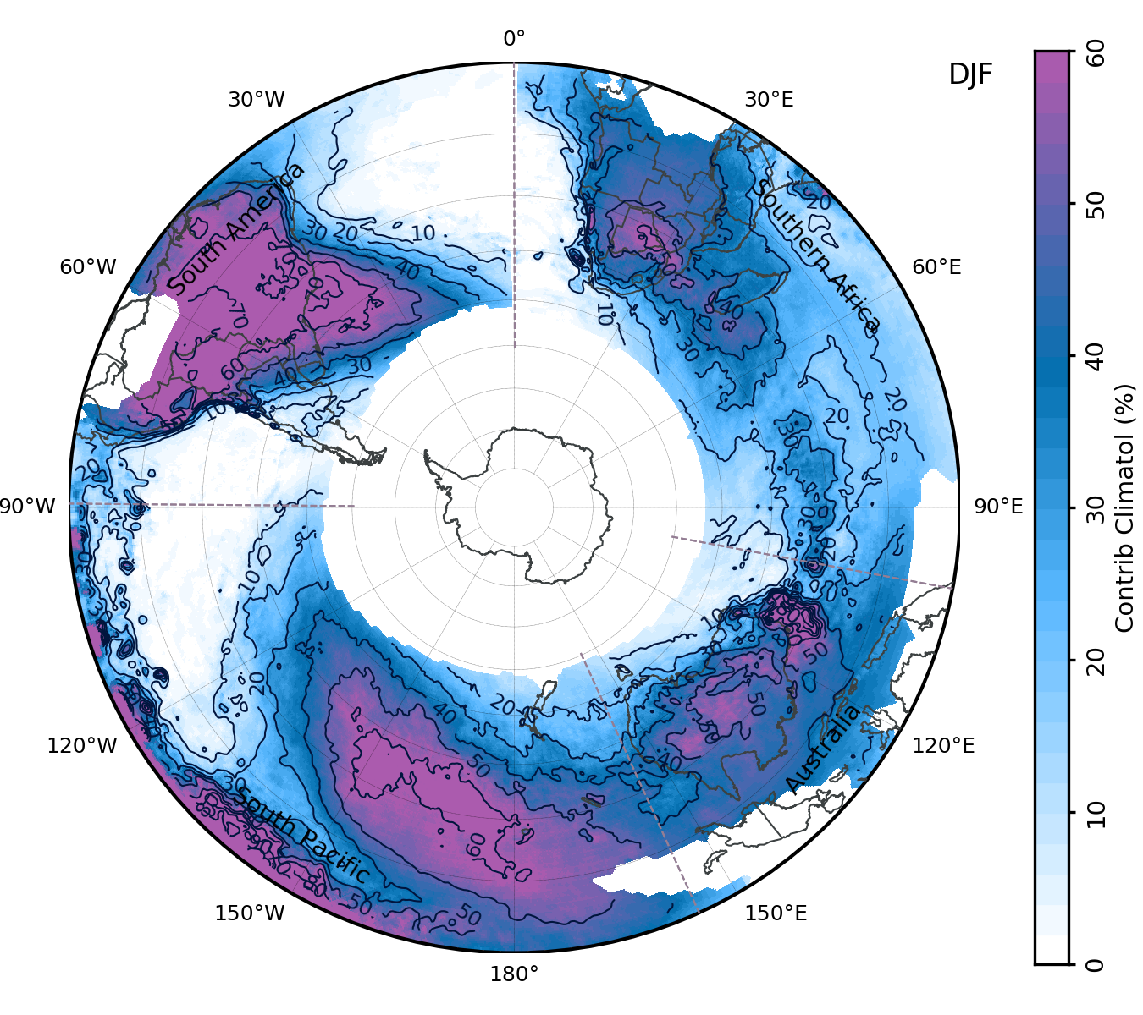
Climatology
Number of Days with cloud bands per month
Contribution to Total Precipitation (DJF)

Slide 6
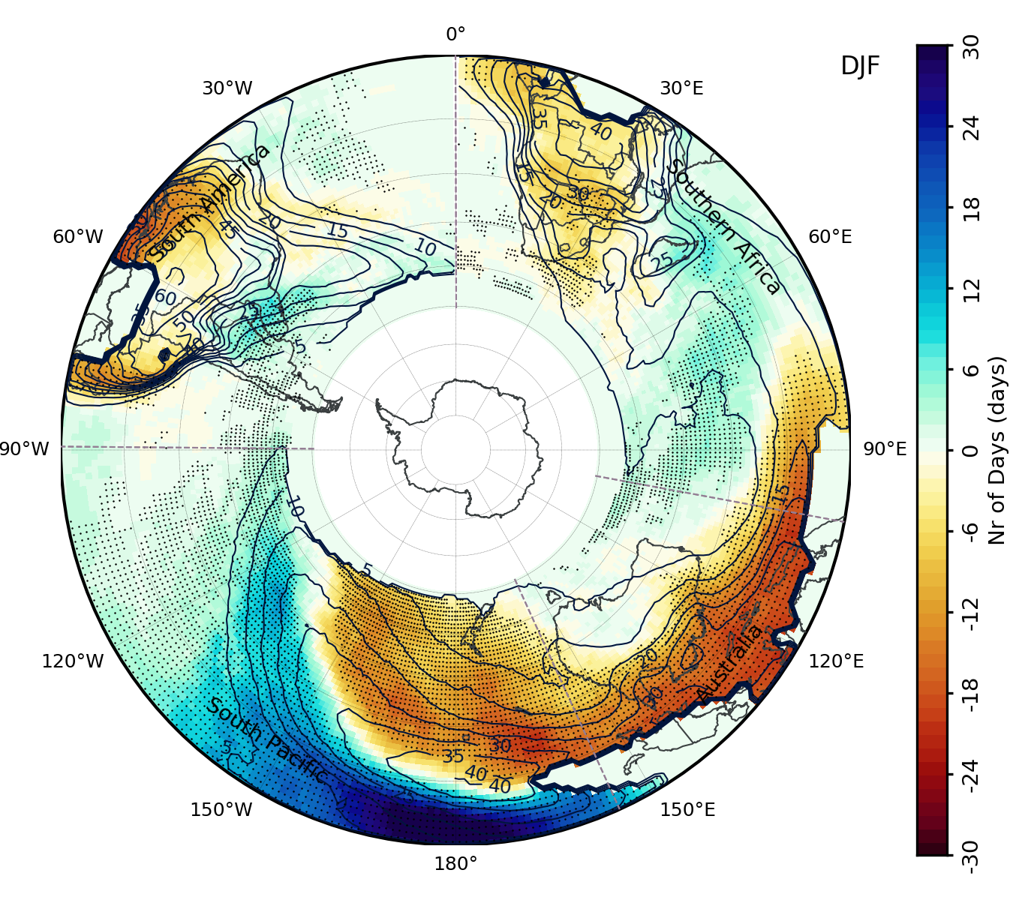
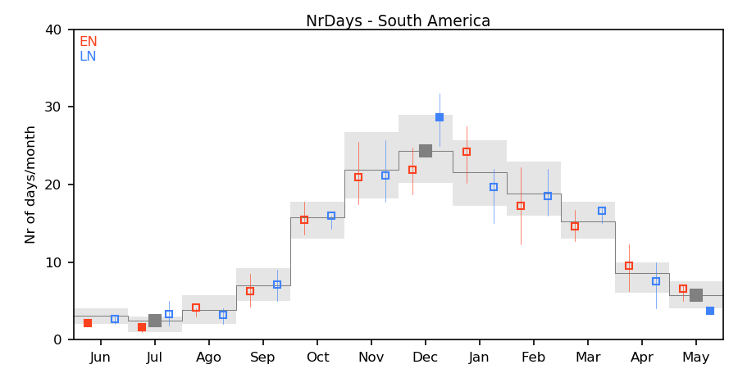
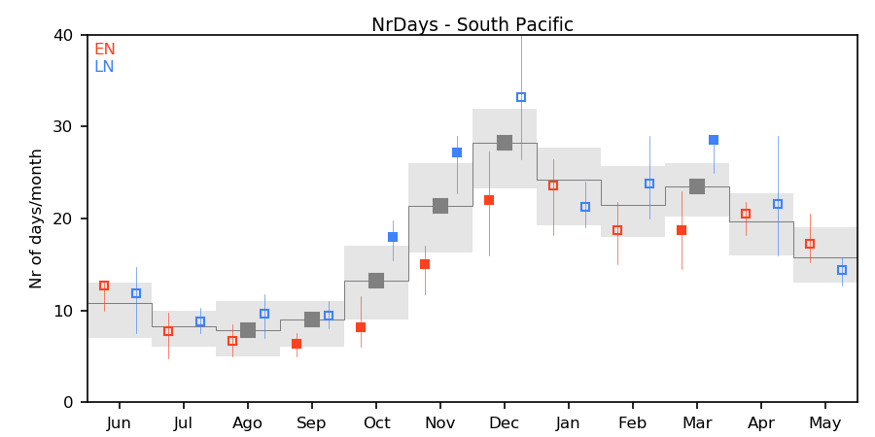
ENSO Anomalies (EN-LN)
Number of Days with cloud bands per month
South America
EN-LN – Number of Days with Events (DJF)
Number of Days with cloud bands per month
South Pacific
EN​​ | 1982​​ | 1986​​ | 1987​​ | 1991​​ | 1994​​ | 1997​​ | 2002​​ | 2009​​ | 2015​​
LN​​ | 1984​​ | 1988​​ | 1995​​ | 1998​​ | 1999​​ | 2007​​ | 2010​​ | 2011​​ | 2020​​

Slide 7
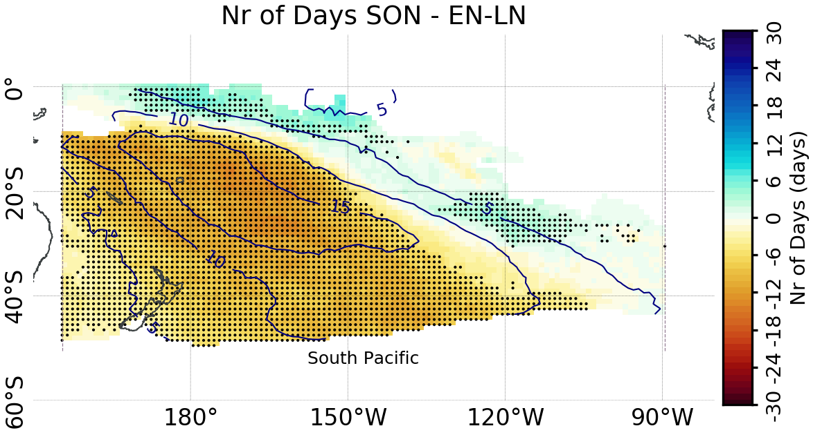
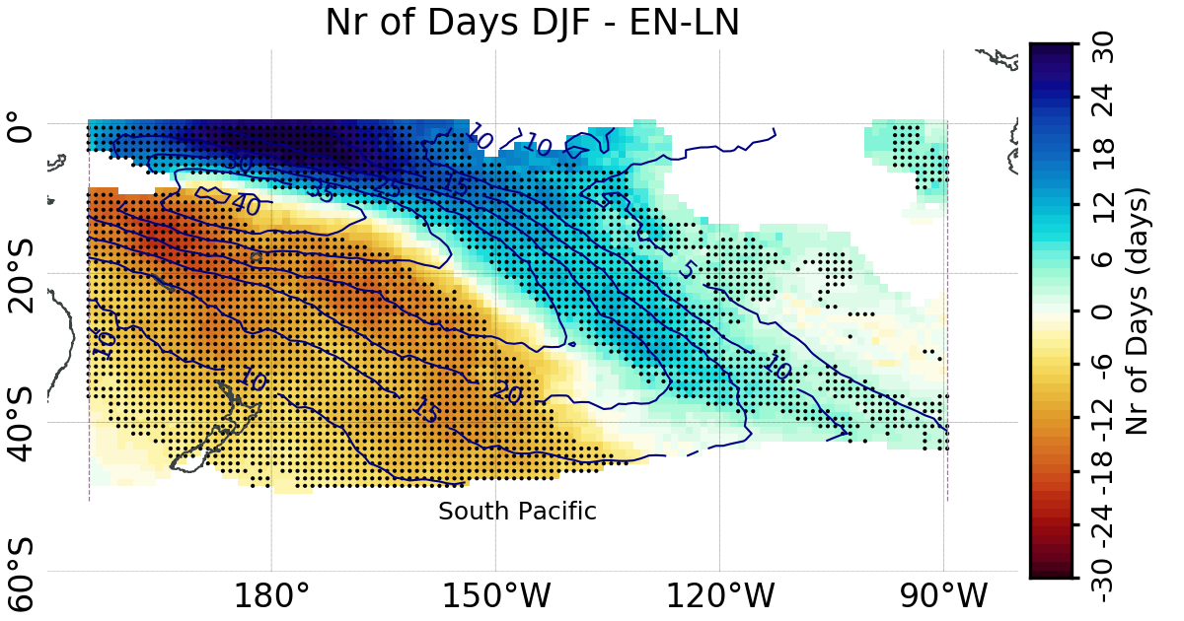
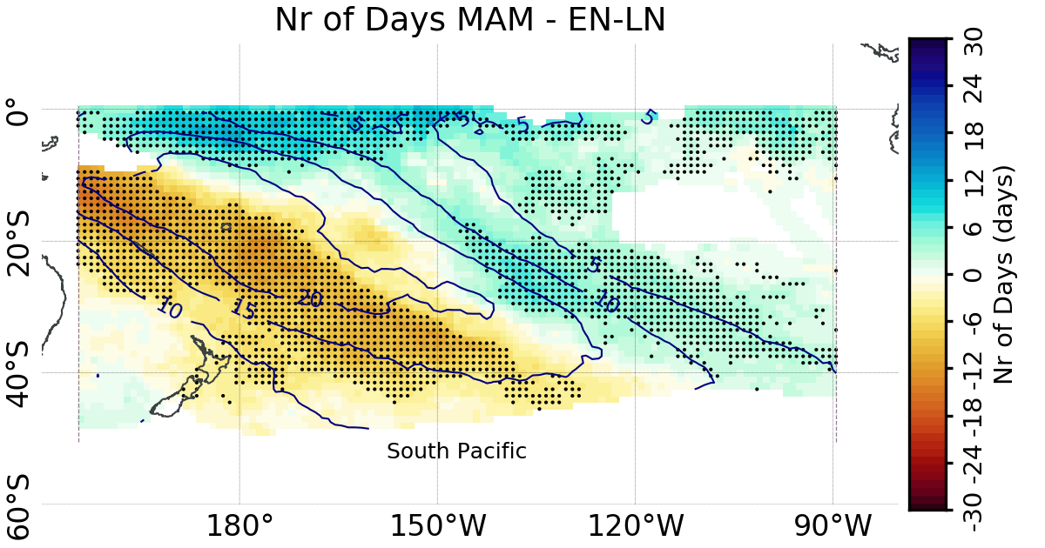
ENSO Anomalies (EN-LN) – South Pacific
SON
DJF
MAM
Number of Days with cloud bands per month
Anomalies during EN (LN):
Systematic shift of the cloud bands towards tropical (subtropical) latitudes throughout the rainy season
Delayed (Early) onset of the cloud band season

Slide 8
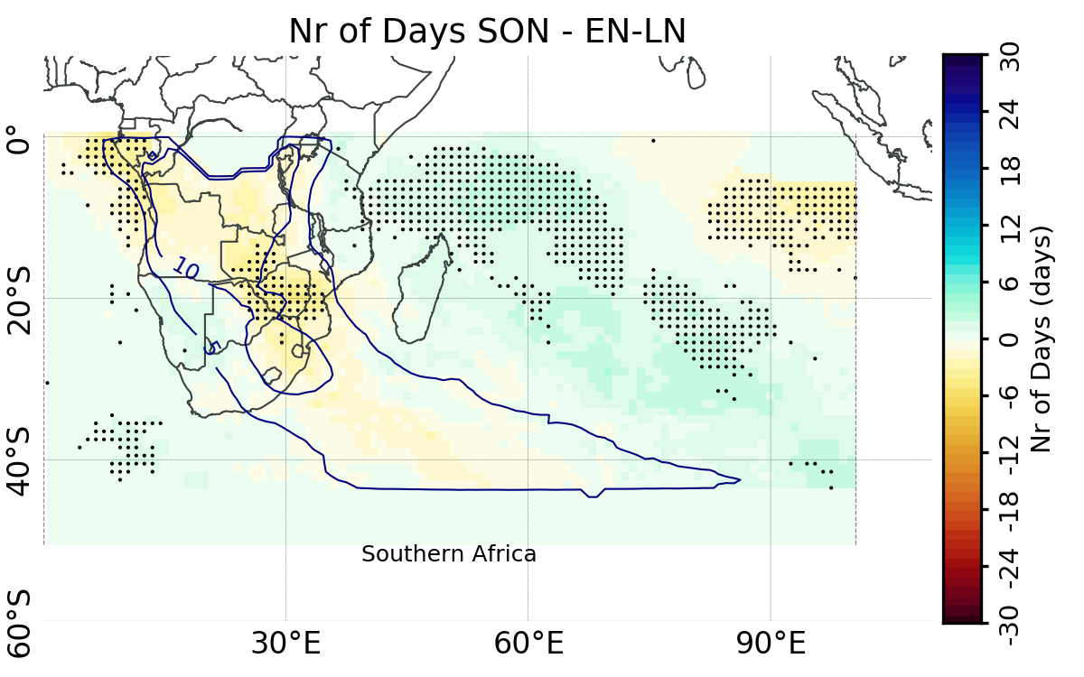
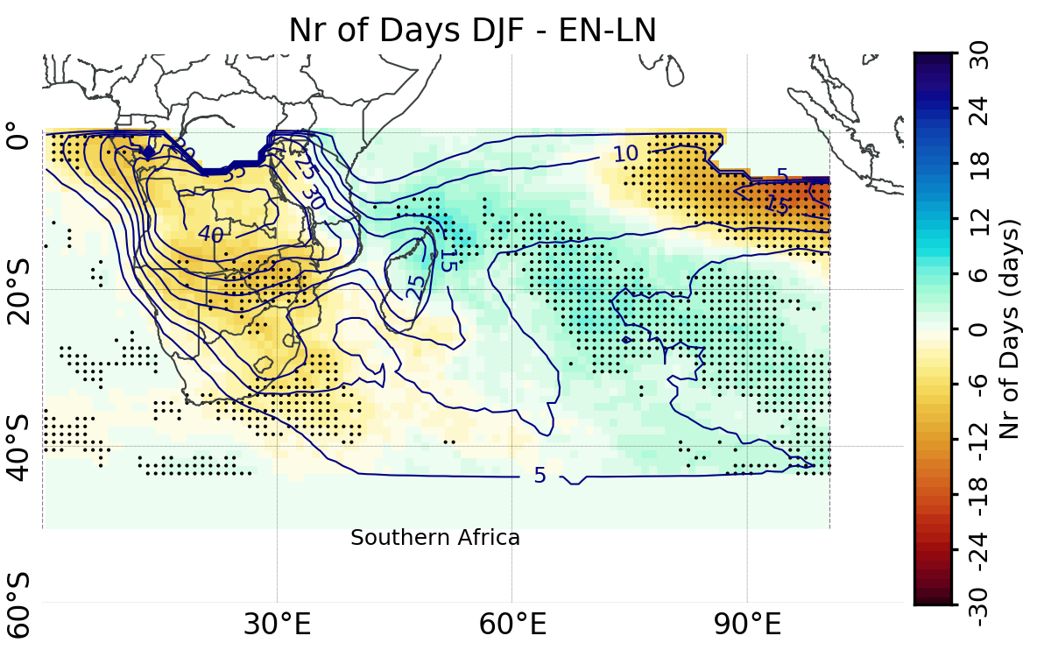
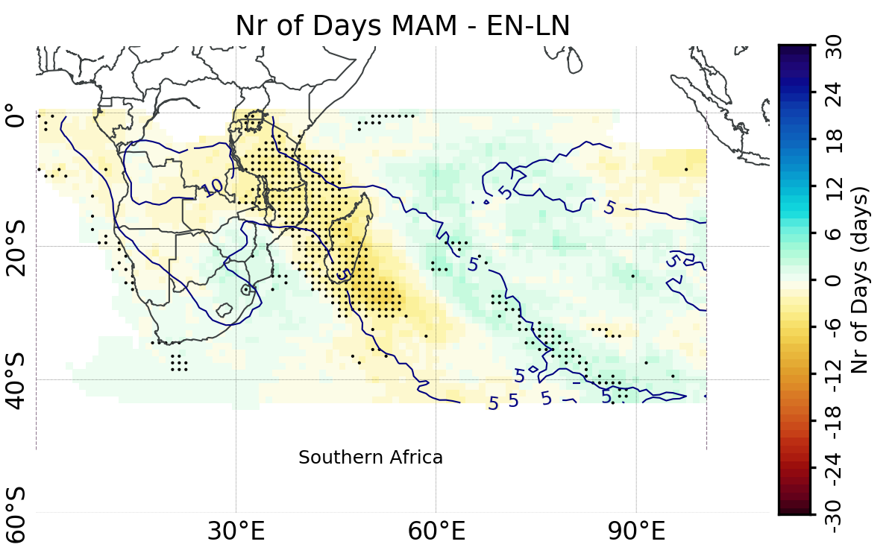
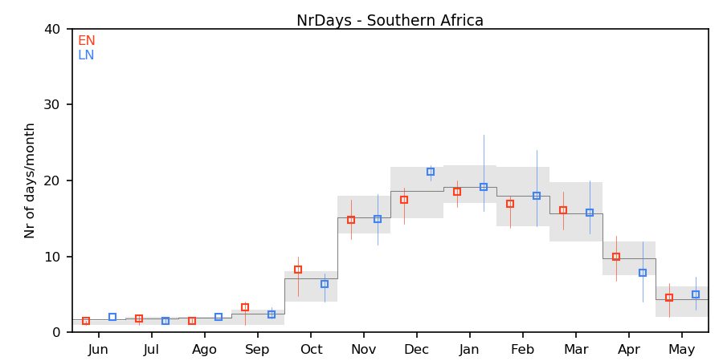
ENSO Anomalies (EN-LN) – Southern Africa
SON
DJF
MAM
Number of Days with cloud bands per month
Anomalies during EN (LN):
Systematic shift of the cloud bands towards tropical (subtropical) latitudes throughout the rainy season

Slide 9
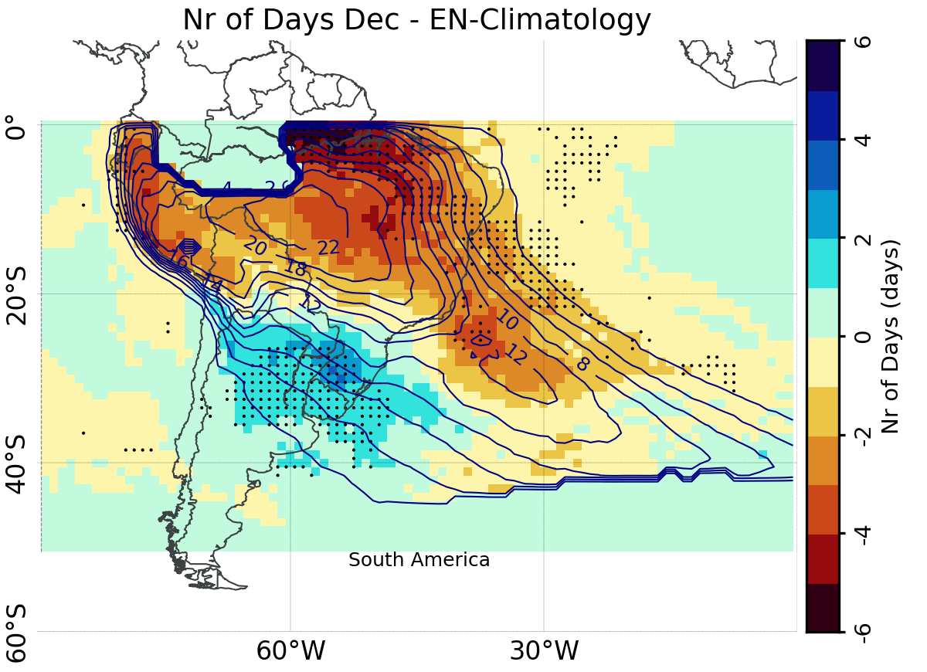
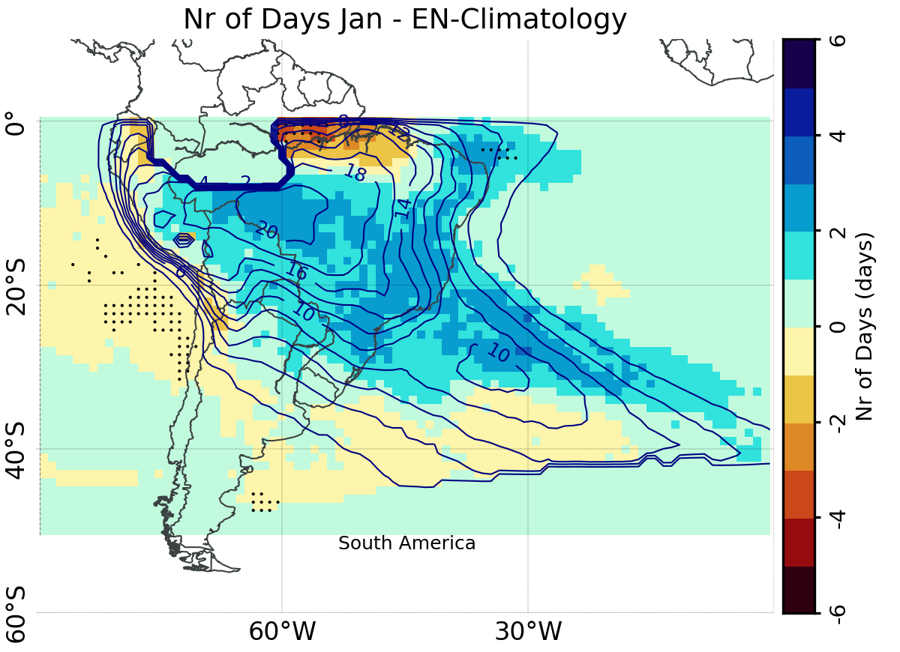
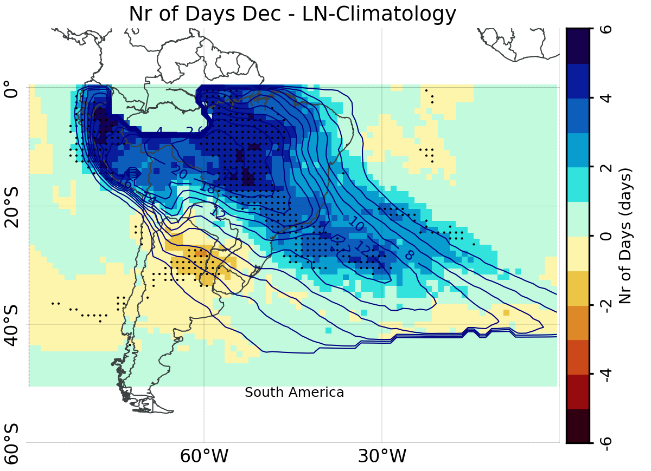
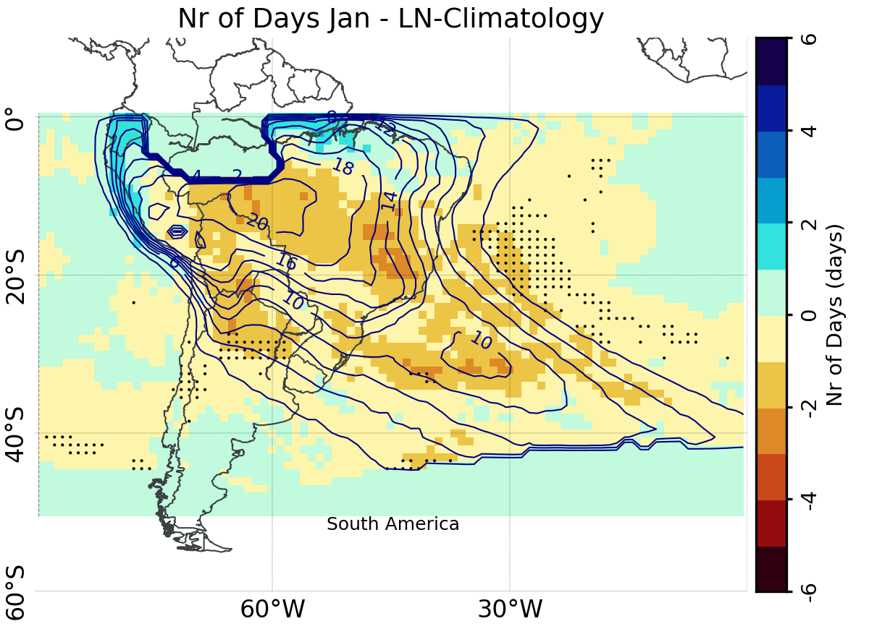
ENSO Anomalies (EN-LN) – South America
Number of Days with cloud bands per month
December
January
El Niño
Anomalies during EN (LN):
Cloud bands located over subtropics (tropics) during onset (Oct-Dec)
Reduction (Increase) in the number of days in December
January anomalies are opposite to December’s
La Niña

Slide 10
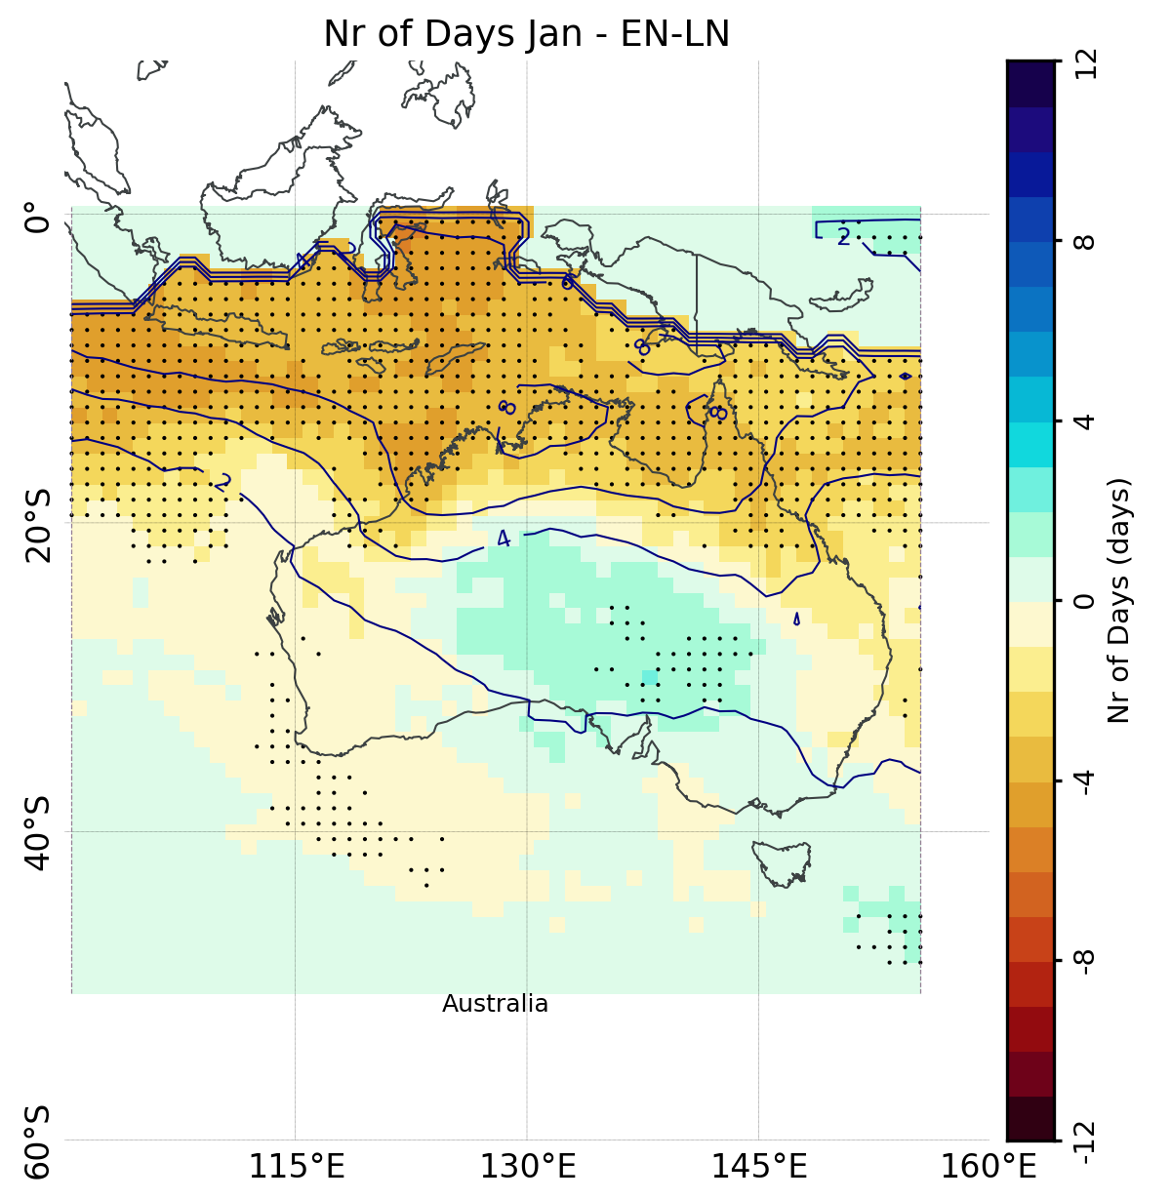
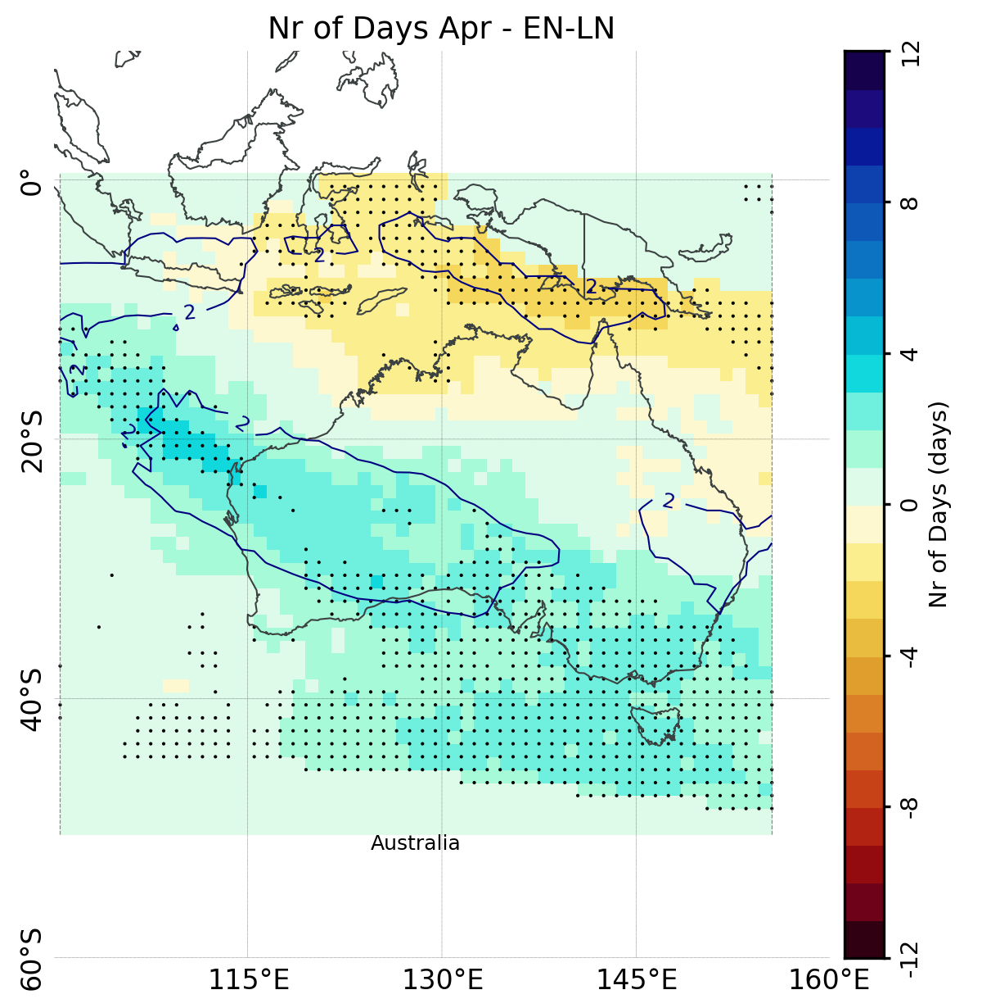
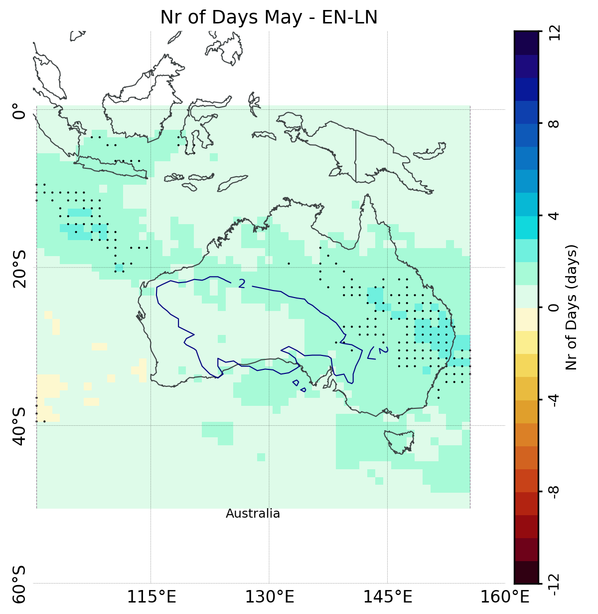
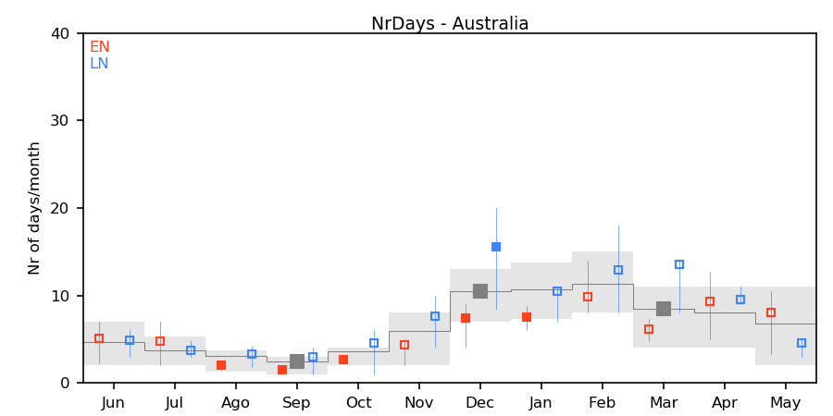
ENSO Anomalies (EN-LN) – Australia
DJF
January
May
April
Number of Days with cloud bands per month
Anomalies during EN (LN):
Reduction (Increase) in the number of days with events throughout most of the year, particularly Dec-Jan
Increase (decrease) in the number of days with cloud bands over SW Australia in April and over NE Australia in May

Slide 11
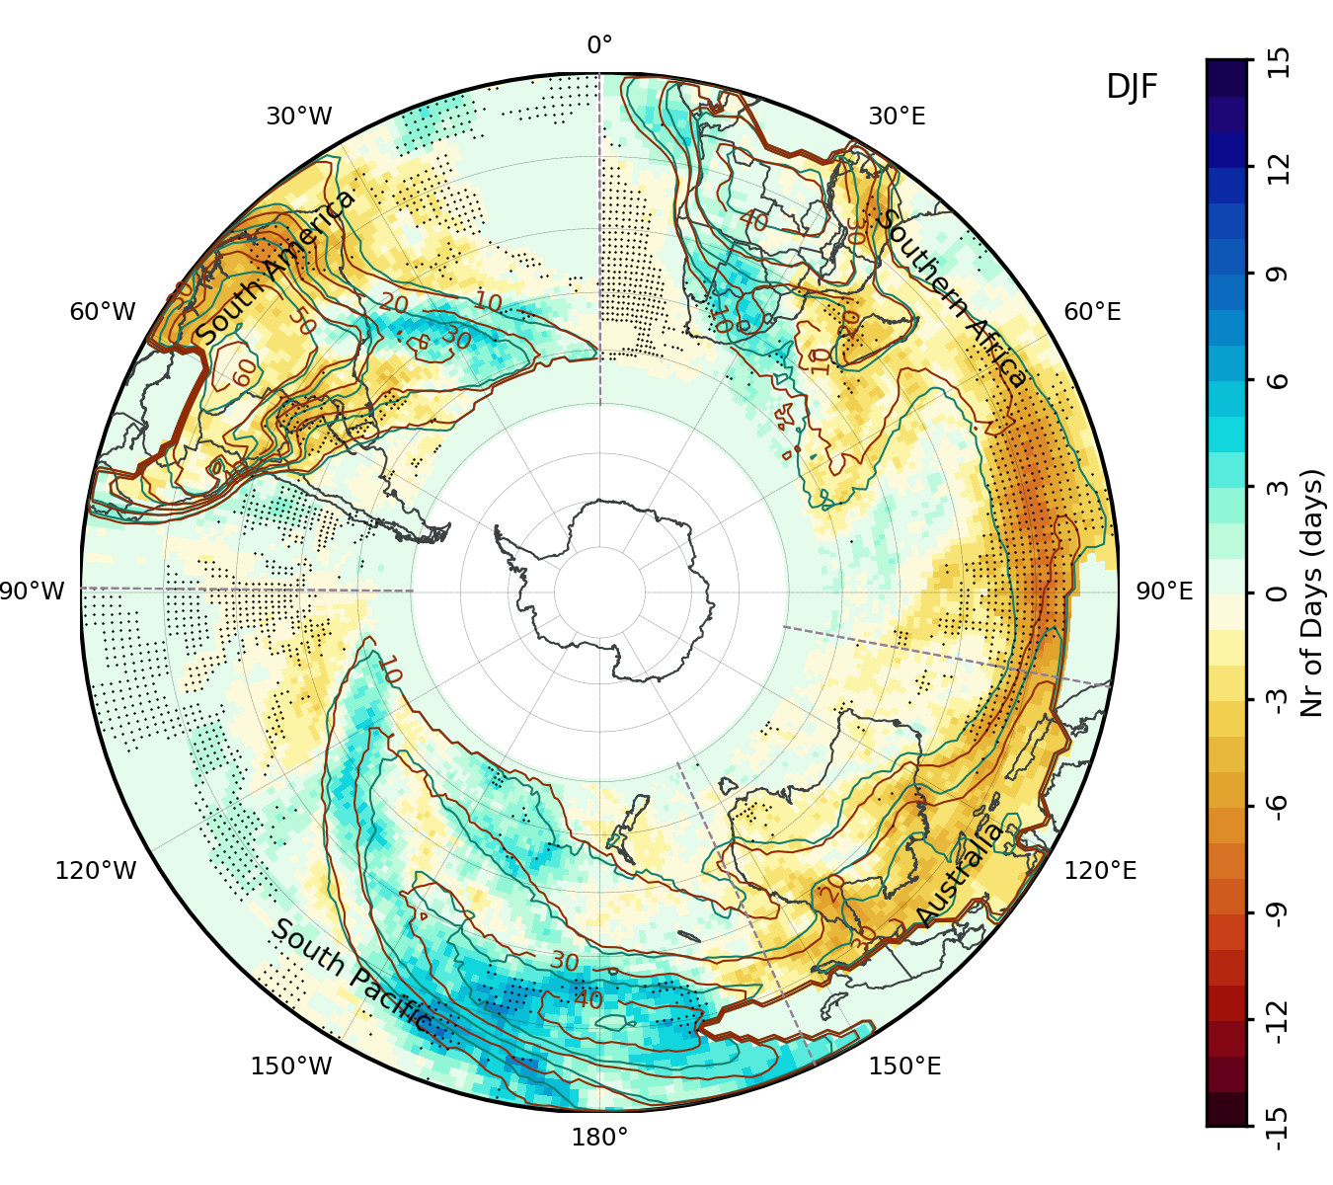
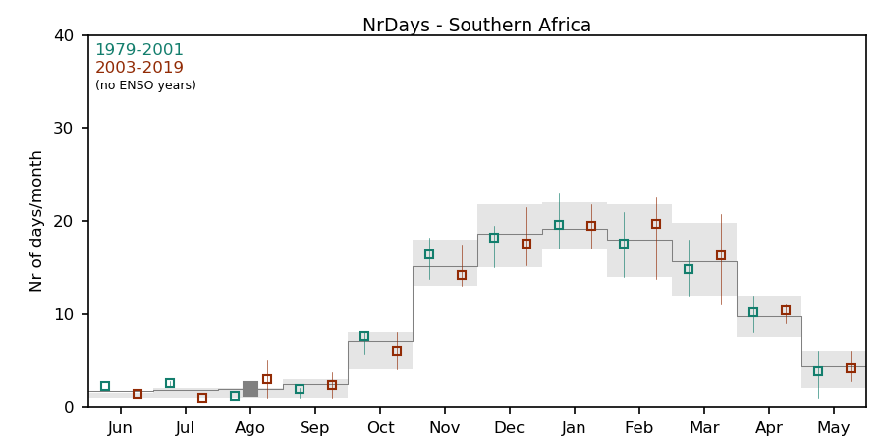
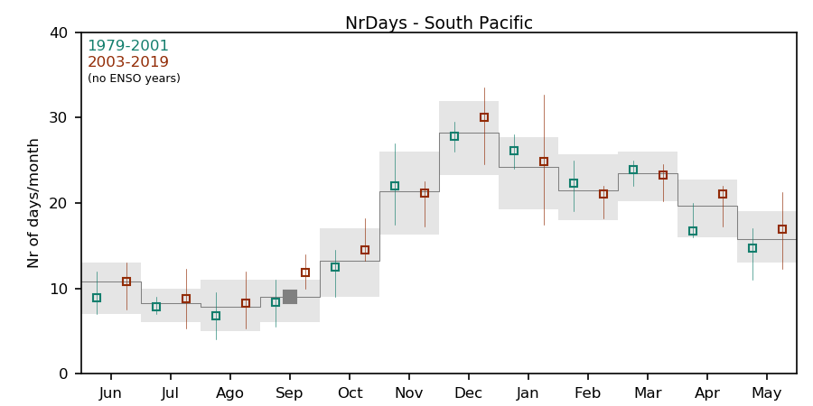
Decadal Changes ([2003-2019]-[1979-2001], no ENSO years)
Number of Days with cloud bands per month
Southern Africa
Change in Number of Days with Events (DJF)
Number of Days with cloud bands per month
South Pacific
EN​​ | 1982​​ | 1986​​ | 1987​​ | 1991​​ | 1994​​ | 1997​​ | 2002​​ | 2009​​ | 2015​​
LN​​ | 1984​​ | 1988​​ | 1995​​ | 1998​​ | 1999​​ | 2007​​ | 2010​​ | 2011​​ | 2020​​

Slide 12
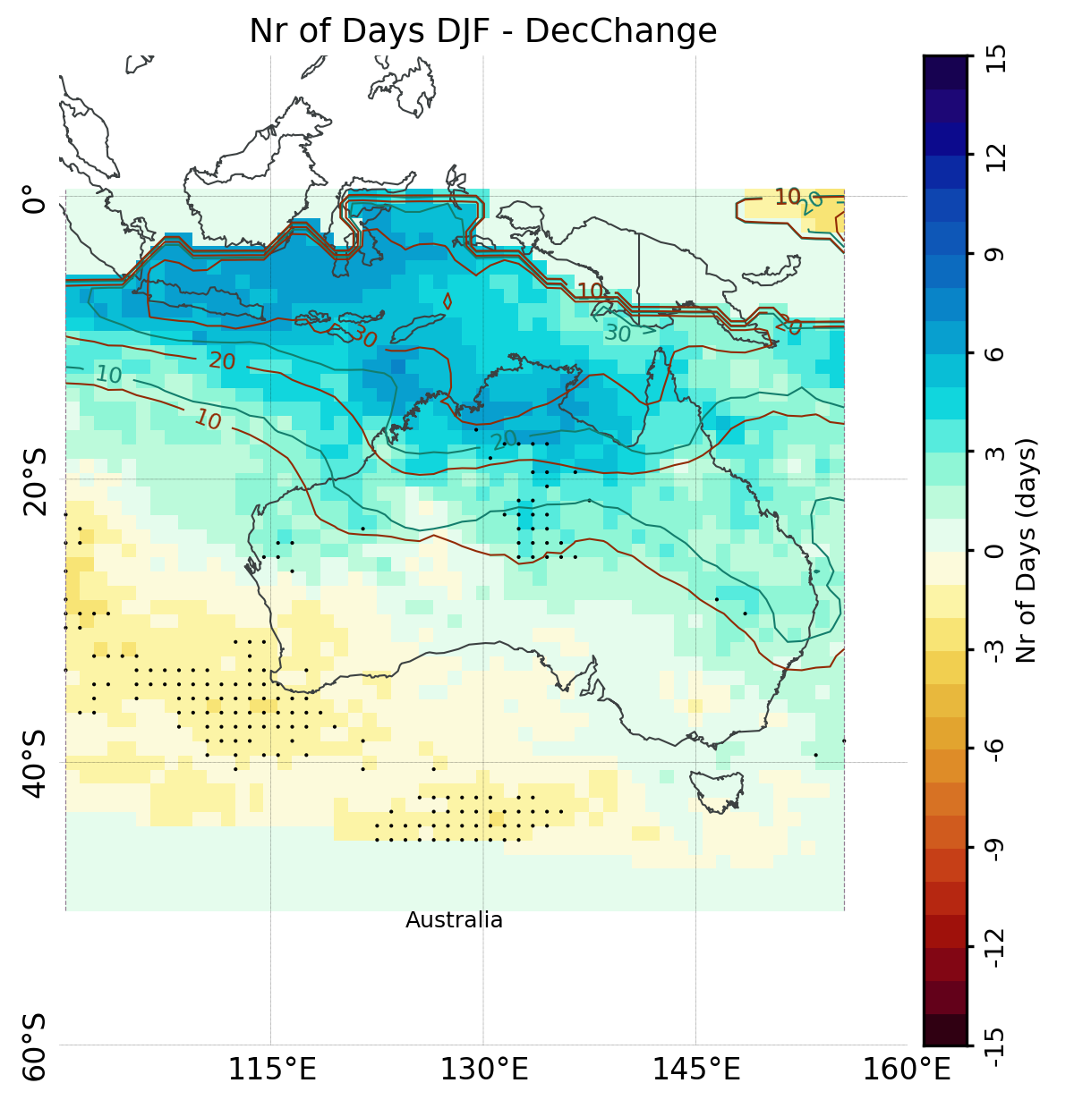
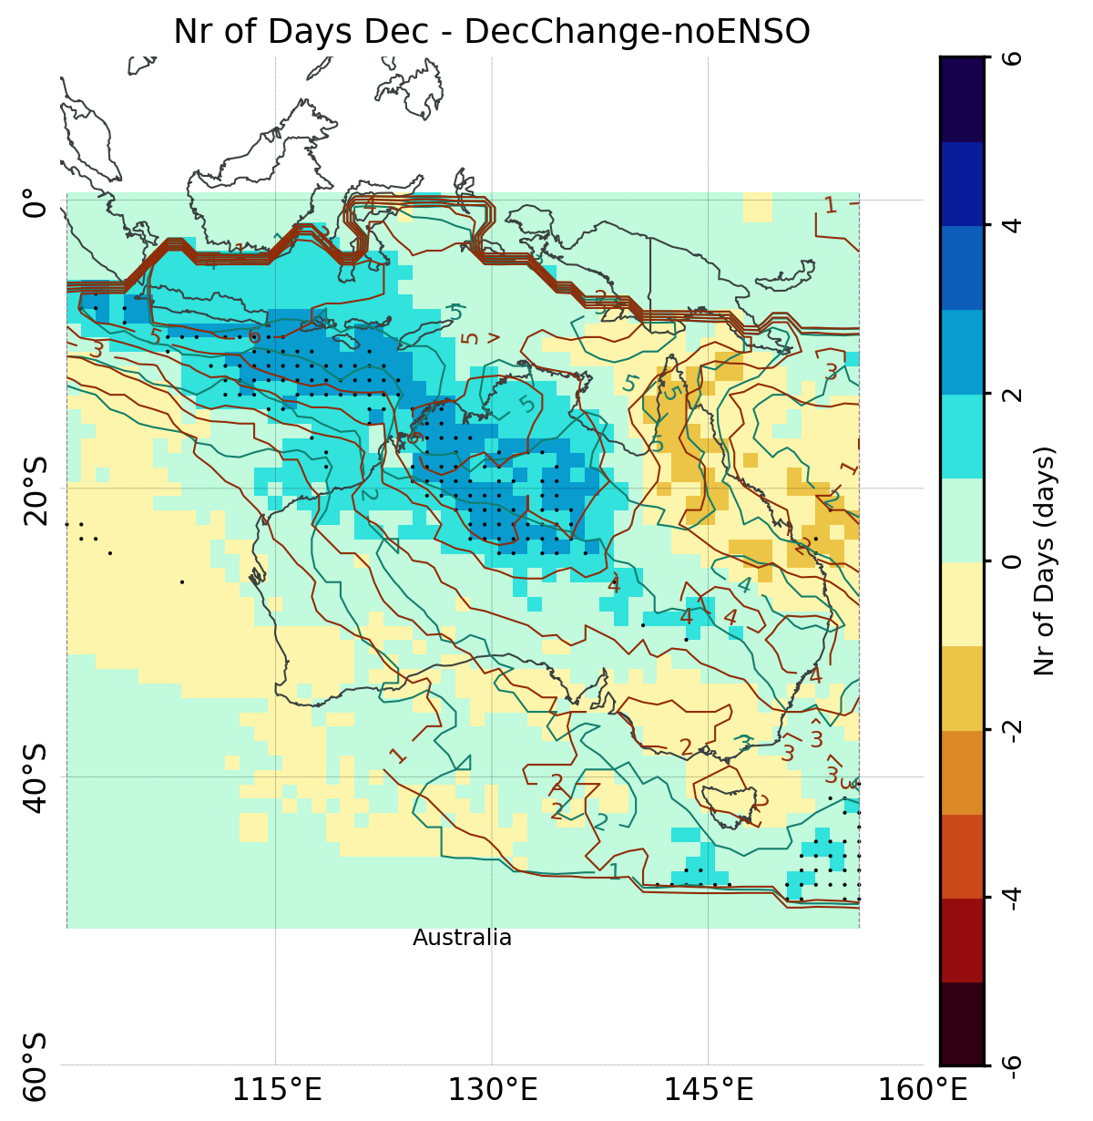
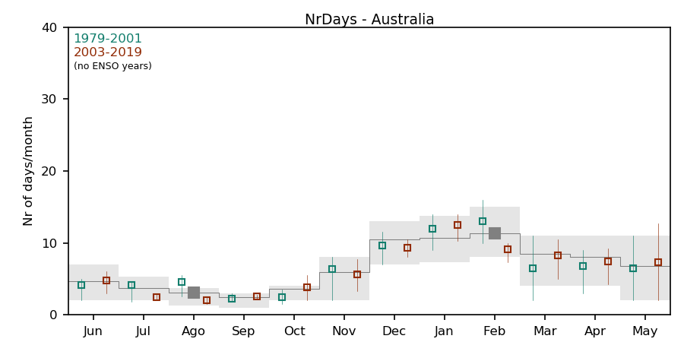
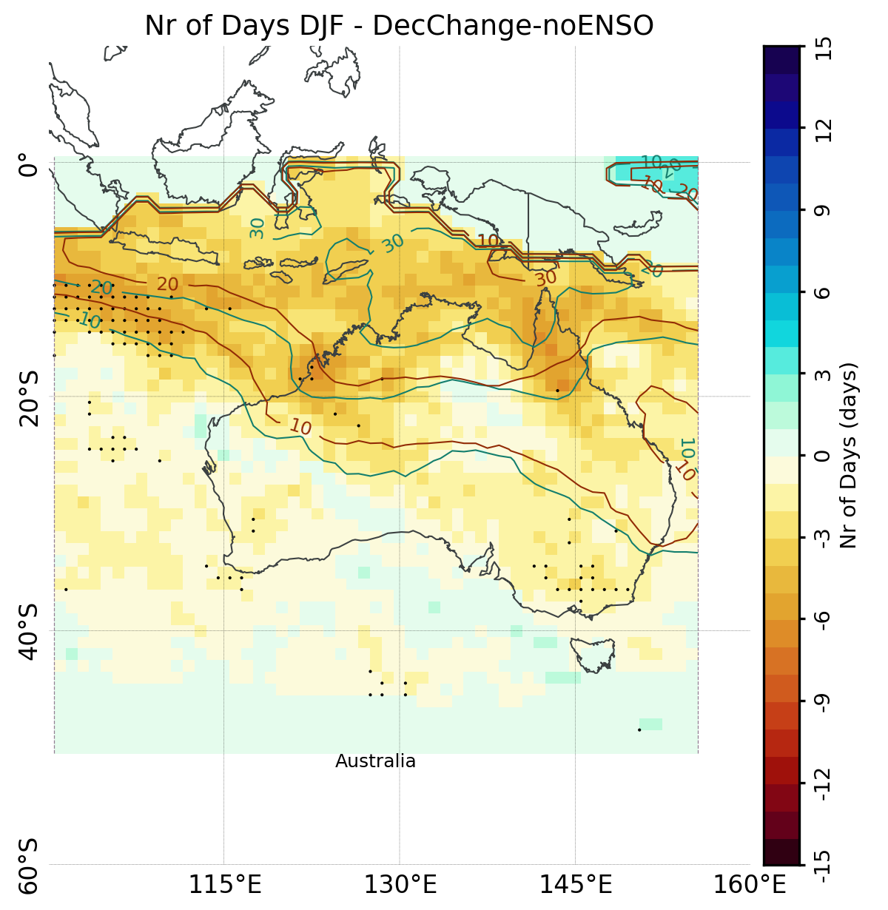
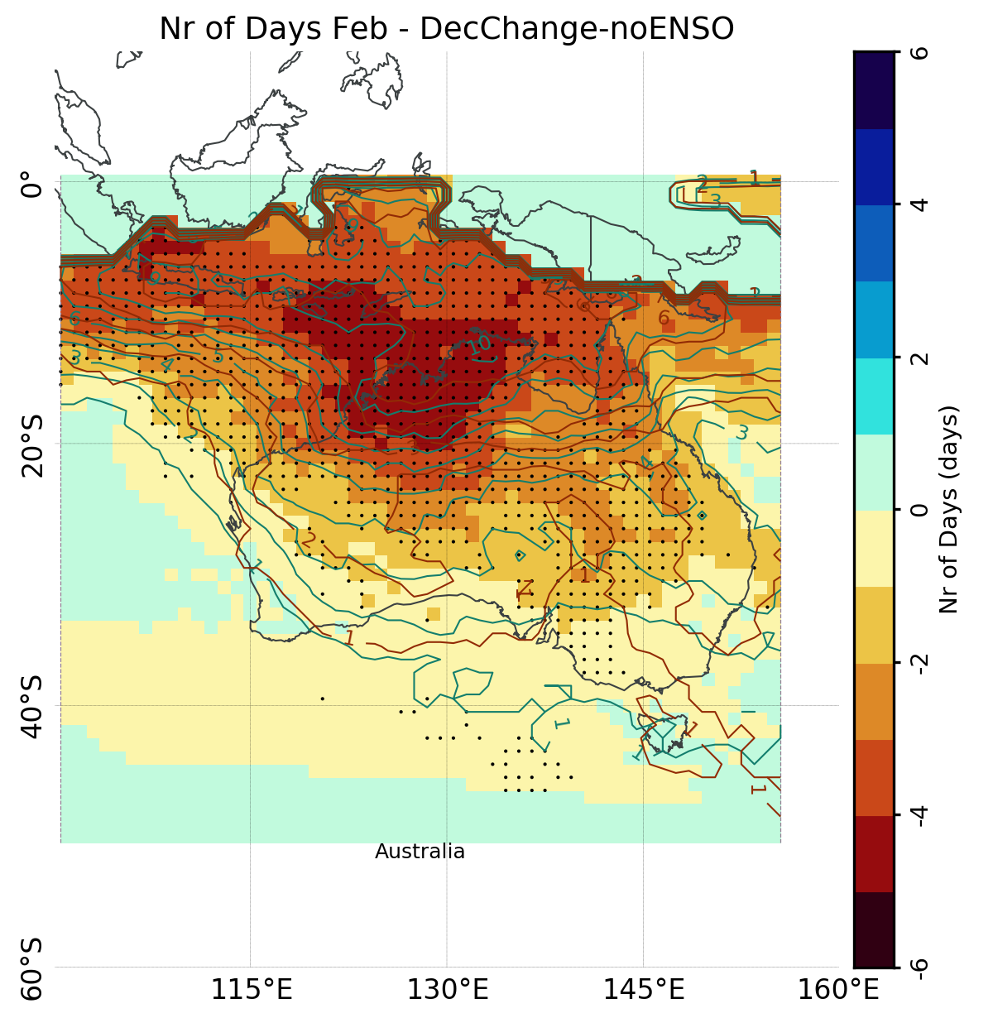
Decadal Changes – Australia ([2003-2019]-[1979-2001], no ENSO years)
All Years
[2007-2020]-[1979-1992]
Opposite behaviors with and without ENSO years
Dec: cloud bands shifted westward
Feb: large decrease in the number of days with events
No ENSO
[2003-2019]-[1979-2001]

Slide 13
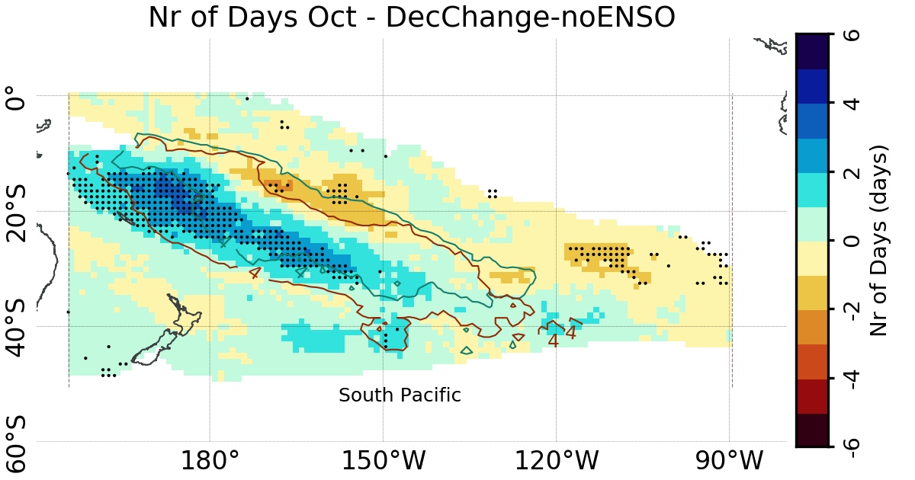
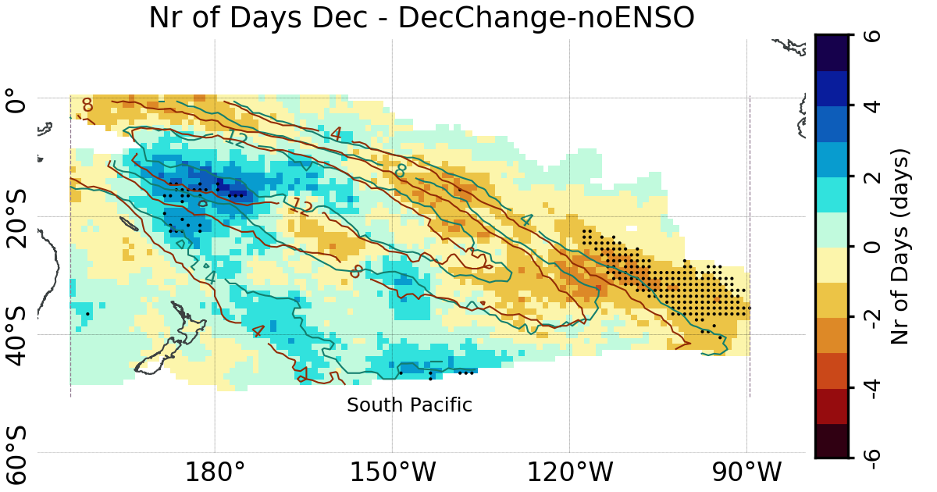
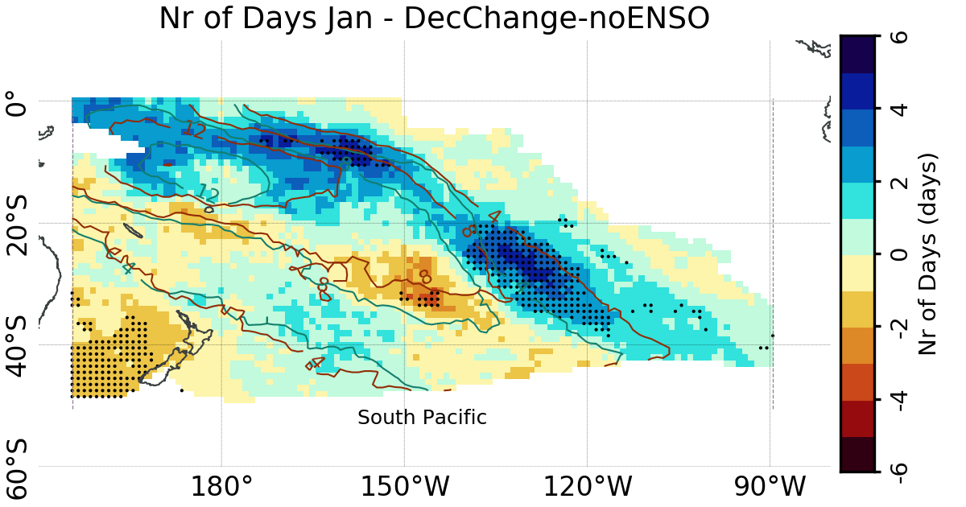
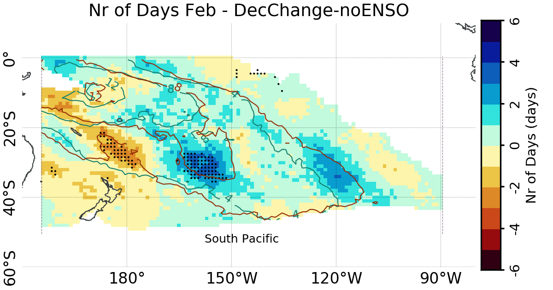
Decadal Changes – South Pacific ([2003-2019]-[1979-2001], no ENSO years)
Southwestward shift of the cloud bands during the onset of the season (Oct-Dec)
Northeastward shift of the events after Jan

Slide 14
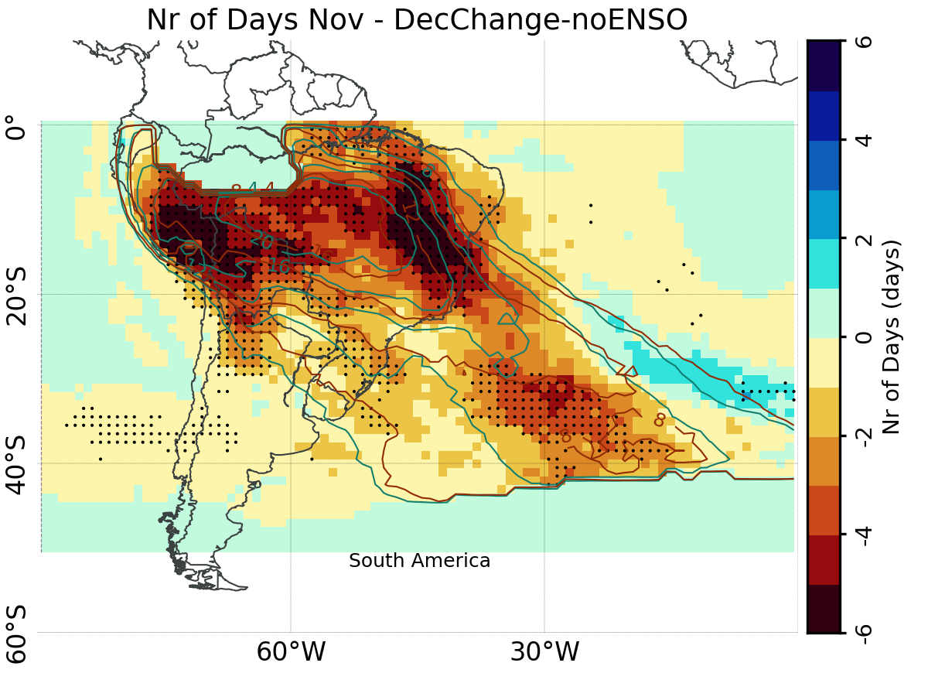
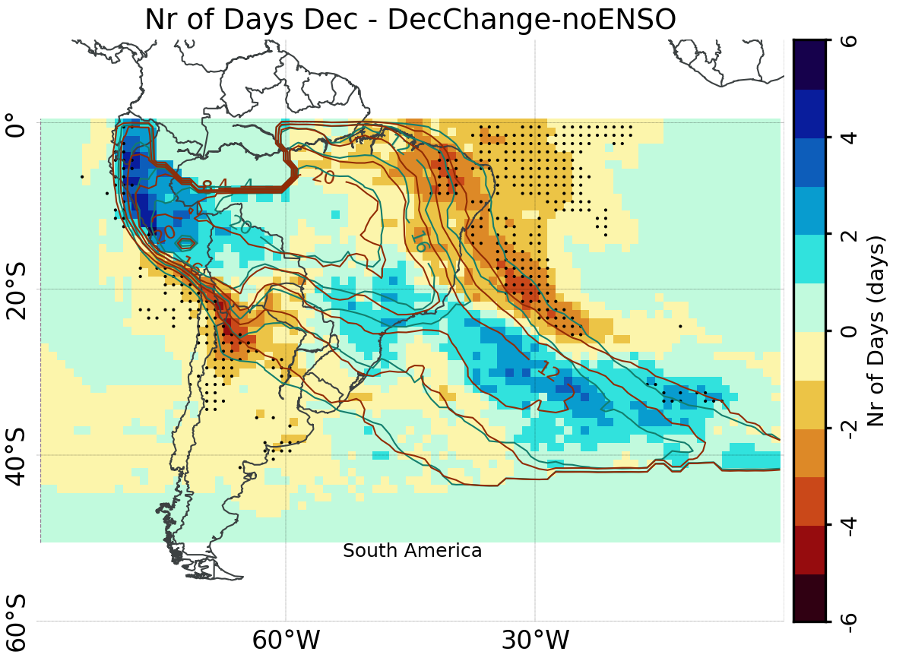
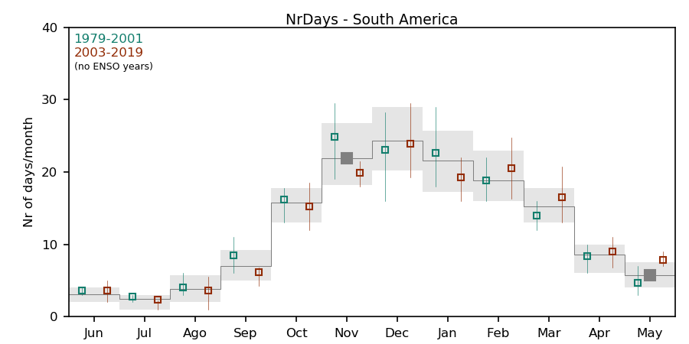
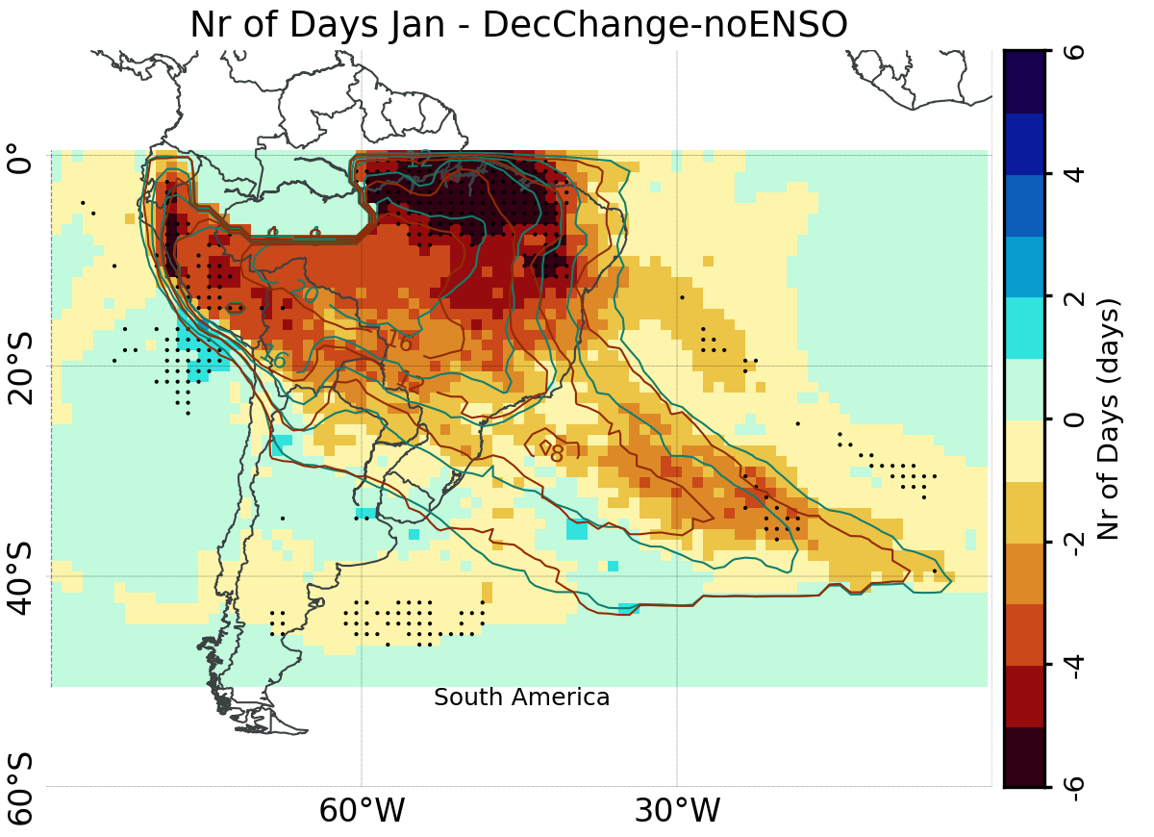
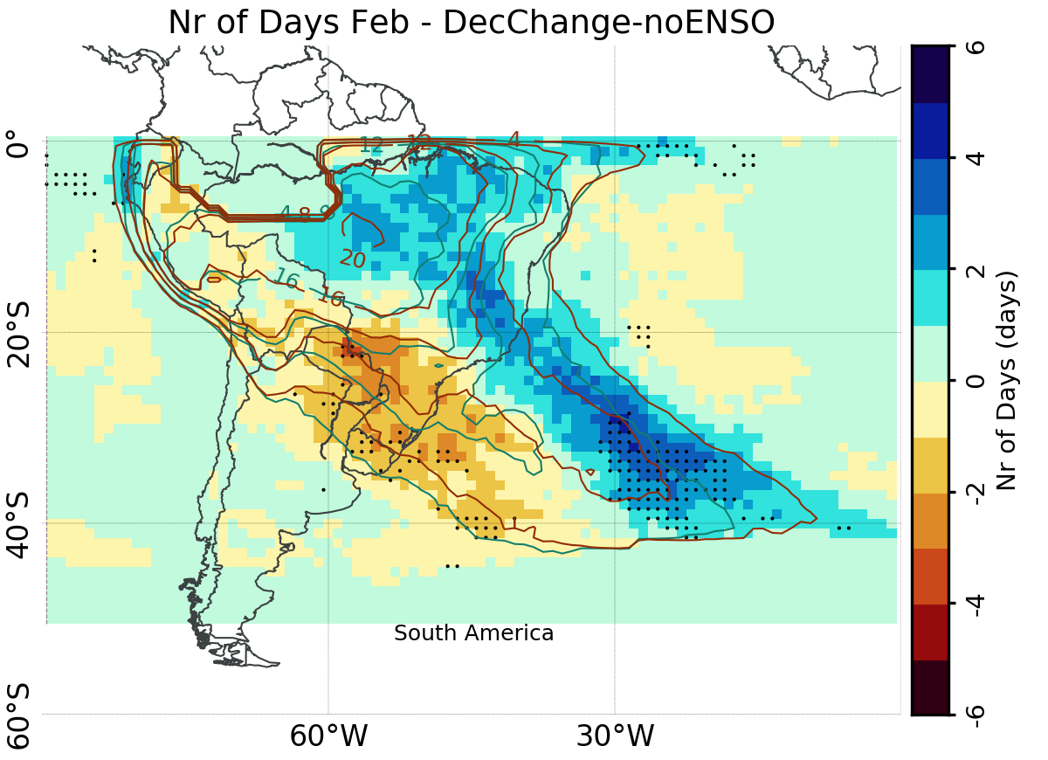
Decadal Changes – South America ([2003-2019]-[1979-2001], no ENSO years)
Delayed onset of the cloud band season
Nov: significant reduction in the number of days with events
Dec: cloud bands shifted southward
Feb: cloud bands shifted northward

Slide 15
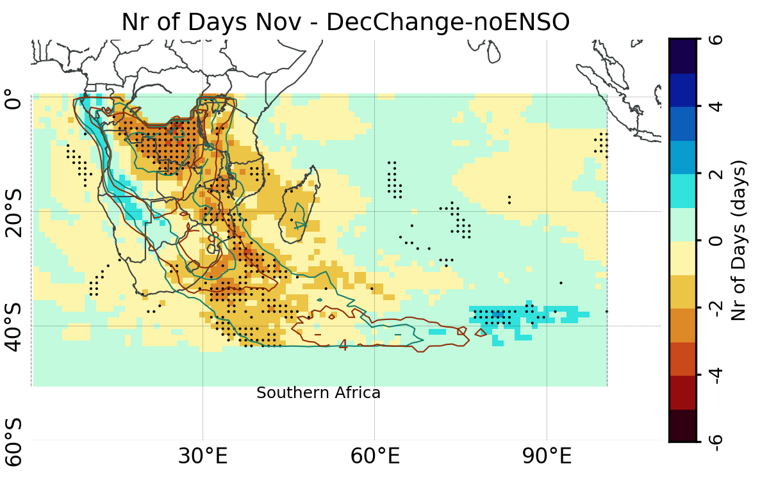
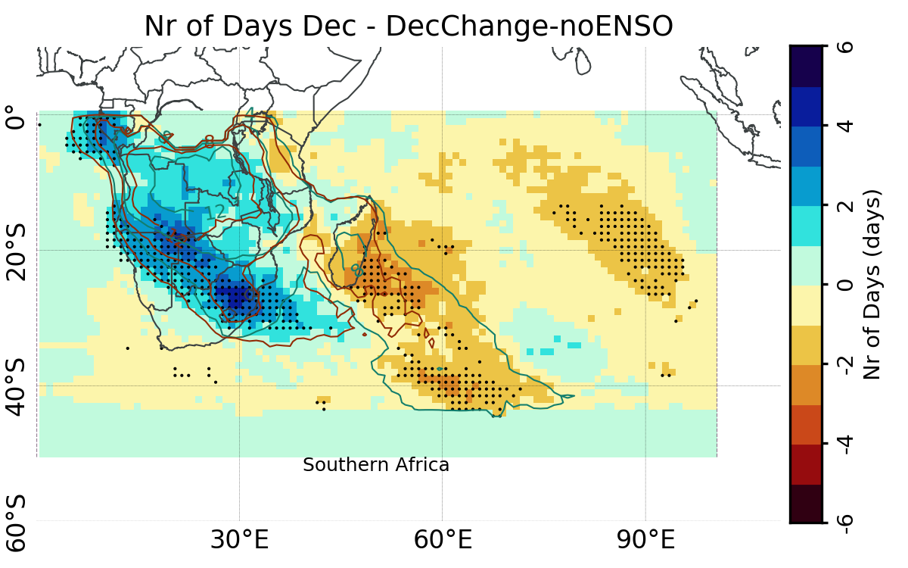
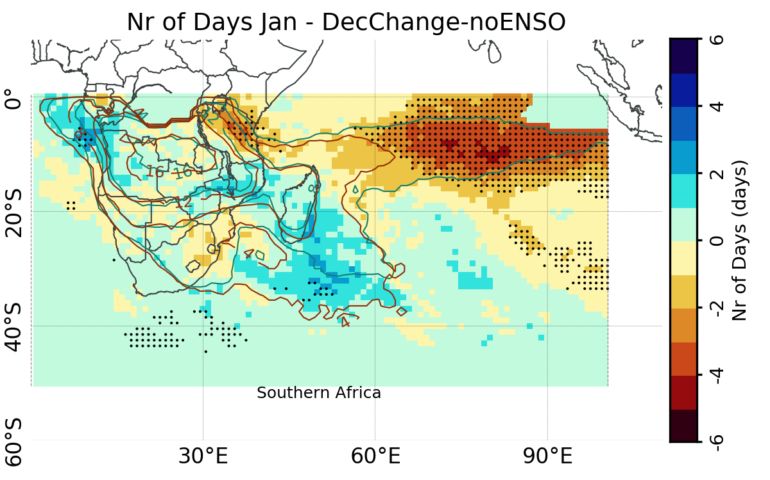
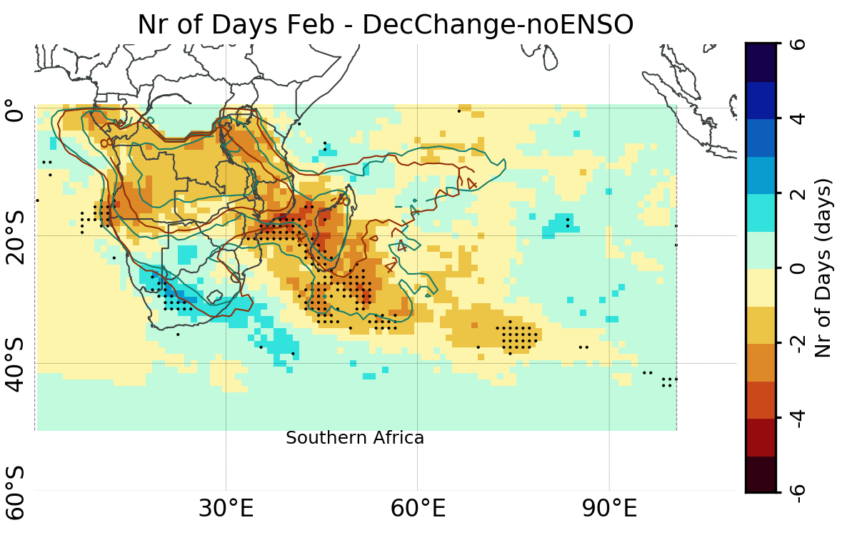
Decadal Changes – Southern Africa ([2003-2019]-[1979-2001], no ENSO years)
Delayed onset of the cloud band season
Nov: significant reduction in the number of days with events
Dec and Feb: cloud bands shifted southward

Slide 16

Next Steps
Improvement of the detection of individual cloud band events
Near real-time monitoring webpage
Analysis of the dynamic aspects related to the development of the cloud band events and connections among them
Implement in climate models of varying resolution
Develop of a near real-time framework to monitor the onset of the cloud band season in a hemispheric perspective
Implementation in tandem with S2S model, in partnership with the Brazilian Center for Weather Forecast and Climatic Studies at the National Center for Space Research (CPTEC/INPE)
SCAN ME
Notes:
Regional meteorological services such as NIWA and BoM

Slide 17




Thank you!!
Contacts:
marcia.zilli@ouce.ox.ac.uk
neil.hart@ouce.ox.ac.uk
Near real-time monitoring webpage
Near real-time monitoring webpage:
https://hart-ncg.github.io/real-time/about.html
References:
Hart N et al (2012) Mon Wea Rev 140, 4005-4016, doi: 10.1175/MWR-D-12-00127.1.
Hart N et al (2018) J Climate 31, 2797-2817, doi: 10.1175/JCLI-D-17-0221.1.
Zilli MT and Hart N (2021) J Climate 34, 8125-8144, doi: 10.1175/JCLI-D-21-0020.1
SCAN ME

