Slide 1

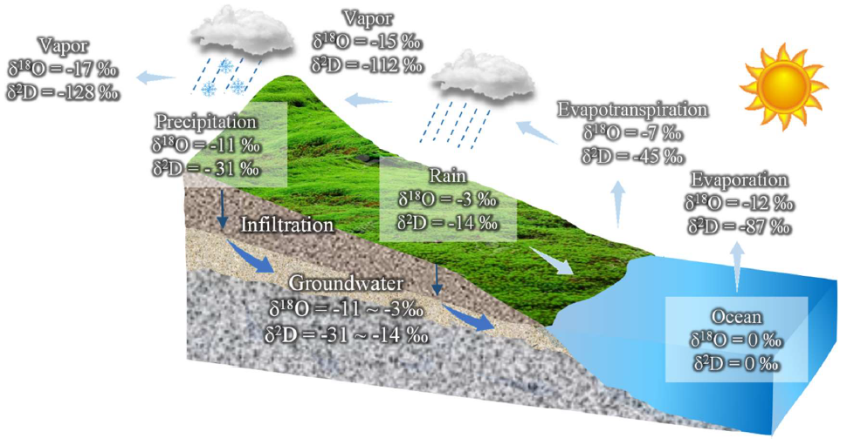



Physicochemical parameters and stable isotope composition of water in Northern Mara Sub-Goldfield, Tanzania: Implications for groundwater-surface water interaction
Justine L. Myovela ^{a,b,}*, Godson Godfray ^{b} and Mohamedi Salimu ^{b}
a University of Pécs, Institute of Geography and Earth Sciences, Department of Geology and Meteorology, Ifjúság u. 6, Pécs, 7624, Hungary
b University of Dodoma, College of Earth Sciences and Engineering, Department of Geology, P. O. Box, 11090, Dodoma, Tanzania
*Corresponding author: justine1@gamma.ttk.pte.hu
Jung et al., 2020

Slide 2
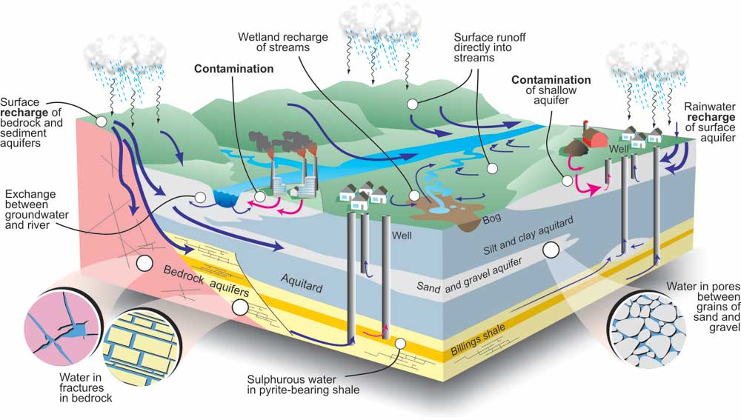
1.INTRODUCTION
Groundwater-surface water interaction is crucial for both physical and chemical fluxes in the hydrologic cycle.
Contamination of water resources through anthropogenic activities has been a major environmental concern (Nisi et al., 2014; UN-water, 2011)
Quinn et al., 2016
Motivation:
70% of industrial and mine wastes in developing countries contaminate the existing water resources.
(UN-water, 2009)

Slide 3
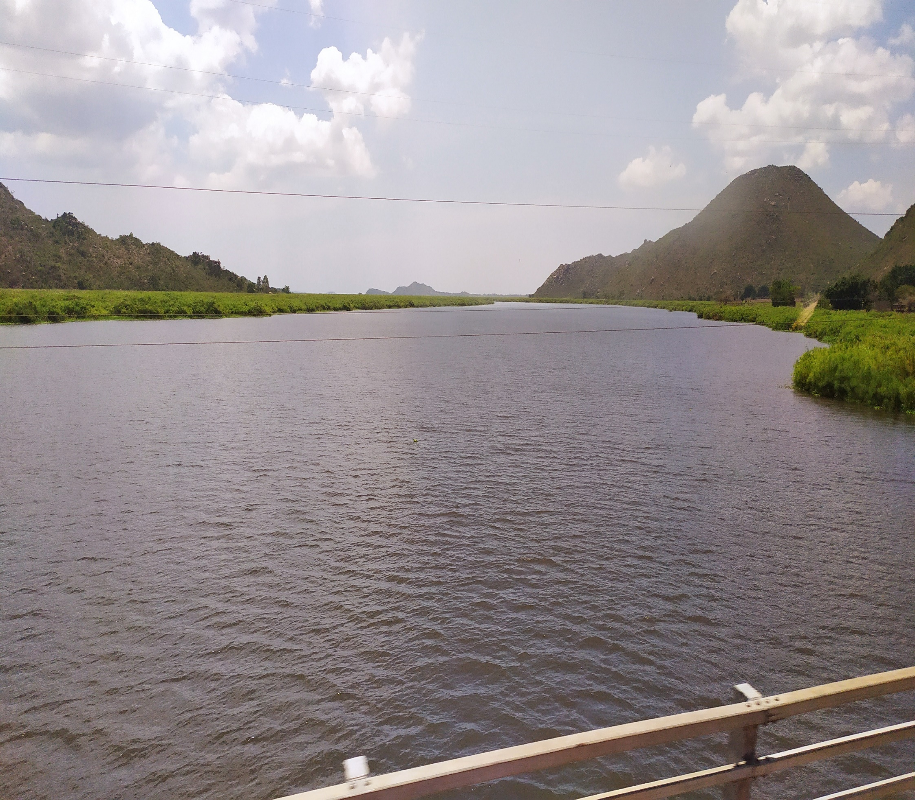
OBJECTIVES
To conduct water quality assessment around Northern Mara Sub-goldfield (NMSF).
To determine spatial variation of δ¹⁸O and δ²H of groundwater and surface water sources.
River Mara (Photo by Justine L. Myovela)

Slide 4
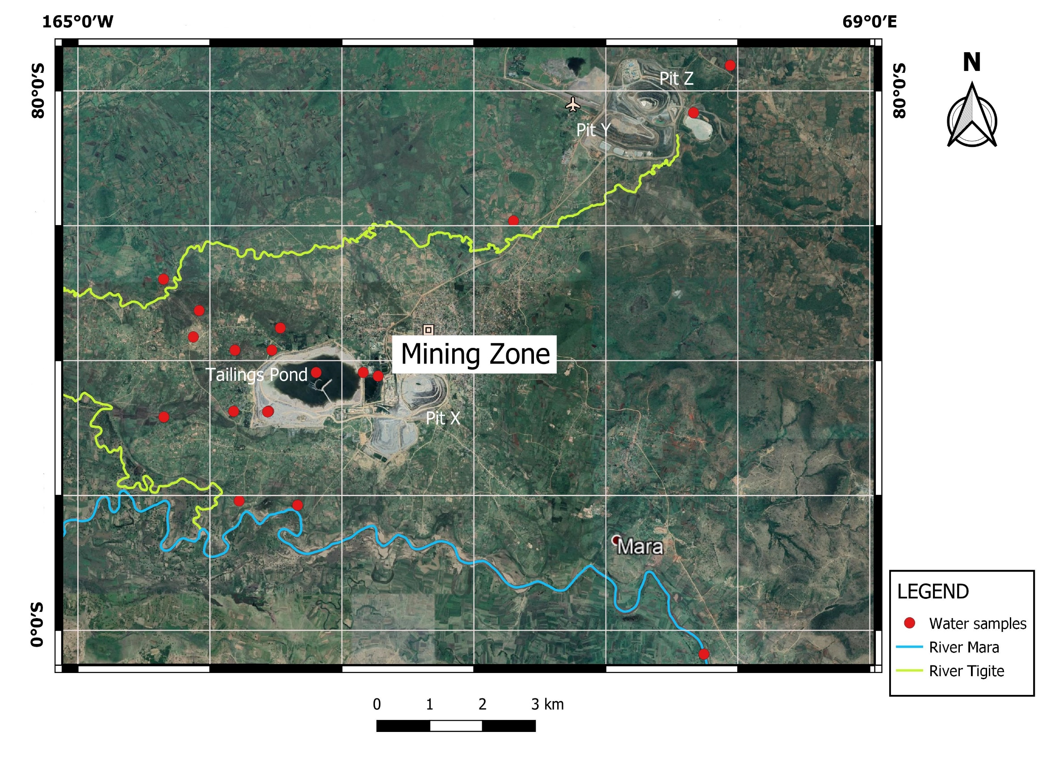
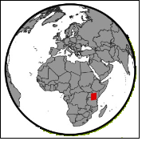
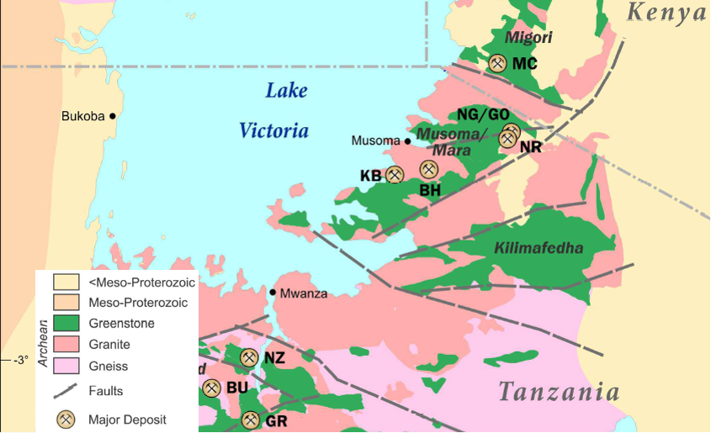
2.STUDY AREA
Northern Mara Sub-gold Field (NMSF) is situated in Tarime district, Mara region, Northwest Tanzania.
This gold-rich field is within the sulfide ore system in Musoma-Mara greenstone belt, a part of Lake Victoria Fields (Henckel et al., 2016)
Henckel et al., 2016
Google Earth image, 2020

Slide 5

OBJECTIVES
3.METHODS
26 water samples: during rainy season (rivers, shallow & deep groundwater, dug wells and tailings pond)
HATCH meter: pH, Electrical conductivity (EC), Total Dissolved Solute (TDS) and Total hardness.
H-O Isotopes analysis-Liquid Isotope Analyzer (V-SMOW)

Slide 6

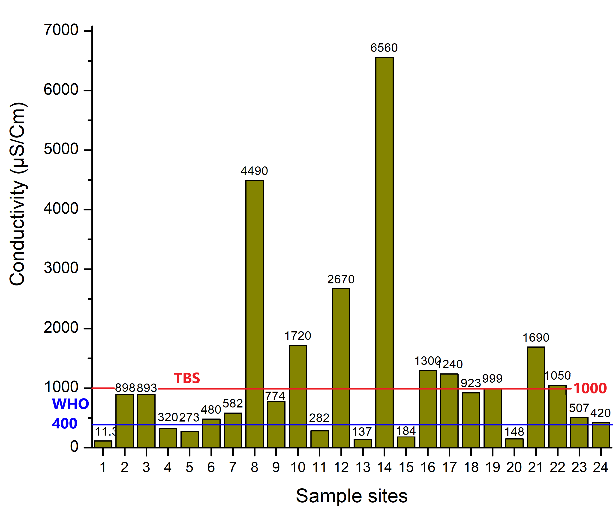
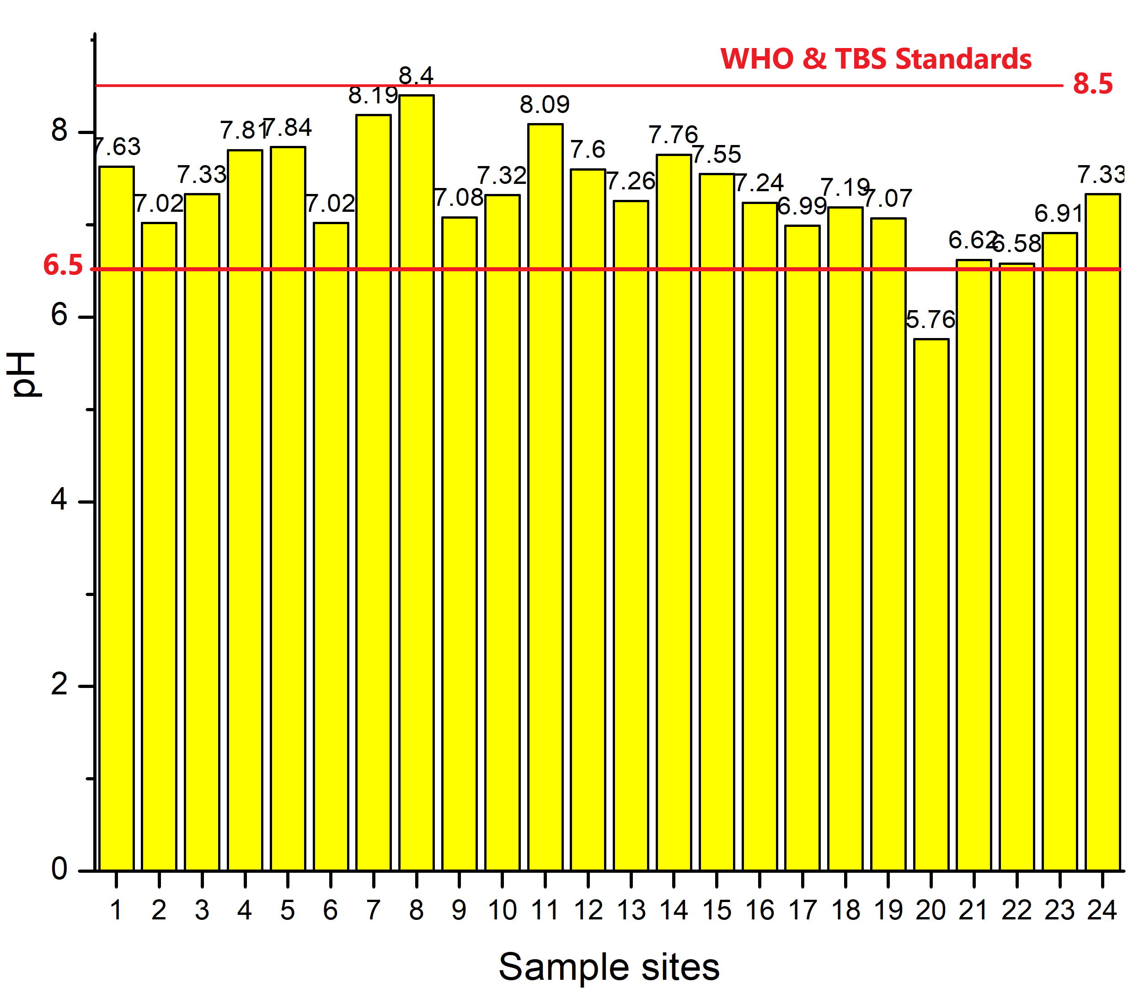
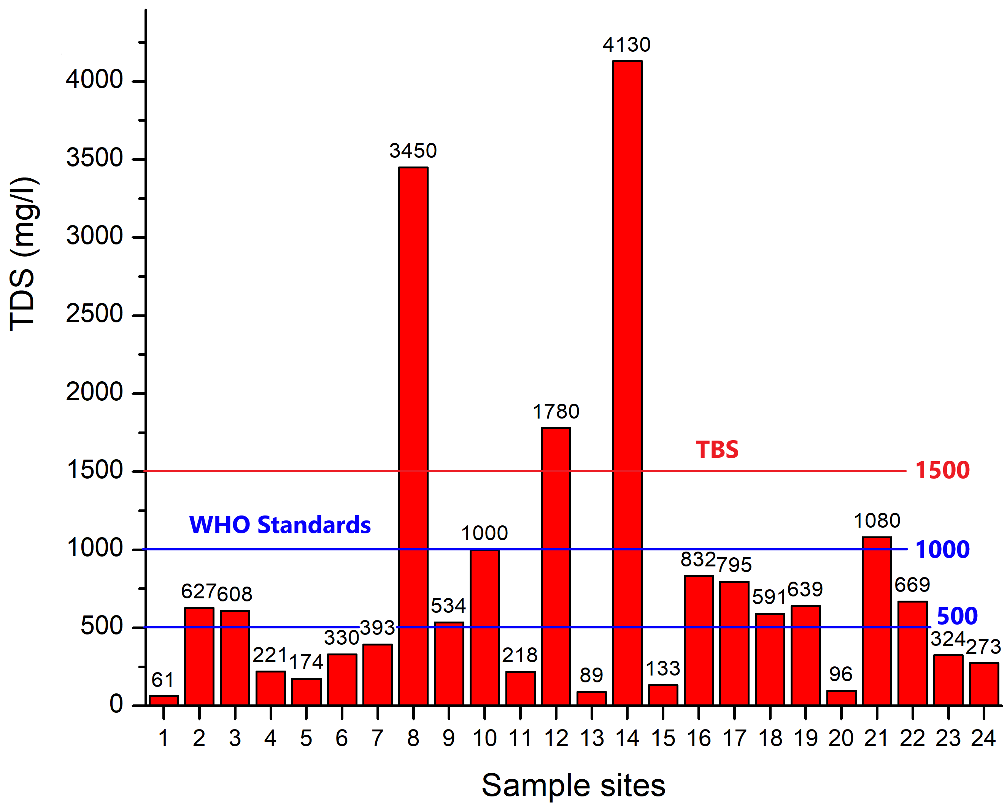
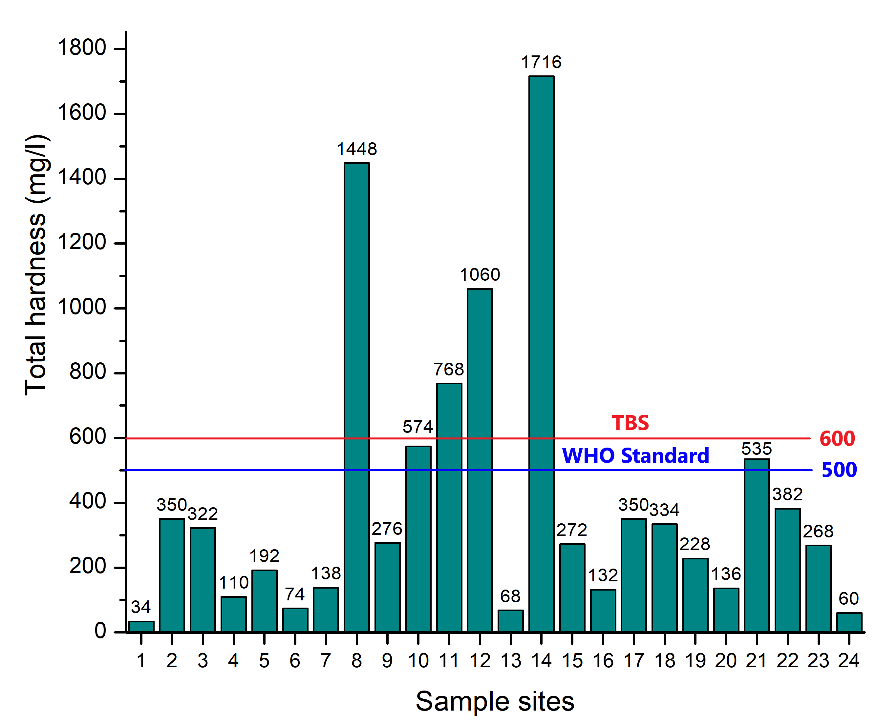
OBJECTIVES
4.RESULTS: WATER QUALITY
Tailings ponds
Myovela et al., in prep
Key message; Most drinking water sources meet
the recommended standards (WHO & TBS)
except; 10-Shallow well east of Ingwe dam
12-Shallow well south of Tailings pond
21-Kegonga community shallow well
22-Matongo community shallow well

Slide 7

4.RESULTS: WATER QUALITY
22
Affected water sources
10-Shallow well east of Ingwe dam
12-Shallow well south of Tailings pond
21-Kegonga community shallow well
22-Matongo community shallow well
10
21
12
Shallow wells are more vulnerable to contamination than deep wells.
Myovela et al., in prep

Slide 8
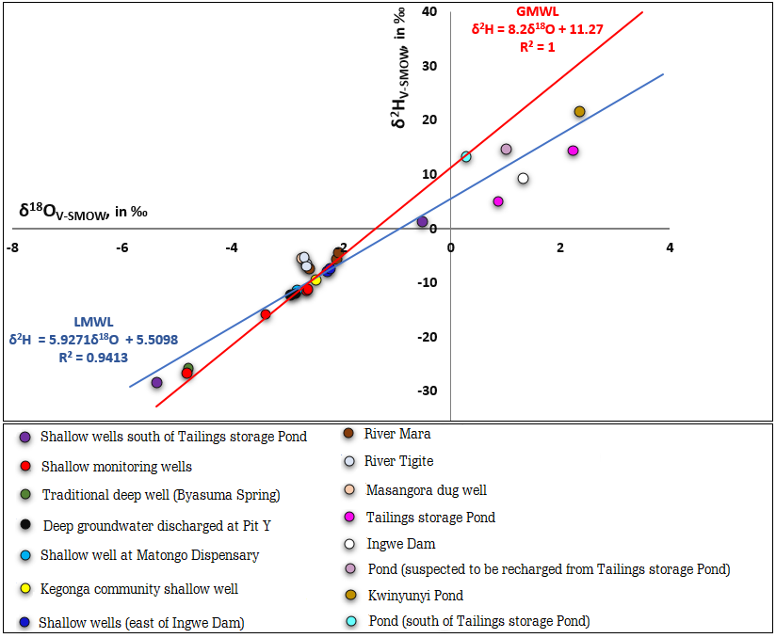

OBJECTIVES
4.RESULTS: δ¹⁸O AND δ²H OF WATER SAMPLES
Myovela et al., in prep
Wide isotopic variations
δ²H; -28.5 to 21.4 ‰
δ¹⁸O; -5.37 to 2.37 ‰
The slope of LMWL(δ²H = 5. 9 δ¹⁸O + 5.51; R²=0.94) is slightly lower than the slope of GMWL (δ²H = 8.2 δ¹⁸O + 11.27; R²=1)
Key message;
Majority of studied water samples have been isotopically modified.

Slide 9

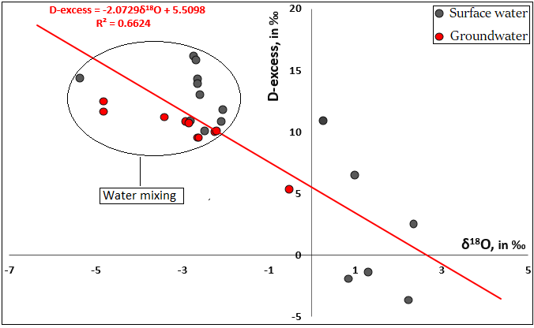
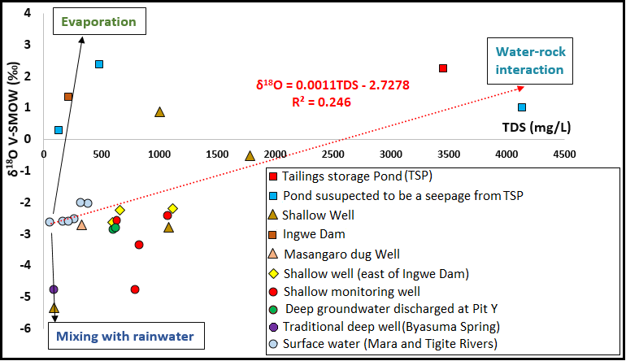
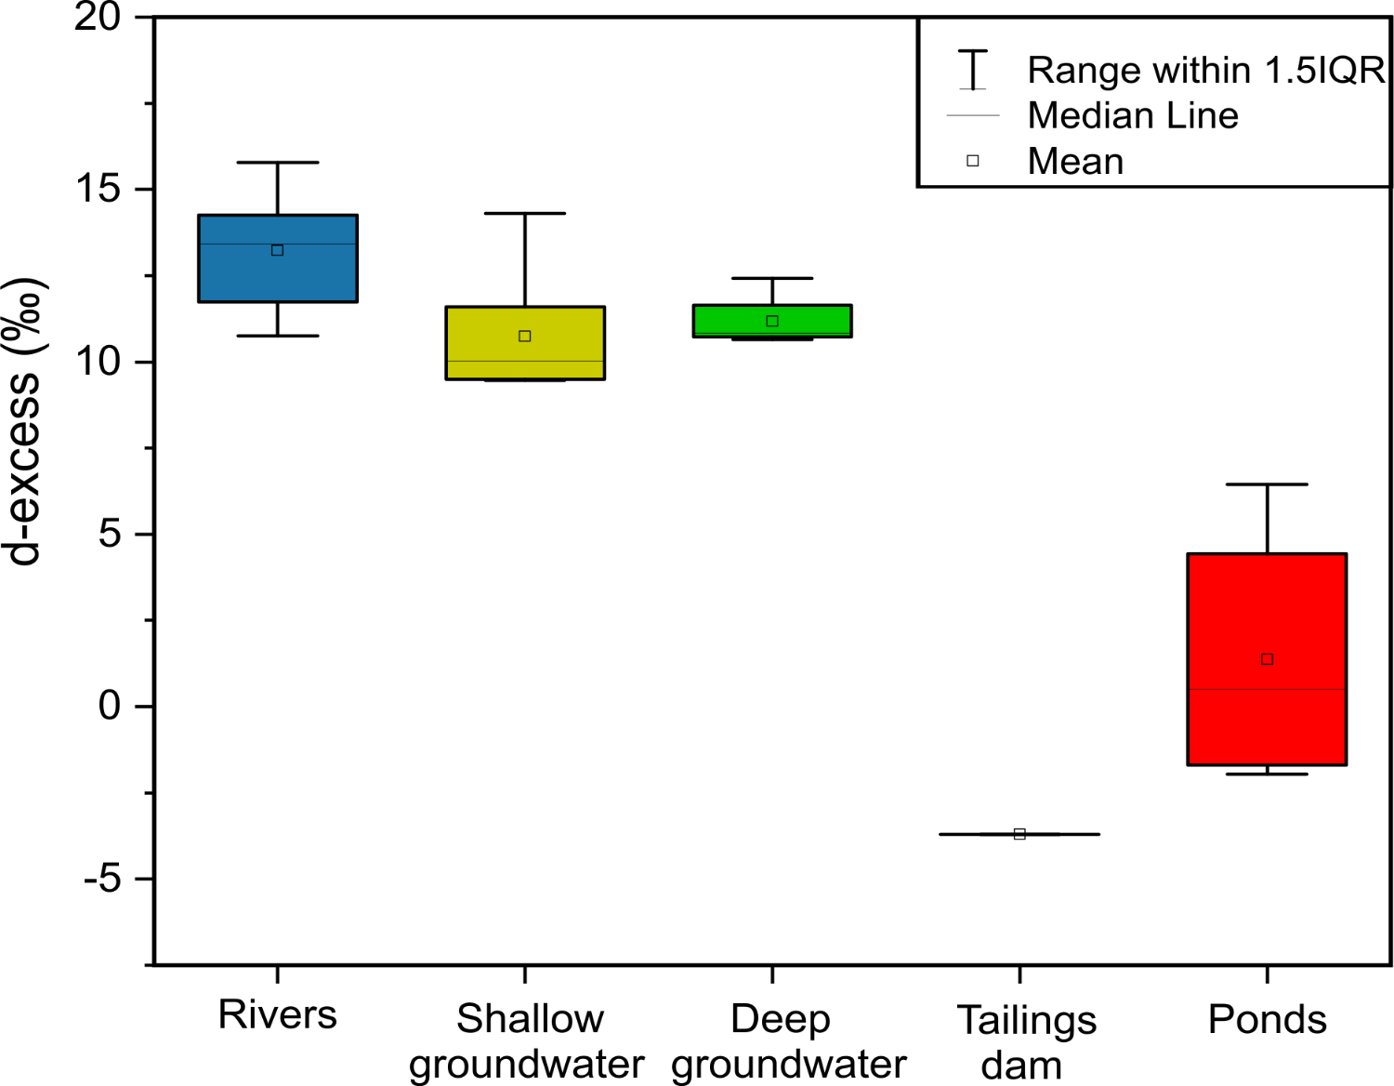
OBJECTIVES
5.DISCUSSION: WATER INTERACTION
Adapted from Yang and Han, 2020
Myovela et al., in prep
-Several shallow and groundwater sources have similar isotopic signatures indicating mixing at a certain stage in their hydrological circle.
-Complex hydrological regime
Myovela et al., in prep

Slide 10
OBJECTIVES
6. FUTURE WORK AND CONCLUSION
FUTUTE WORK
Groundwater modelling to depict the depth of contamination and other possible sources of contaminations.
CONCLUSIONS
Most drinking water sources meet the recommended standards set by WHO &TBS except few water sources such as Kegonga shallow well.
Shallow wells are more vulnerable to contamination than deep wells.
Several shallow groundwater sources have likely been recharged by more evaporated sources for example Shallow well south of Tailings Pond.

Slide 11
THANK YOU FOR LISTENING

Slide 12
OBJECTIVES
REFERENCES
Abu Jabal, M. S., Abustan, I., Rozaimy, M. R., & El Najar, H. (2018). The deuterium and oxygen-18 isotopic composition of the groundwater in Khan Younis City, southern Gaza Strip (Palestine). Environmental Earth Sciences, 77(4)
Henckel J, Poulsen K, Sharp T, Spora P. Lake Victoria Goldfields. Episodes 2016;39:135-154
Jung, Koh, Kim, Jeen, & Lee. (2020). Stable Isotopes of Water and Nitrate for the Identification of Groundwater Flowpaths: A Review. Water, 12(1), 138
Nisi, B., Raco, B., & Dotsika, E. (2014). Groundwater Contamination Studies by Environmental Isotopes: A review. Threats to the Quality of Groundwater Resources, 115–150.
Quinn, N.W.T,., Parrot, S., Farley, M (2016). Conceptual water budget analysis for screening agricultural and wetland water management projects.
Rozanski, K., Araguás-Araguás, L., & Gonfiantini, R. (1993). Isotopic Patterns in Modern Global Precipitation.
UN-Water Annual Report 2009.
UN-Water Annual Report 2011.
Yang, K., & Han, G. (2020). Controls over hydrogen and oxygen isotopes of surface water and groundwater in the Mun River catchment, northeast Thailand: implications for the water cycle.

