Slide 1
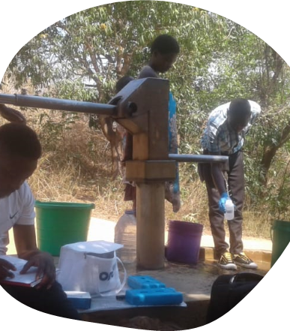
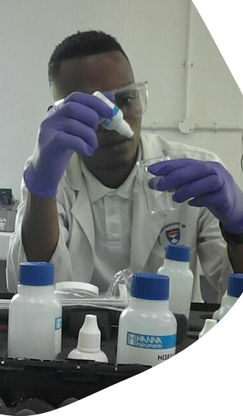
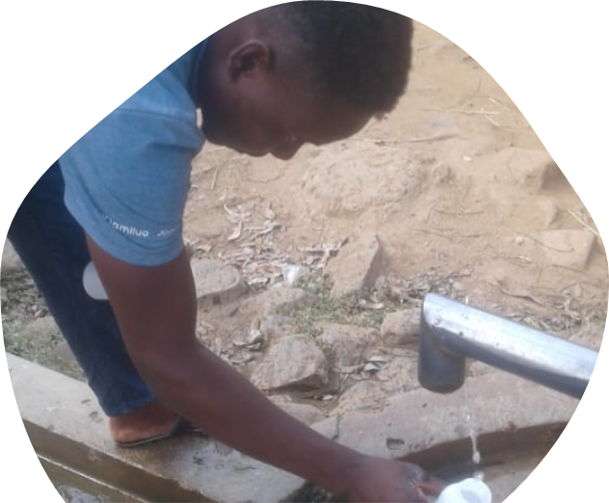



Reflections on collaboration for sustainable groundwater quality monitoring in Malawi during Covid19
Gomo F., Halliday S., Chichlowski W., Chichloska S., Zaunda H., and Geddes A.

Slide 2
Background
A new collaborative effort focused on assessing fluoride/child fluorosis levels in rural Blantyre, Malawi
Data collection and analysis from 220 boreholes in dry and wet seasons + oral screening for c.200 children in 4 villages
FR work involved borehole inspection and maintenance + community health BUT no water testing and monitoring
Water quality monitoring component would upskill the team and enhance their work
My role: Postdoctoral Researcher
Presentation to talk about the challenges faced in this remote collaboration exercise during COVID-19.
COVID-19 added a layer of challenges and complexity to our collaborative efforts
Differences between Malawi and the UK in terms of Covid19 restrictions meant we could go ahead with the project
Geography & Environmental Science
Fisherman’s Rest NGO
Blantyre
south Malawi

Slide 3



Reflecting on the challenges we faced
Testing
Training
Communication
Not able to see tests being done in person, if they were being done/or recorded correctly
Difficulties telling when errors arose
Keeping track of reagents – running out of reagents
Using WhatsApp for monitoring progress and recording results – still with difficulties
Provision of a laptop, but wider computer access limited.
Training was carried out remotely using Teams
Challenges of establishing working relationships via remote methods only)
Issues in existing data recording protocols
i.e. inconsistency in water point records
Project budget included an internet connection to the lab, but the connection was not always good
Difficult to evaluate wider team learning – due to communication channels
We used Teams, WhatsApp, and email throughout the project
Providing water testing kit out to Malawi – an established challenge exacerbated by COVID-19
Miscommunications and lack of clarity in communications

Slide 4

Why does this matter?
Provides a fresh lens to go back and look at the literature base on international collaboration and capacity building
How has the unequal power balance been impacted by Covid19
Did not follow the traditional extractive model
In-country partners had more ownership of the data and the project which would not have been achieved if the project had run as originally conceived
How does our learning from this project inform the balance of in-person vs. remote collaboration for future projects?
Early establishment of communication protocols that work for all collaborators
The establishment of the trust is key, and our experience would suggest early in-person
As life gets back to normal, is remote collaboration something to consider in international collaboration projects?
More responsibility was placed on the in-country partner

Slide 5
