Slide 1
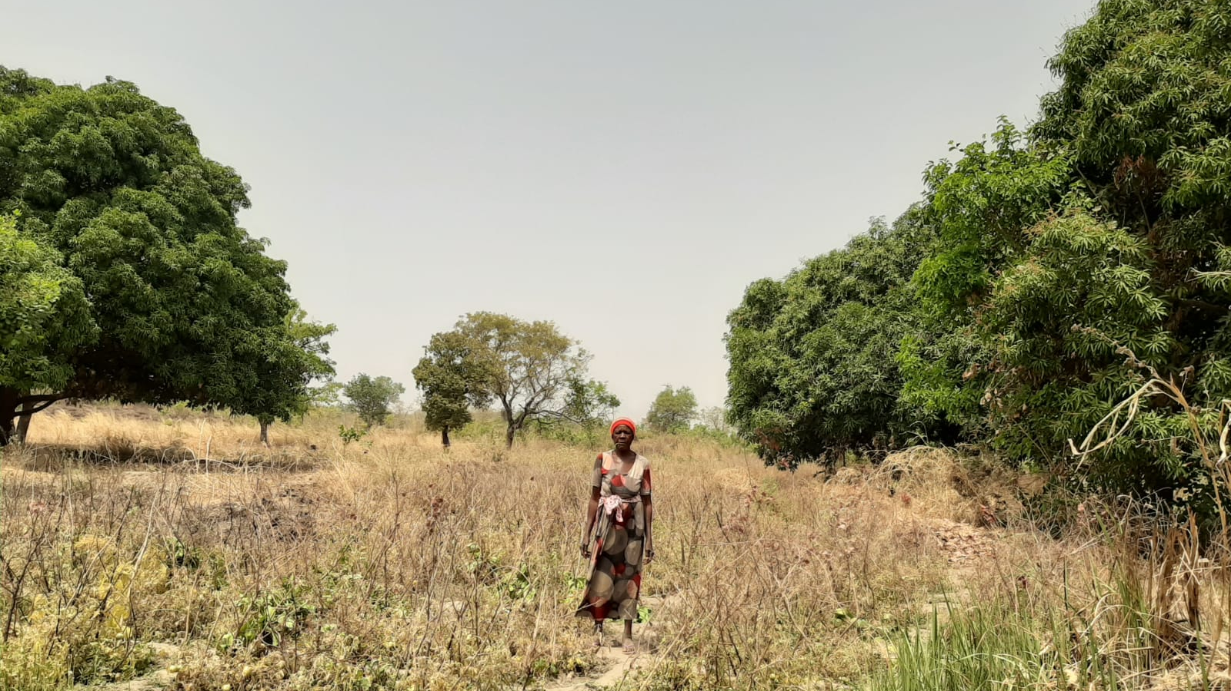

Deep Learning for rainfall detection in a data scarce context: an application to the Sudanian Savanna
Mónica Estébanez Camarena, Fabio Curzi, Riccardo Taormina, Nick van de Giesen, Marie-Claire ten Veldhuis
TU Delft
EGU General Assembly
27th May 2022

Slide 2

Wa, Ghana, February 2020

Slide 3
Why do satellite products perform so poorly over West Africa? Why do they overestimate the event frequency with a factor of two?

Slide 4
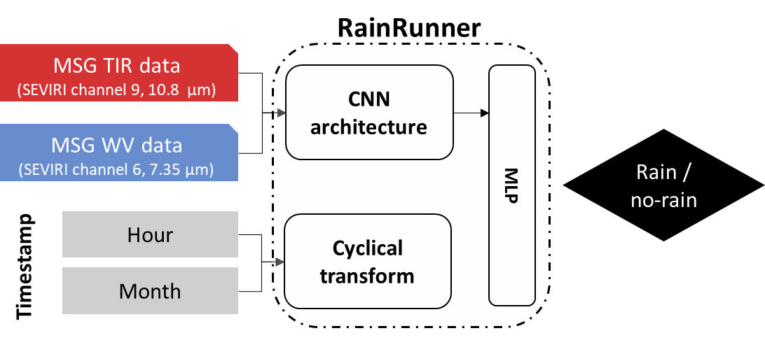
RainRunner Binary classification of 3-hour intervals in rain/no-rain
Fully data-driven and quasi-real time model
Locally trained with a small development dataset
Target data: Rain gauge data from 8 TAHMO stations (2018-2020)
RainRunner model architecture

Slide 5
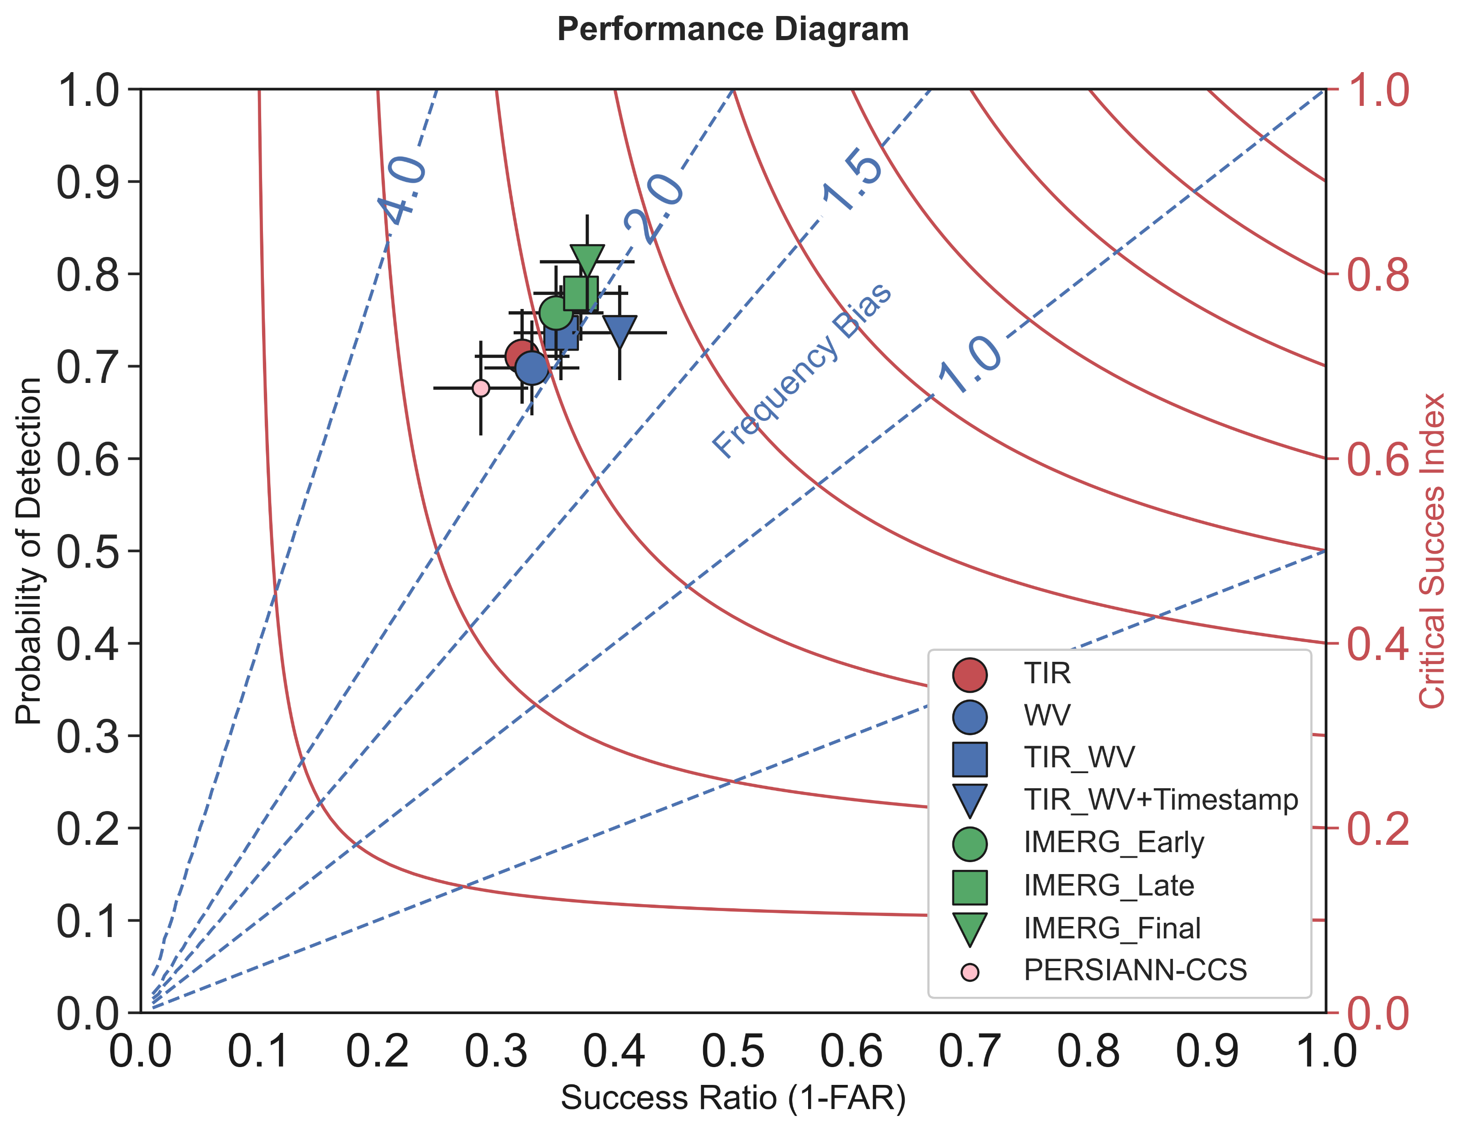
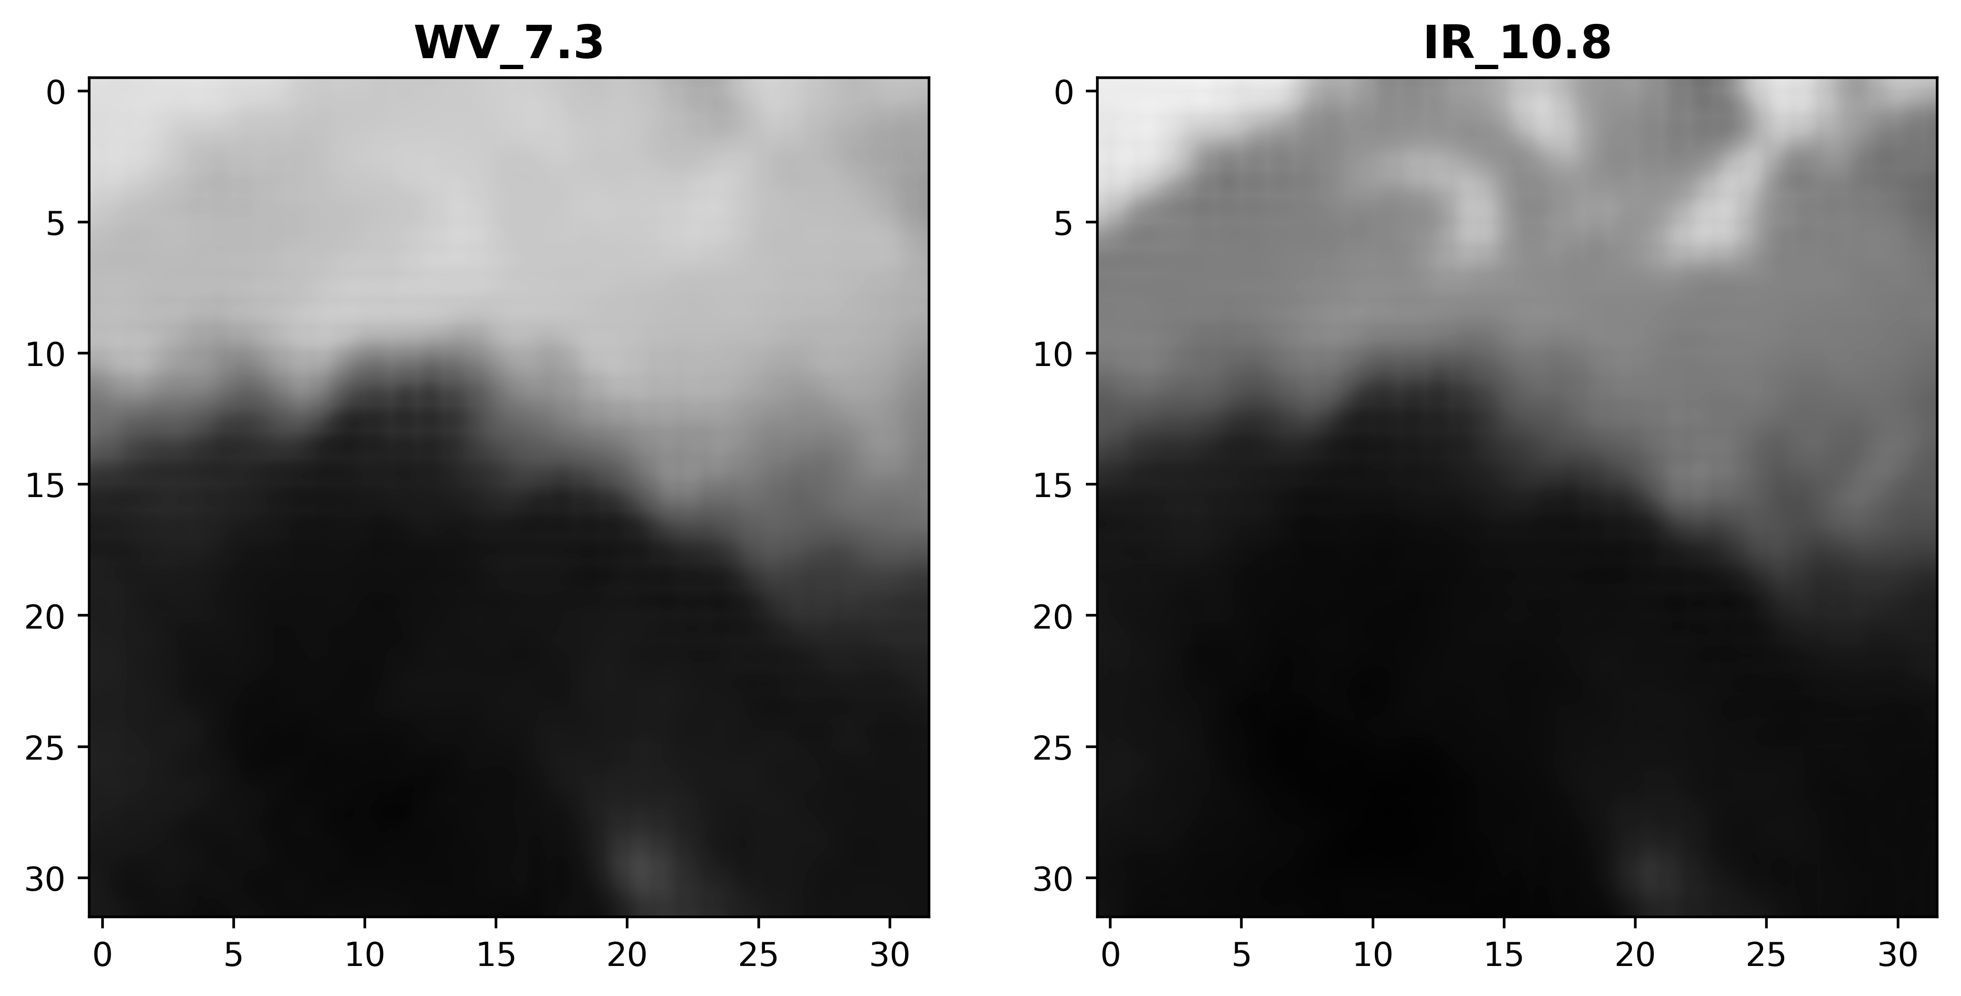
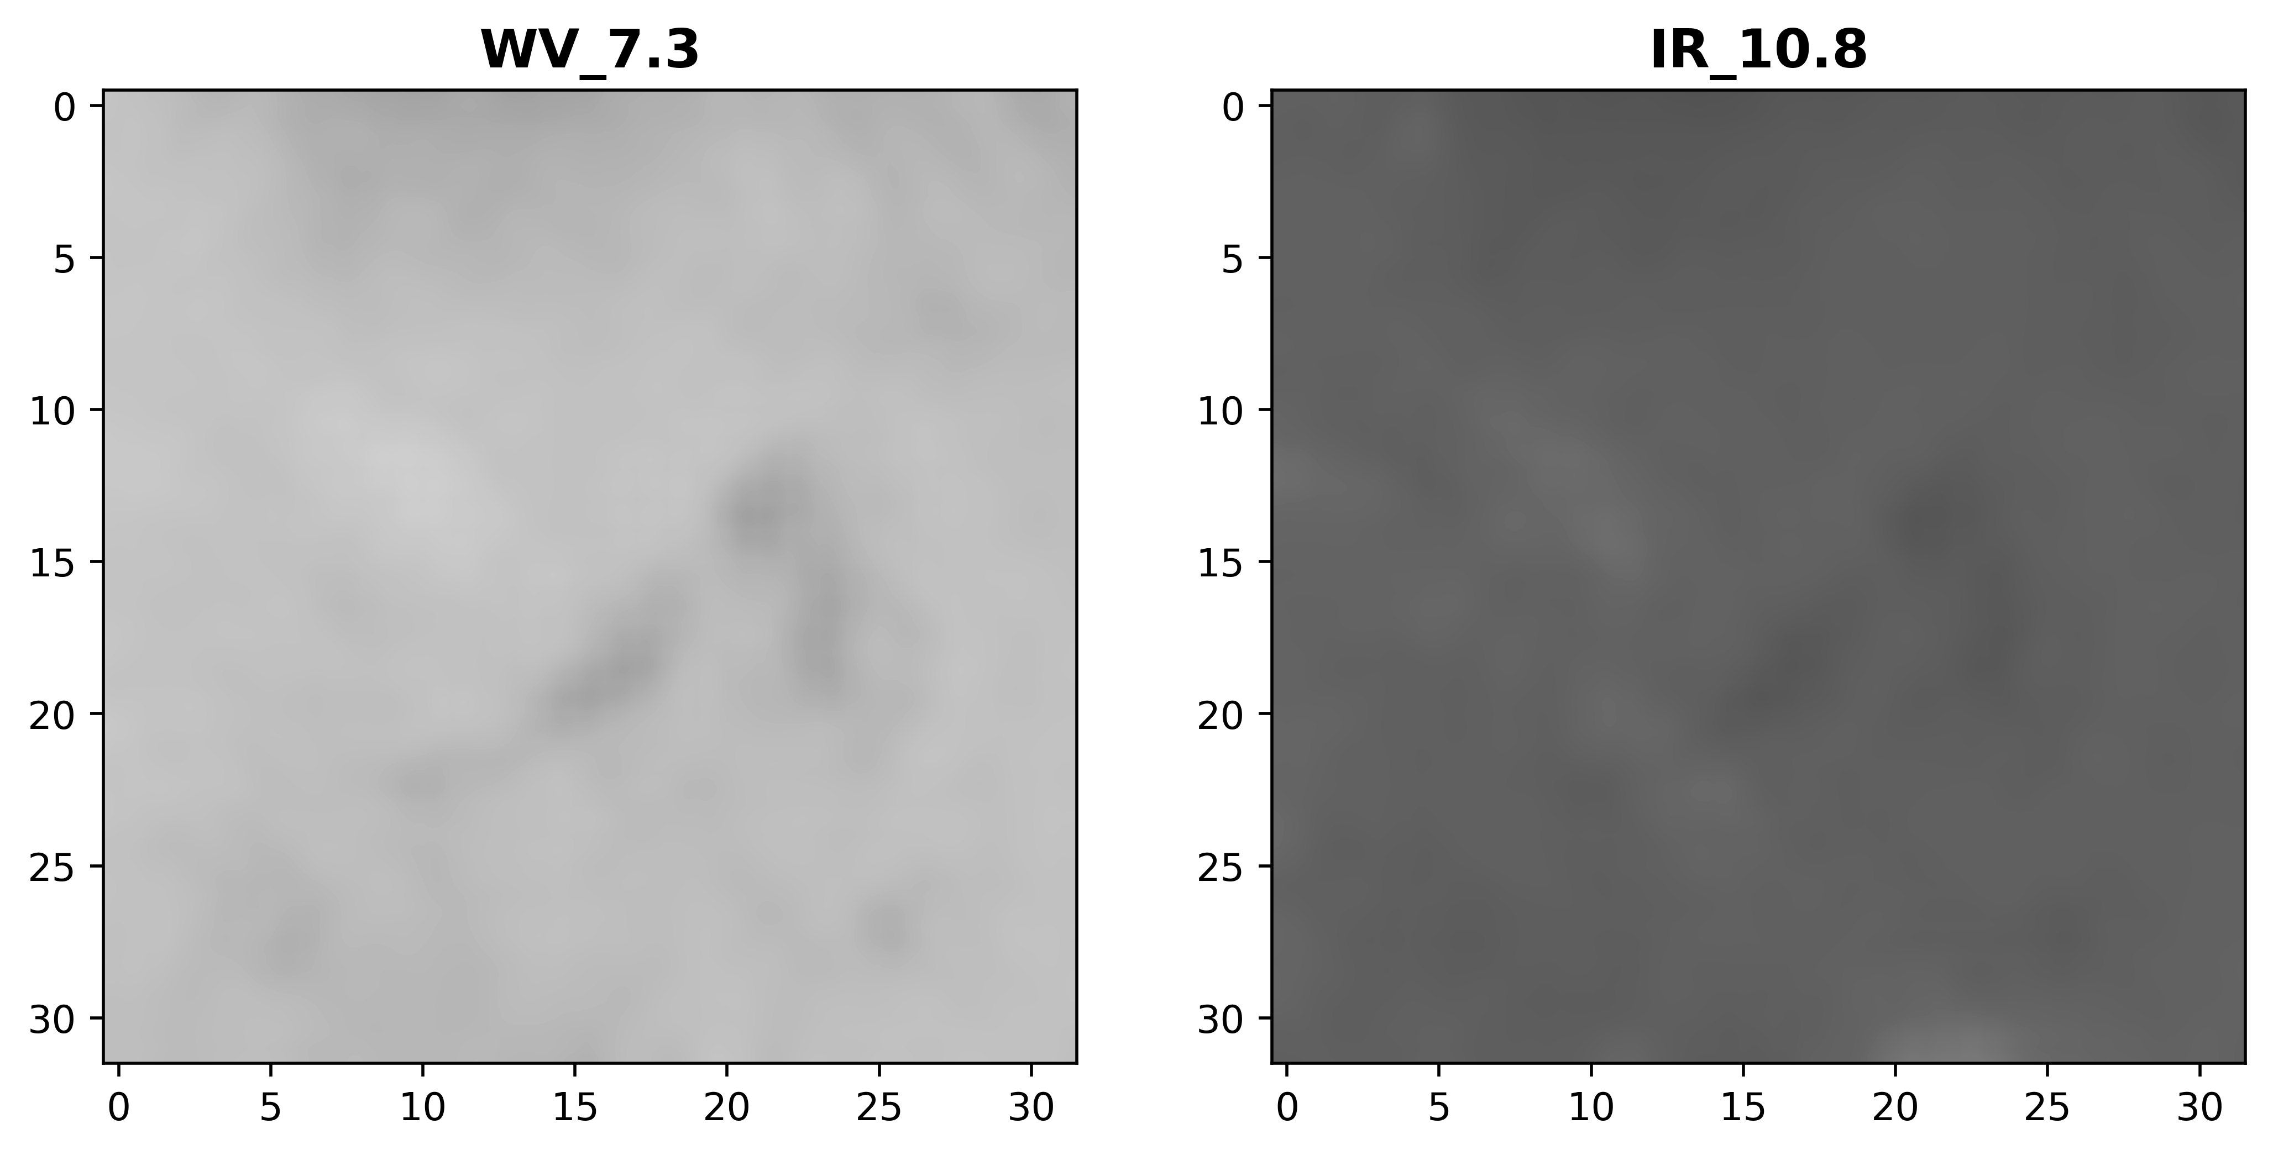
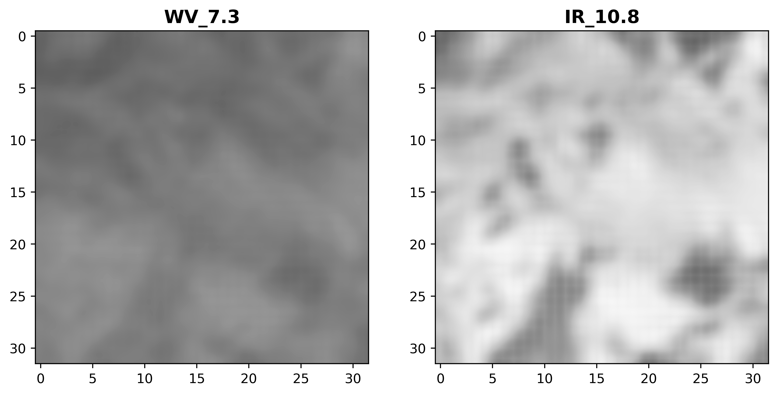
RainRunner TIR and WV data complement each other
Dry intrusion
Dry
Rain
Dry slot
Dry
Dry
Rain
Low-level moisture
Dry
Rain
Dry
Dry

Slide 6
Take-away messages
Deep Learning-based methods are useful to model not-fully-understood processes, avoiding wrong assumptions and oversimplifications
TIR methods, looking only at the cloud tops, are not enough to model rainfall in West Africa. Combining TIR with WV allows us to observe dry air under the clouds and correct false alarms.
Local models vs. global models → Better capture local processes even with small development datasets

Slide 7
Thank you! M.EstebanezCamarena@tudelft.nl

