Slide 1


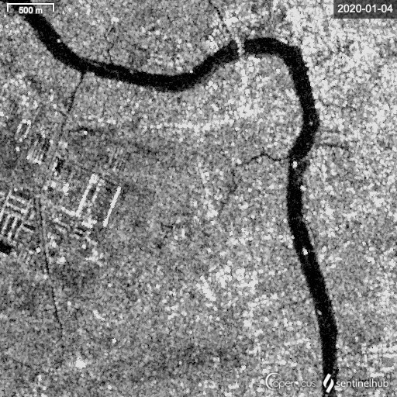
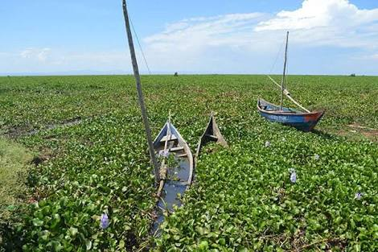



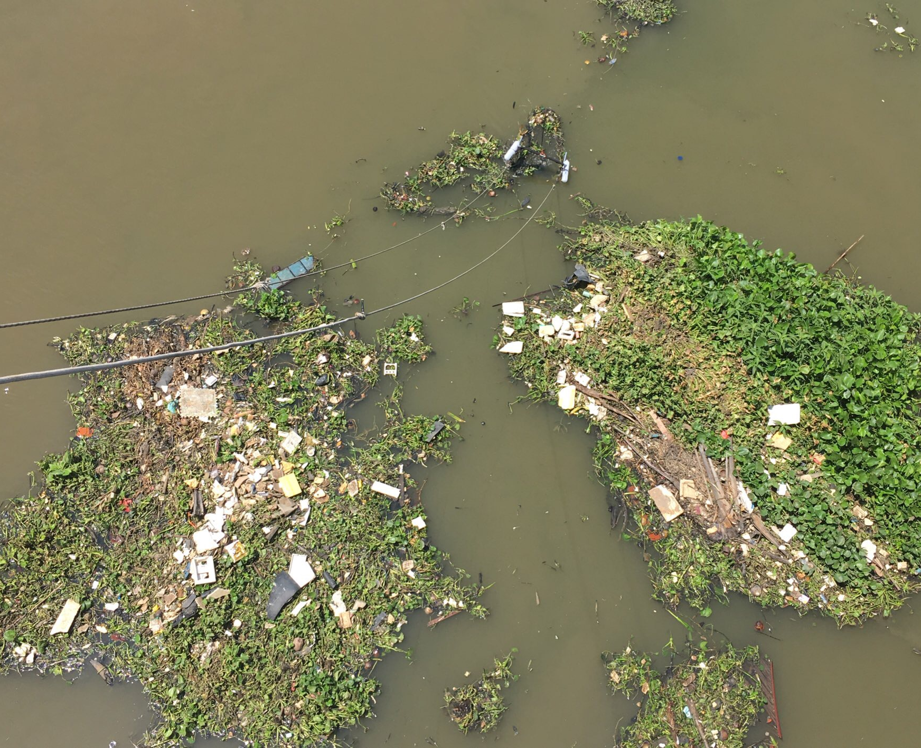
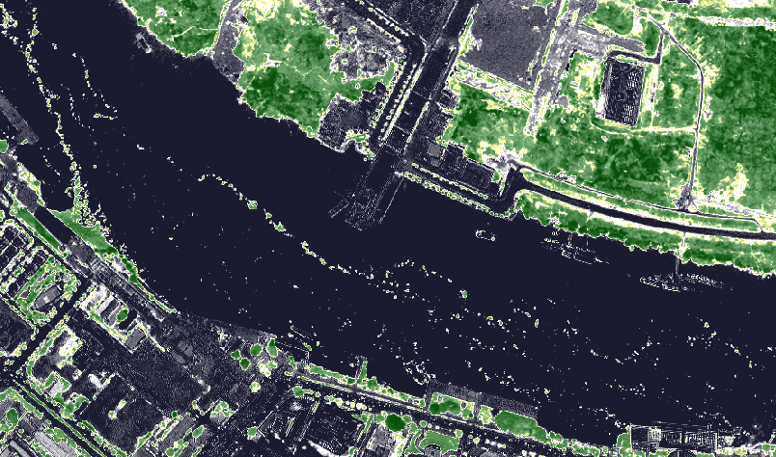
Finding Riverine Plastics in Floating Plant Patches using Worldview-3 Satellite Imagery
Lauren Biermann, Louise Schreyers, Tim van Emmerik, Thanh-Khiet Bui, Yangrong Ling, and Davida Streett
24 May 2022

Slide 2
Main take-away messages
1. Plastics have distinct spectral signatures
Can be detected both in lab and field with hyperspectral/multispectral sensors
2. Satellite imagery shows plastic in rivers
High resolution multispectral imagery, e.g.: Worldview-2 and 3
3. Direct sensing need to be combined with field-based estimates
Due to spatial resolution limitation, estimates of plastic densities are still off by several orders of magnitude!

Slide 3
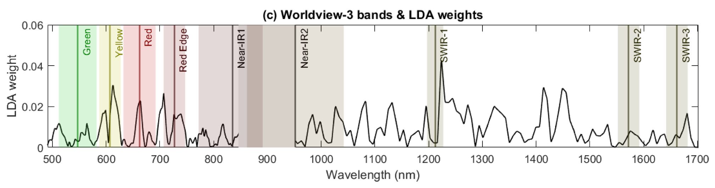
Plastics have distinct spectral signatures (lab)
Leveraging Yellow and Red band for distinguishing vegetation and plastic items
Linear discriminant analysis weight to separate vegetation and plastic items overlaid with central wavelengths and bandwidths of the Wordlview-3. Source: Tasseron et al., 2021
Count 12 patches (patch > 0.1 m2)

Slide 4
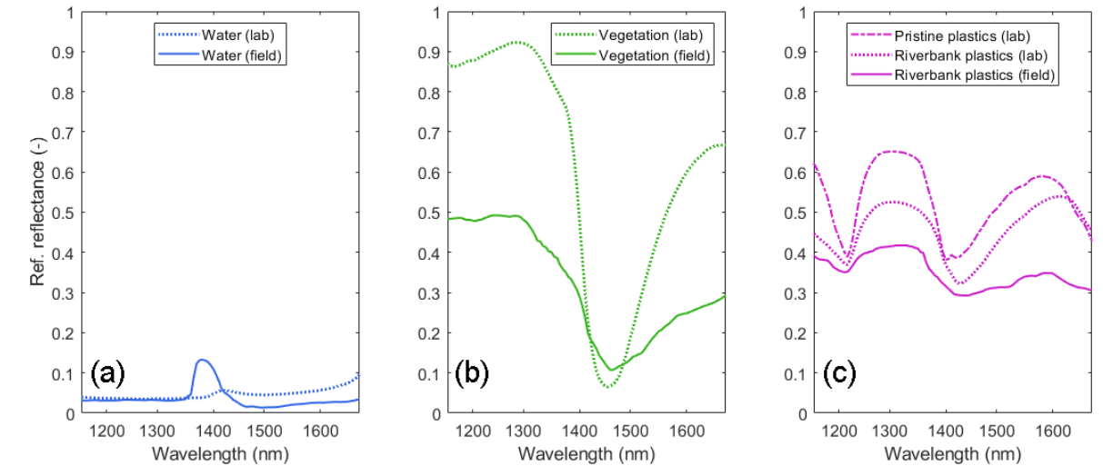
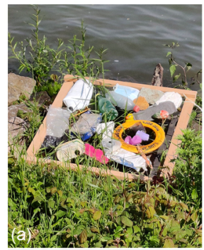
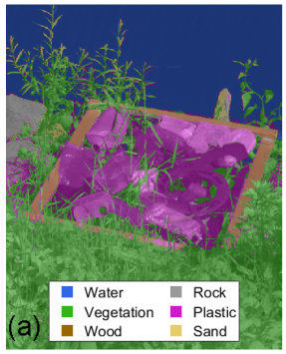
Plastics have distinct spectral signatures (field)
Same curve than in the lab, but signal is less strong
Attenuation probably due degraded state of items
Source: Tasseron et al. (in review)
Count 12 patches (patch > 0.1 m2)

Slide 5
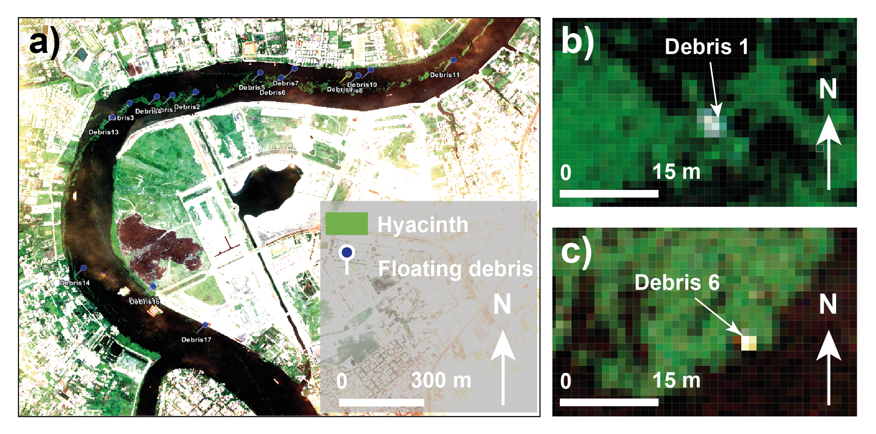
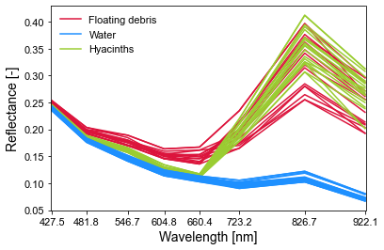
Satellite imagery shows plastics in hyacinths (space)
Worldview-3 optical multispectral sensor: from Visible to Near-Infrared (400-1040 nm)
Spatial resolution of 1.24 m
Direct detection of floating debris in the Saigon river. Source: Worldview-3 image from 3 March 2020 @2020, DigitalGlobe.
Reflectance values for Worldview-3 bands for floating debris, water and hyacinths content (n = 56)
Count 12 patches (patch > 0.1 m2)
Notes:
Distinct spectral characteristics

Slide 6
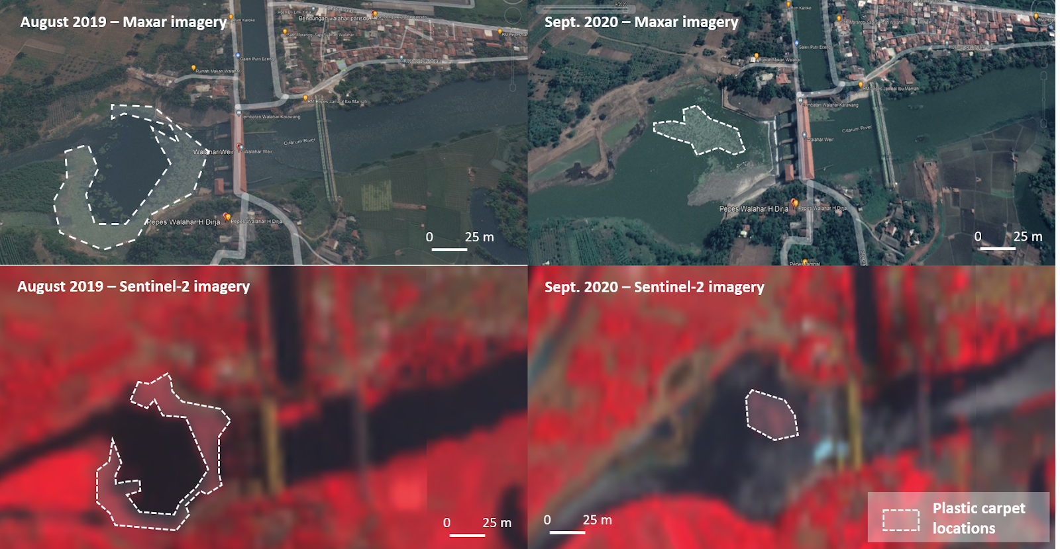
Satellite imagery shows plastics in accumulation zones (space)
Example of satellite imagery used to identify plastic carpet locations and monitor their dynamics in the Citarum River (Indonesia). Credits: Copernicus ESA (Sentinel-2) and Maxar.
Count 12 patches (patch > 0.1 m2)
Notes:
Distinct spectral characteristics

Slide 7
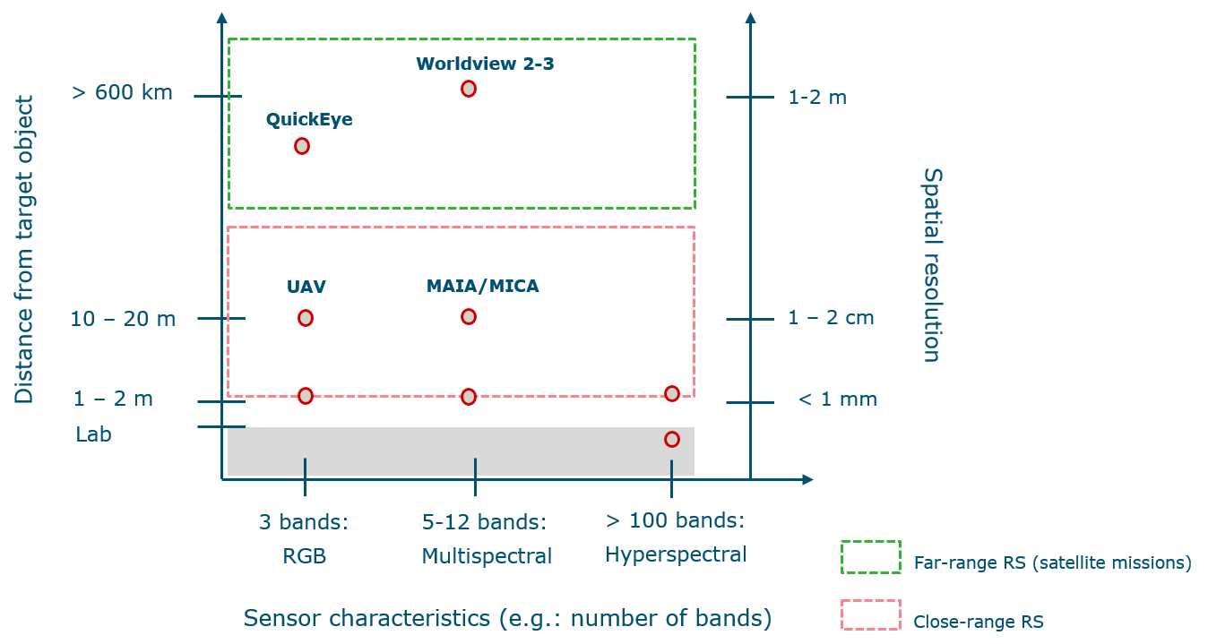
Overview of Remote Sensing techniques for plastic detection
Count 12 patches (patch > 0.1 m2)
Notes:
Distinct spectral characteristics

Slide 8
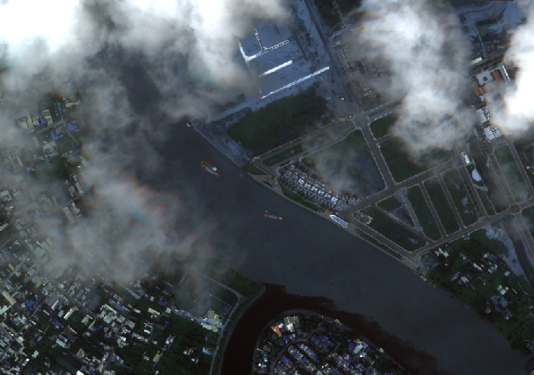
Next steps in detecting plastic items/aggregations
Scene acquisition: clouds!
Very High Resolution: cost of scenes
Can only detect large accumulations: 1.24 meter of spatial resolution
Plastic densities estimated at: 5.8 × 10¹ items km⁻²
(three orders of magnitude lower than with UAV-based estimates)
Only 1% of items are above 1 meter of size!
Validation with ground-truth data difficult to obtain
Notes:
Challenges are technical but also logistical

Slide 9
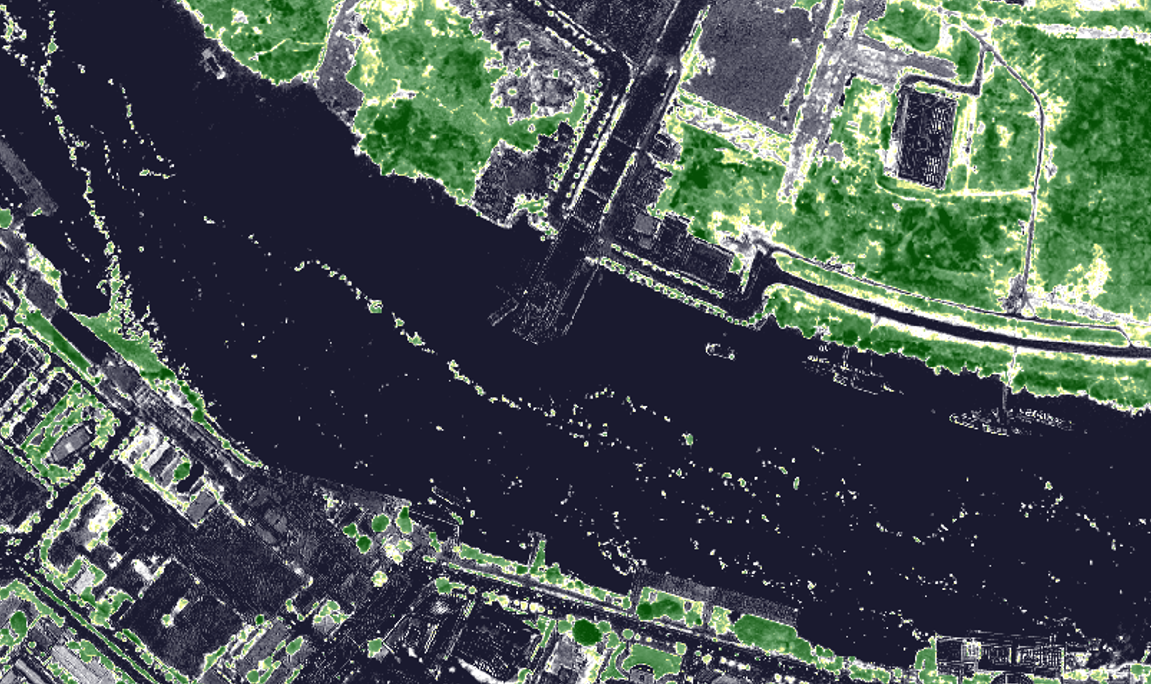
Thank you!

