Slide 1





HS3.3 - EGU22-12857
Bidimensional Spatiotemporal analysis of local atmospherically fluxes and regional moisture budgets in river basins
Karel Aldrin Sánchez Hernández¹, Gerald A. Corzo Pérez¹.
Unesco IHE- Institute for Water Education, Delft, Netherlands

Slide 2
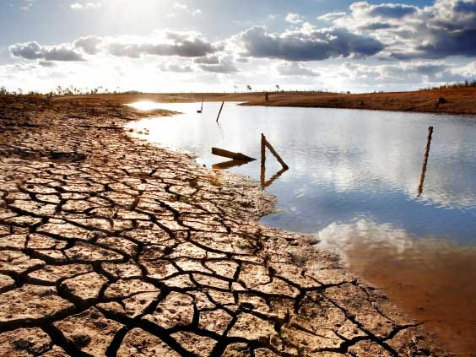
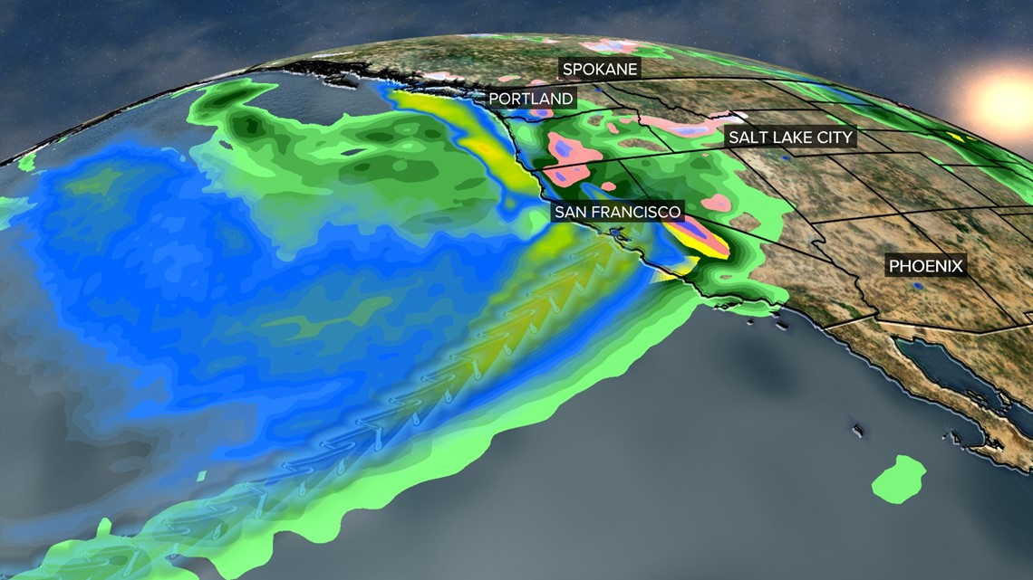
Motivation
Precipitation recycling ratio and water vapor sources are two mainly aspects of regional water cycle, and their quantification is fundamental for understanding processes and their changes
Global warming and climate change had changed in the regional hydrological cycle, spatiotemporal redistribution of water resources (presence of floods and droughts)

Slide 3
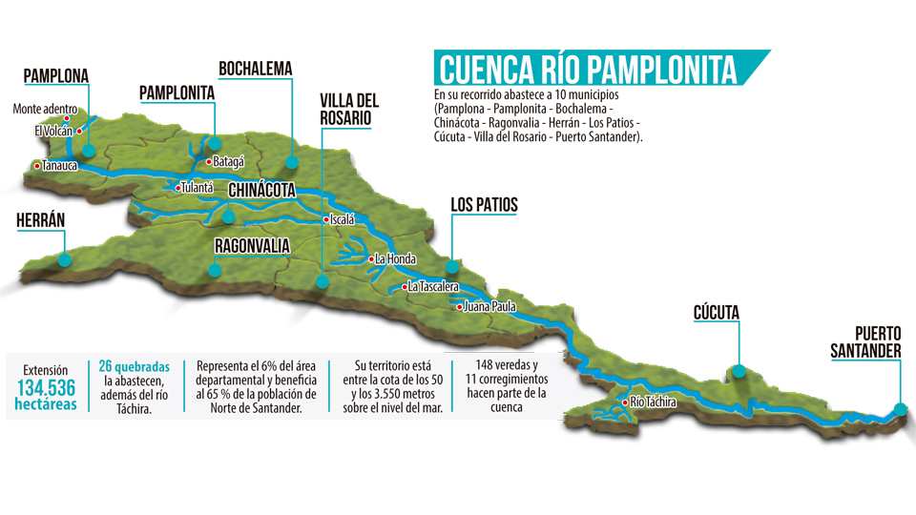
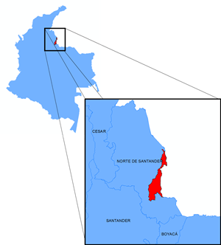
Case study: Pamplonita river basin
Pamplonita river basin is one of the agricultural breadbaskets and is also a prime urban region in Cucuta- Colombia. It therefore plays an important role in social and economic development.
The region takes up nearly 20% of the departamental's population with only 10% of the total water resources and faces the problem of severe water shortages
Floods most common natural disasters and droughts not widely studied
Low availability of information and low research productivity in relation to atmospheric hydrodynamics
Partial ignorance in assumptions for numerical modelling, used in the simulation processes limit the realism of precipitation time series generating unbiased water policies

Slide 4
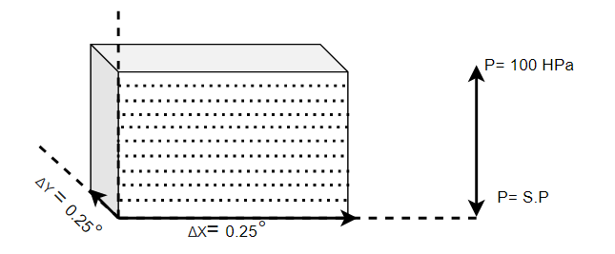
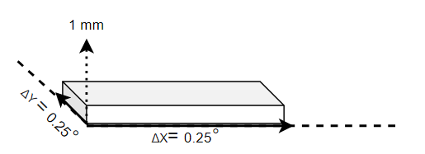

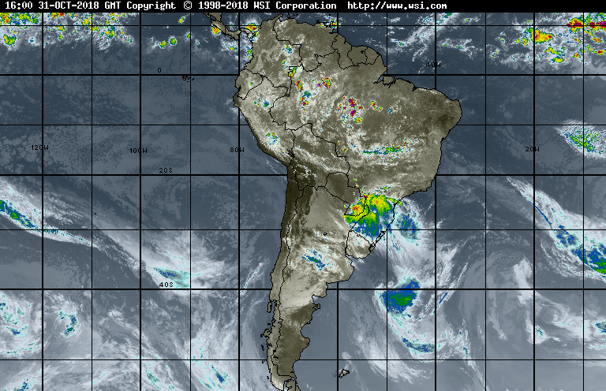
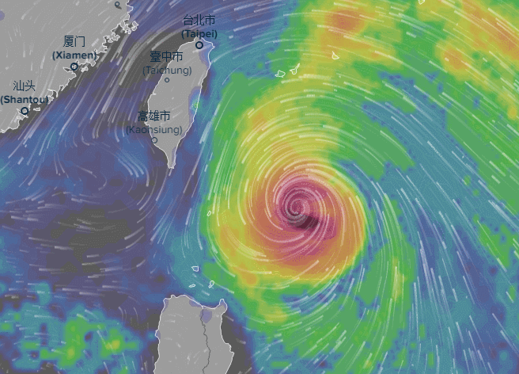
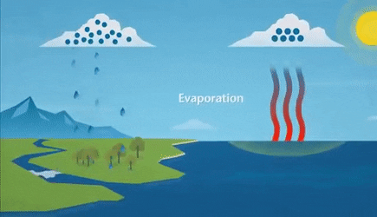
Objectives- Methodology
Data Gathering and analysis
Atmospherically water vapor dynamics
Rainfall recycling rates
To analyse the atmospheric moisture balance around hydrological units (watersheds) using ERA 5 reanalysis data sets evaluating spatiotemporal hydrological patterns
$$\frac{D(q)}{Dt}=\frac{{∂q}_{ij}}{∂t}+\frac{{∂qu}_{ij}}{∂x}+\frac{{∂qv}_{ij}}{∂y}+\frac{{∂qw}_{ij}}{∂z}=E−P=S$$

Slide 5
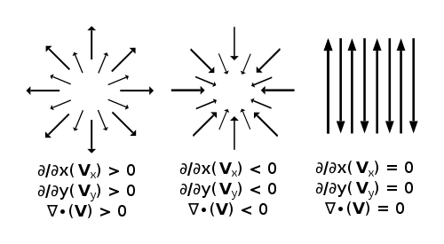
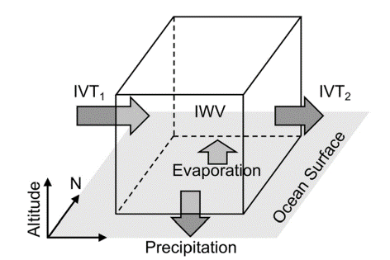
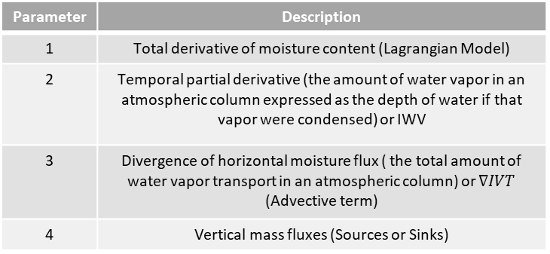
Physical Context
Parameter | Description
1 | Total derivative of moisture content (Lagrangian Model)
2 | Temporal partial derivative (the amount of water vapor in an atmospheric column expressed as the depth of water if that vapor were condensed) or IWV
3 | Divergence of horizontal moisture flux ( the total amount of water vapor transport in an atmospheric column) or $∇IVT$ (Advective term)
4 | Vertical mass fluxes (Sources or Sinks)
Atmospherical Water Vapor Balance
$$\frac{D\left(q\right)}{Dt}=\frac{∂q}{∂t}+\frac{∂qu}{∂x}+\frac{∂qv}{∂y}+\frac{∂qw}{∂z}=E−P$$
1
2
3
4
Eulerian 2D Framework
$$\frac{D(q)}{Dt}=IWV+∇IVT=E−P$$
Divergence condition
Rainfall concentration
(Flooding)
Flux migration

Slide 6
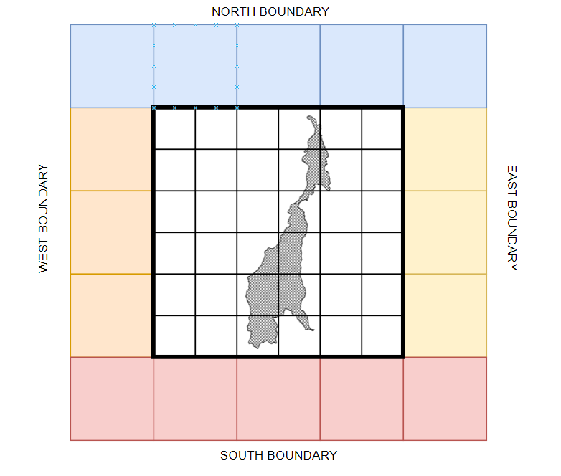

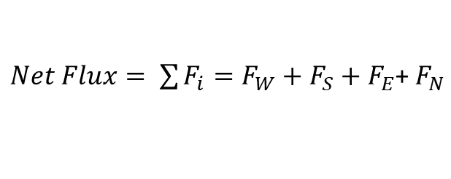

Regional Moisture Budget Model: Bidimensional Domain Discretization
Air Moisture Fluxes
Domain (Region of Interest)
$$F\left(x\right)=\left\{\begin{aligned}\begin{aligned}F_{W}=\int{{IVT}_{u} dy} \\ &F_{S}=\int{{IVT}_{V} dx}\end{aligned} \\ F_{E}=−\int{{IVT}_{u} dy} \\ F_{N}=−\int{{IVT}_{V} dx}\end{aligned}\right.$$
$Net Flux= \sum{F_{i}=F_{W}+F_{S}}+F_{E}$+ $F_{N}$
$$Net Flow= \frac{Net Flux}{A}$$
The water vapor is transported by the atmospheric circulation as the net income of water vapor budget, causing the local atmospheric water vapor budget variations. The length of boundaries for water vapor transport needs to be considered in calculation

Slide 7



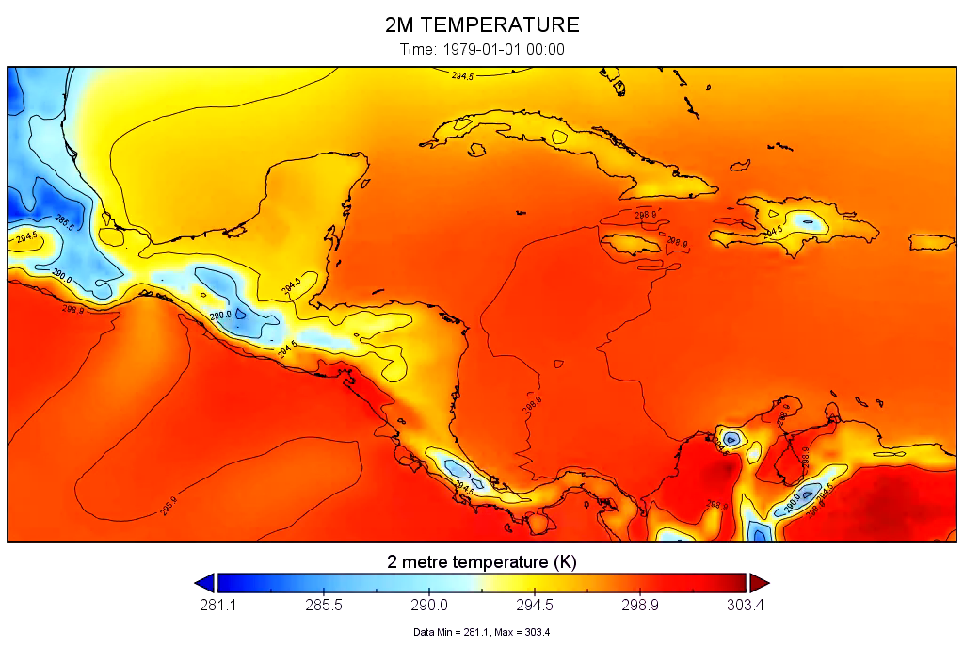
Data Acquisition
From ERA5 high spatial resolution (0.25x0.25), and a temporal resolution of 4 times per day: 0000, 0600, 1200, and 1800 UTC. (1979-2020)
ERA 5 Land- Single Levels (10 m)
TOTAL PRECIPITATION (m/d)
EVAPORATION (m/d)
ERA 5 Pressure Levels
WIND U (m/s)
WIND V (m/s)
SPECIFIC HUMIDITY %

Slide 8
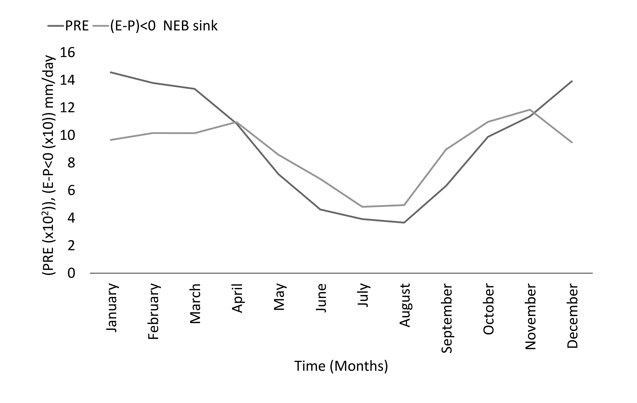
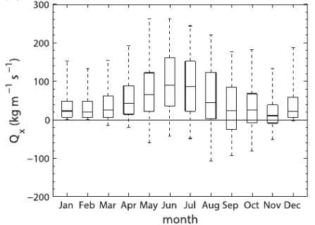
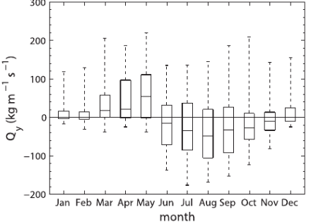
Results
Water vapor budget monthly trends
4.83/2.87
0.10/1.27
1.21/1.59
1.23/2.23
1.22/1.82
0.44/1.65
0.77/1.18
1.17/2.03
1.21/2.60
-0.40/-0.58
EFM
AMJ
Zonal and Meridional (u,v) Fluxes trends
3.21/5.01
0.68/1.79
0.61/1.28
1.61/3.22
1.42/2.45
0.33/0.41
0.56/0.74
1.16/1.98
-0.45/1.74
-0.10/0.14
OND
JAS
Boundary | FE (kg/s⁻²) | FS (kg/s⁻²) | FW (kg/s⁻²) | FN (kg/s⁻²) | INFLOW (kg/s⁻²) | OUTFLOW (kg/s⁻²) | TOTAL (kg/s⁻²)
Pamplonita River Basin | 106.76 | -67.63 | -28.22 | 59.13 | 165.89 | -95.85 | 261.74

Slide 9
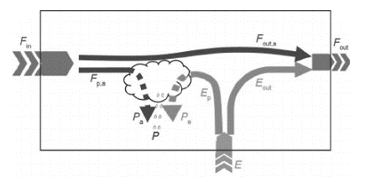
Results
Correlation analysis between water fluxes and
observed precipitation by season
 | EFM | AMJ | JAS | OND
FE | 0.686* | 0.2345 | -0.423 | 0.614*
FS | 0.725** | 0.227 | -0.412 | 0.587
FW | 0.542 | 0.564 | -0.566 | 0.672*
FN | 0.631* | 0.356 | -0.613* | 0.302
Impact of the water vapour budget in relation to summer precipitation in the basin is greater for the low water seasons, which allows us to assess that the flows coming from the north and east directly influence the water supply in the basin.
Recycling Rainfall scheme
 | Percentage of Recycling (Annual averages) | Dry Season recycling rainfall percentage | Wet Season recycling rainfall percentage
E/P rate | 85 | 62 | <20
E-P<0, recycling by evapotranspiration | 22-45 | 75 | <34
E-P>0, recycling by vapor fluxes | <38 | 45 | 77

Slide 10
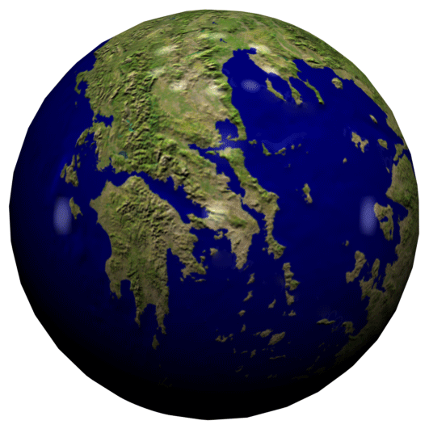
Conclusions and Perspectives
The results show the potential impacts of land surface feedbacks through evapotranspiration on regional precipitation variability
The water vapor transport is weak, which minimizes the advected humidity from external sources, doing that local evaporation contributes more to precipitation in dry summers.
ET should increase with the temperature and radiation, which may be caused by land use/cover changes. A lot of observations show that the land use/cover in the river basin has significantly changed, that reported in the annual population query around the zone.
High evaporation with a weak water vapor transport have a positive effect on the recycling ratio. High recycling rates in a dry summer are low total precipitation evaporation rates increasing, which results in low absolute values of recycled precipitation.
Implementing Atmospheric river algorithm and its spatiotemporal tracking will allows characterising other factors related on the water fluxes dynamics as direction, live cycles improving drought or flooding monitoring systems.

Slide 11
References
E. B. Jaeger, R. Stöckli, and S. I. Seneviratne, ‘Analysis of planetary boundary layer fluxes and land-atmosphere coupling in the regional climate model CLM’, J. Geophys. Res. Atmos., vol. 114, no. 17, 2009, doi: 10.1029/2008JD011658.
J. O. Haerter, P. Berg, and S. Hagemann, ‘Heavy rain intensity distributions on varying time scales and at different temperatures’, J. Geophys. Res. Atmos., vol. 115, no. 17, 2010, doi: 10.1029/2009JD013384.
R. Sasse, G. Schädler, and C. Kottmeier, ‘The Regional Atmospheric Water Budget over Southwestern Germany under Different Synoptic Conditions’, J. Hydrometeorol., vol. 14, no. 1, pp. 69–84, Feb. 2013, doi: 10.1175/JHM-D-11-0110.1.
M. G. Bosilovich, F. R. Robertson, L. Takacs, A. Molod, and D. Mocko, ‘Atmospheric water balance and variability in the MERRA-2 reanalysis’, J. Clim., vol. 30, no. 4, pp. 1177–1196, 2017, doi: 10.1175/JCLI-D-16-0338.1.
P. J. Neiman et al., ‘Diagnosis of an intense atmospheric river impacting the pacific northwest: Storm summary and offshore vertical structure observed with COSMIC satellite retrievals’, Mon. Weather Rev., vol. 136, no. 11, pp. 4398–4420, 2008, doi: 10.1175/2008MWR2550.1.
I. V. Gorodetskaya, M. Tsukernik, K. Claes, M. F. Ralph, W. D. Neff, and N. P. M. Van Lipzig, ‘The role of atmospheric rivers in anomalous snow accumulation in East Antarctica’, Geophys. Res. Lett., vol. 41, no. 17, pp. 6199–6206, Sep. 2014, doi: 10.1002/2014GL060881.
B. Guan and D. E. Waliser, ‘Atmospheric rivers in 20 year weather and climate simulations: A multimodel, global evaluation’, J. Geophys. Res., vol. 122, no. 11, pp. 5556–5581, 2017, doi: 10.1002/2016JD026174.
S. M. Hagos, L. R. Leung, J. H. Yoon, J. Lu, and Y. Gao, ‘A projection of changes in landfalling atmospheric river frequency and extreme precipitation over western North America from the Large Ensemble CESM simulations’, Geophys. Res. Lett., vol. 43, no. 3, pp. 1357–1363, Feb. 2016, doi: 10.1002/2015GL067392.

Slide 12
References
Y. Zhu and R. E. Newell, ‘Atmospheric rivers and bombs’, Geophys. Res. Lett., vol. 21, no. 18, pp. 1999–2002, 1994, doi: 10.1029/94GL01710.
D. Nash, D. Waliser, B. Guan, H. Ye, and F. M. Ralph, ‘The Role of Atmospheric Rivers in Extratropical and Polar Hydroclimate’, J. Geophys. Res. Atmos., vol. 123, no. 13, pp. 6804–6821, Jul. 2018, doi: 10.1029/2017JD028130.
M. D. Dettinger, F. M. Ralph, T. Das, P. J. Neiman, and D. R. Cayan, ‘Atmospheric rivers, floods and the water resources of California’, Water (Switzerland), vol. 3, no. 2, pp. 445–478, 2011, doi: 10.3390/W3020445.
B. Guan and D. E. Waliser, ‘Detection of atmospheric rivers: Evaluation and application of an algorithm for global studies’, J. Geophys. Res., vol. 120, no. 24, pp. 12,514-12,535, Dec. 2015, doi: 10.1002/2015JD024257.
V. A. Alexeev, P. L. Langen, and J. R. Bates, ‘Polar amplification of surface warming on an aquaplanet in “ghost forcing” experiments without sea ice feedbacks’, Clim. Dyn., vol. 24, no. 7–8, pp. 655–666, May 2005, doi: 10.1007/S00382-005-0018-3.
Y. Gao, J. Lu, and L. R. Leung, ‘Uncertainties in projecting future changes in atmospheric rivers and their impacts on heavy precipitation over Europe’, J. Clim., vol. 29, no. 18, pp. 6711–6726, 2016, doi: 10.1175/JCLI-D-16-0088.1.
D. A. Lavers, R. P. Allan, E. F. Wood, G. Villarini, D. J. Brayshaw, and A. J. Wade, ‘Winter floods in Britain are connected to atmospheric rivers’, Geophys. Res. Lett., vol. 38, no. 23, Dec. 2011, doi: 10.1029/2011GL049783.
B. Guan, N. P. Molotch, D. E. Waliser, E. J. Fetzer, and P. J. Neiman, ‘Extreme snowfall events linked to atmospheric rivers and surface air temperature via satellite measurements’, Geophys. Res. Lett., vol. 37, no. 20, Oct. 2010, doi: 10.1029/2010GL044696.

Slide 13
Thanks for your attention
Contact:
sanchezkarel@gmail.com
gerald.corzo@gmail.com

