Slide 1





    Point clouds and Hydroinformatics
Vitali Diaz, Haicheng Liu, Peter van Oosterom, Martijn Meijers, Edward Verbree, Fedor Baart, Maarten Pronk, and Thijs van Lankveld
The project
Publications
May, 2022

Slide 2

Introduction

Slide 3
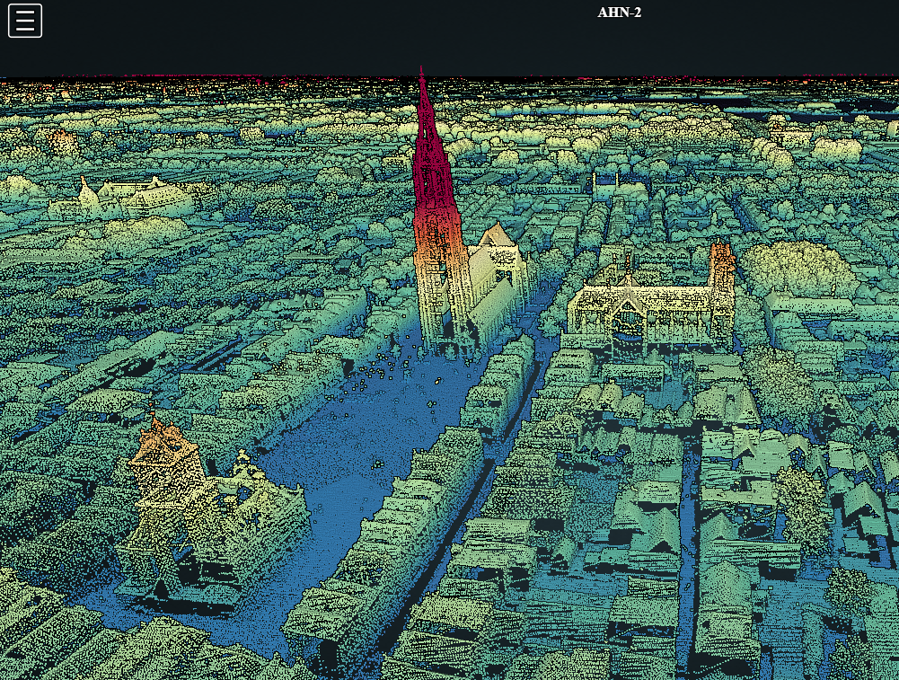
Point cloud

Slide 4
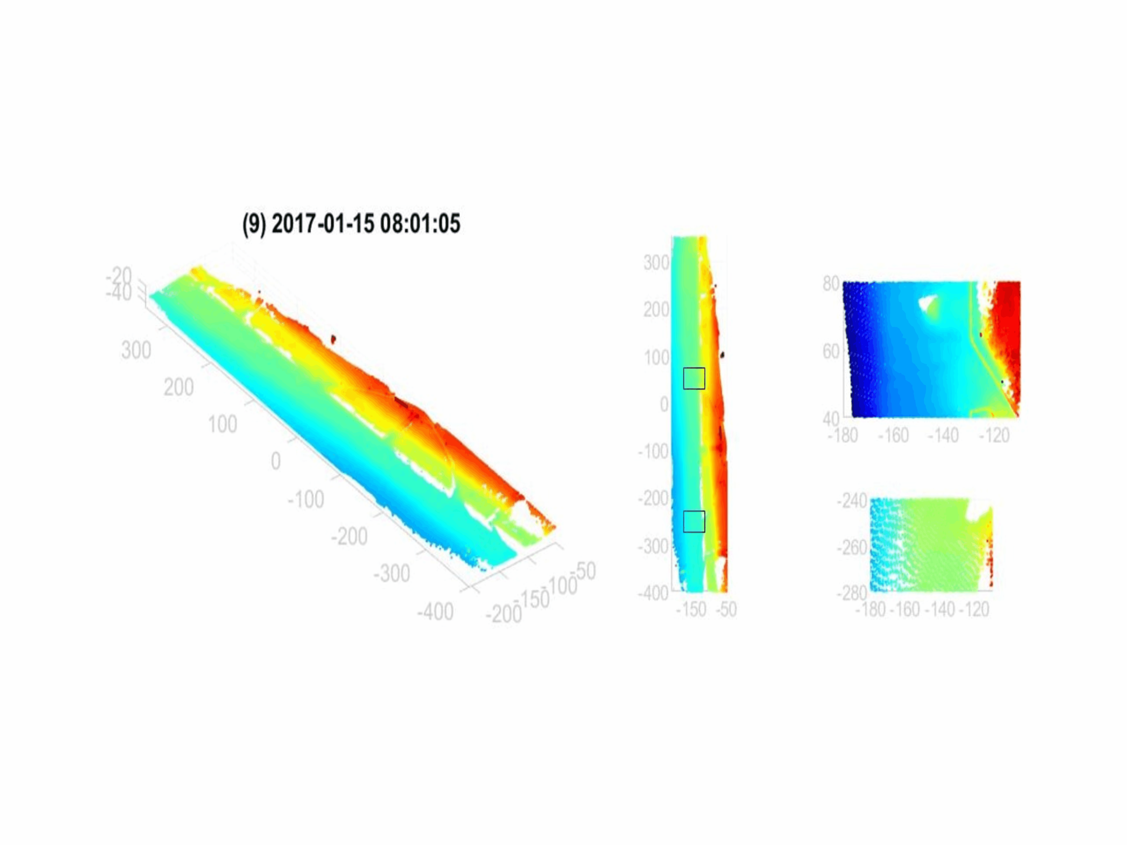
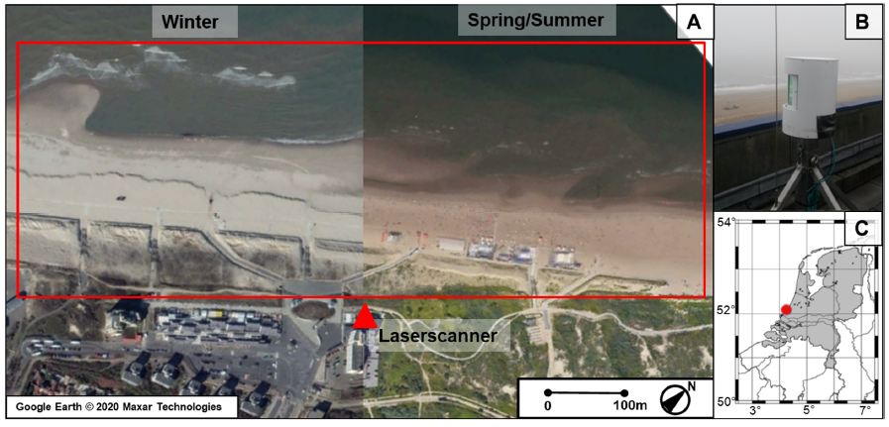
Attributes/Dimensions
Vos et al. (2022)
The Kijkduin beach-dune system dataset
Stationary terrestrial laser scanner (TLS)
(A) Aerial photo of the beach-dune in Kijkduin and the scan Area within the red rectangle.
(B) The laser scanner positioned on a hotel next to the beach (indicated by a red triangle in A).
(C) The location of Kijkduin (52.07°N, 4.22°E) in The Netherlands.

Slide 5
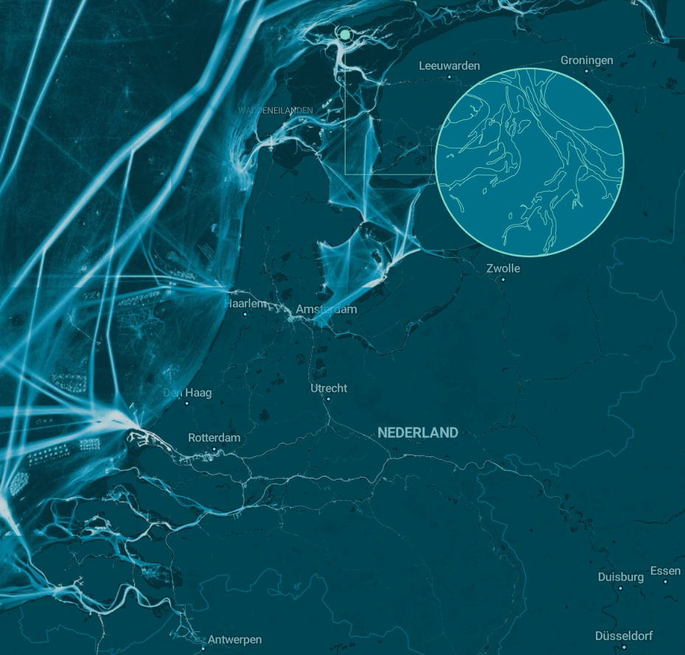
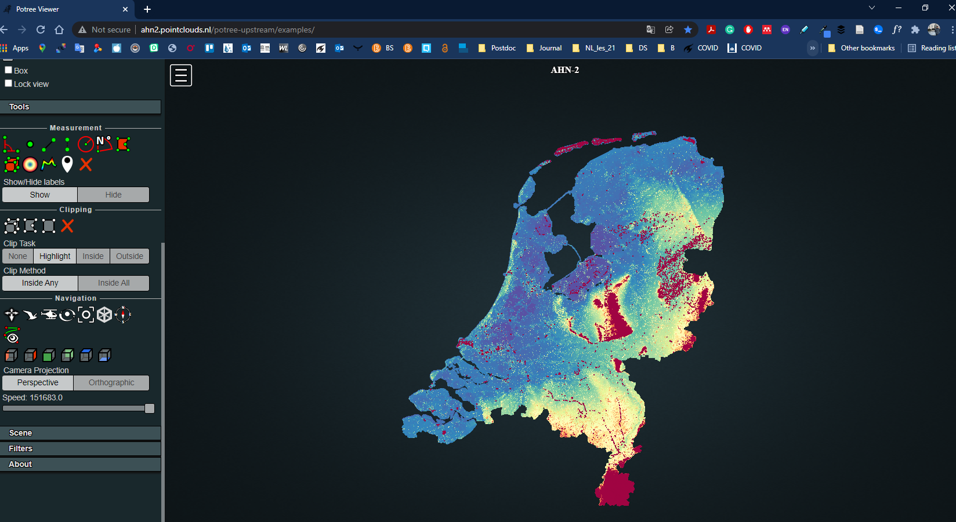
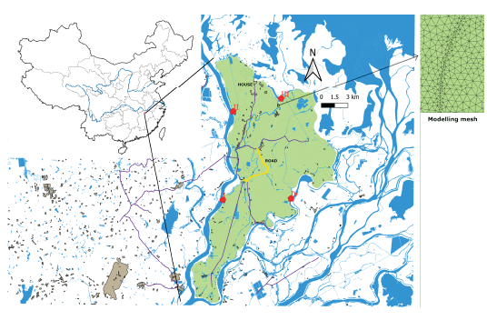
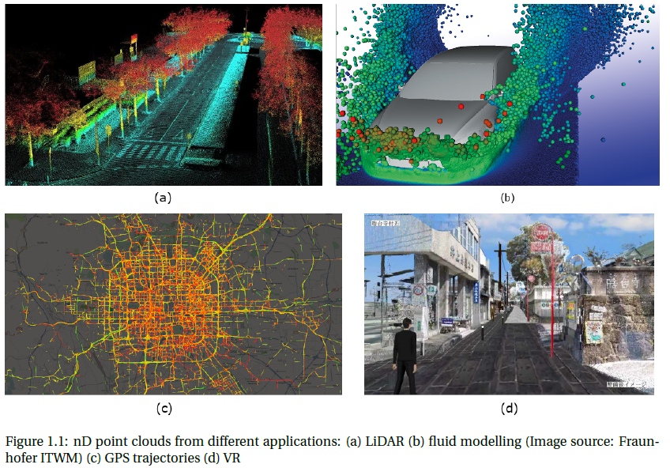
Point Cloud from different sources
https://ais-scrolly.netlify.app/
(b)
(a)
Laser
Sonar
Navigation systems
Conversion
(d)
(c)
Liu et al. 2020
Notes:
Niansi Levee (green zone), with locations of simulated breach in red. A small piece of mesh used for modelling is also shown on the right

Slide 6
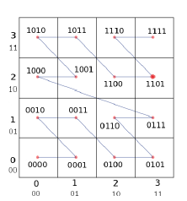
Management and access
File
Database
Blocks
Flat table
indexing
Liu 2022

Slide 7
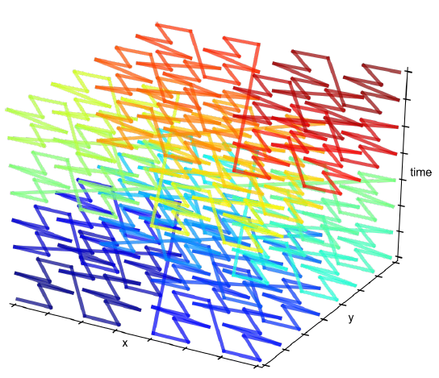
Management and access
Space Filling Curve (SFC)
Psomadaki 2016

Slide 8
Applications

Slide 9
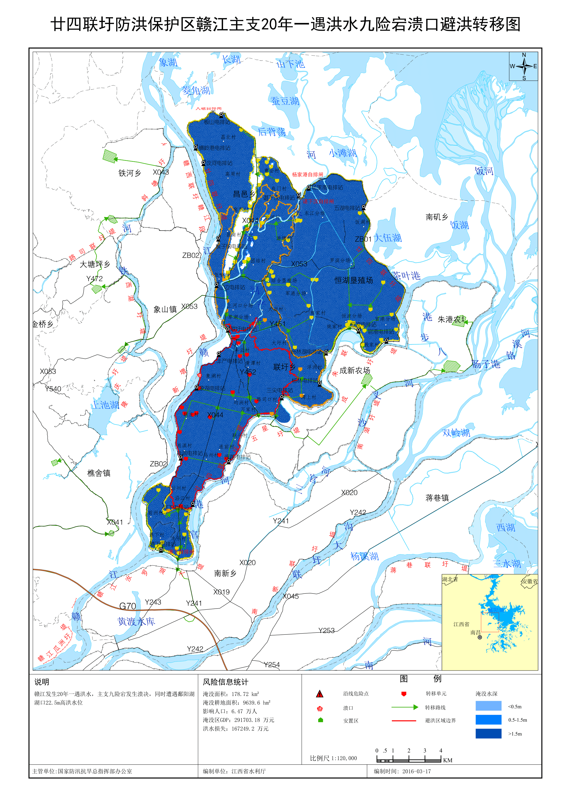
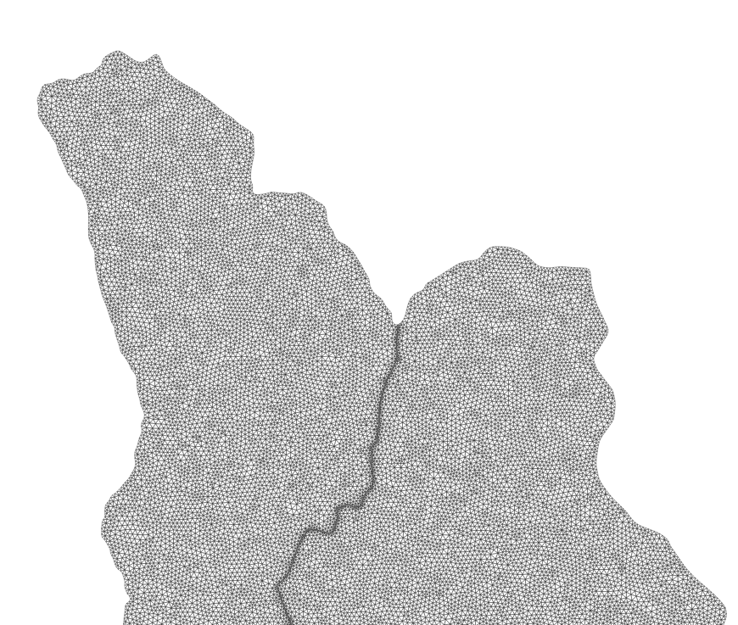
Floods
The problem
Maps are static, no more details can be derived.
Flood maps can be retrieved from database queries, e.g., all grid cells with positive water depth
An efficient database for querying flood risk?
  Conventional indexing structure is huge
  GIS software mainly focuses on small data
  Multidimensional array databases cannot handle irregular grids
Liu 2022
-> Point cloud database?
Notes:
The mapping process needs two steps: first step runs a coupled hydrodynamic model on a grid, to compute water depth, velocity, flow direction at different time steps; then, the results are extracted and processed to make various maps. Although electronic maps are generated, still they only show limited information. New risk anlaysis other than the maps cannot be addressed.
Actually, these maps can be retrieved and derived from original data by using queries. For example, inundation map is to select all grid cells with positive water depth.
So, we might build an efficient database solution, which can address different kinds of queries. However, using flat tables with B-tree indexes is less efficient given big data. GIS software only support small databases, while multid array databases fail to manage data stored in irregular grids.
Then, can we use a point cloud database which is developed to store massive point data?

Slide 10
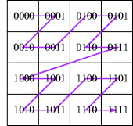
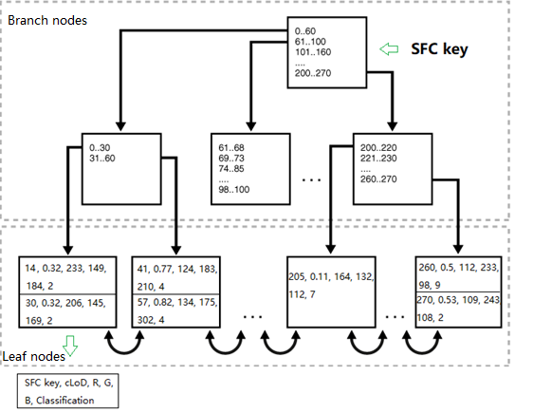
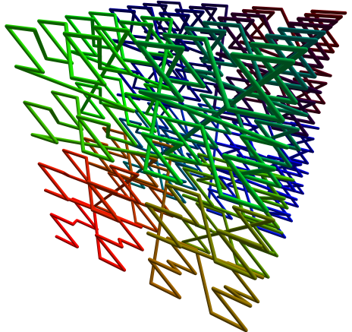
HistSFC – storage
Data structure: Space filling curve (SFC) + Oracle index-organized tables (IOT)
X 2
Y
Liu 2022
3
B+ tree
2D Morton curve
X: 2 -> 10 Y: 3-> 11
Morton key: 1110 -> 14
3D Morton curve -> nD
Notes:
This is possible because we can represent each cell by its centroid, and attach all data including water depth, vecocity to that point. Then we store these multidimensional points into the point cloud database.
Using this database, despite previous maps, new queries like evaluating water depth along roads can be addressed.
In addition, our group has developed an advanced solution, called HistSFC for managing and querying multidimensional points. It performs better than state-of-the-art, e.g., Oracle

Slide 11
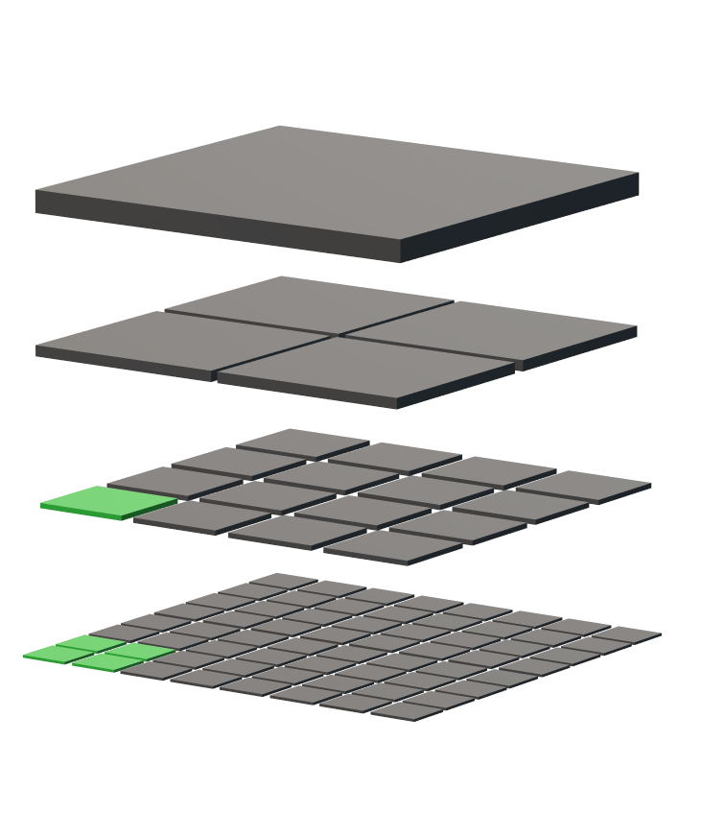
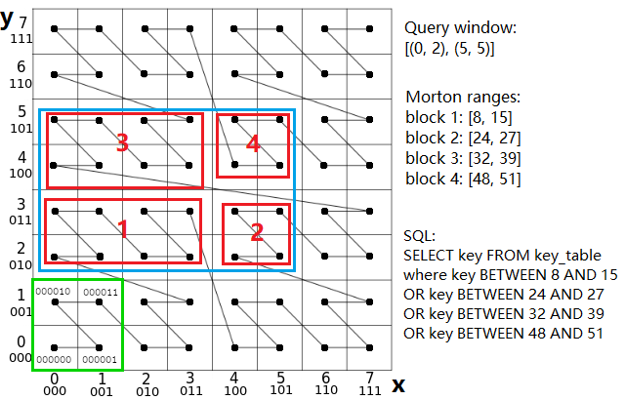
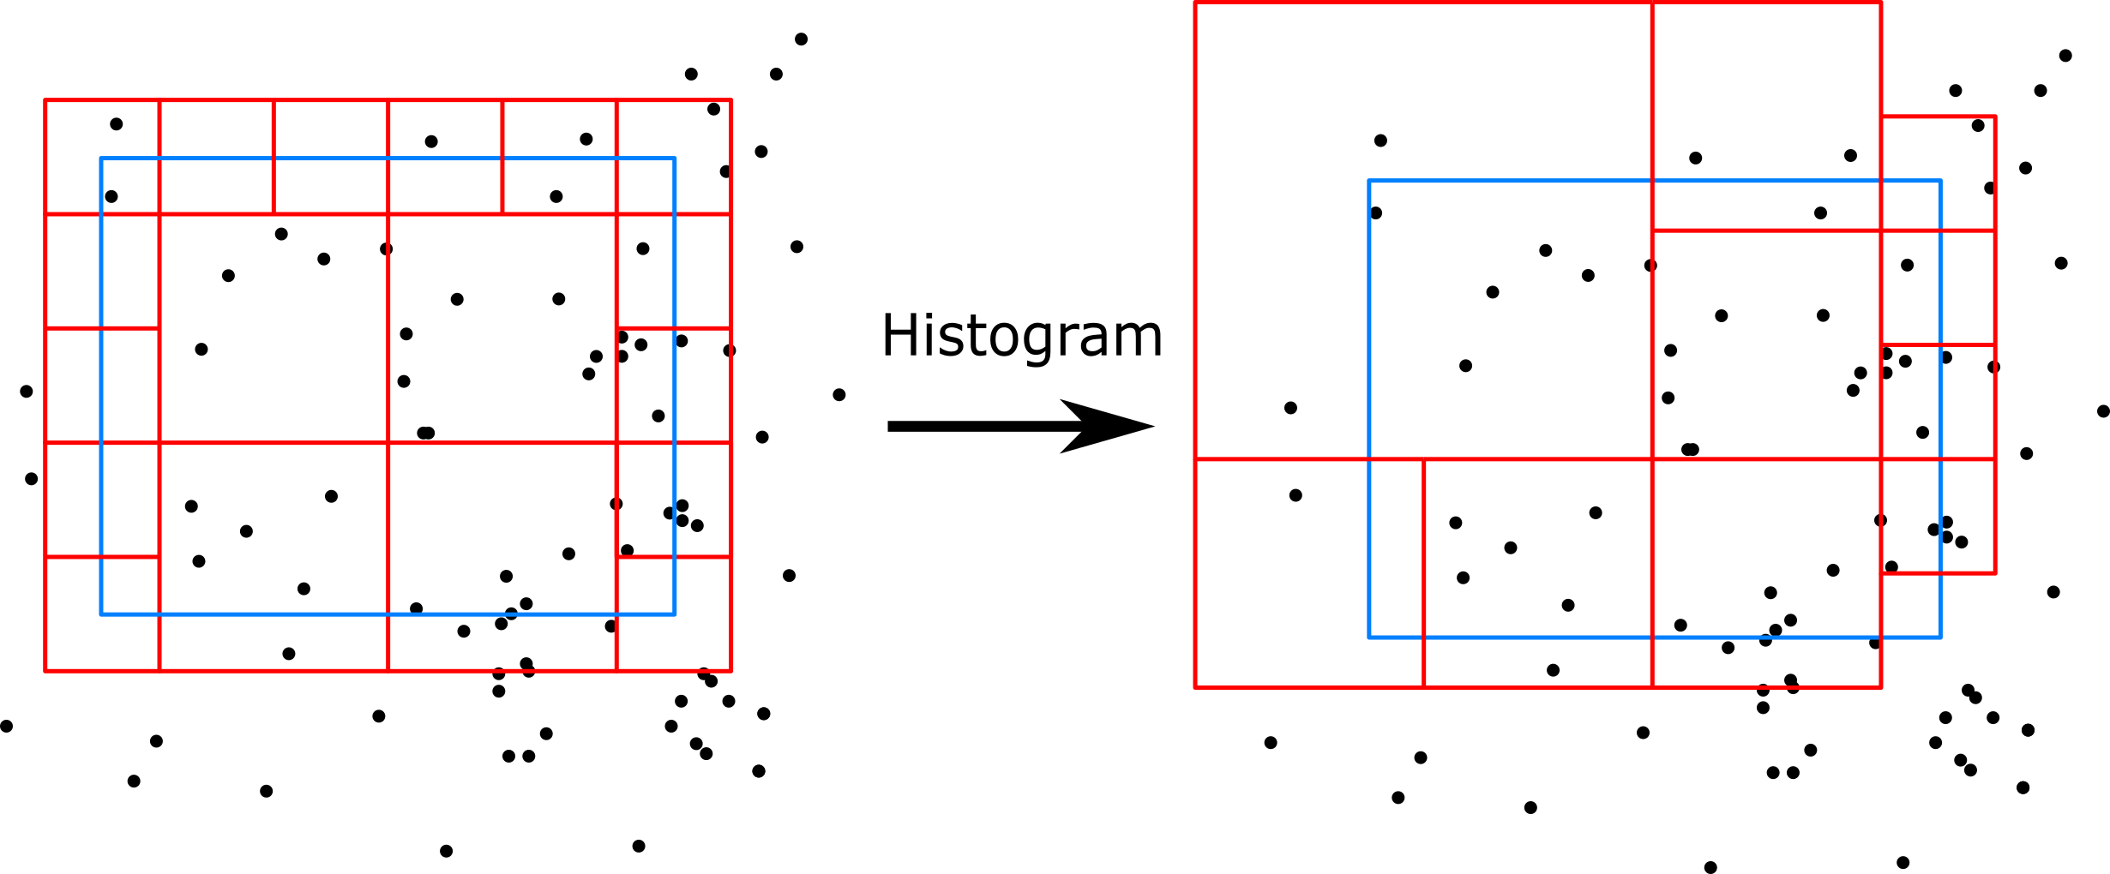
HistSFC – query
Conversion of query geometry
Liu 2022
Query window
Whole extent of data
Morton hierarchy
Notes:
As to queries, in order to retrieve all the one-dimensional keys, the query window has to be converted to one-dimensional ranges as well. HistSFC uses the Morton hierarchy where the extent of data region is reclusively decomposed to match the query window to derive such ranges.
Besides, we also considered skewed point distribution, and used an nD-histogram to reduce number of ranges generated. And as a result, the querying performance is improve further.
For the details of HistSFC, please refer to the conference paper

Slide 12
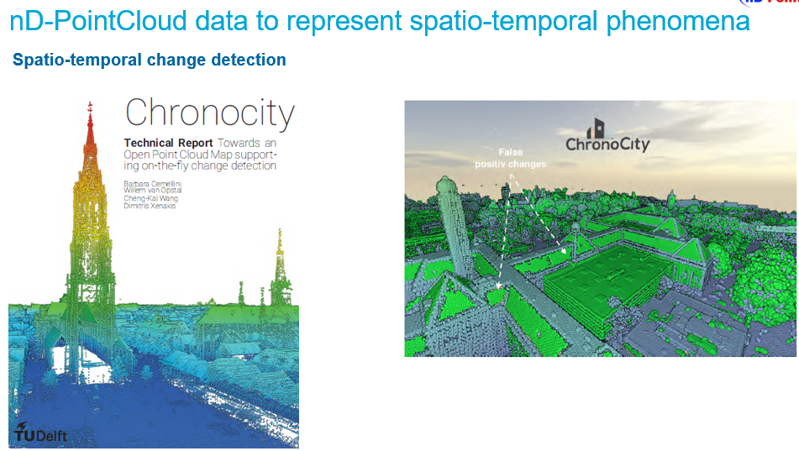
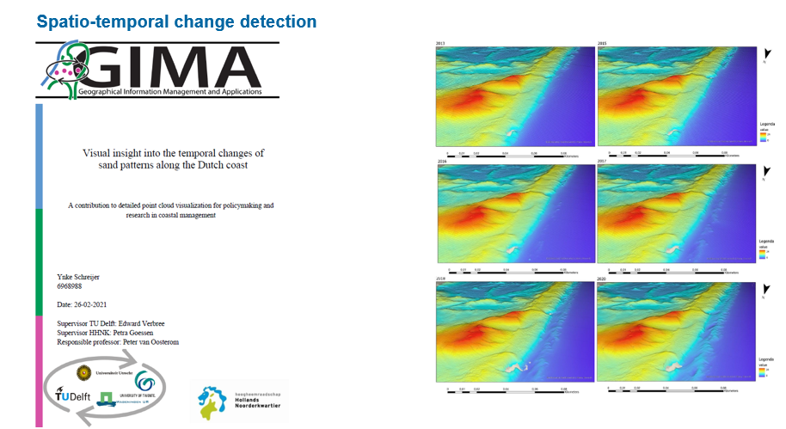
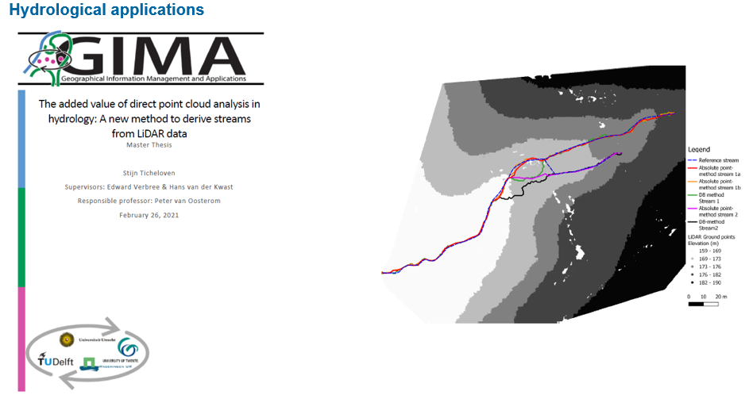
And many more…

Slide 13
Future development

Slide 14
Making point clouds the primary representation of ultra-high-resolution spatio-temporal features, throughout the whole processing chain: data acquisition, storage, analysis, visualization and dissemination.
Liu 2022

Slide 15

nD-PointCloud continuous level representation for spatio-temporal phenomena in Open Point Cloud Maps
Based on a novel use of high-resolution nD space filling curves our project will realize deep integration of space, time and scale as basis for data organization, and enable High Performance/Throughput Computing for enormous point clouds.
By enabling operations directly on the raw point cloud data, nD-PointCloud realizes major advances in domains requiring lossless spatio-temporal data of extremely high accuracy.
Applications from the domain of water management are used as Proof-of-Principle.

Slide 16
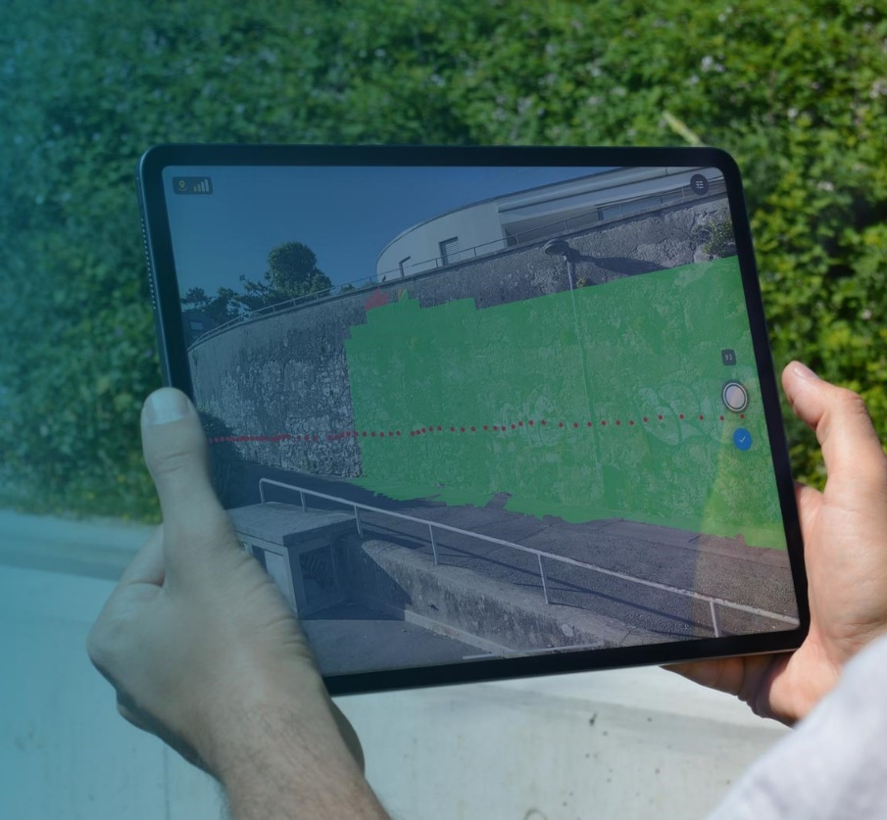
Distributed Open Point Cloud Map (OPCM) infrastructure will be developed that supports data sharing of big data nD-PointCloud and enables interactive real-time visualization
https://lidarmag.com/2020/11/09/pix4d-launches-new-ground-image-capture-app-for-3d-modeling-with-the-ipad-pro-and-iphone-12-pro/

Slide 17

Distributed Open Point Cloud Map (OPCM) infrastructure will be developed that supports data sharing of big data nD-PointCloud and enables interactive real-time visualization
https://lidarmag.com/2020/11/09/pix4d-launches-new-ground-image-capture-app-for-3d-modeling-with-the-ipad-pro-and-iphone-12-pro/

Slide 18
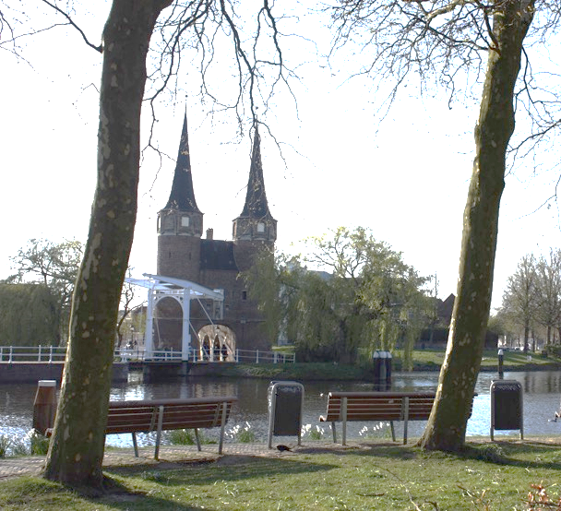

    Point clouds and Hydroinformatics
Thanks!
Vitali Diaz, Haicheng Liu, Peter van Oosterom, Martijn Meijers, Edward Verbree, Fedor Baart, Maarten Pronk, and Thijs van Lankveld
The project
Publications

Slide 19
Visualization of AHN2 with Potree viewer
http://ahn2.pointclouds.nl/#?camera_x=140183.36973145982&camera_y=351353.9722696242&camera_z=80588.82034192001&lookat_x=140176.50197337763&lookat_y=351412.5714400772&lookat_z=80508.08019647106
Notes:
2) Martijn has set the Potree viewer to visualize AHN2

