Slide 1



¹⁹F-MRI and numerical modeling as a combined method for the measurement and prediction of fluorinated substances (e.g. PFASs) transport in porous media
Elisabeth Fries^{1,3}, Denis Courtier-Murias¹, Jaime Gil Roca², Pierre-Emmanuel Peyneau¹,
Eric Michel³, Béatrice Béchet¹
¹ GERS-LEE, Univ Gustave Eiffel, IFSTTAR, F-44344 Bouguenais, France
² Laboratoire Navier, Ecole des Ponts ParisTech, CNRS, Univ Gustave Eiffel, 77420 Champs-sur-Marne, France
³ EMMAH, INRAE, Avignon Université, 84000 Avignon, France
24.05.2022

Slide 2
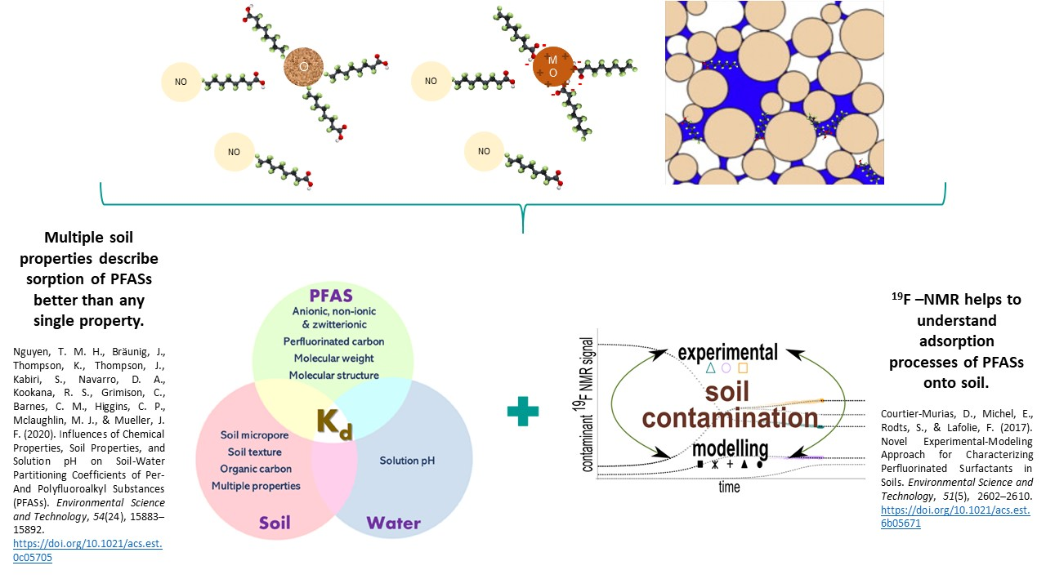
Introduction
State of the art

Slide 3
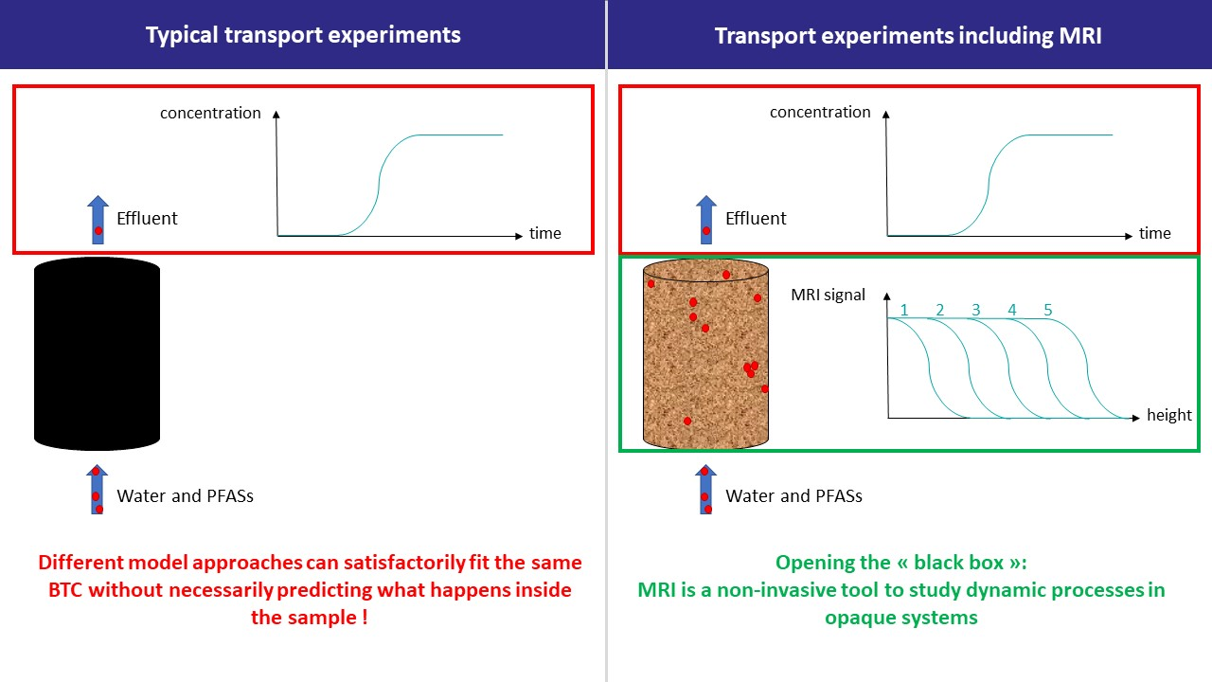
Introduction
Particularity of the project

Slide 4
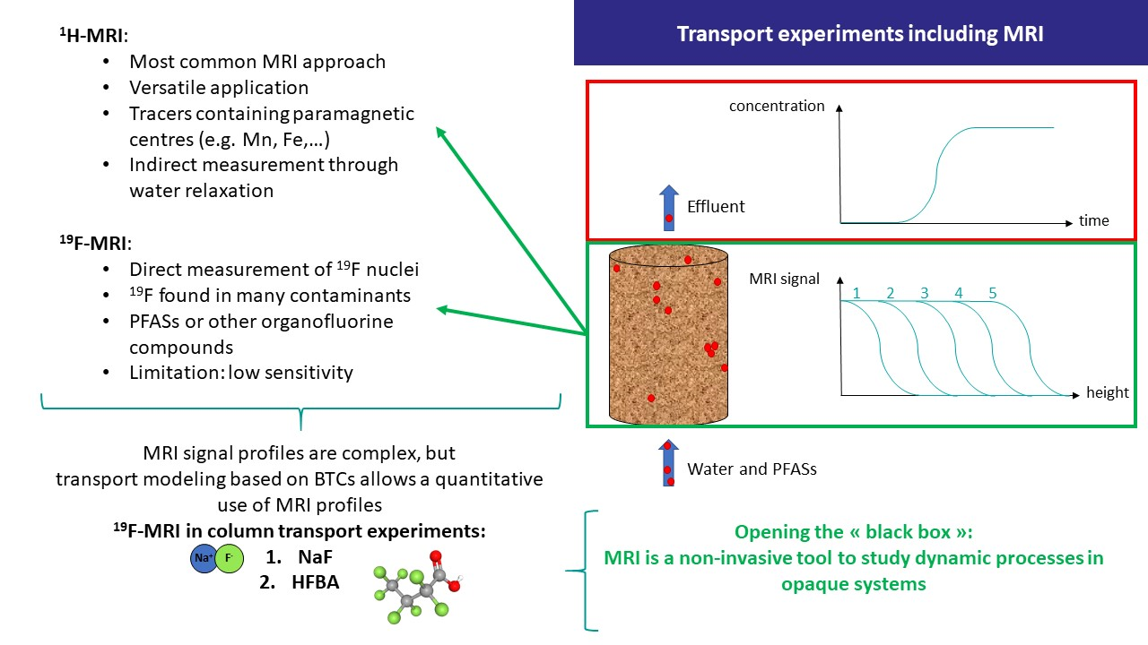
Introduction
Particularity of the project

Slide 5
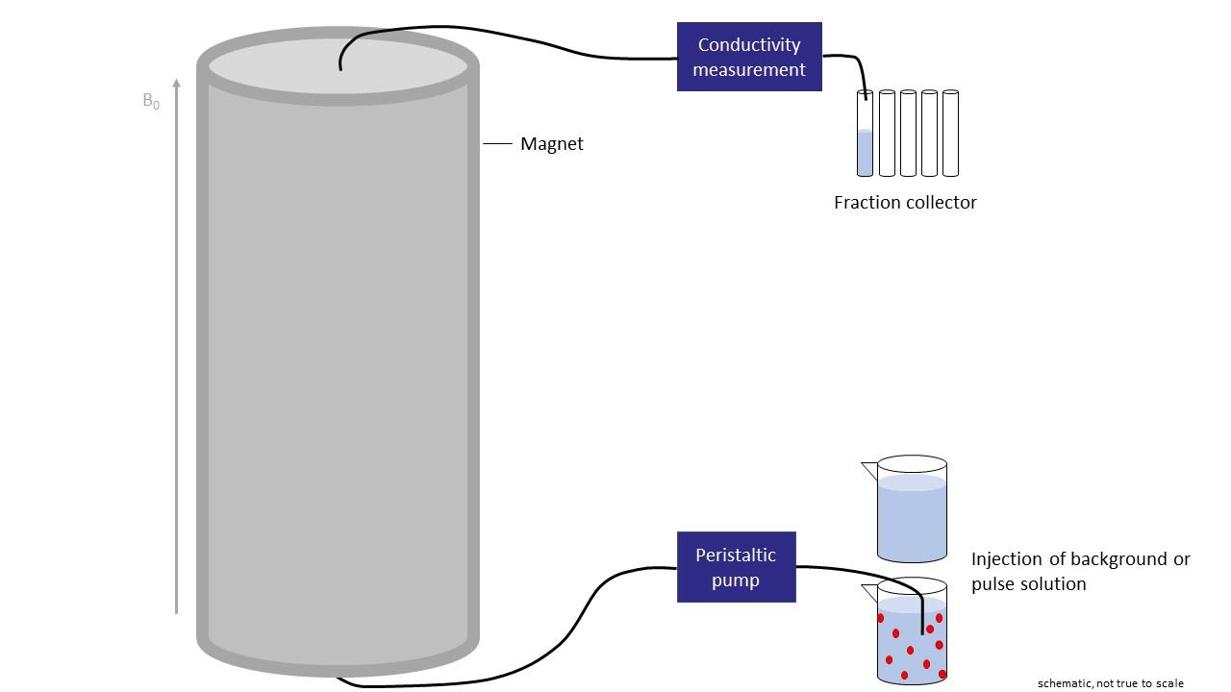
Materials and methods
¹⁹F-MRI

Slide 6
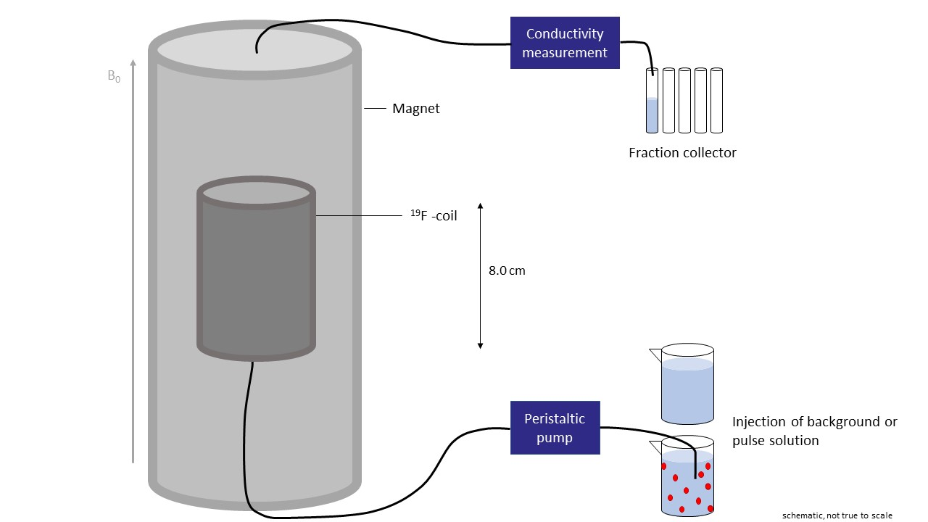
Materials and methods
¹⁹F-MRI

Slide 7
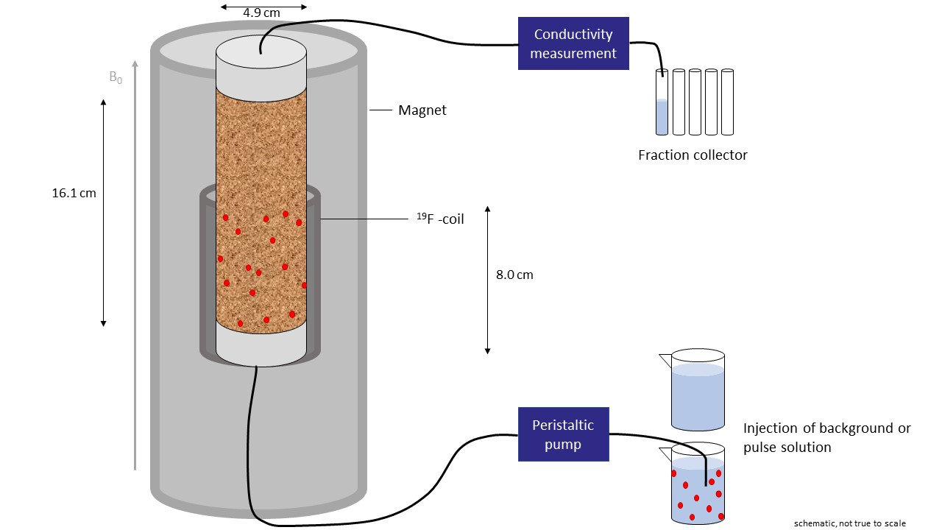
Materials and methods
¹⁹F-MRI
Entrance of column

Slide 8
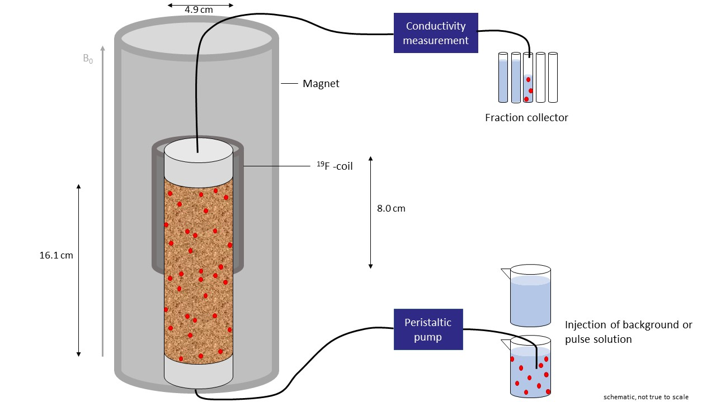
Materials and methods
¹⁹F-MRI
Exit of column

Slide 9
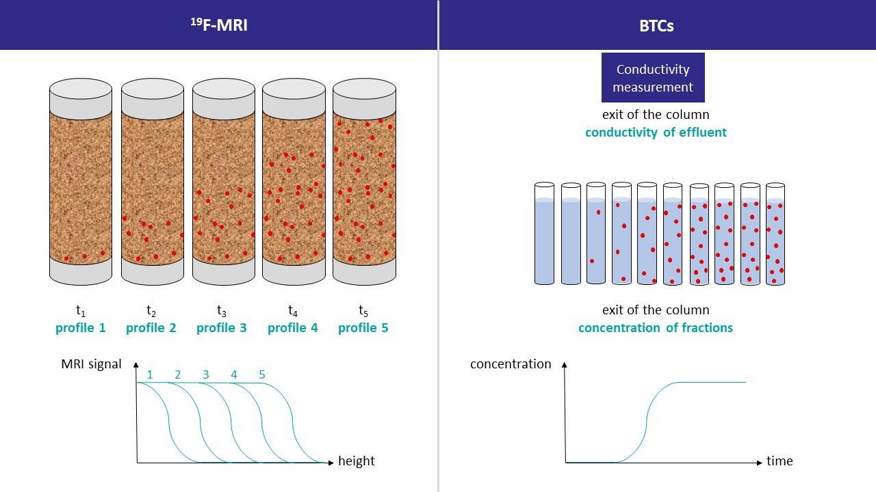
Materials and methods
¹⁹F-MRI and modeling

Slide 10
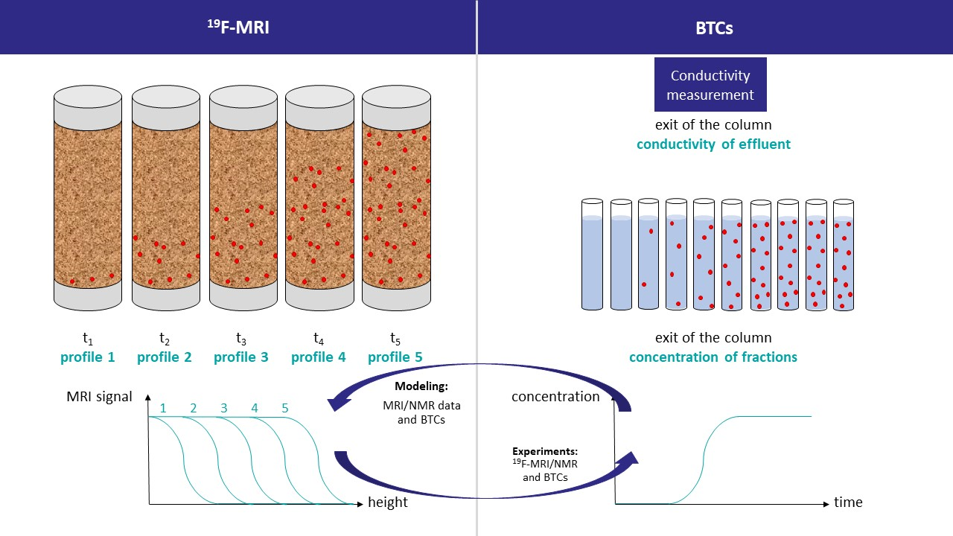
Materials and methods
¹⁹F-MRI and modeling

Slide 11
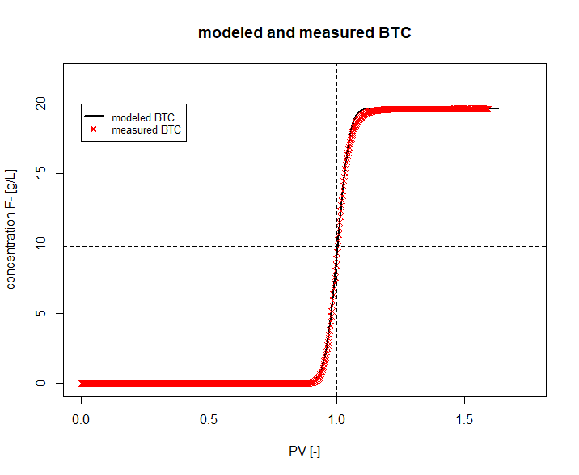
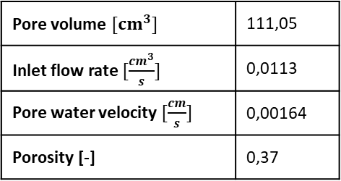
Preliminary results
Transport experiments and modeling with NaF
Na⁺
F⁻
Pore volume $[cm^{3}]$ | 111,05
Inlet flow rate $[\frac{cm^{3}}{s}]$ | 0,0113
Pore water velocity $[\frac{cm}{s}]$ | 0,00164
Porosity [-] | 0,37

Slide 12
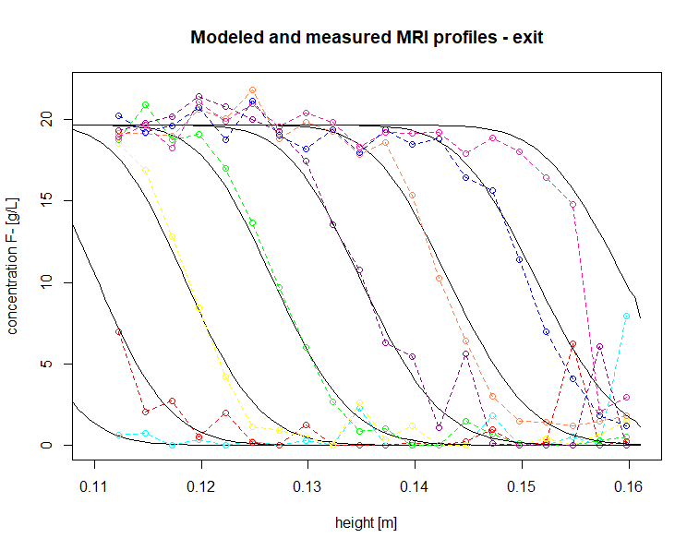
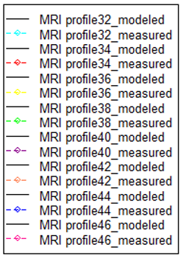
Preliminary results
Transport experiments and modeling with NaF
Na⁺
F⁻

Slide 13
Preliminary results
Transport experiments and modeling with NaF
Na⁺
F⁻
Dispersion coefficient calibrated from the BTC is overestimated
Khrapitchev, A. A., Stapf, S., & Callaghan, P. T. (2002). NMR visualization of displacement correlations for flow in porous media. Physical Review E - Statistical Physics, Plasmas, Fluids, and Related Interdisciplinary Topics, 66(5), 16. https://doi.org/10.1103/PhysRevE.66.051203

Slide 14

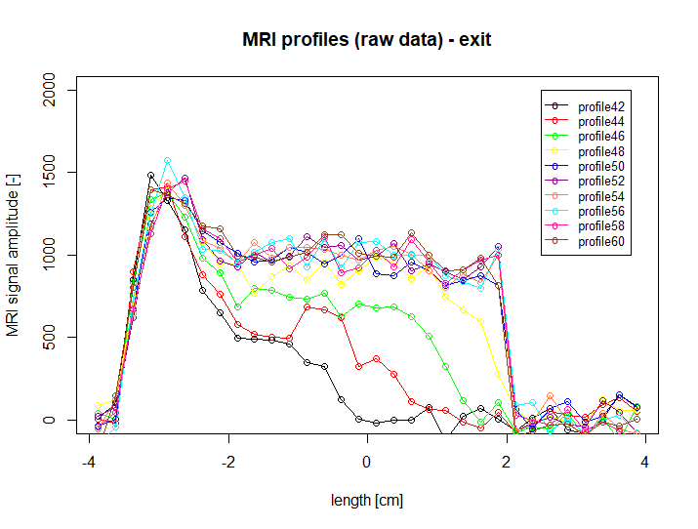
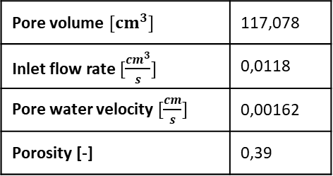
Preliminary results
Transport experiments and modeling with HFBA
Pore volume $[cm^{3}]$ | 117,078
Inlet flow rate $[\frac{cm^{3}}{s}]$ | 0,0118
Pore water velocity $[\frac{cm}{s}]$ | 0,00162
Porosity [-] | 0,39
More complex signal interpretation
Chemical shifts in NMR spectrum ?
Improvements in MRI set-up/parameters necessary ?

Slide 15
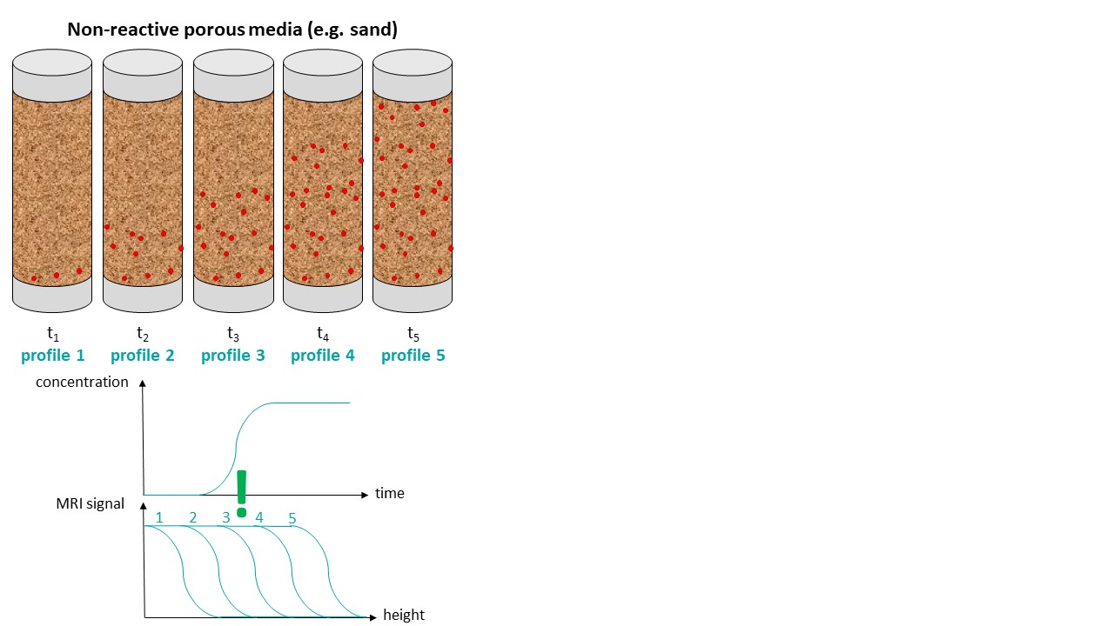
Conclusion and prospects
Transport experiments and modeling with NaF and HFBA

Slide 16
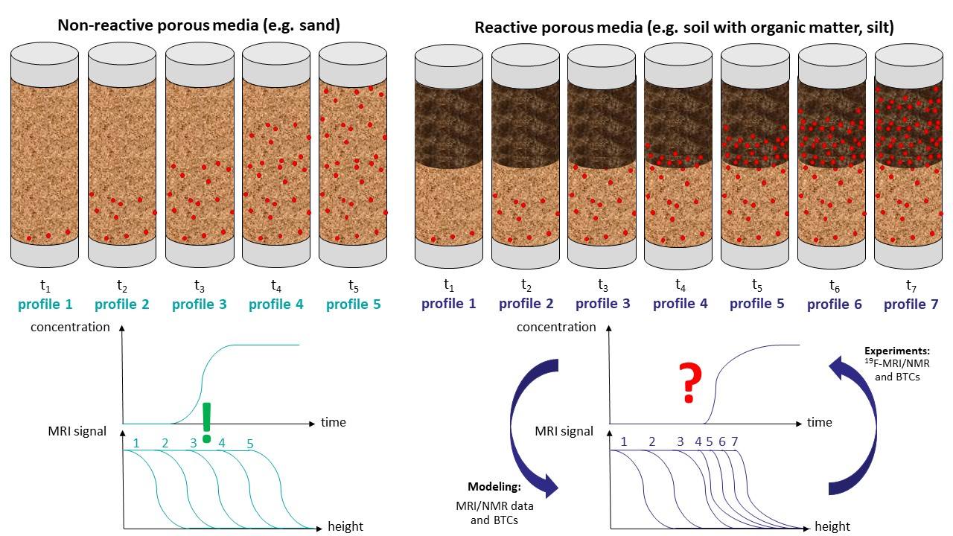
Conclusion and prospects
Transport experiments and modeling with PFASs

Slide 17
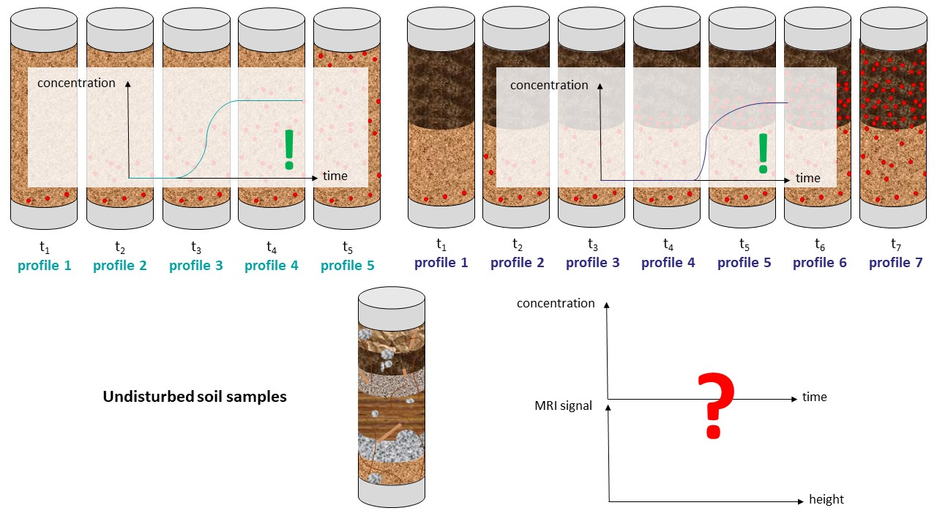
Conclusion and prospects
Transport experiments and modeling with PFASs

Slide 18
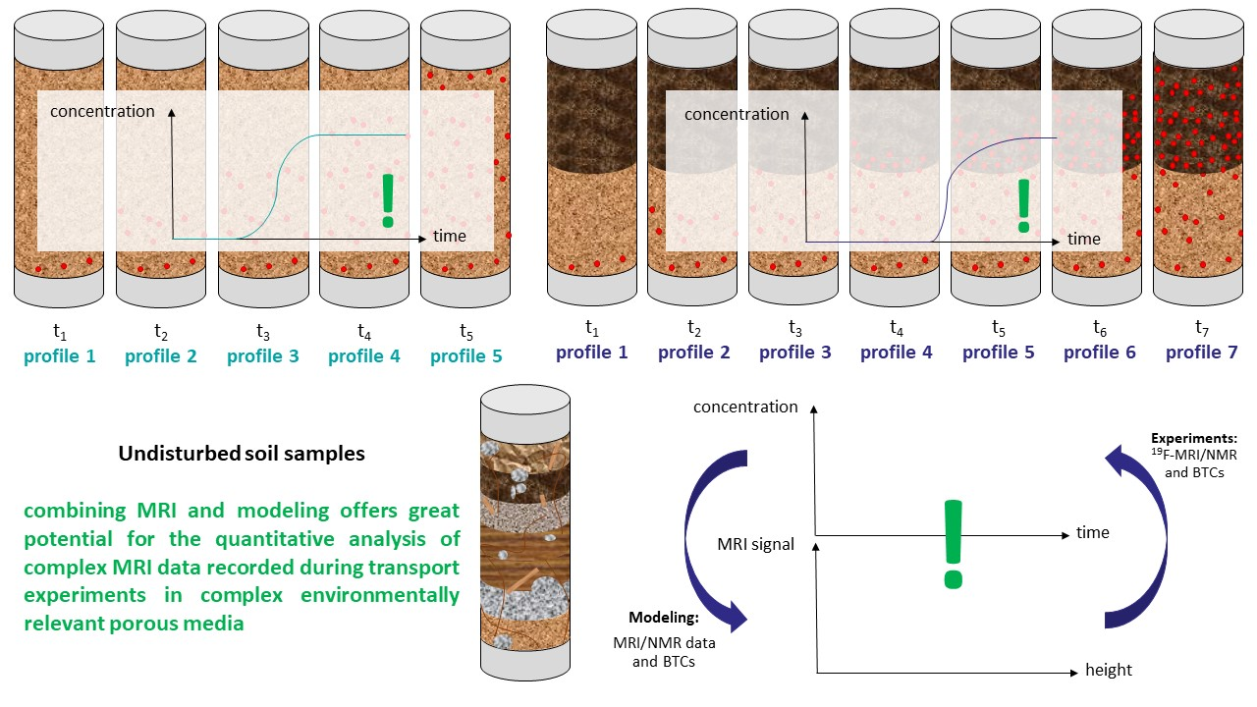
Conclusion and prospects
Transport experiments and modeling with PFASs

Slide 19
Thank you for your attention !
Elisabeth Fries
^{elisabeth.fries@univ-eiffel.fr}
EGU22-1288
24.05.2022

