Slide 1




A 500-year annual runoff reconstruction for 14 selected European catchments
Sadaf Nasreen¹, Markéta Souˇcková¹, Mijael Rodrigo Vargas Godoy¹, Ujjwal Singh¹, Yannis Markonis¹,
Rohini Kumar², Oldrich Rakovec^{1,2}, and Martin Hanel¹
¹Faculty of Environmental Sciences, Czech University of Life Sciences Prague, Praha-Suchdol 16500, Czech Republic
²UFZ-Helmholtz Centre for Environmental Research, Leipzig 04318, Germany
Correspondence: Martin Hanel (hanel@fzp.czu.cz)
Chat Mon, 23 May, 10:48–10:55
EGU2022 session CL1.2.6 – 'Studying the climate of the last two millennia’

Slide 2
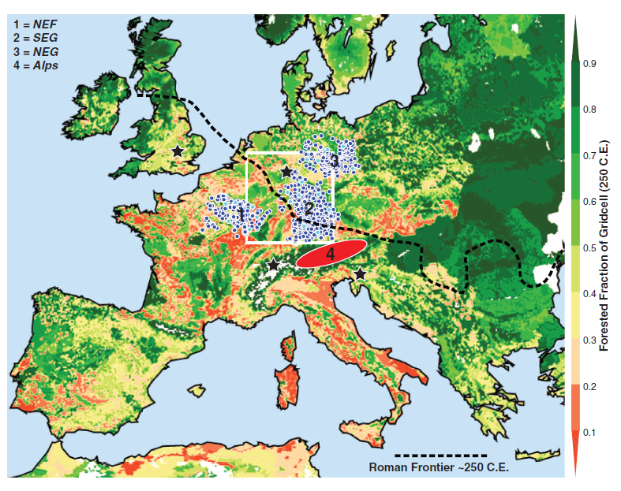
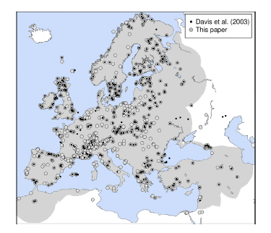

Research Interest (approach)
Runoff is a key element related to water security; it is challenging to interpret recent hydroclimate fluctuations (multi- year droughts in particular) considering observed runoff records
There are available reconstructions of temperature, precipitation, drought indicators, or the 20th century runoff for Europe, multi-century annual runoff reconstructions are still lacking.
Buntgen.et al, (2011). 7284 Precipitation-sensitive oak ring width series of summer precipitation and temperature variability over the past 2500 years.
A.Mauri (2015). Precipitation and temperature reconstruction of 12,000 years based on 60000 pollen data with 1000 yrs. step.

Slide 3
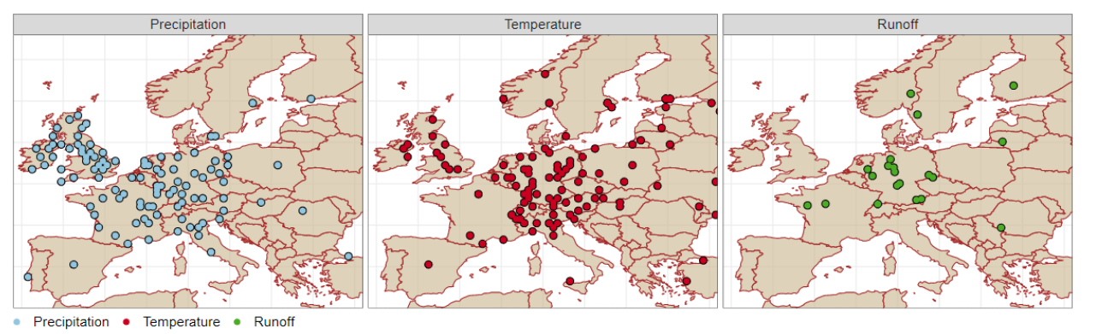
Data settings
Reference | Domain | Temporal coverage (*CE) | Spatial resolution | Variables
Pauling et al. (2006) | Europe | 1500-2000 | 0.5x0.5 | Seasonal precipitation
Luterbacher et al. (2004) | Europe | 1500-2000 | 0.5x0.5 | Seasonal temperature
Menne et al. (2018) | Global | 1760-2010 | 26,000 Point stations | Monthly mean temperature
Menne et al. (2018) | Global | 1760-2010 | 20,590 Point stations | Monthly mean precipitation
Cook et al. (2015) | Europe | 0-2012 | 0.5x0.5 | Summer Palmer Drought severity index

Slide 4
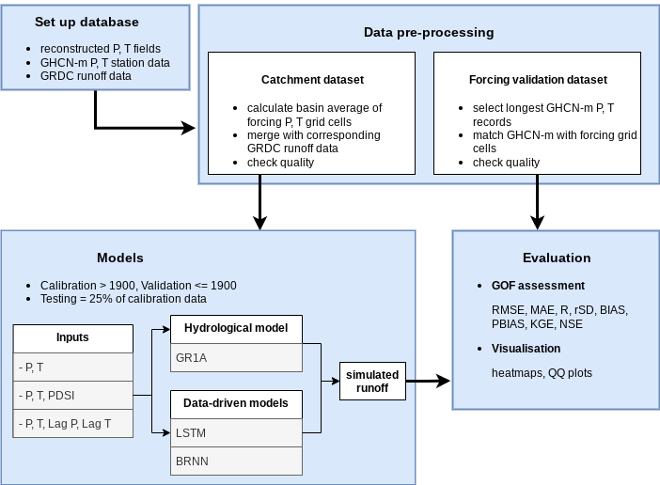
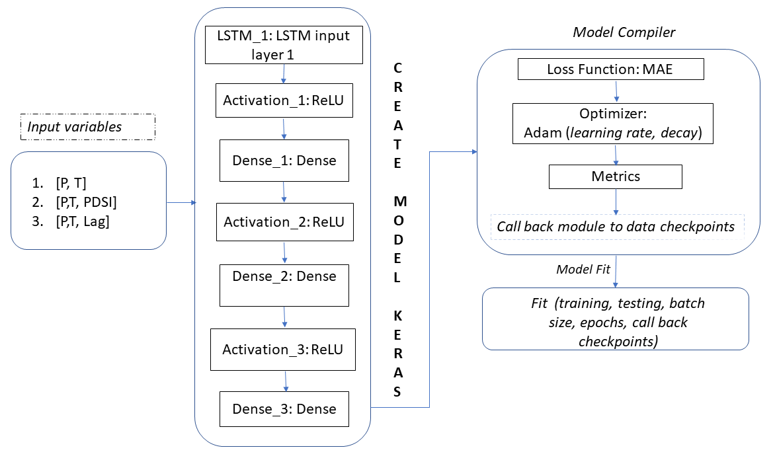
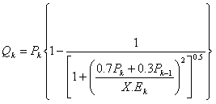
A schematic representation of workflow
Data Driven approaches
Hydrological Model GR1A
BRNN Caret package
X is the parameter of the model to optimize

Slide 5
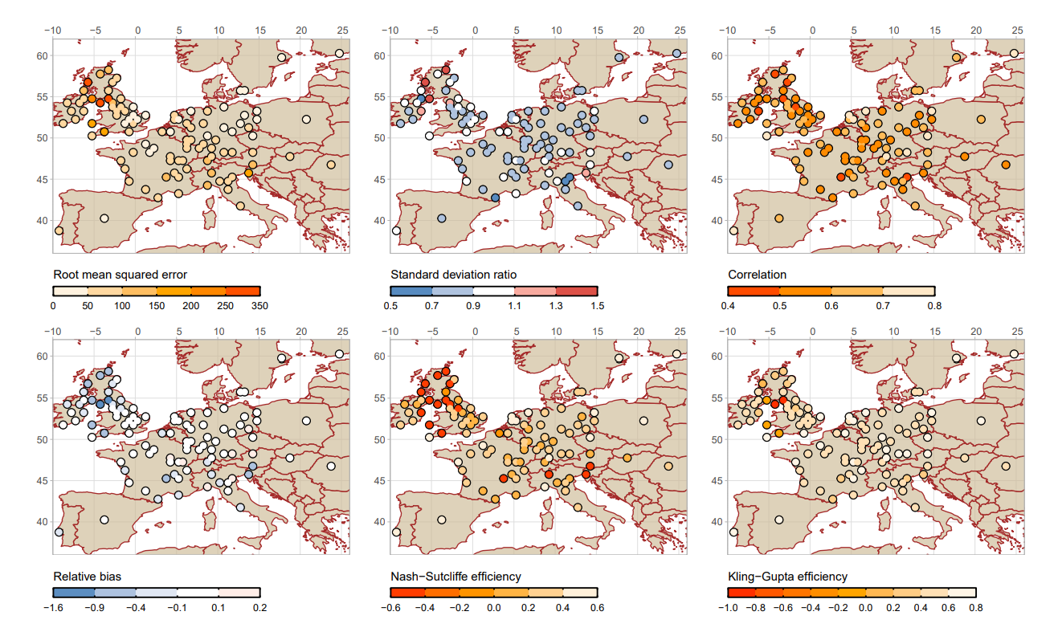
Goodness of fit (Precipitation)
At for most of the sites, the correlation coefficient (R) of P reconstruction is above 0.5;
relBIAS is between -0.1 and 0.1;
KGE and NSE are showing values below 0.5 and 0.6 respectively;
rSD is between 0.7 and 0.9 and RMSE varies between 0 and
150.

Slide 6
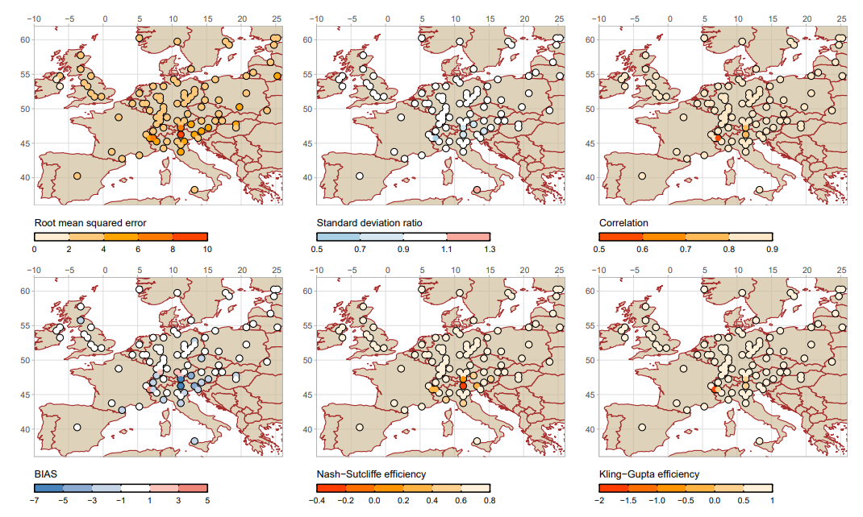
Goodness of fit (Temperature)
Reasons:
Proxies rely on different seasons and climate conditions.
Shortest available instrumental data before the 20th century could encounter certain technical errors, such as problems with instrumental tools, station relocation and dating issues (Dobrovolný et al., 2010).
The chosen statistical technique (principal component regression) could also possibly contribute to variance inflation with larger time-scales (Pauling et al., 2006).
In general, reconstructed precipitation exhibits greater differences from observations than temperature.

Slide 7
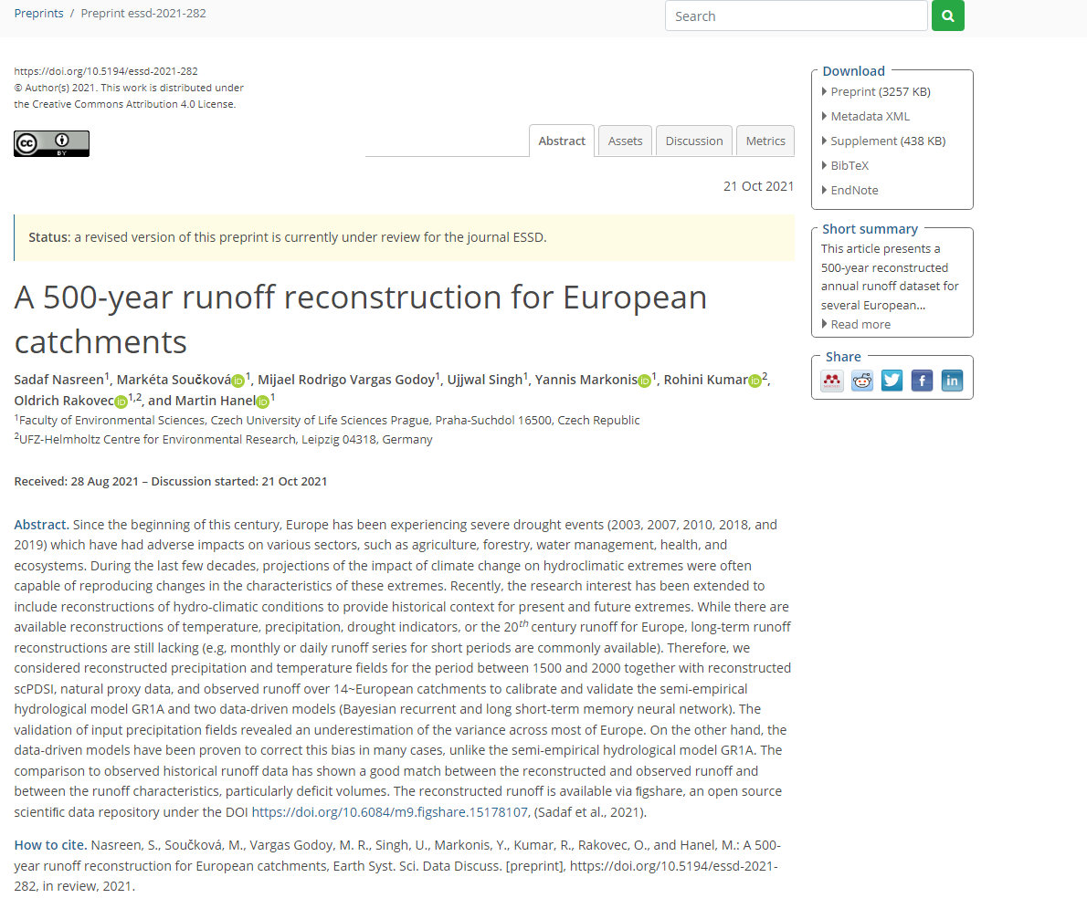
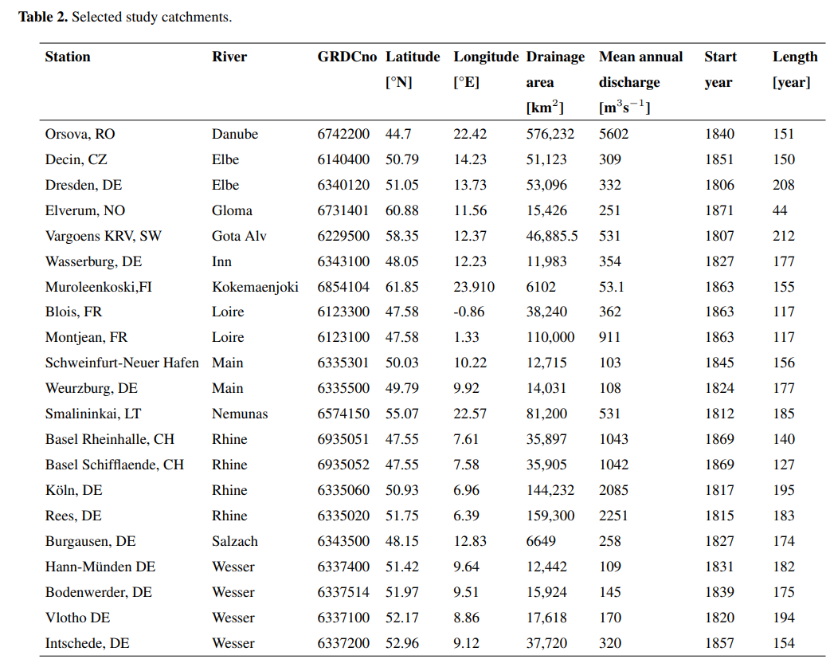
Annual Runoff reconstruction
Nasreen, S., Součková, M., Vargas Godoy, M. R., Singh, U., Markonis, Y., Kumar, R., Rakovec, O., and Hanel, M.: A 500-year runoff reconstruction for European catchments, Earth Syst. Sci. Data Discuss. [preprint], https://doi.org/10.5194/essd-2021-282, in review, 2021.

Slide 8
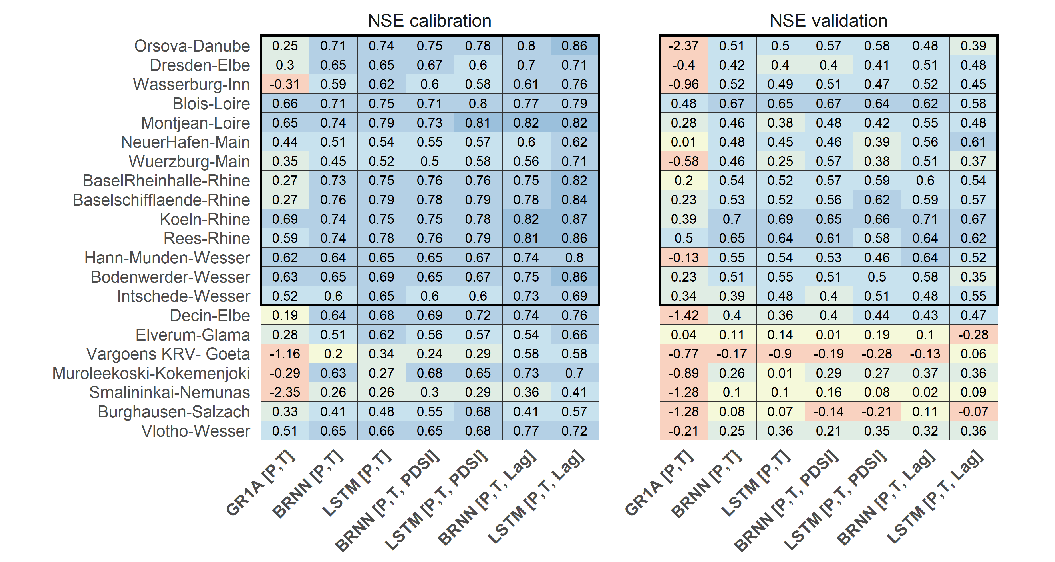
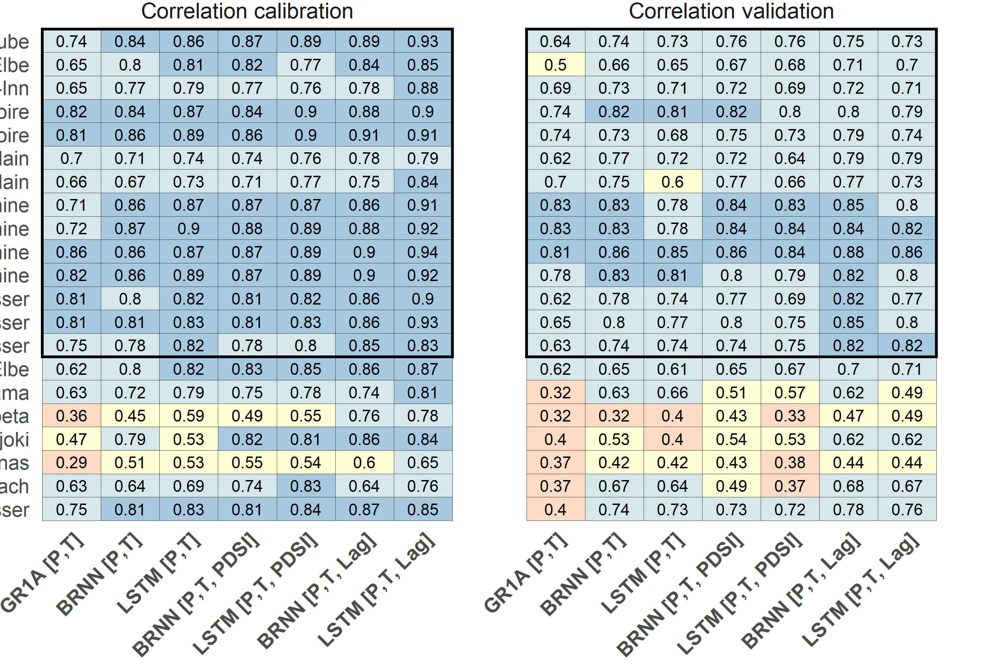
The neural network algorithms are more skilled for runoff prediction than the GR1A model.
The NSE and R statistics for the BRNN and LSTM models indicate a significant improvement in runoff prediction, as compared to the results obtained through the GR1A model

Slide 9
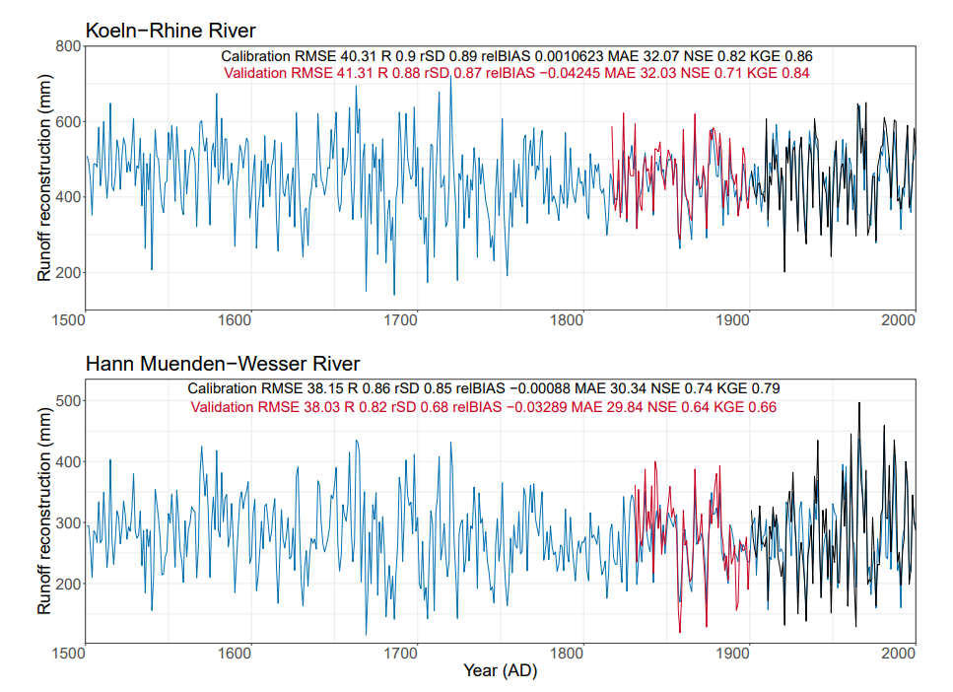
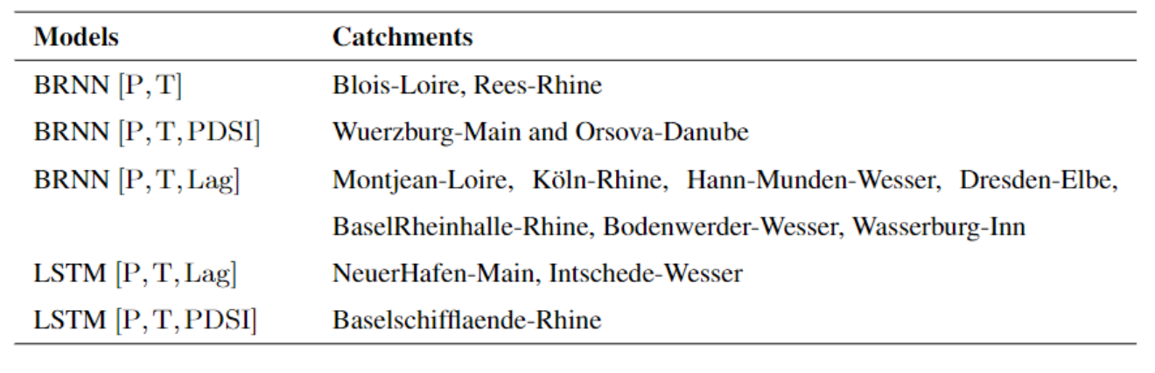
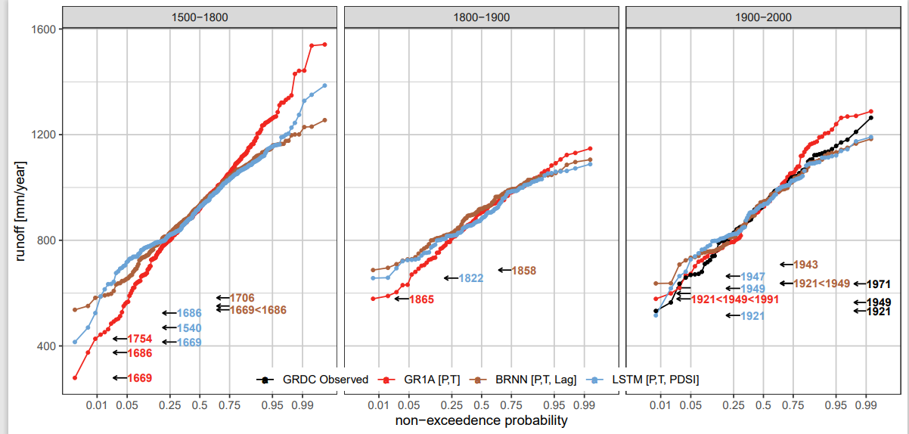
Basel Rheinhalle-Rhine
Does our reconstruction correspond to previous drought events?

Slide 10
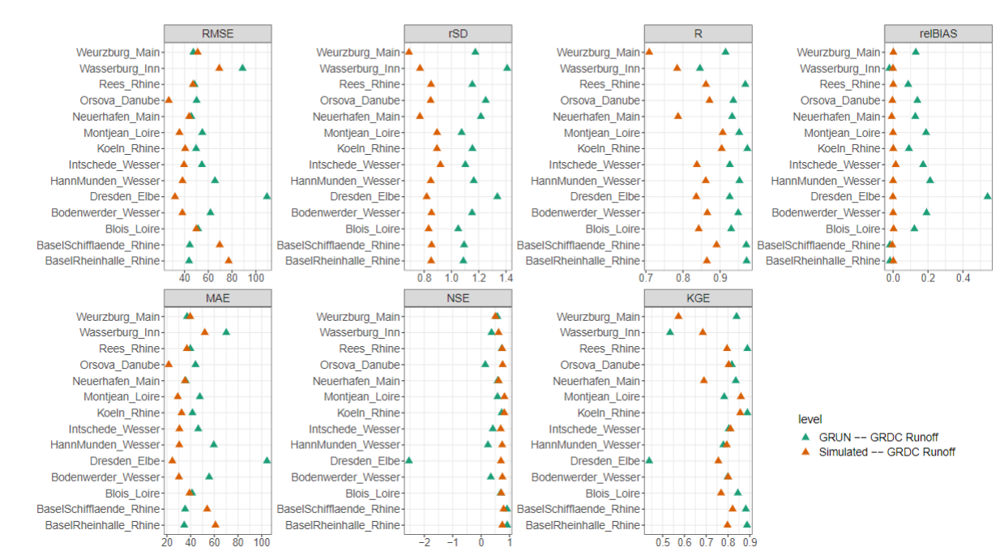
Statistical comparison between reconstructed and GRUN runoff with respect to observed GRDC Runoff for the common period 1902-2000
Skills of Runoff reconstruction

Slide 11
Conclusions
We reconstructed annual runoff reconstruction from 1500 to 2000 year ago. Our modelling approach data-driven methods have proven to be helpful for annual runoff simulations even when there are deficiencies in the driving input fields. This contrasts with a conceptual lumped hydrological model, which would require bias correction before the simulation
The droughts identified in the reconstructed series correlates well with significant documented events (such as 1540,1616, 1669, 1710, 1724 and 1921) relation to the validation metrics
Depends on reconstructed precipitation (Pauling et al., 2006) and temperature (Luterbacher et al., 2004) forcing fields. Lack of appropriate long-term observational datasets led to validation difficulties.
The link between reconstructed forcing and annual runoff is stationary when going back in time.
The number of natural proxies included in the derivation of the forcing dataset decreases, the uncertainty increases. The reconstructed data should, therefore, always be considered with caution.

Slide 12
References
Gridded Precipitation --- https://doi.org/10.1007/s00382-005-0090-8
Gridded Temperature ---- https://doi.org/10.1126/science.1093877
OWDA scPDSI ----- doi:10.1126/sciadv.1500561
Observed GHCN Temperature--- https://doi.org/10.1175/JCLI-D-18-0094.1
Observed GHCN Precipitation ---- doi:10.7289/V5X34VDR
Observed GRDC Runoff---- https://www.bafg.de/GRDC/EN/06_nws/news_node.html
GRUN Runoff --- https://doi.org/10.5194/essd-11-1655-2019, 2019
A mauri(2015) ---- proxy reconstruction https://doi.org/10.1016/j.quascirev.2015.01.013
Bungten., et al 2011 ---- doi: 10.1126/science.1197175
Dobrovolný et al., 2010 ---- doi: 10.1007/s10584-009-9724-x

Slide 13

Thank you for your attention!
Contact: nasreen@fzp.czu.cz

