Slide 1
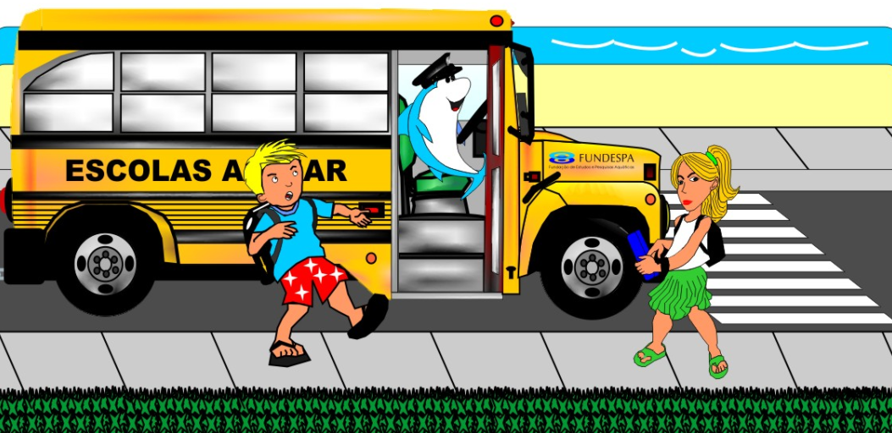



Schools by the Sea
Stacey Alvarez de la Campa & Mario Luiz Mascagni
Paper abstract: https://meetingorganizer.copernicus.org/EGU22/EGU22-12897.html

Slide 2
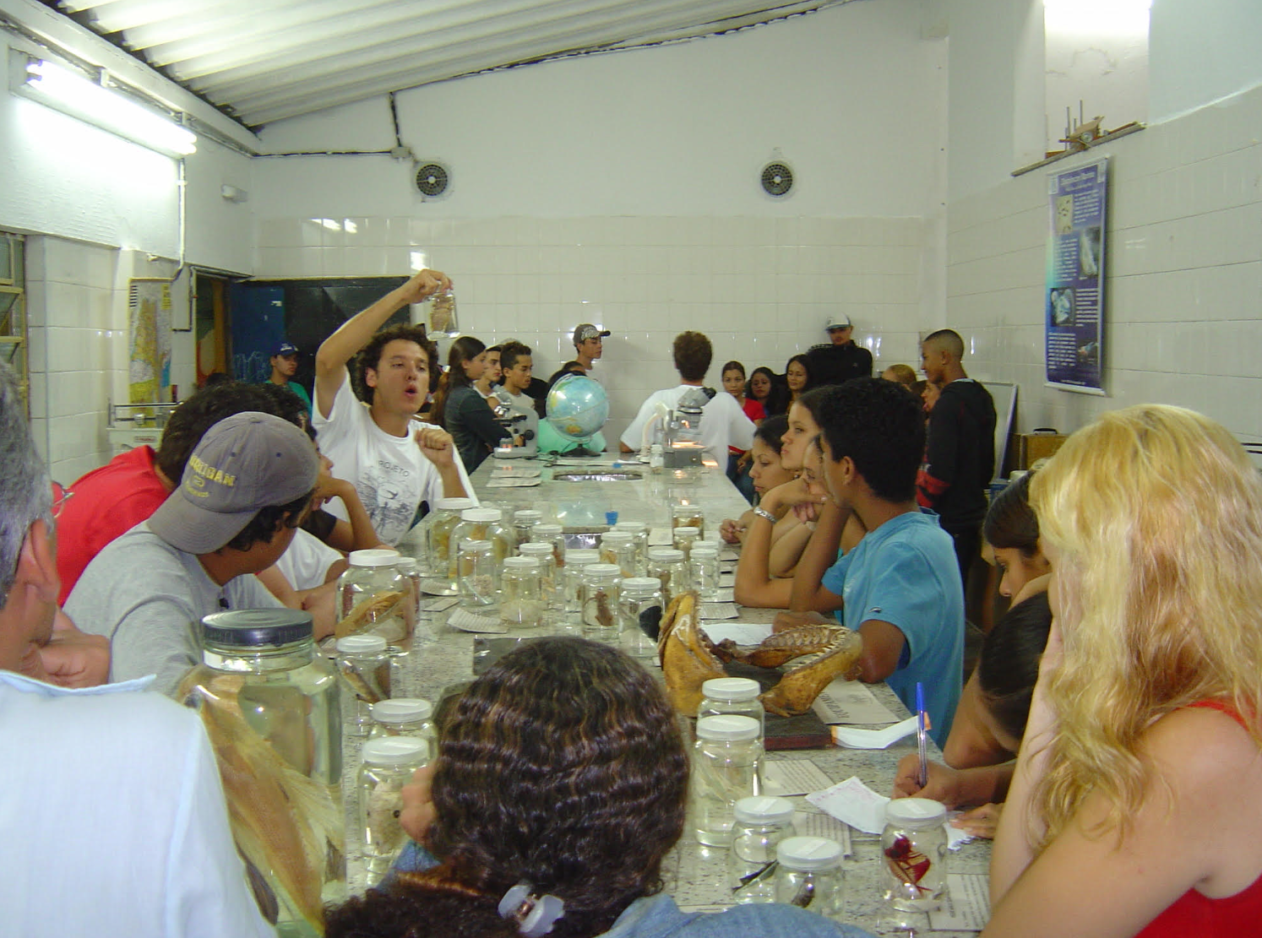

Schools by the Sea
The project Schools by the Sea was developed in order to make the younger population aware of the importance of their individual actions for a more sustainable planet.

Slide 3
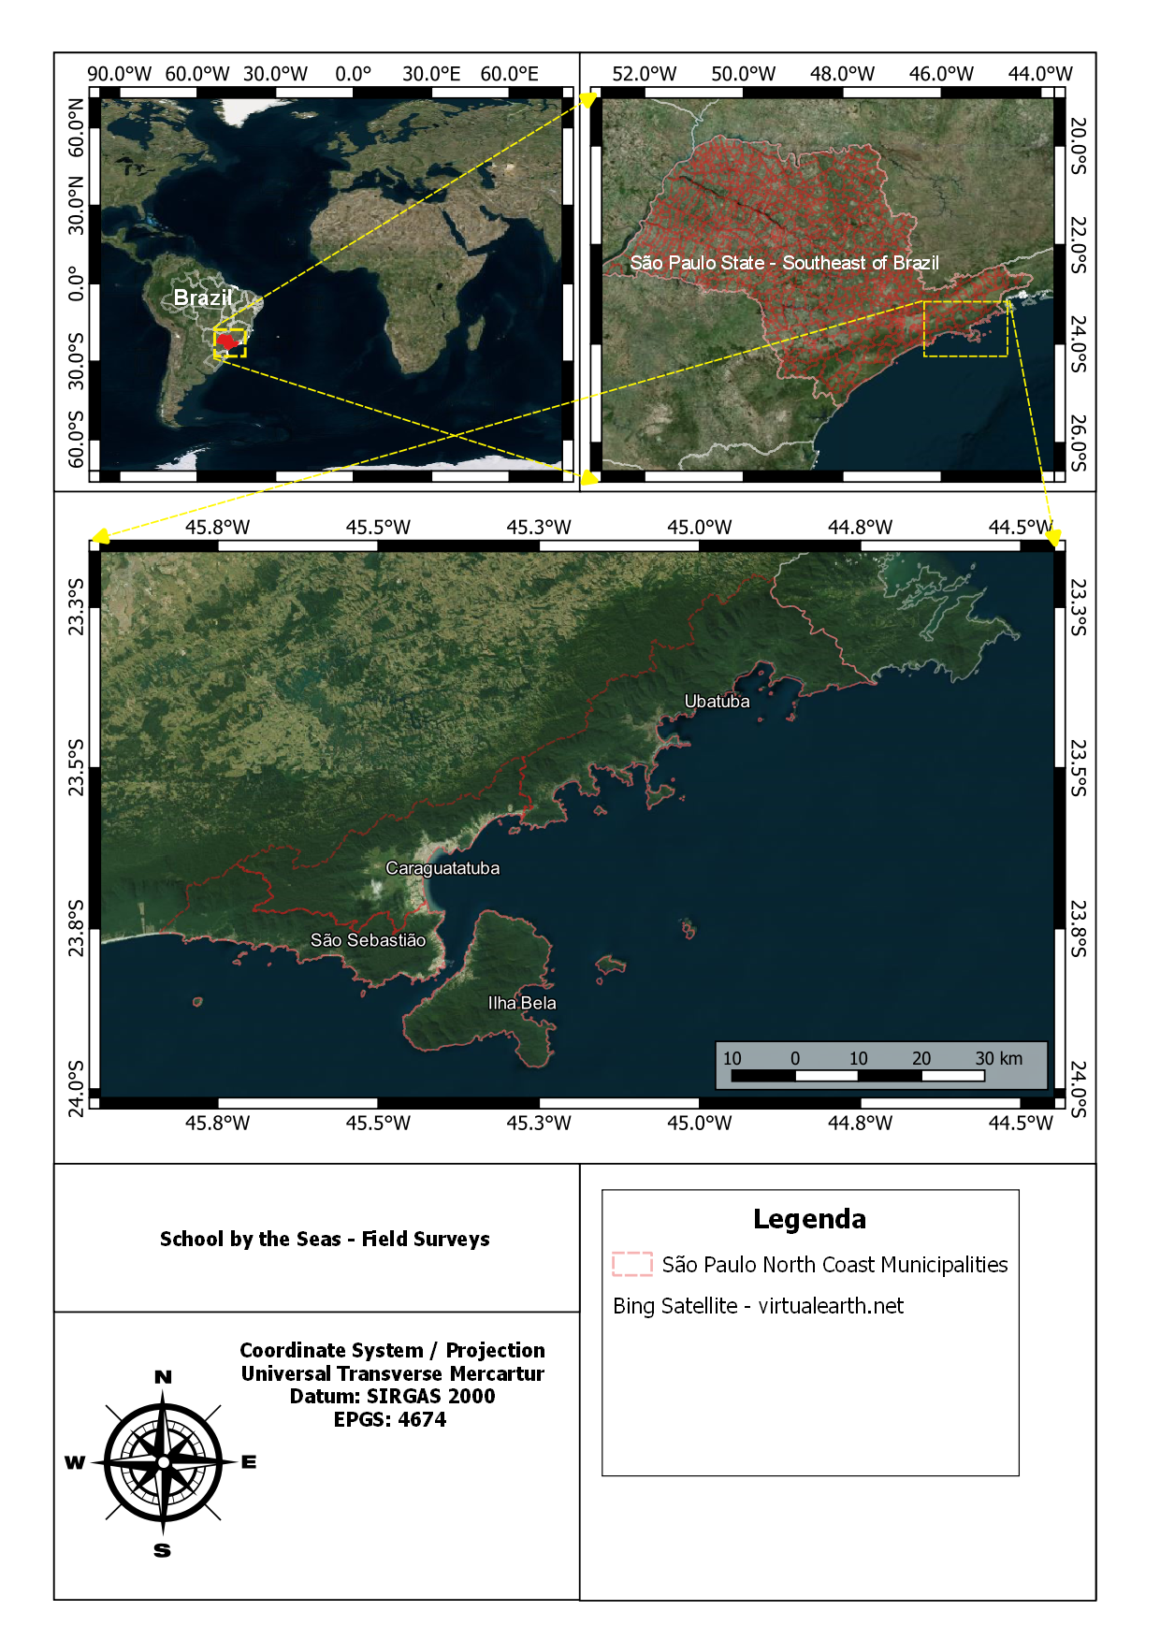
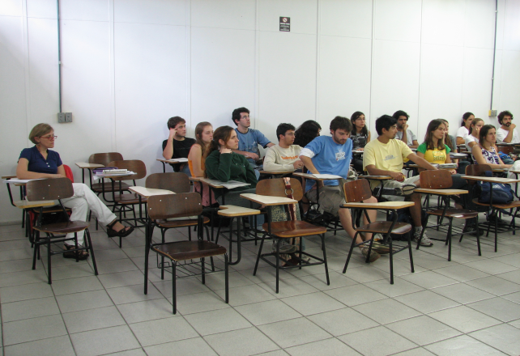
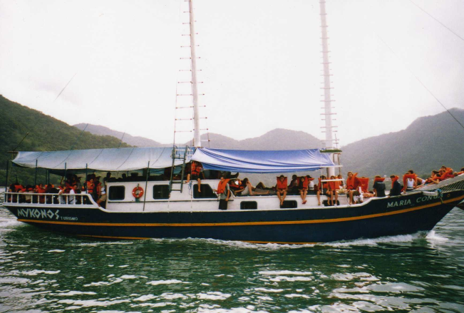
Schools by the Sea
The Schools by the Sea project was carried out with Brazilian high school students, so that they could apply the theoretical knowledge learned in the classroom to practical activities directly in coastal communities under environmental pressure.
Knowledge transported from the classroom to the field.

Slide 4
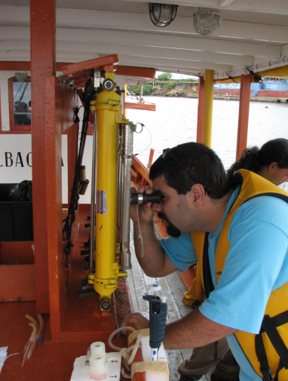
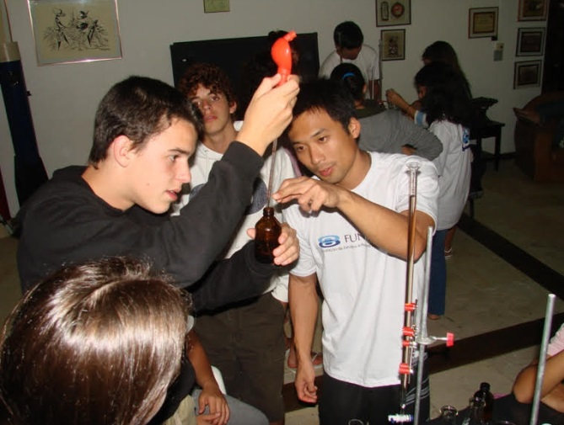
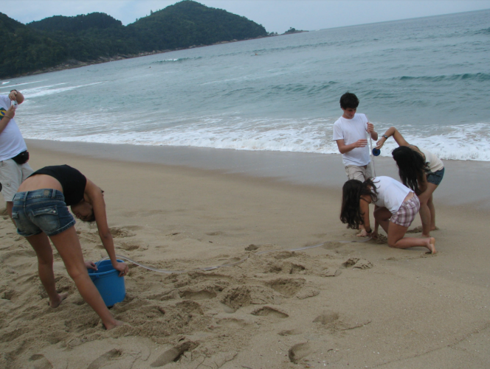
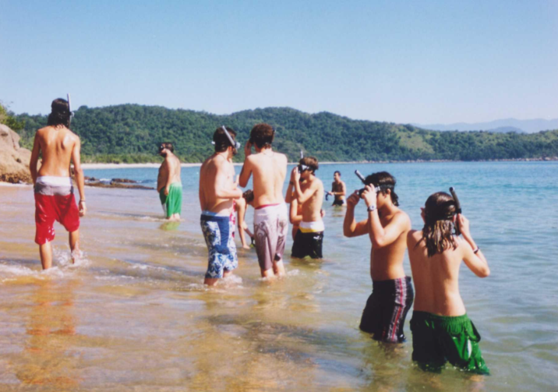
Schools by the Sea
The Schools by the Sea project uses the theoretical knowledge taught in the high school curriculum of Brazilian public and private schools, in an integrated practical study of the environment. This approach explores how physical, chemical, biological and geological processes are interconnected in nature, just as the human being is also an integral part of nature, being directly impacted by imbalances in the environment. These imbalances result from natural changes or are promoted by man himself in the environment.
Physical
Parameters
Chemical
Parameters
Geological
Parameters
Biological
Parameters
Students applying their theoretical knowledge in practical studies of the environment.

Slide 5
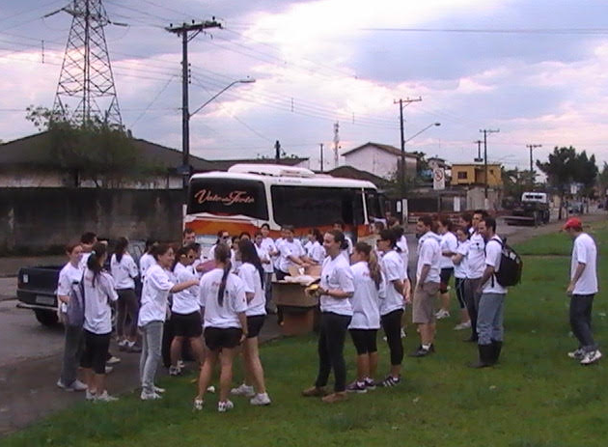
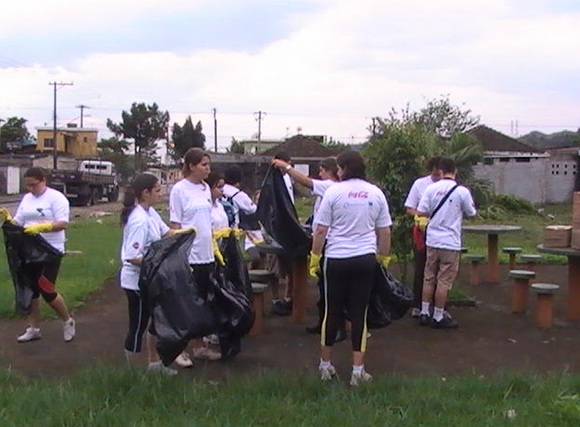
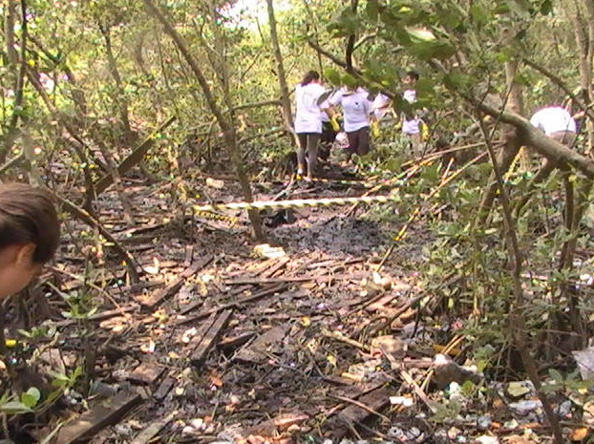
Schools by the Sea
At the end of the studies relating the theoretical and practical part, the students were mobilized to help recover a degraded coastal area close to the places of practical study.
Degraded mangrove being cleaned by the students of the projects

Slide 6
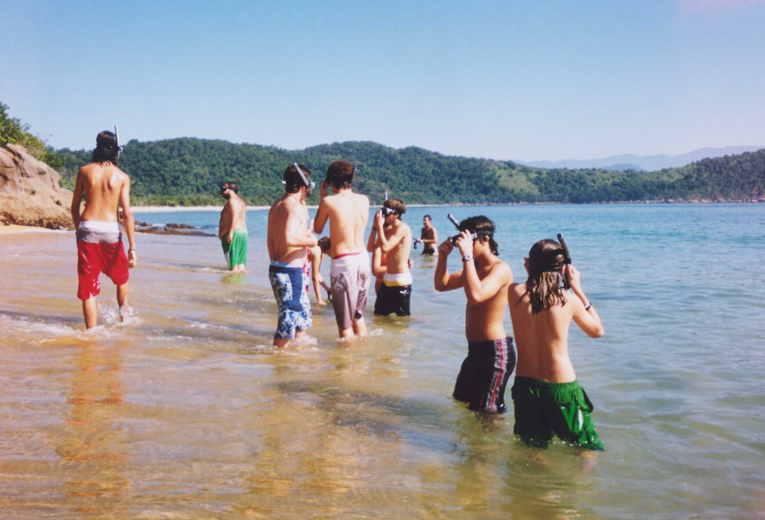
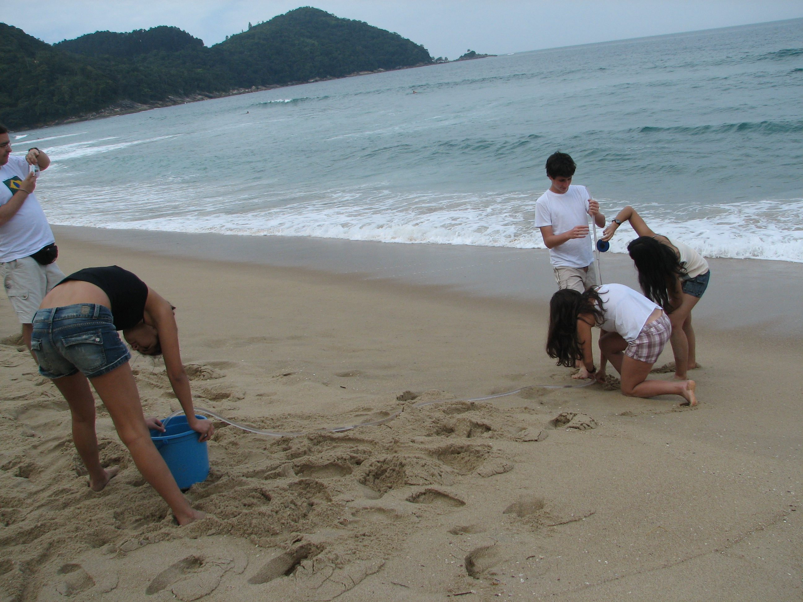
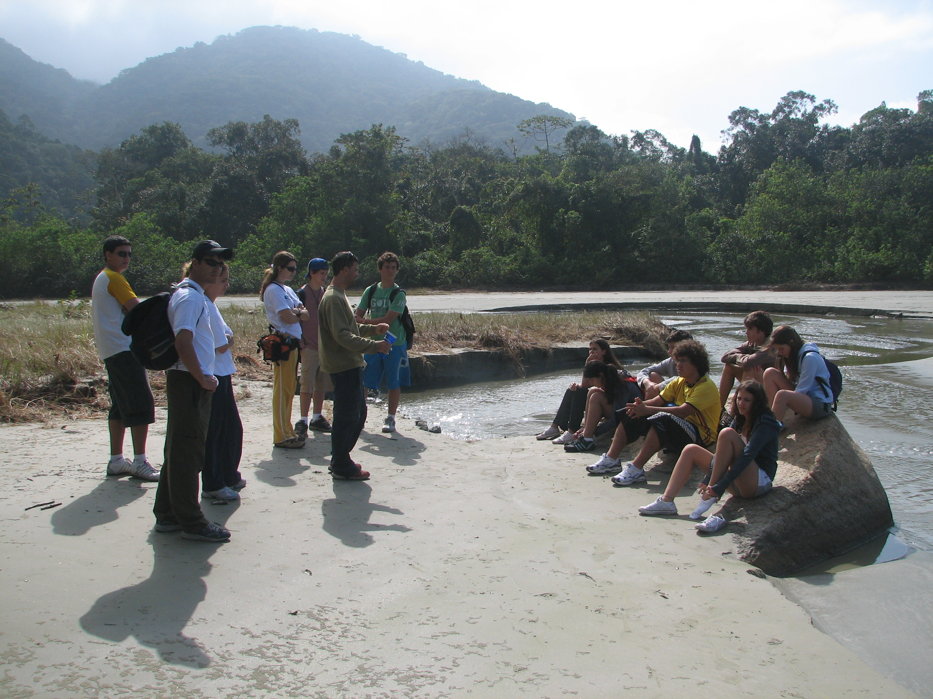
Schools by the Sea: An Example of Participatory Learning
Participatory Learning can be defined as “the body of the lesson, where learners are involved as actively in the learning process as possible. There is an intentional series of activities or learning events that will help the learner achieve the specific objective or desired outcome”. ( University of Saskatchewan )
Students carry out various activities, such exploring different biological communities.

Slide 7
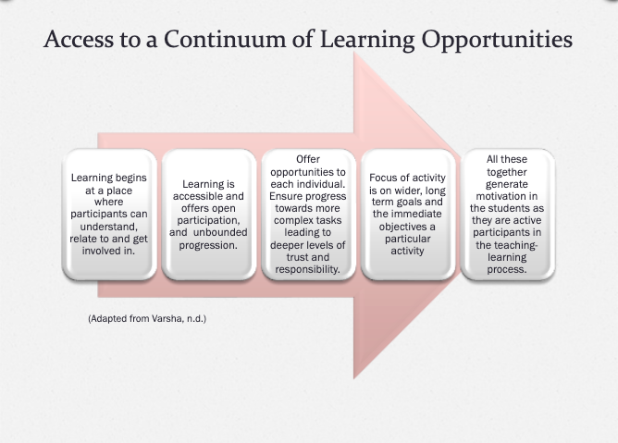
The Benefits of Participatory Learning

Slide 8
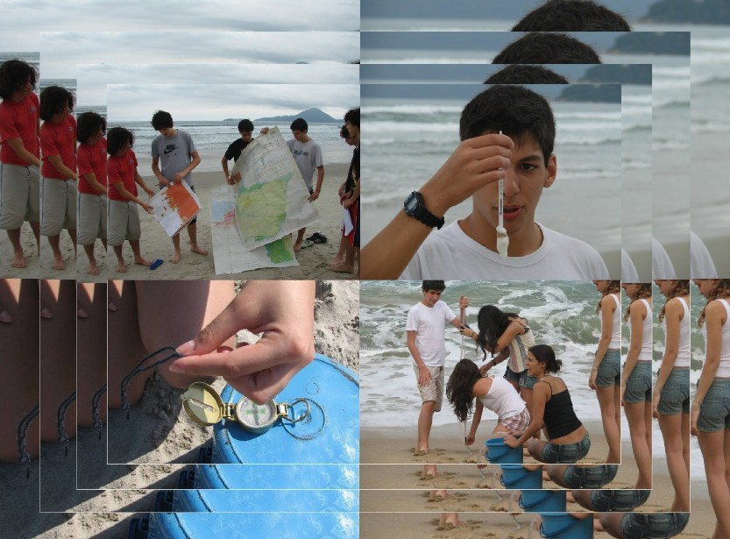
Schools by the Sea
The results of this project sought, regardless of the professional area that the young participants chose in the future, that they could adopt more sustainable practices in an analytical, critical and mainly participatory way in relation to the environment in which they live.
Contacts:
staceysdream2017@gmail.com (Alvarez de la Campa, S.)
tatramario@gmail.com (Mascagni, M. L.)
The end - thank you!

