Slide 1


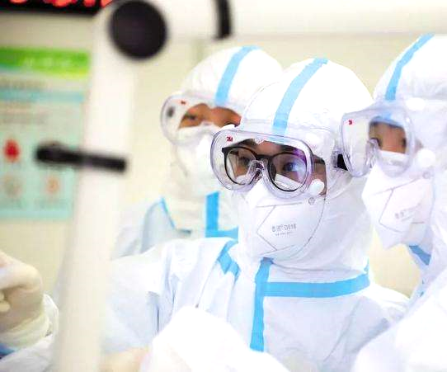
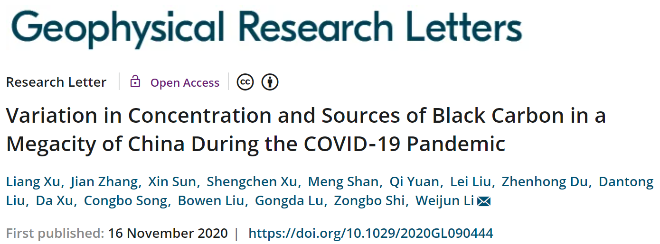
Responses of concentration and sources of black carbon in a megacity during the COVID-19 pandemic
Weijun LI Liang XU
Department of Atmospheric Sciences, School of Earth Sciences, Zhejiang University
Session: Geoscience and health during the Covid-19 pandemic
2022/05/26 EGU22-12907

Slide 2
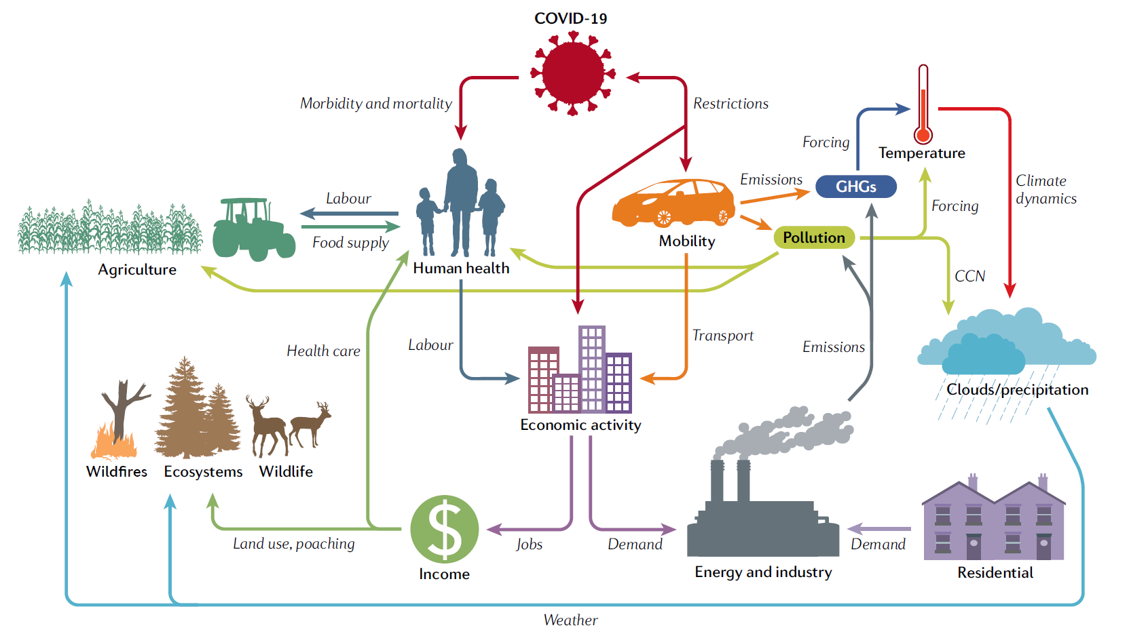
Rare opportunities for studying natural and human systems
Short-term impacts: energy, emissions, health, climate and air quality
Providing rare opportunities for studying the interactions between humans and the earth system
Diffenbaugh et al., 2020, Nature Reviews Earth & Environment

Slide 3
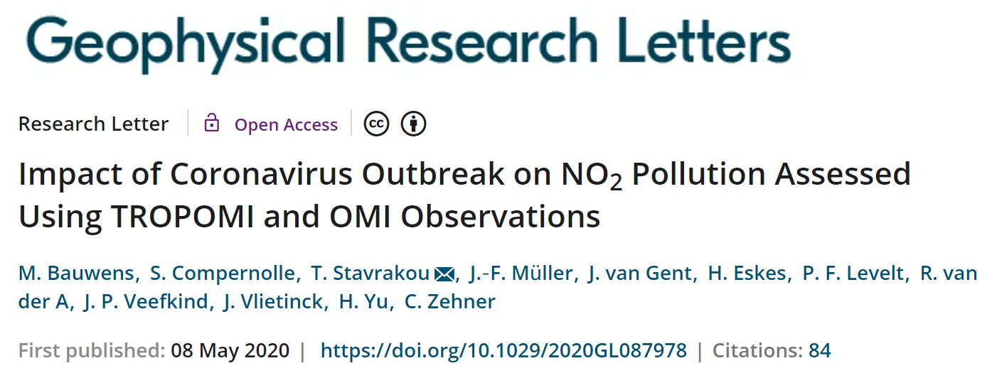
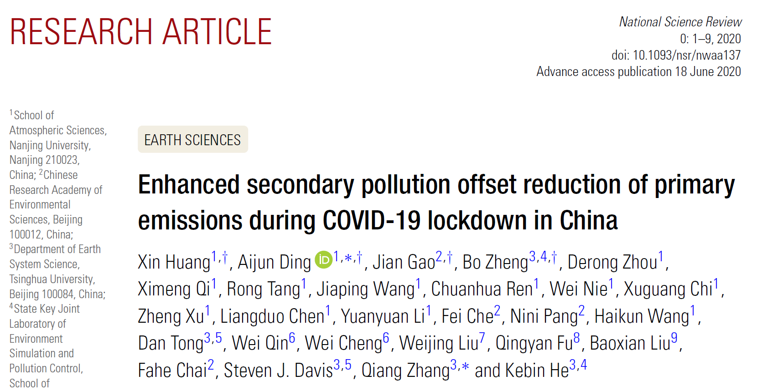
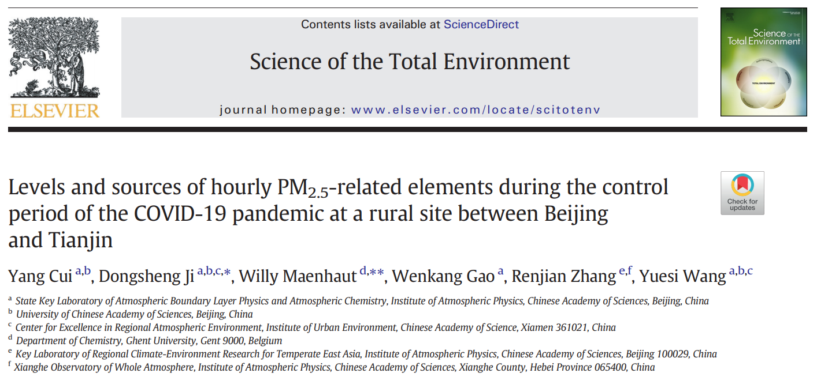
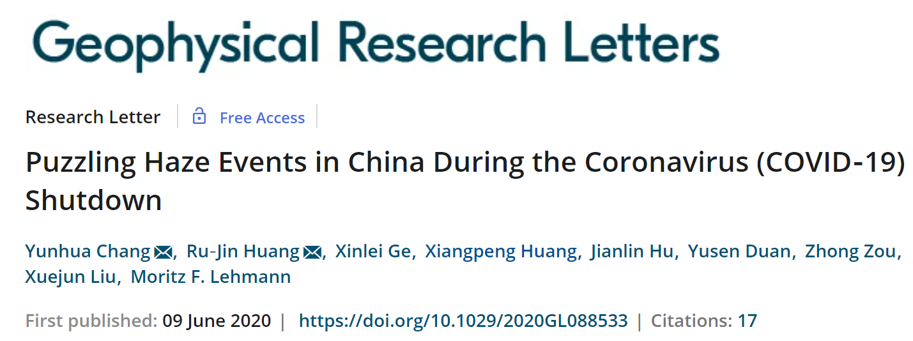
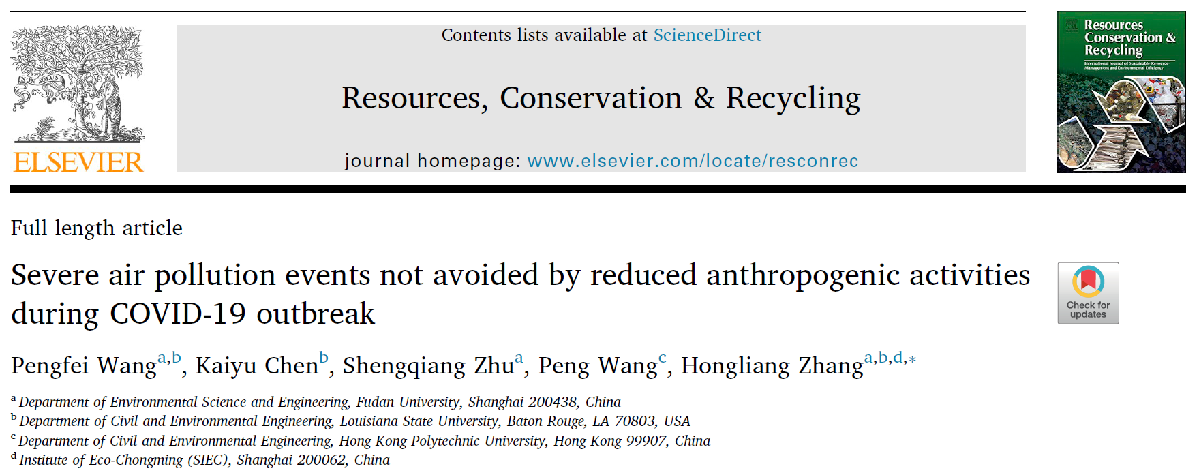
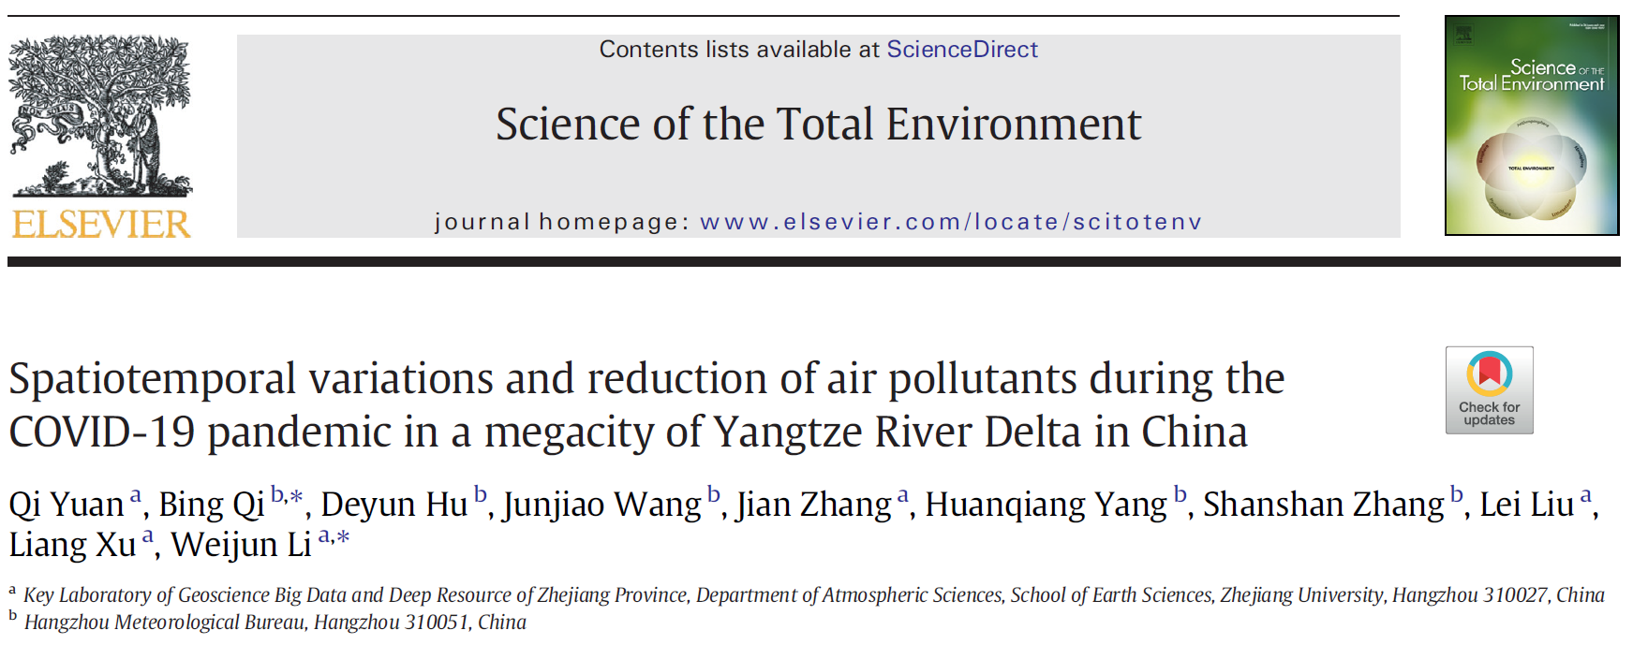
新冠肺炎相关研究剧增
A new sight to study the air pollution
During COVID-19 period,
mechanisms of air pollution events;
variation of emission sources;
changes in pollutants help to understand the impact of their sources
And health, climate …
No study focuses on the BC variations during the COVID-19 lockdown at the megacity level

Slide 4
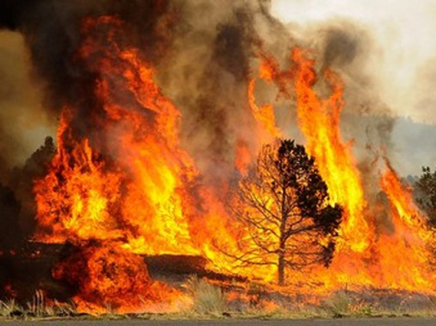
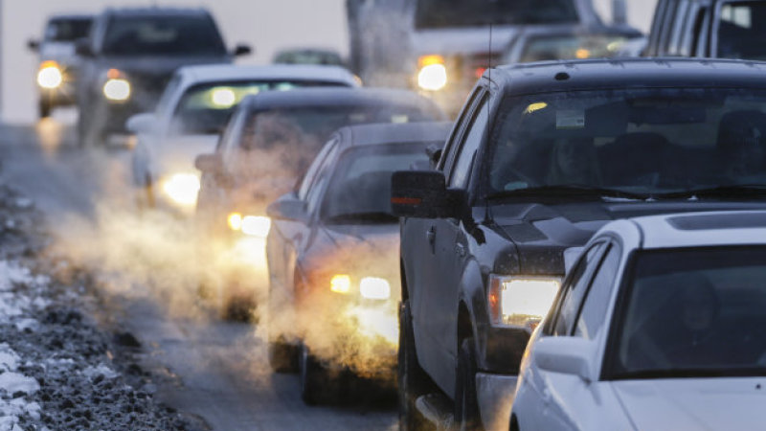





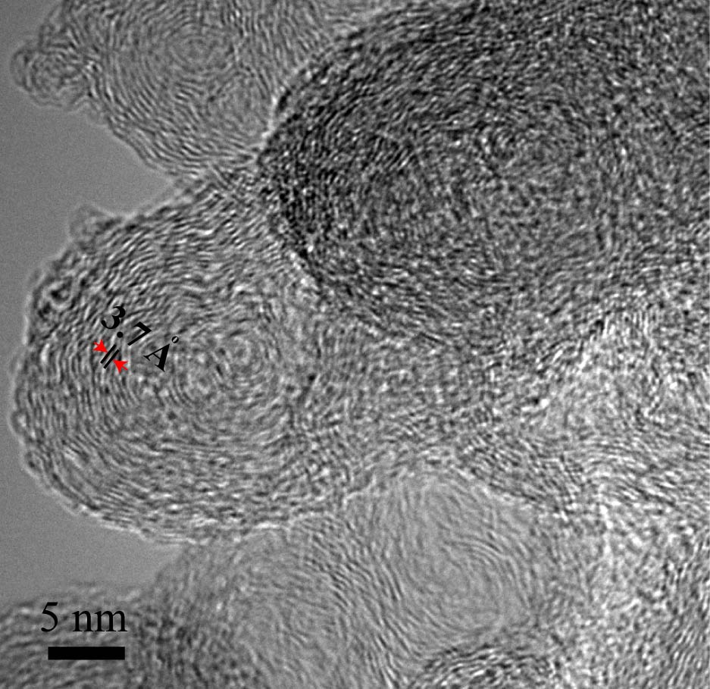
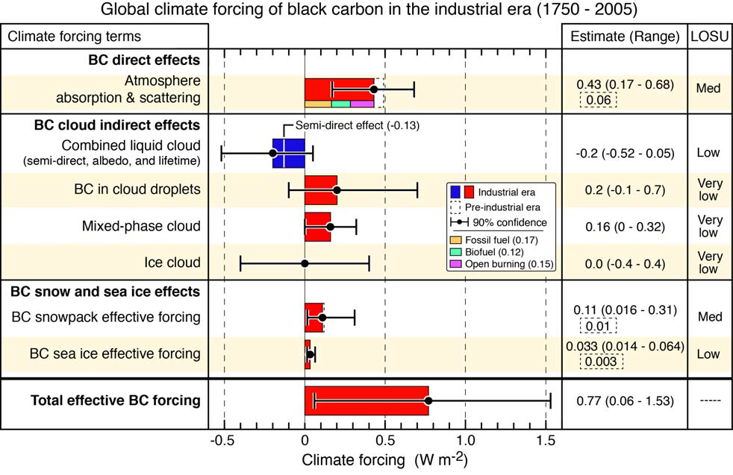
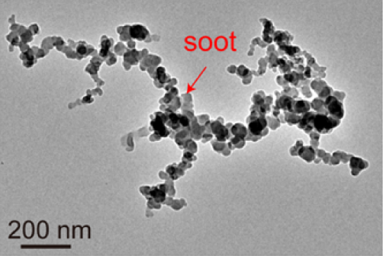
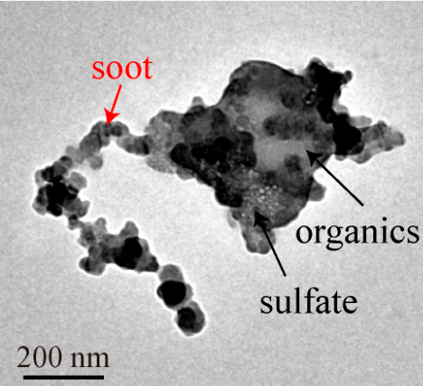
Atmospheric BC（black carbon, soot, elemental carbon）
an indicator of primary emissions
Wang..Li* et al., ESTL, 2017 ; Li et al., 2013, ACP
Bond et al., 2013, JGR
  Soot aggregation
Radiative forcing 0.77W m⁻²

Slide 5
Uncertainty in assessing source and distribution of BC in the megacities
Conventional observations and simulations are hard to accurately assess the sources and distribution of BC emissions in the megacities
Bottom-up technology-based emission inventories (EIs) for BC carry an uncertainty from variations in BC emission factors and in emission activities.
Fang et al., 2018, JGR-A
There is no specific tracer for BC from different sources, it is hard to asses BC emissions from different sources.
Isotope method could quantify the BC contribution from coal, liquid fossil fuels, and biomass, but are with the low time resolution, expensive, and time-consuming.
Fang et al., 2018, JGR-A; Zotter et al., 2017,ACP
Quantifying BC emissions from large numbers of motor vehicles in megacities is still a challenge.
AIMS
Taking a megacity as model, assessing the contribution of different sources to BC emissions based on the BC changes

Slide 6
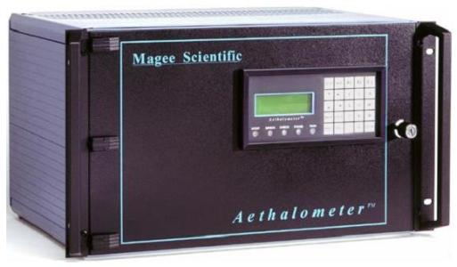
Study area: Hangzhou
Aethalometer AE-31
BC source apportionment
online monitoring +
traffic data +
machine learning +
Aethalometer Model
Study area: a typical new and template city with rapid urbanization in YRD – Hangzhou
Nine BC observation sites, including urban, urban-industrial, suburban, and rural areas

Slide 7
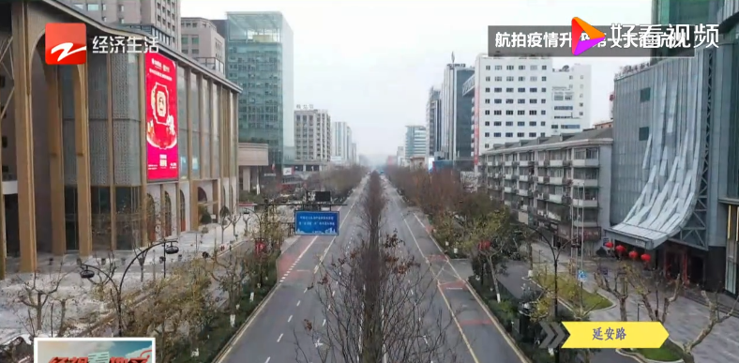
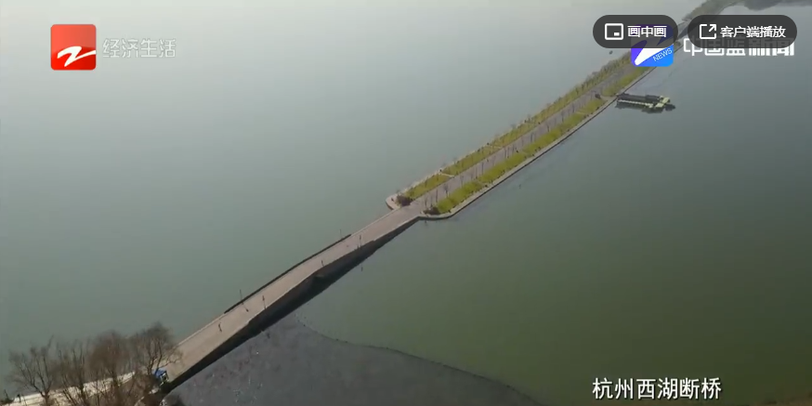
Extremely low traffic flow during lockdown
Yan’an road
Westlake
The first day after the strictest Lockdown (5 February), traffic disappeared from the streets and scenic spots in Hangzhou
Pre-COVID:
1-23 January;
Spring festival:
24 January – 4 February;
Lockdown:
5-19 February;
Recovery-I:
20 February – 2 March;
Recovery-II:
3-31 March

Slide 8
Diurnal variations in BC mass concentration
Comparing the BC peaks during the pre-COVID and lockdown, the traffic reduction contributed to 1.33 μg/m³ BC peak decline in the urban area, 1.84 μg/m³ in the urban industrial area, accounting for 55% and 57% of the total BC

Slide 9
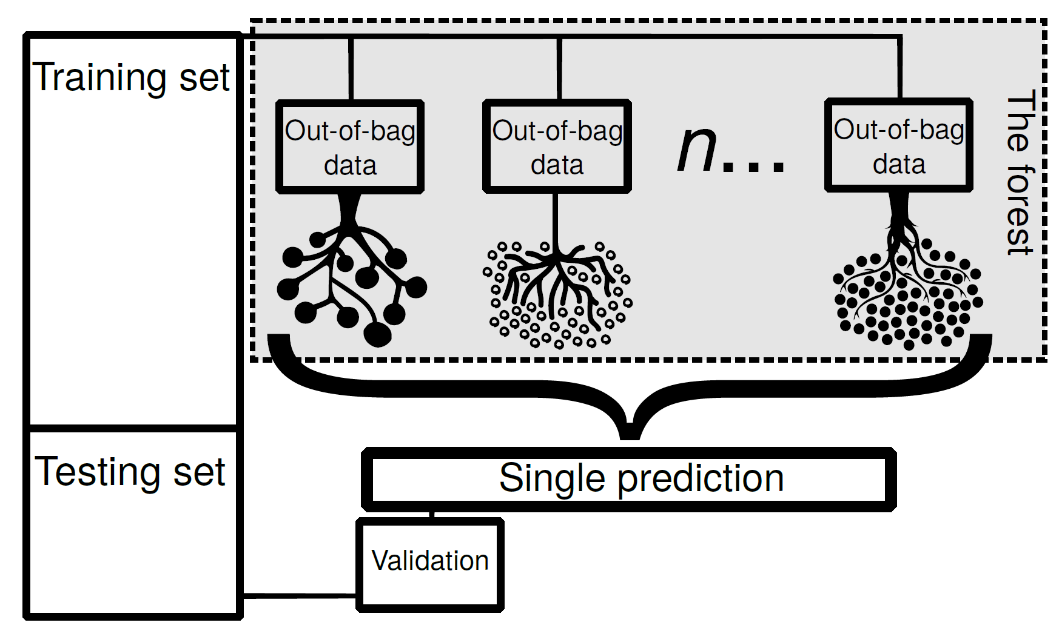
Decouple the effects of meteorological conditions on BC using machine learning
Changes of weather conditions could cause variations in the concentration of air pollutants even with the constant emissions. It is important to decouple the effects of weather from emission-related changes.
70%
30%
machine‐learning based
random forest (RF) algorithm
70% of the original data were randomly selected to train the model to build different decision trees, which was then evaluated with the rest (30%) of the data set.
Grange et al., 2018, ACP; Grange & Carslaw, 2019, STOTEN; Vu et al., 2019, ACP

Slide 10
Average BC concentration in different areas
BC emissions from heavy-duty diesel vehicles can be 50 times higher than light-duty gasoline vehicles
Dallmann et al., 2012, 2013, ES&T
84%
Different reduction proportion of gasoline and diesel vehicles may affect BC emission in the city
82%
83%
44%
COVID-19 lockdown period:
The traffic flow decrease ratio was 84% in the urban area;
BC reduced by 44% (2.30 to 1.29 μg/m³);
Gasoline and diesel vehicles experience similar reduction proportion.

Slide 11
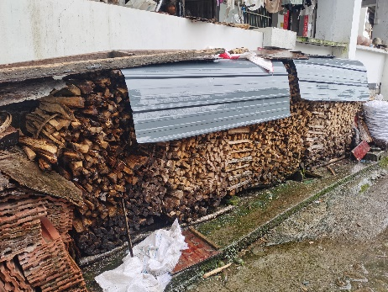
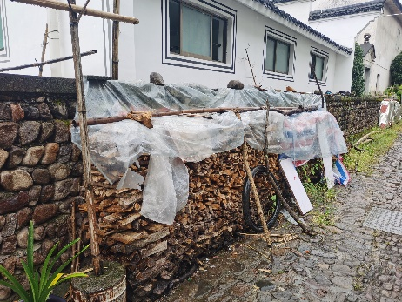
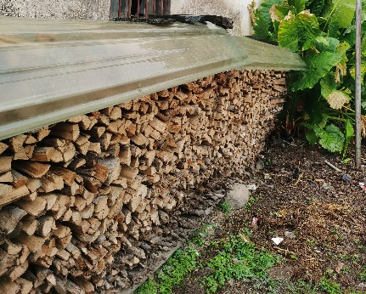
Average BC concentration in different areas
Site | Pre-COVID | COVID-lockdown
 | Concentration (μg/m³) | Concentration (μg/m³) | Variation (μg/m³) | Percentage (%)
Urban | 1.99 | 1.06 | -0.93 | -47%
Urban industry | 2.59 | 1.32 | -1.27 | -49%
Suburban | 1.92 | 1.13 | -0.79 | -41%
Rural | 2.67 | 1.65 | -1.02 | -38%
Urban area：Traffic emissions
Urban industrial area: Industrial activities and traffic emissions
Rural area：biomass burning contribution

Slide 12
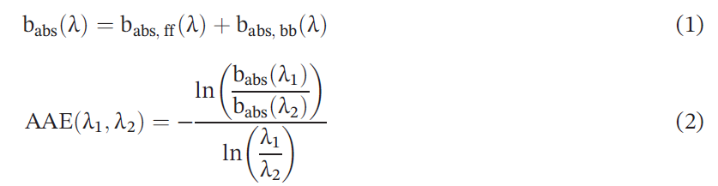
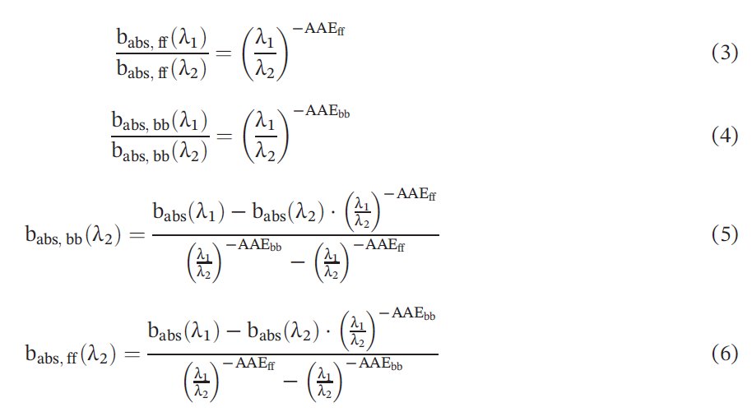
Contribution From Different Sources for BC Mitigation
The Aethalometer model
Assuming that biomass burning and fossil fuel emissions only contribute to BC absorption, the AAEs can be used to estimate the contribution from these two sources based on the Aethalometer model
Wavelengths：470 nm & 950 nm
AAEs：AAE_{ff} = 1.0, AAE_{bb} = 2.0
The f_{bb} values range from 5–9% in the urban, urban industry, and suburban areas during the pre-COVID period but increase up to ~20% during the spring festival and lockdown.
f_{bb} returns to lower values at ~10% in the COVID-recovery-I and -II periods.
Sandradewi, Prévôt, Szidat, et al., 2008, ES&T; Zheng et al., 2019, ACP

Slide 13
Contribution of fossil fuel and biomass burning to BC mitigation
The variation and source apportionment of BC in megacities based on online monitoring, traffic data, machine learning, and Aethalometer Model
13% industry
36% Traffic
47% Traffic
17% Traffic
100%
63% industry
20% BB
The BC_{ff} in the urban area decreased from 1.86 μg/m³ in the pre‐COVID period to 0.90 μg/m³ during the COVID‐19 lockdown.
Lower BC_{bb} concentrations and small fluctuations (0.13–0.21 μg/m³) occurred in the urban, urban industry, and suburban areas.

Slide 14
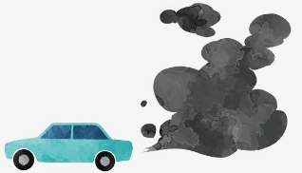
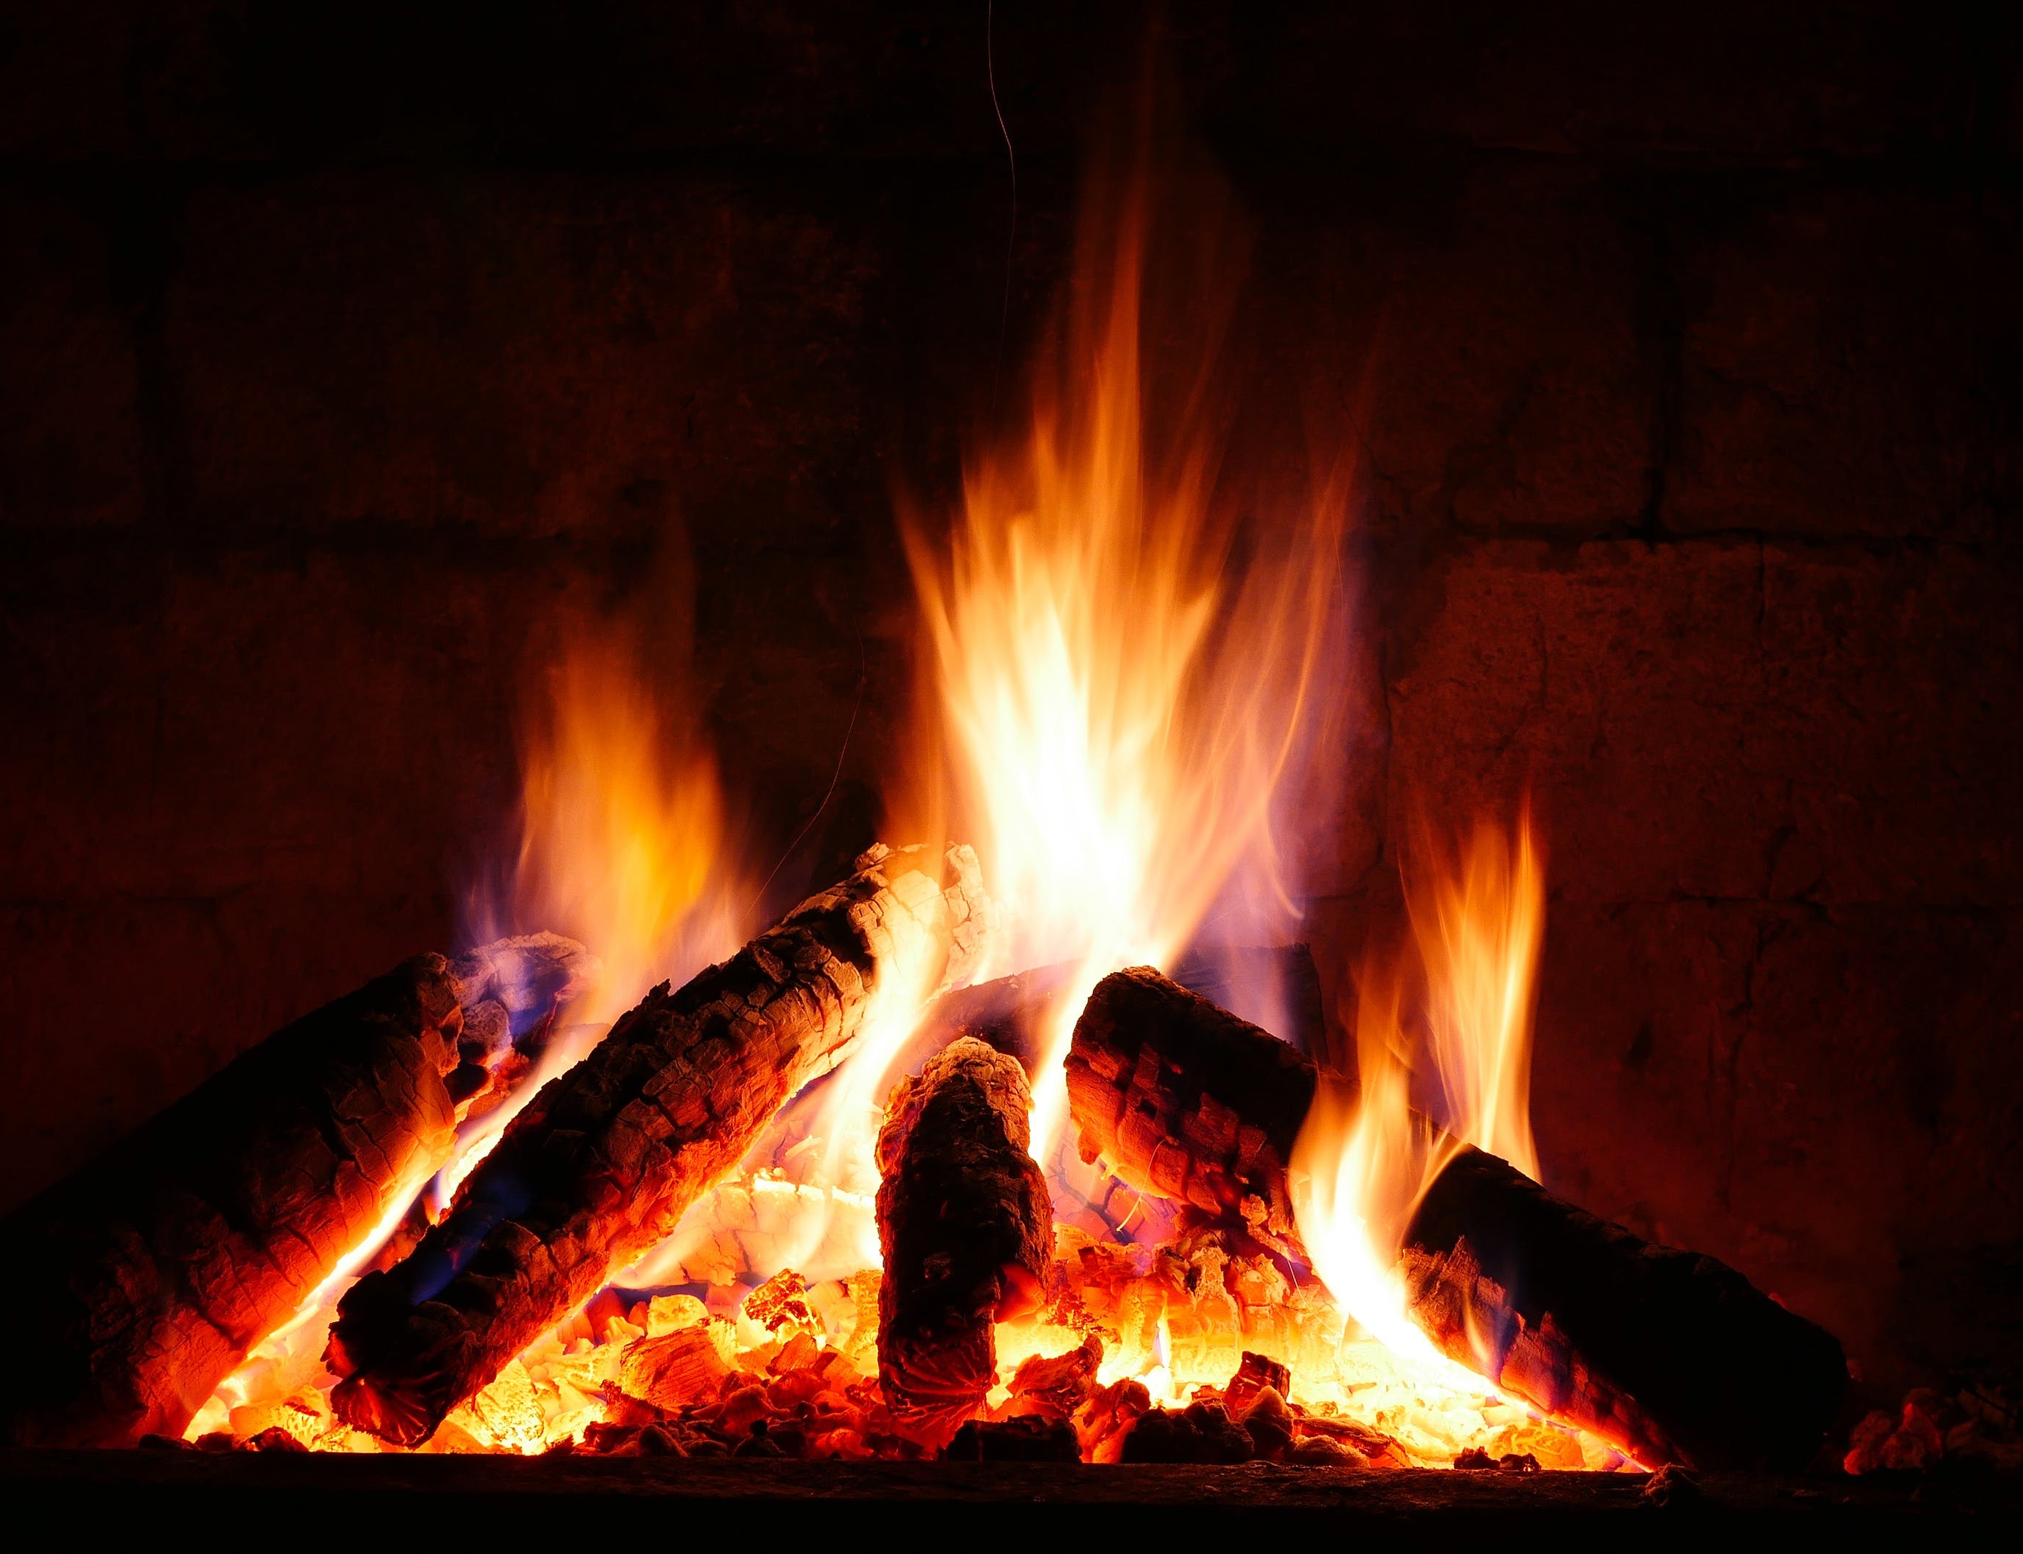
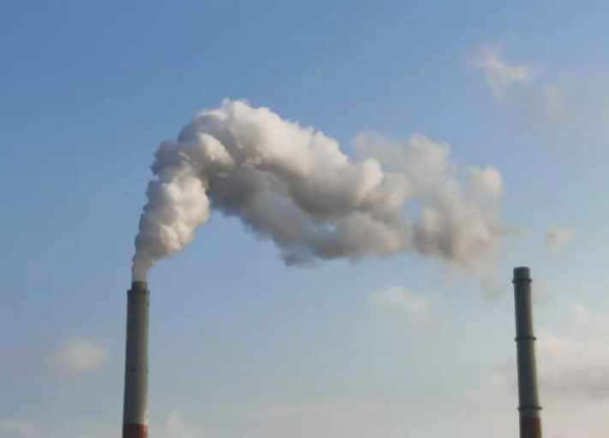
Atmospheric Implications
The BC reduction and source assessment during the COVID‐19 lockdown in the megacity provides us with a clear picture of how to reduce BC in the megacities of China in the future.
A variety of methods were applied to study the variation of BC concentration during the epidemic, providing a new paradigm for quantifying BC sources in megacities.

Slide 15

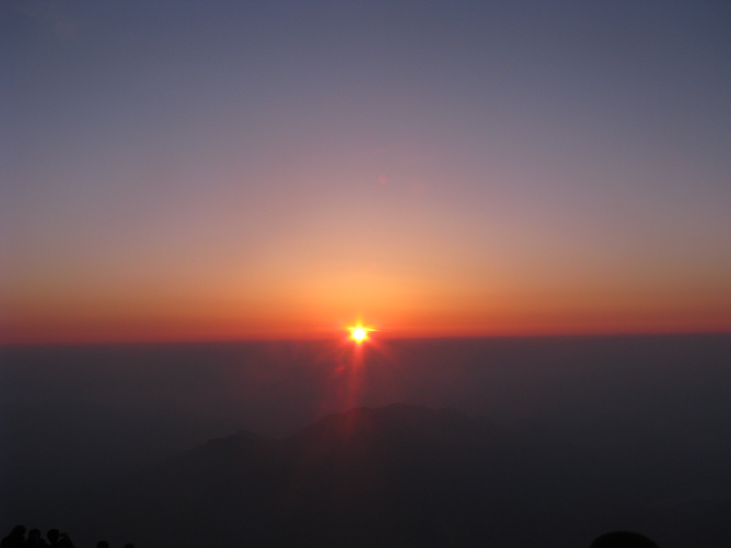

Thank you for your attention！
Link to the paper
Photo taken by WJL

