Slide 1
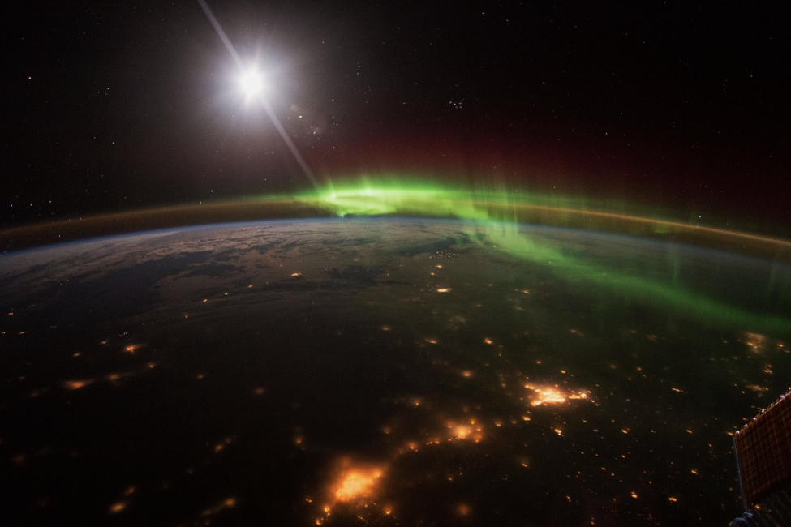


Main ionospheric trough and field-aligned currents responses to the geomagnetic storms in October 2015 and September 2017
Agata Chuchra-Konrad, Dorota Przepiórka, Barbara Matyjasiak, and Hanna Rothkaehl

Slide 2
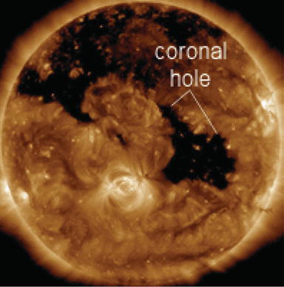
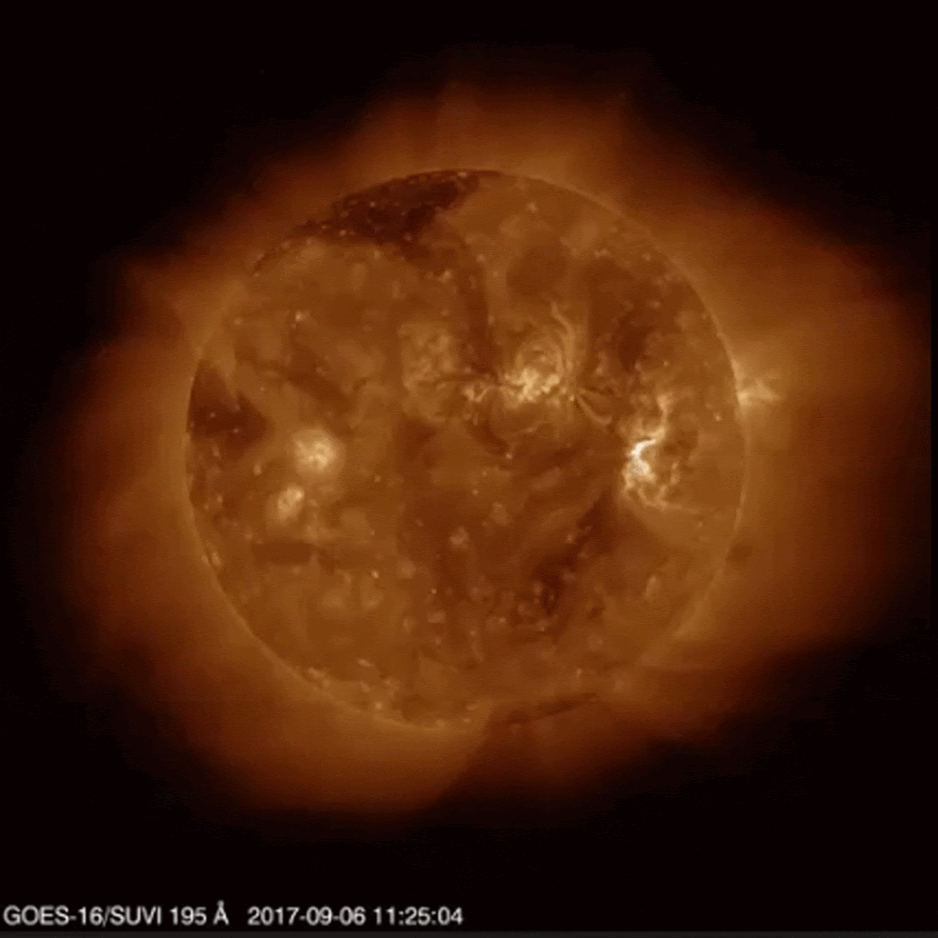
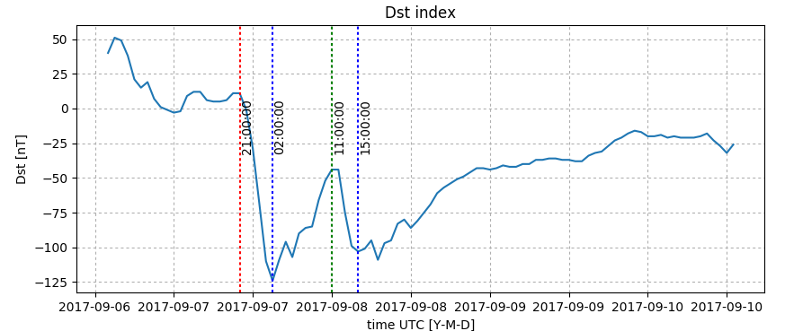
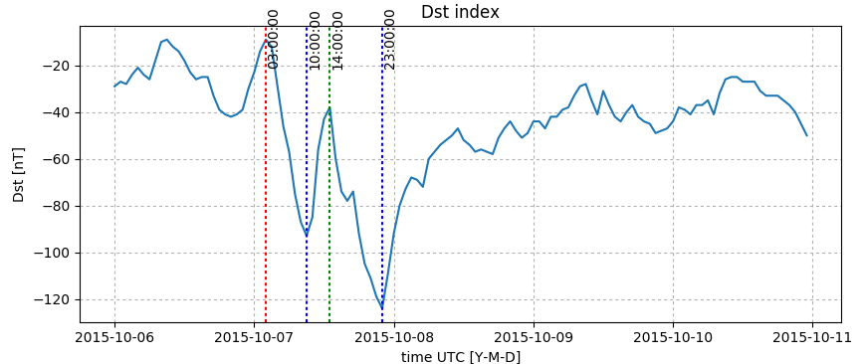
Geomagnetic conditions
September 2017
Cause of the geomagnetic storm: CME associated with eruptive flare X9.3 released at 11:53 UT 6th Sept. (the strongest flare of Solar Cycle 24).
The main phase started ~ 22 UT on 7th Sept. The second peak around 10 UT 8th Sept.
Two Dst-index minima on 8 Sep.: first -122 nT at 02 UT, and second −109 nT at 18 UT (WDC for Geomagnetism, Kyoto).
October 2015
Cause of the geomagnetic storm: CIR associated with HSS, ejected on 6 Oct. from the positive polarity coronal hole; enhancement of the storm due to crossing of the HCS by Earth.
The main phase started ~ 12:45 UT on 7th Oct.
Two Dst-index minima on 7 Oct.: first -101 nT at 10 UT, and second −130 nT at 22 UT (WDC for Geomagnetism, Kyoto).

Slide 3
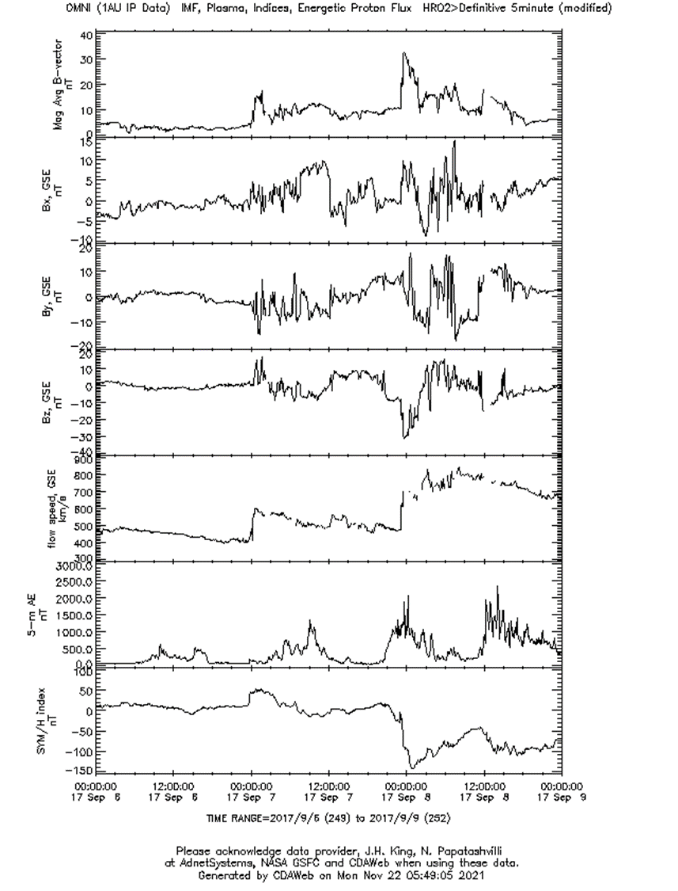
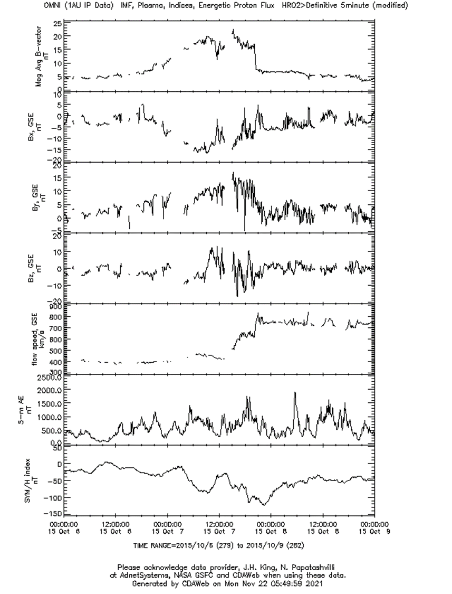

Slide 4
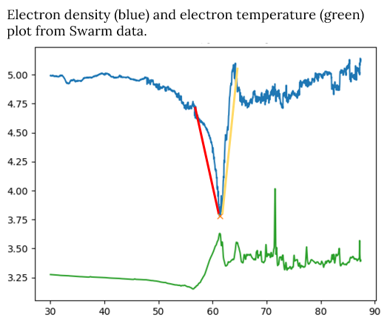
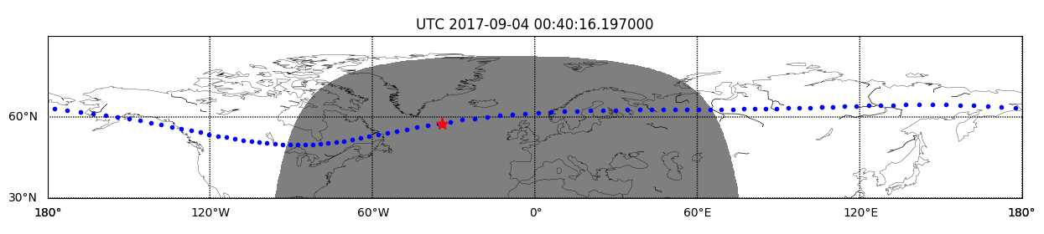
Main ionospheric trough (MIT)
storm-phase dependent structure, very sensitive to geomagnetic conditions
narrow in latitudes but extended in longitudes
sudden electron density drop at 60º-67º dip latitudes, both hemispheres
mostly night-time phenomenon
PW usually steeper than EW
formation mechanism: stagnation model
its variability strongly affects the propagation of different natural and artificial signals
We can distinguish 3 characteristic regions of MIT:
equatorial wall (EW)
polar wall (PW)
trough minimum
The animation shows how the trough minimum is located around geomagnetic latitude of 62° on 4 September 2017.

Slide 5
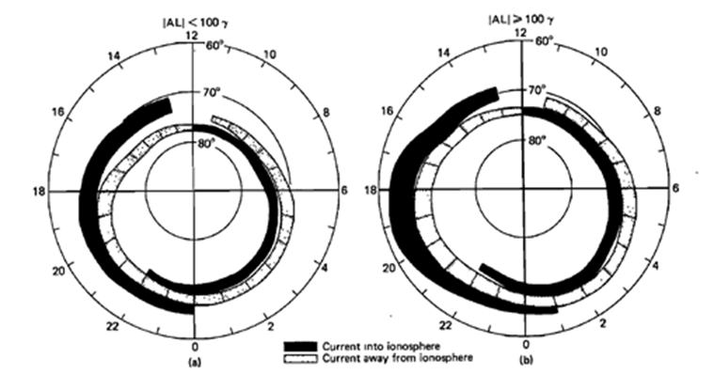
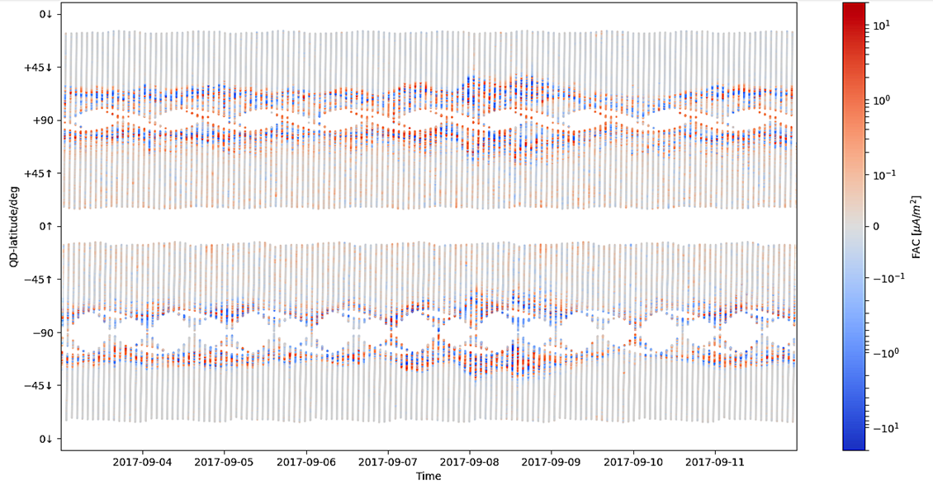
Field-aligned currents (FACs)
Flow along magnetic field lines and transfer energy and momentum of the solar wind between M-I-T.
Consist of two current sheets (Iijima & Potemra, 1976; 1978): Region 1 at higher latitudes, where currents flow into the ionosphere on the dawn side and out of the ionosphere on the dusk side and Region 2 at lower latitudes, in which currents flow opposite of that in the Region 1 (Forsyth et al., 2018).
Very sensitive to geomagnetic conditions.
Downward currents (toward the ionosphere)
Upward currents (away from the ionosphere)
Distribution of field-aligned currents during (a) weakly disturbed geomagnetic conditions and (b) strong geomagnetic activity (Iijima, Potemra, 1978)
There is clear intensification of FACs after the main phase of storm.

Slide 6
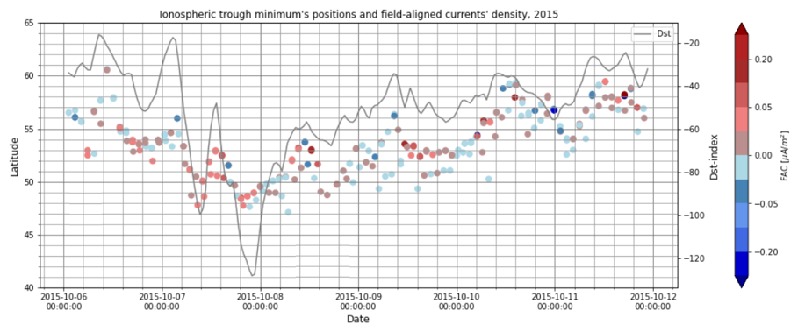
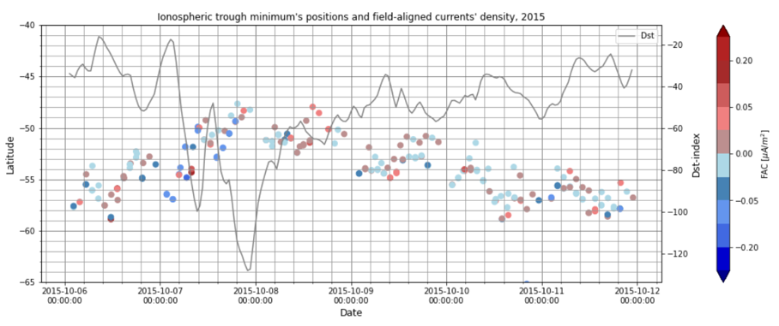
Correlation of Dst-index with main ionospheric trough minimum’ positions
Positions of MIT’s minima, FACs’ density in the minimum, Dst index during October 2015 geomagnetic storm (North (top) and South Hemisphere (bottom)).

Slide 7
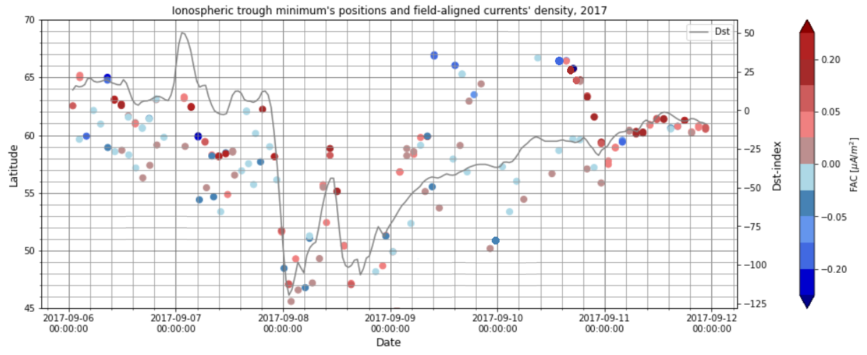
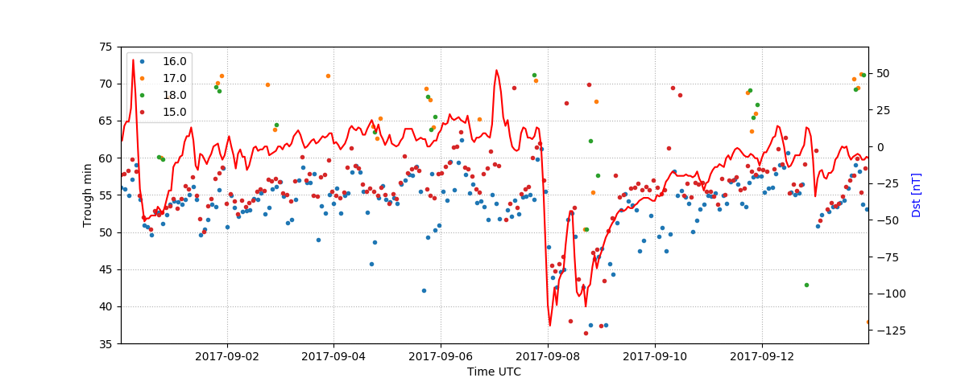
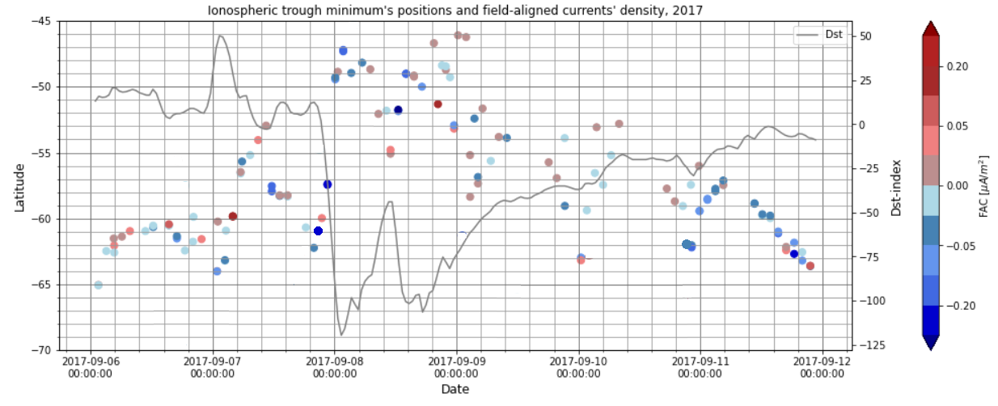
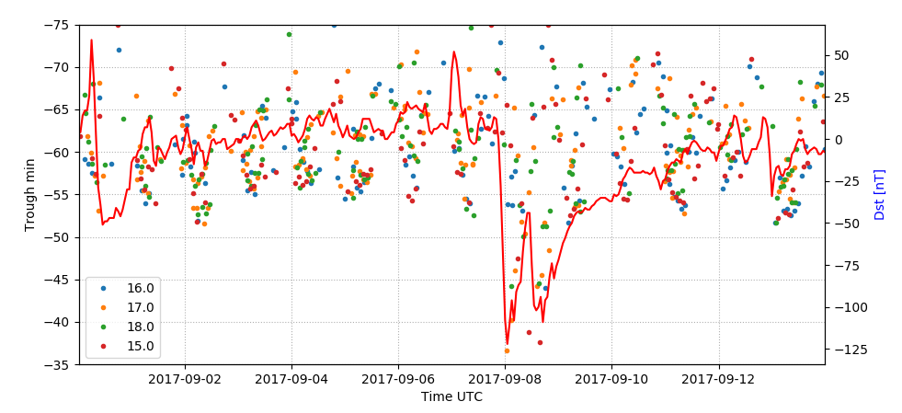
Left: Positions of MIT’s minima, FACs’ density in the minimum, Dst index during September 2017 geomagnetic storm (North (top) and South Hemisphere (bottom)).
Right: Positions of MIT’s minima and Dst index during September 2017 from DMSP data.

Slide 8
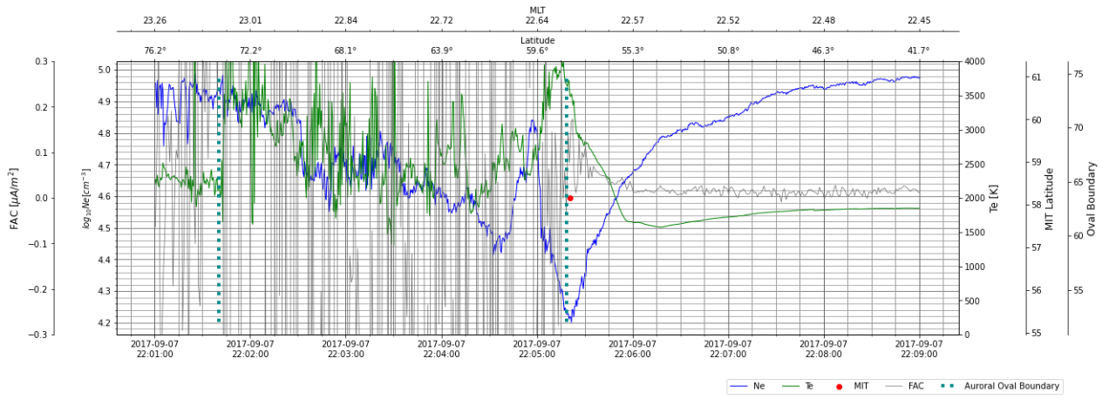
Correlation of MIT and FACs
September 2017’s geomagnetic storm
Sudden storm commencement - field-aligned currents, electron temperature, electron density (with marked MIT), and auroral oval boundary

Slide 9
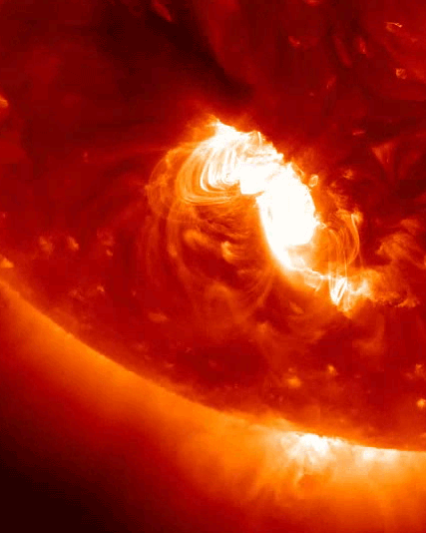
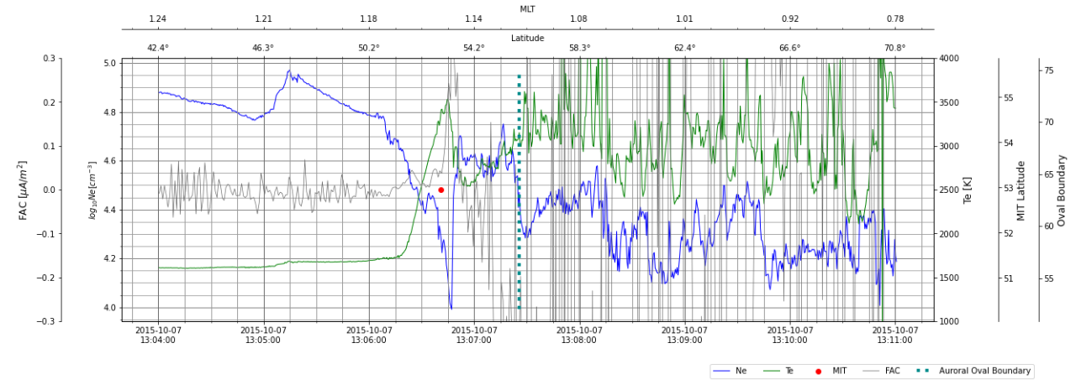
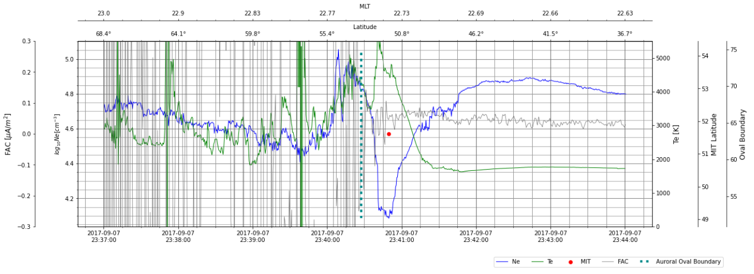
Correlation of MIT and FACs
Main phase (2015 and 2017)

Slide 10
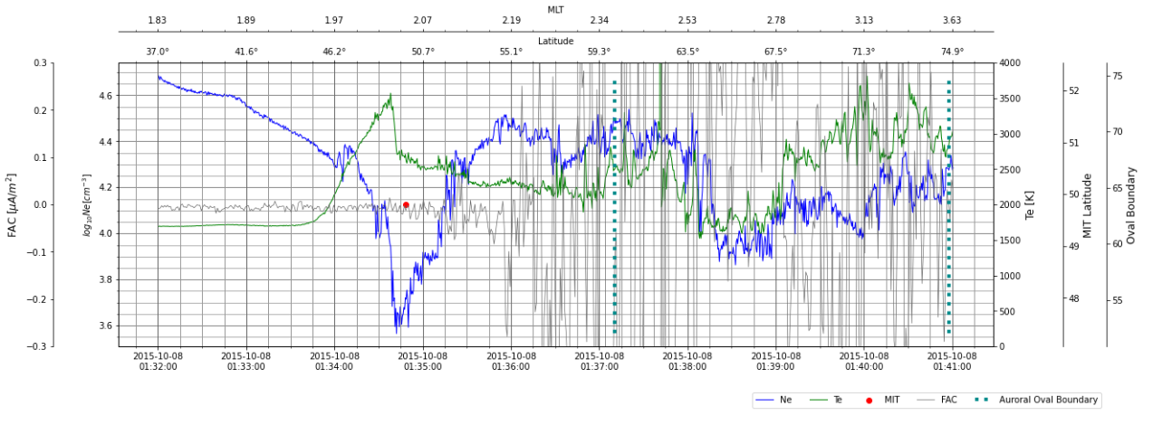
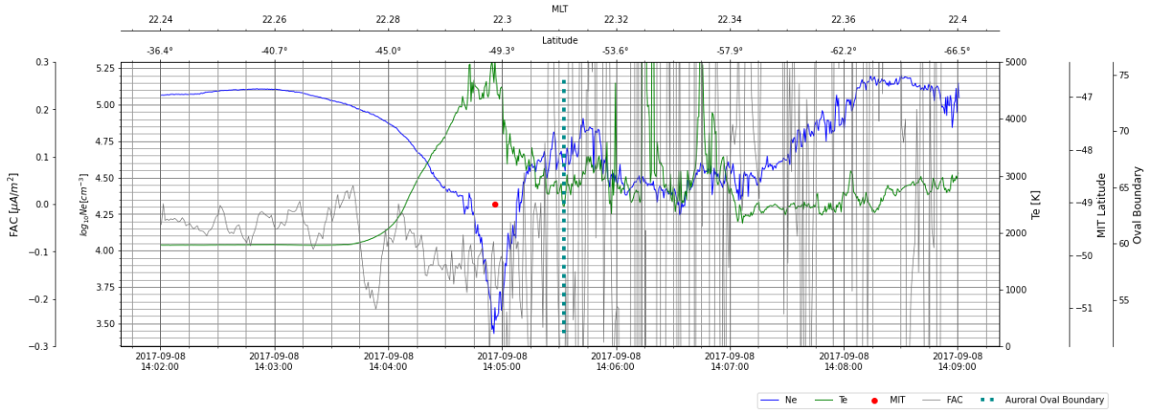
Correlation of MIT and FACs
Recovery phase (2015 and 2017)

Slide 11
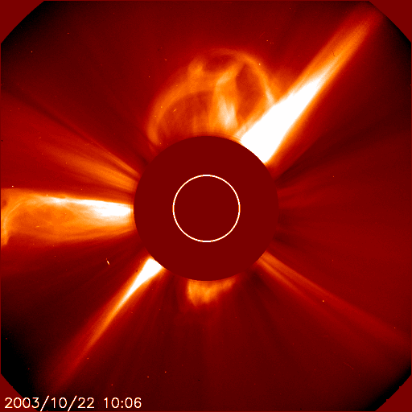
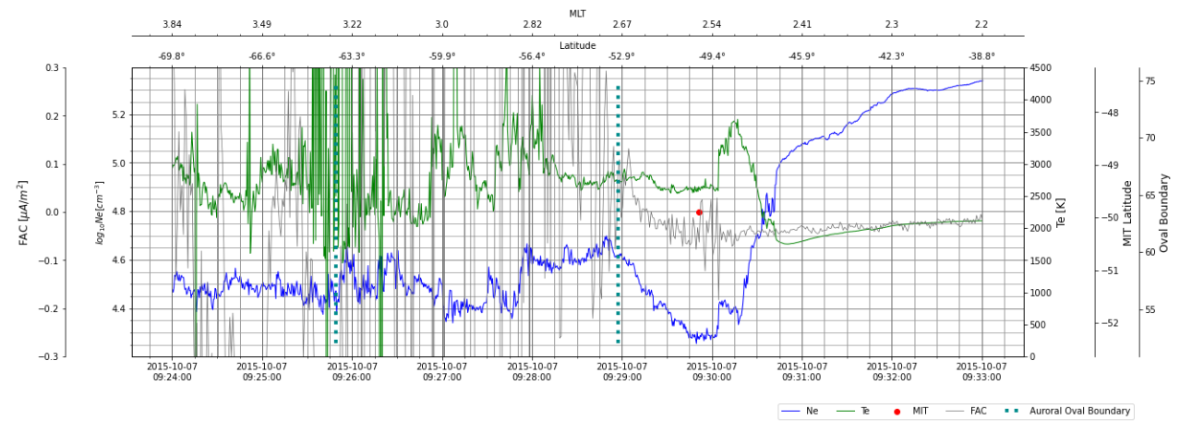
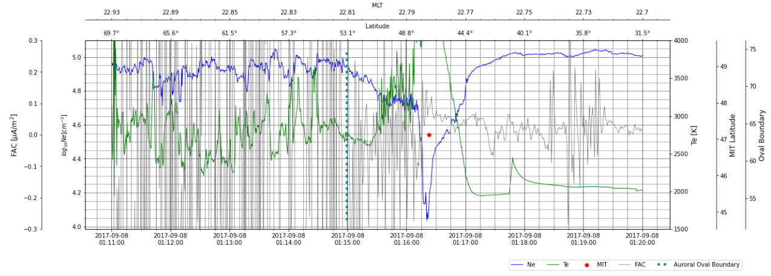
MIT and FACs in relation to Dst-index minima
Credits: ESA&NASA, SOHO/LASCO

Slide 12
Statistics for 2017’s geomagnetic storm
Statistics for 2015’s geomagnetic storm

Slide 13
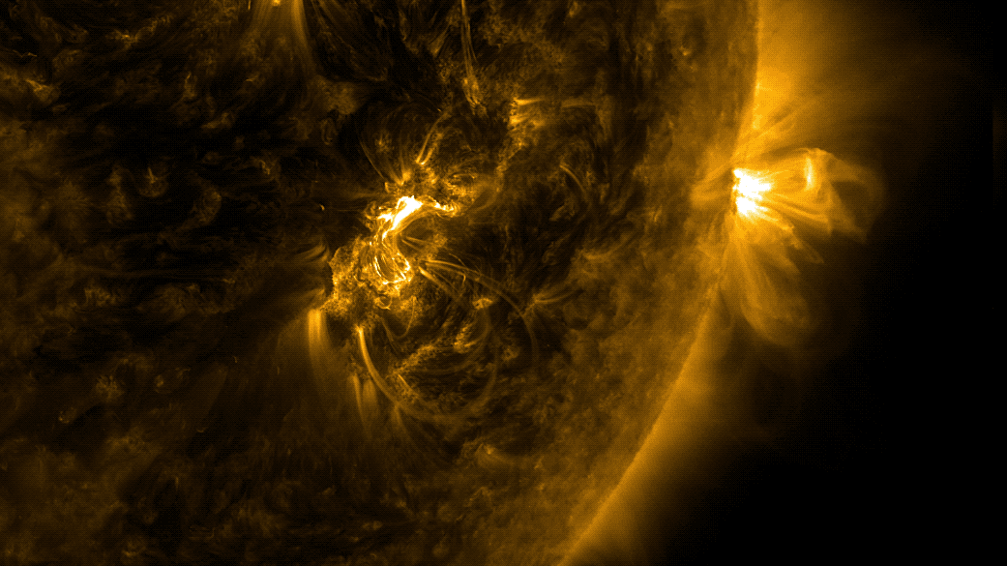
Summary
There is a correlation between Dst-index and positions of mid-latitude ionospheric trough’ minimum.
The relationship between the ionospheric trough and field-aligned currents is under investigation.
There are stronger FACs on the polar wall than on the equatorial wall of the trough.
The upward currents prevail in the SH and downward in the NH.
An intensification of field-aligned currents' intensity is also observed in response to the minima of the Dst-index.
From the satellite in situ measurements we can track movement of the whole ionosphere as a result of the strong geomagnetic storm - e.g. equatorward shift of the trough position.
Credits: SDO

Slide 14
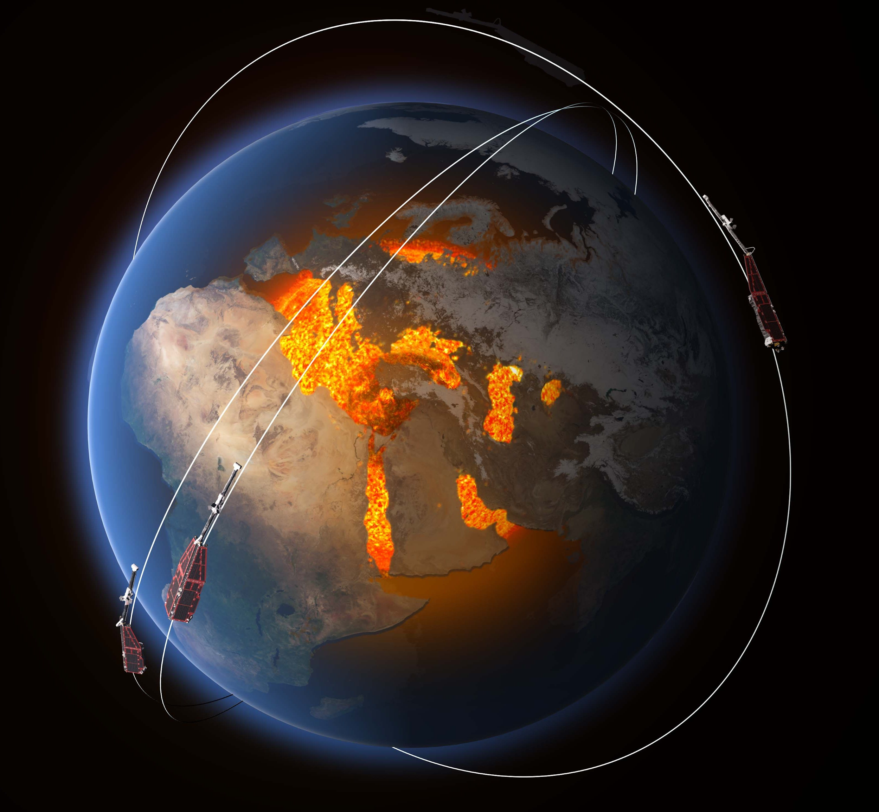
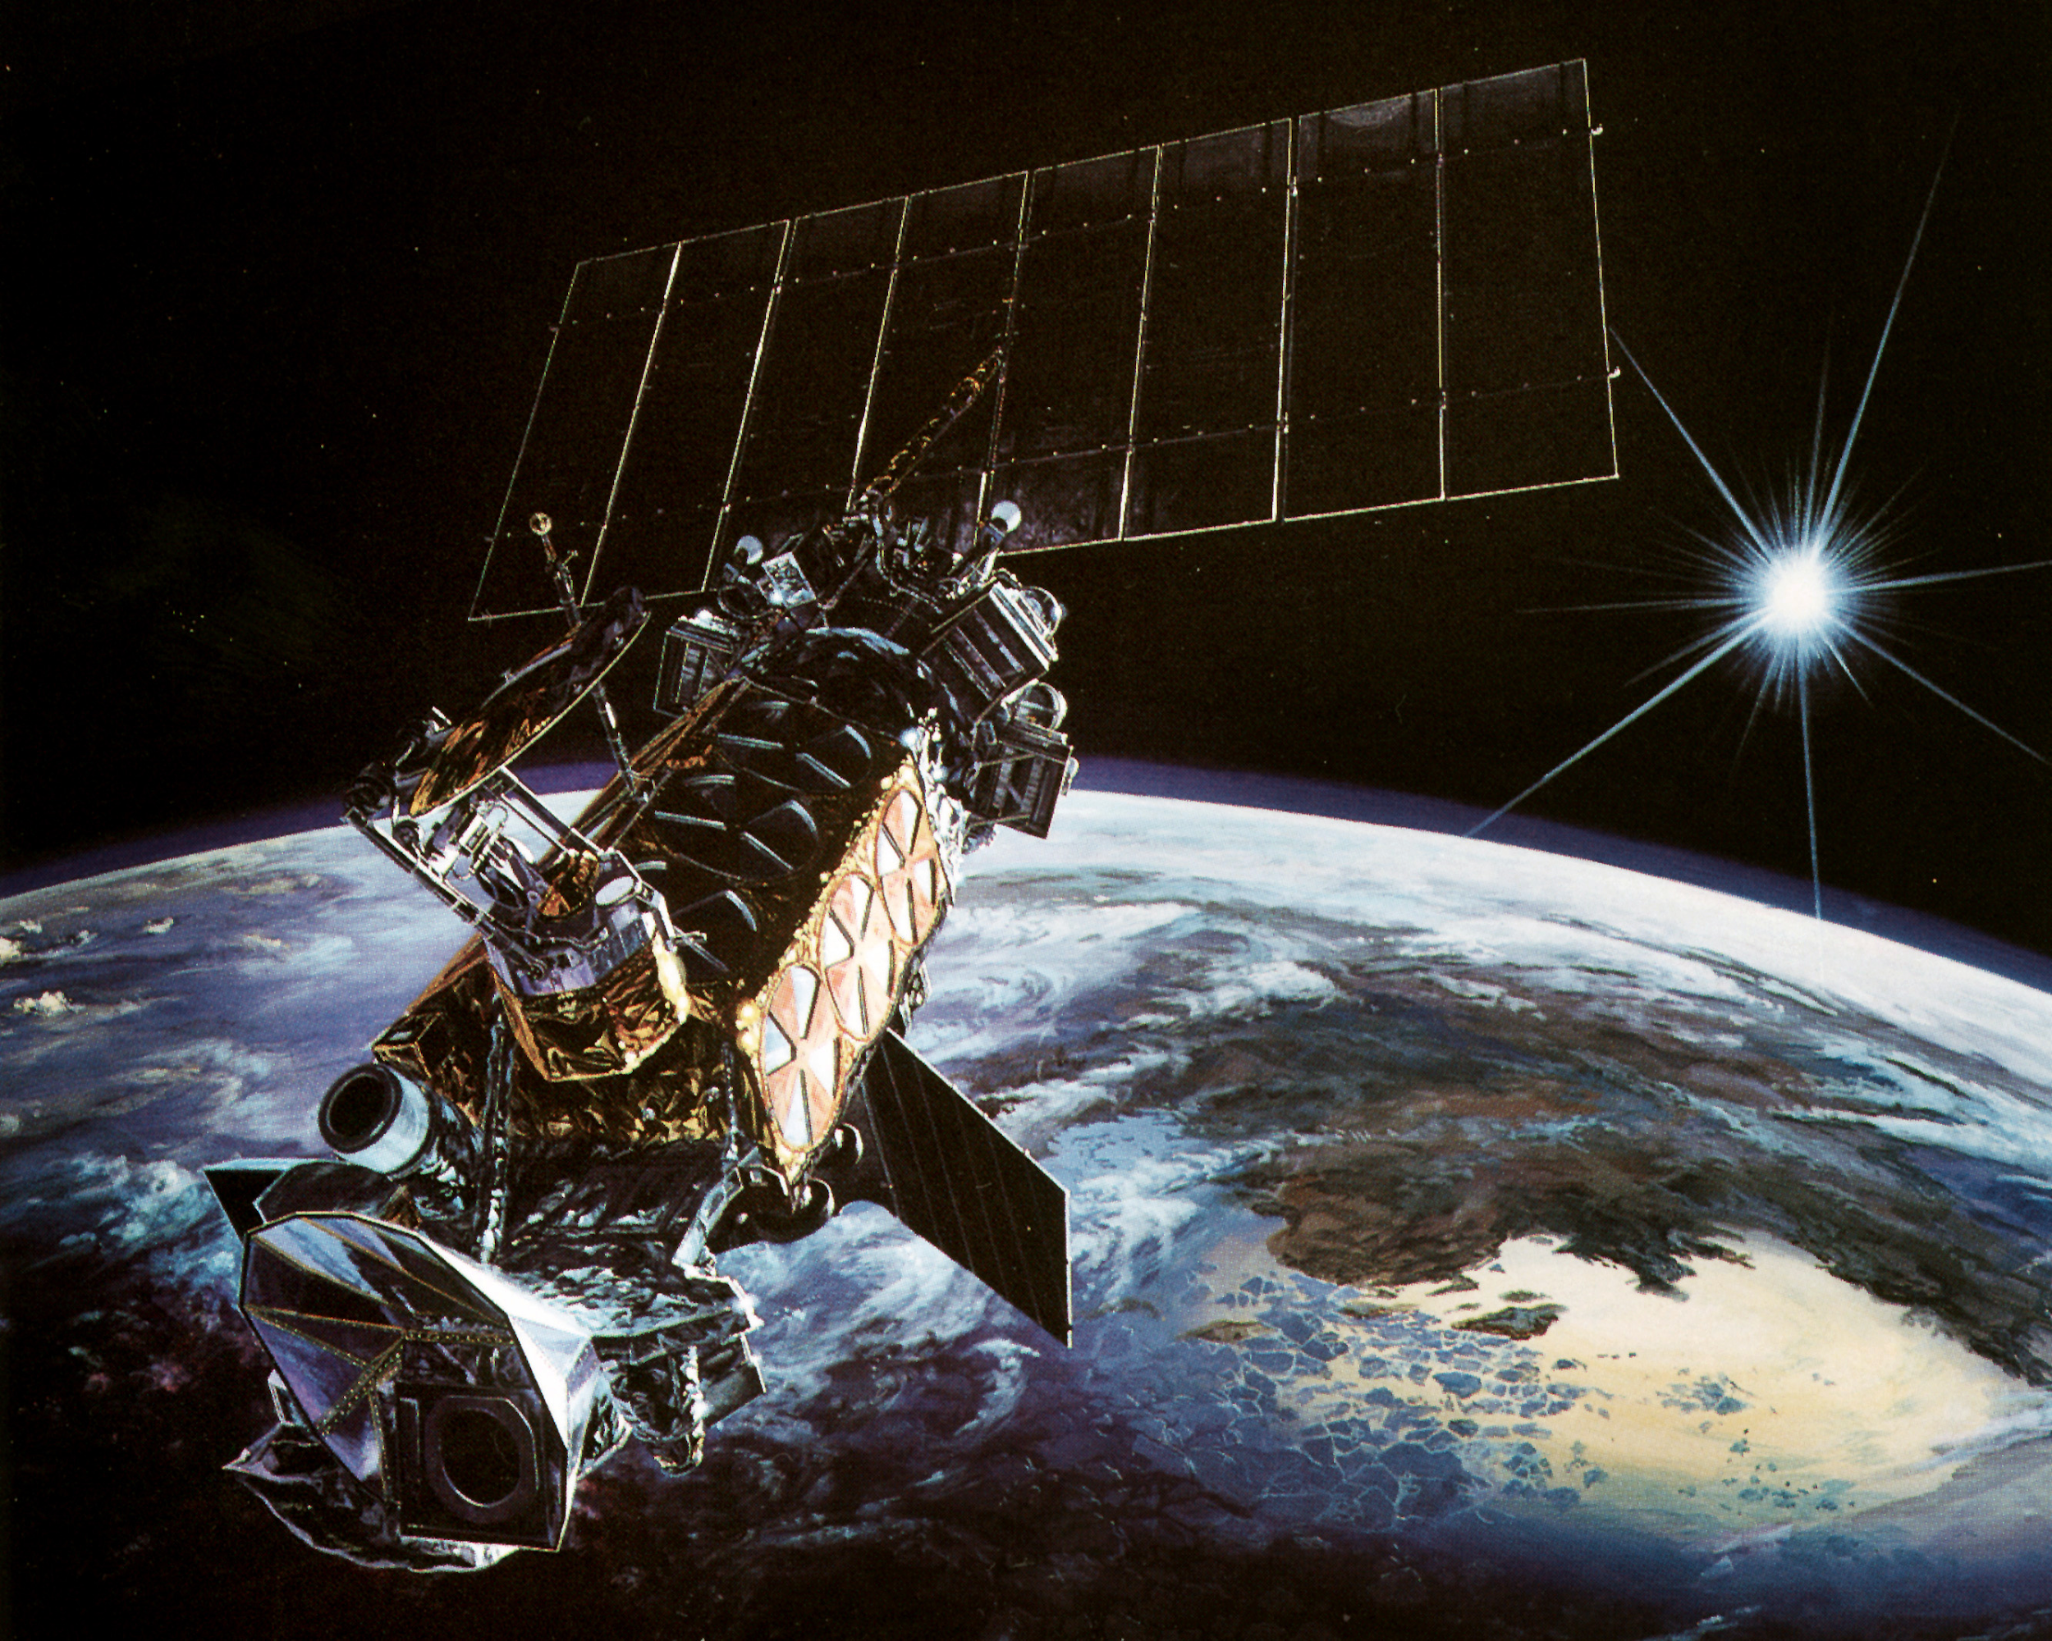
We acknowledge the Swarm Science Team for providing the Level 2 data, the Swarm visualization tool (https://vires.services/), Virtual Research Environment ("VRE") with very useful Jupyter notebooks, and PRISM product.
The Dst index used in this presentation was provided by the WDC for Geomagnetism, Kyoto (http://wdc.kugi.kyoto-u.ac.jp/wdc/Sec3.html).
Data from the DMSP satellites are kindly provided by Patricia Doherty and were downloaded from the CEDAR Madrigal Database (http://cedar.openmadrigal.org/).

