Slide 1
AGU LANDInG: Reviewing the First Year of AGU’s NSF-Funded Initiative to Promote and Support Equity, Diversity, and Inclusion in the Geosciences
Margaret Fraiser, Billy Williams, Pranoti Asher, Brooks Hanson, AGU
Stephanie Goodwin, Incluxion Works, Inc.

Slide 2
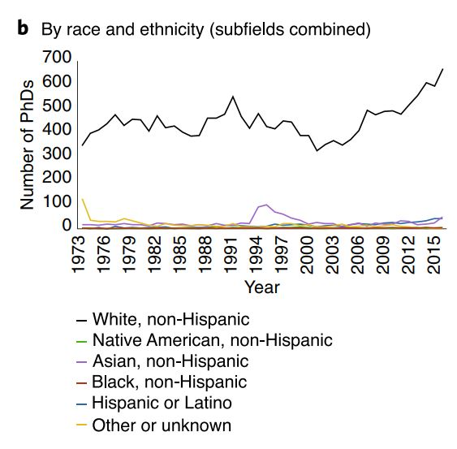
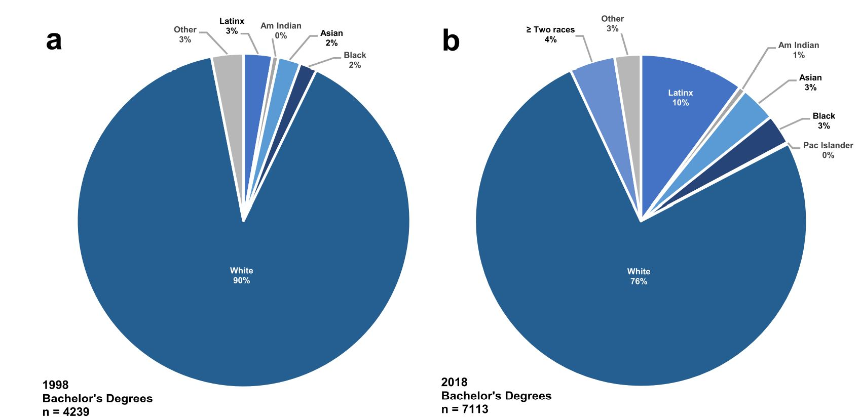
Geoscience’s ‘Whiteness Problem’
Bernard and Cooperdock, 2018; Goldberg, 2019; Beane et al., 2021
Notes:
Impetus for this project is what has been called Geoscience’s whiteness problem– These data represent the US-- that people identifying as white comprise the majority of undergradate BS degree recipients and PhDs. Data from these authors. It’s true for geosciences and allied disciplines in Earth and Space Sciences.

Slide 3

Community of Practice
Academy
Cultural Change
Leadership Academy and Network for Diversity and Inclusion in the Geosciences
(LANDInG)
Notes:
A Community of Practice (CoP) to build DEI champion networks within and beyond AGU.
An Academy will provide targeted professional development for DEI champions.
To lead to a shift to a more inclusive geosciences culture where all people feel safe and welcome to bring all aspects of themselves.

Slide 4
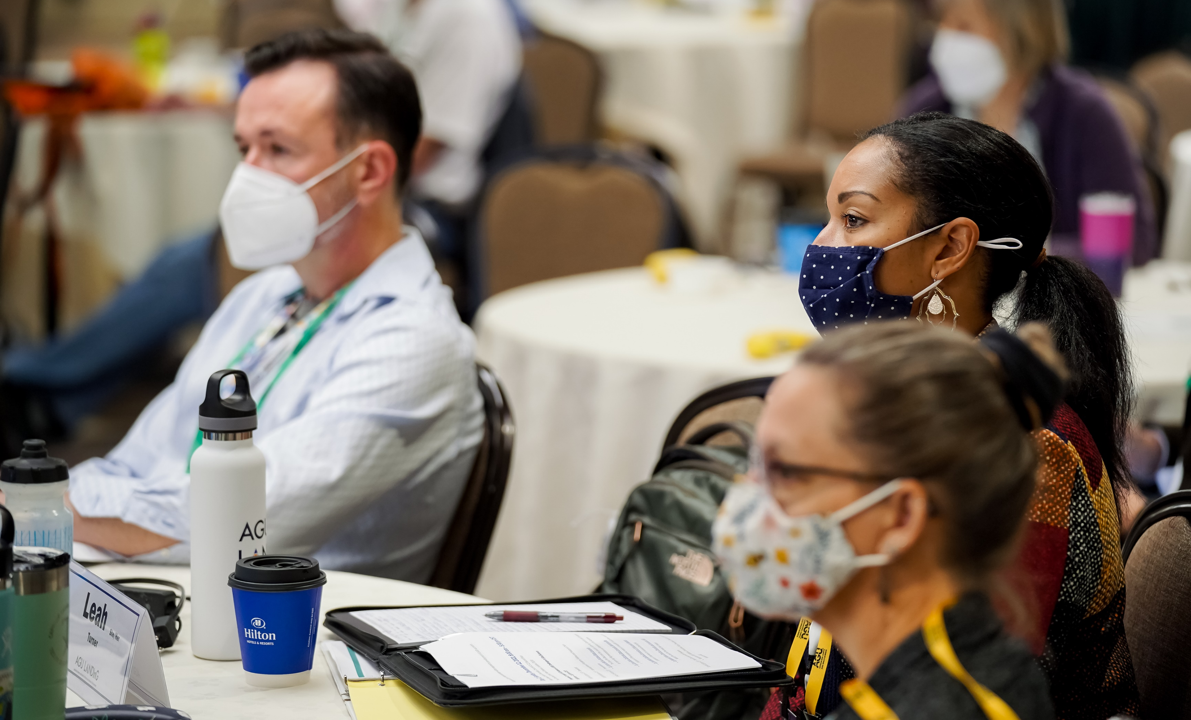
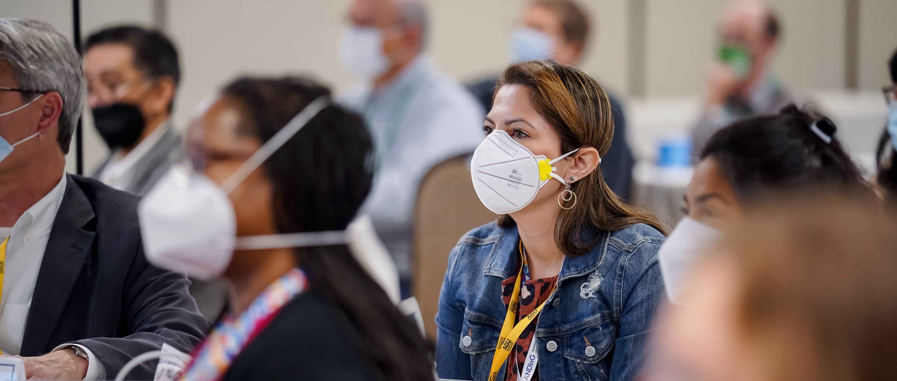
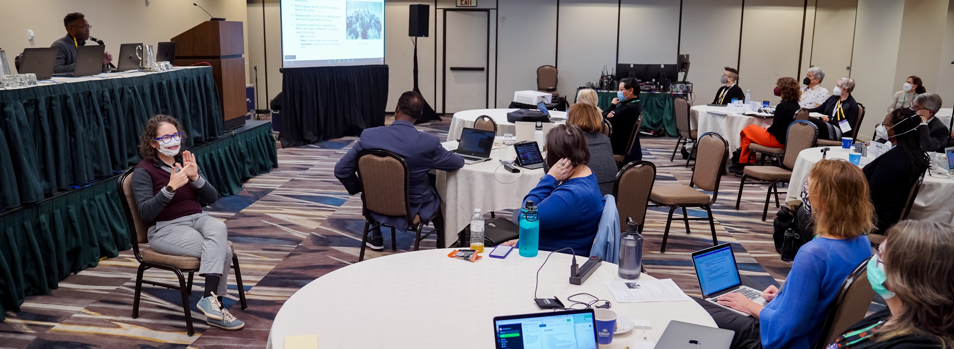
LANDInG Academy
Two-year program
Cohort-based
Professional development of DEI leaders in geosciences
Broadening participation project
Notes:
Photos of the first Academy cohort at their first meeting

Slide 5
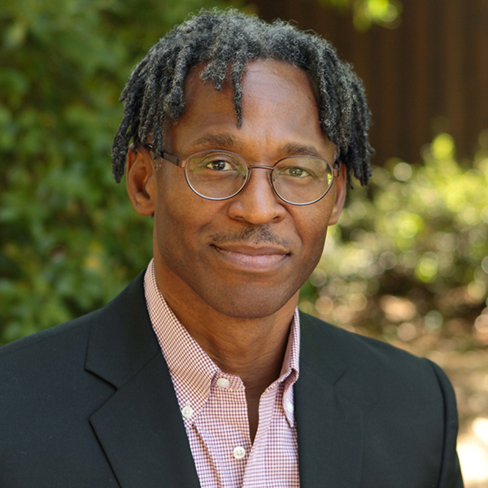
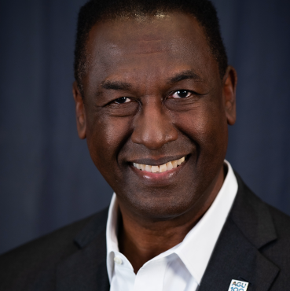
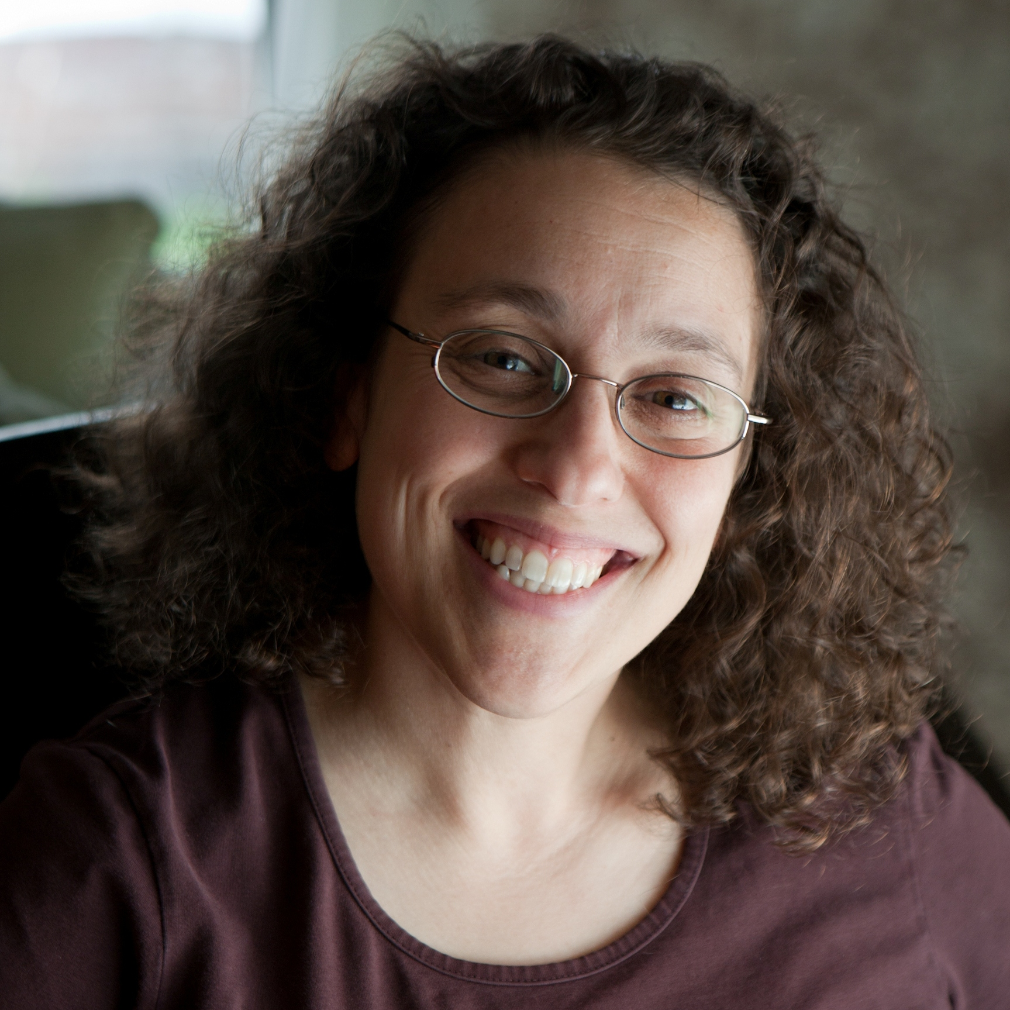
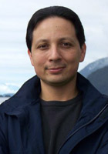
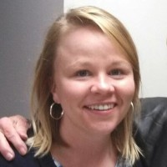
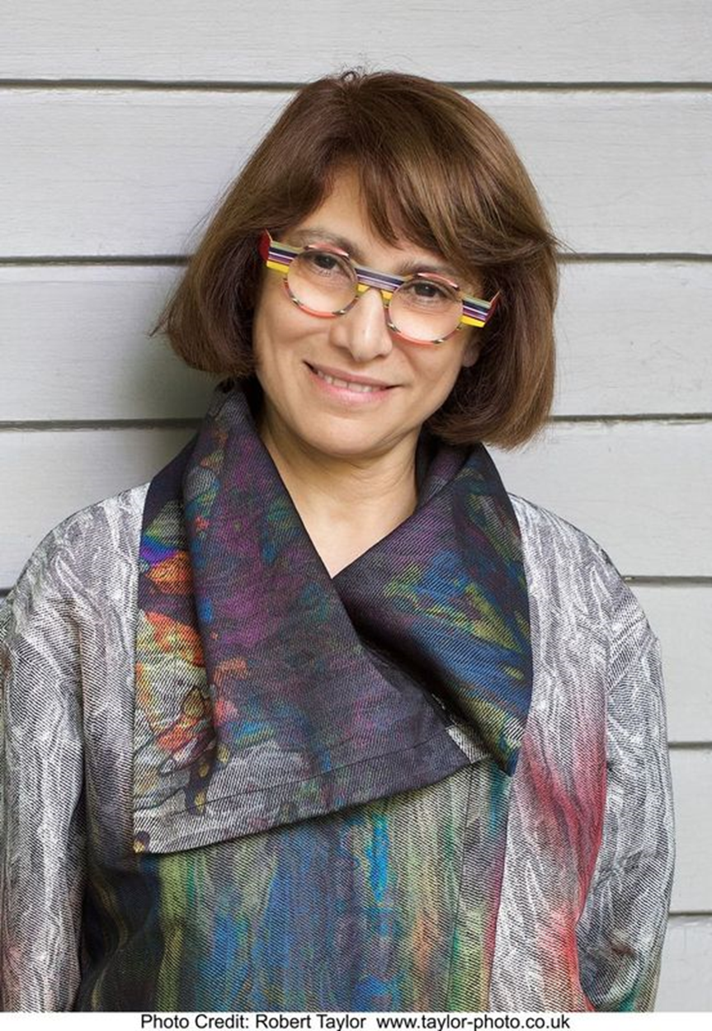
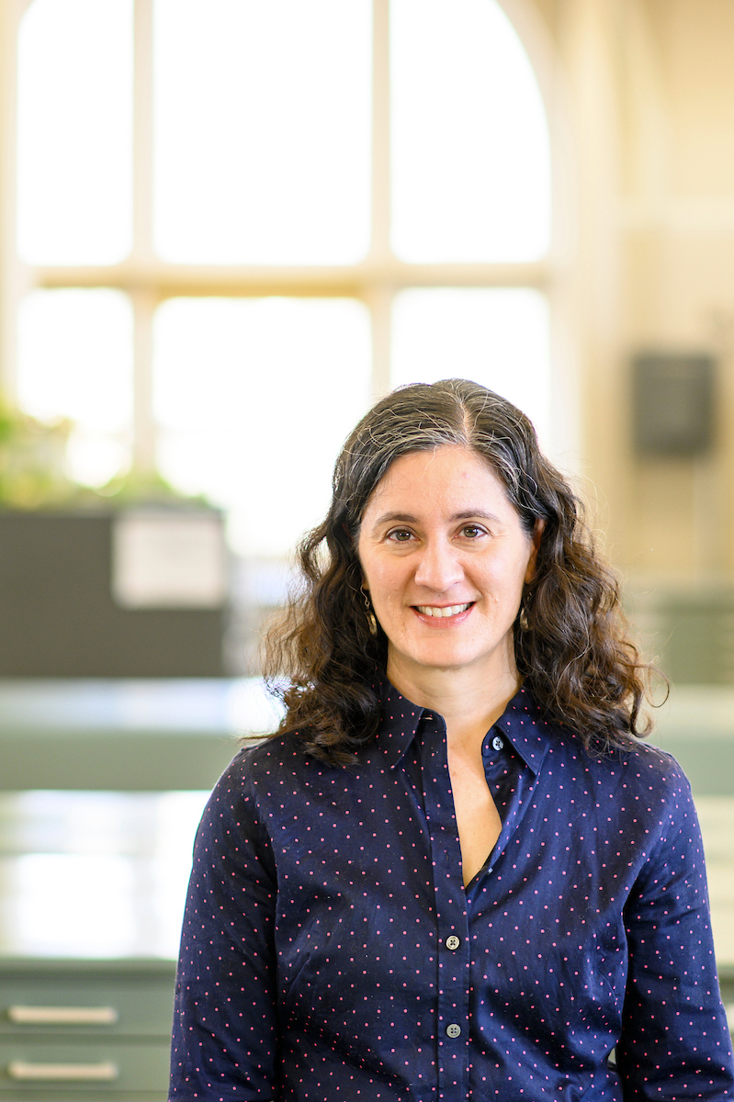
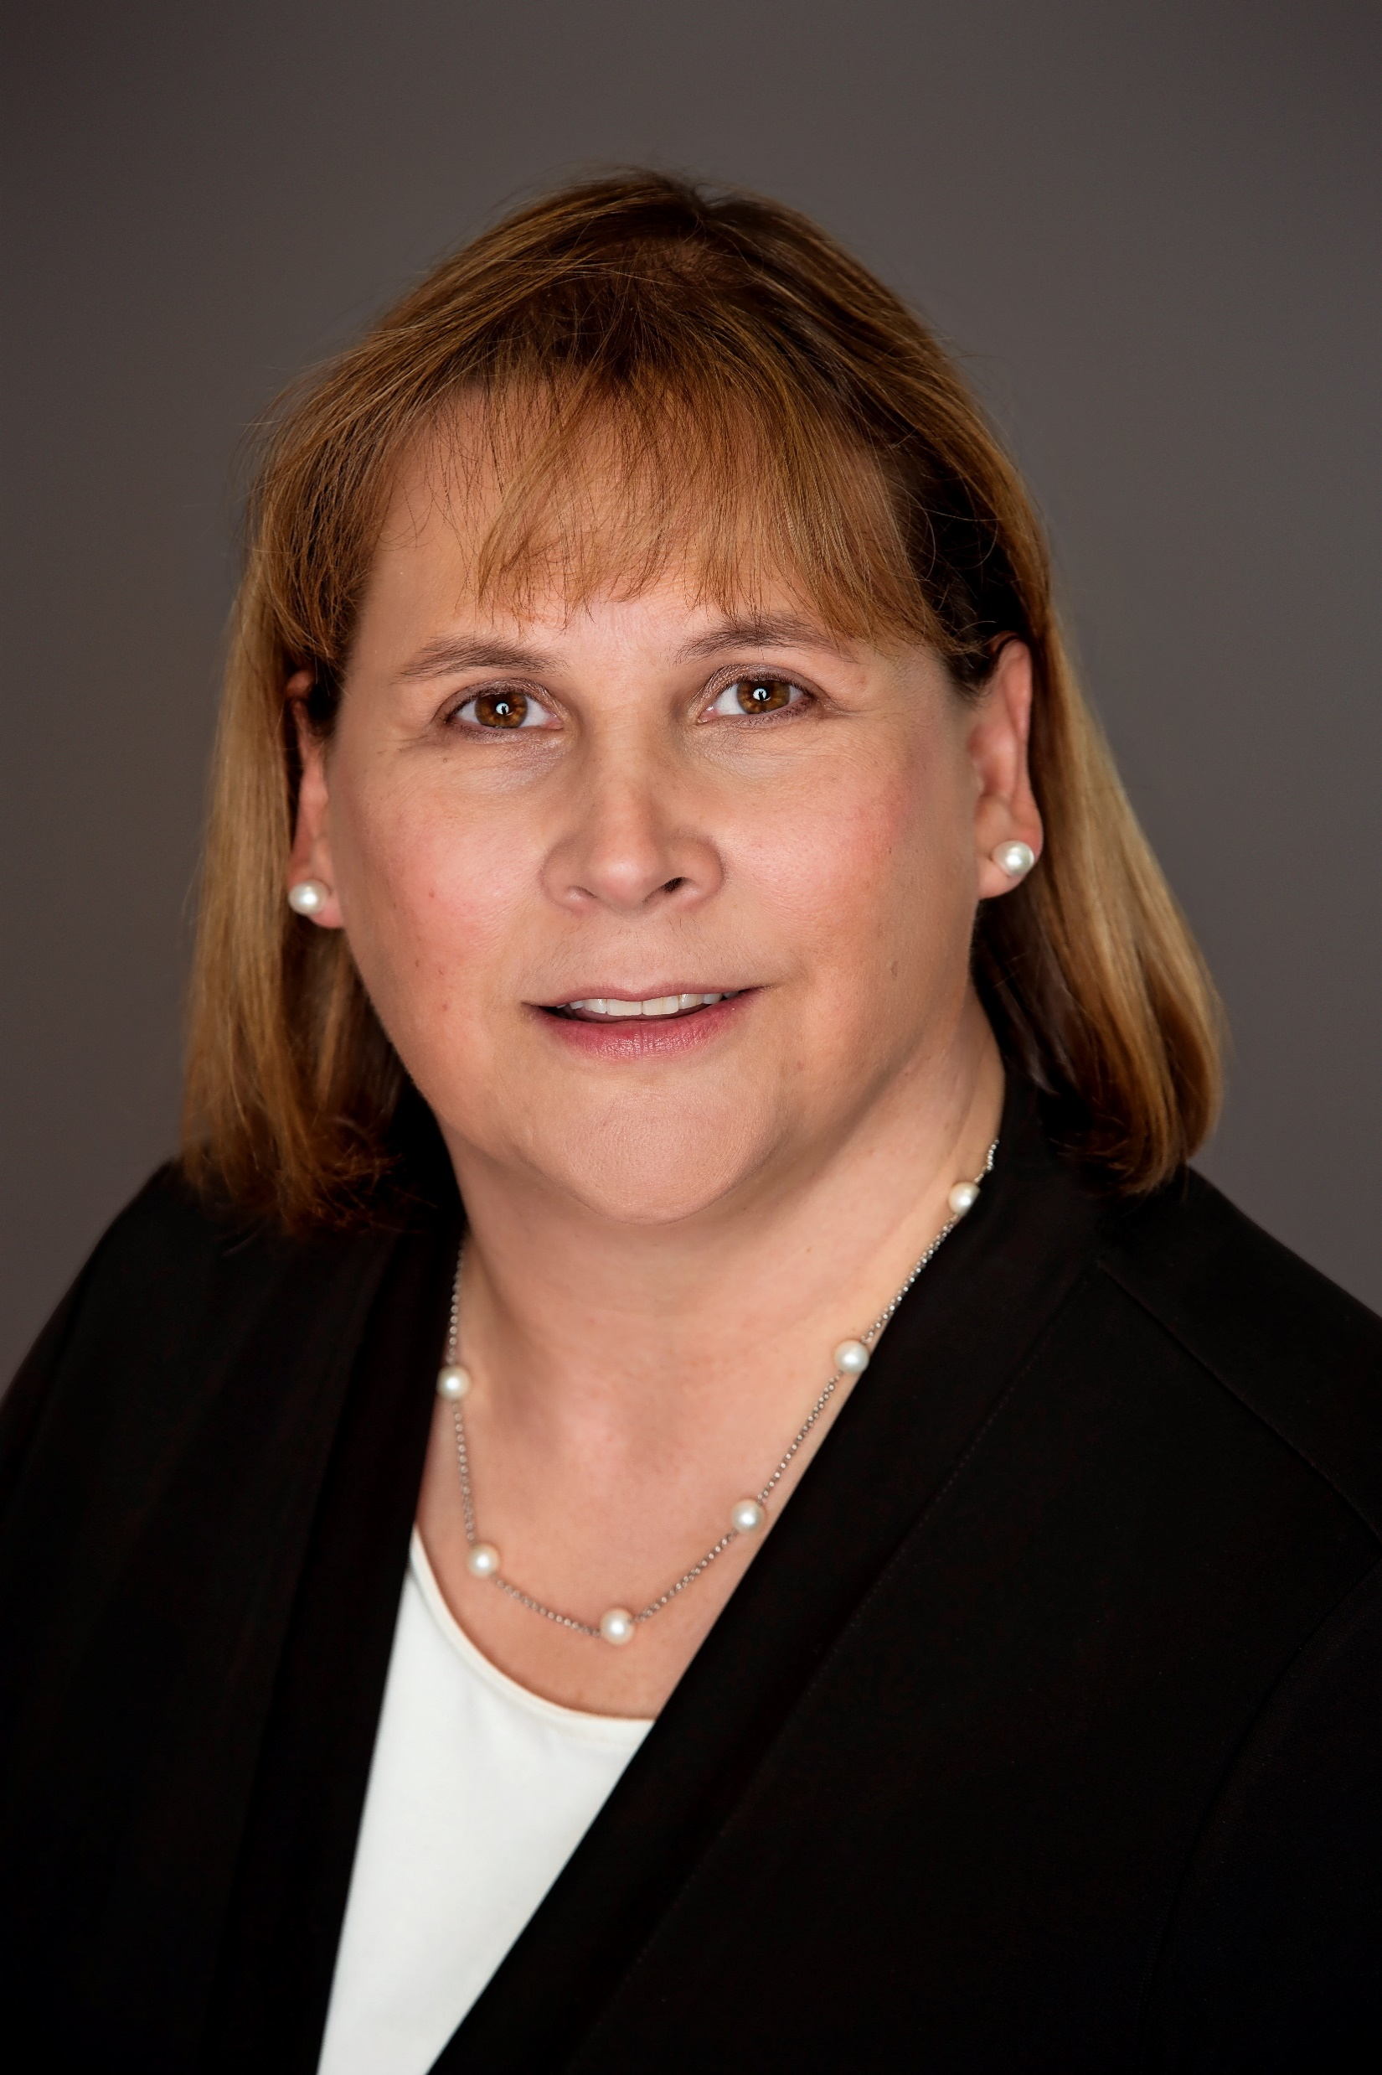
LANDInG Academy Summit 1
Formal Programming
14+ hours of expert-led workshops, panels
4+ hours of formal networking
DEI Foundations
Building connections
Understanding barriers in STEM
Understanding science of biases
Speaking up to bias
Billy Williams, EVP Ethnics & Equity, PI
Vernon Morris, Ph.D.
L.inda Tropp, Ph.D.
Margaret Fraiser, PhD, Co-PI
Corey Garza, Ph.D.
Dr. Mahzarin Banaji
Erika Marin-Spiotta, Ph.D.
Stephanie Goodwin, Ph.D., Co-PI
Notes:
Over 3 days, the LANDInG Fellows participated in a series of expert-led workshops, panels, and discussions, along with formal and informal networking events.
In alignment with our curriculum goals, the first Summit was focused on DEI Foundations – including understanding the challenges of broadening participation in STEM, the science of bias, how to build connections across difference, and how to speak up to bias when it occurs.

Slide 6
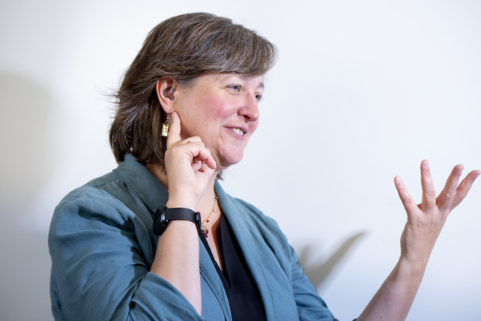
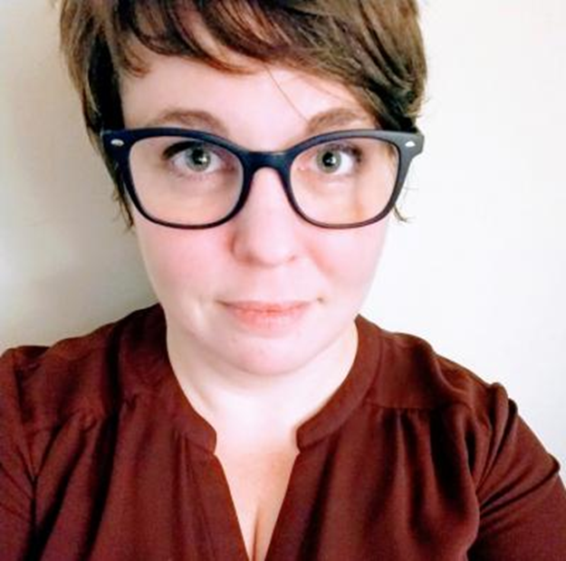
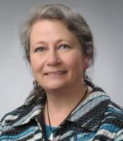
LANDInG Academy: Virtual Meetings
Dr. Michele Cooke
Professor of Geosciences
University of Massachusetts at Amherst
Formal Programming
monthly meetings
expert –led workshops,
DEI Foundations
Disability, Equity and Inclusion
DEI Assessment 101
Logic Models
Dr. Beth Ruedi
Director of Operations AAAS & SEA Change
Dr. Marie Garland
Assoc. Provost, Faculty Affairs
Syracuse University
Notes:
Since that time, our Fellows have met for Virtual Meetings. These meetings are ~2.5-3hrs in length and offer additional professional development on focal topics within each unit.
In addition to the expert speakers, these monthly meetings include time for leadership discussions and identifying emerging needs.
Finally, these meetings are the space where we work to support the Fellows’ development of a Broadening Participation Leadership project.

Slide 7




DEI Leadership Project
Develop Plan
Create a proposal for applying new strategies to address DEI needs.
Identify DEI Needs
Seek and understand institutional data on individual and organizational outcomes to identify key areas of need for change.
Engagement &
Implementation
Invite feedback and build engagement to implement your proposal. Include program evaluation in your efforts to understand what works.
Identify Solutions
Research evidence-based models, strategies, and frameworks for promoting change relevant to your institution’s needs.
Jan - March
April - Aug
Sept - Nov
Dec →
Notes:
This graphic illustrates how the Academy curriculum overlaps with Fellows’ development and implementation of the Broadening Participation Leadership projects.
Key deliverables: a formal proposal, a proposal presentation, quarterly progress reports in year 2 of the program, and a final report and presentation at the end of year 2.

Slide 8
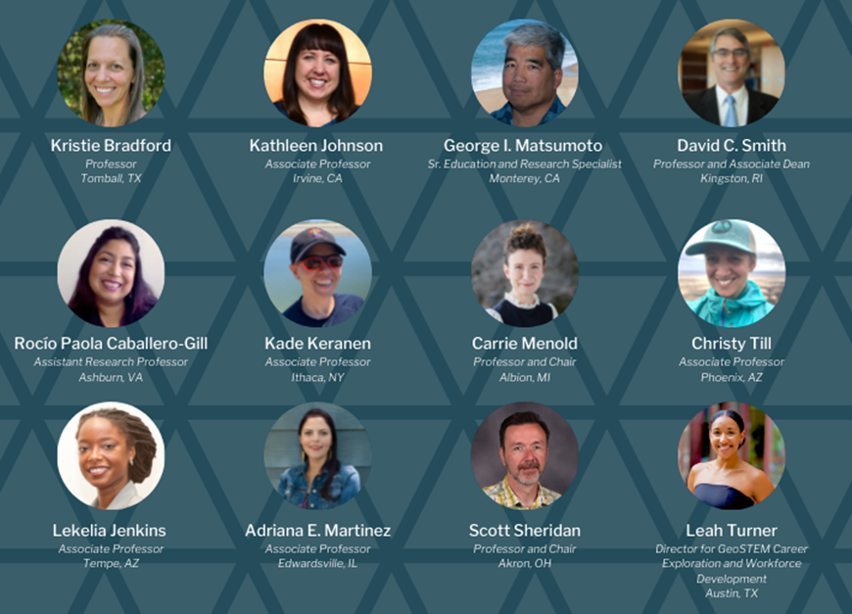
LANDInG Academy Cohort 2 Applications are Open
DEADLINE: June 01, 2022
11:59 pm EDT/ 3:49 am UTC
APPLICATION: https://www.agu.org/AGU-LANDInG/Pages/Academy/Apply
The second cohort of Academy participants will focus on building capacity for those individuals at mid-career and in positions to effect change at a U.S. academic, academic-adjacent, or research institutions.
E-mail landing@agu.org with any questions.

Slide 9
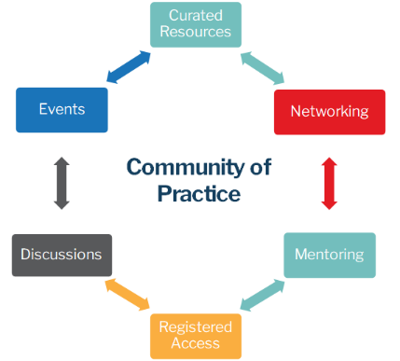
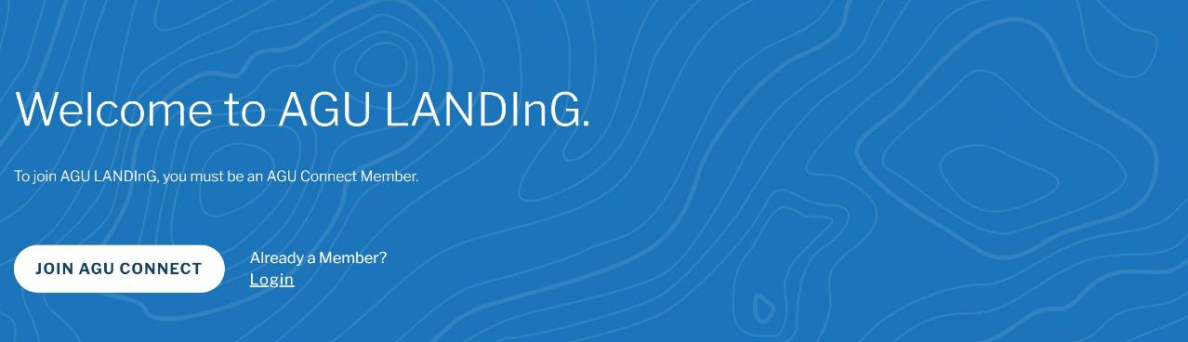

Community of Practice
https://www.agu.org/AGU-LANDInG
Notes:
The CoP is a registered-access, virtual platform of resources and to develop virtual and in-person events to engage and support a broad community of current and aspiring DEI champions. Launched March 1.
•No collective community existed previously to support DEI champions’ networking and professional development needs in the geosciences.
•The CoP Network offers: (a) training; (b) scholarly resources; (c) exemplary practice and policy documents; (d) peer-mentoring through discussion forums and networking events; (e) promotion of opportunities to engage in DEI service; and (f) events, publications, and initiatives to promote recognition and visibility of DEI champions/leaders within the discipline.
Dedicated Community Manager and Community Engagement Fundamentals by The Center for Scientific Collaboration and Community Engagement

Slide 10
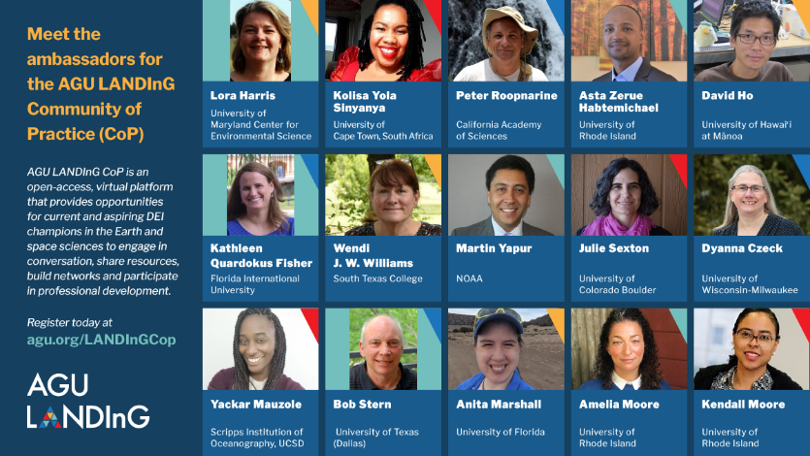
Community of Practice Ambassadors
Notes:
In addition to a Dedicated Community Manager, we have
Community Ambassadors
Active in justice, equity, diversity and inclusion work within the geosciences
Seeding/facilitating discussions in partnership with Community Manager / Monthly themes

Slide 11
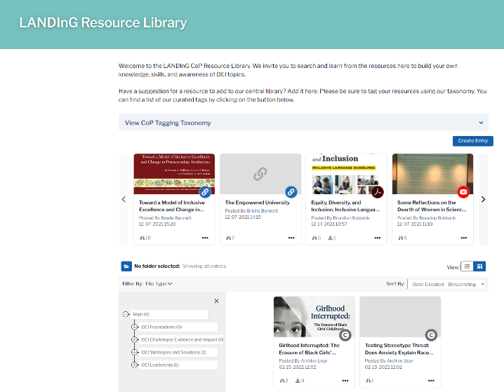
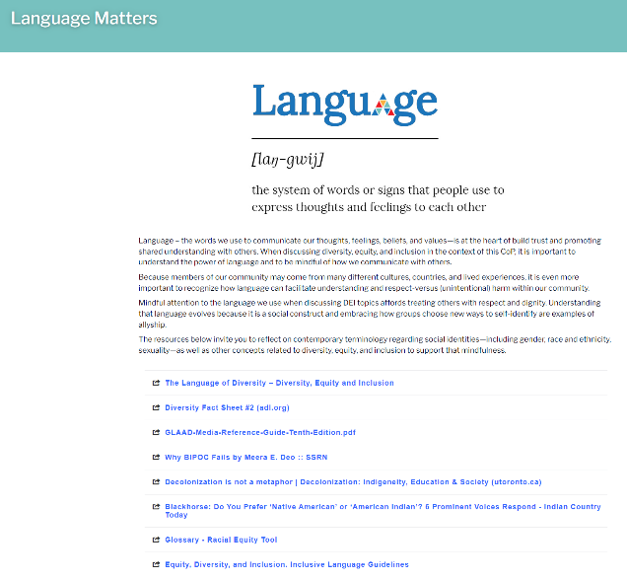
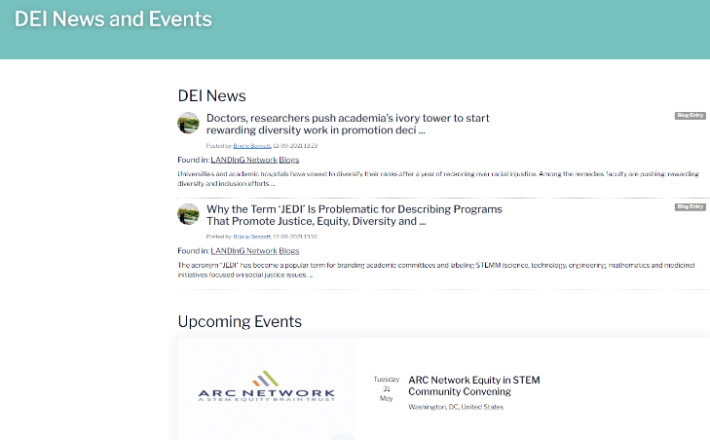
Features of the Community of Practice

Slide 12
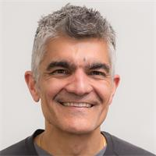
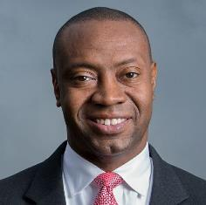
Community of Practice Webinar Series
Highlighting DEI champions’ personal journeys and impacts, and lessons they’ve learned along the way.
25 May 2022, 12-1pm EDT / 16:00 UTC
Dr. Raj Pandya
Community Science: Science for Climate and Justice
Vice President, Thriving Earth Exchange
AGU
22 June 2022 , 12-1pm ET
Dr. Marshall Shepherd
Professor of Geography and Atmospheric Sciences
University of Georgia

Slide 13

Help us build a community of DEI Champions
Join the CoP connect.agu.org/landingcop/
Participate in discussions
Share your reasons for joining the CoP + upcoming webinars with your network

Slide 14

Curated Learning
Networking
Cultivate DEI leaders in OCE and OPP
LANDInG-PRFP
Notes:
Leverage LANDInG CoP
Goal 1: Leverage the LANDInG CoP resource to provide a curated learning experience for OCEPRF Scholars.
Goal 2: Building professional networks for DEI champions among cohorts of OCE-PRF scholars and between these scholars and other DEI Leaders through the LANDInG Academy.
The proposed activities will have potential for a broader impact across the discipline, cultivating future generations of DEI leaders in OCE and beyond.

