Slide 1

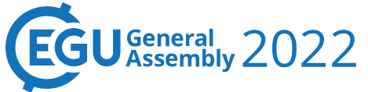



Presentation On Reliability-Based Hybrid Metaheuristic Optimization Model for the Design of Two Loop Network Under Mechanical Uncertain Scenarios
Vienna, Austria and Online
by
Seelam Naga Poojitha¹ and Vinayakam Jothiprakash²
¹Research Scholar, ²Professor, Indian Institute of Technology, Bombay, Powai, Mumbai, Maharashtra, India, 400076
Correspondence E-mail: pooji.pujitha@gmail.com, vprakash@iitb.ac.in
Session HS3.8, Presentation: EGU22-12971

Slide 2
Contents
Introduction
Objective
Methods
Methodology
Case study
Results and Discussions
Conclusions

Slide 3
Introduction
Water supply system (WSS) is worldwide valuable public infrastructure asset used for conveying water from source to communities (Alegre and Coelho 2012)
Water distribution network (WDN) is the part of WSS that transports treated water from supply source at treatment plant to the communities (Elshaboury et al. 2020)
WDN design alone accounts for about 50 to 70% of total cost invested for the design of WSS (Zhao 2003)
Its operation, maintenance, and rehabilitation involve significant financial investments (Ezzeldin et al. 2014)
Major initial capital investment of WDNs is on the installation, inspection, and maintenance of pipes (Ghesis et al. 2016)
The study focuses on the economical design of WDNs, considering network pipes as the primary design variables

Slide 4
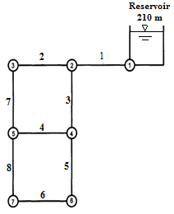
Nature of the WDN Design Problem
Contd.,
Combinatorial optimization problem (Suribabu 2010)
e.g. TLN
Number of Pipes = 8
Number of commercially available pipes = 14
Possibilities = 14⁸
Enumeration - Not tractable
Discrete Feasible solution sets (due to nonlinear relationship)
Non deterministic polynomial time hard (NP-hard) problems (Yates et al. 1984)
Easy to verify but, difficult to solve
The quest for the formulation of a new efficient, global convergence based optimization technique is still gaining momentum
Figure 1. Layout of TLN
Alperovits and Shamir (1977))

Slide 5
Reliability of WDN
Contd.,
Reliability of the WDN is the probability that the network is able to deliver the required demands within the minimum required pressure conditions to the communities (Su et al. 1990)
In its lifetime liable to mechanical failures and vulnerable to hydraulic uncertainties
Mechanical failure refers to the failure of WDN components like pipes, pumps, and valves, etc.
Hydraulic failure occurs due to insufficient heads available at various demand nodes because of uncertainty in nodal demands and pipe roughness (Bao and Mays 1990)
“For the effective design of WDNs it is necessary to consider the reliability of the system”

Slide 6
Objective of the Study
Reliability-based optimal design of WDNs using metaheuristic optimization model under mechanical uncertain scenarios
Methods
A reliability-based hybrid metaheuristic optimization model is formulated
Optimization model
Hybrid optimization technique with combined features of evolutionary and swarm intelligence techniques, DE-KHA is considered
Simulation model
EPANET simulation tool Rossman (2000) that simulates the WDNs hydraulic properties, nodal pressure head and actual demand delivered at the demand nodes is considered
Reliability model
Reliability of the WDN is assessed considering the pipe failure using the minimum cut set method

Slide 7
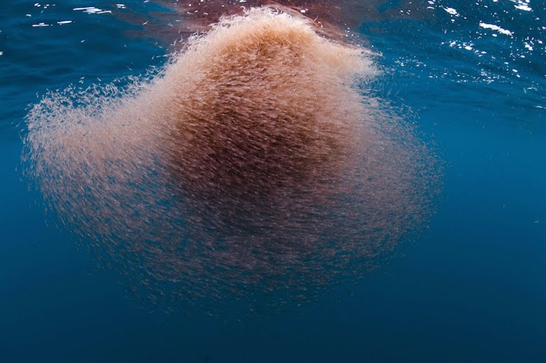
Optimization Model
Contd.,
Krill herd algorithm (KHA)
(Gandomi and Alavi 2012)
Operators : (1) Foraging motion, (2) Neighbor induced motion, and (3) Physical diffusion
Excellent exploitation abilities – Intensified search
Differential evolution (DE)
(Storn and Price 1995)
Operators : (1) Mutation, (2) Crossover, and (3) Selection schemes
Excellent exploration abilities – Diversified search (Das et al. 2005)
Figure 2. Krill Herd
(Source:https://images.squarespacecdn.com/content/v1/5ba0efb9266c077060b48c68/1537849392860H6IMD6H4JUC52OIHVKC6/Krill_Coronado.jpg?format=1000w)
Hybrid metaheuristic algorithm DE-KHA
(Poojitha and Jothiprakash 2022)

Slide 8
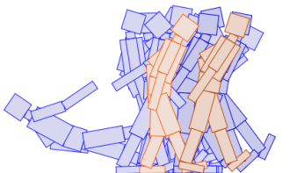
Framework of Optimization Model
Contd.,
Improve population using DE mutation and crossover schemes by exploring with available information
Fitness evaluation
Improve population using KHA schemes by exploiting the available information
Selection scheme
Fitness evaluation
Initial random population
Optimal solutions
Population-based evolutionary search
Selection scheme
Figure 3. Darwin’s principle of survival of fittest
Source: https://towardsdatascience.com/making-a-robot-learn-how-to-move-part-1-evolutionary-algorithms-340f239c9cd2
Perform until the termination criterion

Slide 9
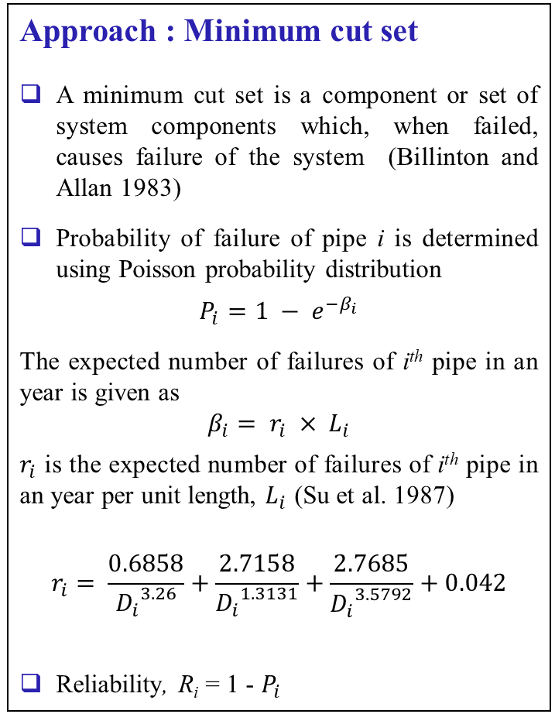
Reliability Model
Contd.,
Start
Approach : Minimum cut set
A minimum cut set is a component or set of system components which, when failed, causes failure of the system (Billinton and Allan 1983)
Probability of failure of pipe i is determined using Poisson probability distribution
$$P_{i}=1 − e^{−β_{i}}$$
The expected number of failures of i^{th} pipe in an year is given as
$$β_{i}= r_{i} × L_{i}$$
$r_{i}$ is the expected number of failures of i^{th} pipe in an year per unit length, $L_{i}$ (Su et al. 1987)
$$r_{i}= \frac{0.6858}{{D_{i}}^{3.26}}+\frac{2.7158}{{D_{i}}^{1.3131}}+\frac{2.7685}{{D_{i}}^{3.5792}}+0.042$$
Reliability, R_{i} = 1 - $P_{i}$
Compute probability of failure of each pipe
Apply pipe closure combinations
For pipe closure combination = 1
Simulate network hydraulic properties
no
Hydraulic Infeasibility
yes
Record minimum cut set
Maximum pipe closure combinations
no
Pipe closure combination + 1
yes
Calculate failure probability of minimum cut sets
Estimate reliability of WDN
Stop

Slide 10
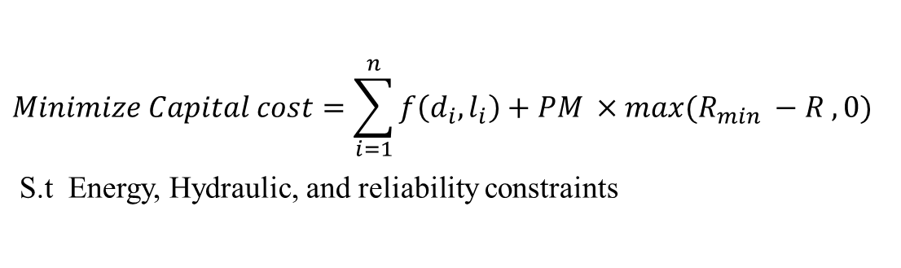
Methodology
$$Minimize Capital cost=\sum_{i=1}^{n}{f\left(d_{i}, l_{i}\right)+PM ×max(R_{min} −R , 0)}$$
S.t Energy, Hydraulic, and reliability constraints
Alternate diameter set
Hydraulic properties
I_{s} = 1
Optimization model
Simulation model
Reliability model
Start
Assessment of mechanical reliability
I_{s} + 1
no
Termination criteria
Capital cost of WDN
yes
R < R_{min}
Penalty is added
Note:
d_{i} and l_{i} are the diameter and length of i^{th} pipe
PM is the static penalty multiplier
I_{s} is the iteration size
R is the reliability of WDN
R_{min} is the predefined minimum reliability of the WDN, which in the present case is varied from 0.6 to 0.8 with a step size of 0.1
Penalty is not added
yes
no
Capital cost of WDN
Stop

Slide 11
Case Study
Two-Loop Network (TLN) Benchmark Problem
TLN is a hypothetical network first studied by Alperovits and Shamir (1977).
It is a two looped network with 8 pipes each of 1000 m length, 6 demand nodes and a single reservoir with a fixed head of 210 m (CWS, Exeter)
The minimum pressure head requirement at each demand node is 30 m.
Table 1. Details of TLN
No. of Links | No. of commercially available options | Possible options | Hazen Williams constant
8 | 14 | 14⁸ (1.47578 ×10⁹) | 130
Figure 4. Layout of TLN
(Alperovits and Shamir (1977))

Slide 12
Results and Discussions
Results of sensitivity analysis
To calibrate the optimal (best) values for model parameters guidelines of Hofmann et al. (2004) and Gandomi and Alavi (2012) are followed
Table 2. Calibrated parameter values of DE-KHA
Mutation factor | 0.8
Crossover probability | 0.5
Foraging velocity | 0.3
Maximum induced speed | 0.08
Maximum diffusion speed factor | 0.6
Sensing distance factor | 0.9
Time step | 0.9
Number of krill (population size) | 300
Maximum iteration size | 200
Penalty Multiplier | 10⁷

Slide 13
Contd.,
Figure 5. Convergence plot showing the variation of the optimal cost obtained over iterations with R_{min} = 0.8 and 0.9

Slide 14
Contd.,
Figure 6. Convergence plot showing the variation of the optimal cost obtained over iterations with R_{min} = 0.8 and 0.9

Slide 15
Contd.,
Figure 7. Tradeoff of capital cost and mechanical reliability of TLN with R_{min} varied from 0.6 to 0.9

Slide 16
Contd.,
Figure 8. Tradeoff of capital cost and mechanical reliability with R_{min} varied from 0.6 to 0.9

Slide 17
Contd.,
Figure 9. Tradeoff of capital cost and mechanical reliability with R_{min} = 0.6

Slide 18
Conclusions
The computation results on successful application of the reliability-based metaheuristic optimization on TLN
Demonstrates the efficacy of the optimization model in locating the best possible design costs with less computational effort
Of 200 maximum iterations considered for a single run, irrespective of the R_{min} considered, the model converged to best solutions in just 24 to 63 iterations
For the same design cost, discrete feasible diameter options are located with discrete mechanical reliability values
The feasible designs options with a wide range of mechanical reliability varying from 0.42837 to 0.94921 are proposed
The study suggests the explicit consideration of reliability and surrogate measures for robust design of WDNs by extending the hybrid model as a multi-objective framework

Slide 19
Any Questions, comments, or Suggestions?

Slide 20
Thank You All for your Attention!

