Slide 1
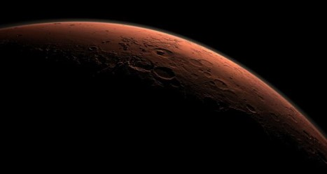




A new classification and terminology system towards the development and utilisation of Martian simulants
Hector-Andreas Stavrakakis 1,3,4 , Dimitra Argyrou 2,3 , Elias Chatzitheodoridis 1,3,4
Image: REUTERS/NASA/JPL
EGU General Assembly 2022 23-27 May 2022 Vienna, Austria *Corresponding Authort: hecstavrakakis@gmail.com
Notes:
Dear Collagues good afternoon,
my name is Hector-Andreas Stavrakakis and I am a PhD student at the National Technical University of Athens,
Since 2018 we have investigated martian simulants for their potential applications in our work. In the last year we focused on the topic and systematically scrutinised the literature.
Today, I report on our findings and suggestions on the topic of martian simulants, that can also be expanded to all extraterrestrial simulants and their applications

Slide 2
Current state-Proposed actions
  The current state
    Non-standardised
    Implications in research
  Proposed actions for standardisation
    Highlight shortcomings
    Create new ontology and semantic based databases.
      → Better and more complete consolidation of the scattered information regarding the Martian simulants
    Develop a classification system for fidelity estimation and proper etymological usage
Image: REUTERS/NASA/JPL
Notes:
During our research it became apparent that the current state of the field could get improved across many facets.
Thus we implemented a course of action based on 3 axes, to act as a cornerstone in standardization efforts.
Firstly, to highlight the shortcomings of the currently used and past martian simulants, to increase scientific accuracy and comparability.
Secondly, to consolidate existing literature into a database with easy access and tools via the development of a new informational construct based on ontologies and semantics
Thirdly, to develop and propose a new classification system that borrows elements from ontological structures. In addition, it should allow a fidelity estimation and mitigate terminology confusion.

Slide 3
Simulant Classification system (1/2)
Analogue Natural Materials (ANM)
  Materials collected from analogue locations
  (i.e. igneous rocks or material of astrobiology interest)
Untreated natural materials
Analogue Simulants (AnSi)
Mildly processed rock materials
(usually of igneous origin)
Low reliability
(chemistry and mineralogy
significantly deviate from martian datasets)
Image: REUTERS/NASA/JPL
Stavrakakis H.-A. et al (in preparation)
Notes:
The classification system we developed consists of 4 classes.
The first class, named Analogue Natural Materials or (ANM) includes the utilised materials directly after sampling Analogue sites. These materials can be suitable igneous rocks, or materials from locations of specific interest, such as the Atacama dessert for Astrobiology
It is important to note that Analogue Natural Materials are untreated materials, in contrast to the following classes which are processed, and thus artificial representative materials.
The second class is “Analogue Simulants” or (AnSi). This class includes igneous materials that have been collected and underwent minor artificial processing, such as sieving or drying. Since the total processing level is usually low, and geochemically terrestrial rocks differ, such simulant materials are the least representative Martian simulant materials.

Slide 4
Simulant Classification system (2/2)
Enhanced Analogue Simulants (EAnSi)
AnSi class materials with additives
Greater mineralogical and chemistry match
(mostly by the addition of ferrous components)
Materials of higher reliability and quality
Mineralogy Based Simulants (MBS)
Aimed at mineralogical accuracy by careful material collection and processing
Highest representation
(usually with very high reliability and production quality)
Image: REUTERS/NASA/JPL
Stavrakakis H.-A. et al (in preparation)
Notes:
“Enhanced Analogue Simulants” or (EAnSi) class consists of simulants made from materials similar to those of “Analogue Simulants”. However, these are extensively processed and modified, for example with the addition of specific minerals to better represent the Martian surface compositions.
The last class is termed “mineralogy-based simulants” or (MBS). This class includes simulants that have been aimed to have accurate mineralogy, based on their target data. The materials utilised underwent careful material collection, and processing to better represent the martian characteristics. As such those materials can be considered some of the best representatives of Mars for most cases
The classification system in addition offers the benefit of providing an indirect fidelity measure, enchasing a simulant selection process for a study, without actually investing in time consuming comparisons, for example on chemistry or mineralogy with the martian surface data.

Slide 5
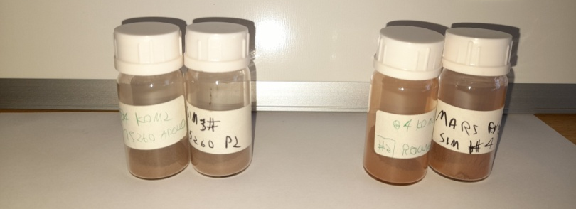
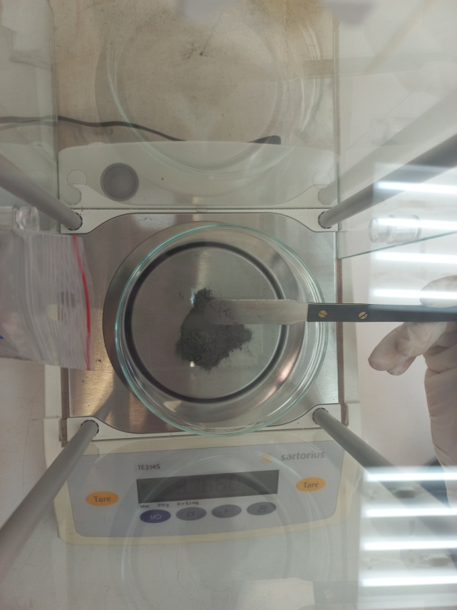
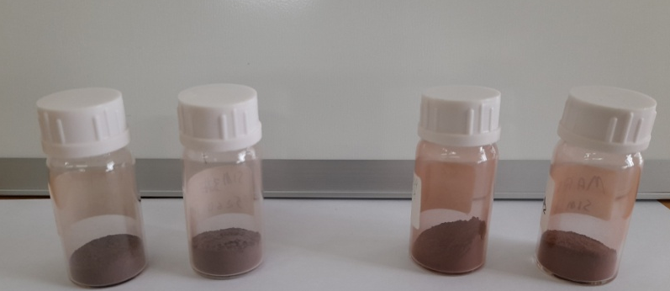
Future work
  Develop a new quantitative figure for fidelity measure
  Announcement of the First Greek Martian and Lunar simulants to the scientific community
    The development of simulant to experiment selection algorithm
Image: REUTERS/NASA/JPL
Stavrakakis H.-A. et al (in preparation)
Notes:
Future work of our team aims to provide a new quantitative figure, for a fidelity measure, that can work independently or in combination with the classification system.
This should further enhance the simulant selection processes and ease comparisons with the literature
To better understand the topic and to apply the classification system our team has also developed a number of high fidelity simulants.
As such, I am glad to report to the scientific community of the first Greek Martian and Lunar Simulants
Those tasks also culminate into the development of simulant to experiment selection algorithm.
Thank you.

Slide 6
A new classification and terminology system towards the development and utilisation of Martian simulants
Thank you for your attention
Hector-Andreas Stavrakakis 1,3,4 , Dimitra Argyrou 2,3 , Elias Chatzitheodoridis 1,3,4
Image: REUTERS/NASA/JPL
EGU General Assembly 2022 23-27 May 2022 Vienna, Austria *Corresponding Authort: hecstavrakakis@gmail.com

