Slide 1



Towards Understanding Evapotranspiration Shifts Under a Drying Climate
Hansini Gardiya Weligamage¹
Co-authors: Keirnan Fowler¹, Tim Peterson², Margarita Saft¹, Dongryeol Ryu¹, and Murray Peel¹
¹Department of Infrastructure Engineering, University of Melbourne, Melbourne, Australia
²Department of Civil Engineering, Monash University, Melbourne, Australia

Slide 2
Introduction
How did actual evapotranspiration (AET) change during the Millennium Drought (from 1997 – 2009) in Victoria, Australia?
Reliable estimation of AET is challenging
AET responses to prolonged drought is poorly understood
Understanding changes in other water balance components under prolonged droughts

Slide 3
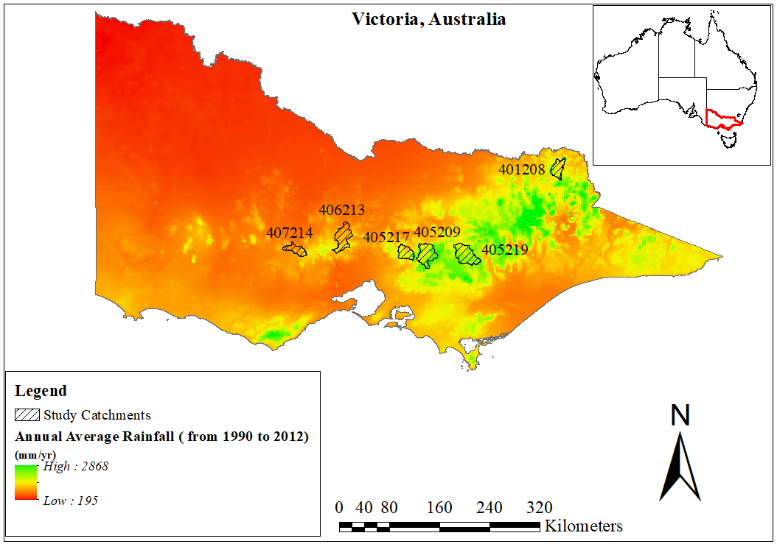
Sensitivity Analysis
Figure 1: Selected six study catchments in Victoria, Australia

Slide 4
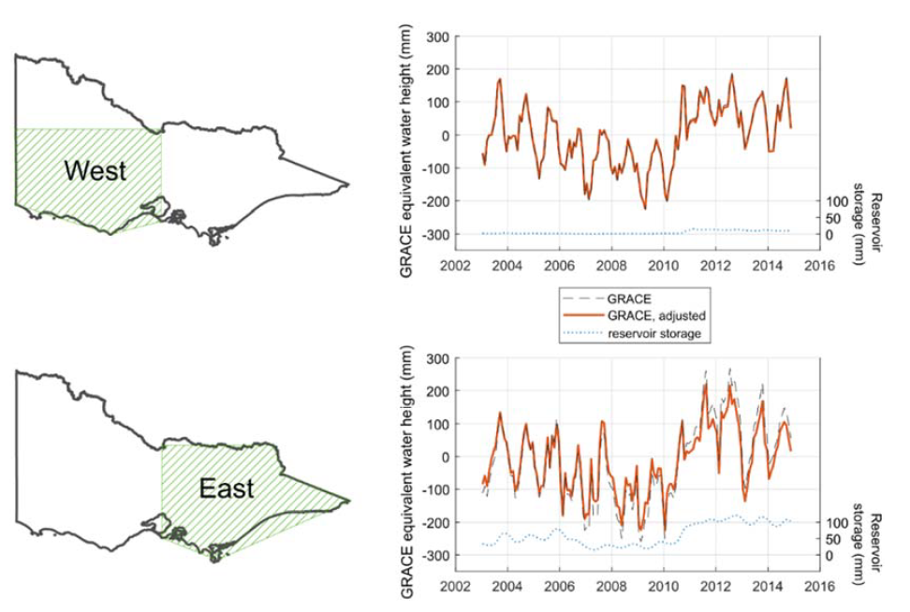
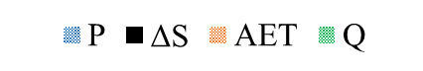
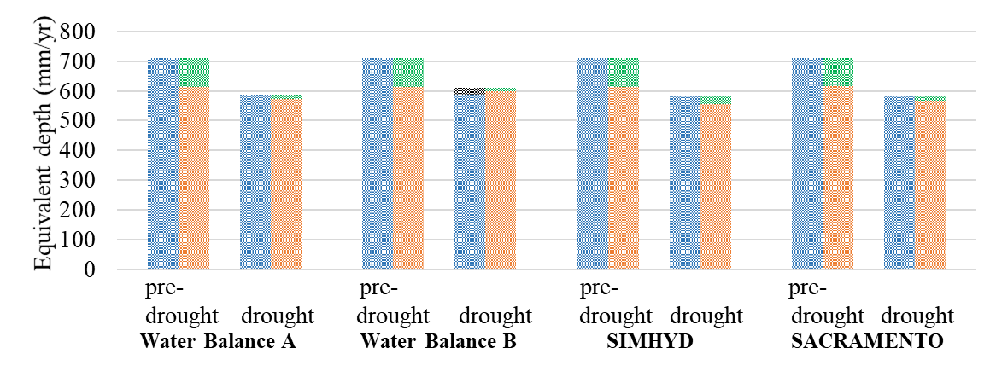
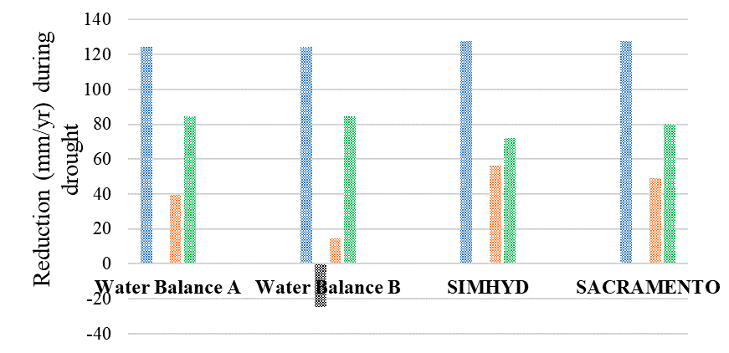
Sensitivity Analysis
Catchment 407214
a) Overall water balance
b) Reduction in water balance components in absolute terms
𝐴𝐸𝑇=𝑃−𝑄
𝐴𝐸𝑇 = 𝑃−𝑄−Δ𝑆
Source of GRACE estimates: Fowler, K., Knoben, W., Peel, M., Peterson, T., Ryu, D., Saft, M., Seo, K.W., Western, A., 2020. Many Commonly Used Rainfall-Runoff Models Lack Long, Slow Dynamics: Implications for Runoff Projections. Water Resour. Res. 56. https://doi.org/10.1029/2019WR025286
Source of SIMHYD & SACRAMENTO estimates: Fowler, K., Peel, M., Western, A., & Zhang, L. (2018). Improved Rainfall-Runoff Calibration for Drying Climate: Choice of Objective Function. Water Resources Research, 54(5), 3392–3408. https://doi.org/10.1029/2017WR022466

Slide 5
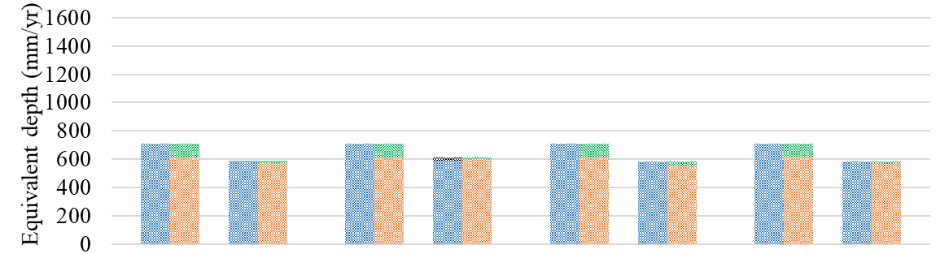
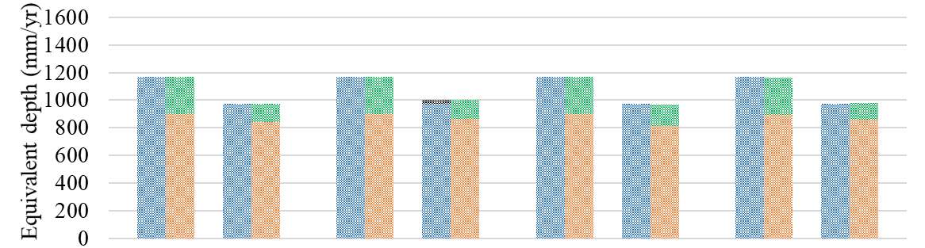
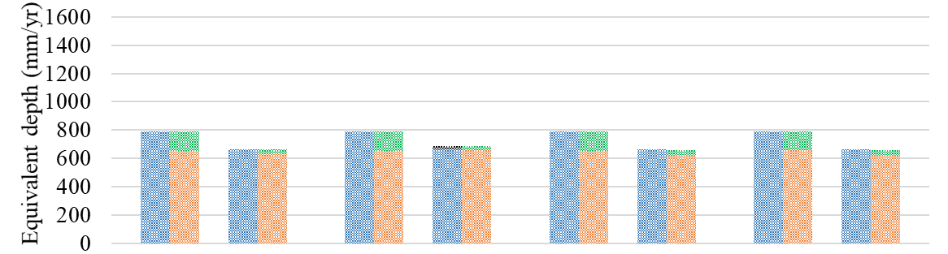
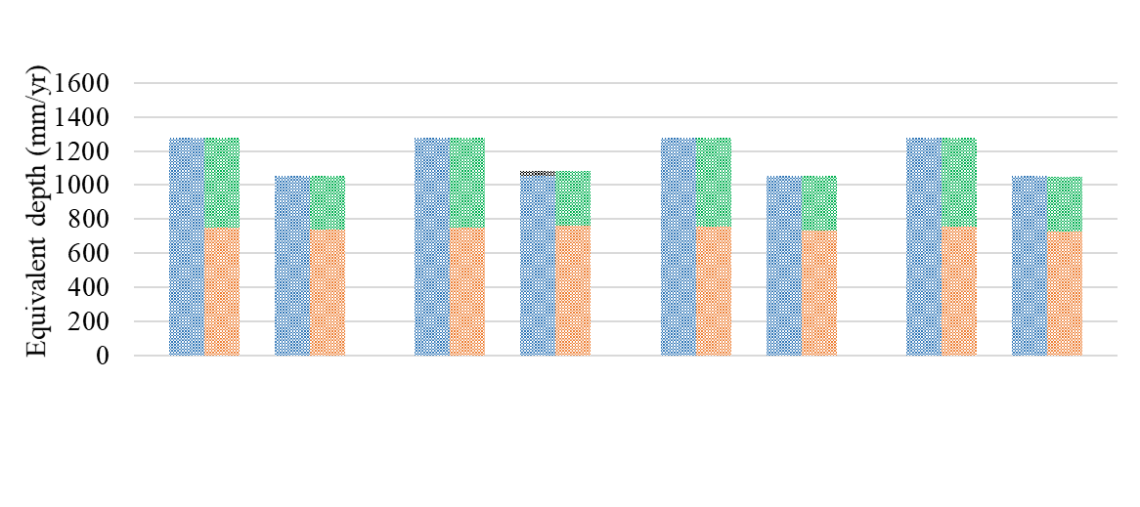
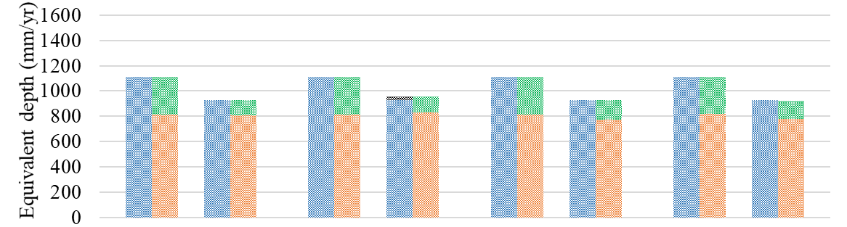
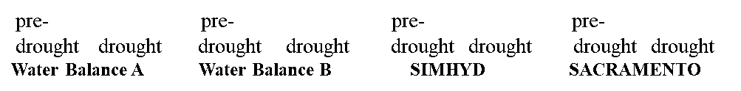
Results – Overall water balance
Drier Catchments
Wetter Catchments
Catchment 407214
Catchment 401208
Catchment 406213
Catchment 405219
Catchment 405217
Catchment 405209

Slide 6
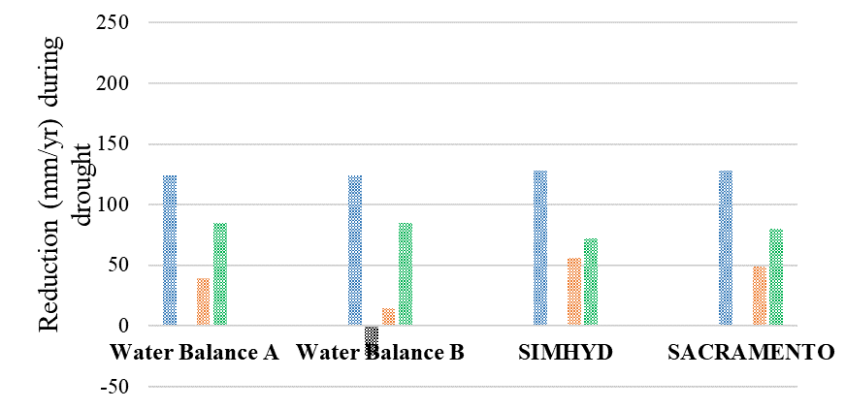
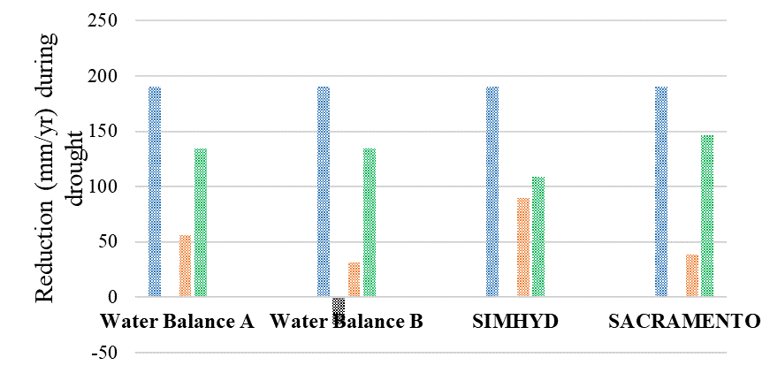
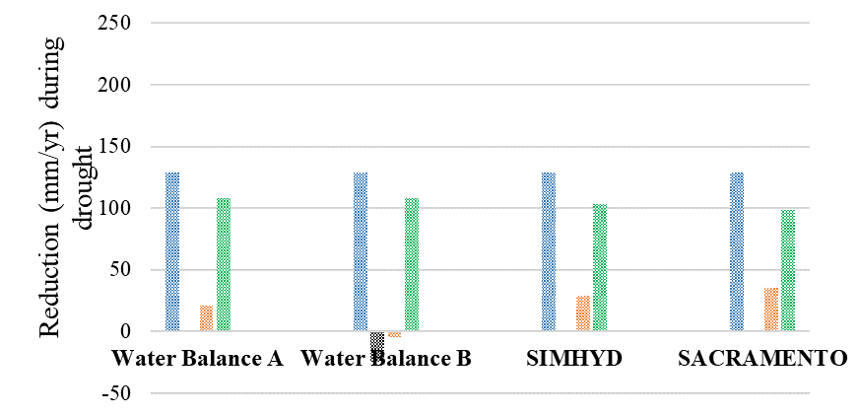
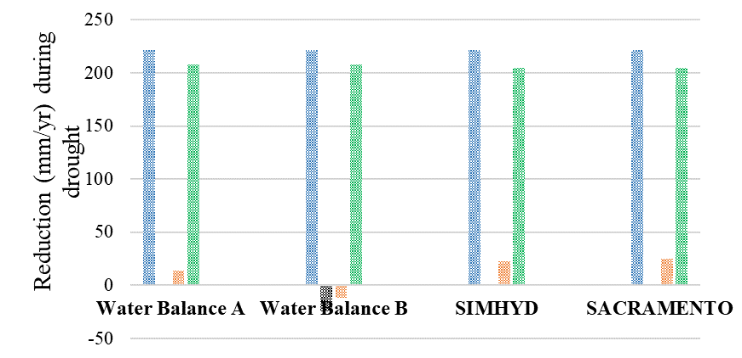
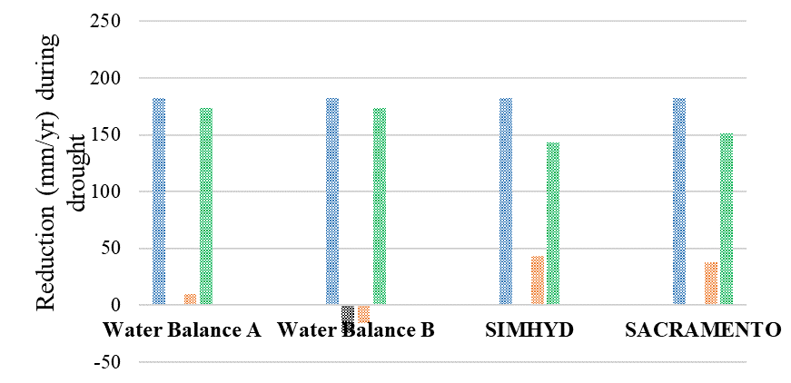
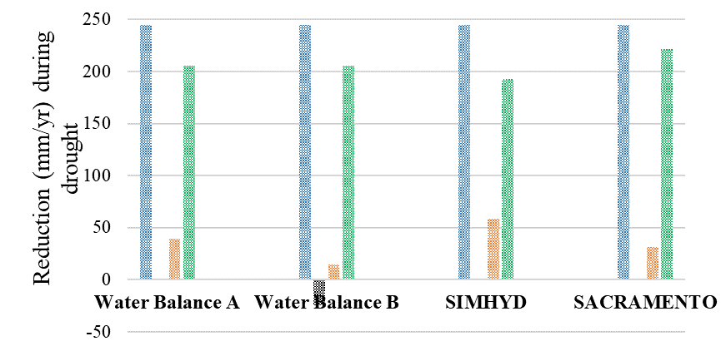
Results – Reductions in water balance components in absolute terms
Drier Catchments
Wetter Catchments
Catchment 407214
Catchment 401208
Catchment 405219
Catchment 406213
Catchment 405209
Catchment 405217

Slide 7
Regional scale variations of AET

Slide 8
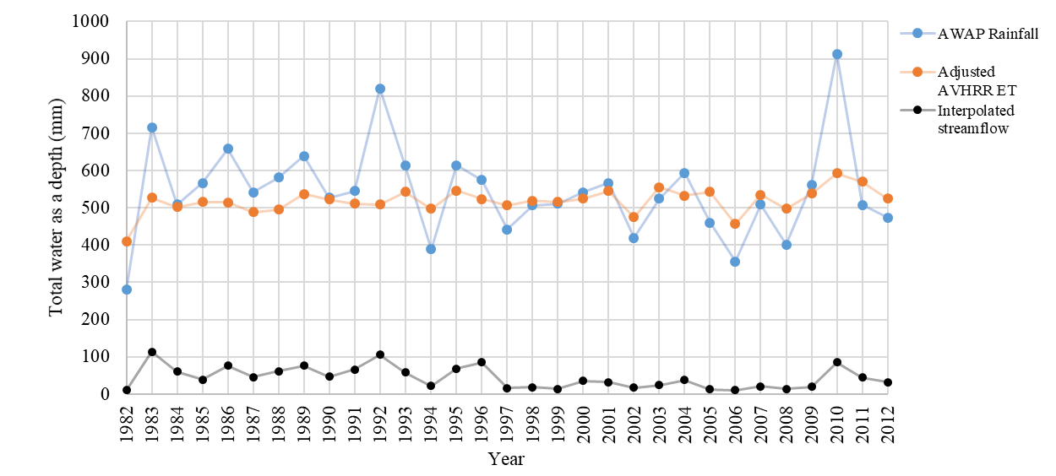
Regional scale variations of AET - West

Slide 9

Conclusion
Relatively constant AET during the Millennium Drought
AET gets priority over streamflow following a drying shift in precipitation partitioning
Rainfall-runoff model results acknowledge the need for model improvements to provide more realistic AET estimates under future drying climates
Abstract

Slide 10
Email: hgardiyaweli@student.unimelb.edu.au

Slide 11
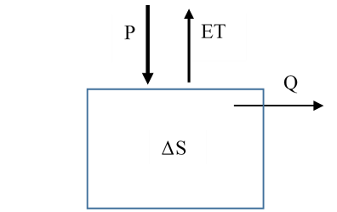

Regional scale variations of AET
$$P=ET+Q+ ΔS$$
$$PAWAP=ETAVHRR+QInterpolated+ ΔS$$
Table 1: Sources of water balance components
Water balance component | Product
Rainfall | AWAP
Discharge | Observed discharge, spatially interpolated
AET | AVHRR NDVI based ET

Slide 12
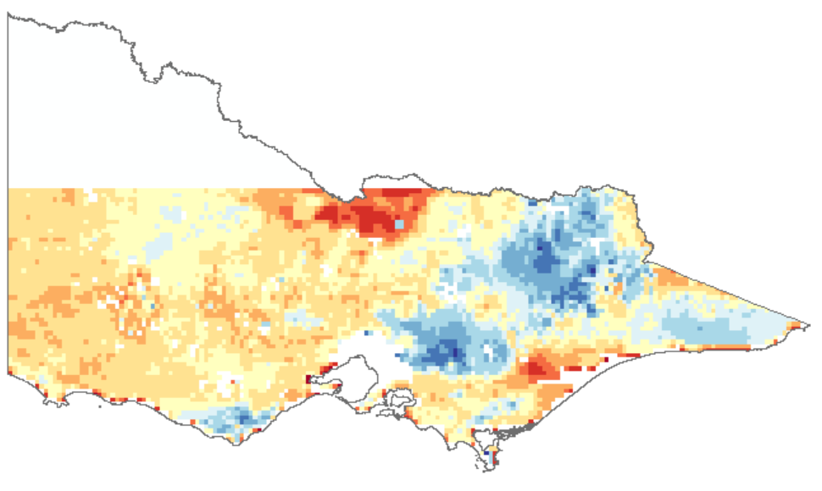
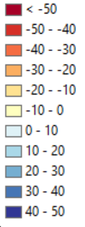
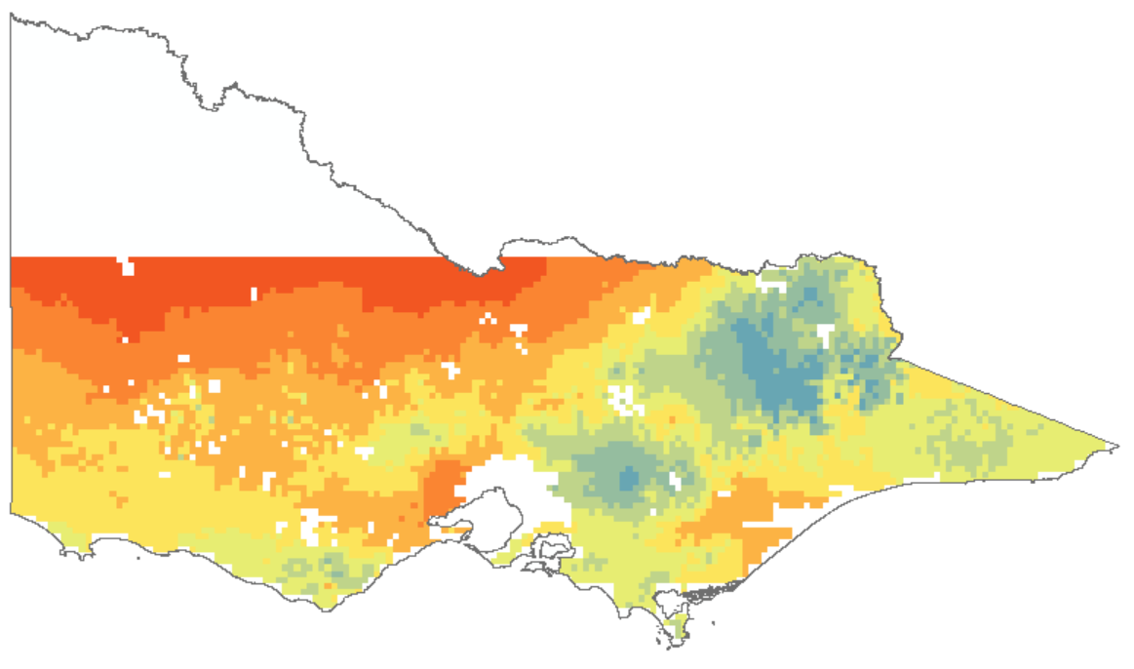
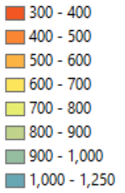

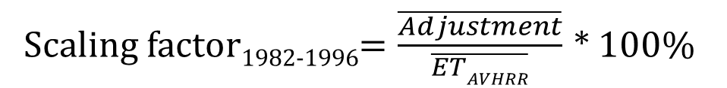
Regional scale variations of AET
Concept of water balance closure
a) Scaling factor applied to close water balance during 1982-1996, in percent
b)Average annual AVHRR ET (mm) over 1982-2012 after adjusting whole dataset by the factor
$$PAWAP=ETAVHRR+QInterpolated+ ΔS$$
$$≅0$$
Scaling factor₁₉₈₂₋₁₉₉₆$=\frac{\overline{Adjustment}}{\overline{ETAVHRR}}$ * 100%

