Slide 1



MJO modulation of subseasonal-to-seasonal (S2S) prediction in the Northern Hemisphere
Hera Kim¹, Hyemi Kim², Seok-Woo Son¹, & Kyong-Hwan Seo³
¹School of Earth and Environmental Sciences Seoul National University
²School of Marine and Atmospheric Sciences, Stony Brook University, Stony Brook, NY, USA
³Department of Atmospheric Sciences, Pusan National University, Busan, South Korea
Notes:
일방적인 관계 → 상호작용 X
제목이 예측성 내용을 포함할 수 있도록
겨울인데 열대 얘기만?
겨울 EA 강수라면 고위도의 영향이 main이다 (MJO는 secondary)
AO와 같은
깊이있는 연구를 해라 , 새로운 연구보다 있는걸 깊이 (부족한 점을 채우고)
Draft에 Part 1, part2 하지말고 유기적으로 한통으로 연결
Decadal을 버리고 ENSO에 대한 깊은 기작을 추가분석 (LBM? 등) + 북쪽에서 오는 영향 (AO등)

Slide 2
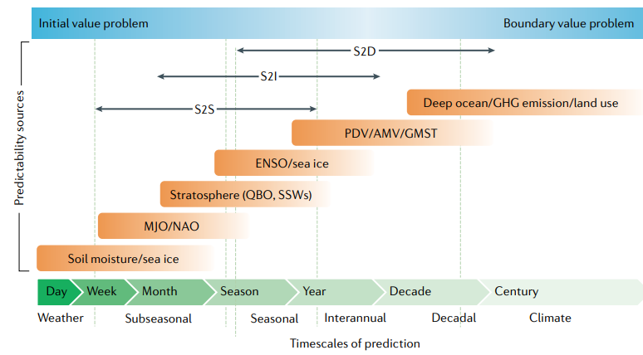
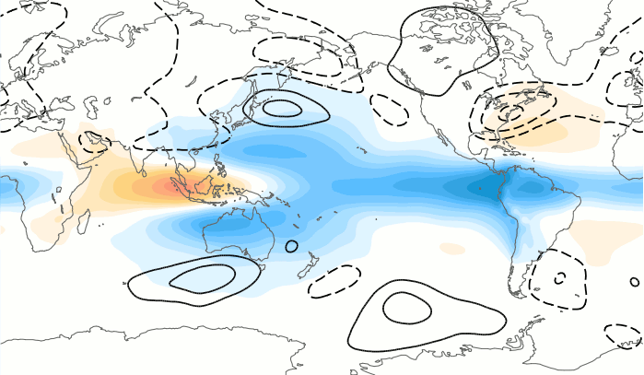
MJO as a source of subseasonal prediction
MJO: Madden-Julian oscillation
Sources of predictability
MJO & upper-level wave responses to the MJO
MJO
Teleconnection with lag
Extratropics
MJO P2-3
MJO P6-7
Enhanced teleconnection
Strong impact
(PNA, NAO)
By Ángel F. Adames
Meehl et al. (2021)
Subseasonal-to-seasonal (S2S) prediction: high demands, low predictability.
MJO is considered as a primary source for subseasonal prediction for its teleconnections.
35~40% of NH upper-level circulation is explained by the MJO (Matthews et al., 2004).
Notes:
가장 기간이 길고 예측성이 높은것으로 알려진 ECMWF를 이용, 정밀분석

Slide 3
MJO as a source of subseasonal prediction
MJO: Madden-Julian oscillation
MJO & upper-level wave responses to the MJO
MJO
Teleconnection with lag
Extratropics
MJO P2-3
MJO P6-7
Enhanced teleconnection
Strong impact
(PNA, NAO)
By Ángel F. Adames
Subseasonal-to-seasonal (S2S) prediction: high demands, low predictability.
MJO is considered as a primary source for subseasonal prediction for its teleconnections.
35~40% of NH upper-level circulation is explained by the MJO (Matthews et al., 2004).
Notes:
가장 기간이 길고 예측성이 높은것으로 알려진 ECMWF를 이용, 정밀분석

Slide 4
Key questions
Q1: How long and how much does the MJO affect NH extratropical prediction?
Q2: In which region is the prediction skill most sensitive to the MJO?
Q3: Which factor (property) of predicted MJO should be considered?
Notes:
가장 기간이 길고 예측성이 높은것으로 알려진 ECMWF를 이용, 정밀분석

Slide 5
Data: subseasonal prediction models
Model | Version | Ensemble Size | Initialization frequency | Reforecast length (analysis period)
ECMWF | IFS CY45R1 | 11 | 2/week | 1998-2018
CNRM-Meteo | CNRM-CM6.0 | 15 | 4/month | 1993-2014
UKMO | GloSea5-GC2-LI | 7 | 4/month | 1993-2016
46LCESM1 | CESM1 | 10 | 1/week | 1999-2015
Reference data: ERA-Interim
Only the extended winter (November-March; NDJFM) is analyzed
Notes:
가장 기간이 길고 예측성이 높은것으로 알려진 ECMWF를 이용, 정밀분석

Slide 6
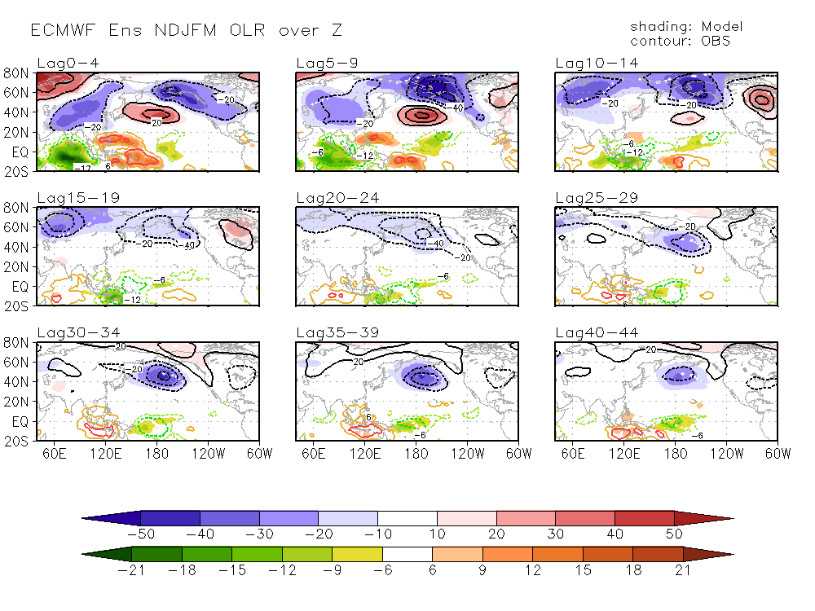
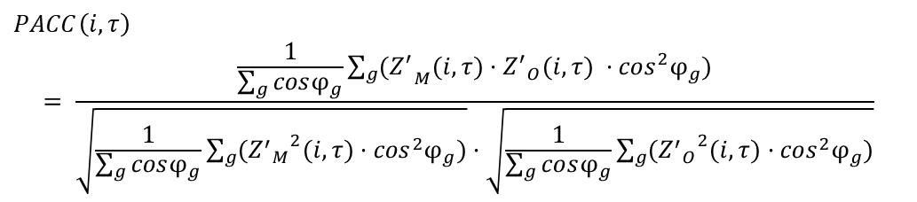


Methods: NH prediction skills
Pattern Anomaly Correlation Coefficient (PACC; uncentered)
$$PACC\left(i,τ\right)$$
$$= \frac{\frac{1}{\sum_{g}{cosφ_{g}}}\sum_{g}{{(Z^{′}}_{M}(i,τ)·{Z^{′}}_{O}(i,τ) ·\cos^{2}φ_{g}})}{\sqrt{\frac{1}{\sum_{g}{cosφ_{g}}}\sum_{g}{({{Z^{′}}_{M}}^{2}(i,τ)·\cos^{2}φ_{g})}}·\sqrt{\frac{1}{\sum_{g}{cosφ_{g}}}\sum_{g}{({{Z^{′}}_{O}}^{2}(i,τ)·\cos^{2}φ_{g})}}}$$
$$\%DIFF$$
$$= 100 ∗\frac{{PACC}_{groupA} −{PACC}_{groupB}}{{PACC}_{ALL}}$$
To produce 1-D Skill of PACC
To produce 2-D Map of PACC
Notes:
가장 기간이 길고 예측성이 높은것으로 알려진 ECMWF를 이용, 정밀분석

Slide 7
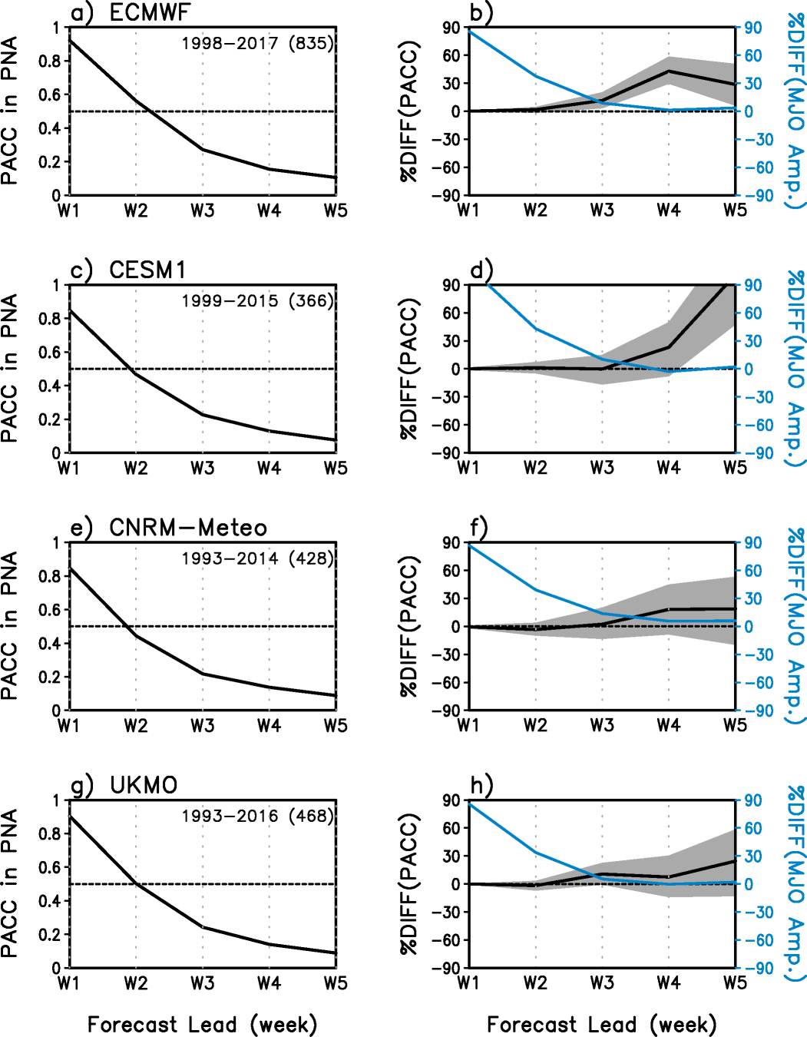
Results: Initial MJO amplitude → PNA prediction skills
Q1
PACC(Z500)
Pattern Anomaly Correlation Coefficient (PACC; uncentered)
MJO amplitude
PACC(Z500)
Strong-Inactive
$$PACC\left(i,τ\right)$$
$$= \frac{\frac{1}{\sum_{g}{cosφ_{g}}}\sum_{g}{{(Z^{′}}_{M}(i,τ)·{Z^{′}}_{O}(i,τ) ·\cos^{2}φ_{g}})}{\sqrt{\frac{1}{\sum_{g}{cosφ_{g}}}\sum_{g}{({{Z^{′}}_{M}}^{2}(i,τ)·\cos^{2}φ_{g})}}·\sqrt{\frac{1}{\sum_{g}{cosφ_{g}}}\sum_{g}{({{Z^{′}}_{O}}^{2}(i,τ)·\cos^{2}φ_{g})}}}$$
$$\%DIFF$$
$$= 100 ∗\frac{{PACC}_{groupA} −{PACC}_{groupB}}{{PACC}_{ALL}}$$
Models tend to predict circulation in the PNA region better with strong MJO than with inactive MJO.
In ECMWF, the modulation effect peaks in lead week 4 (W4).
Notes:
가장 기간이 길고 예측성이 높은것으로 알려진 ECMWF를 이용, 정밀분석

Slide 8
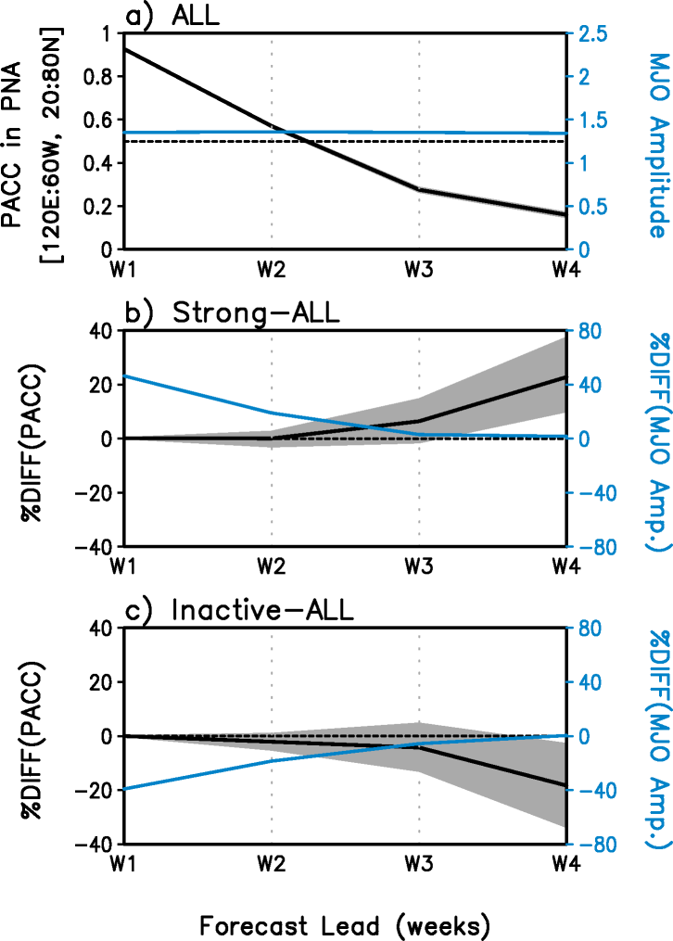
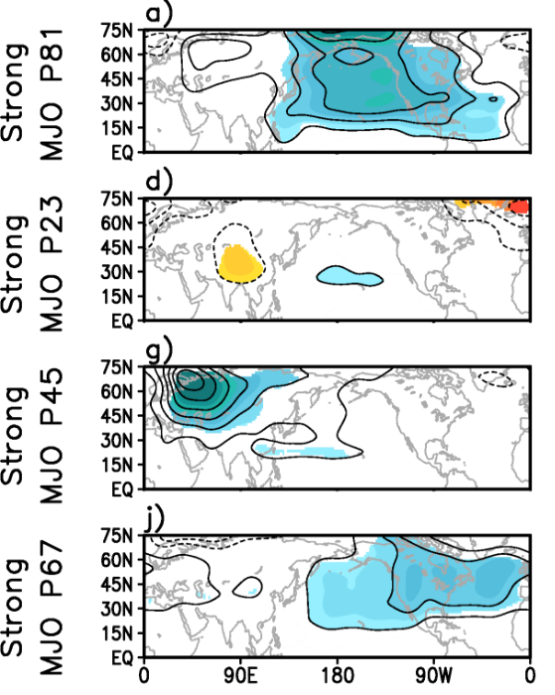
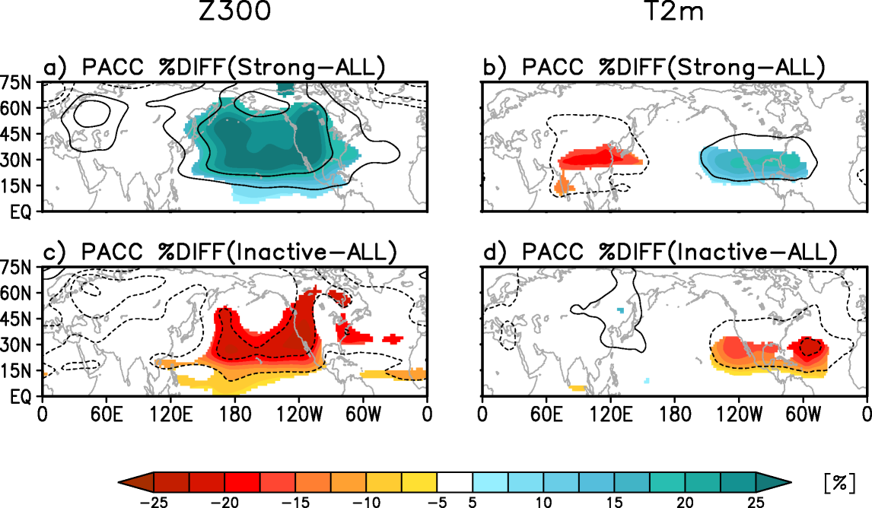
Initial MJO amplitude & phase → PNA prediction skills in W4 (ECMWF)
Q2
Z300 PACC in PNA (20:80N,120E:60W)
PACC %Diff (W4) relative to ALL
PACC %Diff (W4): Strong-Inactive
PACC(Z300)
MJO amplitude
Shading: 95% confidence level
The impact from the Initial MJO amplitude is concentrated in the PNA region, in terms of Z300 prediction skill.
The PACC difference between Strong and Inactive accounts for 40~50% of average PACC.
Initial MJO phase also has the modulation impact: P81 has the greatest impact, P23 has little impact.
Notes:
가장 기간이 길고 예측성이 높은것으로 알려진 ECMWF를 이용, 정밀분석

Slide 9
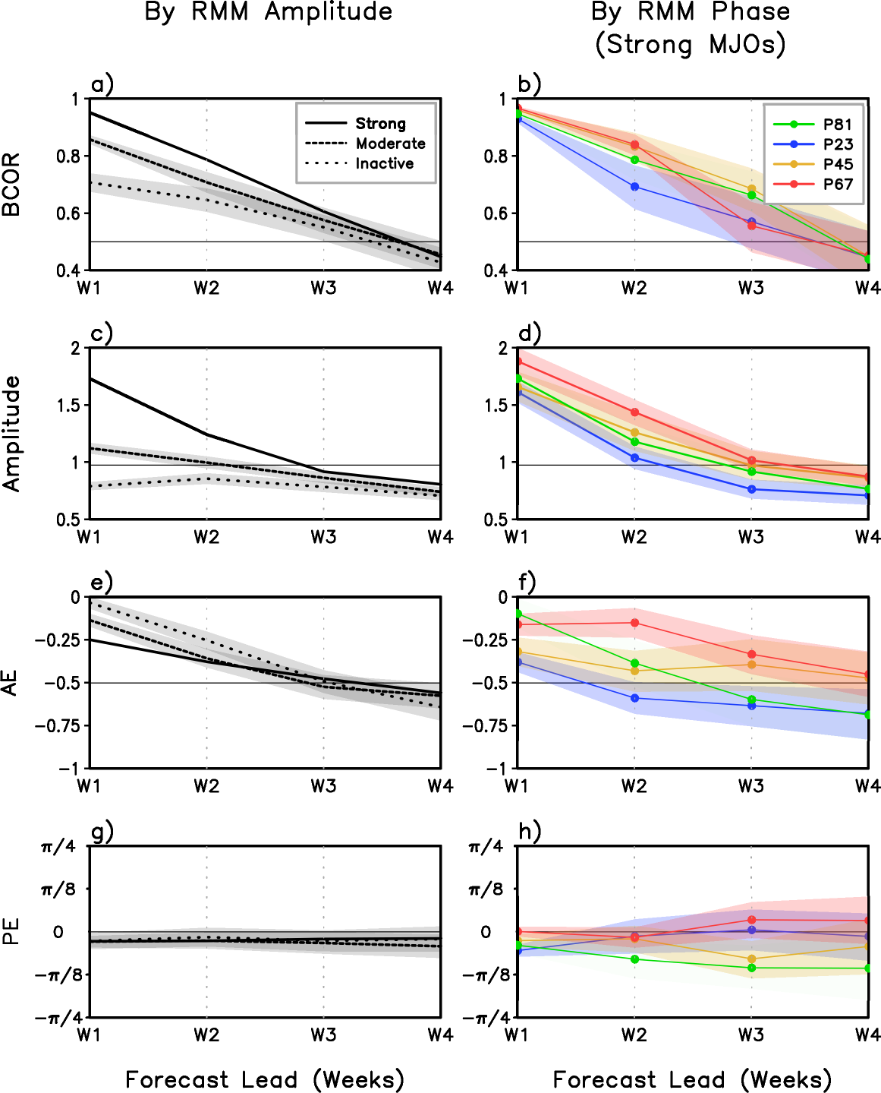
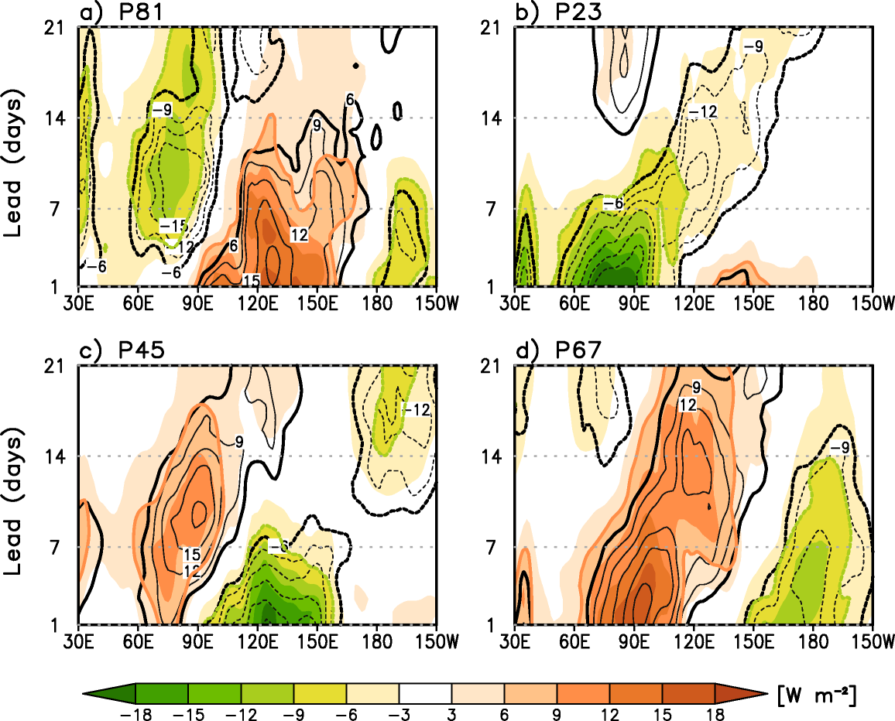
Predicted MJOs
Q3
OLR anomaly, 15°S:10°N (ECMWF, OBS)
Black contours: OBS
MJO prediction skill (amplitude): Strong < Inactive
MJO prediction skill (phase) : Other phases > P23
Persistent MJO (model) → better NH prediction
P23: Maritime Continent barrier (Kim et al. 2016)
P81: Dipole structure in W2-3 → strong teleconnections (Seo & Lee, 2017).
Notes:
가장 기간이 길고 예측성이 높은것으로 알려진 ECMWF를 이용, 정밀분석

Slide 10
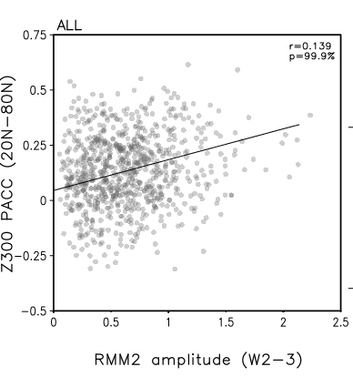
Predicted MJOs
Q3
OLR anomaly, 15°S:10°N (ECMWF, OBS)
Black contours: OBS
MJO prediction skill (amplitude): Strong < Inactive
MJO prediction skill (phase) : Other phases > P23
Persistent MJO (model) → better NH prediction
Dipole structure in W2-3
strong teleconnections (Seo & Lee, 2017)
Effective modulation of NH prediction skill
Notes:
가장 기간이 길고 예측성이 높은것으로 알려진 ECMWF를 이용, 정밀분석

Slide 11
Summary & conclusions
Strong MJO
MJO
NH extratropical
Prediction
Persists
Teleconnection with lag
MJO P2-3
No MJO
No/adverse
impact
Barrier Effect
No source
MJO P8-1
MJO P2-3
(dipole)
Improved
prediction
Propagates
Stronger
Teleconnection
Initial state
Week 2-3
Week 4
MJO during the forecast helps improving the NH prediction skill in S2S timescale (~week 5), thus simulating the MJO persistence (amplitude) should be important.
The phase and zonal structure of the MJO are also associated with the subseasonal NH prediction.
Notes:
가장 기간이 길고 예측성이 높은것으로 알려진 ECMWF를 이용, 정밀분석

