Slide 1
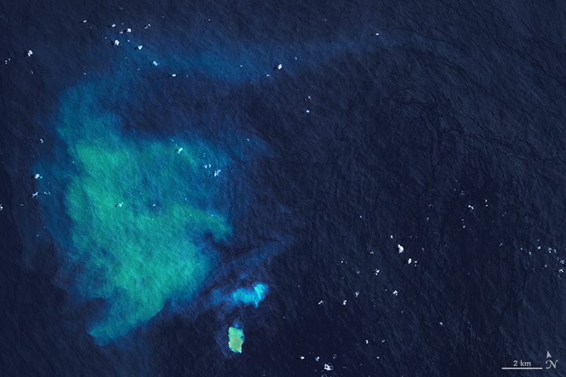



CHARACTERIZATION OF DISCOLORATION PLUMES RESULTING FROM SUBMARINE VOLCANISM USING REMOTE SENSING TECHNIQUES BETWEEN 2000 AND 2018
Joana R. Domingues ¹ *; Vasco M. Mantas ^{1,2}; Alcides Pereira ^{1,2}
¹ Centre for Earth and Space Research of the University of Coimbra (CITEUC)
² Earth Science Department of University of Coimbra
* joana_barreto_domingues@hotmail.com
Notes:
Hi everyone. My name is Joana Domingues and I’m a geologist by University of Coimbra, in Portugal.
I’m going to be presenting some results from my dissertation work on remote sensing applied to submarine volcanism, more concretely the characterization of discoloration plumes between 2000 and 2018.

Slide 2

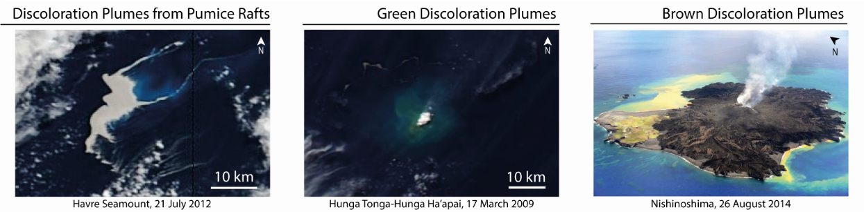
INTRODUCTION
More than 80% of volcanic activity happens in submarine environments, and have associated risks;
Discoloration plumes are one of the by-products of this type of events.
Notes:
More than 80% of volcanic activity happens in submarine environments but the depth and site at which they are located make detection and monitoring difficult.
These types of events are recurrent and have associated risks, like air and ship traffic and tsunamis, as the case of the january Hunga Tonga-Hunga Há’apaí submarine eruption. As a way to help monitoring, remote sensing allows the acquisition of data in near real time.
Discoloration plumes are one of the resulting products of Submarine Volcanism and can have 3 types of coloration:
- Turquoise discoloration plumes are associated with bleaching of pumice rafts;
- Green discoloration plumes are associated with rise of Aluminum concentration;
- And Brown discoloration plumes result from an increase of Iron concentration.

Slide 3
METHODOLOGY
Creation of a database of pre-recorded submarine eruptions;
Selection of relevant images;
Data download and extraction of spectral signatures;
Creation of a classification model;
Smithsonian, Coastal guards, scientific papers
WorldView software
L2 MODIS analysed with SeaDAS software
Weka software (Decision Tree & k-fold = 10)
Notes:
The methodology used is based on 4 steps:
Creation of a database of pre-recorded submarine eruptions based on existing databases like Smithsonian, on Information from coastal guards and scientific papers;
Then with WorldView software we selected the most representative images for each eruption – these are real color images with sharp discoloration plumes, without cloud cover or glint;
Next, we downloaded Level2 MODIS data to proceed with the extraction of spectral signatures with SeaDAS software;
And with the spectral signatures extracted we created a classification model with Weka Software.

Slide 4
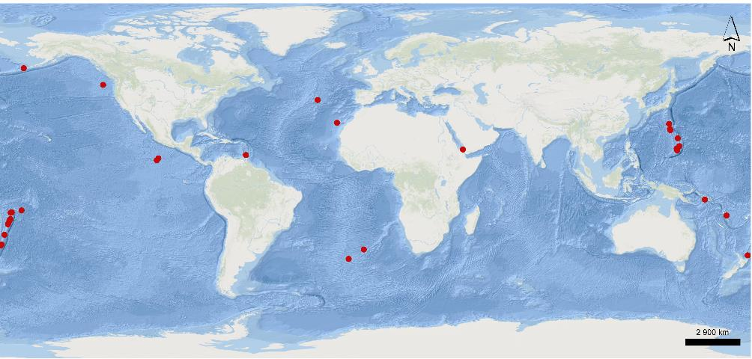

RESULTS
60 Submarine eruptions accounted from 31 different volcanoes
450 satellite images selected (82 used for spectral signature extraction)
263 sample points classified into several classes
Home Reef
Classification model with 96% accuracy
ATLANTIC
OCEAN
PACIFIC
OCEAN
Notes:
We identified 60 submarine eruptions from 31 different volcanoes – Most of these volcanoes are located on the Pacific Ocean, along the Mariana Trench and Tonga Kermadec arc – only in 15 of these volcanoes were we able to detect discoloration plumes;
450 satellite images of discoloration plumes associated with submarine events were selected, and 82 of these images were subsequently used for extraction of spectral signatures;
263 sample points were used for extraction of spectral signatures that based on the different colorations and origin were classified into 5 classes (ocean, chlorophyll, green, brown and turquoise discoloration plumes).
The model created based on the spectral signatures had a 96% accuracy, and may have some associated noise but overall, the model can differentiate biological plumes from discoloration plumes of geological origin.

Slide 5

DISCUSSION
Discoloration plumes associated with pumice rafts
Home Reef
Dacitic
Havre Seamount
Rhyolitic
(Notes: HR – Home Reef; HS – Havre Seamount)
Notes:
Where it concerns discoloration plumes resulting from the bleaching of pumice rafts, these exhibit maximum peaks of 469 to 488 nm, decreasing sharply to 645 nm. The difference on the spectral signatures that we see here, might be the result of different textures and geochemical composition of the pumice.

Slide 6
DISCUSSION
Green discoloration plumes
Similar characteristics
within phases
Discrepancies related to
specific environment dynamics
Notes:
The most common discoloration plumes are the green ones and we verified that there were similarities between some spectral signatures, and therefore we divided them into 5 different phases. The maximum peaks range from 469 nm to 547. The discrepancies cases are usually not in open sea and might be related to specific dynamics, such as coastal zones.

Slide 7
DISCUSSION
Brown discoloration plumes
Small expressions
Variable expressions during the eruption period, between green and brown colors
Notes:
As far as the brown plumes are concerned, the spectral signatures do not show many similarities between them and they show peaks on the green wavelengths, which shouldn’t be the case. The small expression of this type of plumes and the low spatial resolution of the sensor used, may make it impossible to extract them effectively. In some cases, we see a variable expression of brown and green components during the eruption period, thus showing a spectral behavior similar to green discoloration plumes.

Slide 8
CONCLUSIONS & NEXT STEPS
Different types of discoloration plumes show different spectral behaviors;
The methodology used has proven to be effective and efficient and opens doors to detection and monitoring of submarine volcanic eruptions;
Use of multi-sensors for enhanced extraction of the spectral signatures of brown discoloration plumes;
Extending the study with extensive testing in order to validate the model.
Notes:
The main conclusions of my dissertation work are, that different types of discoloration have different spectral behaviors and the methodology used was effective and efficient in differentiating biological from geological plumes, and therefore can help detect and monitor submarine volcanic eruptions in near real time.
Since the accuracy of the model is a bit high, we would need to use multi-sensors to improve the extraction of the spectral signatures, specially from brown discoloration plumes, and by extending the study with exhaustive testing we would validate the model.

Slide 9
THANK YOU
FOR YOUR TIME!
any questions:
joana_barreto_domingues@hotmail.com
Notes:
Thank you for your time, if you have any questions, please send me an email.

