Slide 1
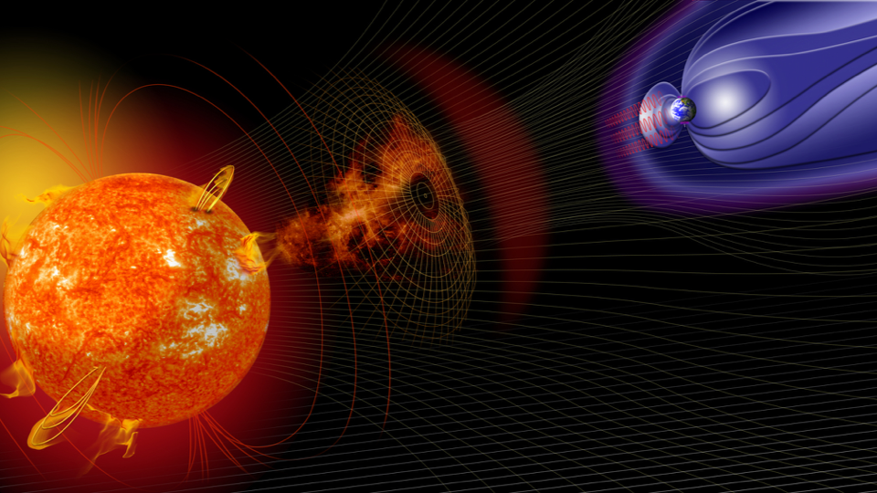



A New Interactive 3D Data Viewer for the Enlil Solar Wind Model
EGU May 2022
Chris Pankratz¹, Greg Lucas¹, Dusan Odstrcil³, Jim Craft¹, Jenny Knuth¹, Tom Berger²
¹Univ. Of Colorado, Boulder Lab. for Atmospheric and Space Physics (LASP) (USA)
²SWx TREC: Space Weather Technology, Research & Education Center (USA)
³George Mason University (USA)
Funded by NASA Award 80NSSC20K1449
https://enlil.swx-trec.com/
https://www.colorado.edu/spaceweather/
Notes:
Hello, my name is Chris Pankratz of the LASP and SWx TREC
at the University of Colorado in Boulder, USA
Along with my colleagues ()
I will be presenting today an overview of and initial results
on a project to develop new 3D interactive visualization capabilities for solar wind models, particularly the Enlil solar wind model
This work is funded on NASA Award 80NSSC20K1449
As part of NASA’s Space Weather Operations-to-Research Program
I would invite you all to visit our web site at the URL indicated at the bottom,
at which you will find links to other applications and tools that we have available
Including the one being presented in this talk.

Slide 2
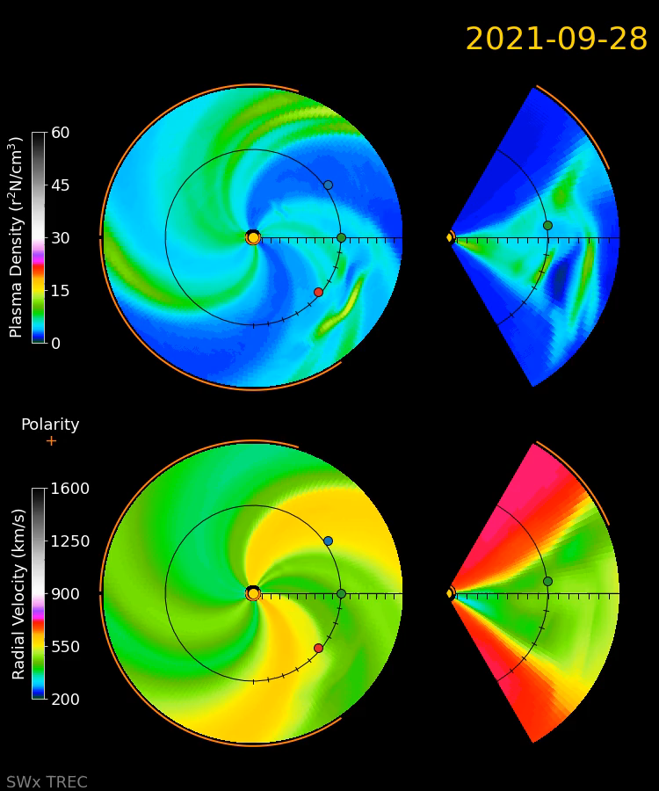
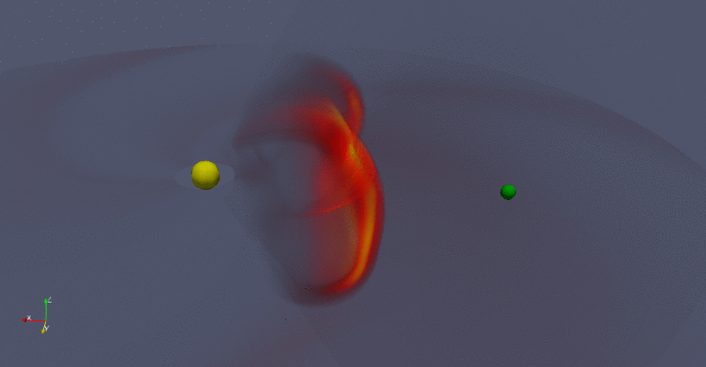
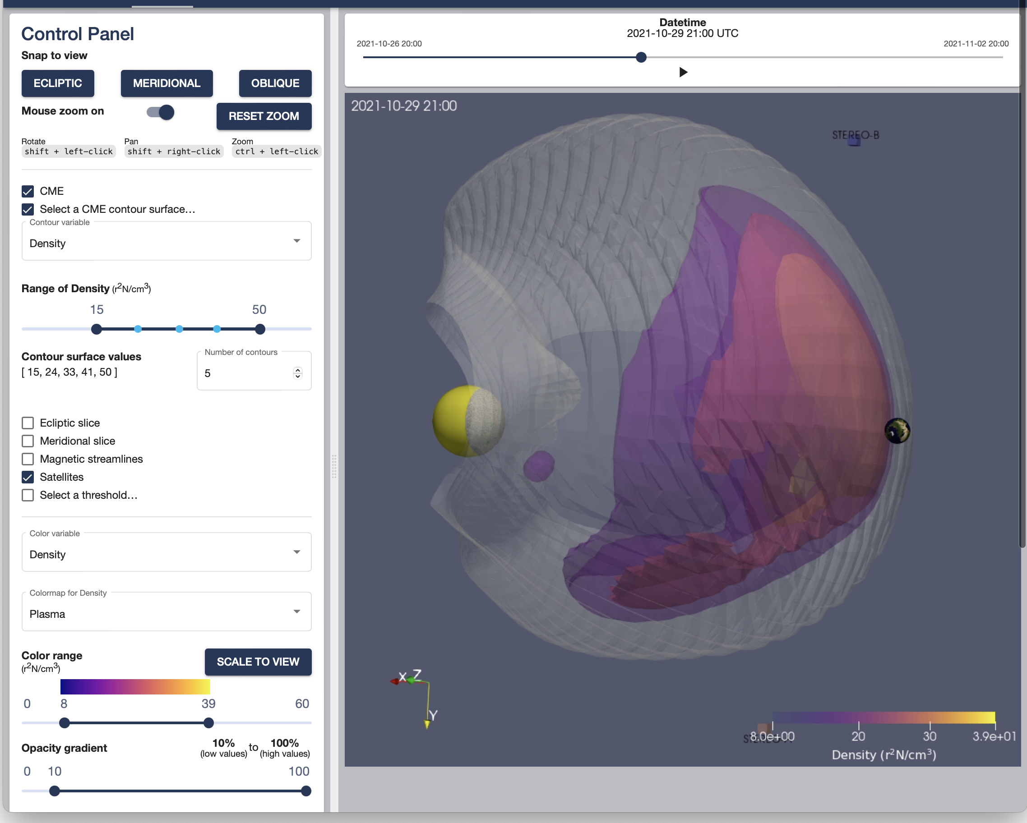
3D Enlil Data Visualization in the Cloud
Motivation
Enlil is a critical model for space weather
forecasters
Viewing the data is presently limited to 2D
Project
We have developed a Cloud-based web interface for full 3D Enlil visualization
A prototype is available for testing. Feedback requested!
Both the visualization tool and Enlil data reside together
        No need for users to download large volumes of data
Established an active collaboration between researchers, forecasters, and modelers
https://enlil.swx-trec.com/
Notes:
I will start out with my summary slide, with details to follow
As many in the space weather community know, ENLIL provides crucial data for forecasters and researchers alike
Modeling the evolution of CMEs as they propagate throughout the heliosphere
ENLIL produces a rich output data set that can be massive in volume depending on the resolution selected
With beautiful and information packed graphics
But they are limited to 2D planes, which can limit the usefulness of the data
We’ve been working on this project for a bit more than one year
There are two primary objectives for the project
3D Enlil Data Visualization Capability
Deploying and running Enlil into the Cloud
We have developed a new visualization capability to take advantage of the full Enlil 3D data volume and interactively visualize the CME expansion from any perspective
We are deploying the Enlil model into a scalable Cloud-based model staging platform computing environment, which allows the full 3D Enlil output to reside in-situ with the visualization engine
Being accomplished through active multi-organization collaboration

Slide 3
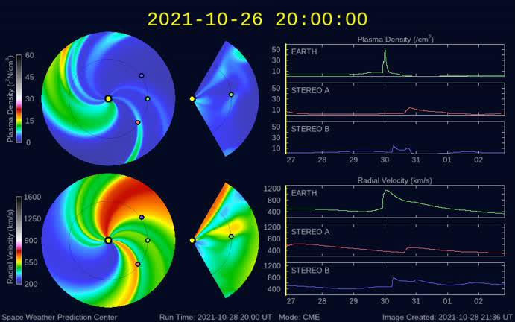
Traditional Enlil Model Visualization from the 2021-10-28 CME
Notes:
Shown here is a traditional 2D visualization of the CME from 2021-10-28
Courtesy SWPC
This shows both the ecliptic and meridional slices/planes
Plasma density
Radial velocity
And the evolution of the CME over time

Slide 4
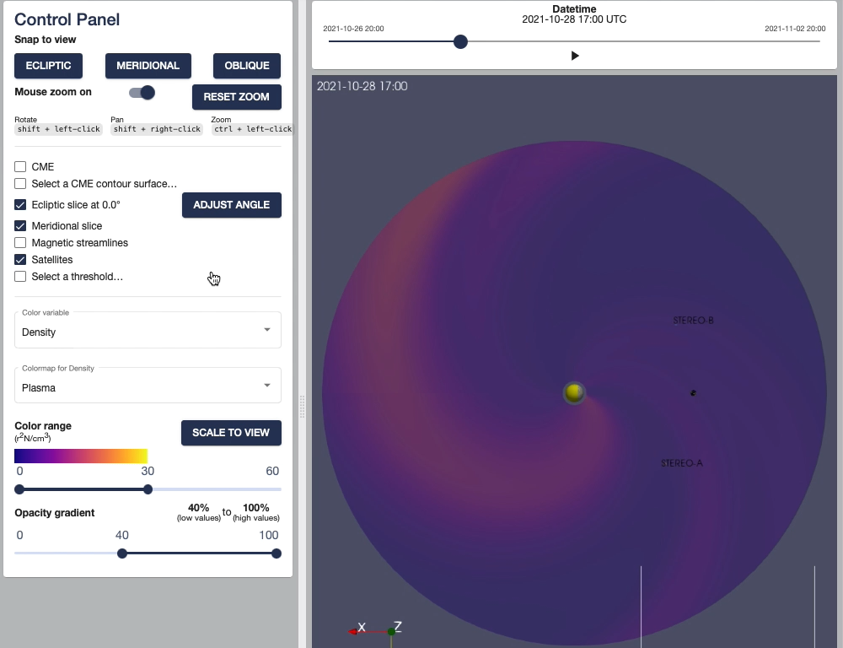
Demo
https://enlil.swx-trec.com/
Notes:
Using the 3D Visualization tool that we are developing, we look at the same CME
With the tool,
We can look at data as an ecliptic slice
And provide controls for different views
We can “play” the CME evolution like a movie, or move the time slider to the time of interest
In this way, the CME can be observed as it propagates in time
By clicking on the Meridional button, one can view the meridional slice
And can reposition it in the view
You can then use the mouse to rotate the view to being examining the data in 3D
Seeing projections onto each of the planes
You can turn on thresholding to be able to explore the data associated with the CME itself
As a 3D volume
And turn off the plane projections to see just the data points matching the selected condition
Here, we’re looking at the plasma density, but only for higher velocity particles
Other variables are available for viewing, as well
The view can be manipulated interactively in 3D to show the data from different perspectives
The threshold filter can be changed on-the-fly to see, for example, only points with even higher speeds
We can also switch what is shown,
Now changing the threshold filter to density
And the displayed data to velocity
Thus showing the speed of higher-density regions
Additional controls are available, as well
This tool is available for use/testing right now

Slide 5
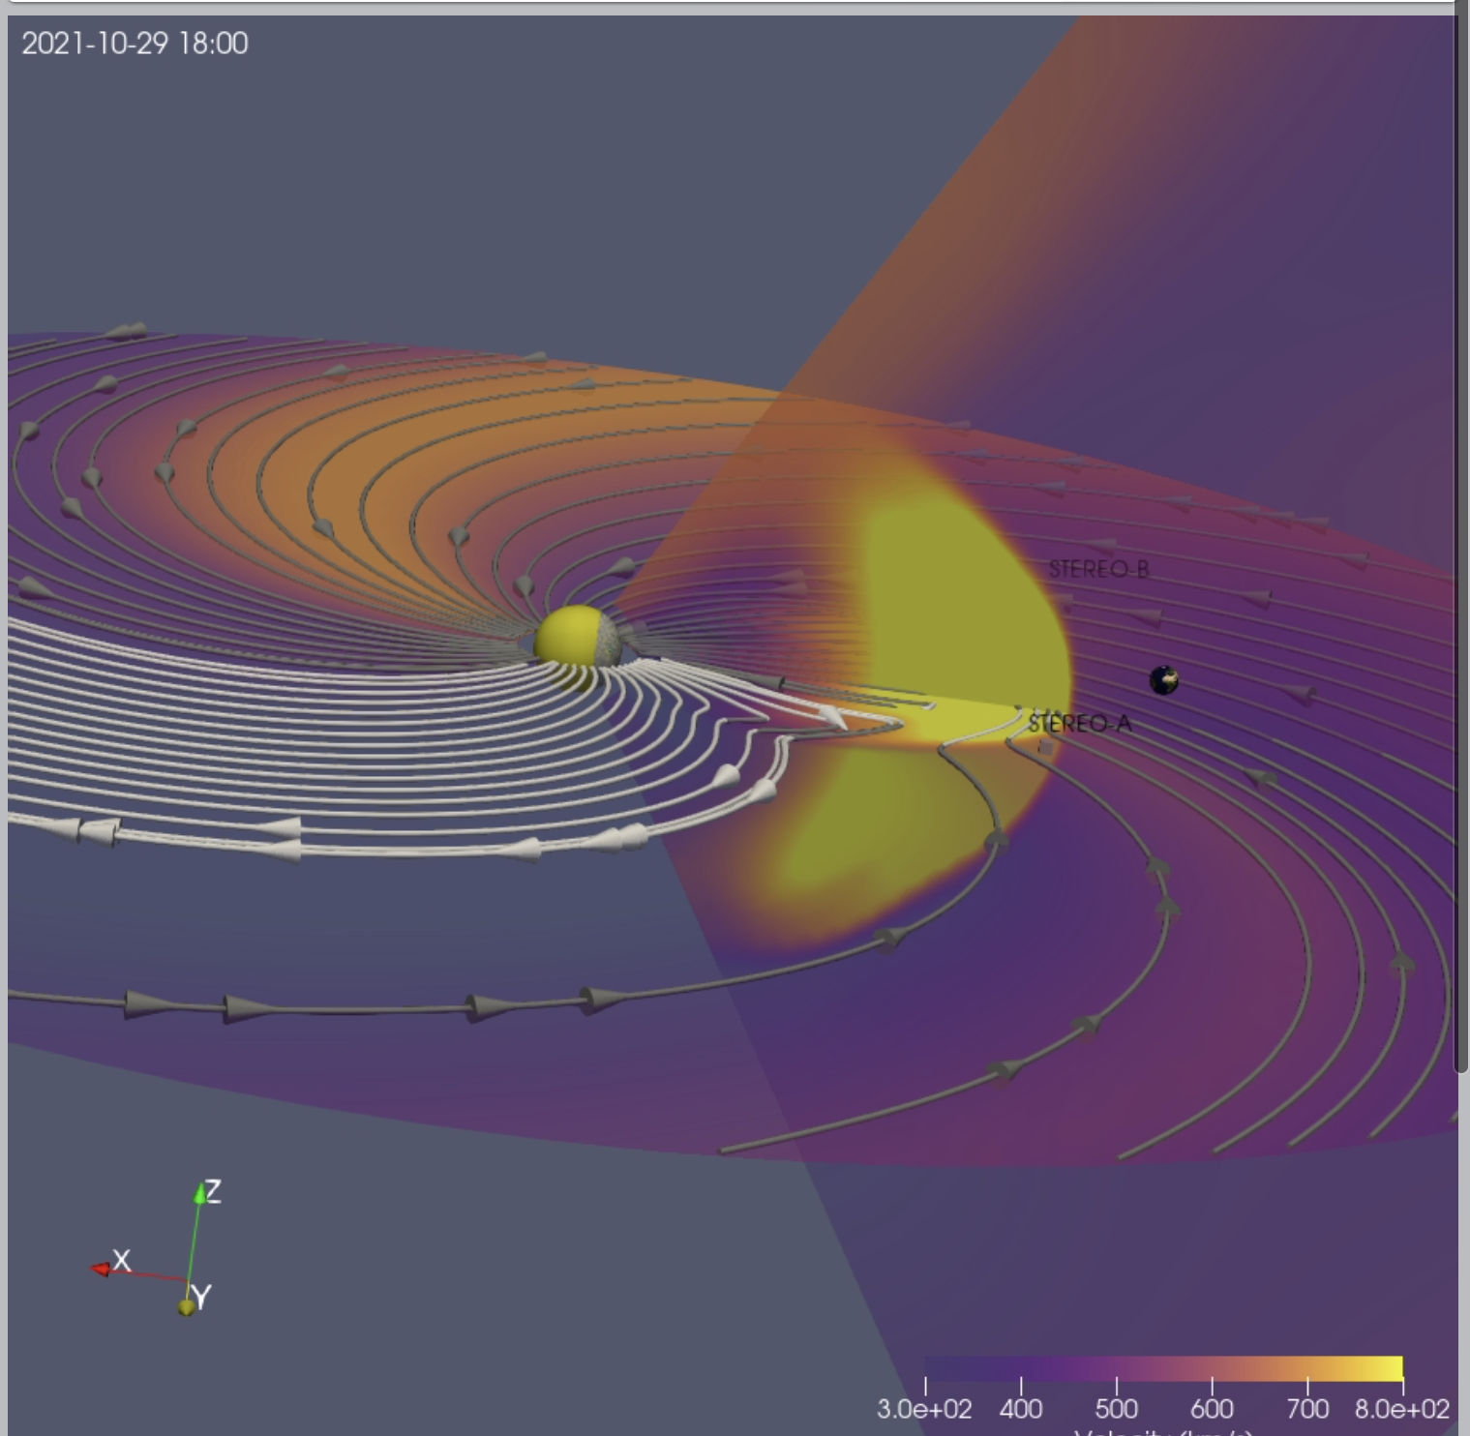
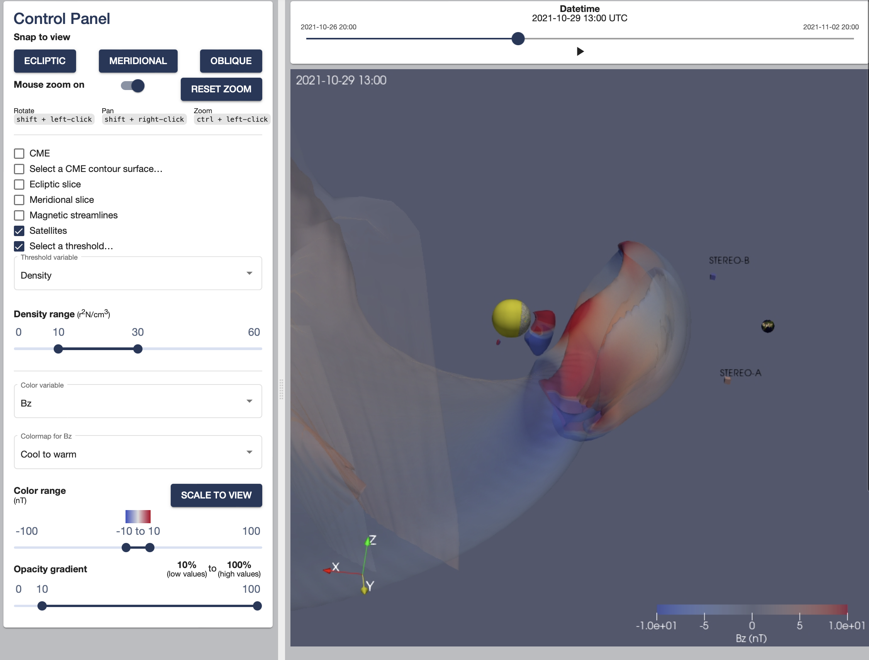
Next Steps
Add multiple runs for viewing (currently only a single event for tool dev/testing)
  e.g CCMC’s runs-on-demand and SWPC forecaster output files
Continuing to gather use cases and progressively adding features.
Continue in-progress work to add Enlil code version control and software workflows
Continue in-progress work to get Enlil running stably in AWS (Cloud) containers
https://enlil.swx-trec.com/

Slide 6

Thank You!
We welcome feedback, questions, and additional collaboration!
  Chris.Pankratz@lasp.colorado.edu
  +1 303-492-0696
Also consider trying our Space Weather Data Portal to access dozens of different data sets: https://lasp.colorado.edu/space-weather-portal
Special Thanks to my colleagues and collaborators
  Greg Lucas – Paraview 3D and AWS Cloud implementation
  Jenny Knuth – Web application design and implementation
  Dusan Odstrcil – ENLIL Model developer
  SWPC (Pizzo, Adamson, Steenburgh, Marble, and more)
  UK Met Office (Bingham, Gonzi, Henley, Stone, Spalton, Hammond, and more)
  CCMC (Mays)
https://enlil.swx-trec.com/

