Slide 1

Nonlinear seismic phenomena as recorded by distributed acoustic sensors
Alexey Yurikov, Roman Isaenkov, Konstantin Tertyshnikov, Boris Gurevich, Evgenii Sidenko and Roman Pevzner (Curtin University, Perth, Australia), Valeriya Shulakova (CSIRO, Perth, Australia)
Julia Correa, Barry Freifeld, Stanislav Glubokovskikh, Todd Wood (Lawrence Berkeley National Lab)
27 May 2022
^{CRICOS Provider code 00301J}
Curtin University is a trademark of Curtin University of Technology.

Slide 2
Motivation
Seismic exploration is based on linear elasticity.
But nonlinear elasticity effects are well documented, especially in ultrasonic NDT.
Nonlinear interaction of seismic waves of different frequencies should generate higher harmonics and combinational frequencies.
Analysis of these effects in field data can potentially help find areas of anomalous nonlinear properties, such as fractured zones, mixed saturation or overpressure.
Nonlinear elasticity effects have been observed in controlled surface seismic experiments.
Downhole fibre-optic distributed acoustic sensors (DAS) allows recording wavefiled over an entire length of the well.
This should help observe the sources and nature of the nonlinear phenomena in the subsurface.

Slide 3
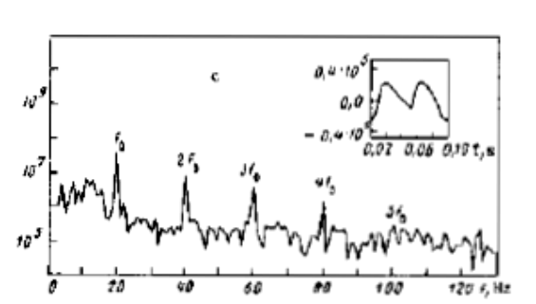
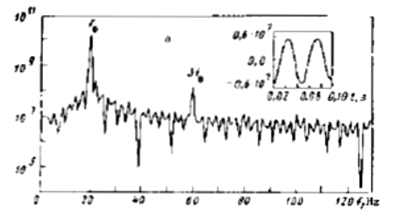
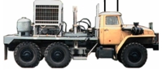






Can we see it in the field?
$$f_{0}$$
$${3f}_{0}$$
$$f_{0}$$
$${2f}_{0}$$
$${3f}_{0}$$
$${4f}_{0}$$
$${5f}_{0}$$
Small offset
Large offset
Beresnev & Nikolayev,
PEPI, 50, 1988

Slide 4
Introduction
Heterodyne
Sources of nonlinearity
Geometrical – high order terms of the equations of motion
Mechanical – interaction between the sources
Physical – nonlinear relation between stress and strain in rocks
Ideal mixer
(multiplier)
Input signal
Output signal
f₁ – f₂
f₁
f₁ + f₂
f₂
Local oscillator
Reginald Fessenden (1902) Wireless signaling. US706740A
Notes:
Do not interfere, but interact

Slide 5

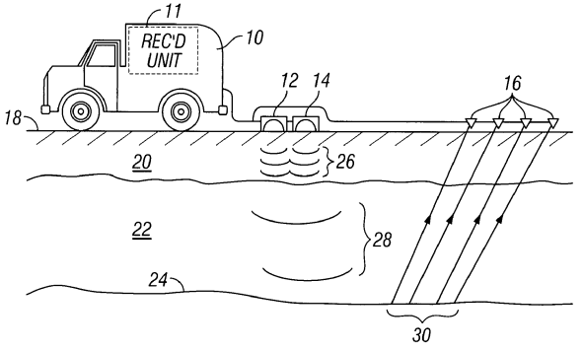

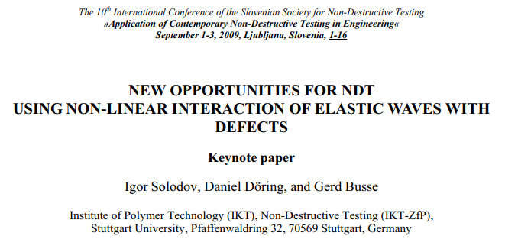
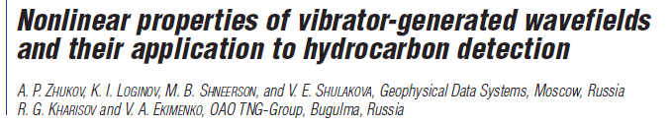
Motivation
Applications
Broadening frequency band of seismic signal
Detection of defects in materials
Monitoring and characterisation of subsurface
Challenges
Understanding of nonlinear effects is limited
Lack of credible examples

Slide 6
Motivation
Enabling technology
Borehole DAS receivers
Our goal
Examine nonlinear elastic effects
Improve understanding of how these effects can be used
Testing program
Seismic vibrator trucks – Curtin GeoLab
Permanent surface orbital vibrators – CO2CRC Otway site
Laboratory tests – Curtin Rock Physics lab

Slide 7
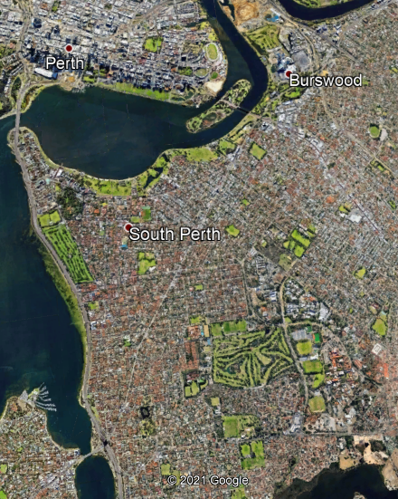


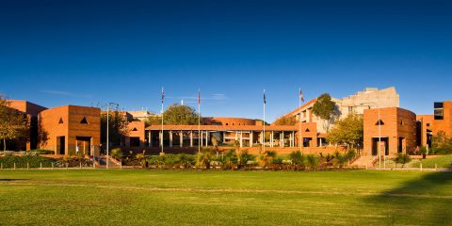
Western Australia
Perth
Curtin campus
1 km

Slide 8
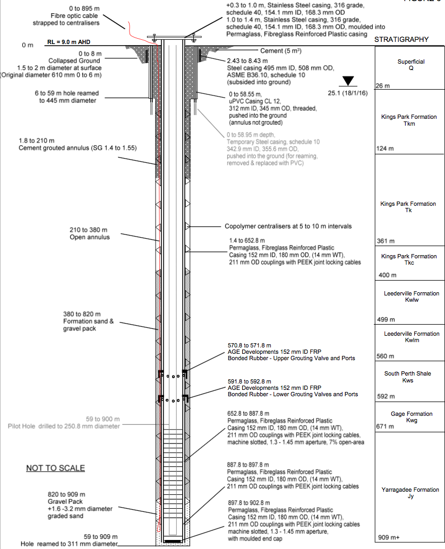
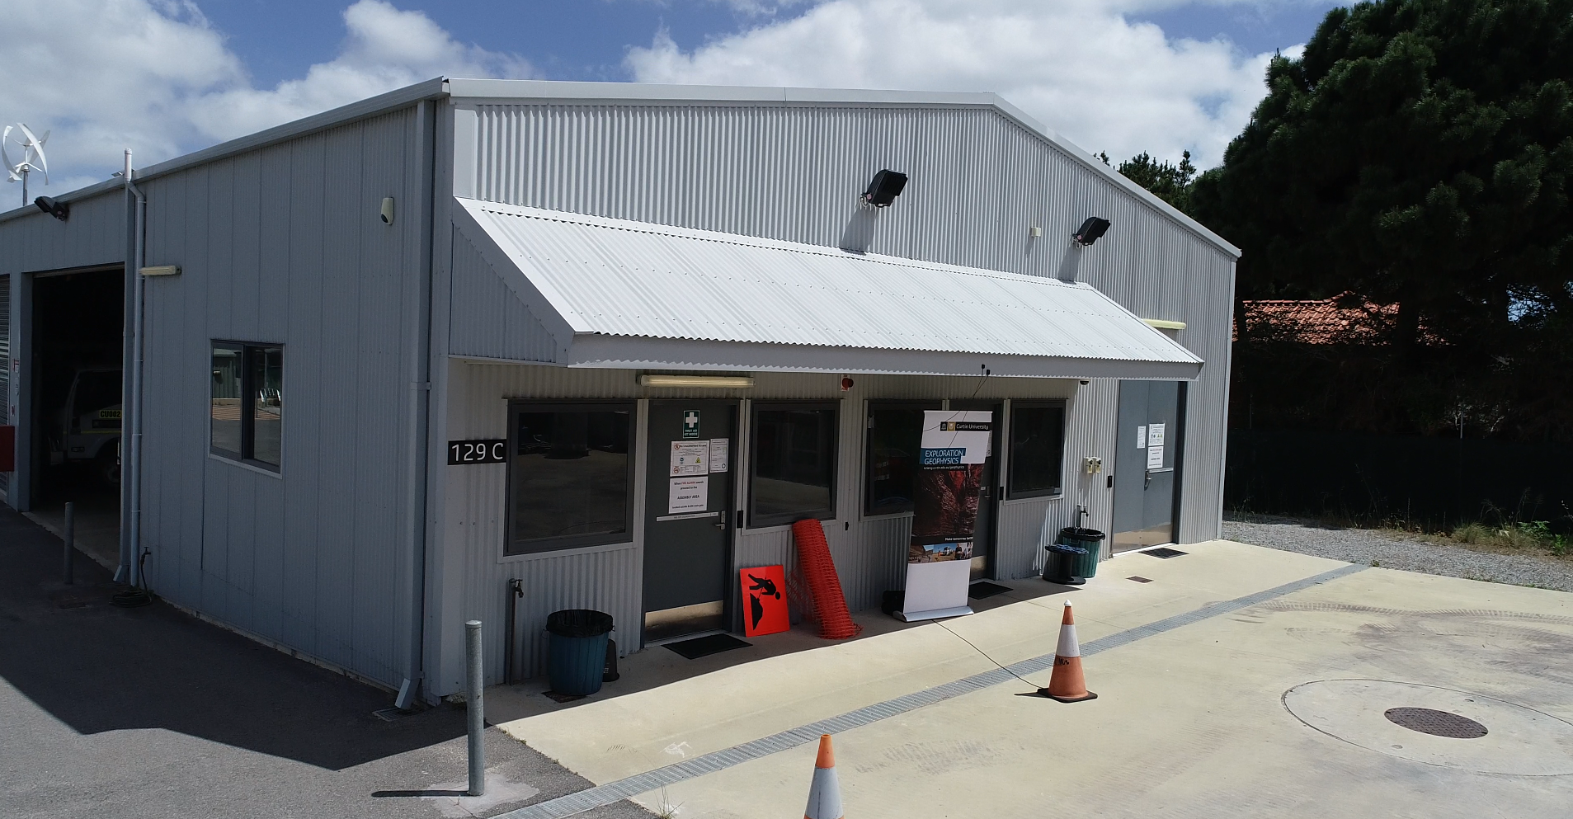
Curtin GeoLab experiment
Curtin NGL well
Depth: 900 m
Instrumented with fibre-optic cable
DAS unit (inside)
Well

Slide 9
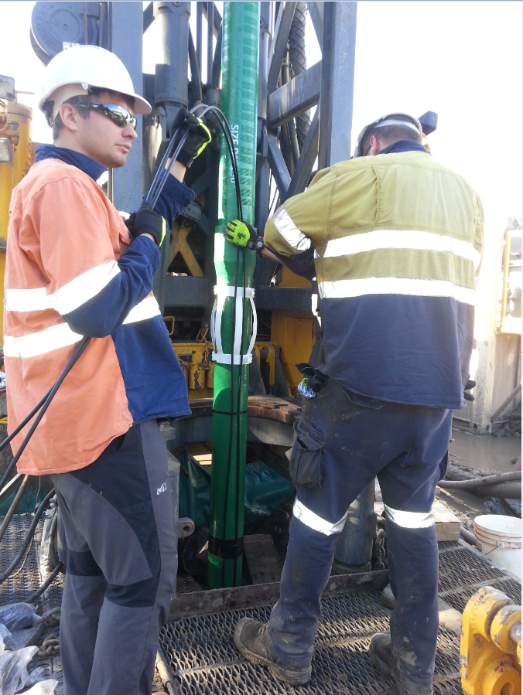
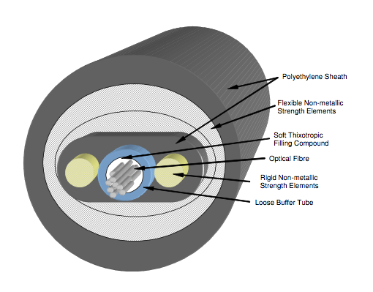
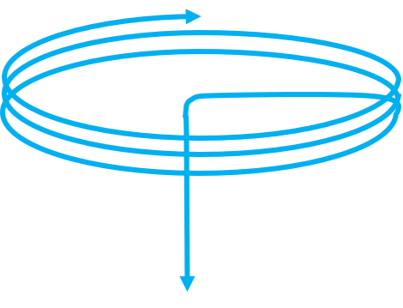
Curtin GeoLab experiment
Fibre optic cable cemented at NGL
Armored non-metallic cable
10 mm OD
Temperature range -40 to 80 deg C
2 x 62.5µm (OM1), 2 x 50µm (OM2) and 2 x G652.d SM
In excess of ~200 m of fibre optic cable is coiled around the well head
Coil has ~3 m in diameter
To DAS unit
To well
~3 m in diameter

Slide 10
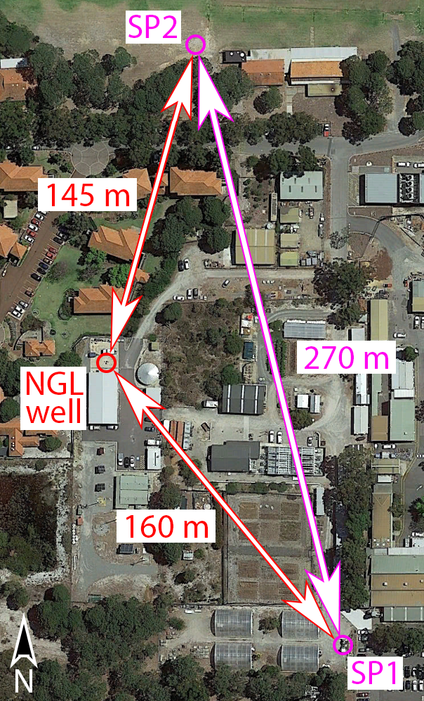
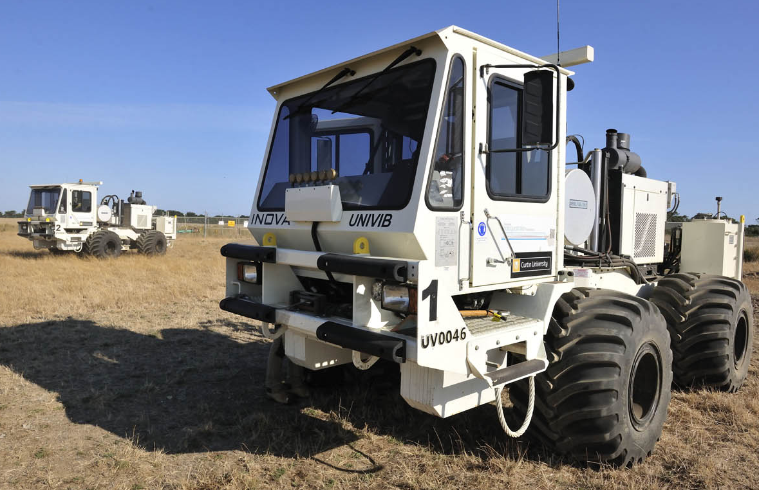
Experiment
Source
26,000 lbs INOVA vibroseis
10 x 30 s
5 s listen time
Procedure
Vib1 solo (30 Hz)
Vib2 solo (22 Hz)
Vib1 and Vib2 (22 & 30 Hz)

Slide 11
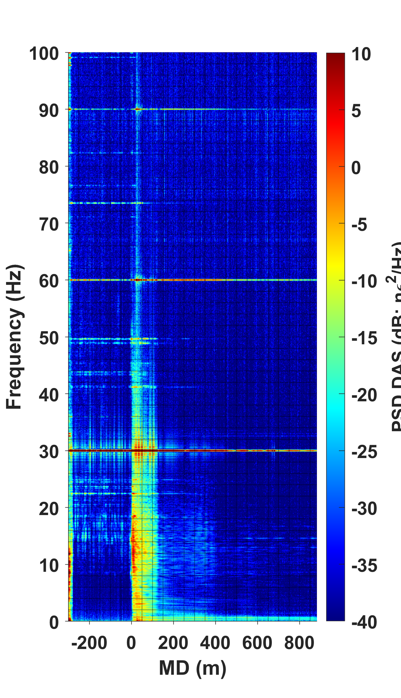
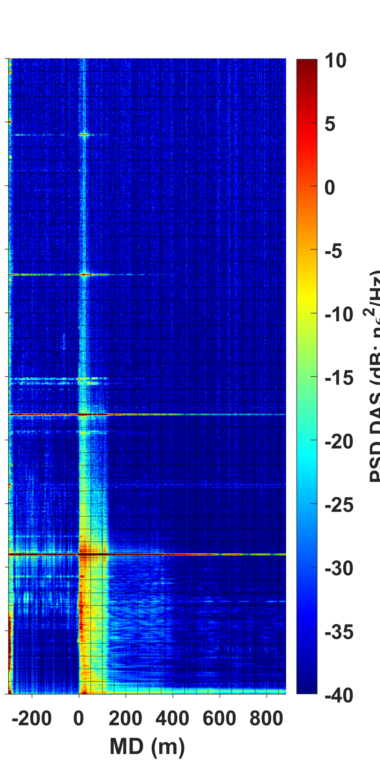
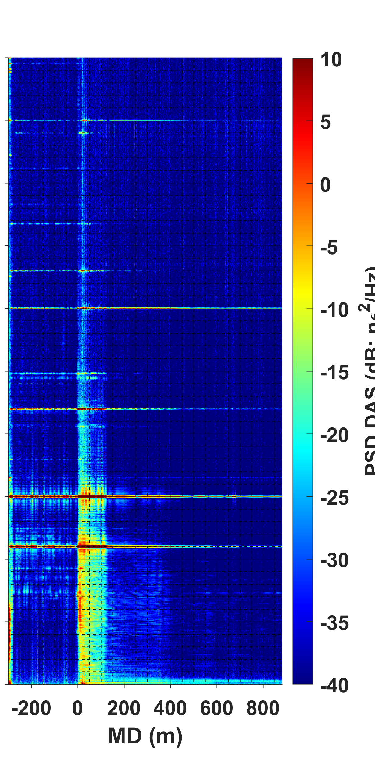
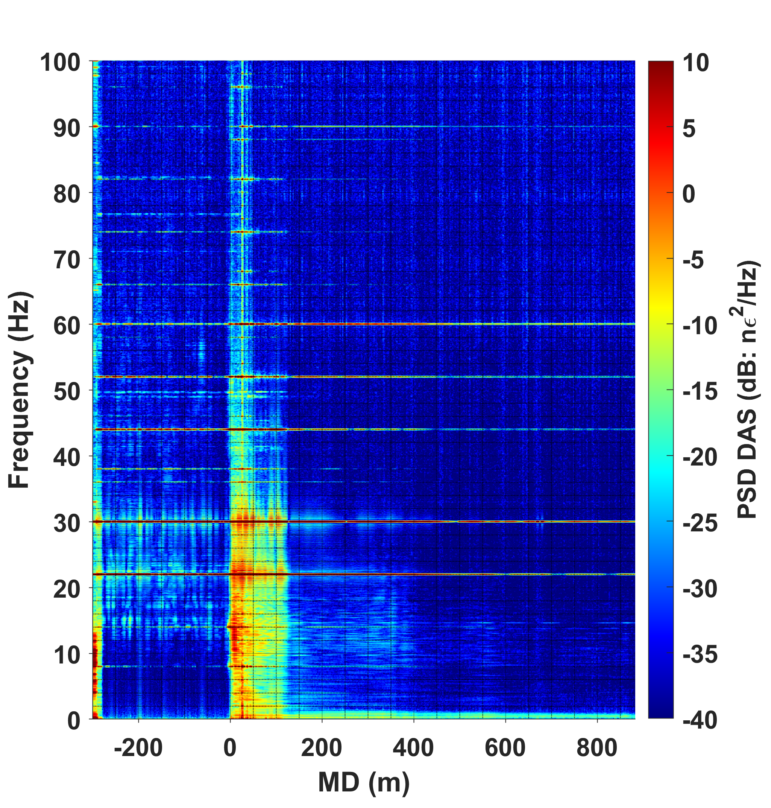
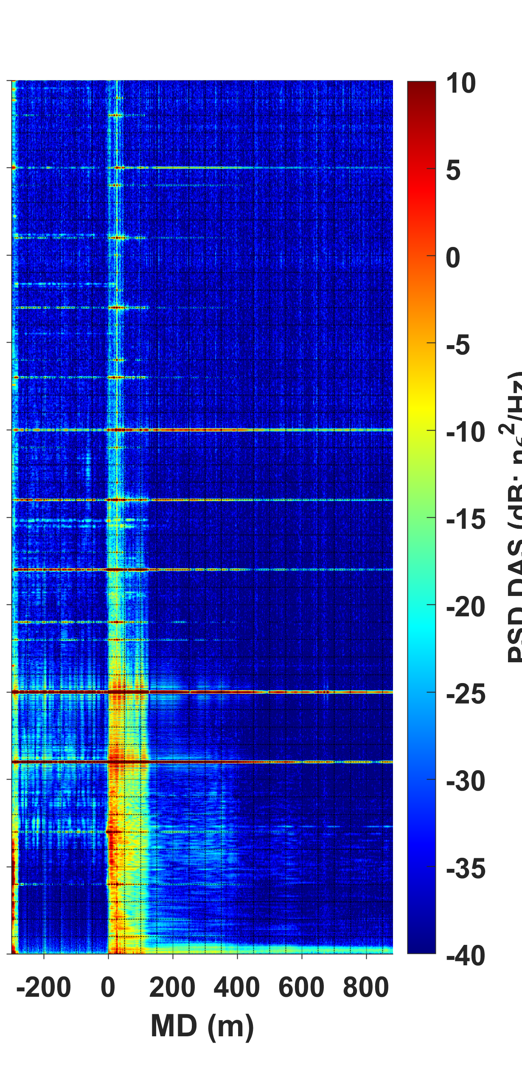
Curtin GeoLab experiment
Vib1
Vib2
Vib1 + Vib2
Vib1 & Vib2
Combinational frequencies are present only when two vibrators work at the same time
3f₁
2f₁+f₂
f₁+2f₂
3f₂
2f₁
f₁+f₂
?
2f₂
f₁
f₂
f₁-f₂

Slide 12
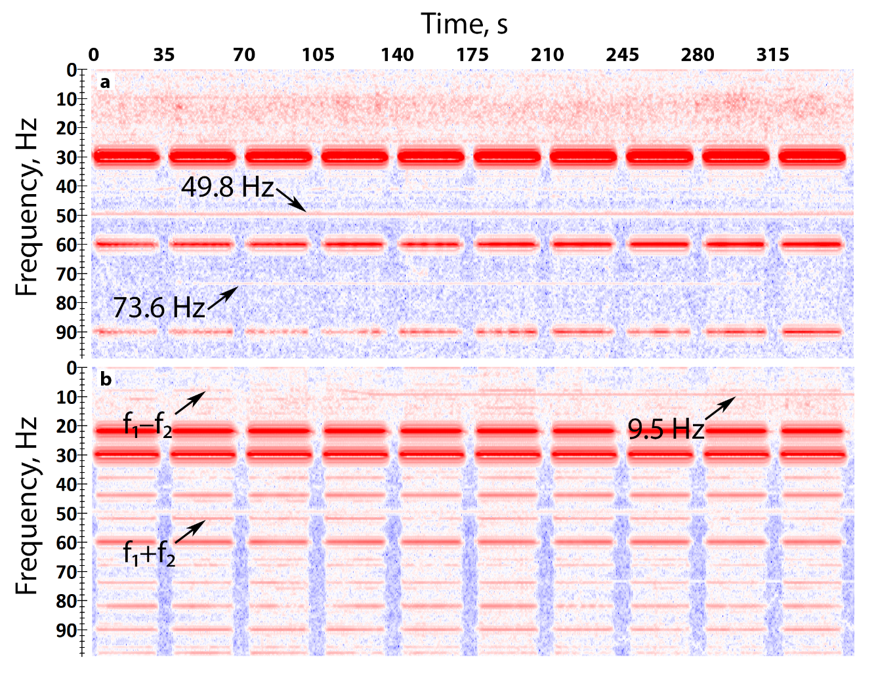
Curtin GeoLab experiment
The wavefield contains
Fundamental frequencies
Higher harmonics
Combinational frequencies
Noise from human activity
Vib1 (f₁ = 30 Hz)
Vib1 & Vib2

Slide 13
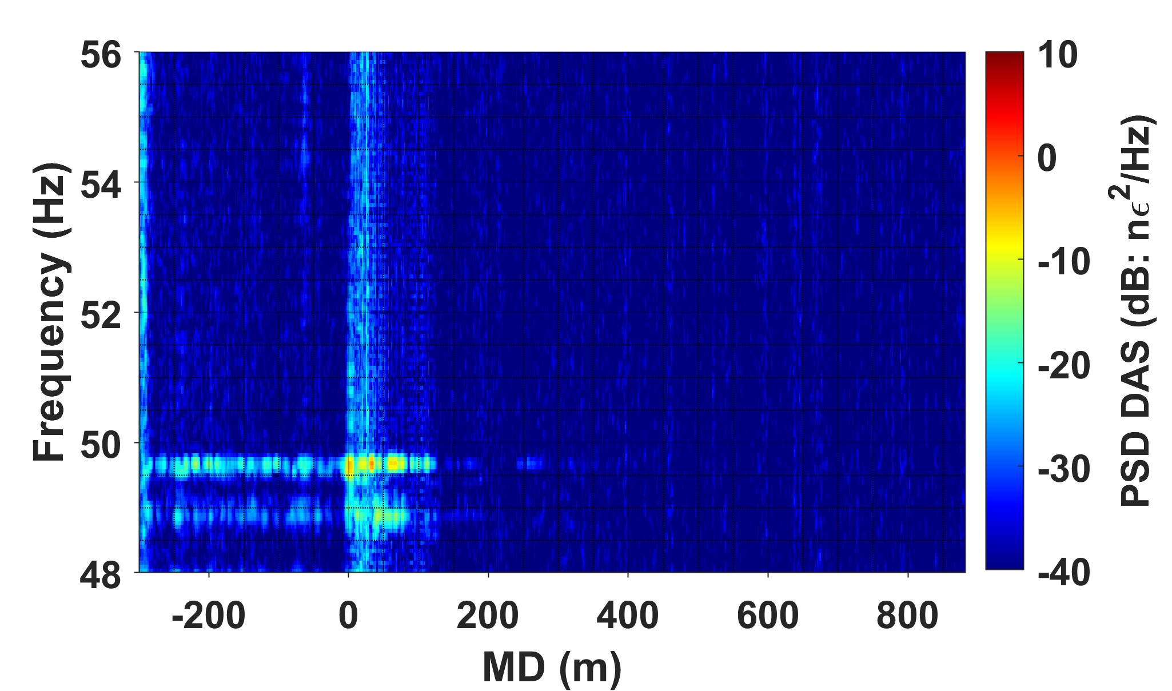
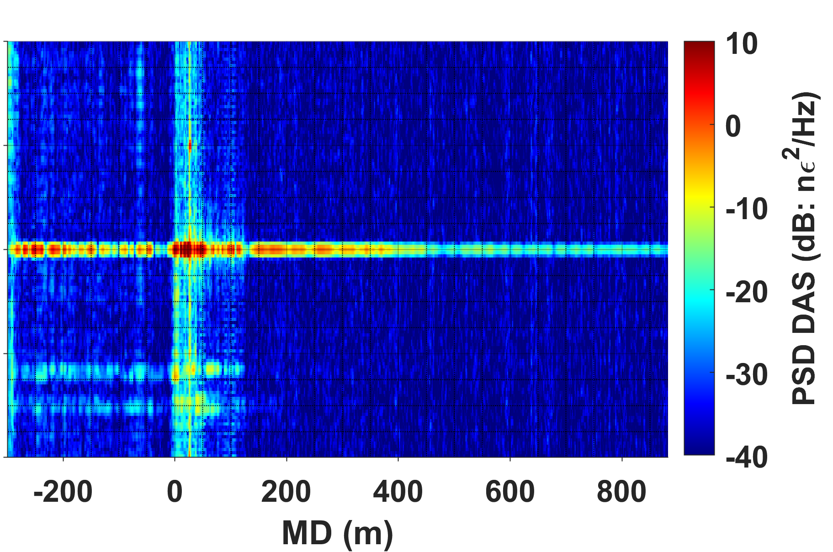
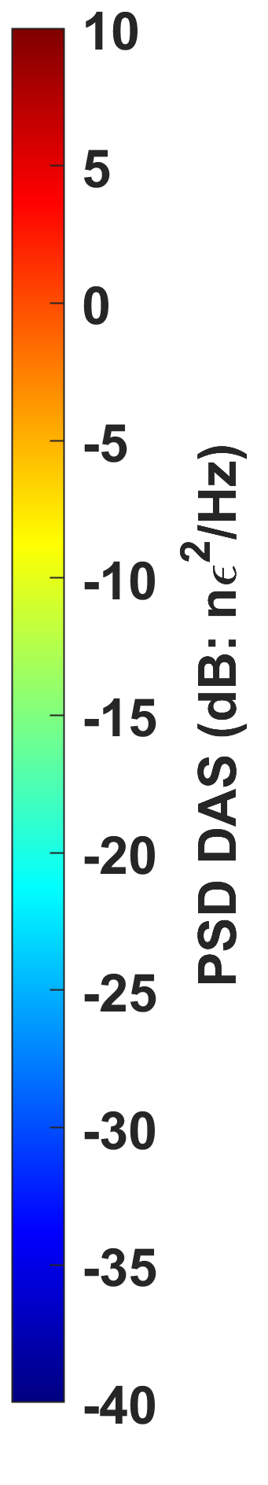
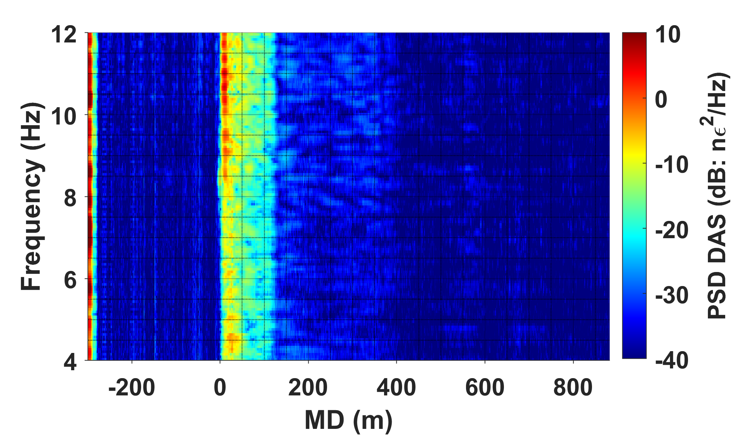
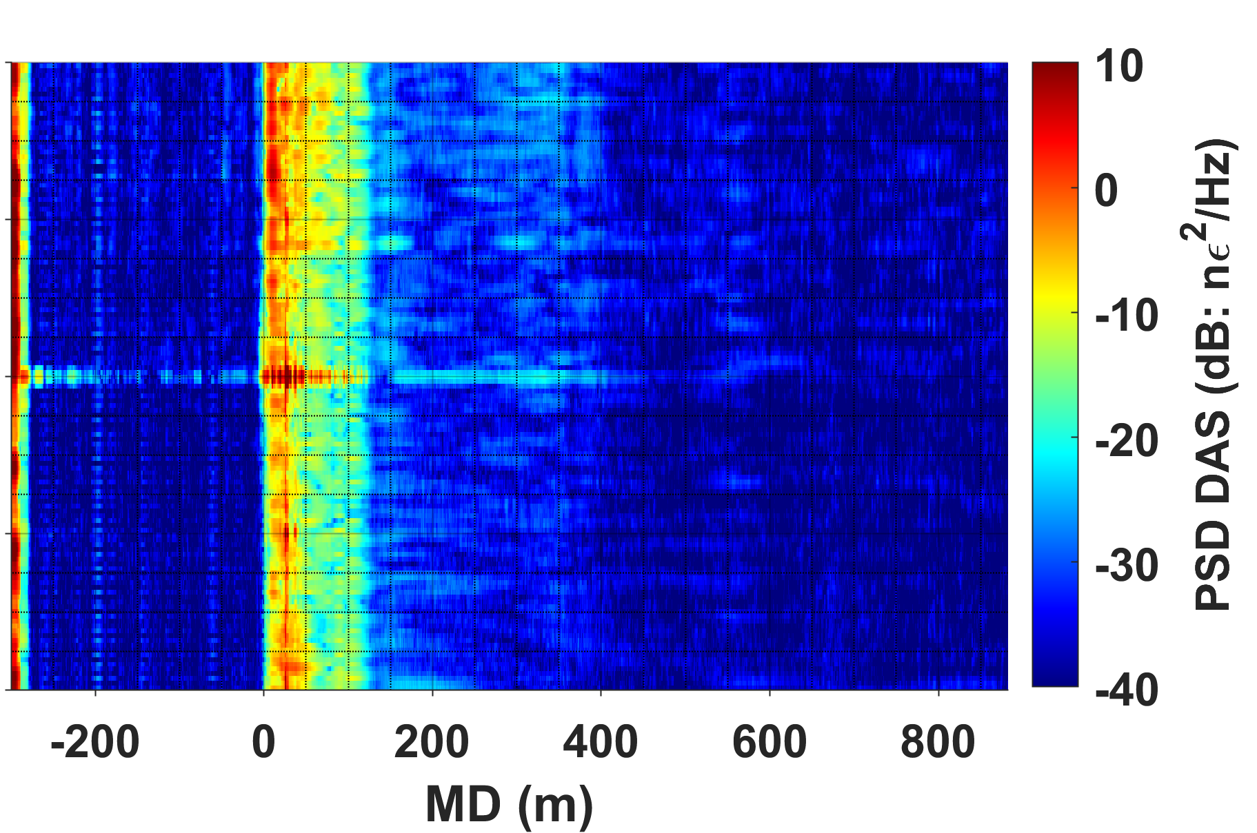
Curtin GeoLab experiment
Vib1 + Vib2
Vib1 & Vib2
Near field test
f₁ + f₂
10 m
f₁ – f₂

Slide 14
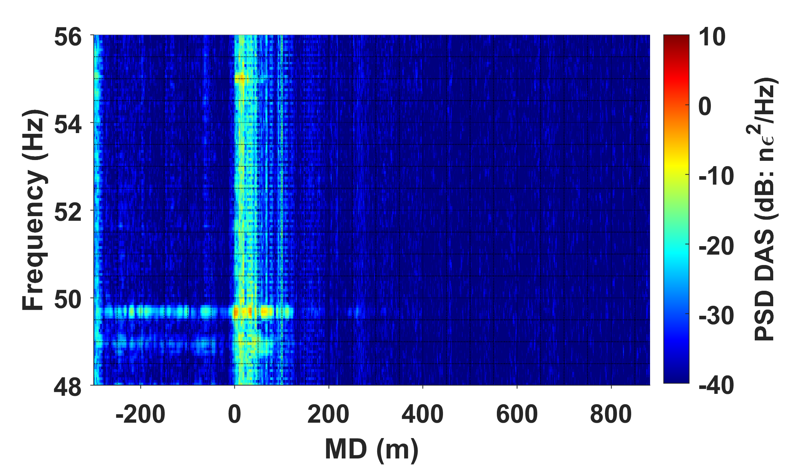
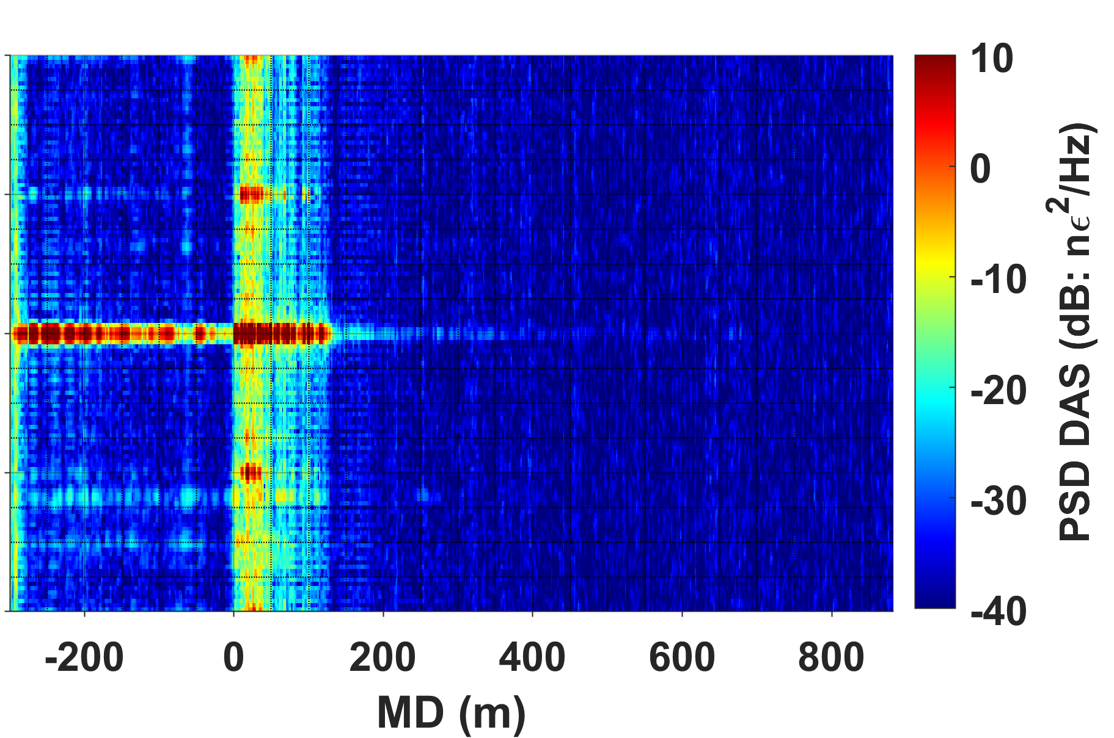
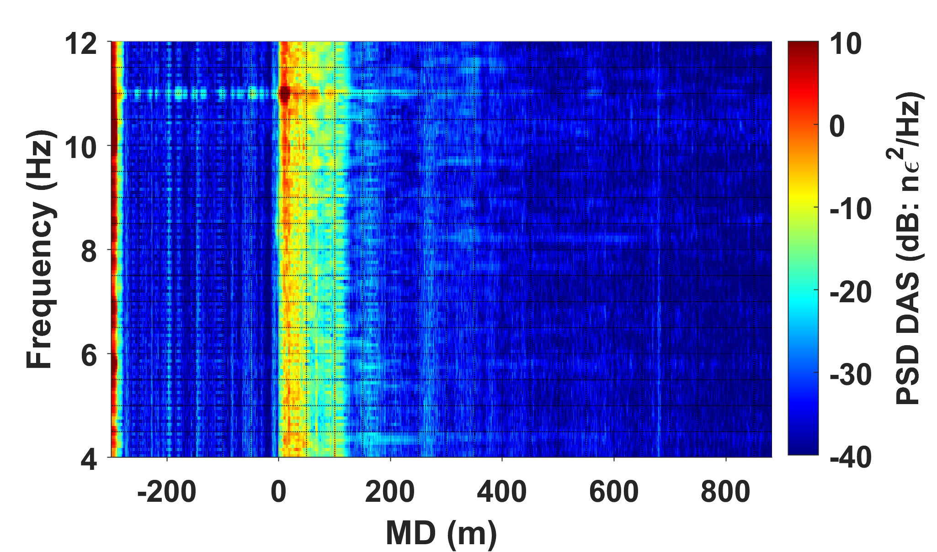
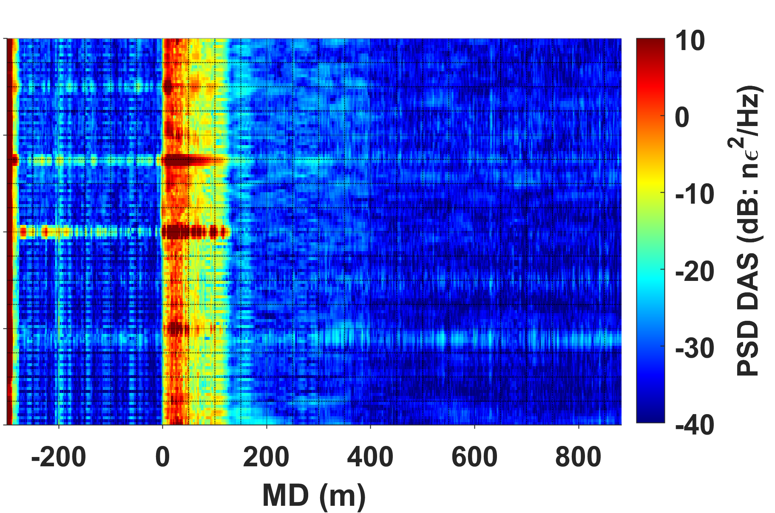
Curtin GeoLab experiment
Vib1 + Vib2
Vib1 & Vib2
Far field test
f₁ + f₂
270 m
Noise from
human activity
f₁ – f₂

Slide 15
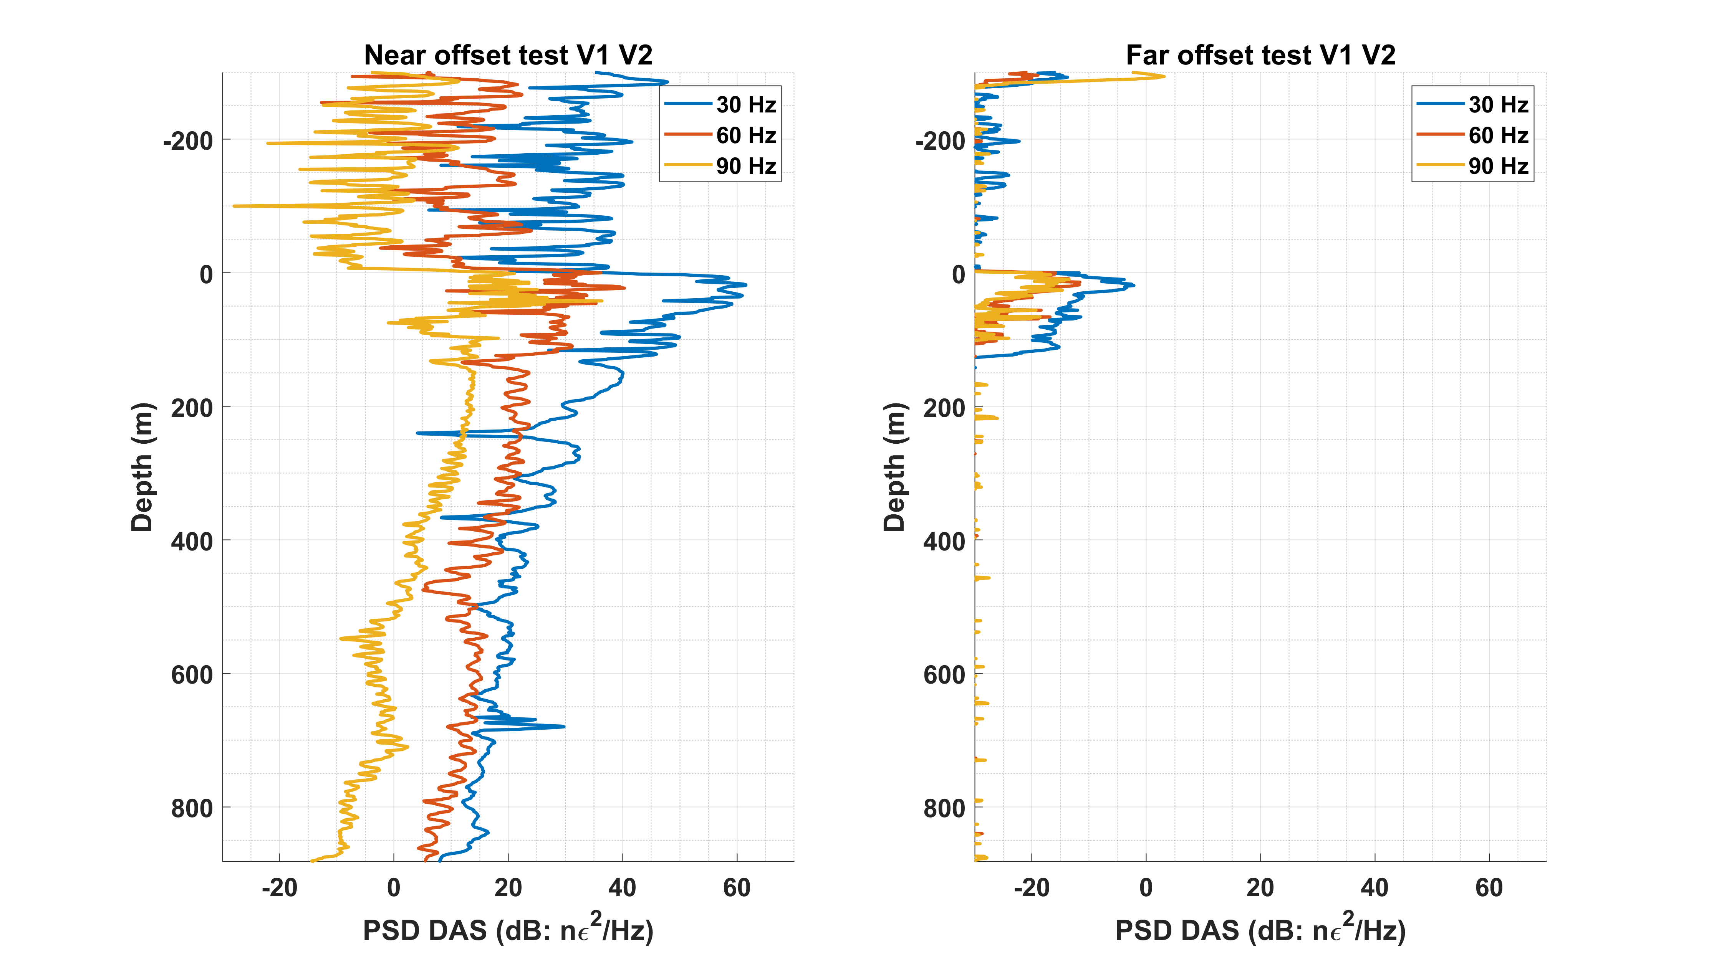
Curtin GeoLab experiment
Higher harmonics attenuate along the well slower than fundamental frequencies
Nonlinear frequencies are possibly reinforced in the formation
Amplitudes of the fundamental frequency and higher harmonics
3f₁
2f₁
f₁

Slide 16
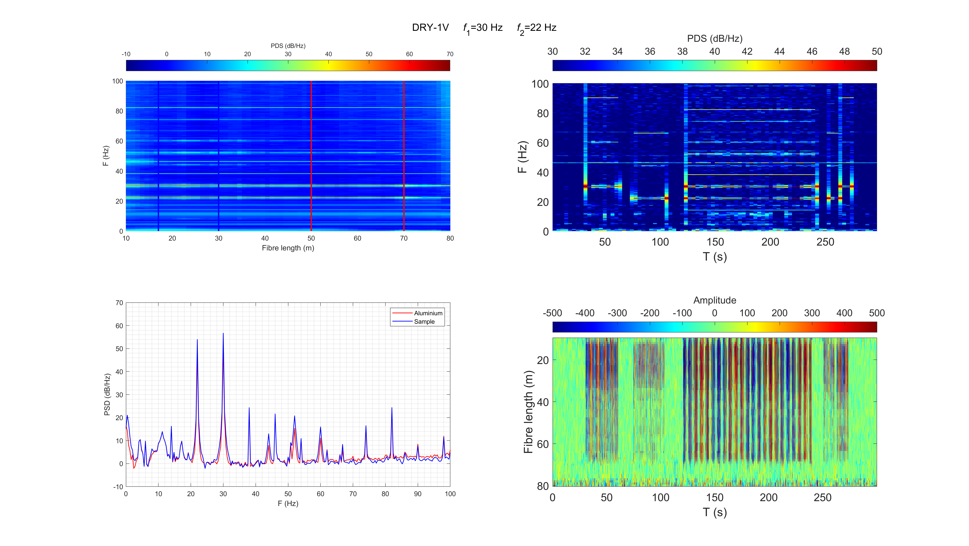
Laboratory tests
Laboratory experiment at low frequencies*
f₁ = 30 Hz
f₂ = 22 Hz
Nonlinear combinational frequencies emerge in the rock when two actuators work
30 Hz
22 Hz
30 and 22 Hz
2f₁ + f₂
Lab
noise
f₁ + 2f₂
f₁ + f₂
f₁
f₂
f₁ - f₂
*Tomorrow, Dec 3, 3:15 PM – 3:40 PM Laboratory measurements with DAS

Slide 17
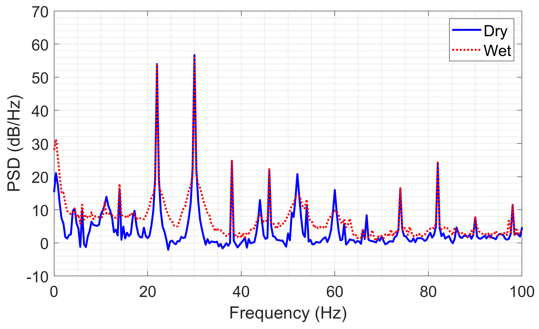
Laboratory tests
Dry vs. Saturated
sandstone sample
Change in saturation affects 2f₁, 2f₂ and f₁+f₂
Potential of nonlinear seismic for reservoir characterisation is confirmed
f₂
f₁
f₁+f₂
2f₂
2f₁
2f₁+f₂
f₁+2f₂

Slide 18
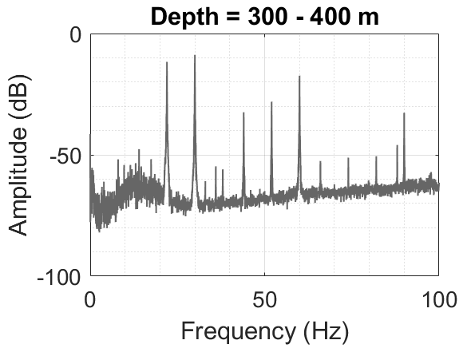
Conclusions
Earth
Seismic nonlinear effects were observed in both field and lab experiments
Experiments confirm that seismic waves interact nonlinearly in rocks
Applications include reservoir monitoring and broadening of seismic frequency band
Borehole DAS is an enabling technology for such research
Input signal
Output signal
f₁
Nf₁ ± Mf₂
f₂
Local oscillator
f₁ + f₂
3f₁
f₁ – f₂
Seismic vibrator test
300-400 m in the well
3f₂
f₂
2f₁
2f₂
f₁

Slide 19
Acknowledgements
The authors thank Prof. Igor Beresnev for insightful discussion and useful advice.
We are grateful to Michael Mondanos and Stoyan Nikolov (Silixa Ltd.) for helping with DAS equipment and great support in the field.
The authors thank the sponsors of the Curtin Reservoir Geophysics Consortium for financial support.
Funding for LBNL was provided through the Carbon Storage Program, U.S. DOE, Assistant Secretary for Fossil Energy, Office of Clean Coal and Carbon Management through the NETL, under contract No. DE-AC02- 05CH11231.

