Slide 1

Long-term field studies in Canada on monitoring pedogenic carbonate formation in agricultural soils via enhanced weathering of wollastonite: status and latest findings
Reza Khalidy*, Yi Wai Chiang, Rafael M. Santos
School of Engineering, University of Guelph, Guelph, Ontario, Canada

Slide 2
Introduction
Mineral carbonation is one of three main technologies proposed for reducing atmospheric CO₂ concentration
During this process, alkaline earth metals (Ca²⁺ and Mg²⁺) are converted to stable carbonates for geological timeframes
Comminuted forms of silicate rocks enriched in Ca²⁺ and Mg²⁺ (e.g., basalt, dolerite and olivine) have been found effective to sequester atmospheric carbon in urban and agricultural soils around the world
Wollastonite (CaSiO₃) is promising candidate due to higher dissolution rate, facilitating production of carbonates due to the weaker bonding of Ca ions to its silica matrix and being environmental benign
Atmospheric CO₂ dissolves | CO_{2(g)} + H₂O_{(l)} ↔ H₂CO_{3(aq)} ↔ CO₃²⁻ + 2H⁺ (1)
Wollastonite dissolution | CaSiO_{3(s)} + 2H⁺ → Ca²⁺ + H₂O_{(l)} + SiO_{2(s)} (2)
Pedogenic inorganic carbonate precipitation | Ca²⁺ + CO₃⁻ → CaCO_{3(s)}↓ (3)

Slide 3
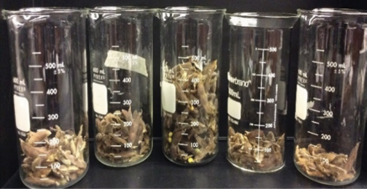
Previous Research on Wollastonite Application (Laboratory scale)
Impact of wollastonite rate on growth of two plants, soybean and alfalfa
Soybean
Alfalfa
Wollastonite dosage (t/ha)
Control 30 100 150 200
Control 30 100 150 200 300 400
Highlighted in black circle: highest plant growth (after 14 weeks)
Highest rate of sequestrated carbon (0.08 kg CO₂ /m²/month) was observed at 300 (t/ha) of wollastonite rate on alfalfa

Slide 4
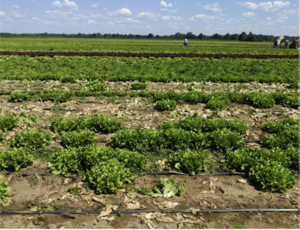
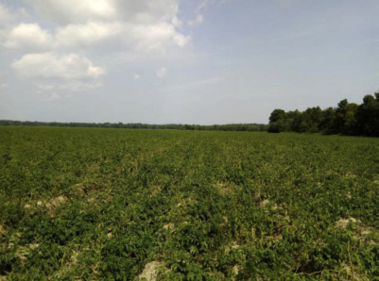
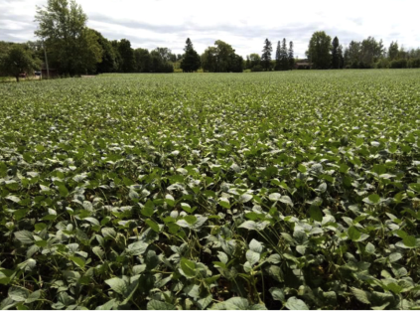
Field study…
Paris (30 ha)
Sequestrated CO₂ (tonne CO₂)
70 , 125, and 181 after 1, 2 and 3 years, respectively.
0.055, 0.11, and 0.2 and 5 (t/ha), respectively for wollastonite application rate of 1.5, 2.5,
2.8
After 5 months
Woodstock (1.5 ha)
Alliston (9 ha)

Slide 5
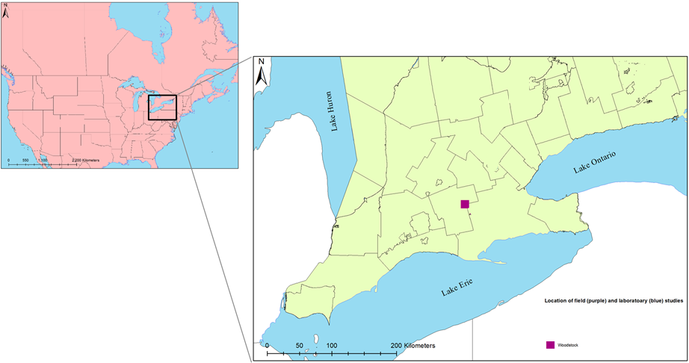
Current field studies
1
2
Woodstock
Thorndale
Dawn Euphemia
3

Slide 6
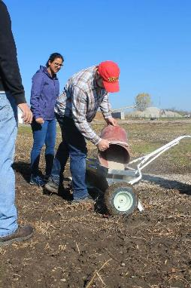
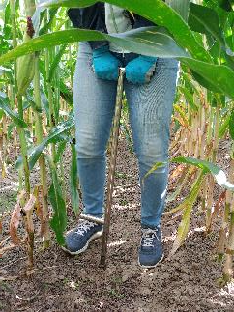
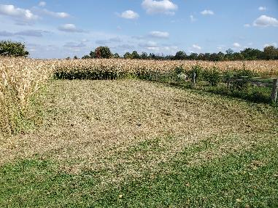
Woodstock
Monitoring distribution of newly formed carbonate over vertical profile of soil over time
Harvested crop
Rye
Area
50 m² = 0.005 ha
15 (t/ha)
^{Wollastonite rate}

Slide 7
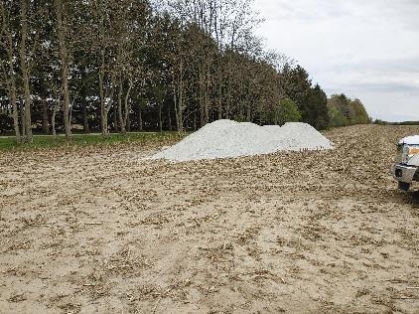
Thorndale
Impact of wollastonite on plants’ growth and soil health
Harvested crop
Rotation (wheat, corn and soybean)
Area
20 ha
10 (t/ha)
^{Wollastonite rate}

Slide 8
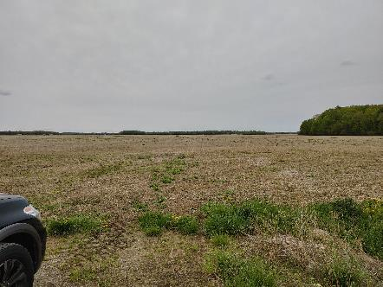
Dawn Euphemia
Impact of wollastonite on soil properties (e.g., pH)
Harvested crop
Rotation (wheat, corn and soybean)
Area
58 ha
4 (t/ha)
^{Wollastonite rate}

Slide 9
Upcoming research
Soil Column study
Investigating geochemical properties of leachates collected from the column setup
Predict long term of carbonates in soil
Using local setting (soil characterization and climate)
Developing a reactive transport modeling framework

Slide 10
References
Haque, F., Santos, R.M. and Chiang, Y.W., 2020. CO2 sequestration by wollastonite-amended agricultural soils–An Ontario field study. International Journal of Greenhouse Gas Control, 97, p.103017.
Haque, F., Santos, R.M. and Chiang, Y.W., 2020. Optimizing Inorganic Carbon Sequestration and Crop Yield With Wollastonite Soil Amendment in a Microplot Study. Frontiers in plant science, 11, p.1012.
Khalidy*, R., Haque*, F., Chiang, Y.W., Santos, R.M., 2021. Monitoring Pedogenic Inorganic Carbon Accumulation Due to Weathering of Amended Silicate Minerals in Agricultural Soils, Journal of Visualized Experiments, in press.

