Slide 1


Relative Utility Value of forecasts
(for customer decisions)
Laugesen, R., Thyer, M., McInerney, D., and Kavetski, D.: Flexible forecast value metric suitable for a wide range of decisions: application using probabilistic subseasonal streamflow forecasts, Hydrol. Earth Syst. Sci. Discuss. [preprint], https://doi.org/10.5194/hess-2022-65, in review, 2022
Richard Laugesen
richard.laugesen@bom.gov.au
https://richardlaugesen.com

Slide 2
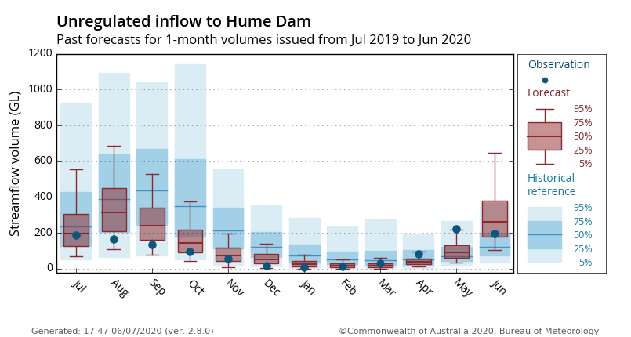
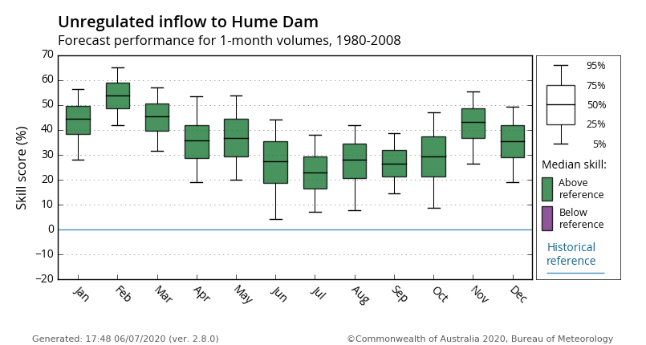
Value? But we already calculate metrics
Forecast verification – How well do these forecasts match the observations?
Forecast value – how much better are our decisions with these forecasts?
Value depends on these:
  Quality of the forecasts
  Decision type
  Decision-makers characteristics
  Decision-making approaches
  Method to quantify how good a decision was
  Economic impact of outcome
We typically do forecast verification and sometimes use it as a proxy for forecast value

Slide 3
Relative Utility Value (RUV)
RUV is a new metric to quantify value of forecasts for decision making using Expected Utility Theory
Has these features:
  Any economic model, damage function and utility function
  Works with binary, multi-categorical and continuous decision types
  Considers risk aversion of decision makers (prefer known outcomes)
  Can model decision-making that uses the whole probabilistic forecast distribution
Same interpretation as existing method (Relative Economic Value - REV) and identical result when assumptions applied
REV assumptions don’t match all real-world decisions

Slide 4
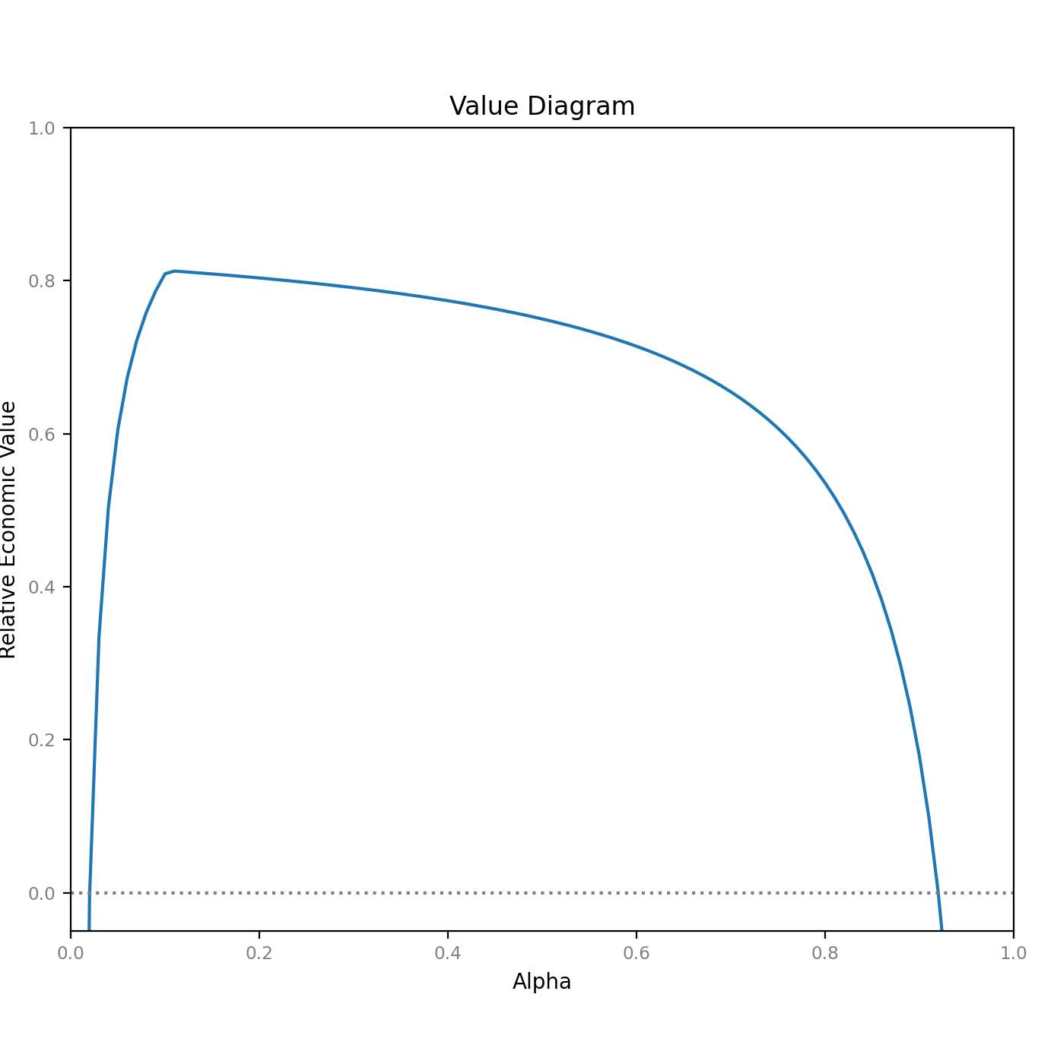
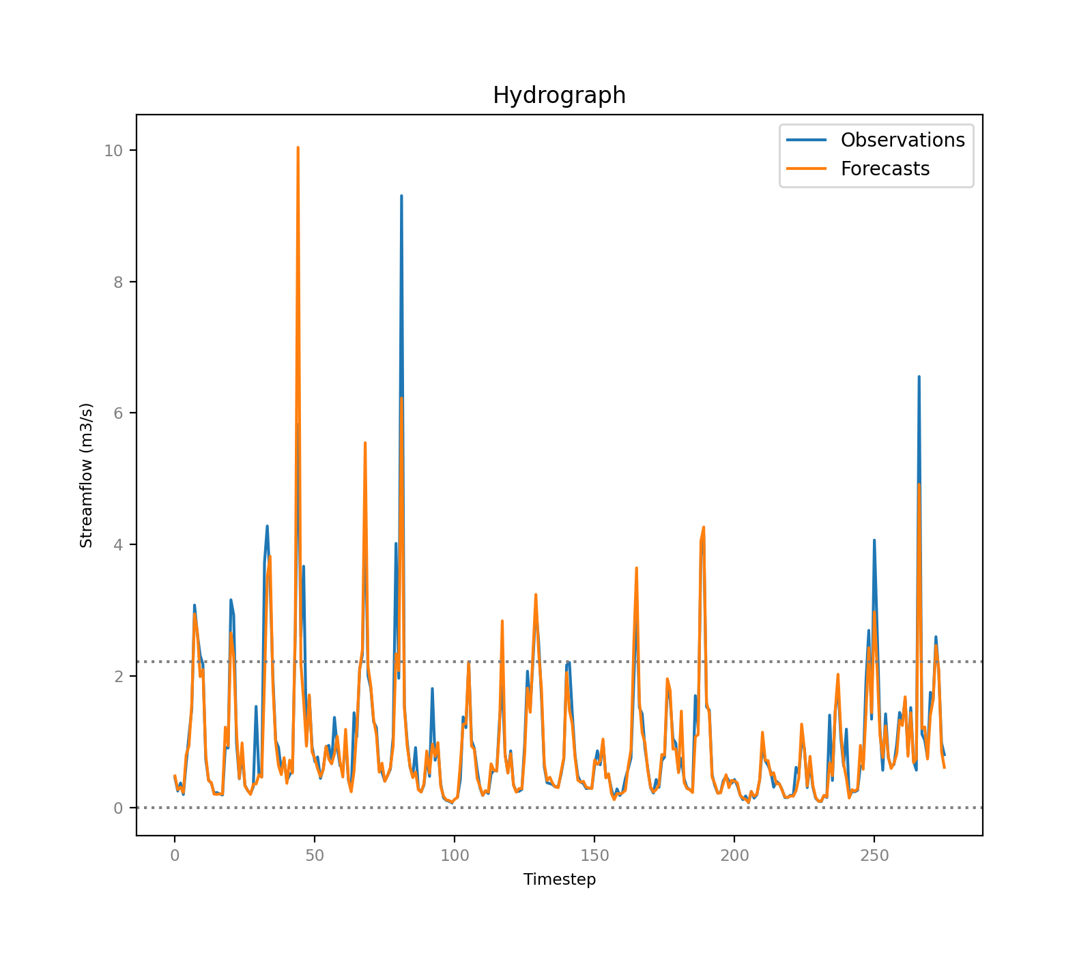
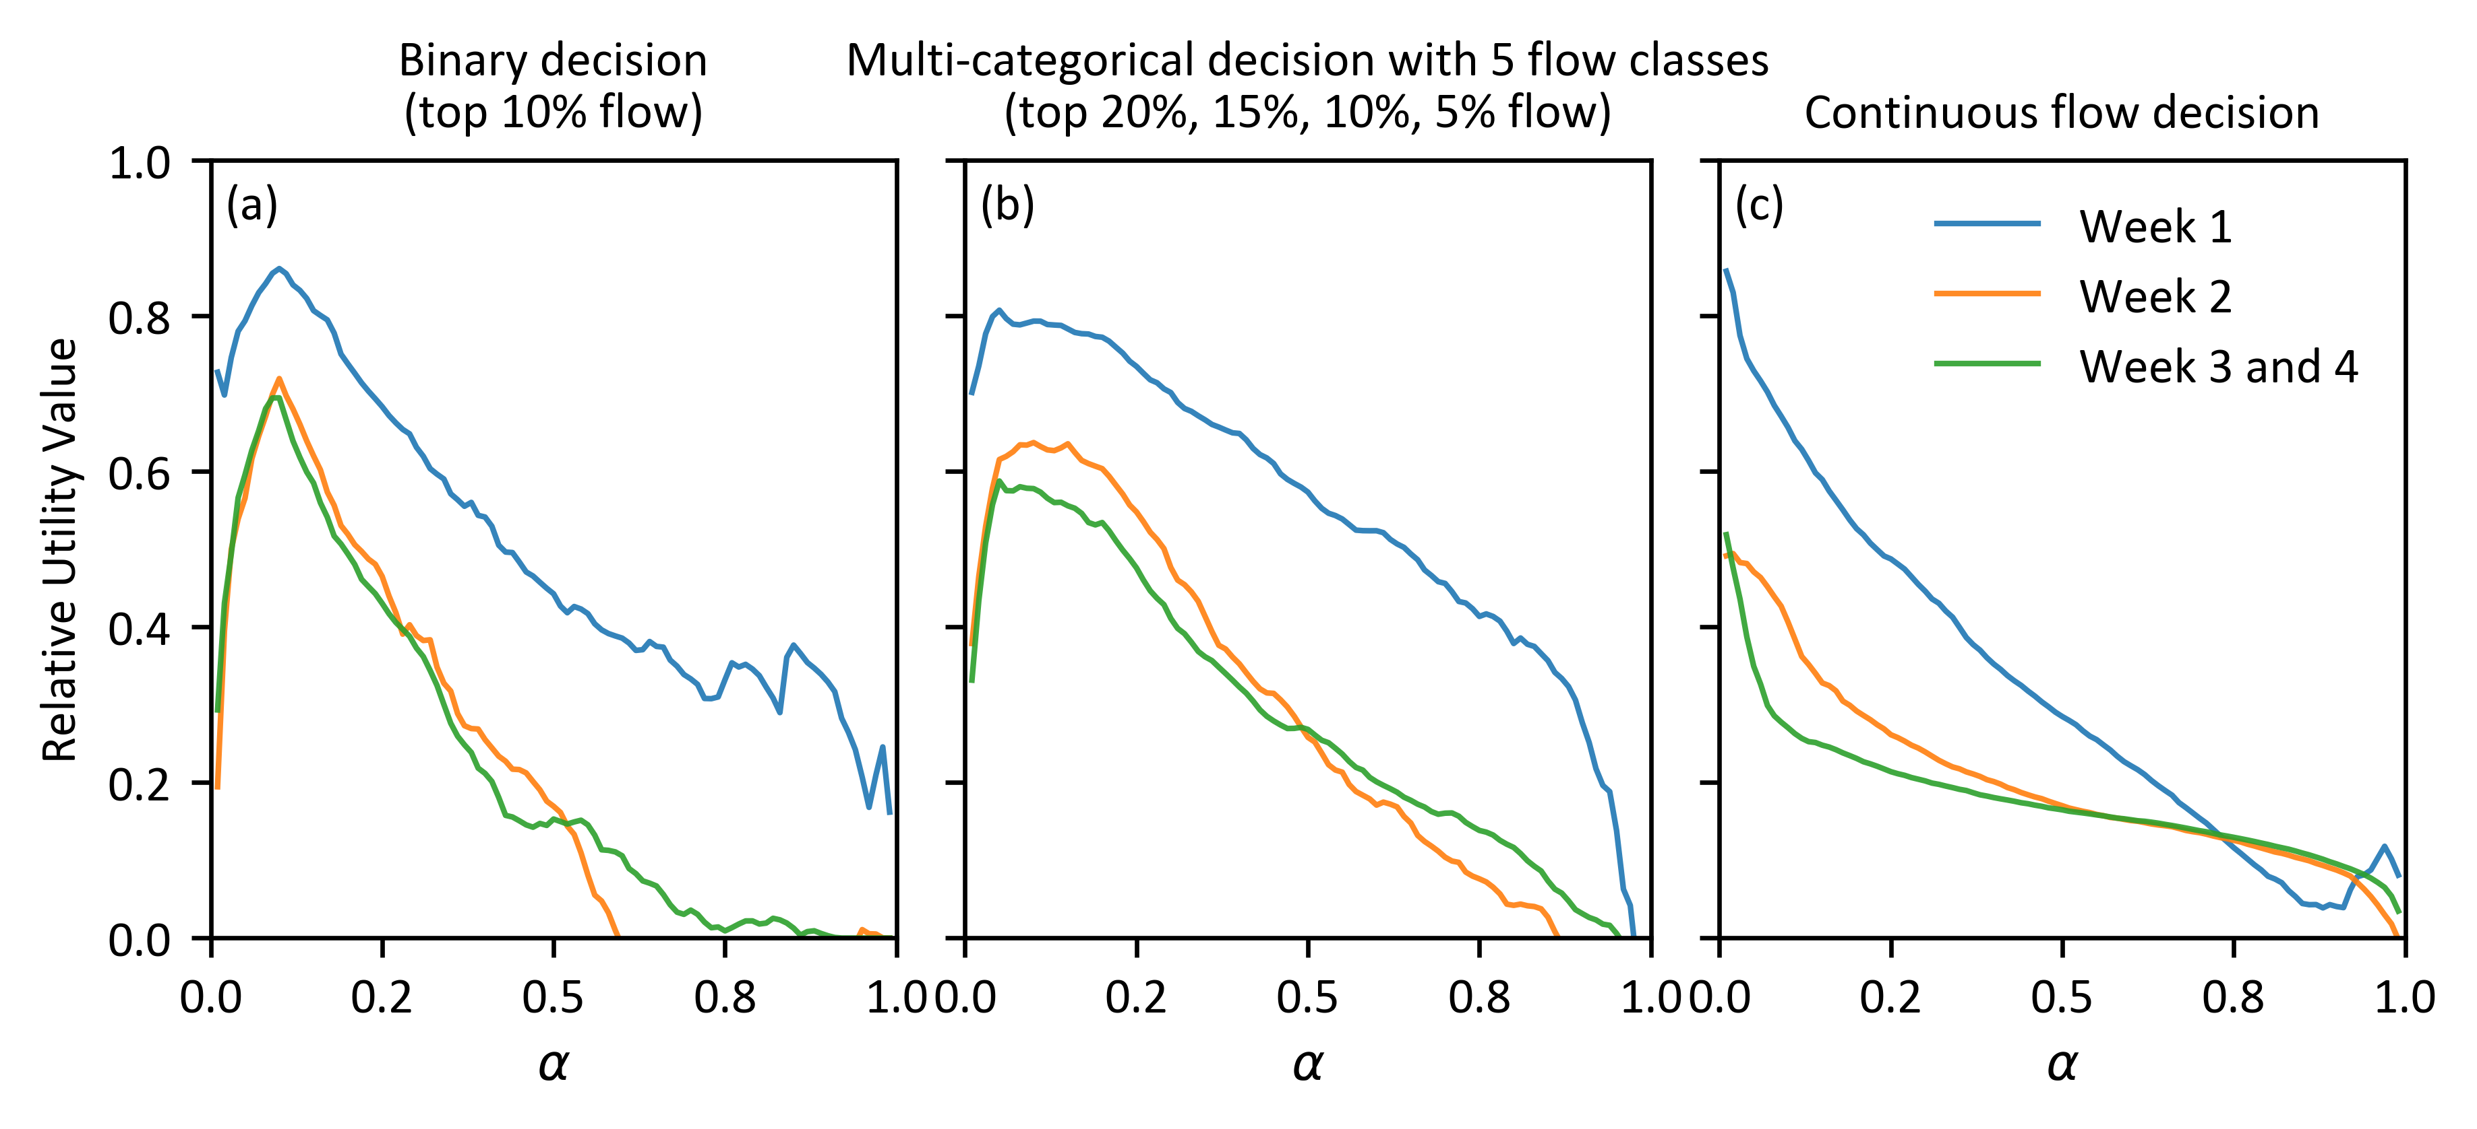
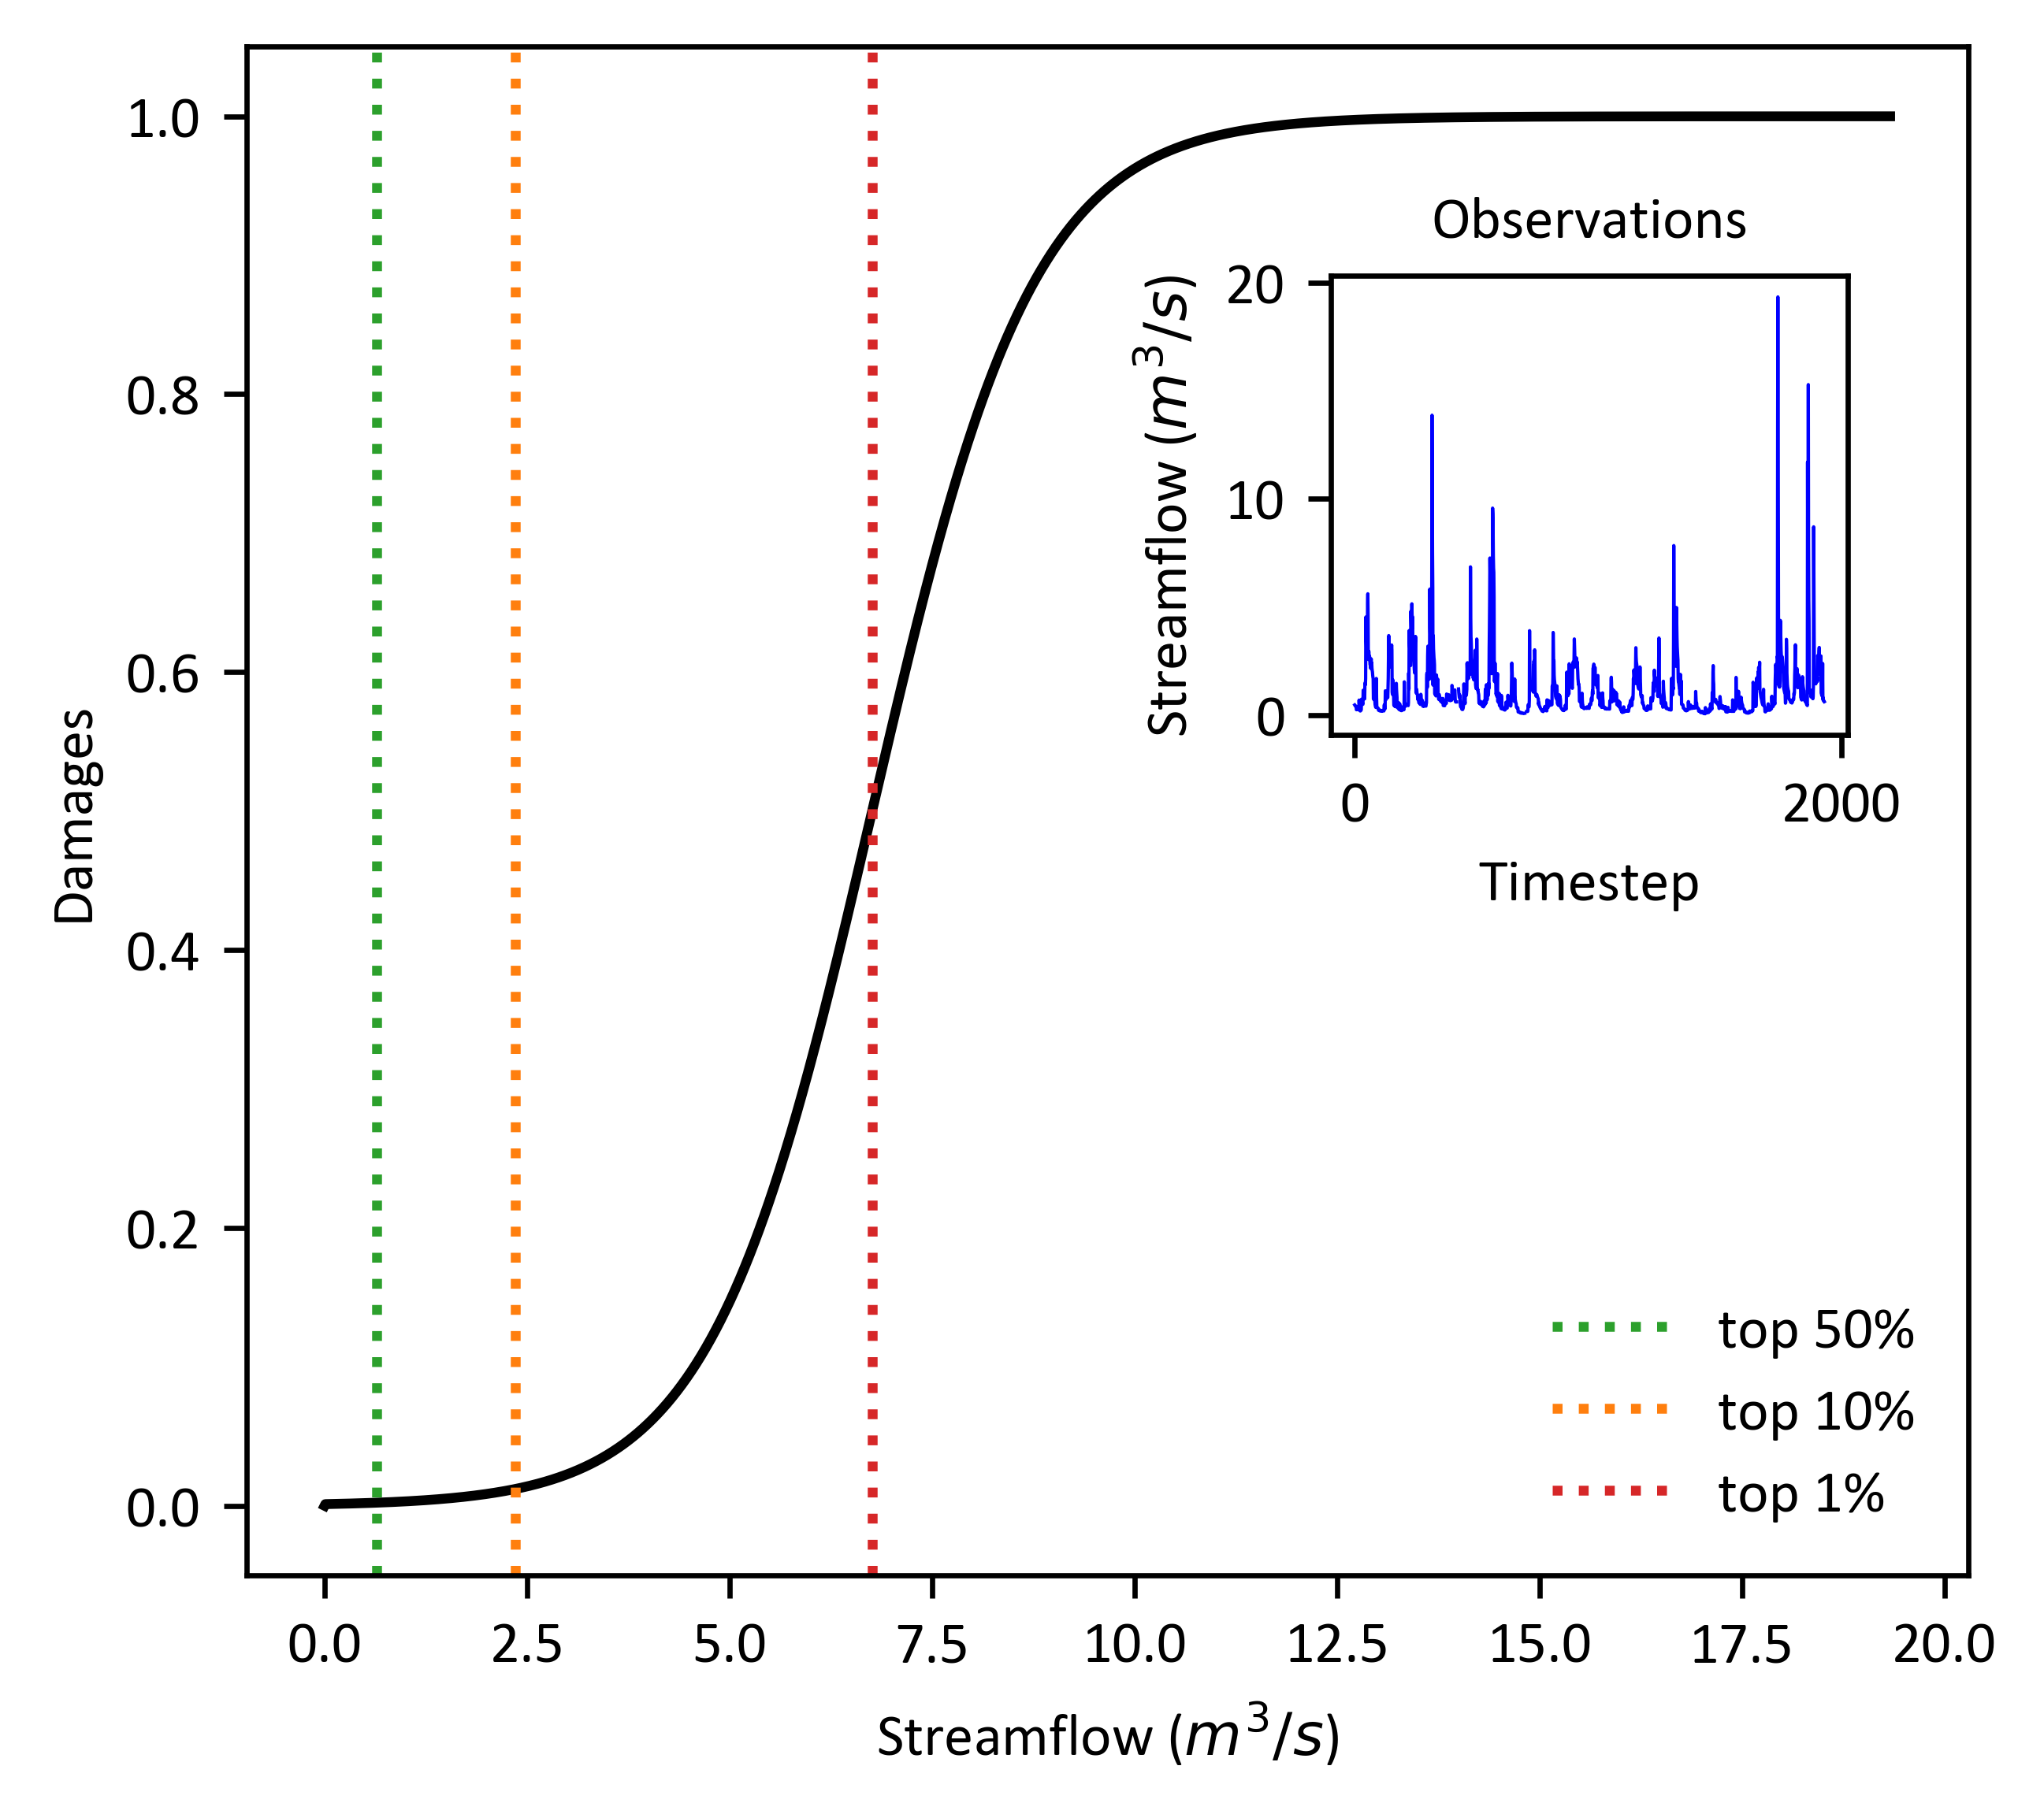
Subseasonal streamflow application
Value of forecast information
Use forecast to decide
Never pay cost
Always pay cost
Compared to reference climatology
More valuable for decision-makers less exposed to losses
Valuable through all lead-times right out to 4 weeks ahead
Similarly valuable for all decision types
Damage function
More exposure to damages
Economic model: how much should I pay now to mitigate a possible future loss?

Slide 5
So what?
If we can quantify forecast value, then we can…
Objectively decide between operationalising forecast system A or B to maximise user impact
Enhance dialog between forecasters & users to encourage adoption of forecasts when and where it counts
Improve water resource management by tailoring forecasts to user decisions

Slide 6
Thank you
Pre-print for open discussion
Laugesen, R., Thyer, M., McInerney, D., and Kavetski, D.: Flexible forecast value metric suitable for a wide range of decisions: application using probabilistic subseasonal streamflow forecasts, Hydrol. Earth Syst. Sci. Discuss. [preprint], https://doi.org/10.5194/hess-2022-65, in review, 2022
Richard Laugesen
richard.laugesen@bom.gov.au
https://richardlaugesen.com

