Slide 1
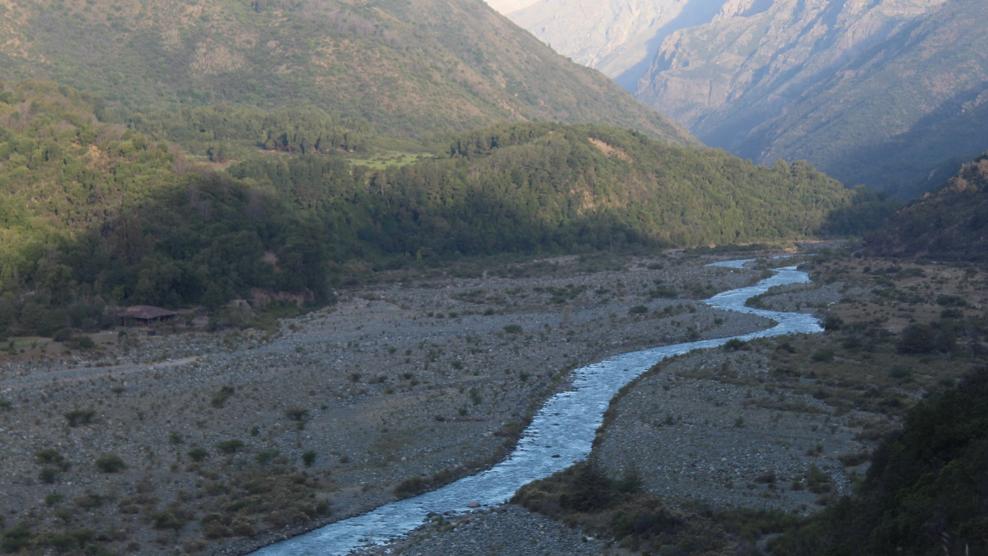



Climate modulates topography-tectonic link in the Andes
Rebekah Harries^{1,2} and Felipe Aron^{1,2}
Linda Kirstien³
¹Pontificia Universidad Catolica de Chile
²Research Centre for Integrated Disaster Risk Management
³Univeristy of Edinburgh

Slide 2
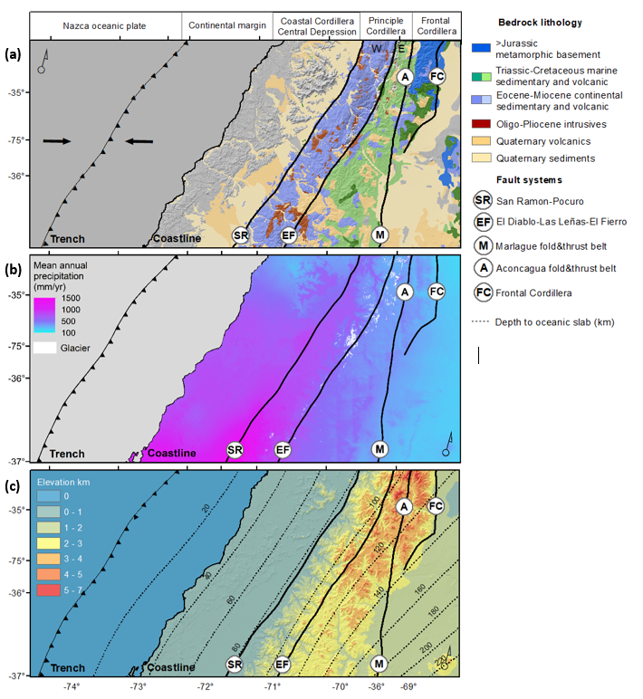
Geology
Influence of climate on the morphological response of the Andes to tectonic uplift?
Topography
Climate

Slide 3
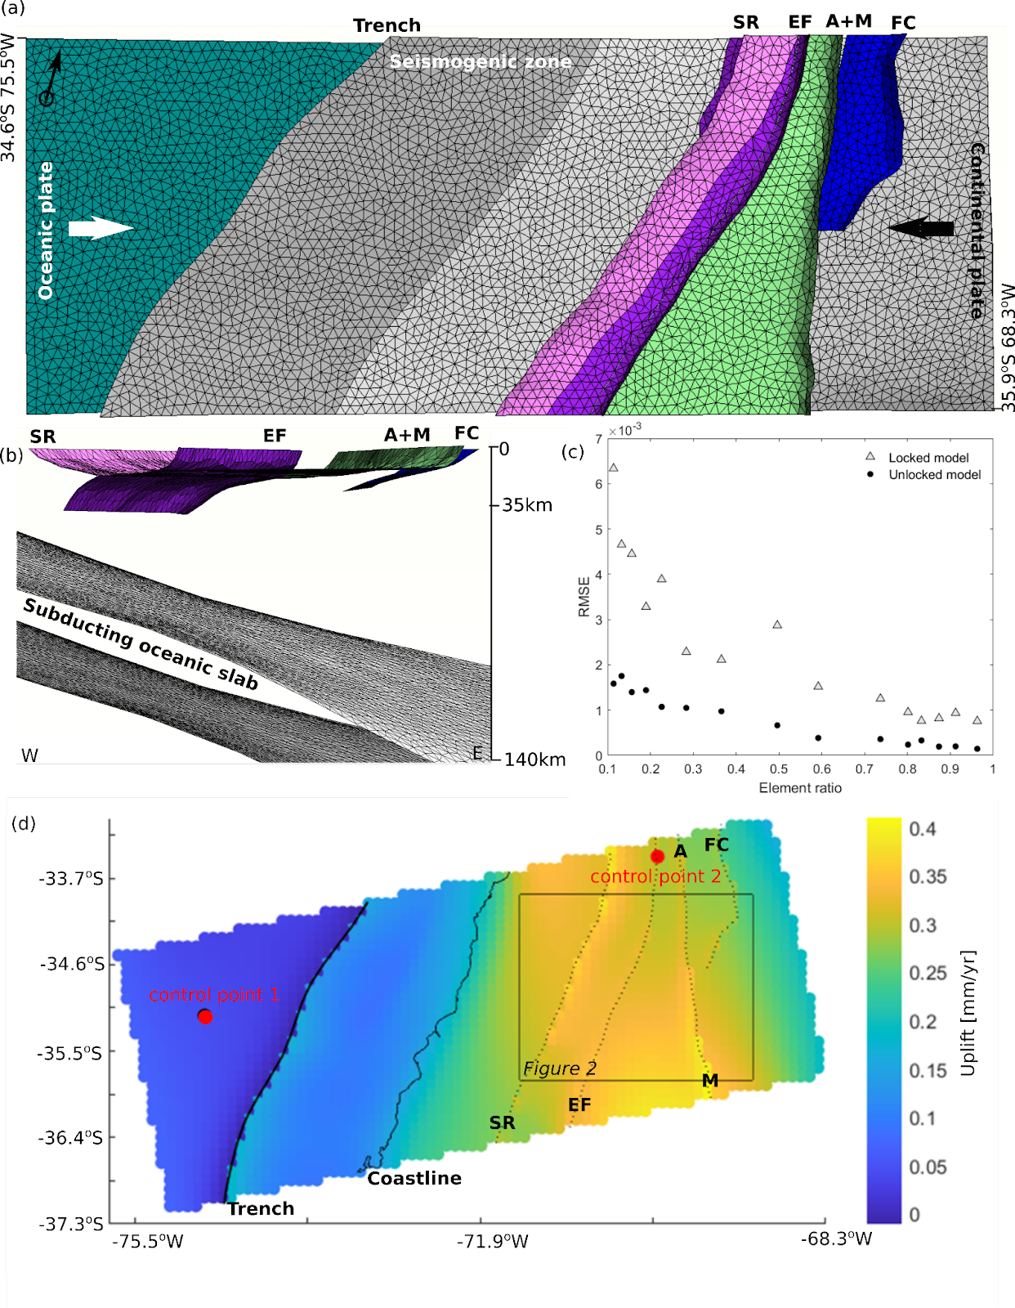
Tectonic model
Boundary Element Methods applied to fault mechanics (Tribem - https://github.com/jploveless/tribem)
Predict vertical crustal motion in response to plate convergence.
Results
SR San Ramon-Pocuro fault system
EF El Fierro-El Diablo-Las Leñas fault system
A Aconcagua fold-and-thrust belt
M Malargüe fold-and-thrust belt
FC Frontal Cordillera thrust

Slide 4
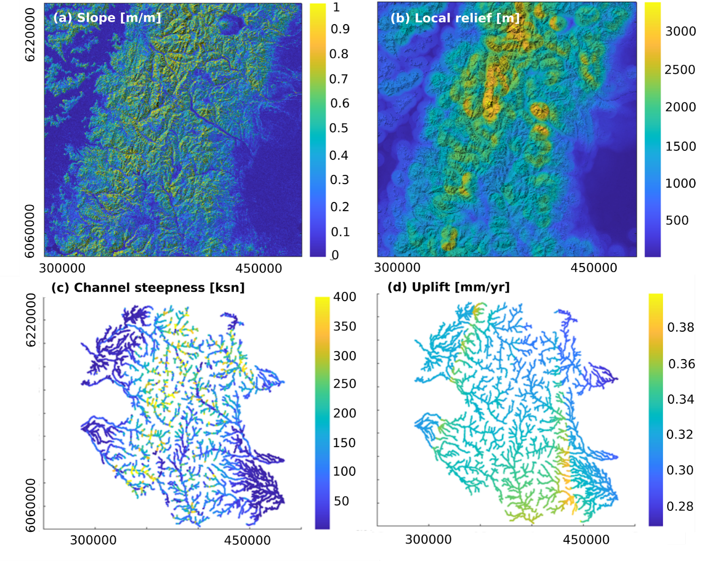
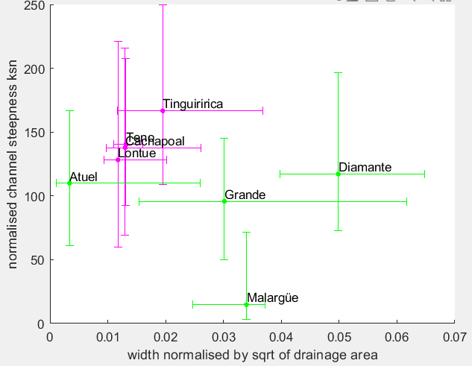
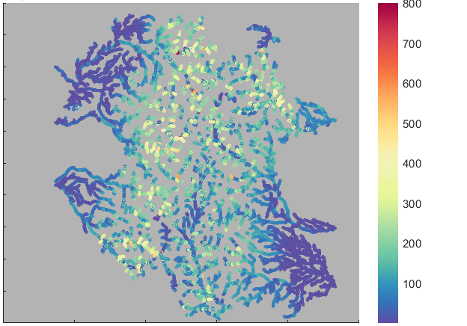
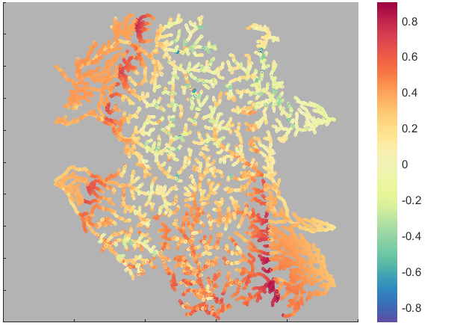
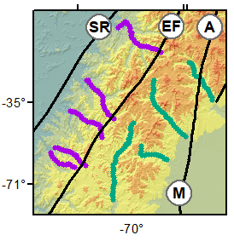
Spatial distribution of uplift
Normalised channel steepness (ksn)
Bedrock valley width vs ksn
Normalised difference between uplift and ksn
Uplift > ksn
Bedrock valley
width profiles
Uplift < ksn

Slide 5
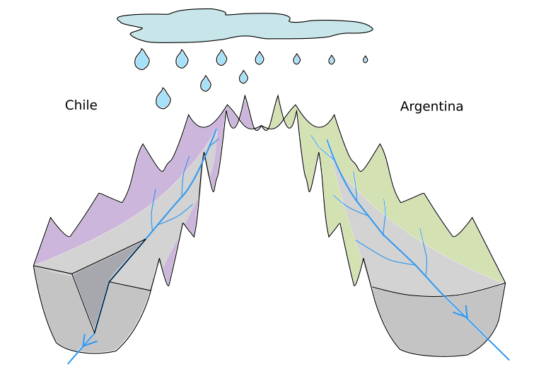
Conceptual model:
Incisional response to uplift delayed by climate
If the transport capacity of the river is not high enough, sediment cannot be evacuated and vertical incision is inhibited, promoting valley widening (e.g. Yanites et al., 2010).
Wetter Chilean rivers have a knick zone propagating upstream in response to faulting (Farias et al., 2008).
Dry Argentinian rivers are filled with sediment. We suggest these rivers have a lower transport capacity and as a result, have delayed vertical incision in response to faulting.

