Slide 1

Development and evaluation of the xGEOID20 Digital Elevation Model at NGS
Jordan Krcmaric
jordan.krcmaric@noaa.gov
U.S. National Geodetic Survey
EGU22-13101
Wednesday, 25 May 2022, 10:34-10:41 CEST

Slide 2
xGEOID20 DEM
3” resolution (90 meter) grid covering the full xGEOID model extent (0ºN to 85ºN, 170ºE to 350ºE)
Combination of TanDEM-X, the USGS 3DEP 1” DEM, and MERIT
Update to the DEM used in previous xGEOID models
SRTMv4.1 south of 60ºN
ASTER (Alaska), CDED (Canada), GIMPv1 (Greenland), and MERIT (Iceland) north of 60ºN

Slide 3
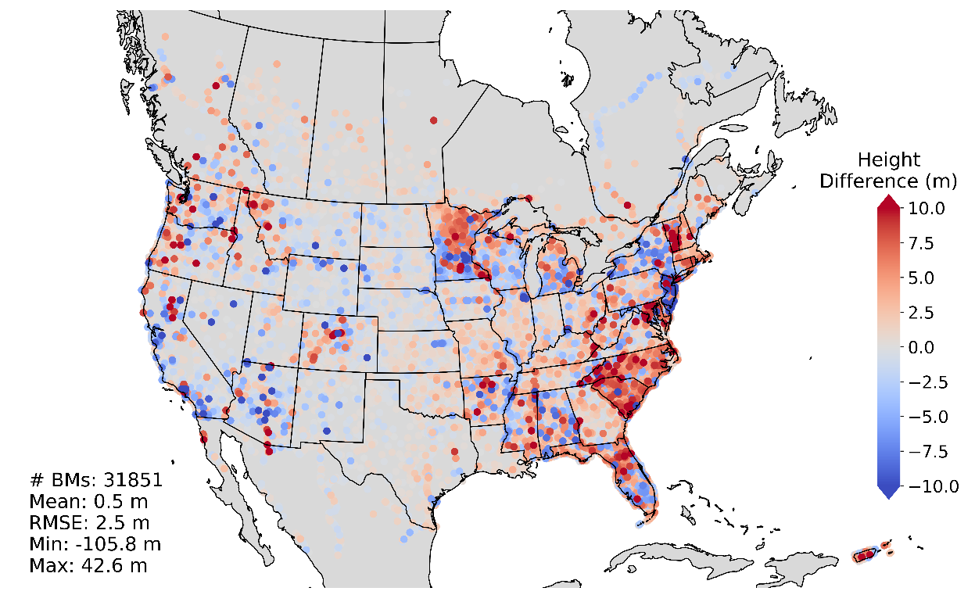
TanDEM-X
Satellite derived model
Data available as a 90 meter resolution global elevation grid
Represents a digital surface model, includes tree canopy and building heights
Dataset is not cleaned or edited, very noisy over water bodies and ice
TanDEM-X vs. GPS-on-Benchmarks
Wessel B, Huber M, Wohlfart C, Marschalk U, Kosmann D, Roth A (2018): Accuracy Assessment of the Global TanDEM-X Digital Elevation Model with GPS Data. ISPRS Journal of Photogrammetry and Remote Sensing. Vol. 139, pp. 171-182.

Slide 4
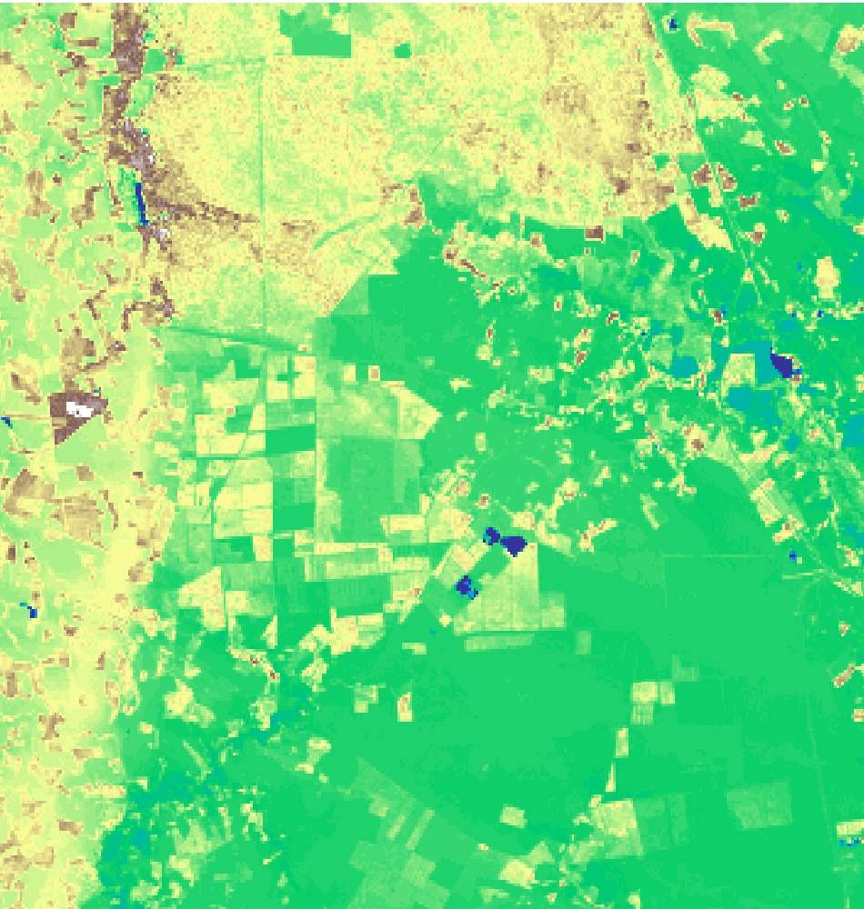
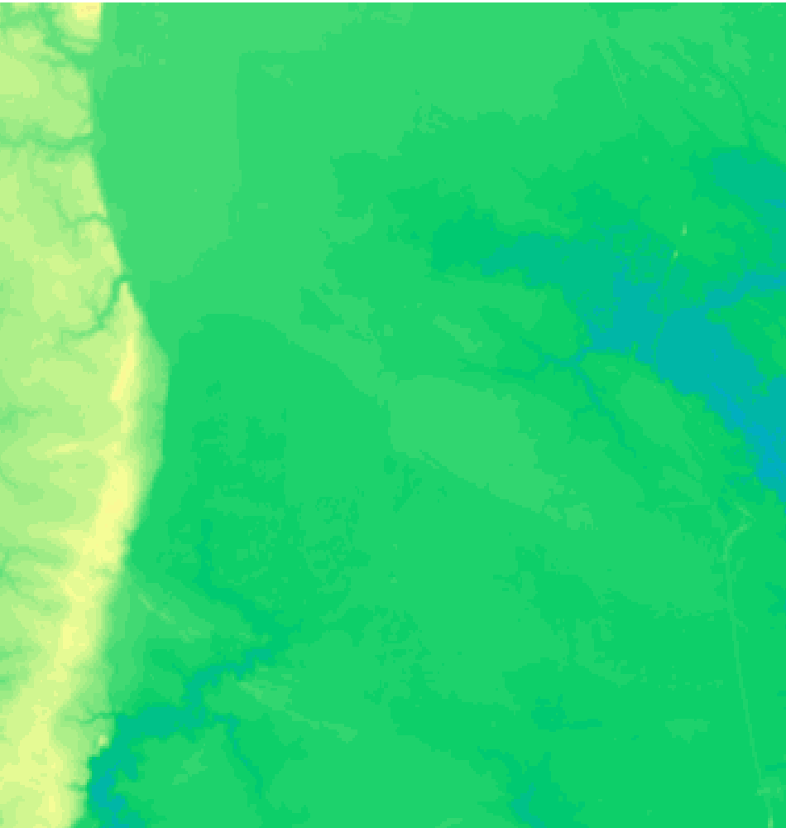
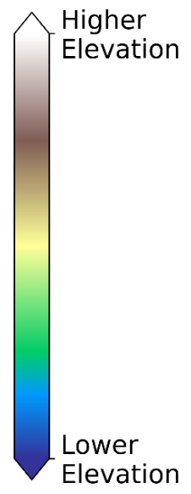
TanDEM-X – Digital Surface Model
TanDEM-X
3DEP (Bare-earth model)

Slide 5
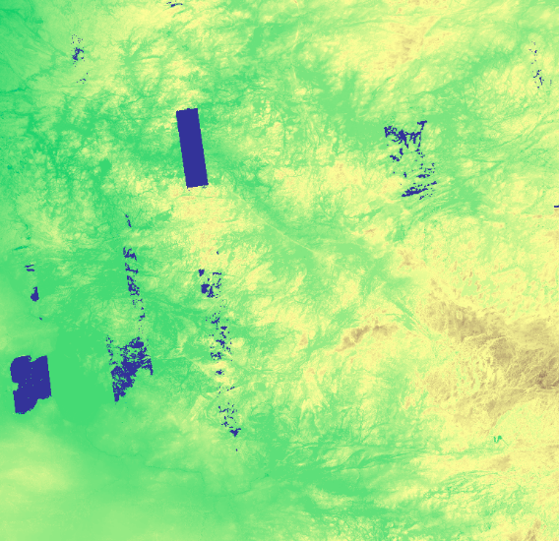
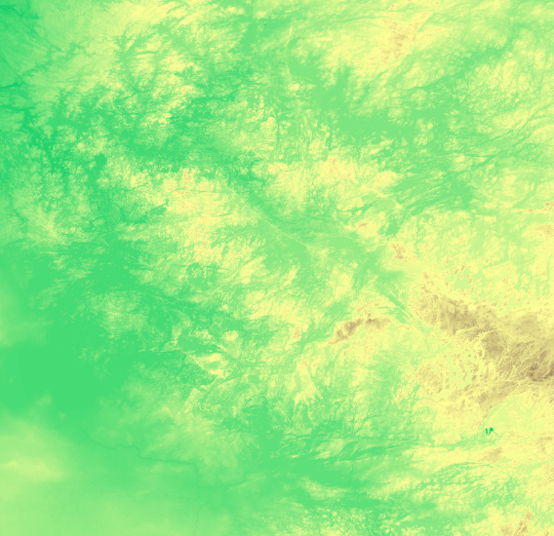
TanDEM-X – Noise and Voids
TanDEM-X
MERIT (error removed model)

Slide 6
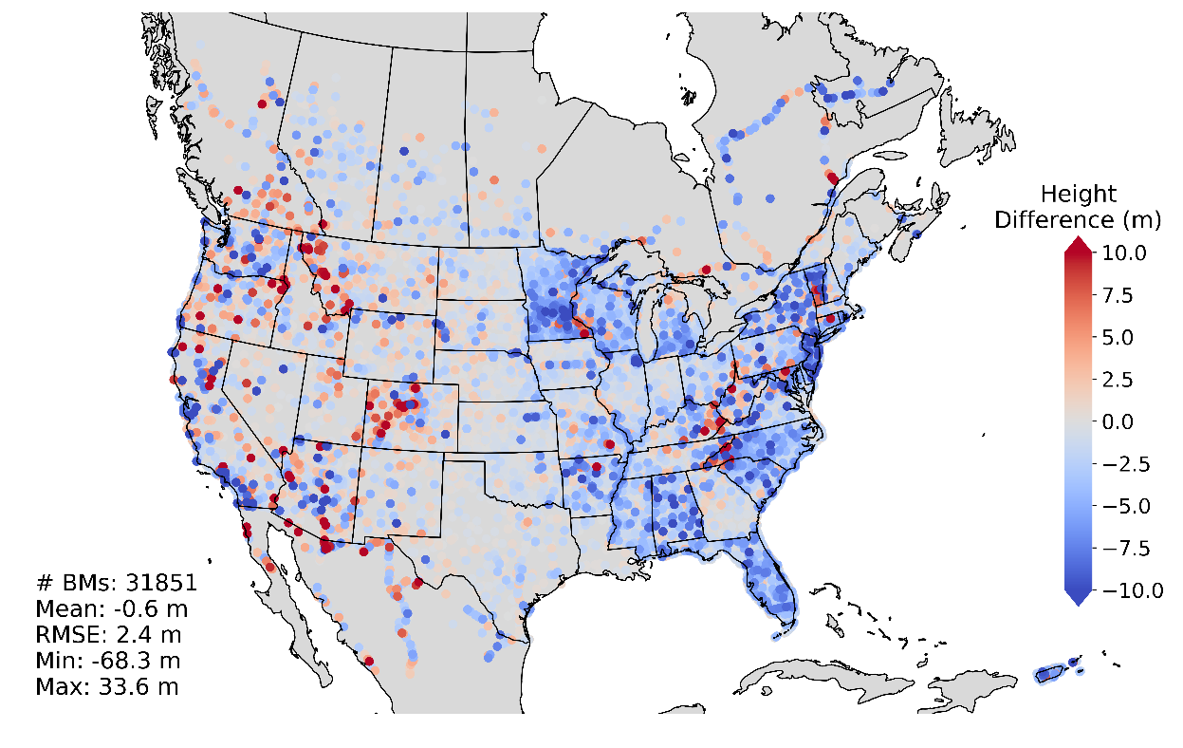
USGS 3DEP 1” DEM
Comprised of LIDAR, digital photogrammetry, IFSAR (Alaska), and USGS topographic contour maps
30 meter resolution (downsampled to 90 meters for combination)
Bare-earth elevation model
Spatial extent limited to U.S., Canada and Mexico, with diminished data quality outside U.S.
3DEP vs. GPS-on-Benchmarks
United States Geological Survey (2021): United States Geological Survey 3D Elevation Program 1 arc-second Digital Elevation Model. Distributed by OpenTopography. https://doi.org/10.5069/G98K778D.
*GPS-on-Benchmarks comparison to downsampled 3DEP dataset

Slide 7
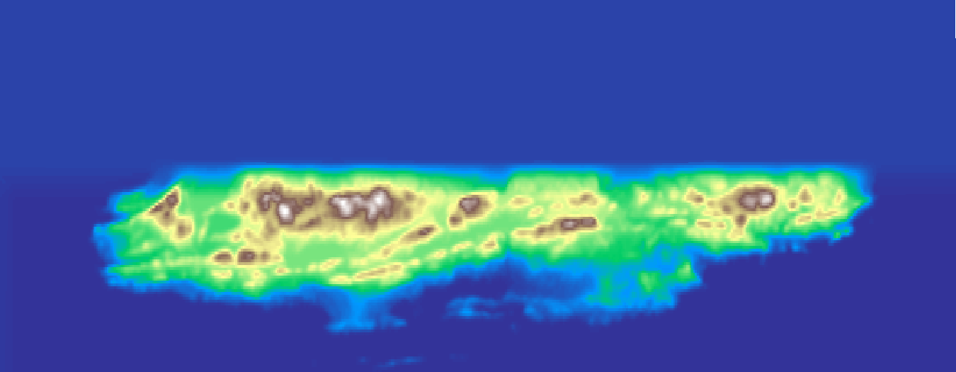
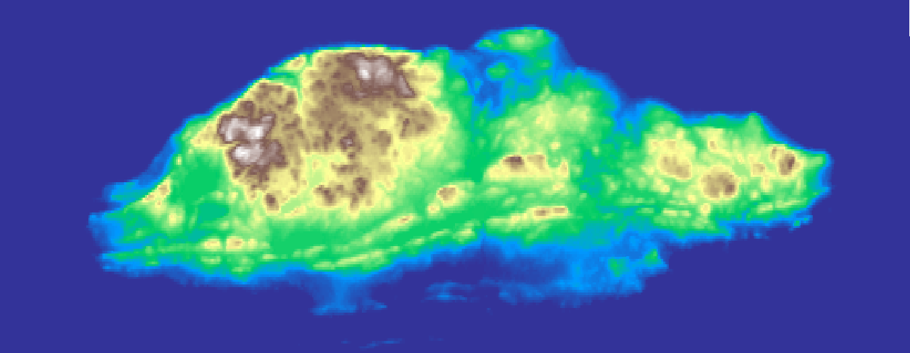
3DEP – Data Outside U.S.
3DEP
MERIT
Michipicoten Island on the Canadian side of Lake Superior

Slide 8
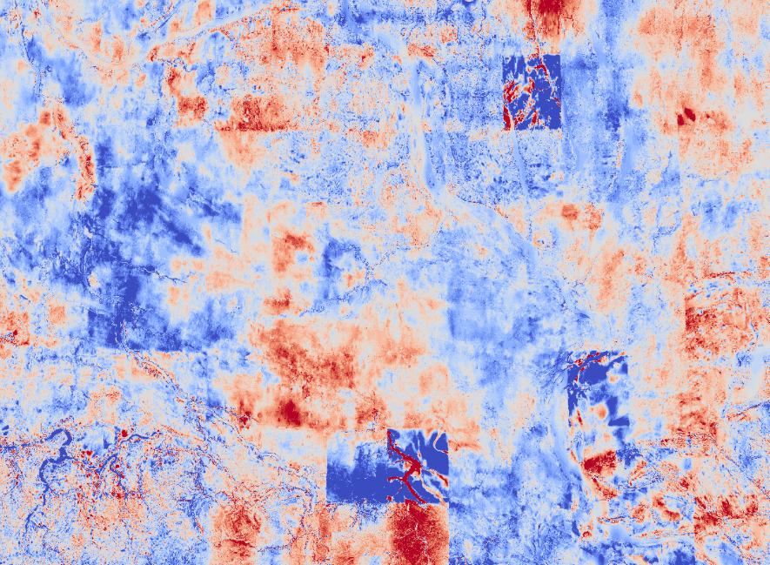
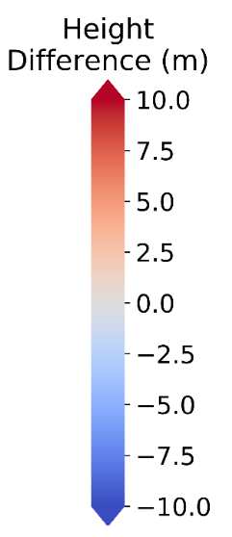
3DEP – Contour Map Scans
3DEP – MERIT, Northwestern Canada

Slide 9
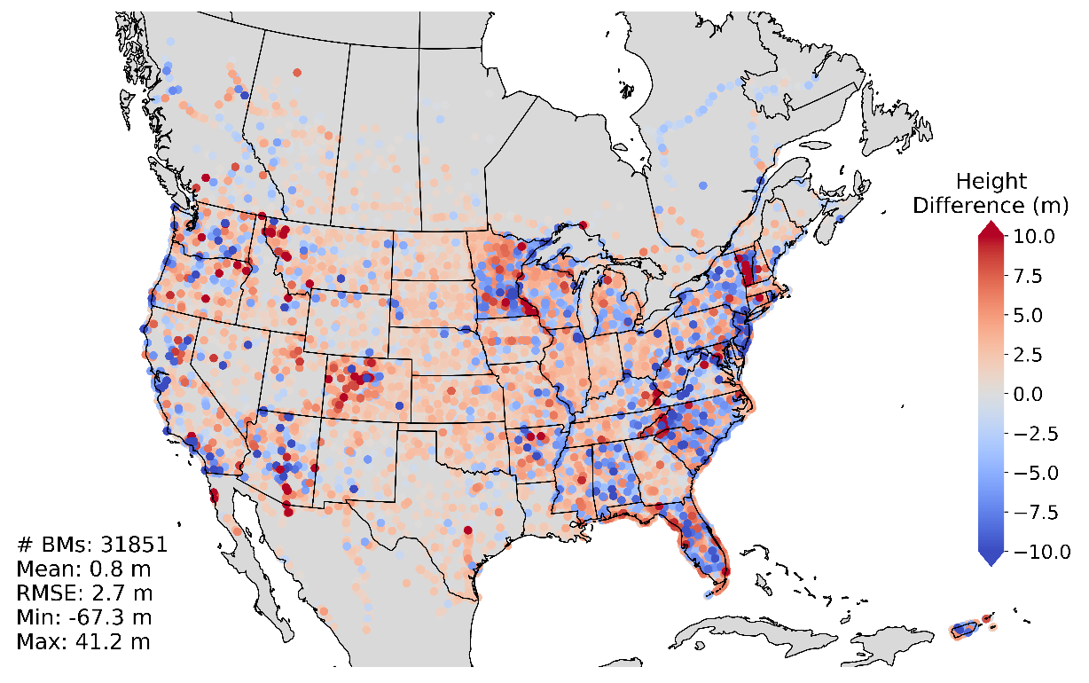
MERIT
Primarily NASA SRTM3 v2.1 with JAXA AW3D-30m DEM v1 used north of 60ºN, Viewfinder Panoramas DEM used for void filling
90 meter resolution
Error corrected bare-earth model
Has ~1m bias, seen in most DEMs based off of the SRTM DEM
MERIT vs. GPS-on-Benchmarks
Yamazaki D, D Ikeshima, R Tawatari, T Yamaguchi, F O’Loughlin, JC Neal, CC Sampson, S Kanae, PD Bates (2017): A high accuracy map of global terrain elevations, Geophysical Research Letters, vol.44, pp.5844-5853.

Slide 10
Geoid Slope Validation Survey (GSVS) Comparison
GSVS11: | 218 pts
 | 3DEP 3sec | TanDEM-X | MERIT
Mean | -0.04 | 0.52 | 1.69
Std Dev | 0.99 | 0.84 | 1.34
Range | 8.88 | 9.09 | 12.4
GSVS14: | 204 pts
 | 3DEP 3sec | TanDEM-X | MERIT
Mean | -0.34 | 0.09 | 0.97
Std Dev | 1.62 | 1.51 | 2.12
Range | 11.21 | 12.09 | 13.61
GSVS17: | 223 pts
 | 3DEP 3sec | TanDEM-X | MERIT
Mean | -0.15 | 0.21 | 1.71
Std Dev | 3.73 | 2.27 | 3.32
Range | 30.68 | 22.31 | 31.84
* All units in meters. Comparison of ellipsoid height.

Slide 11
Combined DEM
TanDEM-X chosen to make up the primary layer of the xGEOID20 DEM based on the GSVS and GPS-on-Benchmarks comparisons
To create a noise free bare-earth model, a forest/non-forest mask (released with the TanDEM-X dataset) is used to flag pixels as forest cover, urban areas, and water bodies and replace them with 3DEP or MERIT
3DEP used inside U.S.
MERIT used outside U.S.

Slide 12
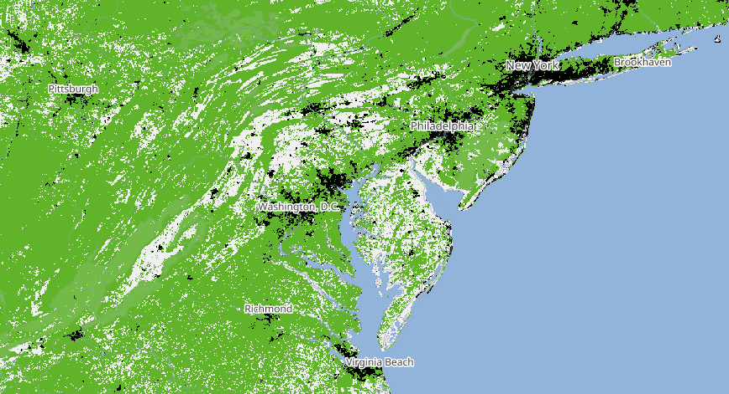
TanDEM-X Forest/Non-Forest Map
https://download.geoservice.dlr.de/FNF50/#details

Slide 13
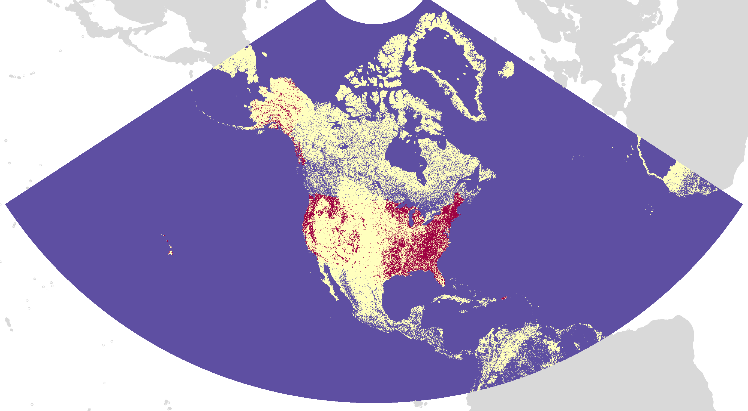
Composition of the xGEOID20 DEM
3DEP
TanDEM-X
MERIT

Slide 14
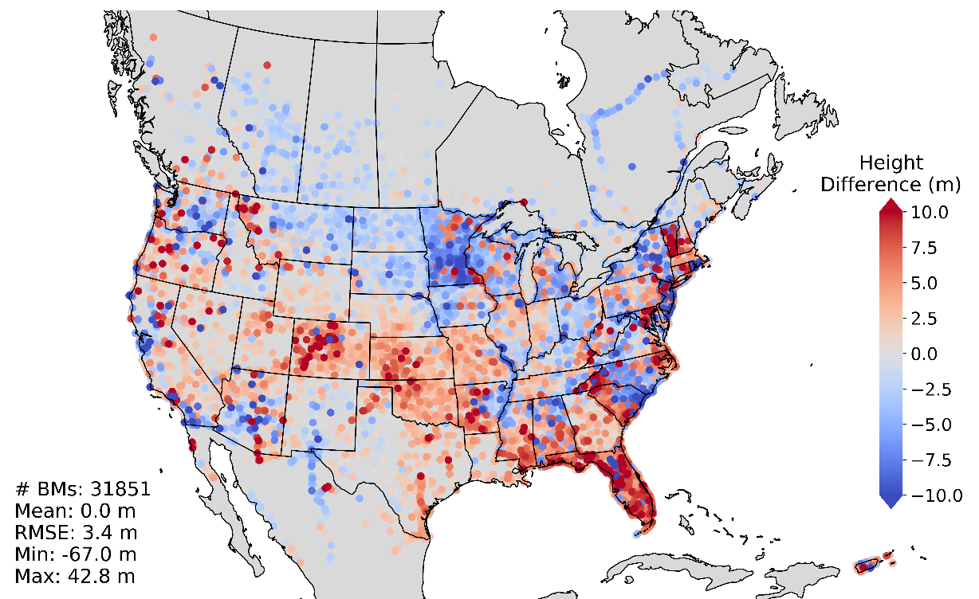
Comparison to Previous xGEOID DEM
xGEOID19 DEM vs. GPS-on-Benchmarks

Slide 15
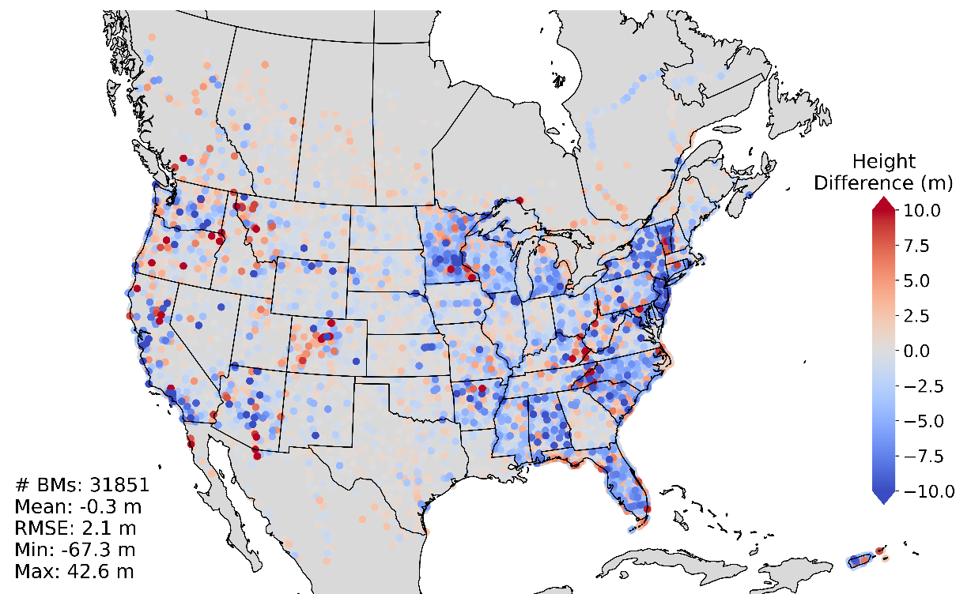
Comparison to Previous xGEOID DEM
xGEOID20 DEM vs. GPS-on-Benchmarks

Slide 16
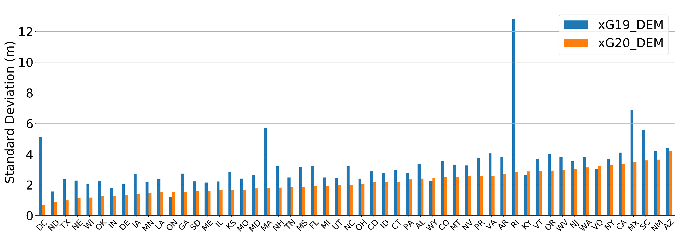
Comparison to Previous xGEOID DEM
State by state GPS-on-Benchmarks comparison

Slide 17
GSVS Comparison
GSVS11: | 218 pts
 | 3DEP 3sec | TanDEM-X | MERIT | xG19DEM | xG20DEM
Mean | -0.04 | 0.52 | 1.69 | 2.61 | 0.32
STD | 0.99 | 0.84 | 1.34 | 1.56 | 0.85
Range | 8.88 | 9.09 | 12.4 | 12.1 | 8.23
GSVS14: | 204 pts
 | 3DEP 3sec | TanDEM-X | MERIT | xG19DEM | xG20DEM
Mean | -0.34 | 0.09 | 0.97 | -1.77 | -0.07
STD | 1.62 | 1.51 | 2.12 | 2.88 | 1.46
Range | 11.21 | 12.09 | 13.61 | 18.12 | 10.07
GSVS17: | 223 pts
 | 3DEP 3sec | TanDEM-X | MERIT | xG19DEM | xG20DEM
Mean | -0.15 | 0.21 | 1.71 | 3.34 | -0.18
STD | 3.73 | 2.27 | 3.32 | 3.3 | 3.12
Range | 30.68 | 22.31 | 31.84 | 21.19 | 28.63
* All units in meters. Comparison of ellipsoid height.

Slide 18
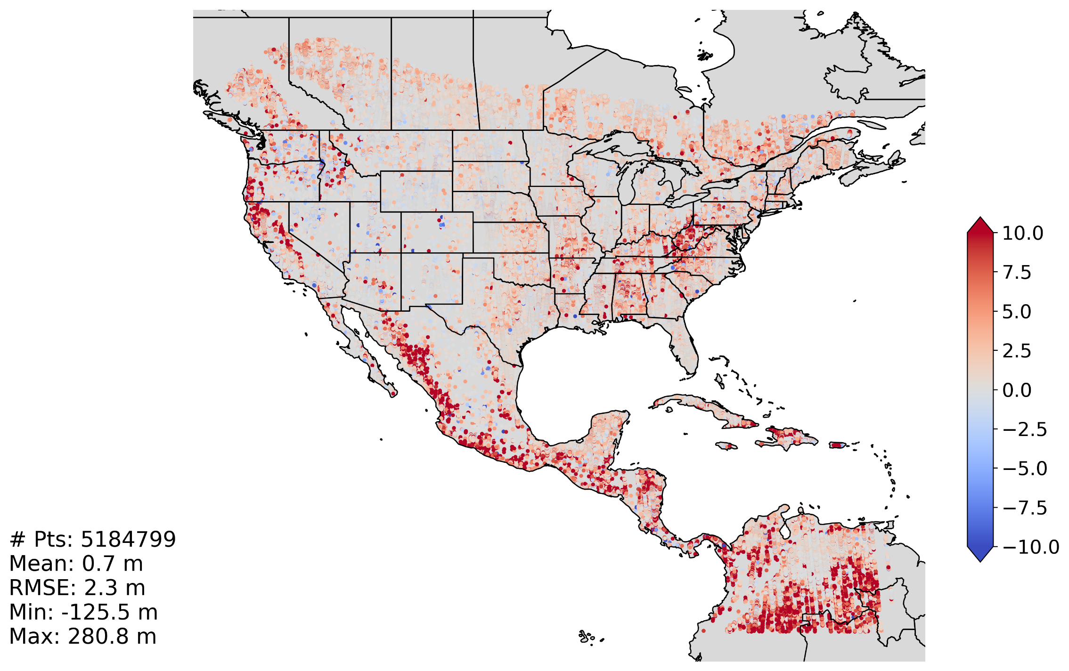
ICESat-2 Comparison
xGEOID20 DEM vs ICESat-2 ellipsoid heights
*Only ICESat-2 data with height error less than 2 meters used.

