Slide 1




EGU22-13104 (Early career scientist)
Virtual presentation
08:48-08:54 CEST, May-23-2022
The observationally constrained shape distributions of atmospheric dust
Yue Huang^{1,†} , Jasper F. Kok¹, Olga Muñoz², and Masanori Saito³
¹Department of Atmospheric and Oceanic Sciences, University of California Los Angeles (UCLA)
²Instituto de Astrofísica de Andalucía (IAA-CSIC)
³Department of Atmospheric Sciences, Texas A&M University
†Now at NASA GISS and Columbia University
Key points:
We present globally-representative parameterizations on dust shape distributions
Accounting for dust asphericity increases the gravitational settling lifetime by 20%
Accounting for dust asphericity increases the mass extinction efficiency, single-scattering albedo, and asymmetry factor

Slide 2
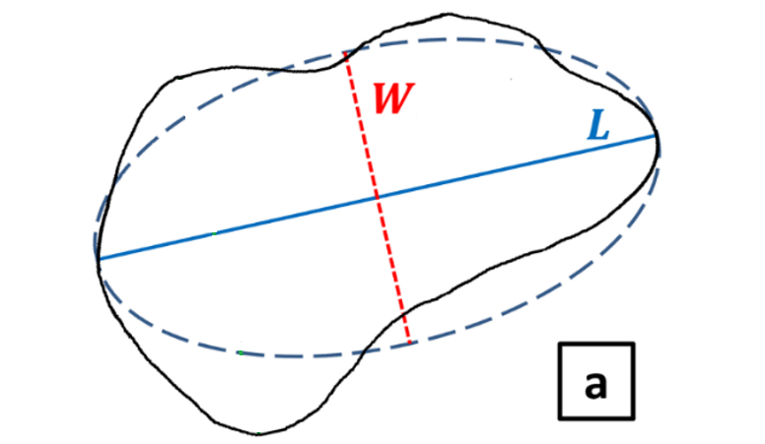
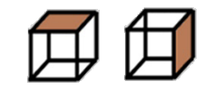
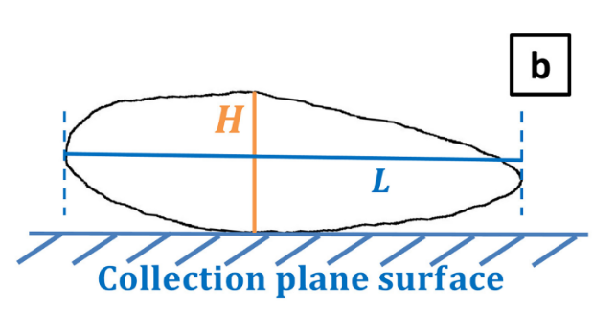

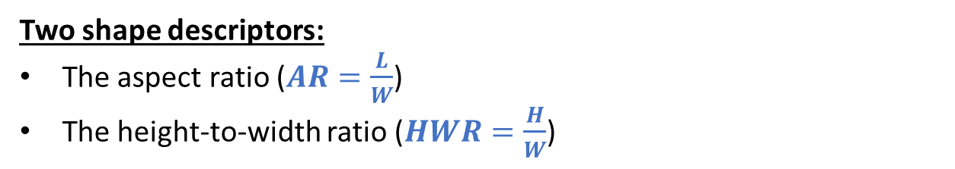
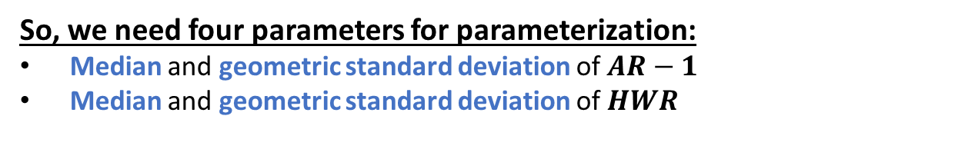
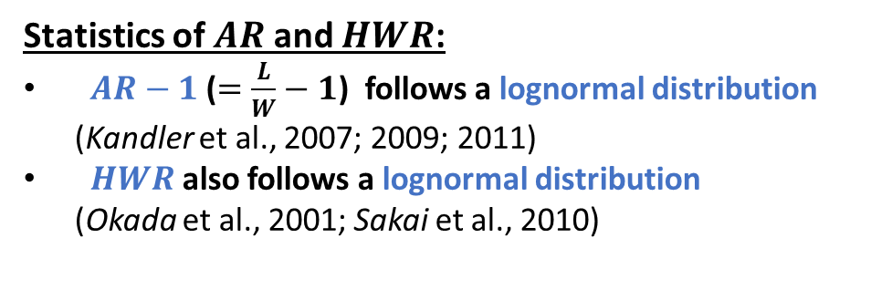
Quantifying dust shape
Two shape descriptors:
The aspect ratio ($AR=\frac{L}{W}$)
The height-to-width ratio ($HWR=\frac{H}{W}$)
Length $L≥$ Width $W≥$ Height $H$
Statistics of $AR$and $HWR$:
$AR−1$ ($=\frac{L}{W}−1$) follows a lognormal distribution (Kandler et al., 2007; 2009; 2011)
$HWR$ also follows a lognormal distribution (Okada et al., 2001; Sakai et al., 2010)
So, we need four parameters for parameterization:
Median and geometric standard deviation of $AR−1$
Median and geometric standard deviation of $HWR$
Page 2/7
Yue Huang (yh3456@columbia.edu) – Dust shape and application

Slide 3
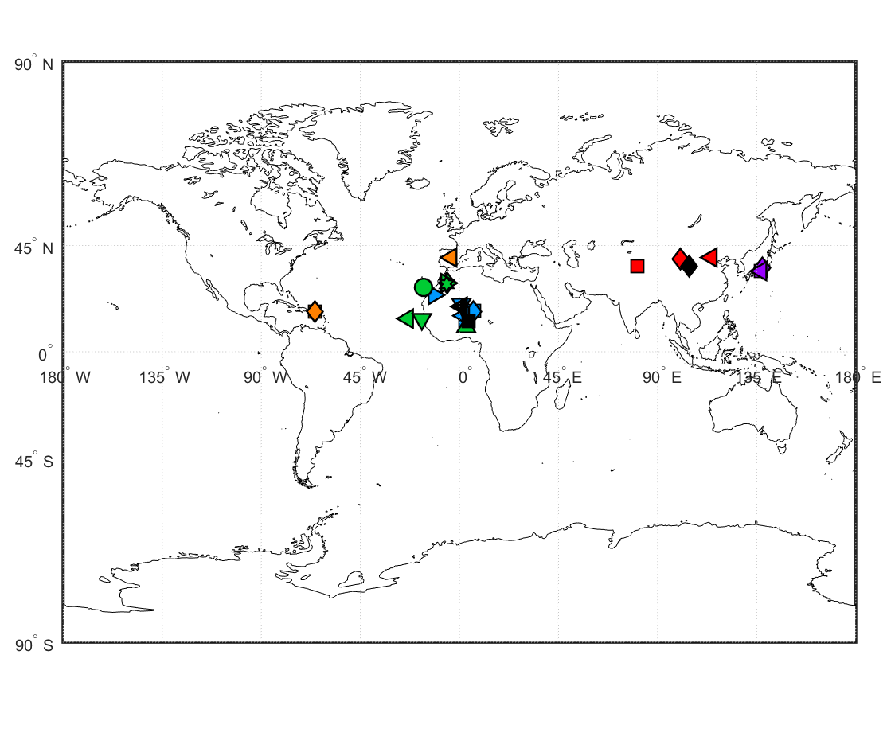
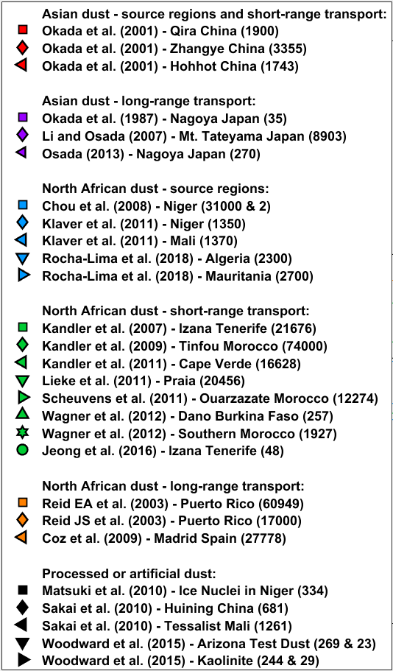
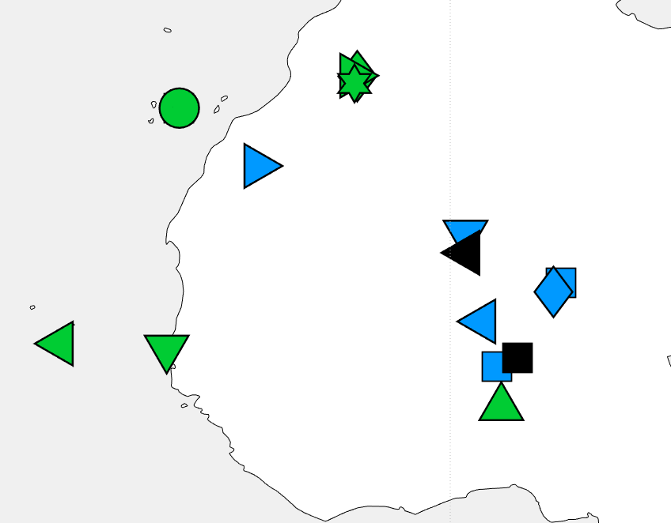
Compiling 27 observations on AR and HWR
For each of the 27 measurements, we obtain median of AR, geometric standard deviation of AR-1, median of HWR, and geometric standard deviation of HWR
Page 3/7
Yue Huang (yh3456@columbia.edu) – Dust shape and application

Slide 4
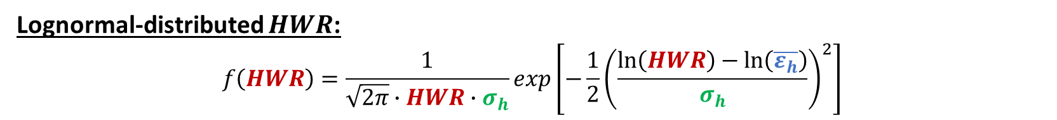
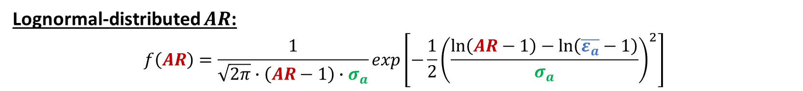
Parameterizations on dust shape distributions
Lognormal-distributed $AR$:
$$f\left(AR\right)=\frac{1}{\sqrt{2π}∙\left(AR−1\right)∙σ_{a}}exp\left[−\frac{1}{2}{\left(\frac{\ln\left(AR−1\right)−\ln\left(\overline{ε_{a}}−1\right)}{σ_{a}}\right)}^{2}\right]$$
The median $\overline{ε_{a}}=1.70±0.03$ and the geometric standard deviation $σ_{a}=0.70±0.02$
Lognormal-distributed $HWR$:
$$f\left(HWR\right)=\frac{1}{\sqrt{2π}∙HWR∙σ_{h}}exp\left[−\frac{1}{2}{\left(\frac{\ln\left(HWR\right)−\ln\left(\overline{ε_{h}}\right)}{σ_{h}}\right)}^{2}\right]$$
The median $\overline{ε_{h}}=0.40±0.07$ and the geometric standard deviation $σ_{h}=0.73±0.09$
Page 4/7
Yue Huang (yh3456@columbia.edu) – Dust shape and application

Slide 5
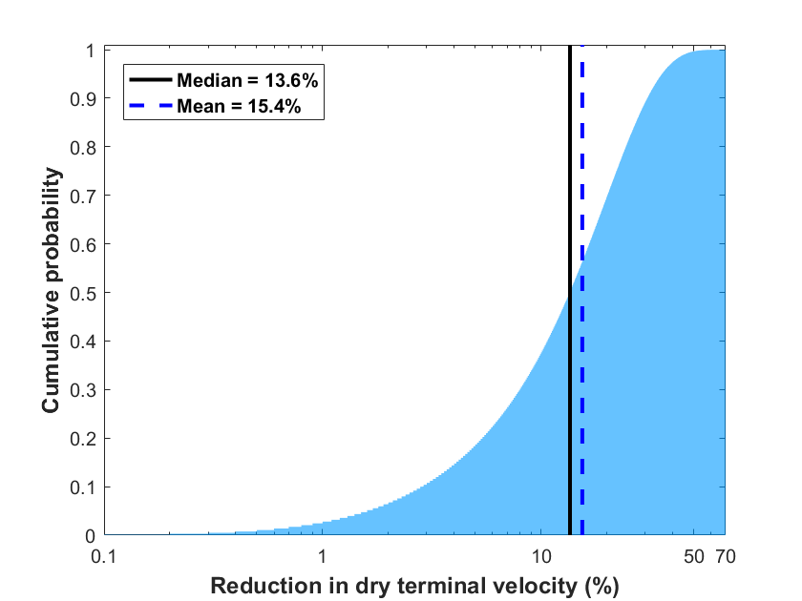
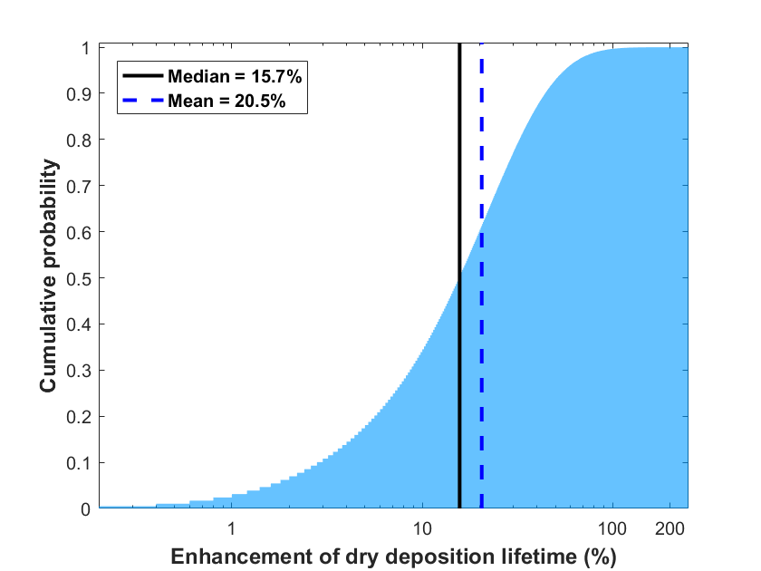
Application of dust shape parameterizations on dry deposition
Finding: dust asphericity decreases gravitational settling terminal velocity by ~15%, and increases gravitational settling lifetime by ~20%
Implication: As almost all aerosol models approximate dust as spheres, dust asphericity helps explain the underestimation of coarse dust in climate models
Page 5/7
Yue Huang (yh3456@columbia.edu) – Dust shape and application

Slide 6
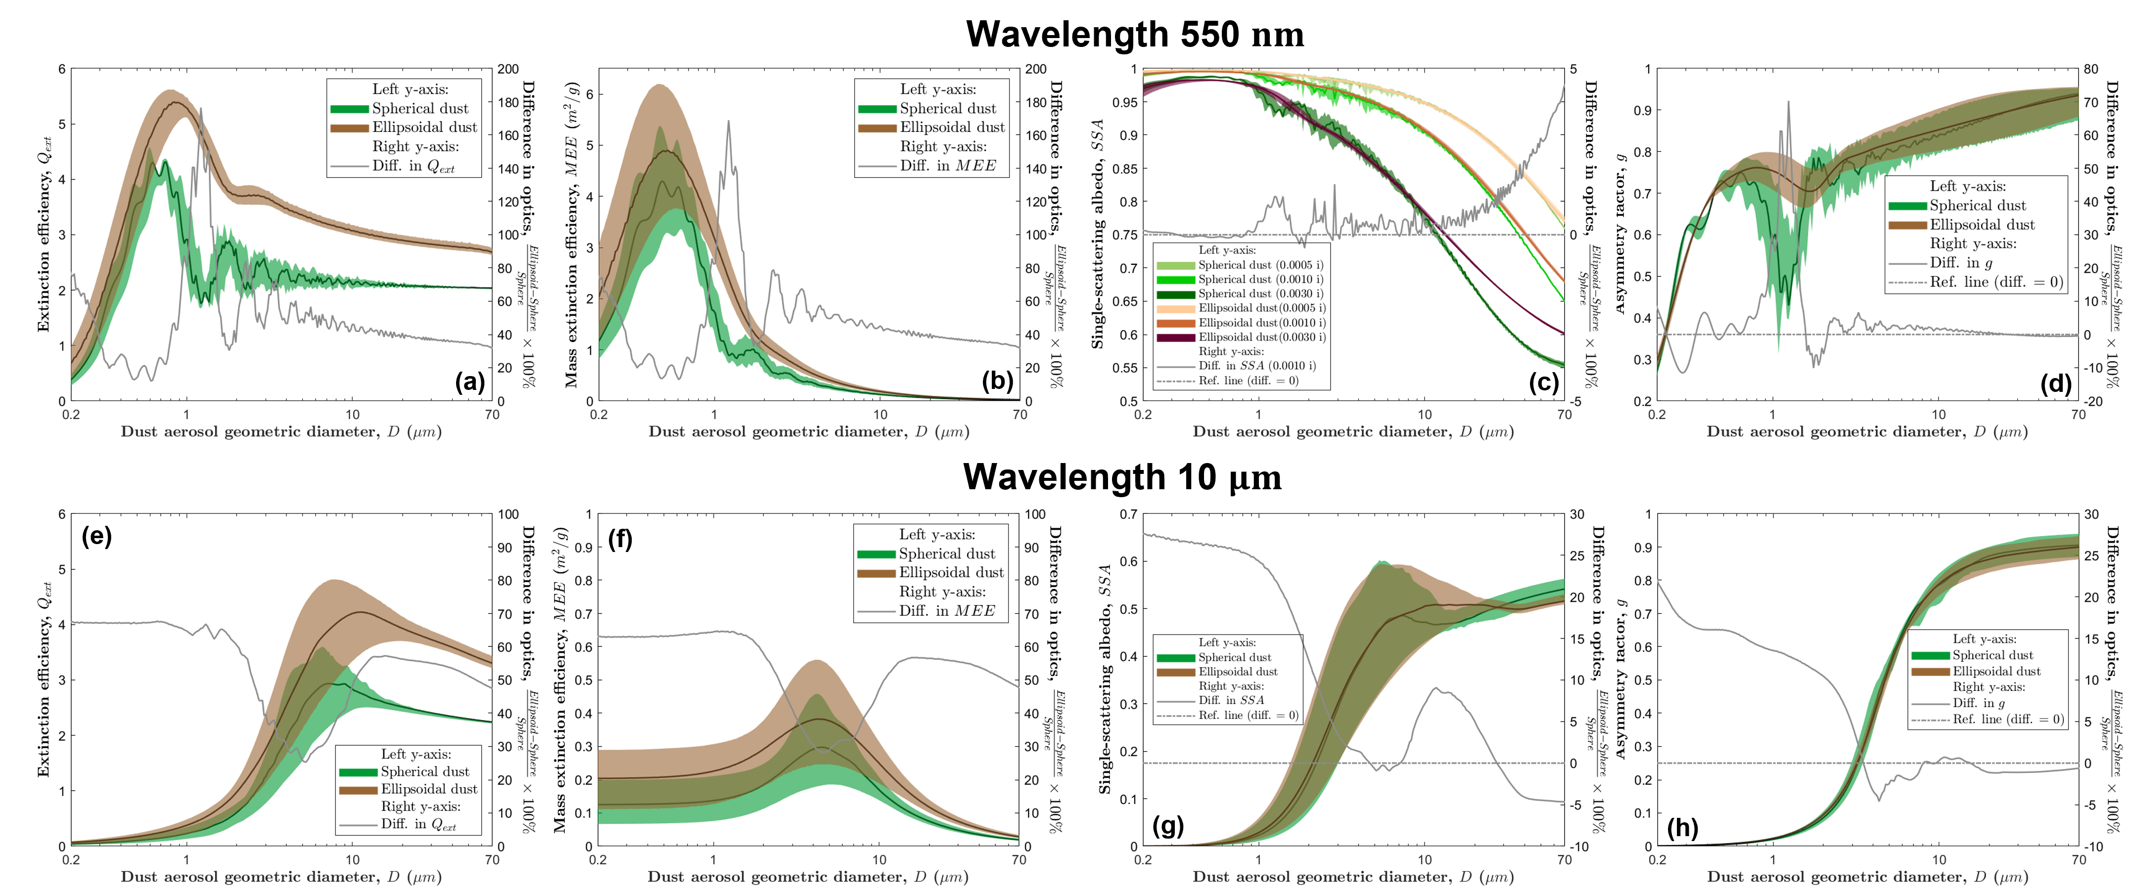



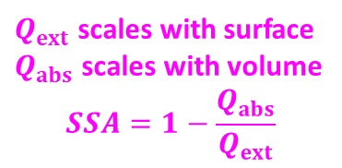
Application of dust shape parameterizations on single-scattering properties
$Q_{ext}$ scales with surface
$Q_{abs}$ scales with volume
$$SSA=1−\frac{Q_{abs}}{Q_{ext}}$$
$Q_{ext}$ scales with surface
$$MEE∝ Q_{ext}/D$$
$g$ scales with forward scattering
Finding: dust asphericity enhances the four single-scattering properties at both shortwave and longwave spectra
Page 6/7
Yue Huang (yh3456@columbia.edu) – Dust shape and application

Slide 7
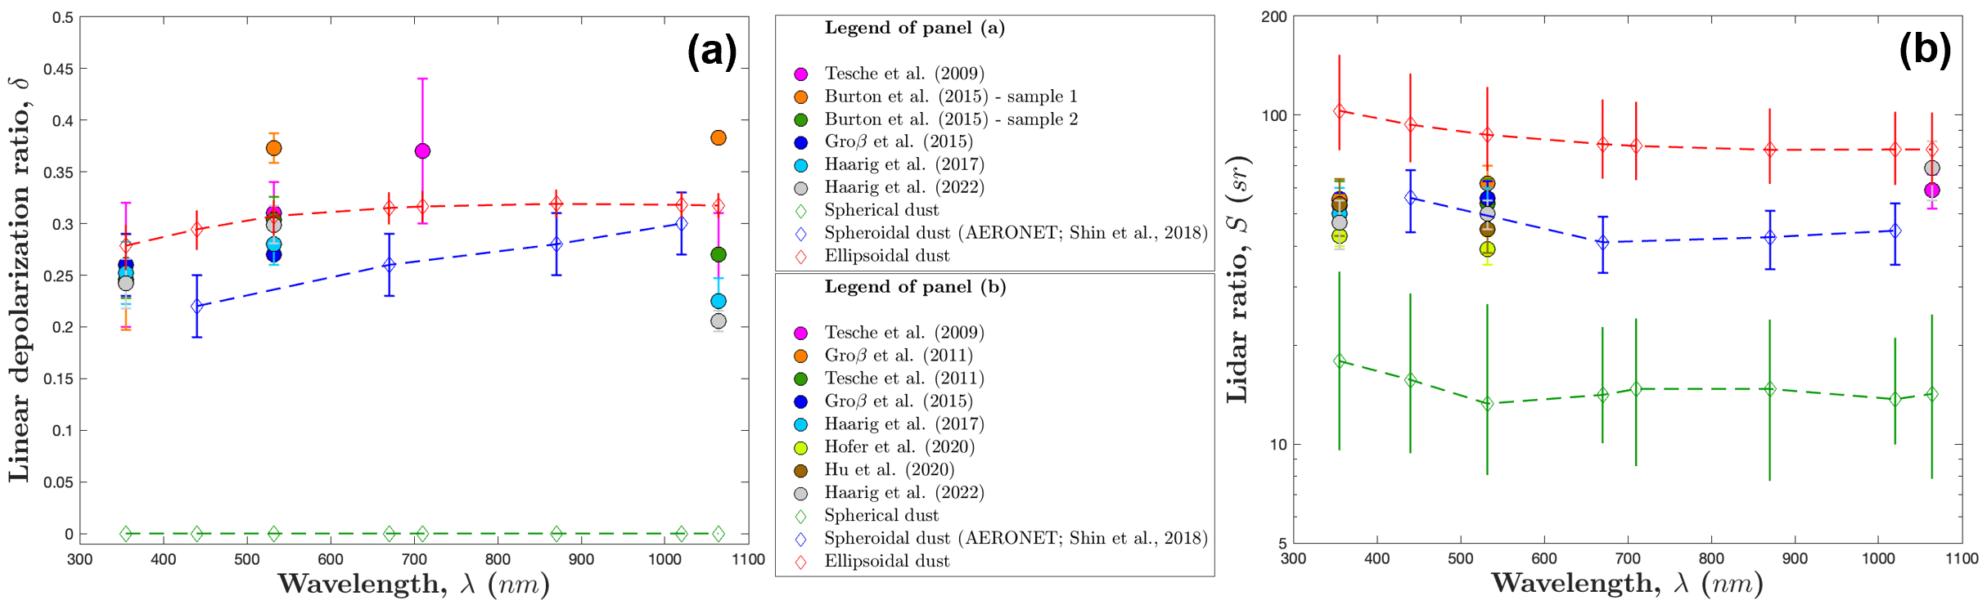
Application of dust shape parameterizations on lidar ratio and depolarization ratio
Finding #1: ellipsoidal dust optics can reproduce the linear depolarization ratio substantially better than the spheroidal dust optics
Finding #2: ellipsoidal dust optics overestimate the lidar ratio by underestimating backscattering intensity
Implication: Future research on surface roughness and sharp corners is important to lidar ratio
Page 7/7
Yue Huang (yh3456@columbia.edu) – Dust shape and application

Slide 8
Thank you!
Thoughts? Comments? -> Yue Huang (yh3456@columbia.edu)
Key points:
We present globally-representative parameterizations on dust shape distributions (Huang et al., 2020)
Accounting for dust asphericity increases the gravitational settling lifetime by 20% (Huang et al., 2021; Meng, Huang, and Kok, 2022)
Accounting for dust asphericity increases the mass extinction efficiency, single-scattering albedo, and asymmetry factor (Huang et al., in prep.)

Slide 9
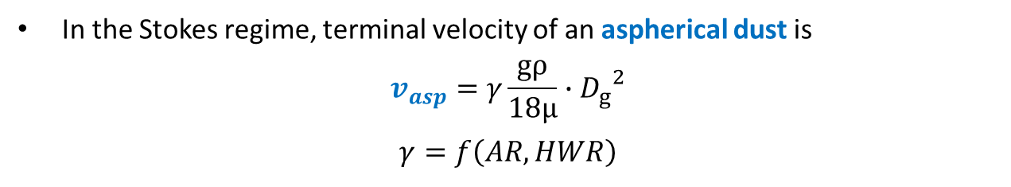
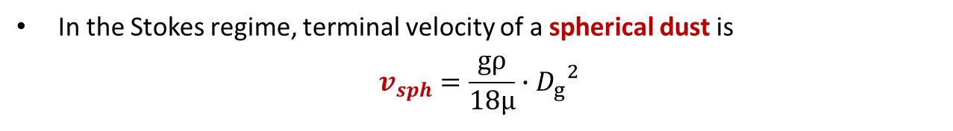
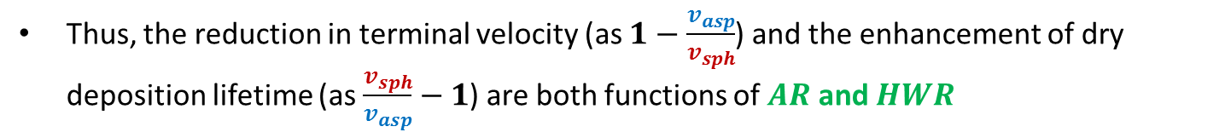
Backup slide #1: dry deposition formula
Formula for dry terminal velocity and lifetime
Dust dry deposition occurs in the Stokes regime, as 𝑅𝑒≪1
In the Stokes regime, terminal velocity of a spherical dust is
$$v_{sph}=\frac{gρ}{18μ}∙{D_{g}}^{2}$$
In the Stokes regime, terminal velocity of an aspherical dust is
$$v_{asp}=γ\frac{gρ}{18μ}∙{D_{g}}^{2}$$
$$γ=f\left(AR,HWR\right)$$
, after Bagheri and Bonadonna (2016)
Thus, the reduction in terminal velocity (as $1−\frac{v_{asp}}{v_{sph}}$) and the enhancement of dry deposition lifetime (as $\frac{v_{sph}}{v_{asp}}−1$) are both functions of $AR$ and $HWR$
I use Monte-Carlo sampling on the globally-representative distributions of AR and HWR to obtain a large number (${10}^{8}$) of volume-equivalent dust
Yue Huang (yh3456@columbia.edu) – Dust shape and application

Slide 10
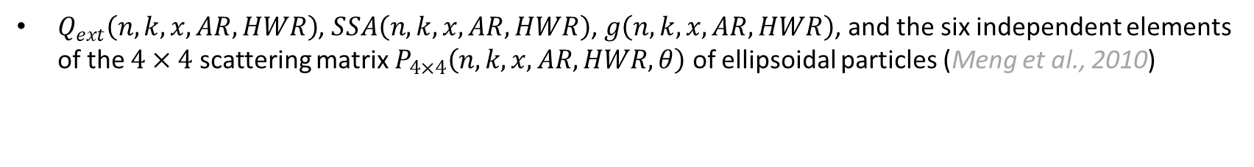
Backup slide #2: ellipsoidal dust optics
Shape-resolved database
$Q_{ext}\left(n,k,x,AR,HWR\right)$, $SSA\left(n,k,x,AR,HWR\right)$, $g\left(n,k,x,AR,HWR\right)$, and the six independent elements of the $4×4$ scattering matrix $P_{4×4}\left(n,k,x,AR,HWR,θ\right)$ of ellipsoidal particles (Meng et al., 2010)
Shape-integrated optics
We integrate the shape-resolved single-scattering properties against the two dust shape distributions
Simulation validation
Three simulations (spherical, spheroidal, and ellipsoidal dust) are validated against laboratory observations of the scattering matrix (Muñoz et al., 2012) and field observations of lidar ratio and depolarization ratio (Tesche et al., 2019)
Yue Huang (yh3456@columbia.edu) – Dust shape and application

