Slide 1

Research on texture features for typical sand dunes
using multi-source data
Ma Junfei, Li Fayuan, Liu lulu, Cheng Jianhua
374077782@qq.com
School of Geography, Nanjing Normal University

Slide 2
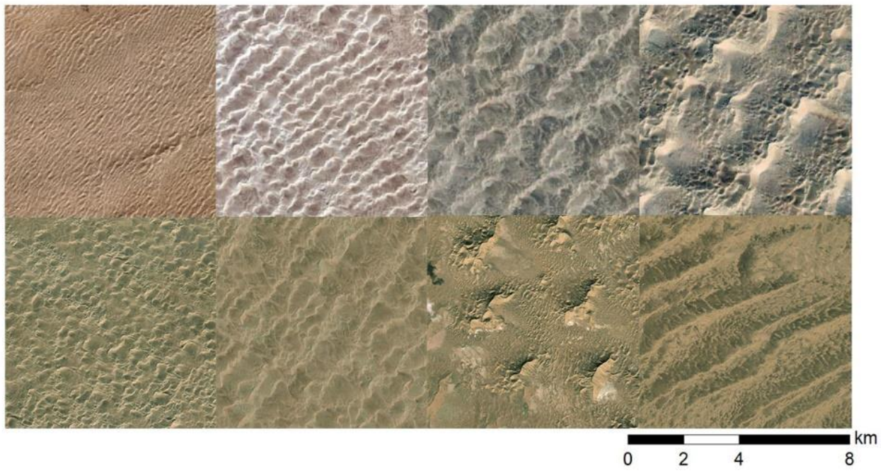
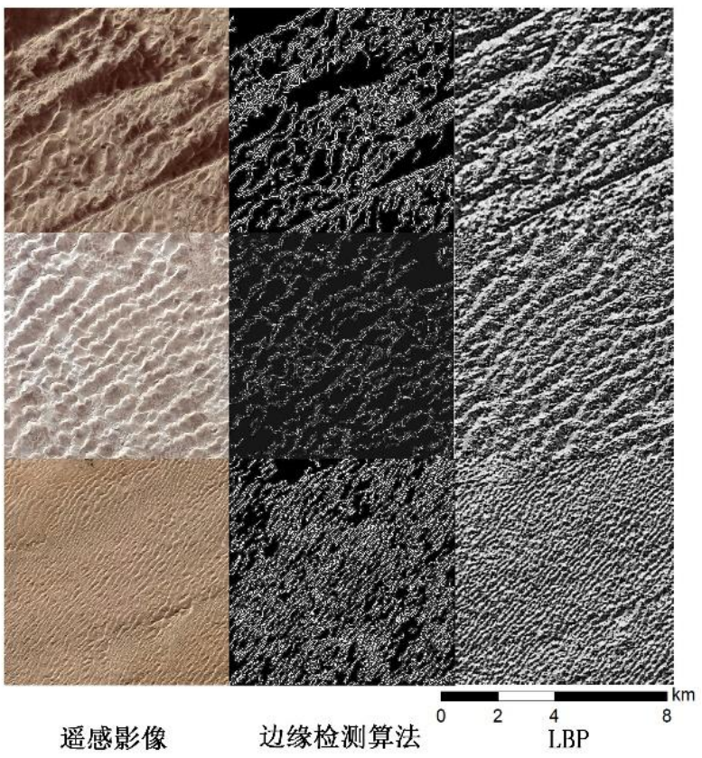
Desert is an aeolian landform formed by the transportation and accumulation of wind. Desert has very significant texture features both macroscopically and microscopically. Different dune types with different morphological characteristics will be formed under different comprehensive climate and environmental conditions, and their texture characteristics are also significantly different.
RS
edge detection algorithm

Slide 3
This study takes Badain Jaran Desert as the study area, and selects four typical sand dune types in this area：starlike chain megadune, barchans chain, compound chain dune, and schuppen chain megadune.This work studies the corresponding relationship between desert texture features and dune morphological features, and tries to build a texture information spectrum of desert based on texture features.

Slide 4
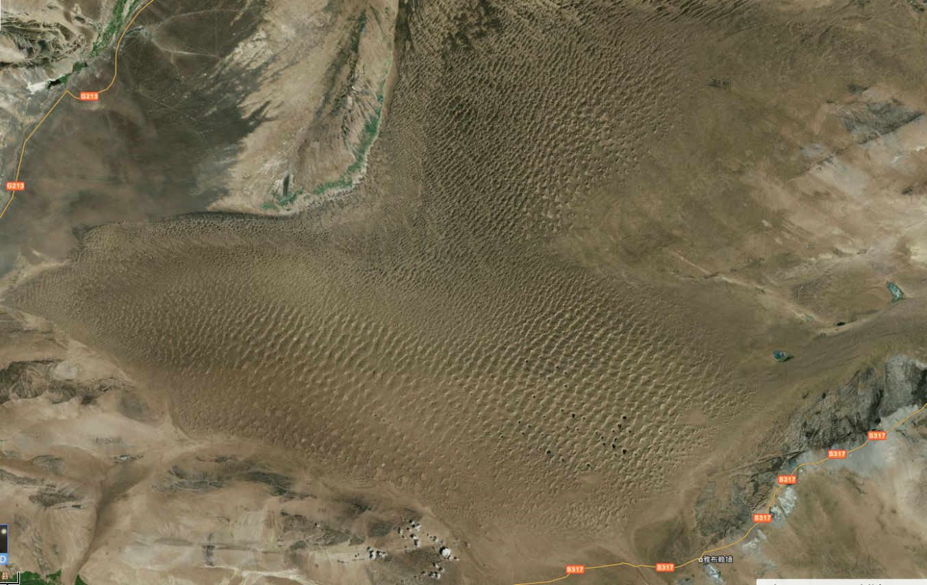
The macro texture of desert is composed of sand dunes and inter dune land arranged and combined according to a certain rule
The micro texture characteristics of desert are mainly composed of dune ridges at different levels

Slide 5
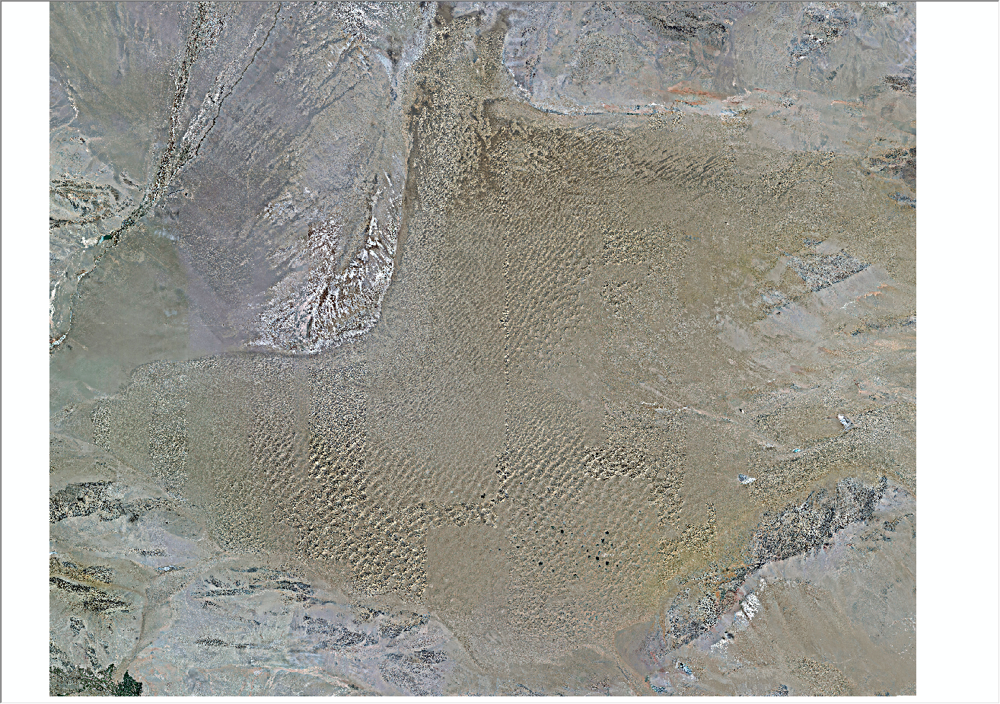
Therefore, extracting the macro texture features of desert is to classify sand dunes and inter dune land.
Based on DEM data, the spatial range of sand dunes can be extracted by using positive and negative terrain method, so as to reflect the macro texture characteristics of desert.

Slide 6
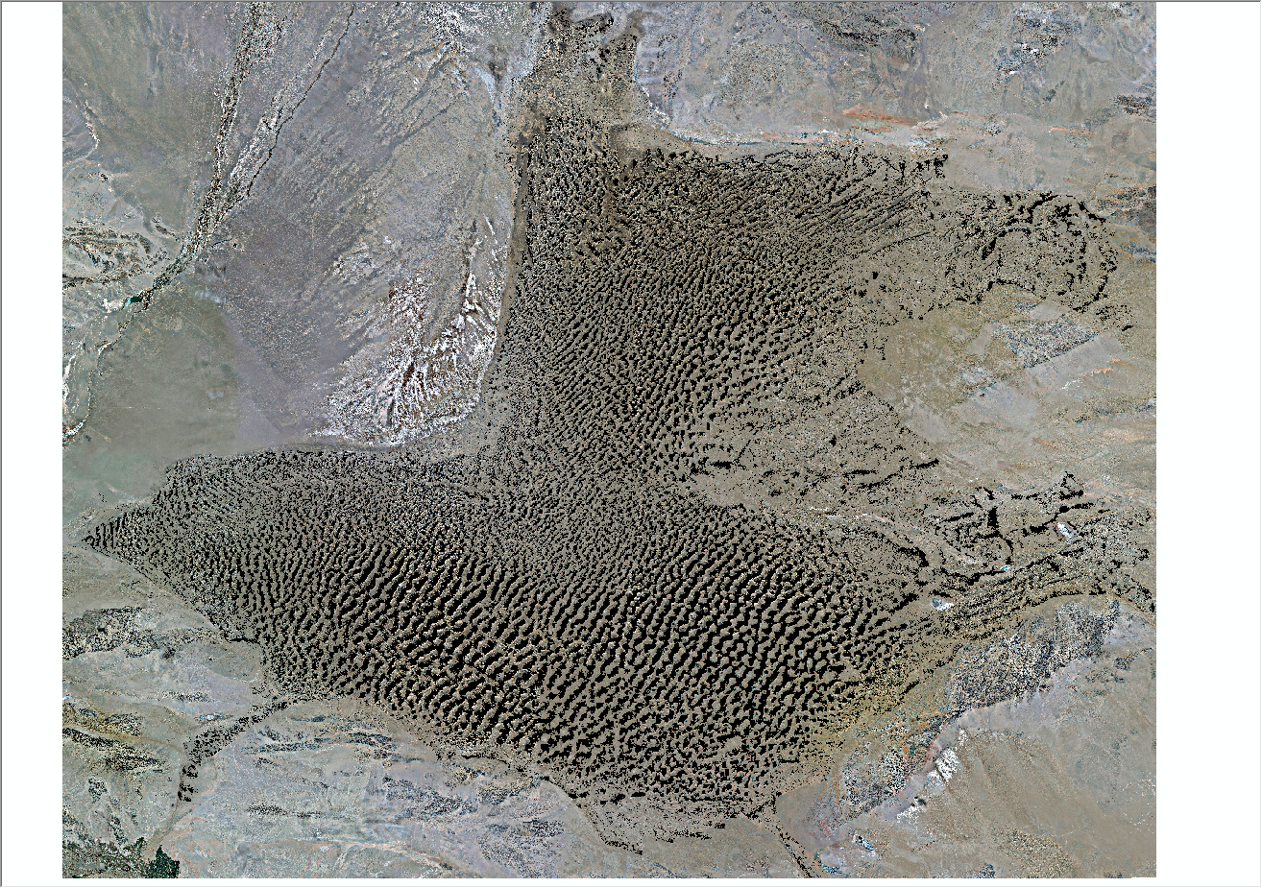
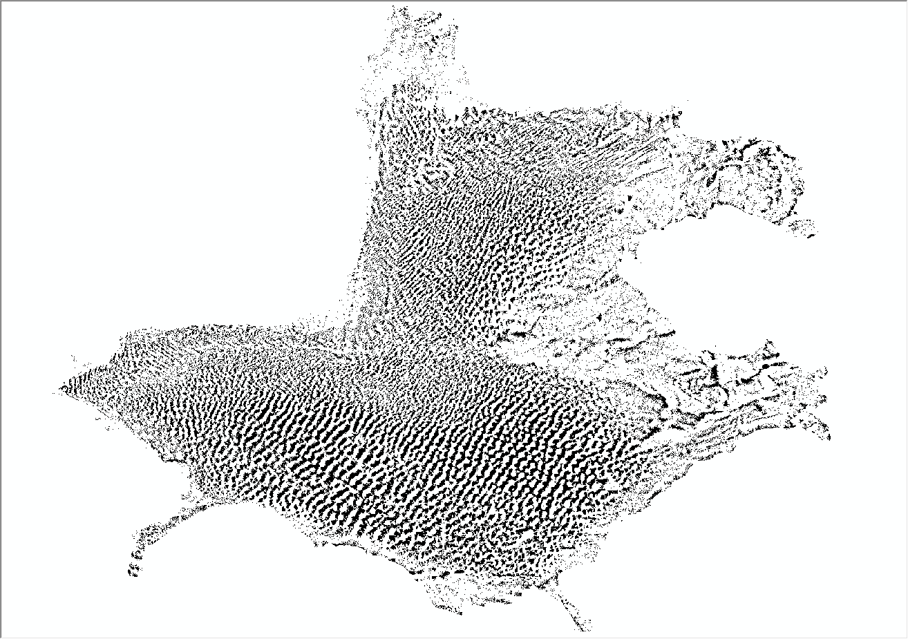
Therefore, extracting the macro texture features of desert is to classify sand dunes and inter dune land.
Based on DEM data, the spatial range of sand dunes can be extracted by using positive and negative terrain method, so as to reflect the macro texture characteristics of desert.

Slide 7
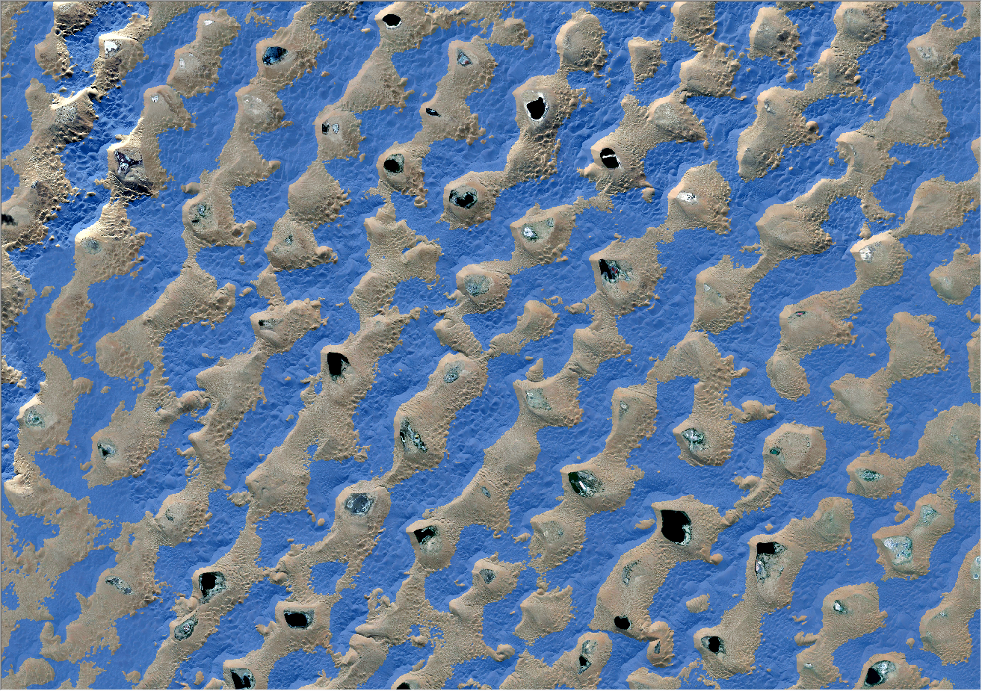
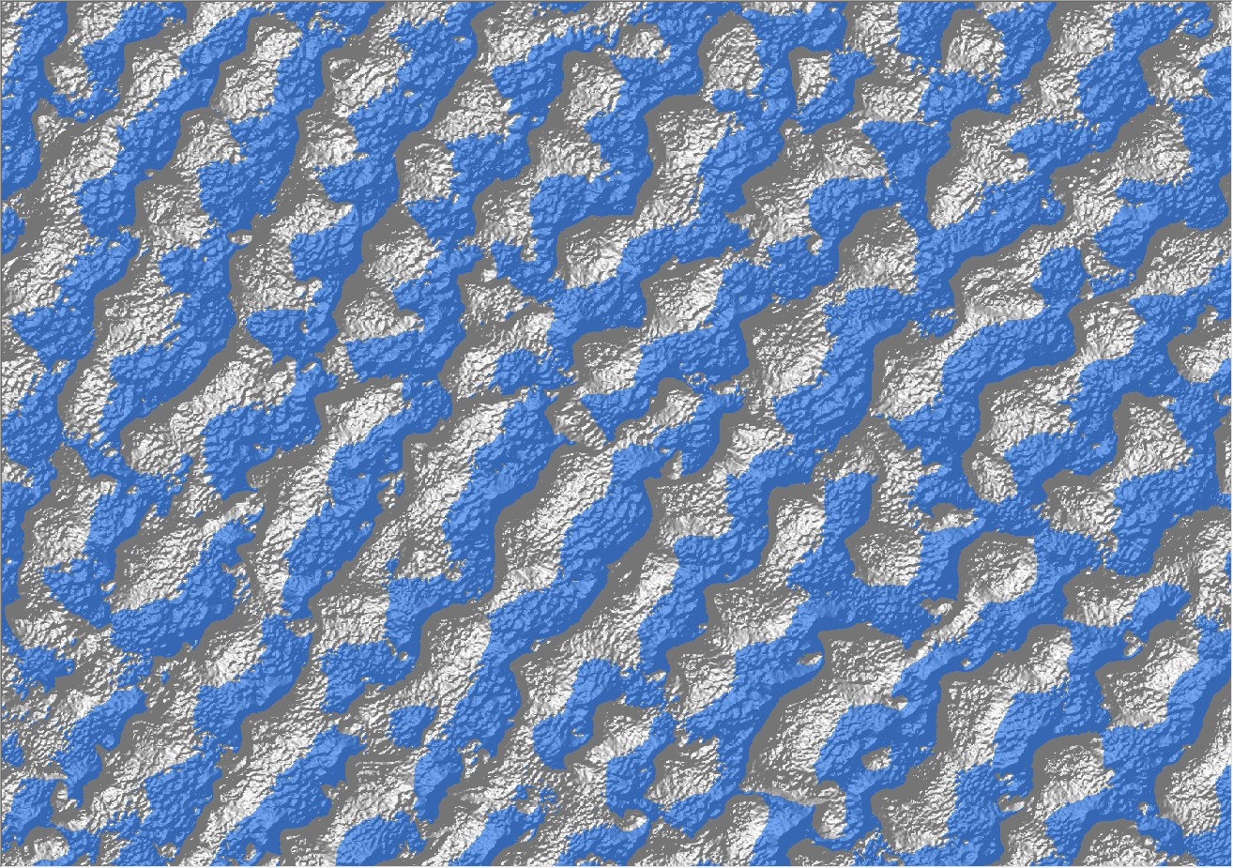
Sand dune contour extracted by positive and negative terrain

Slide 8
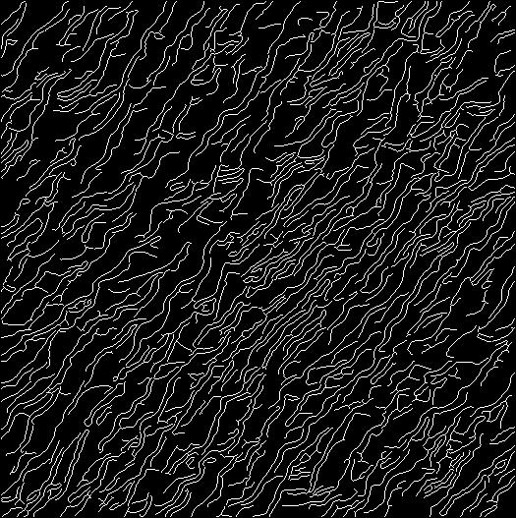
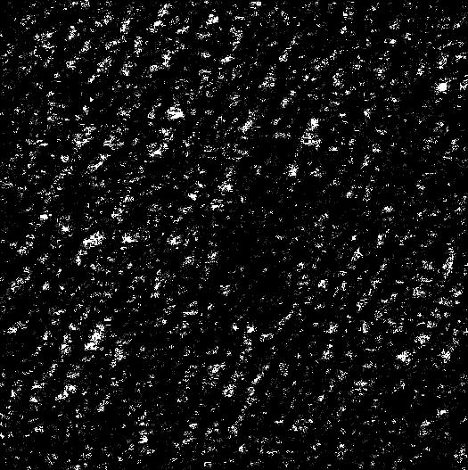
Extracting micro texture features of desert：The edge detection algorithm is used to extract the local texture features of sand dunes based on remote sensing images
RS image
Canny
Susan

Slide 9
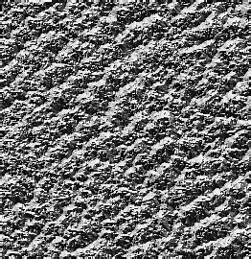
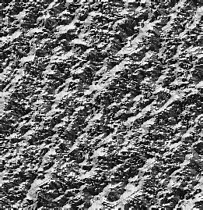
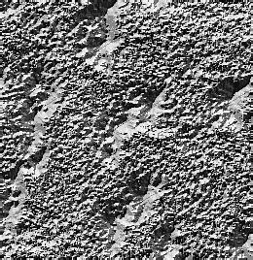
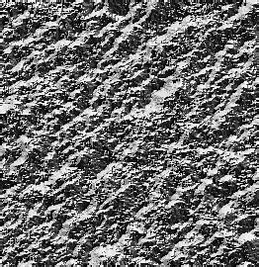
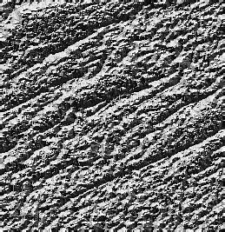
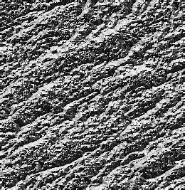
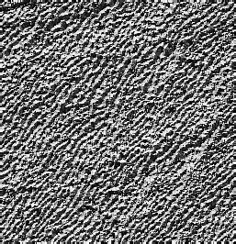
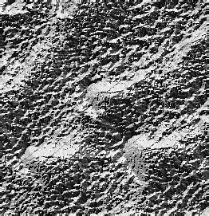
In addition, local binary patterns are used to enhance the texture of DEM data

Slide 10
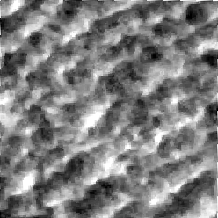
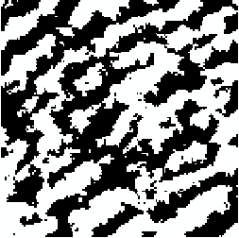
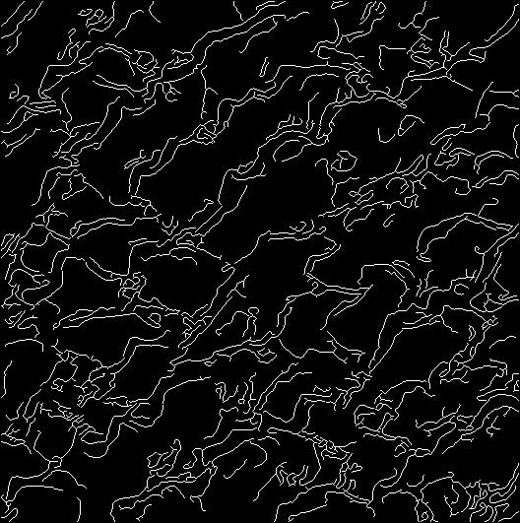
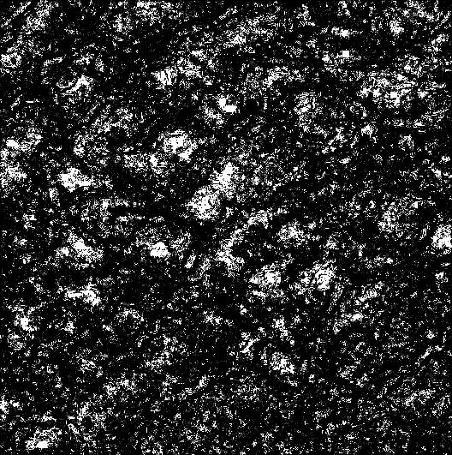
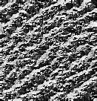
In this way, for each sample area, there are six data methods to express the terrain texture.Eight texture indexes based on gray level co-occurrence matrix(GLCM) are calculated for the original data and the abstract texture data respectively. Each sample area has 48 texture feature indexes

Slide 11
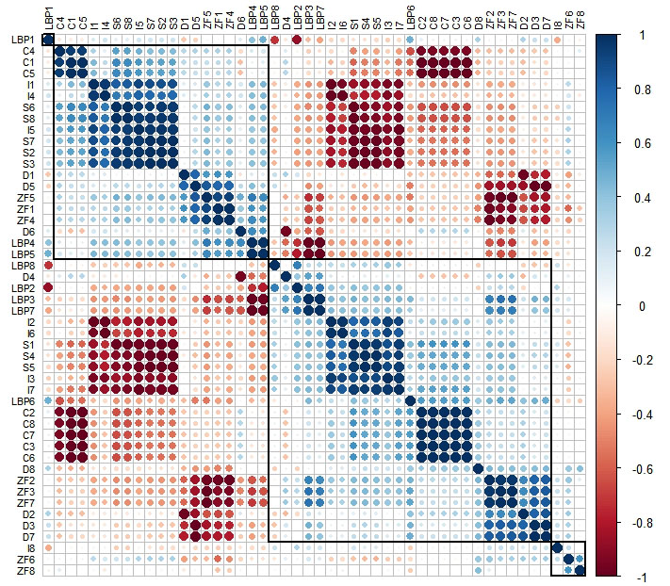
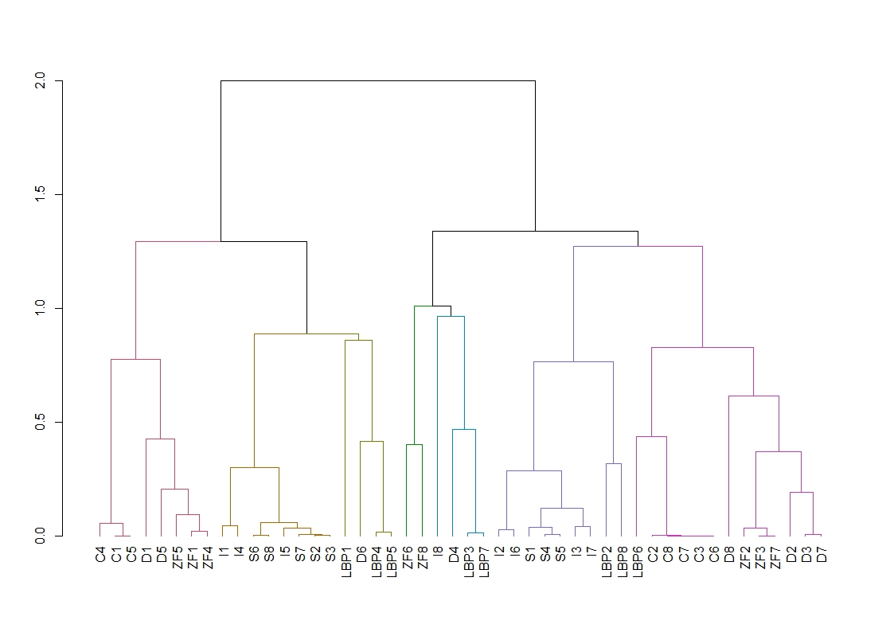
Then these 48 texture parameters are clustered based on the result of Spearman correlation.
The coefficient of variation is used to determine representative indicators for each clusterin order to construct a geomorphological texture information spectrum library of typical dune types.

Slide 12
Finally, eight texture feature indexes are selected: DEM Angular second moment, canny correlation, LBP correlation, DEM correlation, remote sensing image contrast, Susan correlation, LBP variance and positive and negative terrain entropy to construct the geomorphological texture information spectrum.

Slide 14
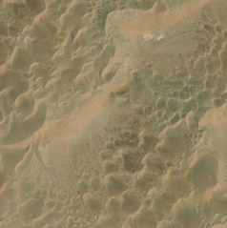
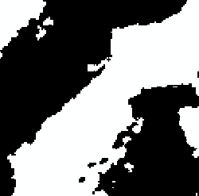
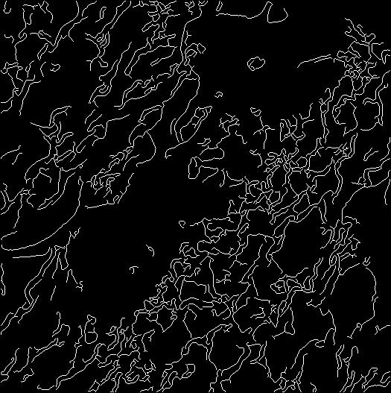
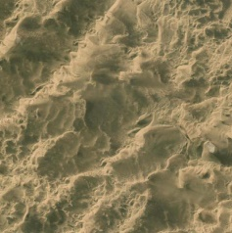
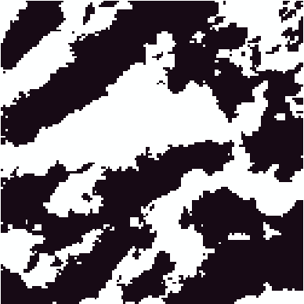
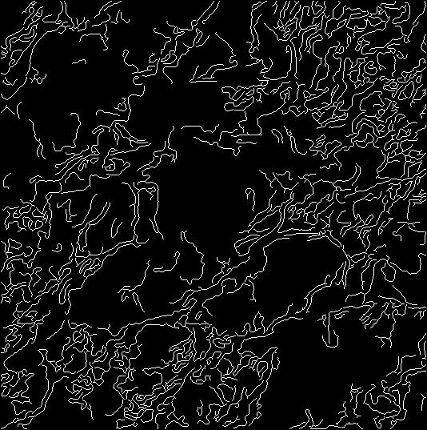
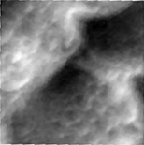
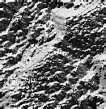
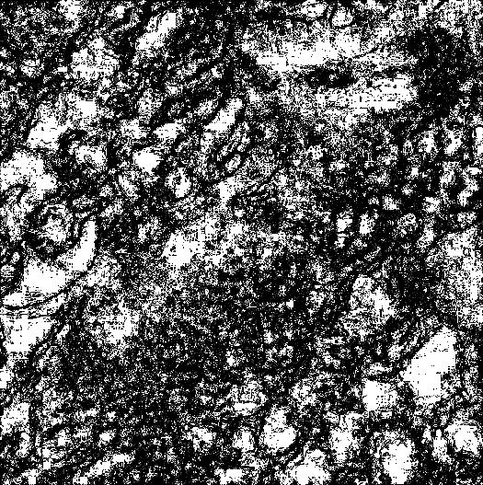
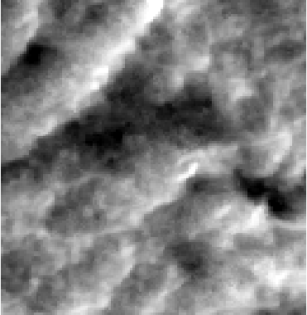
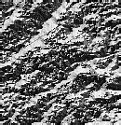
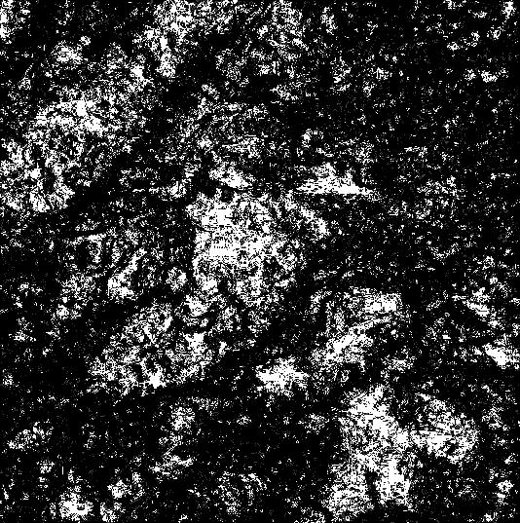
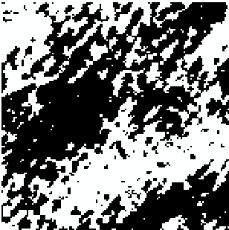
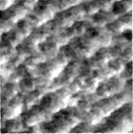
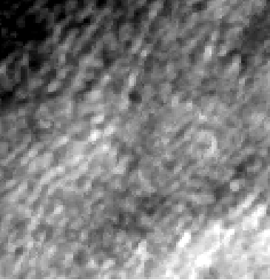
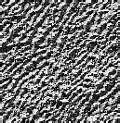
Geomorphological texture information spectrum of desert

Slide 15
Outlook ：
1. There are few samples selected for each dune type, which is not enough to reflect the texture characteristics of specific dune type areas
2. Aster 30m DEM is difficult to reflect the texture features of small-scale sand dunes. In the future, higher precision DEM data can be used to reflect the detailed features
3. Different dune types often have no obvious boundaries. How the texture features change on this gradient boundary needs further research

Slide 16
Thanks
Ma Junfei, Li Fayuan, Liu lulu, Cheng Jianhua
374077782@qq.com
May 25 2022

