Slide 1



Morphological characteristics and evolution model of slope units along loess gully cross section
Lulu Liu, Fayuan Li, Xue Yang
201302098@njnu.edu.cn
May 25, 2022

Slide 2
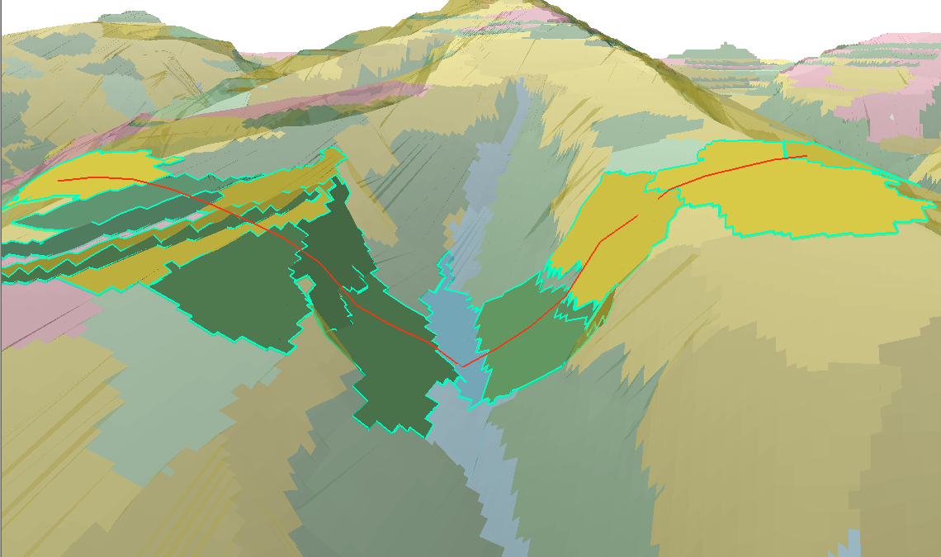
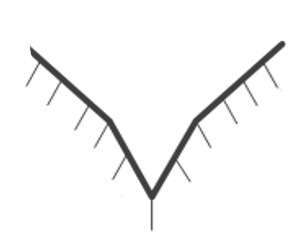
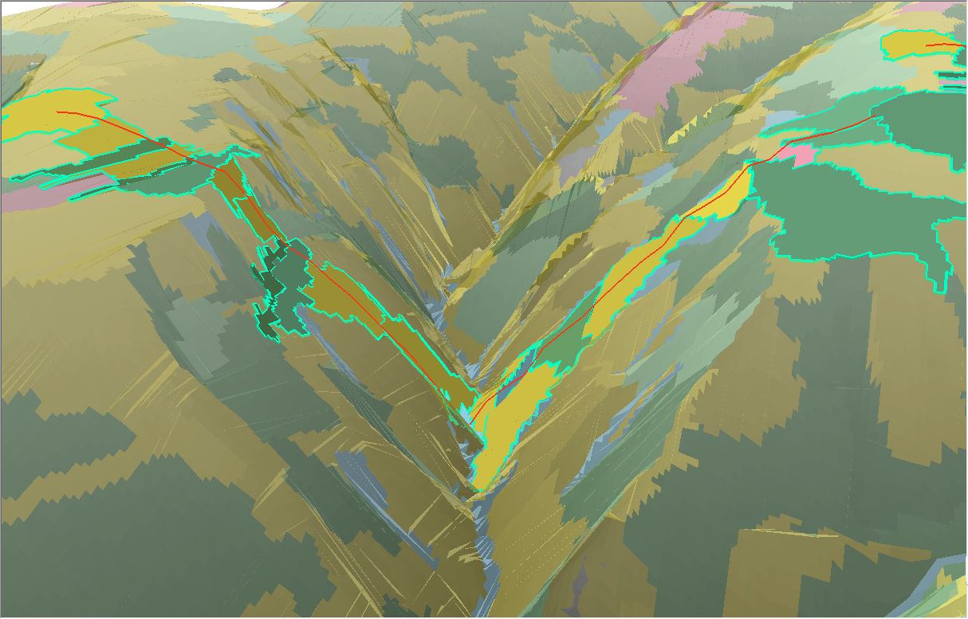
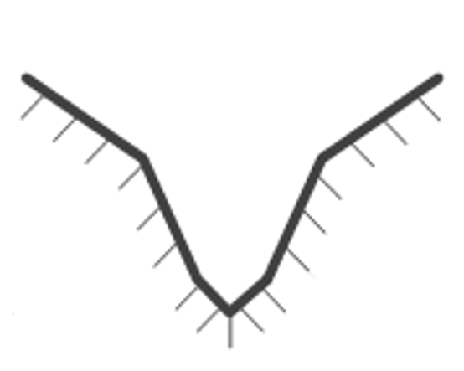
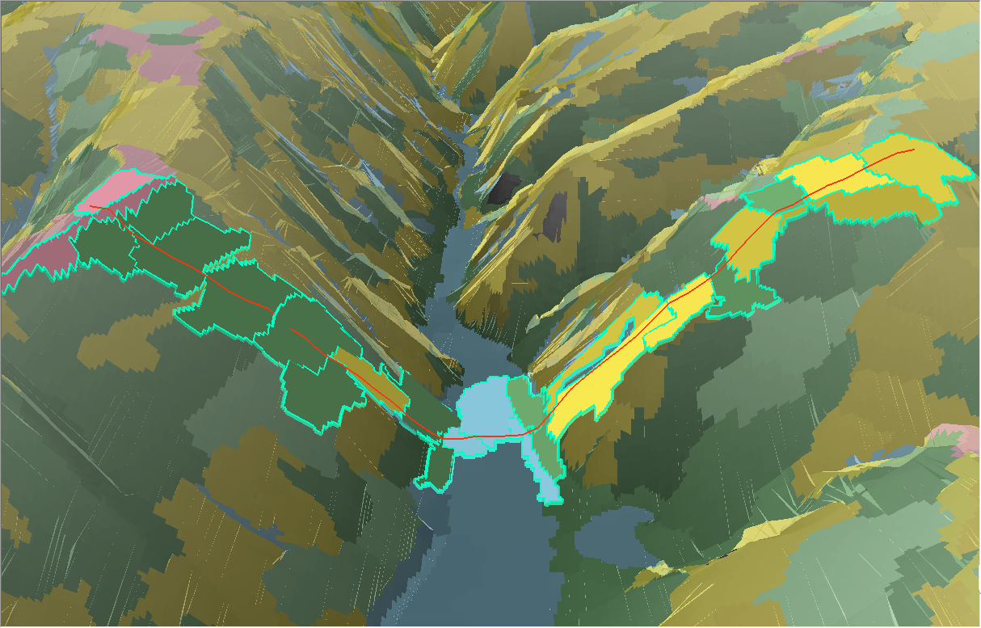
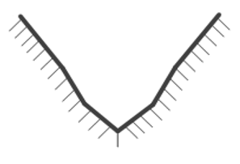
Research background and significance
The gully cross section changes significantly
with gully development.
Distinct morphological characteristics: "V" shape, "U" shape
Regional differences and developmental stage differences
‘V’ cross section
The slope morphology changes continuously
with gully development.
Transitional cross section
Determined by both gradient and slope length
Important for the collection of runoff
Affect soil erosion process and degree
‘U’ cross section

Slide 3
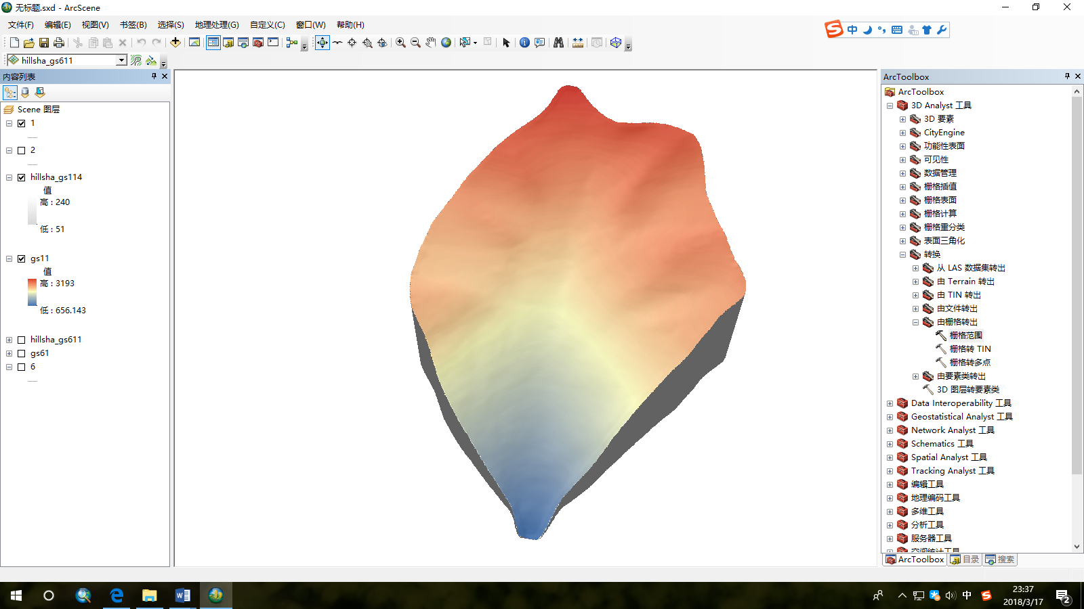
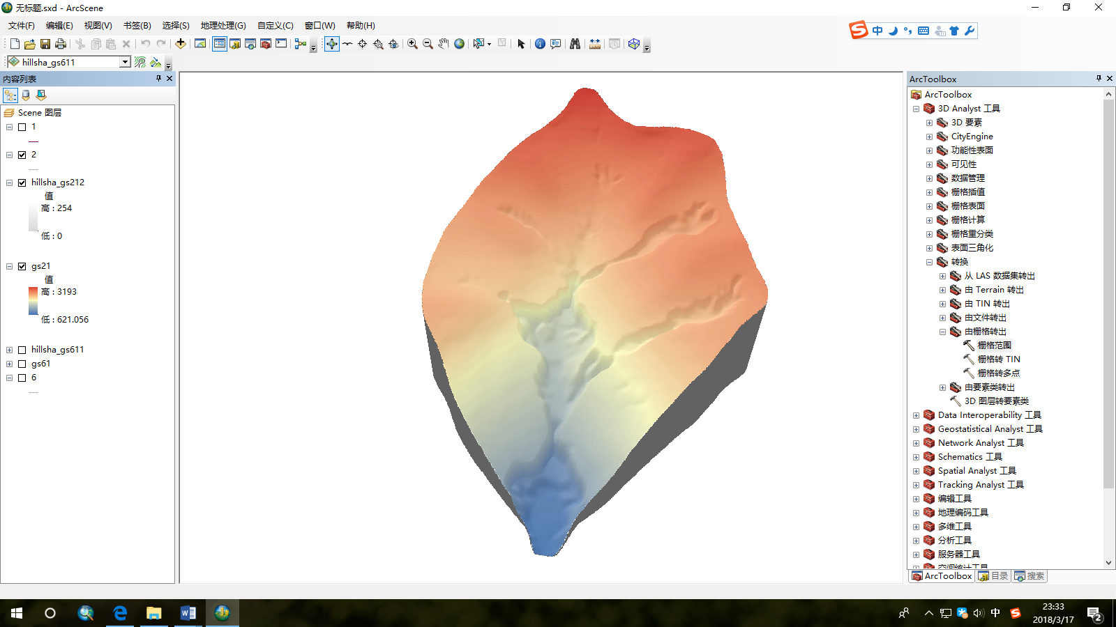

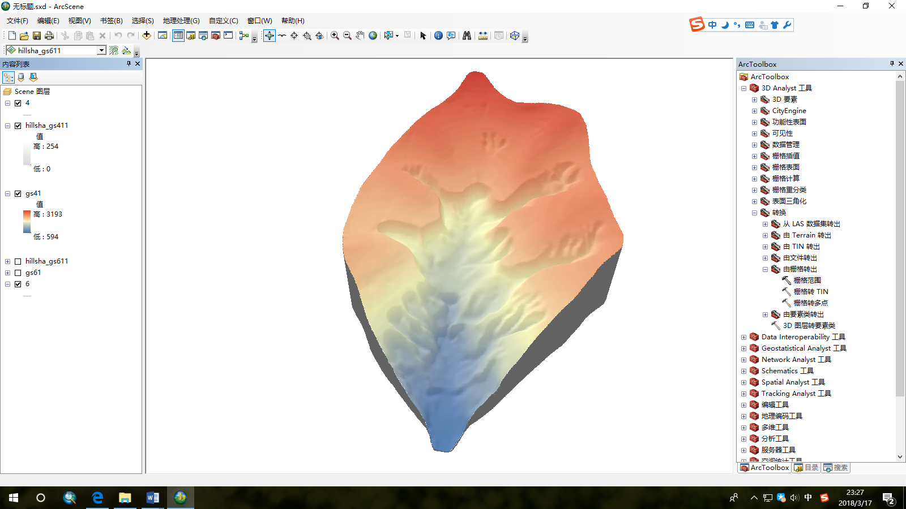
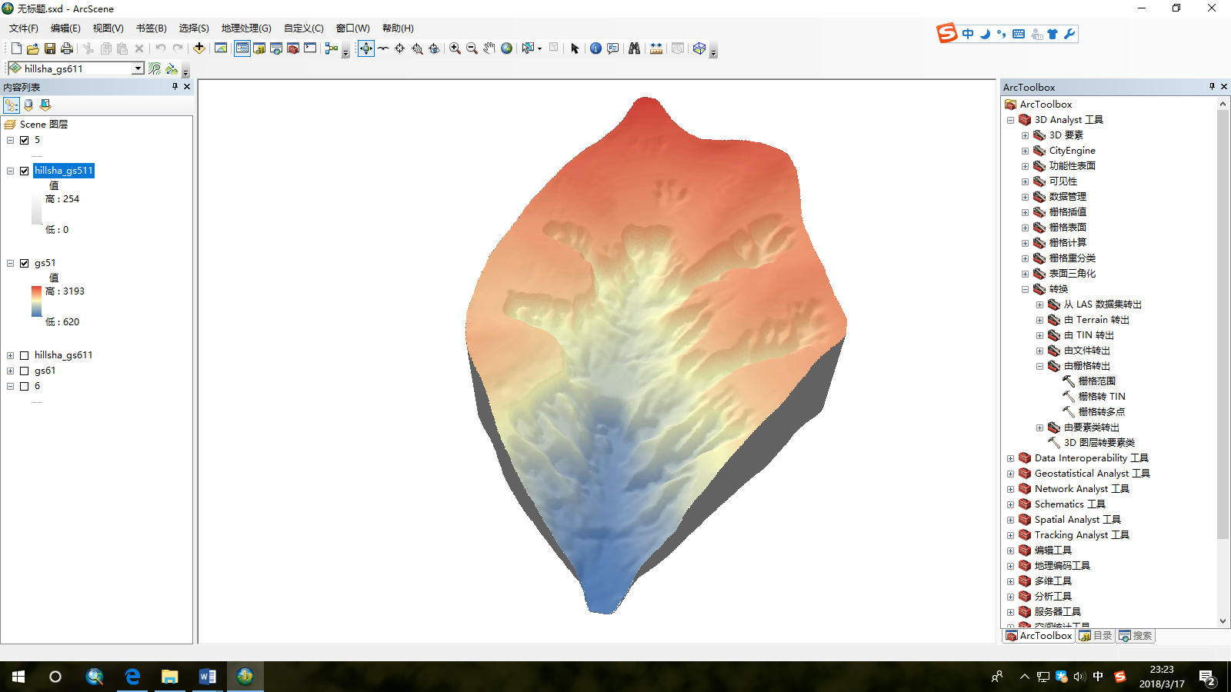
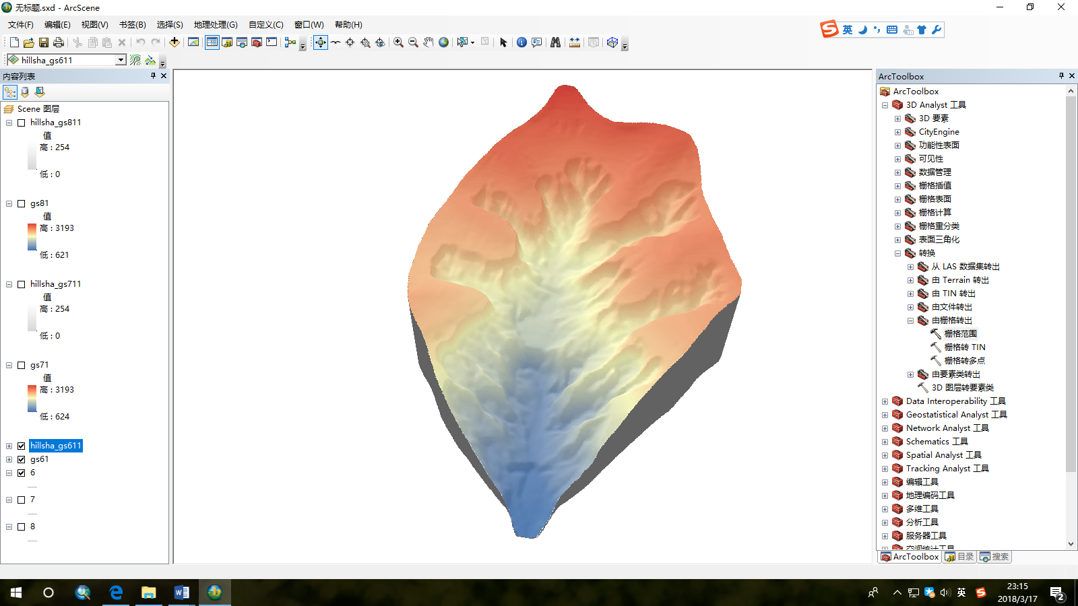

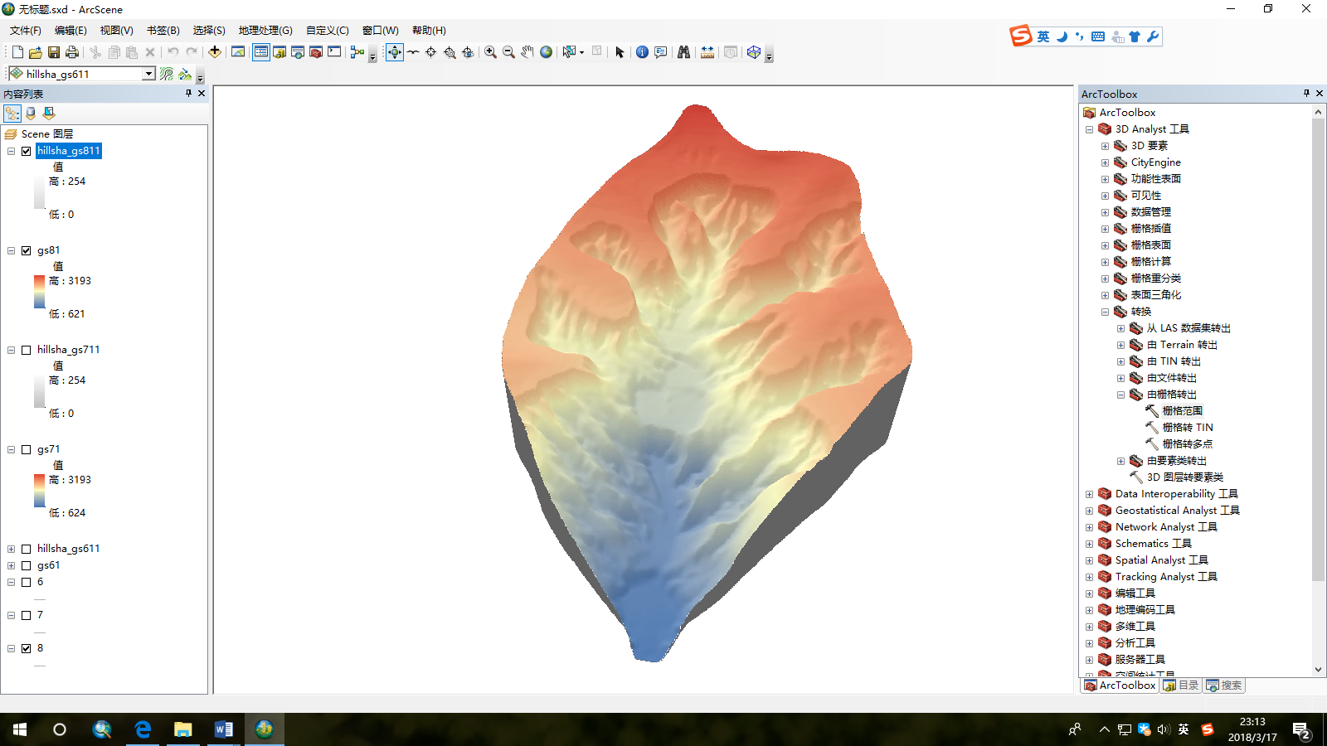

Research data
Indoor simulation of loess small watershed
The soil erosion and rainfall erosion simulation test of the State Key Laboratory of Dryland Agriculture on the Loess Plateau
Evolution simulation of loess small watershed driven by artificial rainfall
Collect high-precision terrain data in 9 different periods
DEM grid resolution: 10mm
第1期
第2期
第3期
第4期
第5期
第6期
第7期
第8期
第9期

Slide 4
Slope unit segmentation and classification
Multiband image synthesis
In order to study the variation of slope morphology in different gully developmental stages and different spaces, this study first divides the slope units. Further research is carried out on the slope units.
Based on DEM, slope, plane curvature, profile curvature, ridge and valley are extracted. The multi-band image is synthesised by DEM and five derived layers. The multi-scale segmentation method is used to segment the image by selecting appropriate band weight, scale parameters, shape index and compactness index.
Segmentation parameters and algorithm
Category of slope units
Classification rules and revision of results
Classification results of slope units

Slide 5
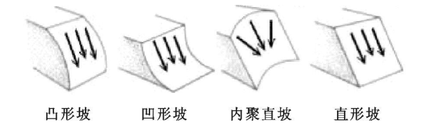
Slope unit segmentation and classification
Category description of slope units
Name | Slope morphology | Profile curvature | Terrain control information
Convex slope |  | < 0 | —
Straight slope |  | = 0 | —
Concave slope |  | > 0 | —
Ridge | — | — | Ridge > 0
Valley | — | — | Valley > 0

Slide 6
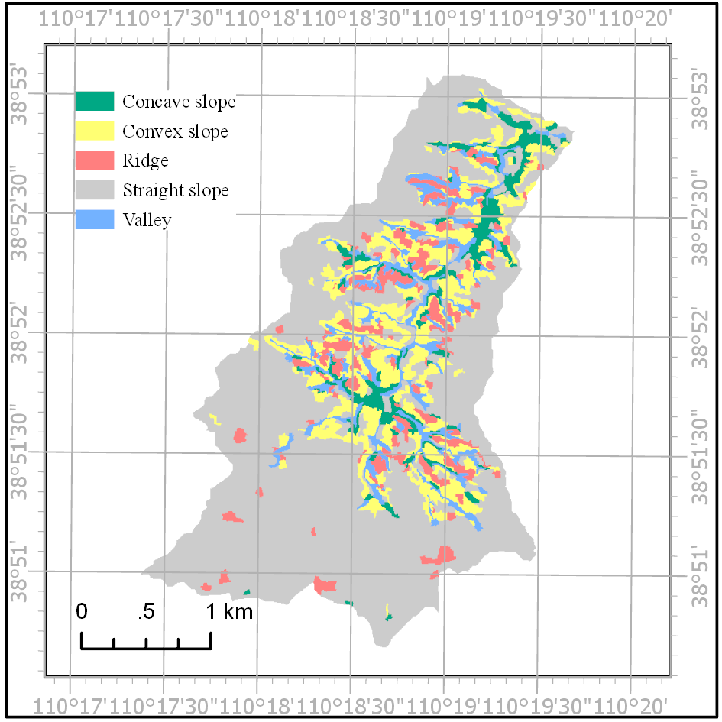
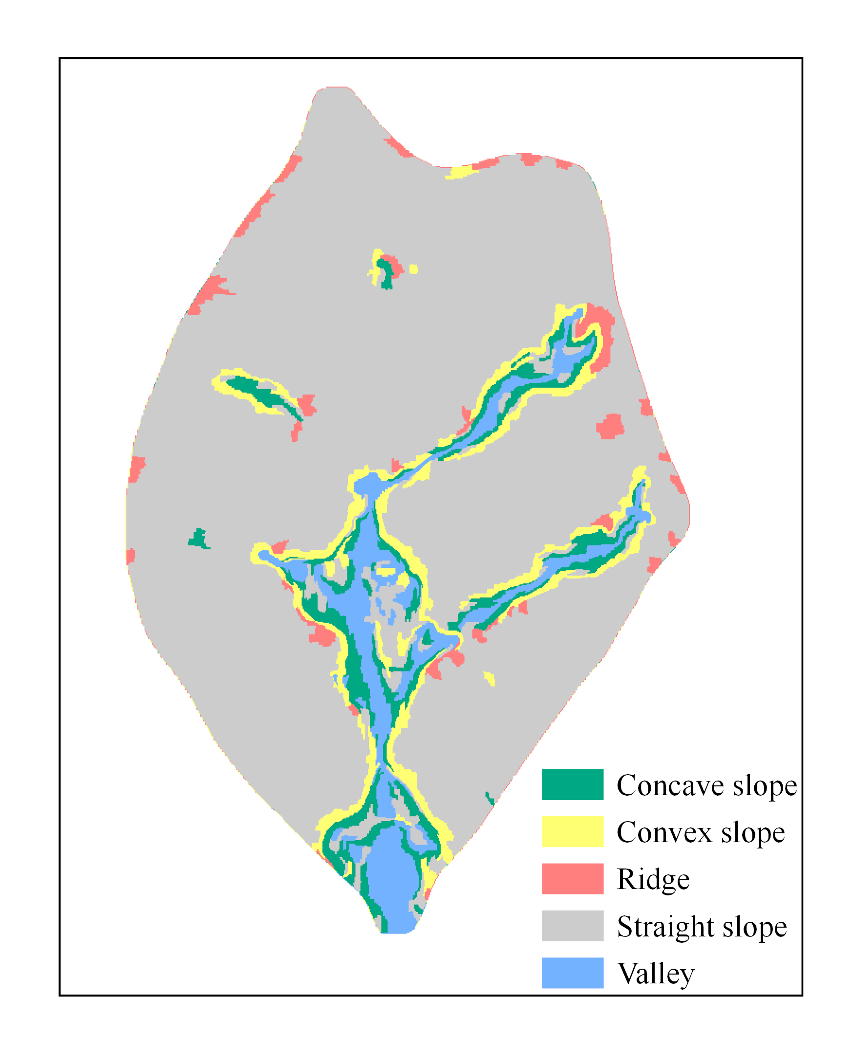
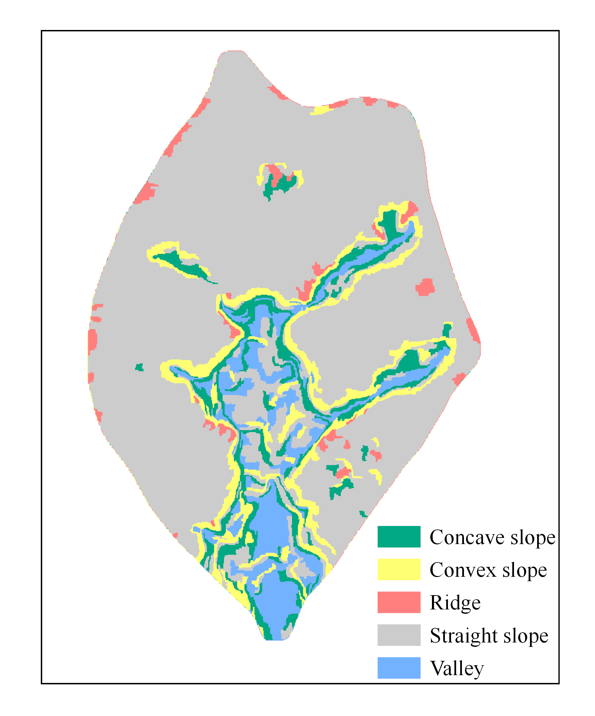
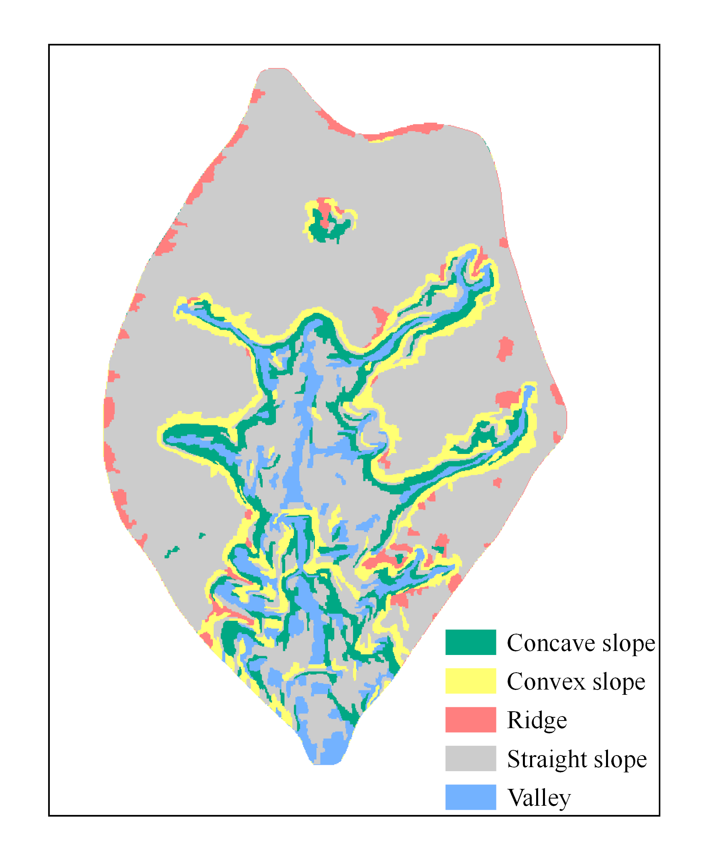
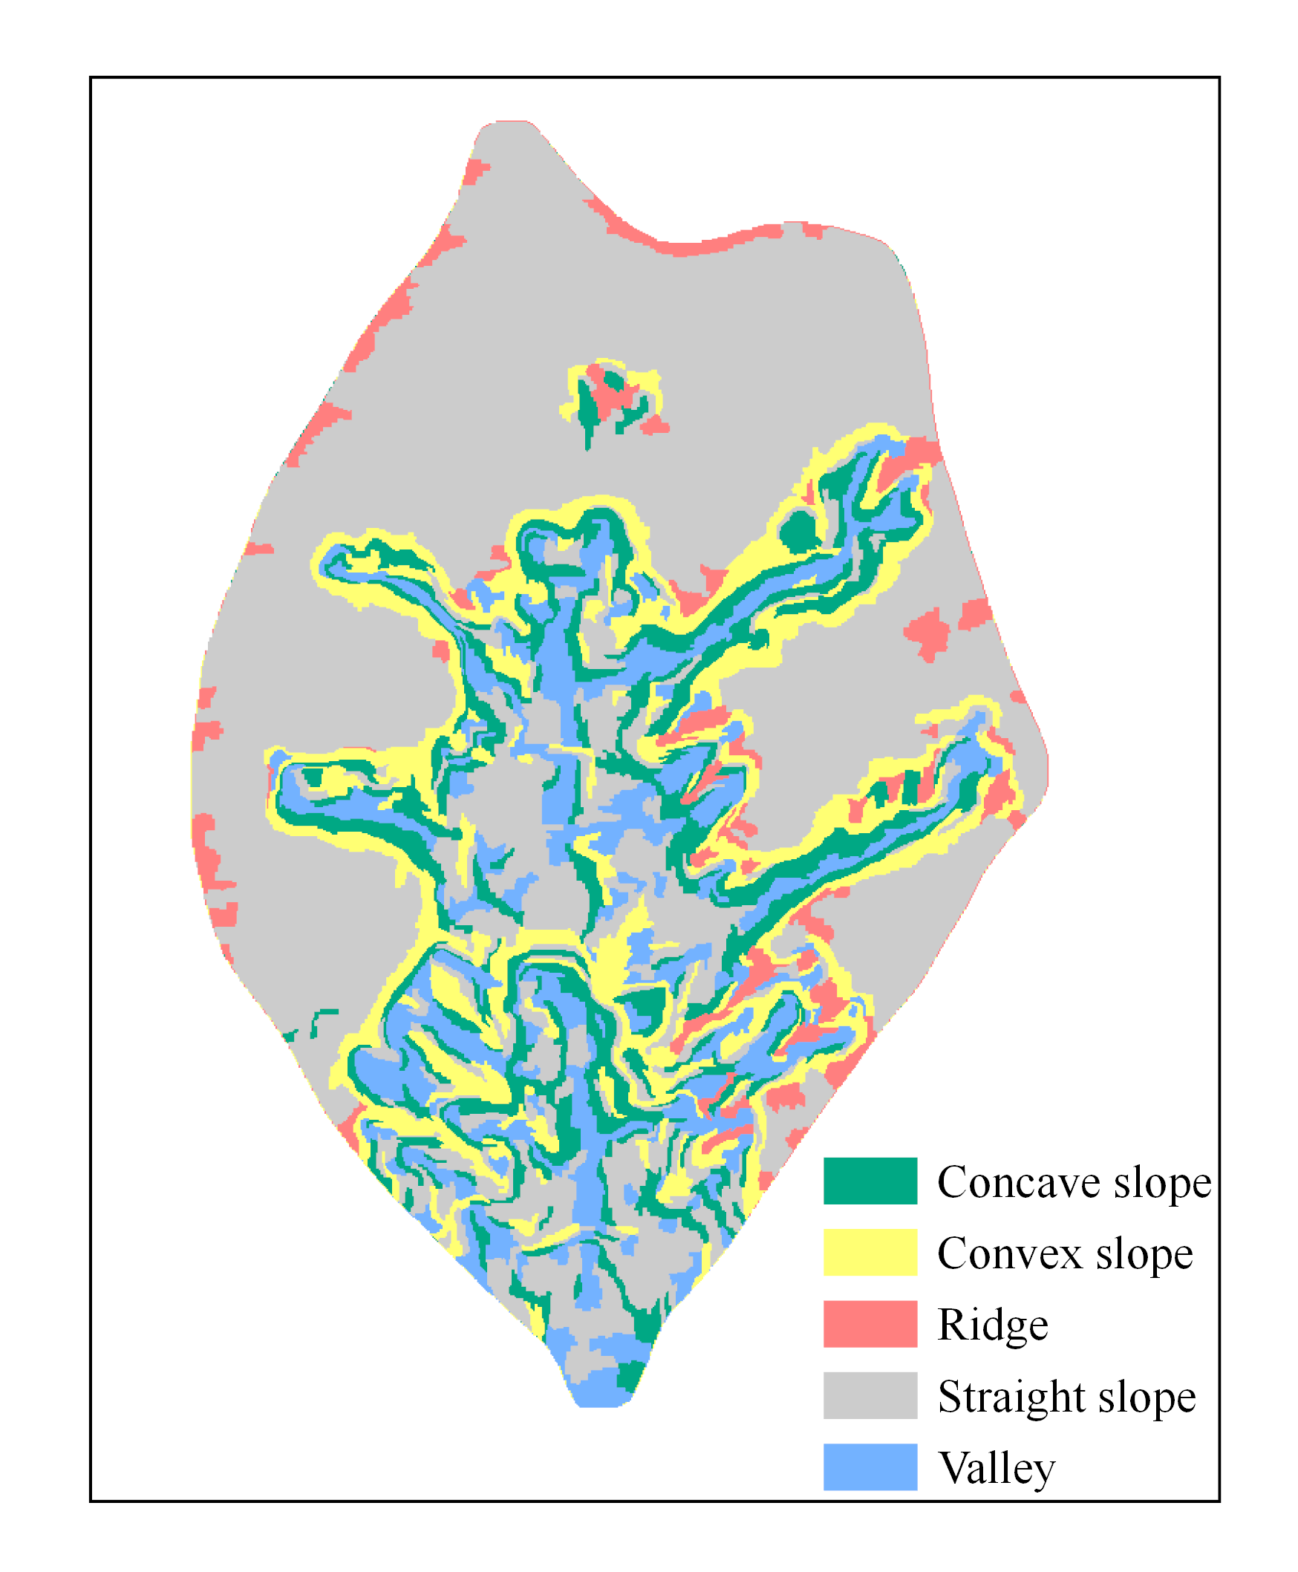
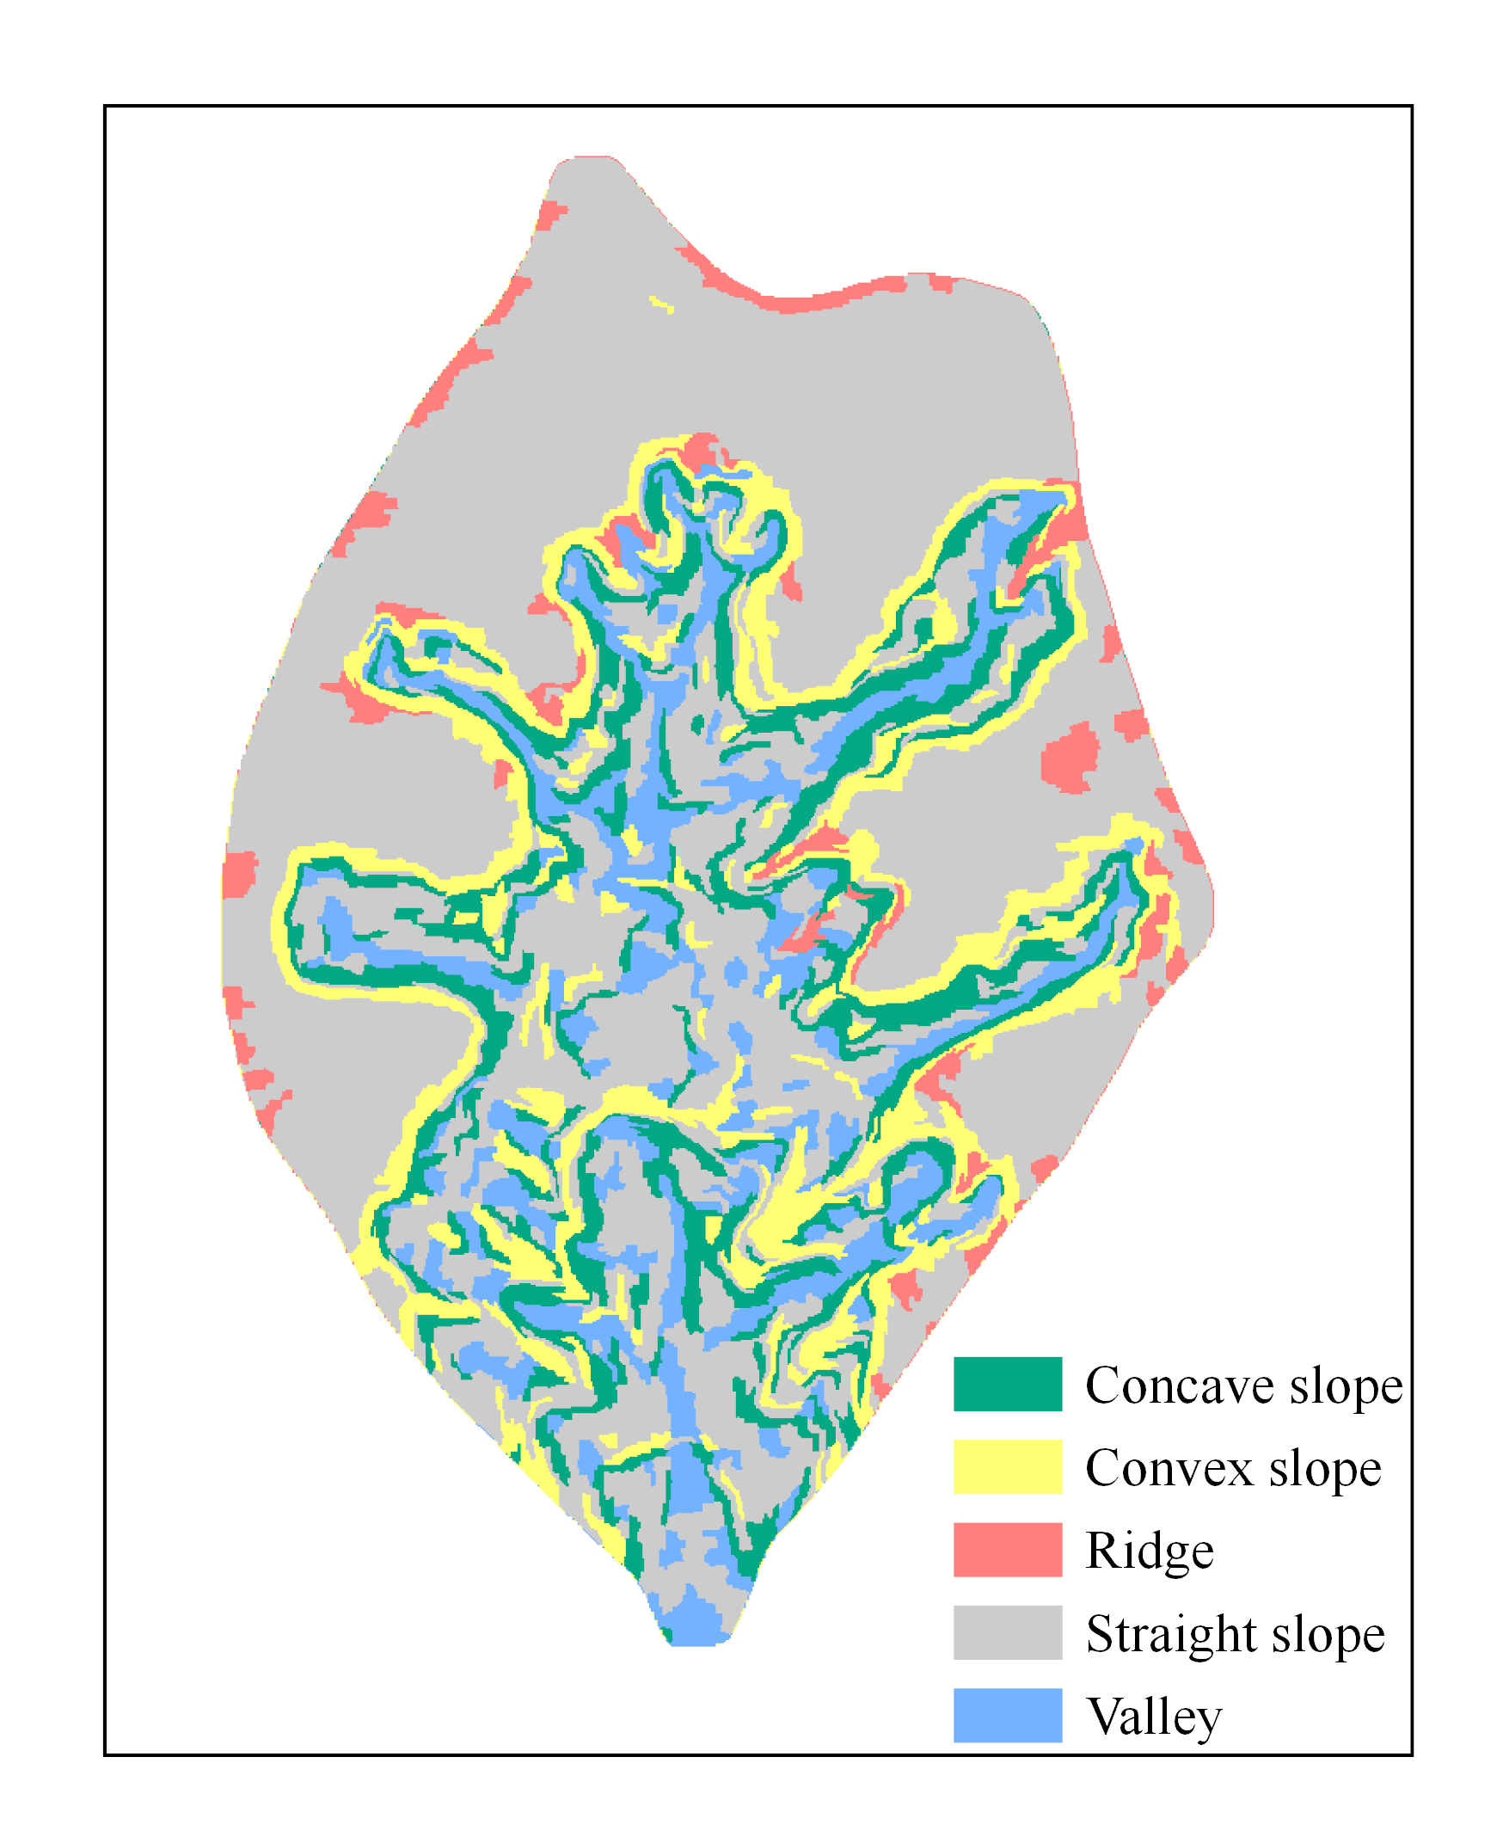
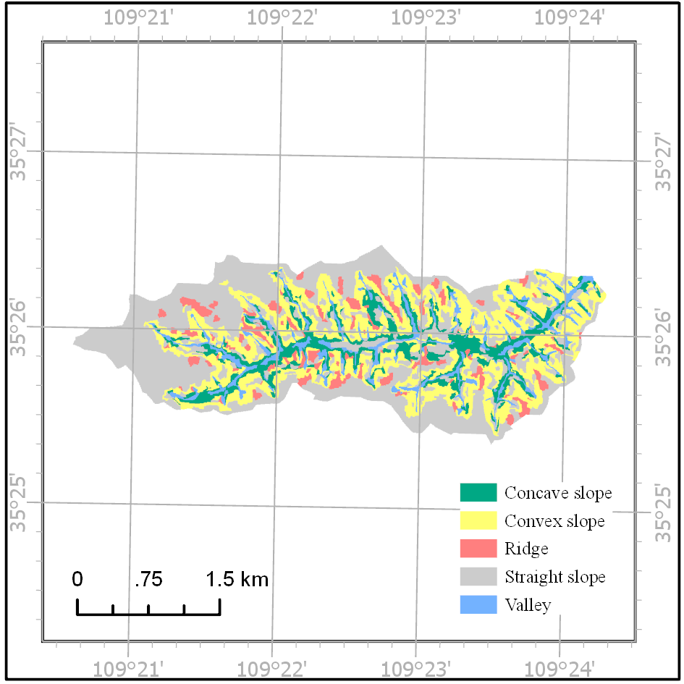
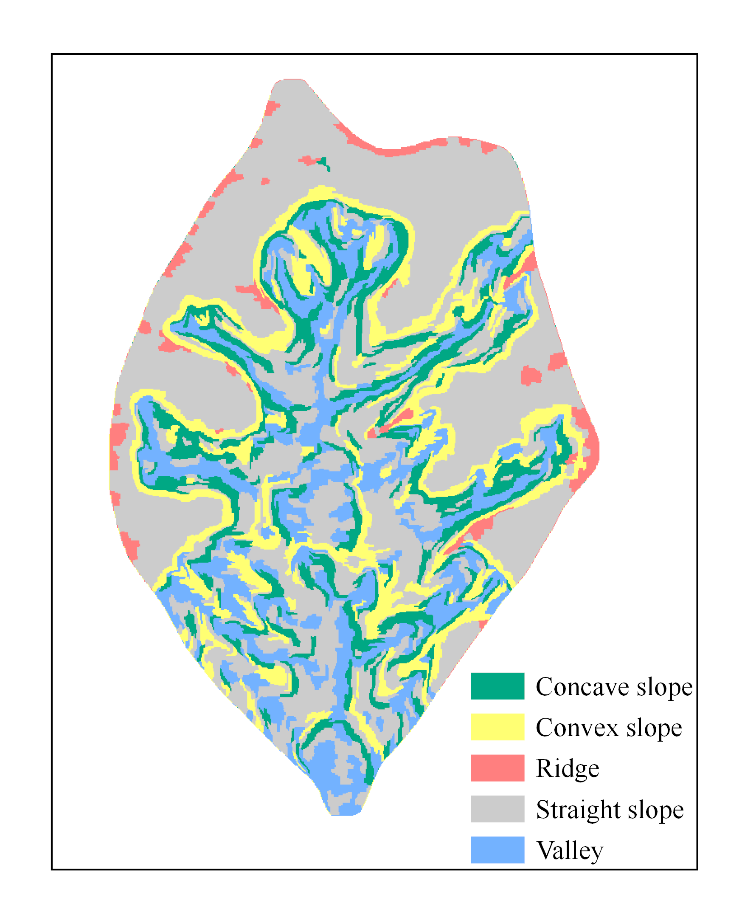
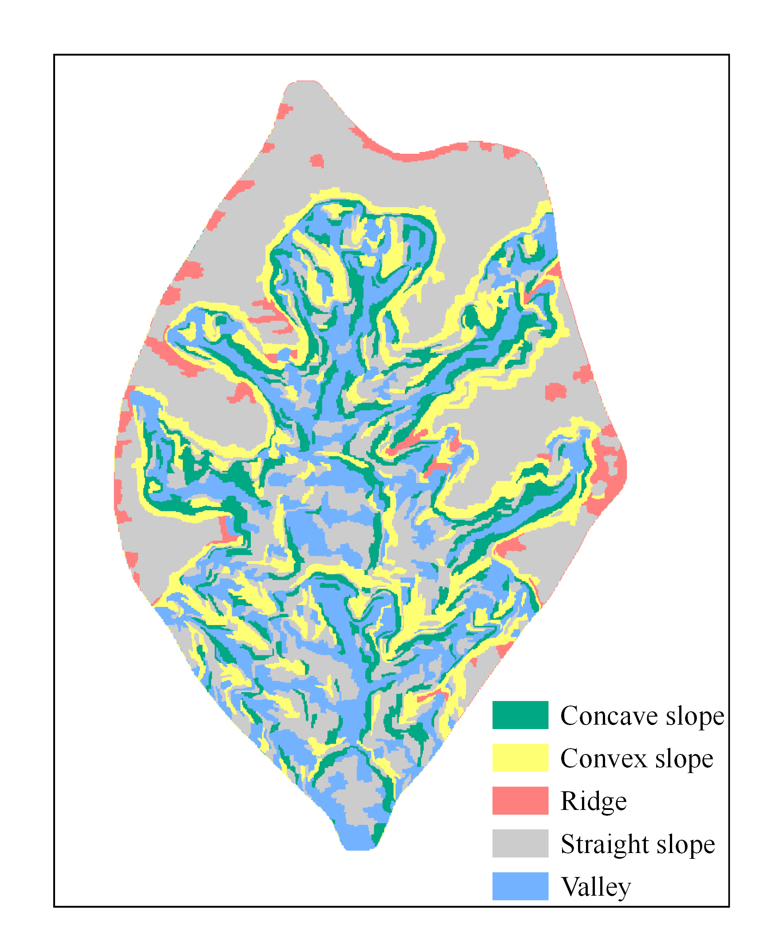
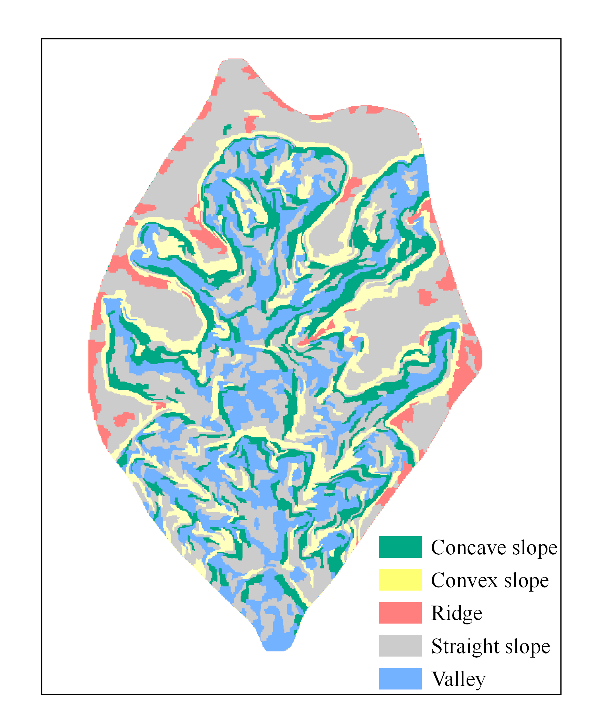
Slope unit segmentation and classification
The classification results of slope units in the indoor simulated small watershed
Stage 2
Stage 3
Stage 4
Stage 5
Concave slope
Convex slope
Ridge
Straight slope
Valley
Stage 6
Stage 7
Stage 8
Stage 9

Slide 7
Analysis and simulation of slope morphological evolution
Concave slope was mainly transformed into a straight slope and valley.
For convex slope, the area converted to a concave slope is the largest, followed by a straight slope.

Slide 8
Analysis and simulation of slope morphological evolution
Most of the straight slope remains so, and a small part transforms into convex and concave slopes.
For the valley, most of the area is still a valley during seven stages.

Slide 9
Analysis and simulation of slope morphological evolution
Markov chain
The key to using the Markov model for prediction is to determine its transition probability at m time, and the expression of its transition matrix is
The Markov prediction model is
where S^(k+1) represents the state vector of the system at t=k+1, which is the prediction result. P^(k+1) represents the transition matrix at t=k+1. S^(0) is the initial state vector of the system. S^(k) is the state vector of t=k. P_ij is the conversion probability of type i to type j in the study period. The prediction result of the Markov chain is determined by the initial state vector and transition matrix.

Slide 10
Analysis and simulation of slope morphological evolution
Average transition matrix from stage 2 to stage 8 (one step is one period)
 | Concave slope | Convex slope | Ridge | Straight slope | Valley
Concave slope | 0.54 | 0.13 | 0.01 | 0.14 | 0.17
Convex slope | 0.17 | 0.58 | 0.03 | 0.17 | 0.04
Ridge | 0.19 | 0.24 | 0.25 | 0.32 | 0.00
Straight slope | 0.10 | 0.10 | 0.02 | 0.70 | 0.07
Valley | 0.19 | 0.09 | 0.01 | 0.14 | 0.56
Area proportion of slope type in cross section of simulated small watershed in stage 8
Type | Concave slope | Convex slope | Ridge | Straight slope | Valley
Proportion | 0.18 | 0.21 | 0.10 | 0.41 | 0.11

Slide 11
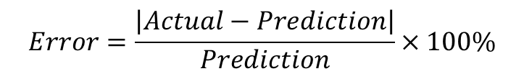
Analysis and simulation of slope morphological evolution
Except for the large error of ridge between the predicted value and actual value, among the other slope types, the accuracy of concave slope is the highest, followed by that of straight slope and convex slope, and the error of valley is the largest among the four types.
The area of the ridge is small. In the early stage and active stage of gully development, the gully is continuously widened, eroding the ridge between branches. The ridge is transformed into other types. Given that the gully development tends to be stable, the change of positive terrain gradually decreases and the transformation of ridge tends to be stable, which is greatly affected by the lack of aftereffect. Thus, the simulation accuracy is low.
Accuracy test
The calculation formula of the prediction error of the model is
$$Error=\frac{\left|Actual−Prediction\right|}{Prediction}×100\%$$
Accuracy verification of Markov chain prediction model
Type | Concave slope | Convex slope | Ridge | Straight slope | Valley
Prediction | 0.21 | 0.22 | 0.04 | 0.39 | 0.13
Actual | 0.20 | 0.20 | 0.06 | 0.42 | 0.12
Error | 5.95% | 6.63% | 53.54% | 6.15% | 8.41%

Slide 12
Summary and outlook
The Loess simulation small watershed is segmented, and the slope units are classified according to the profile curvature and typical slope position, so as to further refine the morphological characteristics of the slope.
The Markov chain is used to establish the prediction model of slope morphology, which can better reflect the dynamic change of slope morphology of gully cross section.
In the future, we hope that research can be carried out on the basis of multi-stage field gully data, gully cross-sectional morphology and the evolution law of slope morphology can be further explored and the results obtained have more practical value.

Slide 13
THANKS
Lulu Liu, Fayuan Li, Xue Yang
201302098@njnu.edu.cn
May 25, 2022

