Slide 1
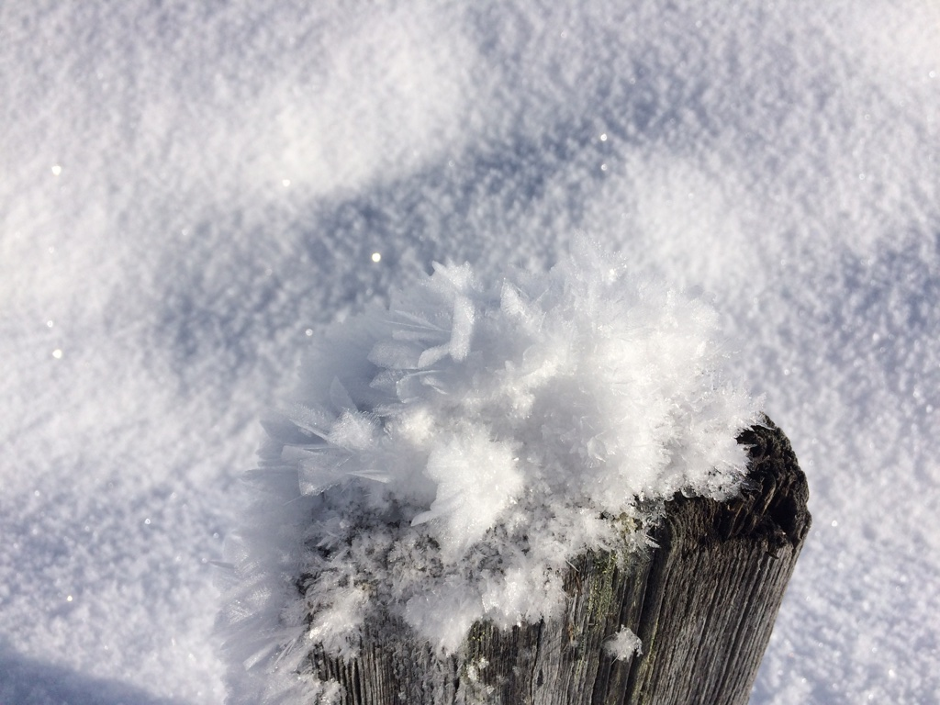

Presented by Silke Griesser and Ingrid Reiweger silke.griesser@students.boku.ac.at
Force measurements during snow stability tests

Slide 2
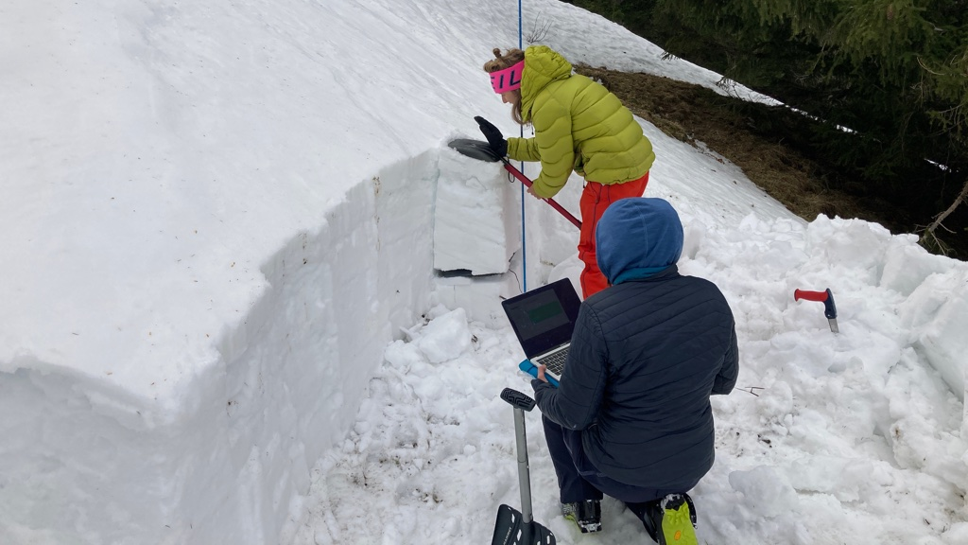
Picture: Sohlenalm, 04.03.2021, Christoph Januscovecz

Slide 3
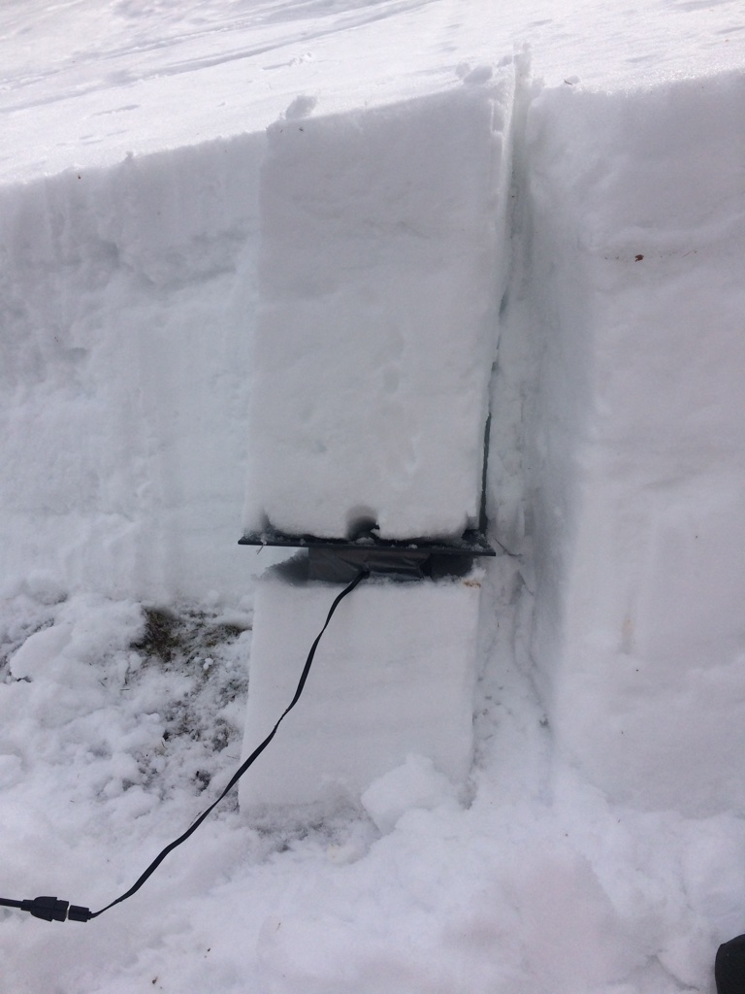
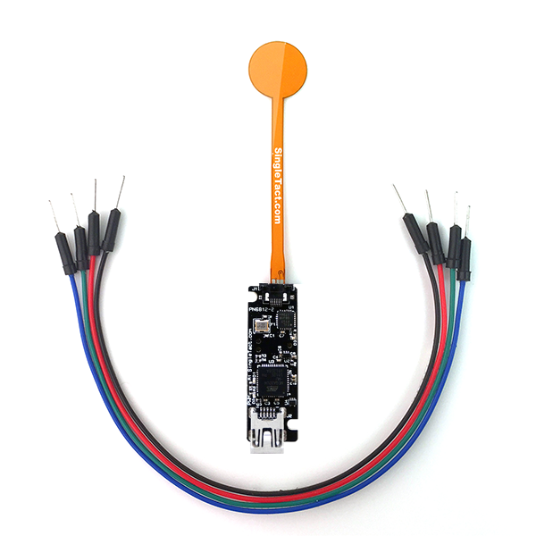
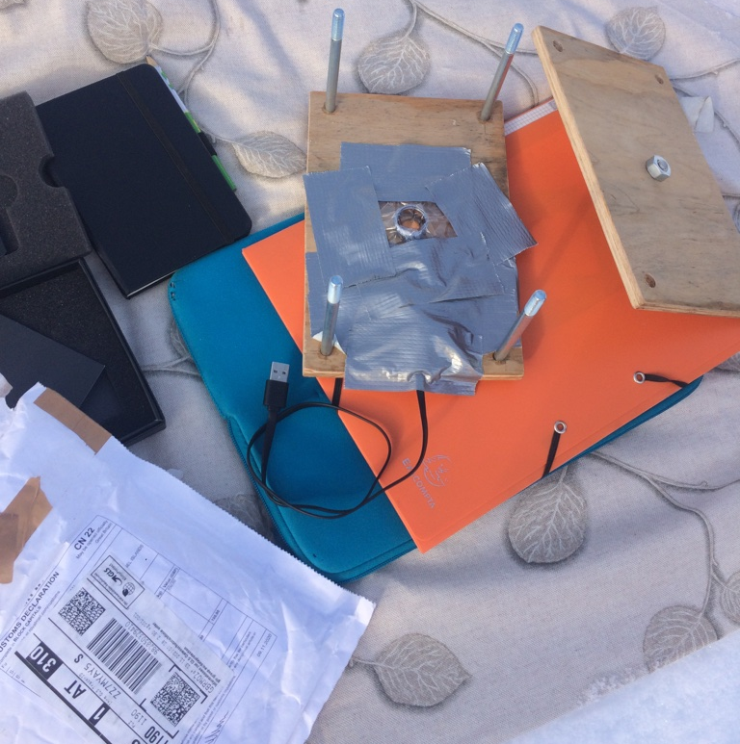
F
https://www.singletact.com/wp-content/uploads/2019/12/SingleTact-15mm-USB.png
Picture: Stoanerne Mandln, 22.12.2020, Silke Griesser
Picture: Sohlenalm, 04.03.2021, Silke Griesser
Notes:
Krautgartenscharte
Sauofen
Sohlenalm

Slide 4
Rising trend within distinct loading steps
20 cm
50 cm

Slide 5
elbow
shoulder
Exponential decrease with increasing effective/
compaction depth
20 cm
elbow
shoulder

Slide 6
elbow
shoulder
Increasing stress levels with increasing armlength and body weight
20 cm
elbow
shoulder

Slide 7
20 cm
Differences between different locations and different people
20 cm

Slide 8
The significance of a CT‘s result increases with increasing fracture depth.

Slide 9
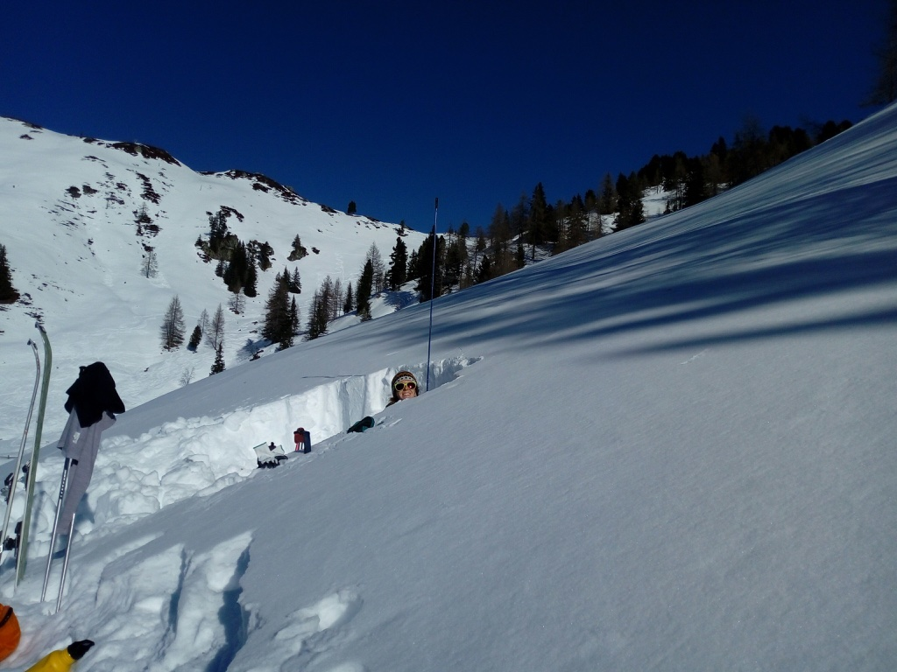
Thank you for your attention!!!
Picture: Loosbühelalm, 21.02.2021, Magdalena Pescoller

