Slide 1






Seepage loss from unlined, lined, and cracked-lined canals: a case study of Ismailia canal reach from 28.00-49.00 Km, Egypt
Elsayed Elkamhawy¹, Martina Zelenakova ², Salvatore Straface ³, Zuzana Vranayová ⁴, Abdelazim M. Negm¹, Andrea Scozzari⁵ and Ismail Abd-Elaty ¹
¹ Water and Water Structures Engineering Department, Faculty of Engineering, Zagazig University, Zagazig 44519, Egypt; Eng_abdelaty2006@yahoo.com
² Department of Environmental Engineering, Faculty of Civil Engineering, Technical University of Kosice, Kosice 04200, Slovakia
³ Department of Environmental and Chemical Engineering, University of Calabria, Ponte P. Bucci, 87036, Rende, Italy, salvatore.straface@unical.it
⁴ Department of Building Services, Faculty of Civil Engineering, Technical University of Kosice, Kosice 04200, Slovakia; zuzana.vranayova@tuke.sk
⁵ ​CNR Institute of Information Science and Technologies (CNR-ISTI), Via Moruzzi 1, 56024 Pisa, Italy, a.scozzari@isti.cnr.it

Slide 2
Introduction
Water resources face global and local challenges.
In Egypt, for example, the negative impacts of climatic changes and the Grand Ethiopian Renaissance Dam (GERD), causes shortage of water resources.
Shortage of water resources is considered an urgent issue particularly in semiarid regions (like many MENA countries) and arid ones (like Egypt).
Therefore, the Egyptian Ministry of Water Resources and Irrigation has launched the national project of canals rehabilitation and lining for effective water resource management and decreasing seepage losses.

Slide 3
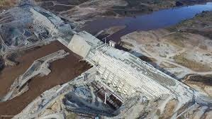

The Egyptian national project for canals lining
Water per capita 600 m3/yr.
The insistence of the Ethiopian side to fill the Renaissance Dam reservoir
http://opiniojuris.org/2020/05/04/so-close-yet-so-far-an- account-of-the-negotiations-on-the-grand-ethiopian-
Technical deal In Egypt
renaissance-dam-part-i/
The deficit will be provided through Lake Nasser
The trend is strong towards desalination of sea water
•
Maximize water utilization by minimizing losses

Slide 4
Purpose and objectives
The purpose of this study is to investigate numerically the impact of different lining materials on the amount of seepage from the Ismailia canal.
The seepage of water is investigated under the effect of extraction from aquifer
The effect of deterioration of the lining material through potential cracks is also examined

Slide 5
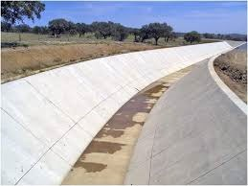
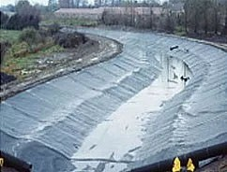
Lining
An impervious layer provided to the bed and sides of the canals to increase the life, discharge and hydraulic efficiency of the canals .
https://www.aboutcivil.org/advantages-disadvantages-
https://www.geoline.ie/lining/canal-lining-applications/
lined-canals

Slide 6
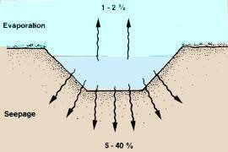
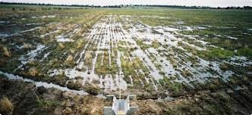
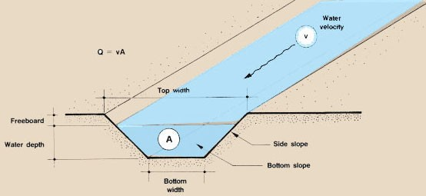
Advantages of lining
Reduce seepage looses through canal.
Prevent Water-Logging.
Increases the discharge carrying capacity of canals.
Increases canal life and reduce the maintenance cost.
http://www.fao.org/fishery/static/FAO_Training/FAO_Tr aining/General/x6708e/x6708e08.htm
https://www.agric.wa.gov.au/waterlogging/waterlogging-
%E2%80%93-science
http://www.fao.org/fishery/static/FAO_Training/FAO_Tr aining/General/x6708e/x6708e08.htm

Slide 7
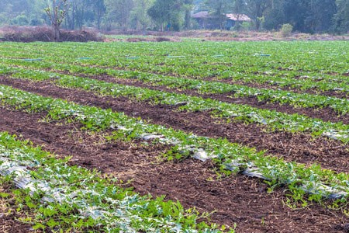
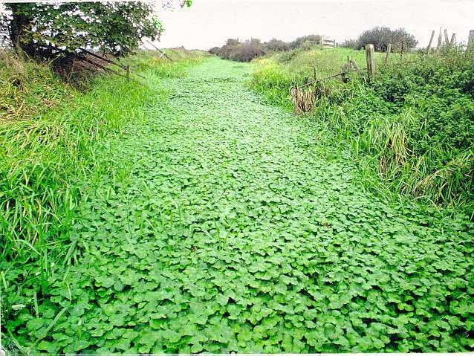
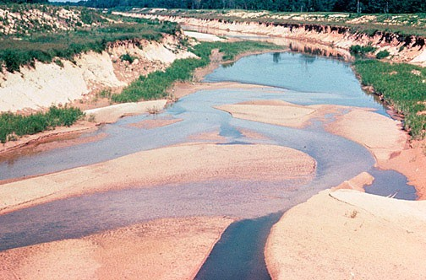
Advantages of lining
Increase gross cultivated area.
Reduce silting as velocity can be increased.
https://www.123rf.com/photo_117609399_land-area- view-watermelon-cultivation-lined-up-in-long-rows- near-the-residential-village-which-is-co.html
Prevent or reduce weed growth.
https://dcrt.org.uk/floating-pennywort-control-2
https://en.wikipedia.org/wiki/Siltation

Slide 8

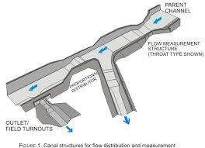
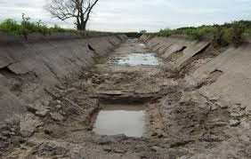
Disadvantages of lining
High initial investment is required.
Difficult to shift the outlets, as lining is permanent.
https://www.canstockphoto.com/cost-symbol-dollar increase-icon-vector-65434171.html
Difficult to repair the damaged lining.
https://nptel.ac.in/content/storage2/courses/105105110/p
df/m3l10.pdf
https://theconstructor.org/water-resources/factors- affecting-selection-canal-lining/30406/

Slide 9
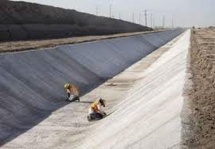
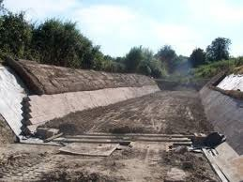
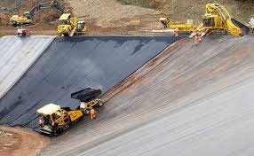
Type of canal lining
Hard Surface Lining
1-Concrete Lining
Concrete lining
https://theconstructor.org/water-resources/canal-linings-types- advantages/11052/
2- Brick and Boulder Lining
Brick Lining
https://theconstructor.org/water-resources/canal /
3- Asphaltic Lining
Asphaltic Lining
https://envirotecmagazine.com/2017/06/28/asphalt- lining-of-landfill-cell-at-westmill/

Slide 10
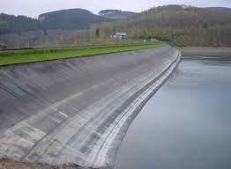
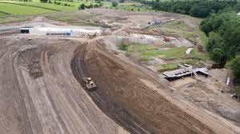
Type of canal lining
Earth Type Lining
1-Soils cement
2-Clay puddle lining
Soils cement lining
https://theconstructor.org/water-resources/canal-linings- types-advantages/11052/
Clay puddle lining
http://soilhillquarries.co.uk/puddling-clay-for-lining/

Slide 11
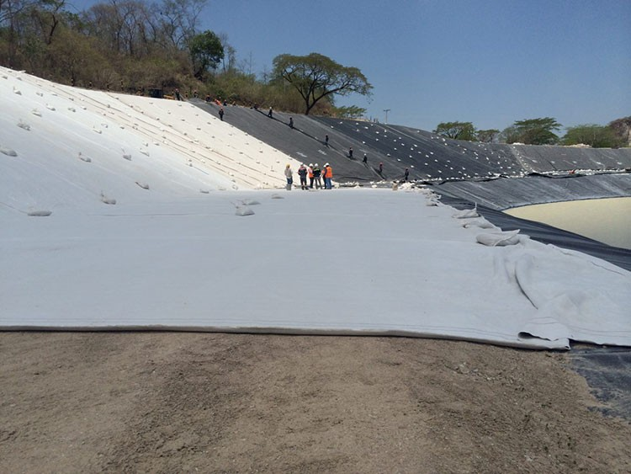
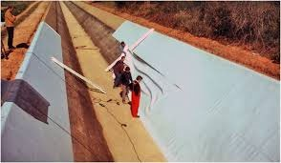
Type of canal lining
Geomembrane type lining
https://www.constructiontechnology.in/products/details/81
https://ascelibrary.org/doi/10.1061/%28ASCE%29CF.19 43-5509.0000230
Prefabricated light membrane

Slide 12
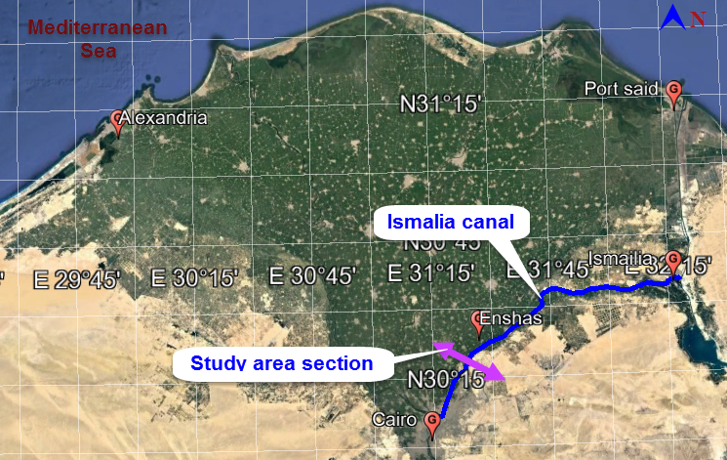
Study area
Ismailia canal is considered one of the most important canals in Egypt, It starts near Cairo with an entire length of 129km and serves about 320,000 ha.
In some reaches of Ismailia canal, severe seepage losses occur, which represent about 20% from the total canal discharge.

Slide 13
Numerical modelling
A numerical solution based on a finite element approach was used to solve the governing equation using Seep/w.
The Seep/w numerical model of the studied section was at the reach (28.00-49.00km) with a canal bed width of 59m and 2:1 side slope.

Slide 14
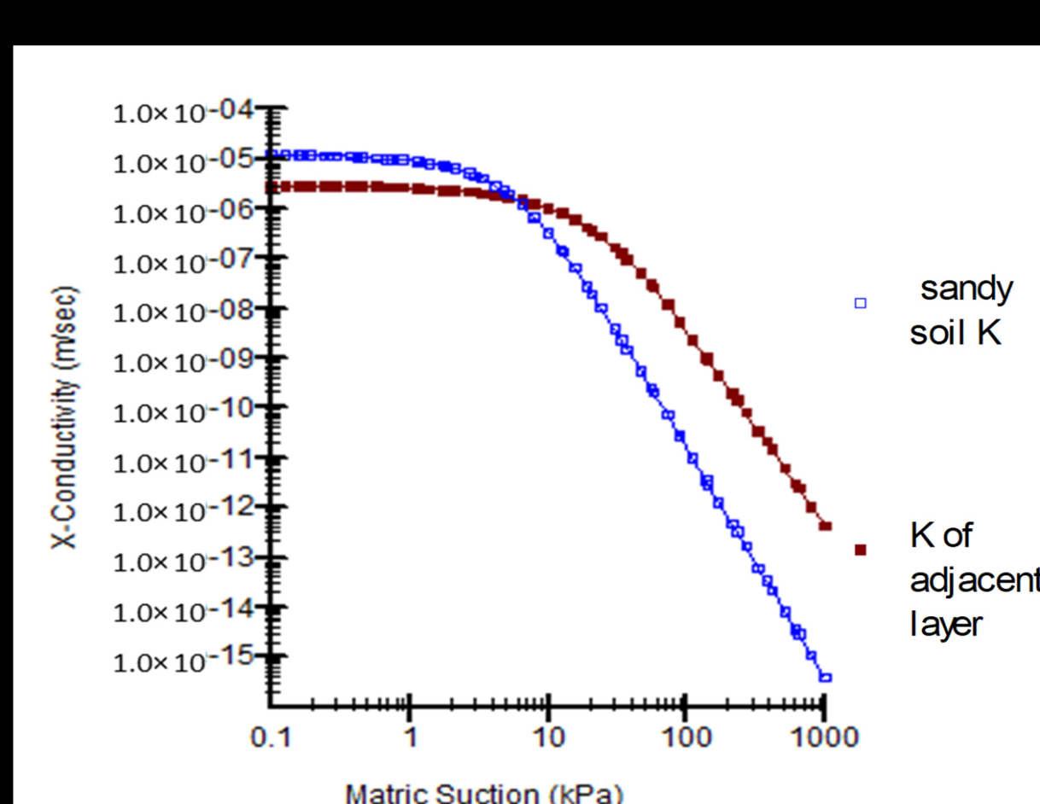
Numerical modelling
The studied section consists of sandy soil with trace of silt as main soil and a thin lined band of silty clay deposits.

Slide 15
Numerical modelling
Three techniques of lining materials are investigated, concrete liner, bentonite liner and geomembrane liner.
Effect of abstraction from aquifer through pumping well was also investigated.
Lining material’s deterioration through potential cracks was also examined, as well the coupling effect of liner’s material deterioration and the abstraction from aquifer

Slide 16
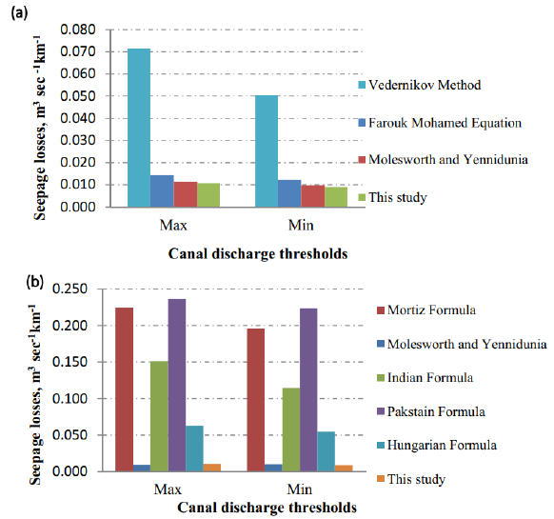
Model verification
Canal seepage losses from earthen canal by (a) analytical formulas (b) empirical formulas

Slide 17
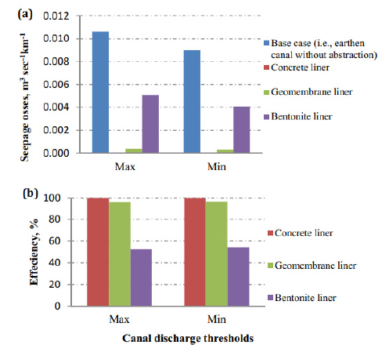
Results and Discussion
Seepage losses from lined canal without extraction
Lined canal with different materials without abstraction a) seepage losses and b) efficiency

Slide 18
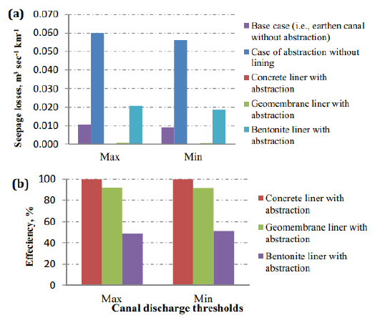
Results and Discussion
Seepage losses from lined canal with extraction
Lined canal with different materials during abstraction a) seepage losses and b) efficiency

Slide 19
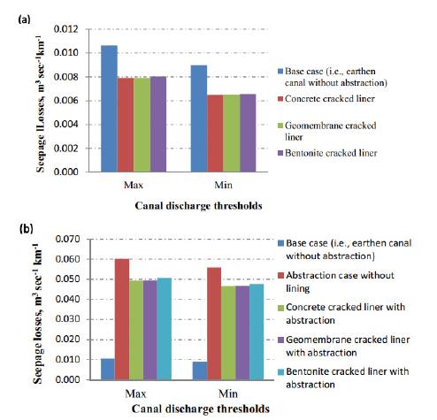
Results and Discussion
Seepage losses from cracked lined canal
Canal Seepage losses of different cracked liners (a) without abstraction and (b) with abstraction

Slide 20
Results and Discussion
Seepage losses from cracked lined canal
(a)
(b)
Canal Seepage losses (a) base case and (b) cracked liner

Slide 21
Conclusions and recommendations
Concrete liner was the most efficient, with 99%; followed by the geomembrane and bentonite liners with efficiency 96% and 52% respectively.
Extraction from an aquifer through well pumping has a considerable impact for earthen canals; however, its impact decreased significantly in the case of lined canals.
Deterioration of lining materials has a considerable impact on lining efficiency, regardless of the utilized liner.
It is recommended to follow all necessary precautions to prevent cracks in the liner material during the implementation process.

Slide 22
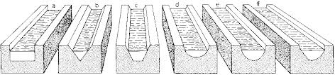


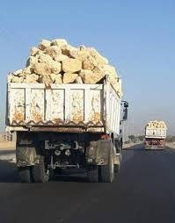
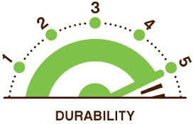
Selection between lining Types
The selection of a particular type of lining should be based on the following considerations
The purpose of lining
http://www.fao.org/3/r4082e/r4082e06.htm
Economic Consideration
Structural Stability
https://ssir.org/articles/entry/behavior al_economics_and_donor_nudges_im pulse_or_deliberation
Material availability
https://www.freepik.com/premium- photo/broken-chain_3058617.htm
Durability
https://www.rushlane.com/trucks-carrying- construction-material-banned-12287263.html
https://www.westpaw.com/scoop/durability-rating-definitions

Slide 23
References
1. El-Molla, D.A.; El-Molla, M.A. Seepage losses from trapezoidal earth canals with an impervious layer under the bed. Water Pract.Technol. 2021, 16, 530–540.
2. Sadek, M.; Hagagg, K. Impact of reduced flow on 137Cs behavior in Ismailia Canal and surrounding groundwater systems.
Environ. Sci. Pollut. Res. 2020, 27, 44279–44291.
3. Abd-Elhamid, H.; Abdelaty, I.; Sherif, M. Evaluation of potential impact of Grand Ethiopian Renaissance Dam on Seawater Intrusion in the Nile Delta Aquifer. Int. J. Environ. Sci. Technol. 2019, 16, 2321–2332.
4. Waller, P.; Yitayew, M. Irrigation and Drainage Engineering; Springer: Berlin/Heidelberg, Germany, 2015.
5. Eltarabily, M.G.; Moghazy, H.E.; Abdel-Fattah, S.; Negm, A.M. The use of numerical modeling to optimize the construction of lined sections for a regionally-significant irrigation canal in Egypt. Environ. Earth Sci. 2020, 79, 80.
6. Mowafy, M.H. Seepage losses in Ismailia canal. In Proceedings of the Sixth International Water Technology Conference, Alexandria, Egypt, 23–25 March 2001.
7. Atmapoojya, S.L.; Ingle, R.N.; Kacimov, A.R.; Swamee, P.K.; Mishra, G.C.; Chahar, B.R. Design of minimum seepage loss canal sections. J. Irrig. Drain. Eng. 2001, 127, 189–192.
8. Wachyan, E.; Rushton, K.R.Water losses from irrigation canals. J. Hydrol. 1987, 92, 275–288.
9. Plusquellec, H. Overestimation of benefits of canal irrigation projects: Decline of performance over time caused by deterioration of concrete canal lining. Irrig. Drain. 2019, 68, 383–388.
10. Abd-Elhamid, H.F.; Said, A.M.; Abdelaal, G.M.; Abd-Elaty, I. Impact of polluted open-drain geometry on groundwater contaminant in unconfined aquifers. Arab. J. Geosci. 2021, 14, 432.
11. Abuzeid, T.S. Conveyance losses estimation for open channels in Middle Egypt case study: Almanna main canal, and its branches. JES J. Eng. Sci. 2021, 49, 64–84.

Slide 24
Thank you

